Slide 1
10-K LLM Analysis Model
By Frank Boal

Slide 2
Project Goals
Utilize Large Language Models (LLMs) to analyze companies’ 10-K filings.
Categorize pages and extract key data for analysis.
Automatically generate reports containing company analysis.
Track all AI logic and data sources.

Slide 3
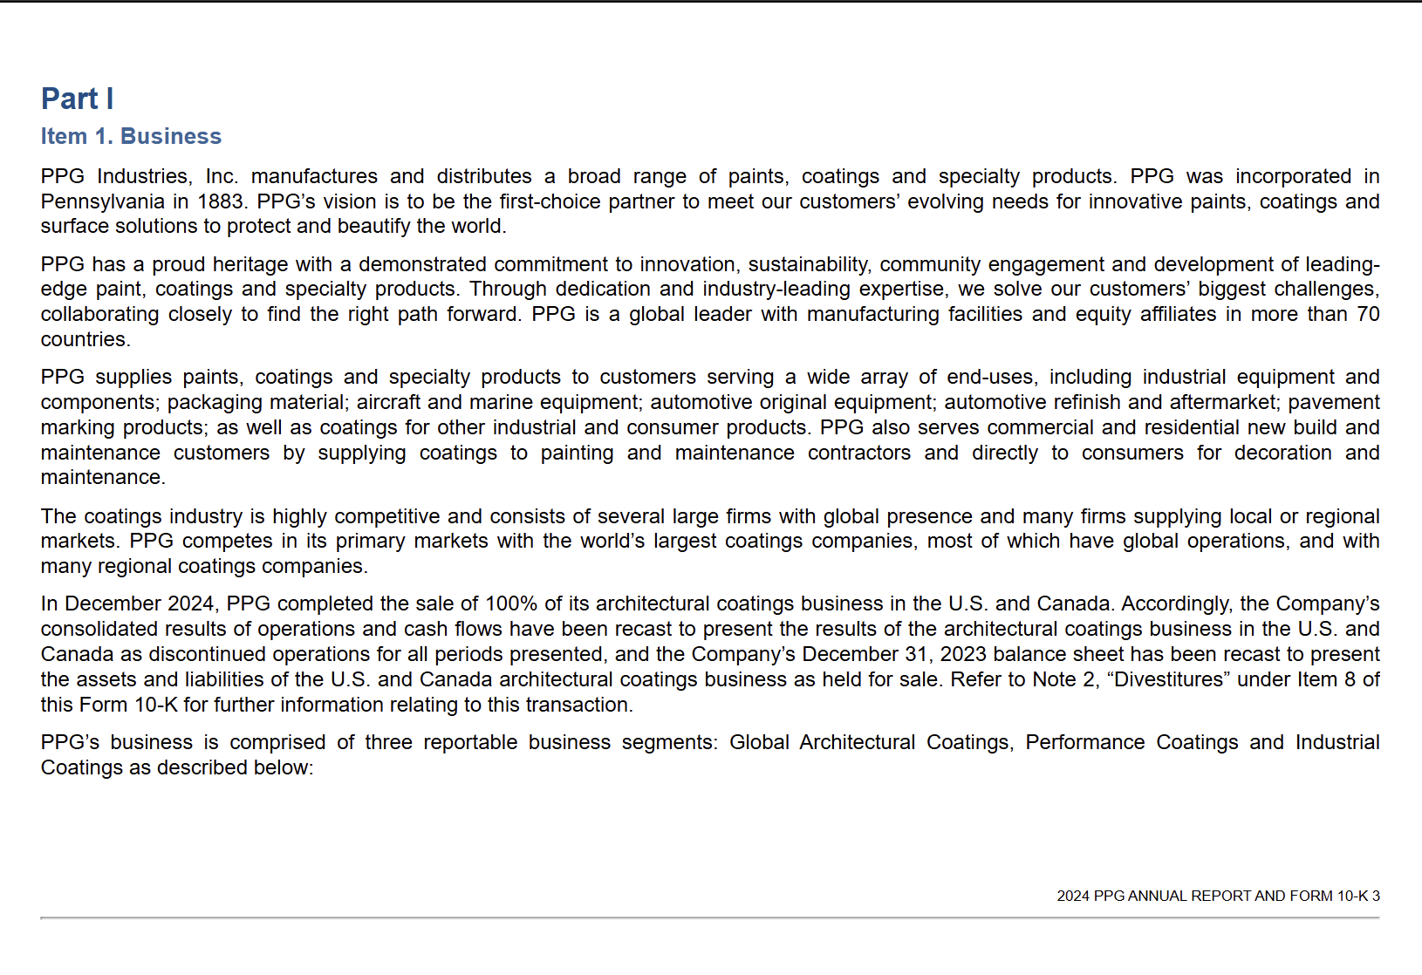
Script Workflow
PDF Data Setup
  Divide PDF into individual Pages
  Used PPG 2024 10K
LLM Call One: Page Classification
  Financial Statements
  Operations and Risk
  Legal
  Debt and Loans
  Other
LLM Call Two: Data Collection
  Created data structures to store information
  Unique for each page type
Page Classified as Operations and Risk
Note: Uses Few-Shot Learning for Both LLM Calls

Slide 4
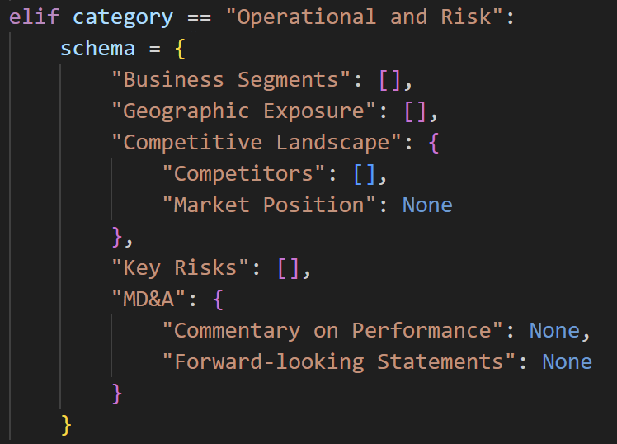
Page Data Structures
  Check Page Classification
  Dictionary storing keywords
  LLM searches keys and returns data
  Can easily add or remove categories

Slide 5
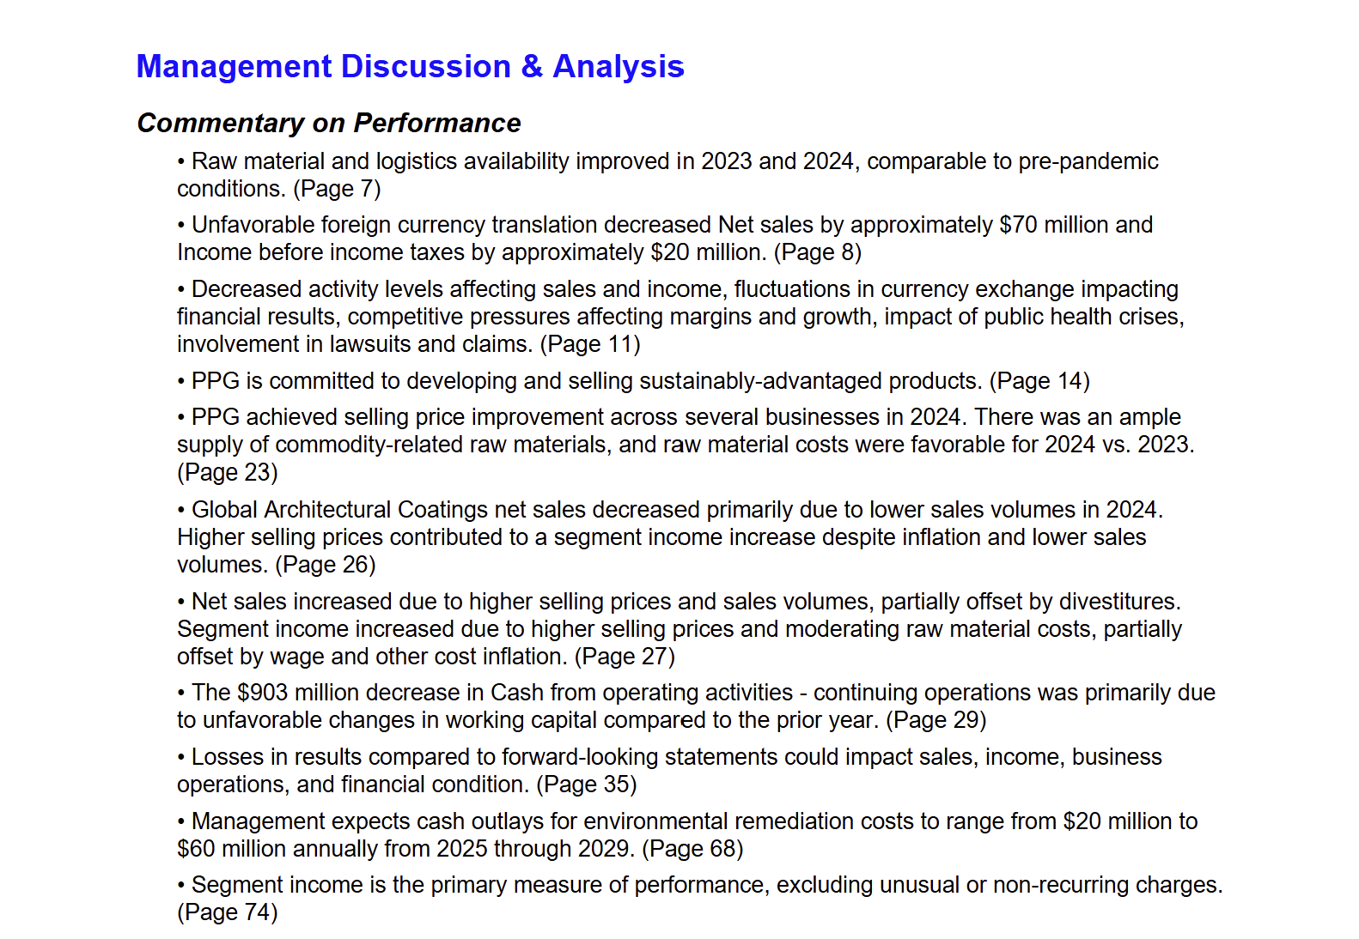
Script Workflow
Data Analysis
  Profitability (ROE, ROA, Margins)
  Key Risk Summary
  Debt Covenants
Report Generation
  Summarize Analysis
  Page number for quick reference to the Original
MD&A Performance Summary

Slide 6
Model Statistic
Runtime of Approximately Two Hours
Cost Per Run of approximately $3
Effectively located written data
Difficulty consistently locating Financial Statement Data

Slide 7
Next Steps
More efficient data collection
  EDGAR API to pull directly from SEC filings
  Deterministic Financial Statement Data
  No PDF reading
Use Data Analysis-specific LLM
  AWS Bedrock
Add more data sources
  Website Data Scraping
  Extend to 10-Qs, Form 4s, etc.
  FinMem Paper

