Slide 1
SWT301
Unit test
with
TestNG framework
Team
Member
01
Vu Thien An
Nguyen Phat Dat
Nguyen Vi Khang
Nguyen Dang Loc
Nguyen Hong Minh

Slide 2


Agenda
01
Basic concepts
Definitions of unit test & some related concepts
02
TestNG framework
What is TestNG, how to use it?
03
Practical demo
Design, implement unit test with TestNG framework

Slide 3

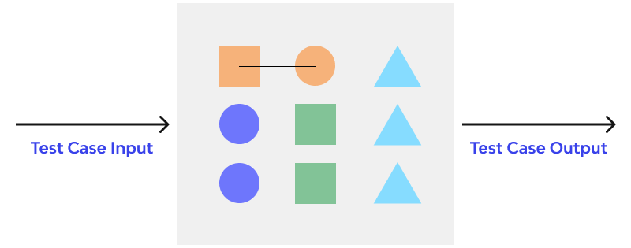
Definition
Unit testing
individual units or components of a software are tested
is white box testing done during the development (coding phase) of an application by the developers
is done before integration testing
by developer
UAT
System test
Integration test
Unit test
Unit
Function
Method
Procedure
Module
Object
…..

Slide 4



Other concepts
Assertion
a statement asserts the expected behavior of the test, fails if the result is different than what expected
Test case
specification of the inputs, execution conditions, testing procedure, and expected results
Testsuite
a collection of test cases

Slide 5
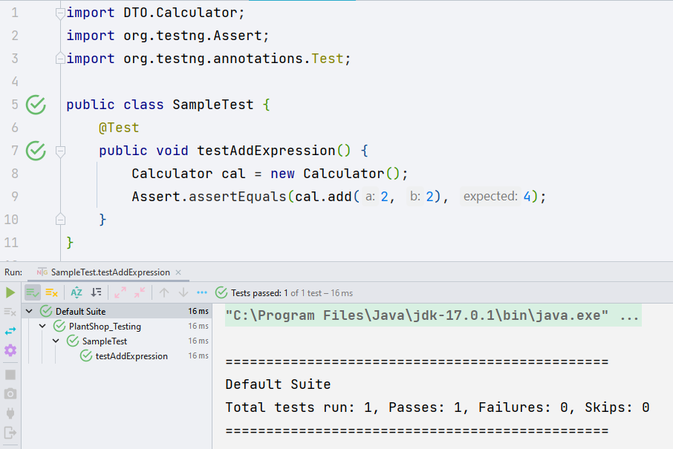
Basic example
public class Calculator {
public int add(int a, int b) {
return a + b;
}
}

Slide 6
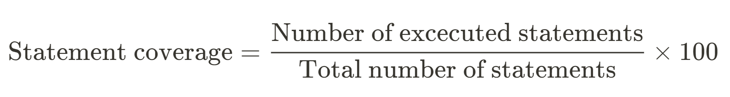
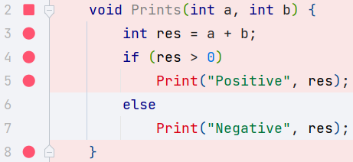
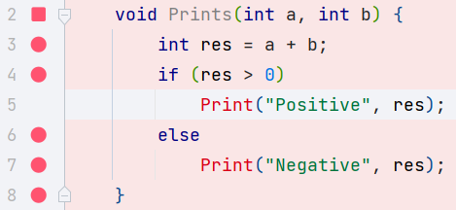
Test coverage
Statement coverage
!
The percentage of statements that have been tested
Test case 1: Input: a = 3, b = 9
Coverage 71%
Test case 2: Input: a = -3, b = -9
Coverage 86%
Test suite
Coverage 100%

Slide 7

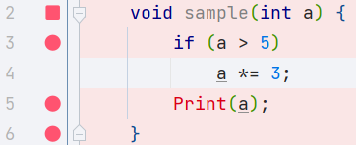
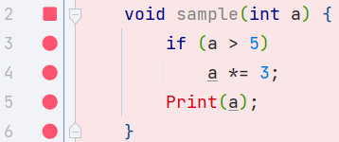
Test coverage
Path coverage
!
The percentage of paths that have been tested.
Test case 1: Input: a = 2
Coverage 50%
Test case 2: Input: a = 6
Coverage 50%
Test suite
Coverage 100%

Slide 8



Design unit test
ARRANGE
Initialize objects, resources, the environment, and other conditions.
ACT
Call the method/function with inputs, get actual results
ASSERT
Compare expected values and actual values received
PASSED / FAILED
Clean up resources, get the test report

Slide 9





Good unit test
Automated & repeatable
Easy to read & understand
Run quickly
Have full control of the unit under test
Be fully isolated

Slide 10

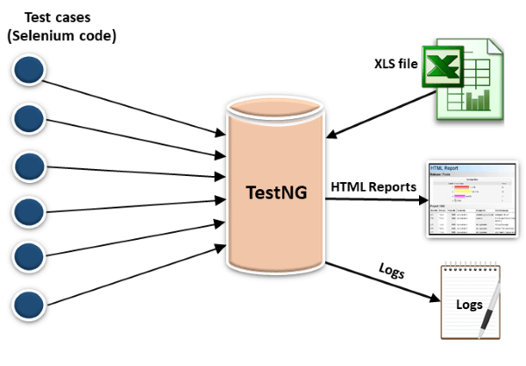
TestNG
An open-source test automation framework for Java
Developed on the same lines of JUnit and NUnit
NG in TestNG stands for ‘Next Generation’

Slide 11


Comparative advantages
Not require declare @BeforeClass and @AfterClass
BASIS | JUNIT | TESTNG
Annotation support
Suite test
Ignore test
Exception test
Timeout
Parameterized test
Dependency test
Group and prioritize the tests easier
Allow dependency on multiple methods
Produces the HTML reports
Sources: https://www.guru99.com/junit-vs-testng.html
Parametrization is more convenient and easier by @DataProvider
Notes:
HTML report in JUNIT require an external tools/plugins to be installed
Annotations of TestNG are easier to understand compared to JUnit
TestNG does not require you to mandatorily declare @BeforeClass and @AfterClass, compared to JUnit
The feature of parametrization provided by TestNG is more convenient and easier to use through dataprovider
Features like prioritization and grouping of tests provided by TestNG makes it more realistic and adaptable as compared to JUnit
TestNG allows dependency on multiple methods, making your tests more maintainable and flow specific as compared to JUnit
TestNG provides the facility of parallel execution in multiple ways compared to JUnit
TestNG gives default reporting in HTML and XML format. These can further be customized using multiple listeners. This makes it much more friendly as compared to JUnit

Slide 12
Demo TestNG

Slide 13
Q & A

Slide 14
Thank you!
Goodbye!

