Slide 1

SWT301 – LAB02
Automation testing
with
Team
Member
01
Vu Thien An
Nguyen Phat Dat
Nguyen Vi Khang
Nguyen Dang Loc
Nguyen Hong Minh

Slide 2
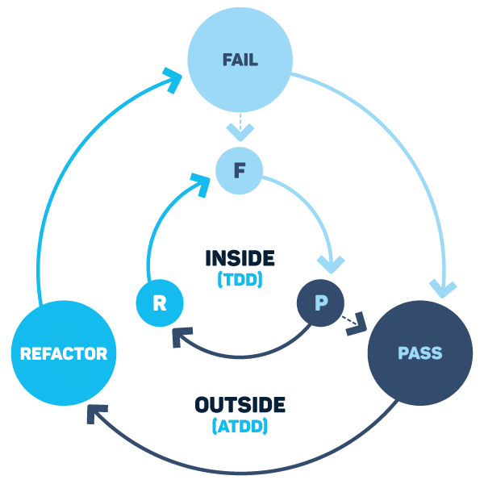

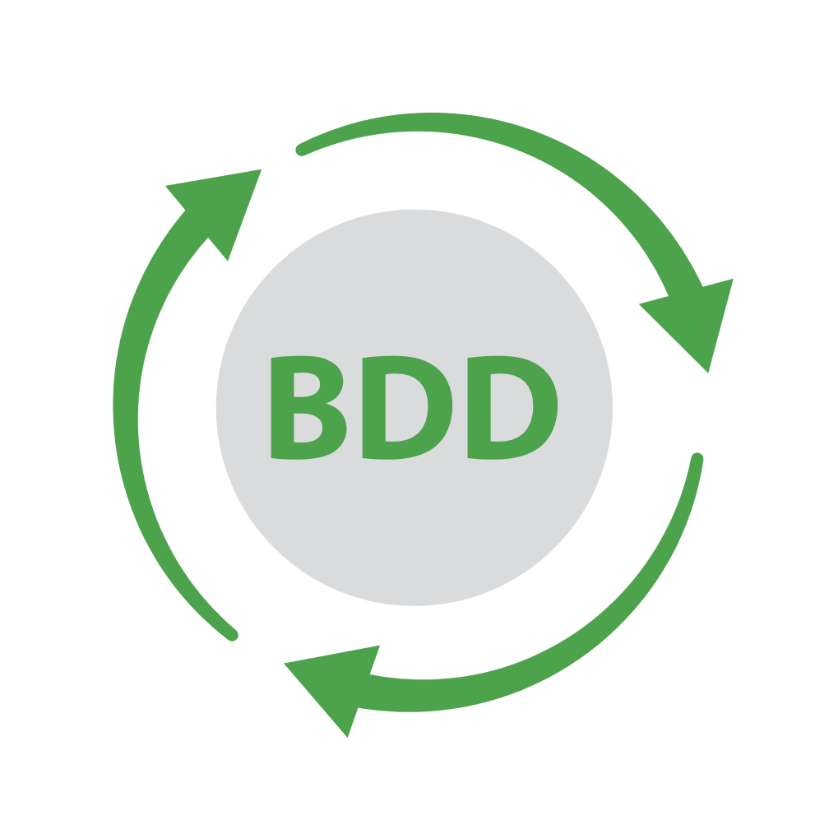

AGENDA
1
Automation testing with BDD
Define automation testing, BDD & related concepts
2
What is Cucumber
Overview of Cucumber tool with Gherkin language
3
Structure of Cucumber
What’s inside Cucumber, some comments about it
4
Demo
Apply Cucumber in BDD
02

Slide 3








Automation testing
The process of automatic executing steps to perform a test case
Performed by Automation Testing Tool
Pros
Cons
High reliability
Repeatable
Low cost
High speed
Reusable
Difficulty expansion
Low coverage
Tool & human resources problems

Slide 4
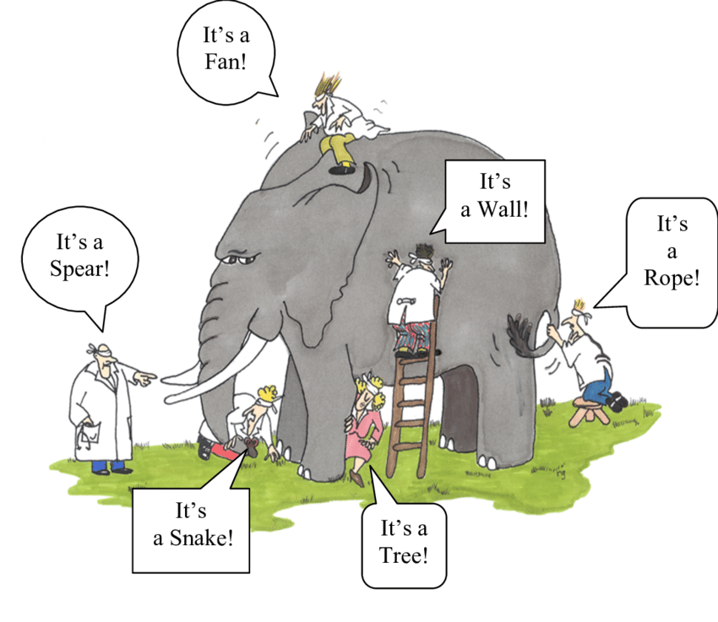

Behavior driven development
Derived from the Test-Driven Development
Test scenarios based on the perspective of devs, stakeholders & customers
Given – When - Then approach

Slide 5
Cucumber testing tool
Support BDD
“
A automatic testing tool based on the implementation of the functions described in the plain-text form.
Write tests that anybody can understand
”
Extend for Ruby, PHP, Java, C#, Python

Slide 6
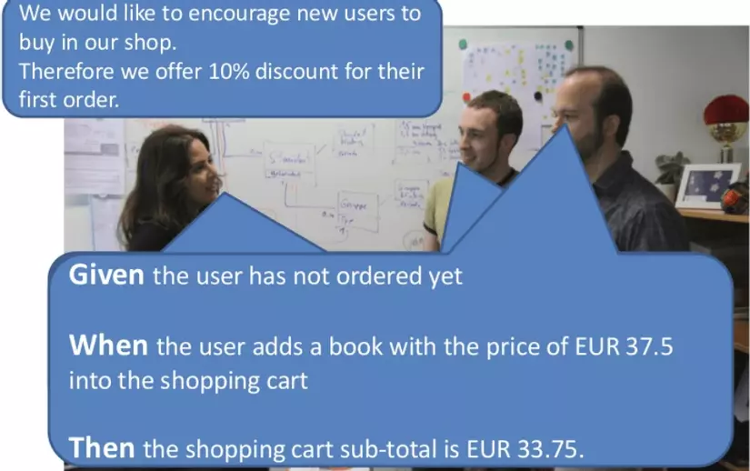
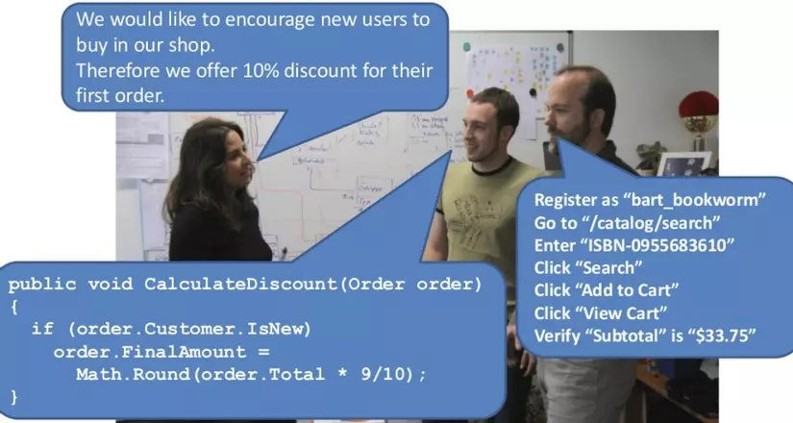
Gherkin language
Helps Cucumber to interpret and execute the test scripts
Common set of keywords in English text
Feature
Scenario
Scenario Outline
Given
When
Then
And
But
Examples
Background
A line-oriented language
Source file gherkin: .feature
1 file describes 1 feature

Slide 7
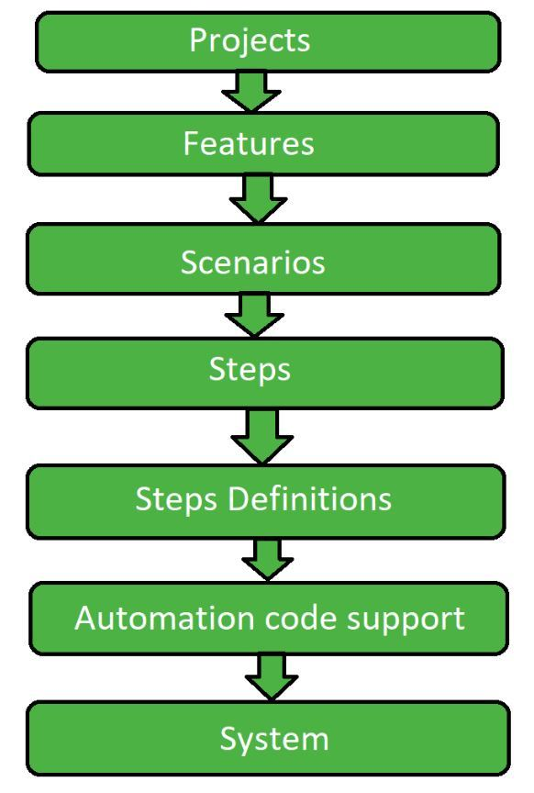
How Cucumber work?
Describe behavior
Run & pass
Write step definition
Work-flows
Write code to make step pass
Run & fail

Slide 8
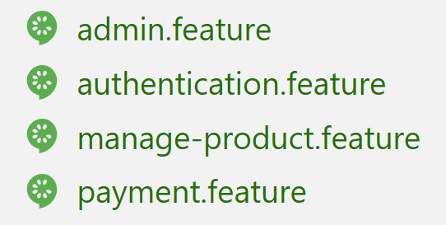
Feature
A standalone unit or functionality of a project.
Feature File
Scenario
Store features, description about features, scenarios to be tested
The core Gherkin structures.
Consists of one or more steps.
Feature: Home page
Background:
Given I access to the Toolqa Demo Homepage
#This screnario checks Homepage without Login
Scenario: Home page without Login
Then I should see the Logo icon and My account icon
Then I should see main Menu
Steps
Scenario

Slide 9
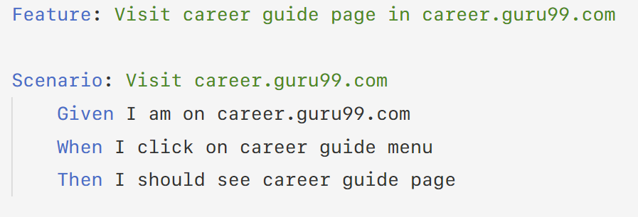
Feature
Feature
Name of the feature under test
Description
Describe about feature under test
Scenario
What is the test scenario
Given
Prerequisite before the test steps get executed
When
Condition should match to execute next step
Then
What happen if the condition mentioned in WHEN is satisfied

Slide 10
Scenario outline
Replaces variable/keywords with value from table.
Feature: Scenario Outline
Scenario Outline: Login a social networking site
Given user navigates to Facebook
When I enter Username as "<username>" and Password as "<password>"
Then login should be unsuccessful
Example:
| username | password |
| username1 | password1 |
| username2 | password2 |
Scenario:
Given user navigates to Facebook
When I enter correct username and password
Then login should be successful
Scenario:
Given user navigates to Facebook
When I enter correct email address and password
Then login should be successful
Scenario:
Given user navigates to Facebook
When I enter correct phone number and password
Then login should be successful
Each row in the table is considered to be a scenario.
@When("^I enter Username as \"([^\"]*)\"$“ and Password as \"([^\"]*)\"$")
public void login(String username, String password) {
}

Slide 11
Step Definitions
Mapping each step of the scenario in the feature file with a function
public class HomepageDef {
@Given("^I access to the Toolqa Homepage$")
public void i_access_to_the_Toolqa_Homepage() throws Throwable {
driver.get("http://store.demoqa.com/");
}
@Then("^I should see main Menu$")
public void i_should_see_main_Menu() throws Throwable {
if (driver.findElement(By.id("main-nav")).isDisplayed()) {
Assert.assertTrue("Main menu icon is dislayed", true);
} else {
Assert.assertFalse("Can not find the Main menu icon", true);
}
} }
Scenario: Home page without Login
Given I access to the Toolqa Homepage
Then I should see main Menu

Slide 12
Run test
Cucumber options
@RunWith(Cucumber.class)
@CucumberOptions(
features = "src/test/java/Features",
glue = "stepDefinitions",
monochrome = true,
plugin = {
"html:target/reportHomepage", "json:target/Homepage-report-json.json" })
public class runTest {
}
Feature: location of .feature file
Glue: location of step definition file
Monochrome: detail information of test result
Plugin: generate test report in HTML or JSON

Slide 13
Conclusion
Cucumber | HP ALM (QTP) | Selenium
Free | Free | Free
Support BDD | Support Functional testing | Support Functional and Performance testing
Fast operating plugin | Plugin works slower than Cucumber and Selenium | Plugin works slower than Cucumber
Support Java, Scala, Groovy | Support VB script | Support Java, .Net, Ruby
Dev, tester write script | Test write test script | Dev, tester write script
Support Web app | Support Web, desktop, client server app | Support web app
Highlights
A bridge between business & technical
Focus on end-user experience
Test script be written without knowledge of any code
Provides code reusability.

Slide 14
Demo

