Slide 1

SWT301 – LAB03
Performance testing
with
Team
Member
01
Vu Thien An
Nguyen Phat Dat
Nguyen Vi Khang
Nguyen Dang Loc
Nguyen Hong Minh

Slide 2

AGENDA
1
Performance testing
What is performance testing, why do we need it?
2
Locust’s introduction
Overview of Locust
3
How to use Locust
Locust’s related components and concepts
4
Demo
Implement load testing with Locust
02

Slide 3










Performance testing
Testing measure that evaluates different quality metrics of program or device under a workload
Identify and eliminate the performance bottlenecks in the software application.
Mainly focus on
Speed
Scalability
Stability

Slide 4

Type of performance testing
Performance testing
Load testing
Endurance testing
Spike testing
Scalability testing
Stress testing
Volume testing
Performance optimization solutions for software
Avoid unforeseen risks before deploying

Slide 5
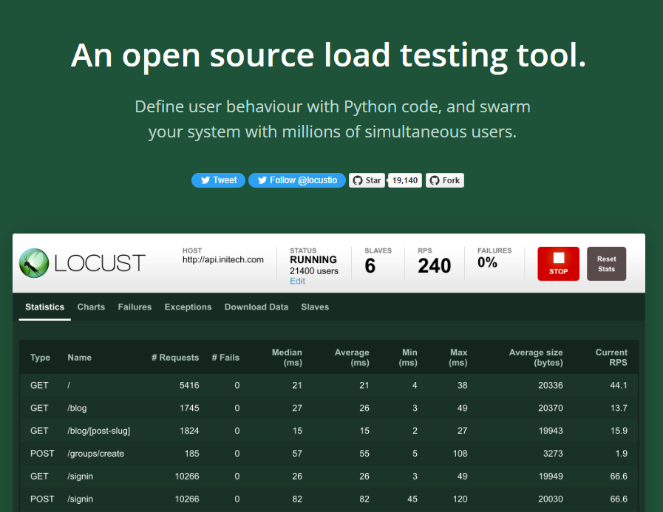

What is Locust?
User load testing tool written in Python
Open source, free
Created by Carl Bystrom in 2010, adopted by ESN Social Software

Slide 6











Locust introduction
Ideas behind
Simulate the request to the website
Define behaviour of users in regular Python code
Load testing with real time tracking by UI
Grasshopper species
Expandable and very developer friendly
swarming behaviour
Used by

Slide 7
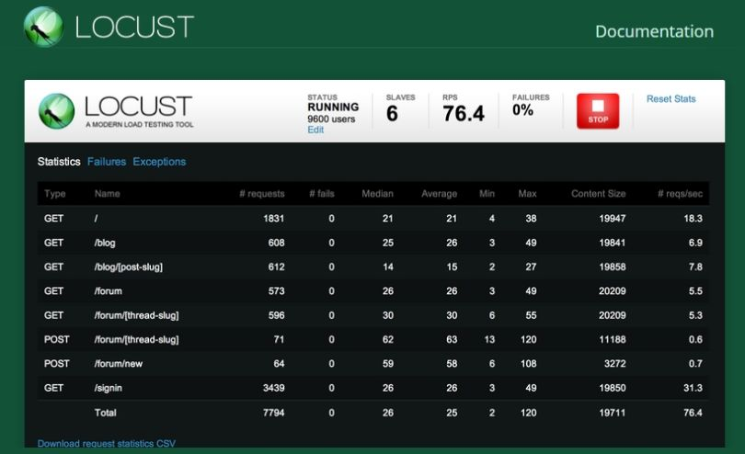
Locust’s features
Write test scenarios in plain old Python
Web-based UI
# locustfile.py
from locust import HttpLocust, TaskSet, task
class UserTaskSet(TaskSet):
@task
def get_index_task(self):
self.client.get("/api")
class User(HttpLocust):
task_set = UserTaskSet
min_wait = 5000
max_wait = 15000
host = "http://localhost:5000"

Slide 8


Locust’s features
Can test any system
Hackable
- wrap calls to a REST API to handle the particulars of your system - run a totally custom load pattern
MacOS
websites
web services
Windows
Distributed and scalable
Linux
API services
- run load tests distributed over multiple machines.
HTTP/HTTPS
SOAP

Slide 9
Install Locust
Use pip
pip install locustio
From github repo
git clone https://github.com/locustio/locust.git cd locust python setup.py install

Slide 10
Locust file
Locust will request a file called locustfile
# locustfile.py
from locust import HttpLocust, TaskSet, task
class UserTaskSet(TaskSet):
@task
def get_index_task(self):
self.client.get("/api") #3
class User(HttpLocust): #1
task_set = UserTaskSet
min_wait = 5000
max_wait = 15000
host = "http://localhost:5000" #2
Simply a python format file (.py)
Classes in Locust:
Locust
HttpLocust
HttpUser
Constant
task
TaskSet
SequentialTaskSet
Include: Users, Tasks
Run locust file:
locust -f locustfile.py

Slide 11
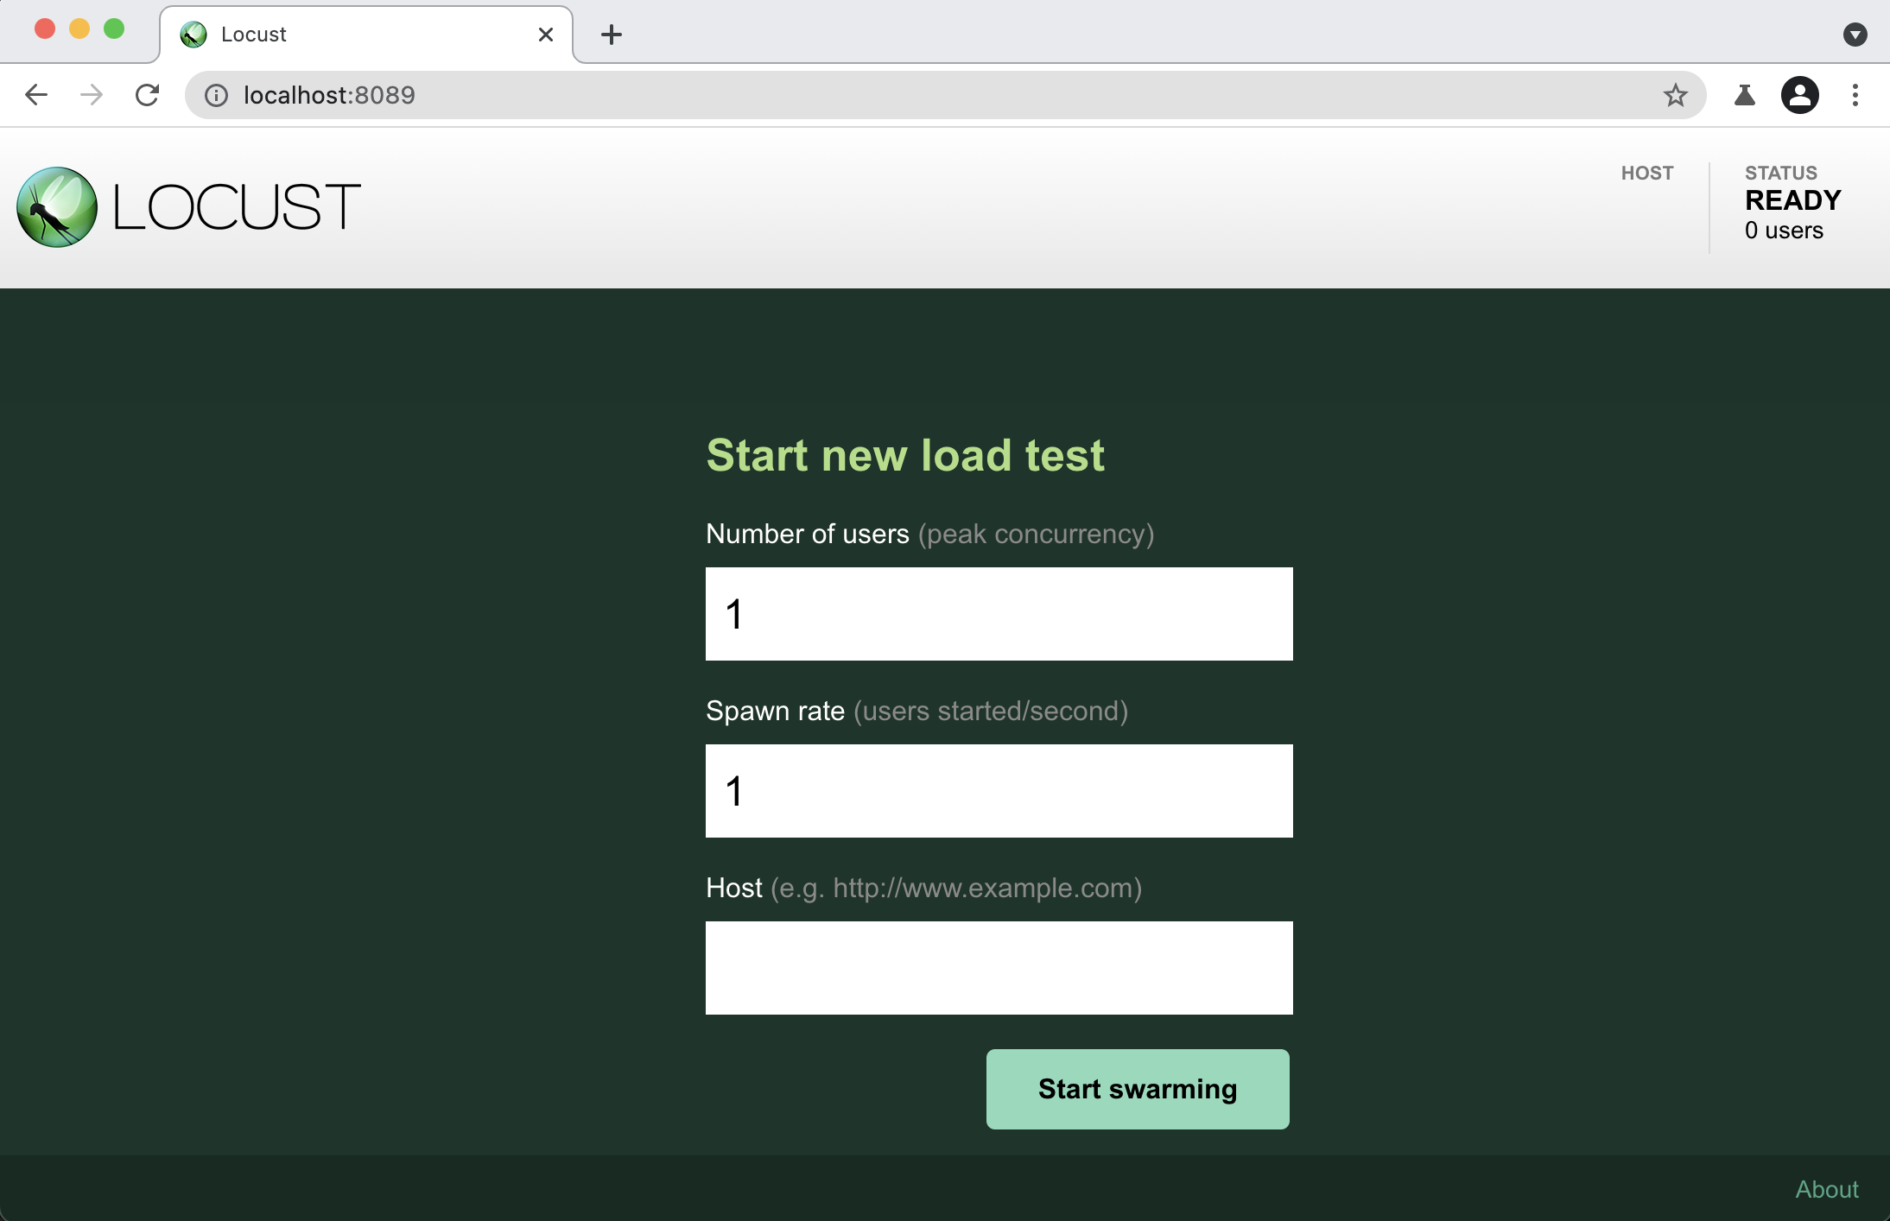
Locust file
Locust will request a file called locustfile
Simply a python format file (.py)
Classes in Locust:
Locust
HttpLocust
HttpUser
Constant
task
TaskSet
SequentialTaskSet
Include: Users, Tasks
Run locust file:
locust -f locustfile.py

Slide 12
Locust file
setup() / teardown(), on_start() / on_stop()
from locust import HttpLocust, TaskSet, task
class WebSiteUserTasks(TaskSet):
def setup(self):
print("Setup of TaskSet")
def on_start(self):
print("Locust hatched");
@task(3)
def get_index(self):
self.client.get("/api", name="GET /api")
@task(1)
def post_index(self):
payload = {'username': 'dolphin'}
self.client.post("/api", data=payload, name="POST /api")
def on_stop(self):
print("Locust stopped")
def teardown(self):
print("Teardown of TaskSet")
class WebsiteUser(HttpLocust):
host = "http://localhost:5000"
min_wait = 2 * 1000
max_wait = 5 * 1000
task_set = WebSiteUserTasks
Similar to BeforeAll / AfterAll, BeforeEach / AfterEach
in other test frameworks
Task get_index() will perform 3 times the number of times the post_index() is done

Slide 13
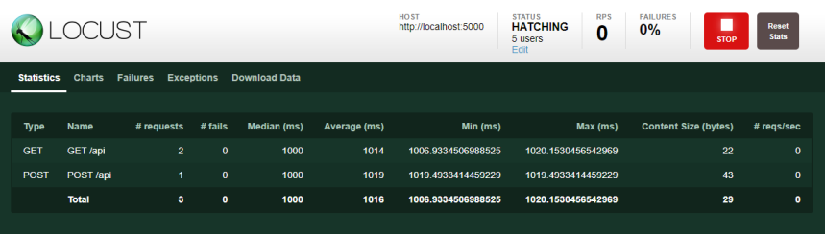
Locust’s web interface
Run scripts
Track metrics in real time
Change the load during test execution

Slide 14
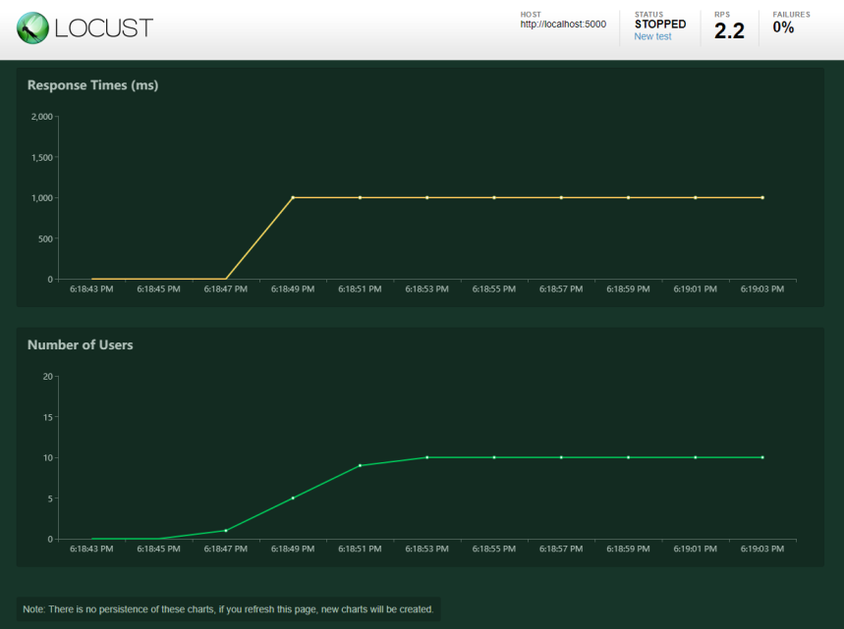
Locust’s web interface
Run scripts
Track metrics in real time
Change the load during test execution

Slide 15
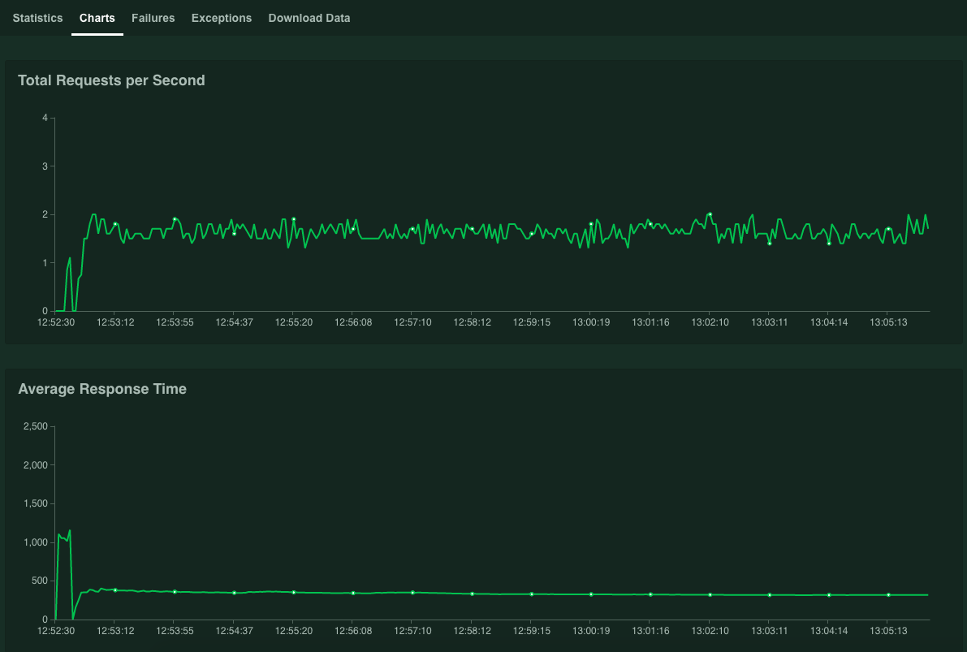
Locust’s web interface
Run scripts
Track metrics in real time
Change the load during test execution

Slide 16
Conclusion
Metrics
Advantages
Average Response Time
Support hundreds of thousands of users
Easy to set up distributed environment
Peak Response Time
Web interfaces, charts to view testing results
Error rate
Test script is written in Python instead of using the interface
Request per second
Throughput
Disadvantages
Need to know Python language
No recording feature as some tools (Jmeter, Gatling ...).

Slide 17
Demo

Slide 18
Demo scenarios
Demo 1
Environment
Host: CPU i5 8250u, 8GB RAM DDR4
Hosting and testing on one machine
Scenarios
Many users find a list of all hostel in the database
Request: GET "localhost://8080/sakura//hostel/list?province=0&district=0”
Metrics
Response time < 3.0s
Goal
Find Load (number of users) makes Response Time more than 3.0 seconds, with current server configuration and source code

Slide 19
Demo scenarios
Demo 2
Environment
Host: CPU i5 8250u, 8GB RAM DDR4
Hosting and testing on one machine
Scenarios
Simulation user’s scenarios, including 4 steps
View list of all hostels
GET "http://localhost:8080/sakura/hostel/list?province=0&district=0"
(2) View detail information of Sakura hostel
GET “http://localhost:8080/sakura/hostel/detail?filterStar=0&hostelId=1"
(3) View 1-star reviews of the Sakura hostel
GET "http://localhost:8080/sakura/hostel/detail?hostelId=1&filterStar=1
(4) View detail information of Big House hostel
GET “http://localhost:8080/sakura/hostel/detail?filterStar=0&hostelId=8"
Goal
Find Bottleneck

