Slide 1

SWT301 – LAB04
SECURITY TESTING
with
Team
Member
01
Vu Thien An
Nguyen Phat Dat
Nguyen Vi Khang
Nguyen Dang Loc
Nguyen Hong Minh

Slide 2

AGENDA
1
SQL injection
What is SQLi, its attack method
2
Sqlmap introduction
Overview of sqlmap
3
Mitigation of SQLi
How to prevent and minimize the vulnerability caused by SQL injection
4
Demo
How to use sqlmap
02

Slide 3
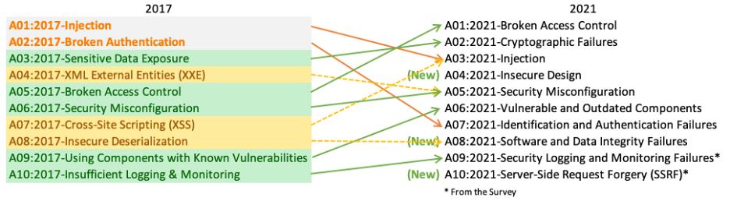
SQL injection
Top 3 out of 10 in OWASP Top Ten
Vietnamworks was hacked and found not to encrypt the password
Large corporations like Sony, Microsoft UK have exposed user data

Slide 4

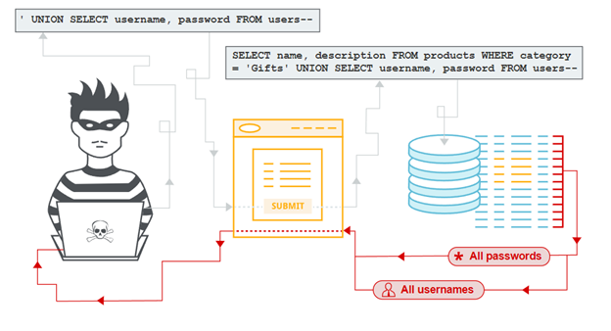
SQL injection
Definitions
A code injection technique
Attacker executes malicious SQL queries
Take control a web app’s databases
The nature of SQL Injection
Insert SQL statements into database connection points.
Successfully run SQL statement on the system.
One of the most common types of attack on the internet!

Slide 5

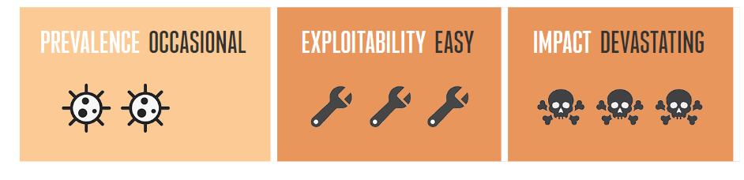
Why SQLi is crucial?
Attacker can:
Bypass user authentication
sql = 'SELECT * FROM Users
WHERE Username = ' + username +
' AND Password = ' + password + '
Insert, delete or modify data
username: ''
password: ' OR 1 = 1 LIMIT 1 --
Stealing information in the database
SELECT * FROM Users
WHERE Username = ‘’
AND Password = '' OR 1 = 1 LIMIT 1 -- '+ password + ';
Take control of the system

Slide 6
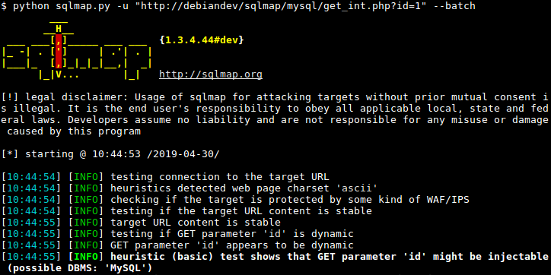

sqlmap introduction
Open source penetration testing tool
Automates detecting and exploiting SQLi
Taking over of database servers
Command line interface
Built-in with Linux
Windows need to install python and sqlmap

Slide 7
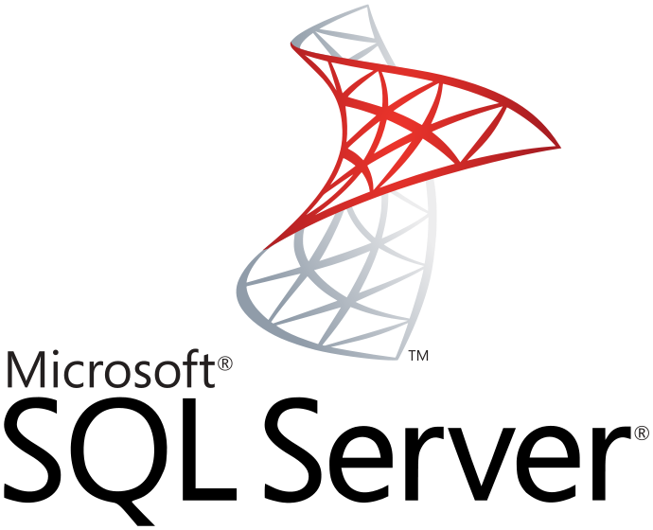




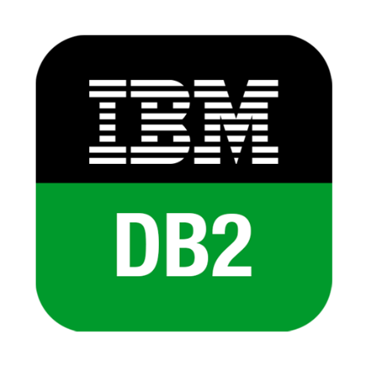





sqlmap’s features
Supports almost different types of DBMS
Full support for 6 SQL injection techniques
Support to directly connect to the database
Enumerate users, password hashes, privileges,
DB metadata
Automatic recognition of password hash formats
Dump database tables entirely
Search for specific DB names, tables across all DB

Slide 8
sqlmap’s usages
Install sqlmap
Download sqlmap at http://sqlmap.org/
git clone --depth 1 https://github.com/sqlmapproject/sqlmap.git sqlmap-dev
Run sqlmap
python sqlmap.py -h
python sqlmap.py
-u http://testphp.vulnweb.com/listproducts.php?cat=1 --dbs

Slide 9
Conclusion
Mitigation of SQLi
Advantages
Parameterized Queries
Free plan
Test automation
Object Relational Mapping
Friendly for CLI user
Authorization in db
Disadvantages
Not showing exception, error message:
No graphical user interface
Escaping Inputs
Low capability of reporting and analytics

Slide 10
Demo

Slide 11
Demo scenarios
Application - Juice shop
hosted on http://localhost:3000/
Goal
Find SQL Injection vulnerabilities using SQLMap
1. Test Login
python sqlmap.py
-u "http://localhost:3000/rest/user/login"
-data="email=test@test.com&password=test"
--level 5 --risk 3 --ignore-code 401 --dbms sqlite
--threads 5 --flush -batch
2. Test search function
python sqlmap.py
-r "C:\Users\admin\Desktop\search.txt"
--dbms sqlite --tables --flush --level 5 --risk 3
--technique=B -batch

