Slide 1


LOGIC
Logic is a science of the necessary laws of thought ...
(Kant, 1785)

Slide 2

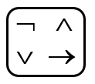

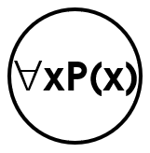

Foundations of Logic
Propositional logic
Operators
Equivalence rules
Predicate logic
Rules of Inference
Design of digital electronic circuits.
Express conditions in programs.
Query to databases & search engines.
Express and manipulate statements in mathematics and computer science.
Produce valid arguments.

Slide 3
Propositions
Proposition: a declaration that is true or false but not both.
Proposition | NOT a proposition
p: Hanoi is the capital of Vietnam. q: 1 + 1 = 3. h: The moon is made of green cheese. | What time is it? Read this chapter carefully. x + 1 = 2. Oh no!

Slide 4
Operators/connectives
∧
∨ →
Compound Proposition | Symbol
My PC does not run Linux. | ¬
He is young and strong. | ∧
You are going to take the final exam on Friday or Saturday. | ⊕
Experience with C++ or Java is required. | ∨
I will be shot if I know. | →
I go to cinema if and only if it rains. | ★

Slide 5
negation of a proposition
➢
¬p: negation of p
Proposition | Negation
p: Hanoi is the capital of Vietnam. q: 1 + 1 = 3. | ¬p: Hanoi is not the capital of Vietnam. ¬q: 1 + 1 ≠ 3.

Slide 6
conjunction of propositions
∧
p ∧ q: the conjunction of p and q Read: p and q
“p and q” is true if p = T, q = T and “p and q” is false otherwise
p | q | p ∧ q
T | T | T
T | F | F
F | T | F
F | F | F
The only
TRUE case

Slide 7
examples
∧
Nam is young (y) and strong (s).
In symbols: y ∧ s
I know (k) but I say nothing (s).
In symbols: k ∧ s

Slide 8
disjunction of propositions
∨
p∨q: the disjunction of p and q
Read: p or qrue if p = T, q = T
and “p and q” is false otherwise
p | q | p ∨ q
F | F | F
T | F | T
F | T | T
T | T | T
The only
FALSE case
p: 3 > 2
q: 1 > 2
p∨q: 3 > 2 or 1 > 2

Slide 9
Exclusive Or
⊕
Nickname: XOR
Symbol: ⊕
p | q | p ⊕ q
F | F | F
F | T | T
T | F | T
T | T | F
DIFERENT FROM ∨

Slide 10
conditional statement
⇨
p ⇨ r
Read: if p, then r
Nickname: implication
” is false otherwise
s | h | s → h
It is sunny. | It is hot. | If it is sunny, then it is hot.

Slide 11

IF _ THEN
⇨
F  F T
T  T T
F  T T
T  F F
The only
FALSE case
A useful way to understand:
think of an obligation or a contract.

Slide 12
Quiz


Suppose p  r is false, find the value of each of these propositions:
r  p
(¬p) ∨ r
p ⊕ r
(¬r)  p

Slide 13

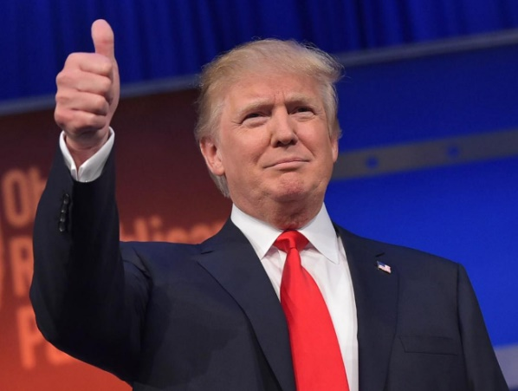
Biconditional statement

p ↔ q
Read: p if and only if q
p | q | p ↔ q
F | F | T
F | T | F
T | F | F
T | T | T
A shape is called a square
if and only if
it has 4 right angles.
2016

Slide 14
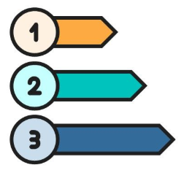
precedence
(1) In parentheses from inner to outer
(2) ¬
(3) ∧
(4) ∨
(5) →
¬p∨q∧r means (¬p)∨(q∧r)

Slide 15
Logical Equivalence
≡
He is young and strong ≡ He is strong and young.
Commutative laws: p∧q ≡ q∧p, p∨q ≡ q∨p

Slide 16
Quiz
p ∨ T ≡ 
p ∧ p ≡ 
p ∧ F ≡ 
p ∧ ¬p ≡ 
¬(¬p) ≡ 

Slide 17
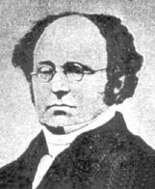

De morgan laws
A. De Morgan (1806-1871)
Ex. Find the negation of the statement
Bob knows Python and Java.
--------------------------------------------
In symbols: P ∧ J
Apply De Morgan law: $\overline{P ∧ J} ≡ \overline{P}$ ∨ $\overline{J}$
--------------------------------------------
➔ Bob does not know Python or Java.

Slide 18

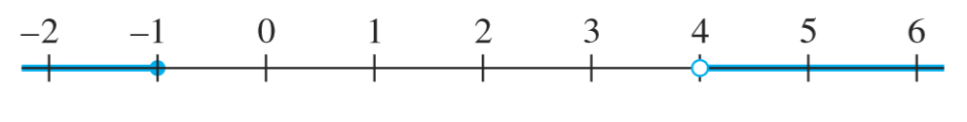

De morgan laws
Write the negation of
−1 < x ≤ 4.
−1 < x ≤ 4 means −1 < x and x ≤ 4.
Its negation is −1 ≮ x or x ❼ 4, which is eq. to −1 ≥ x or x > 4.
The negation is not −1 ≮ x and x ❼ 4.

Slide 19
quiz


p ∨ q ≡ ¬p  q
p  q ≡ q  p
p  q ≡ ¬p ∨ q
A  B ≡ ¬B  ¬A

Slide 20

Distributive laws
p∧(q ∨ r) ≡ (p ∧ q)∨(p ∧ r)
p∨(q ∧ r) ≡ (p ∨ q)∧(p ∨ r)

Slide 21

Important equivalences
De Morgan laws
A  B ≡ ¬A ∨ B
A  B ≡ ¬B  ¬A

Slide 22
Predicates. quantifiers
4 is a prime. // proposition
x is a prime. // not a proposition
x is a prime // a predicate
Let P(x) be the statement x is a prime.
 P(3): 3 is a prime
Notes:
Vị từ: predicate
Quantifiers: Lượng từ
Every, all, each, no one, some

Slide 23

Quiz

Let Q(x, y) be the statement x + y = xy, where x and y real numbers.
Find the truth value of each of these statements:
Q(2, 1)
Q(3, 1)
∀yQ(0, y)
∃xQ(x, 3)

Slide 24
Negating
➢

Slide 25
Rules of inference
P
∴Q
Laws of thought
Rules for producing valid arguments
Rules for avoiding fallacies
Rules for making draws from a hypothesis

Slide 26
Modus pones
A ⇨ B
A
∴B
❶ If A, then B.
❷ A.
❸ Therefore, B.
Valid argument with false conclusion
Notes:
Điều kiện đủ để lập luận
(dấu 3 chấm hình tam giác): therefore
Ngụy biện: lập luận sai logic, nhưng thu đc kết luân jđúng

Slide 27
Modus tollens
A ⇨ B
¬B
∴¬A
If this ﬁgure is a triangle, then the sum of its interior angles is 180°.
The sum of the interior angles of this ﬁgure is not 180°.
Therefore, this ﬁgure is not a triangle.
❶ If A, then B.
❷ ¬B
❸ Therefore, ¬A.
If logic is easy, then I am a monkey’s uncle.
I am not a monkey’s uncle.
Therefore, logic is not easy.
Notes:
Điều kiện cần để kết luận

Slide 28
Other rules
❶ ∨ ❷
¬❶
❶ ⇨ ❷
❷ ⇨ ❸
❶ ∧ ❷
∴❷
∴❶
∴❶ ⇨ ❸
This real number is rational or it is irrational.
This real number is not rational.
Therefore, this real number is irrational.
Sandra knows Java and Sandra knows C++.
Therefore, Sandra knows C++.
If I go to the movies, I won’t ﬁnish my homework. If I don’t ﬁnish my homework, I won’t do well on the exam tomorrow.
Therefore, if I go to the movies, I won’t do well on the exam tomorrow.

Slide 29

fallacies

If this number is larger than 2, then its square is larger than 4.
This number is not larger than 2.
Therefore, the square of this number is not larger than 4.
If Jules solved this problem correctly, then Jules obtained the answer 2.
Jules obtained the answer 2.
Therefore, Jules solved this problem correctly.
If apes are intelligent, then apes can solve puzzles.
Apes can solve puzzles.
Therefore, apes are intelligent.

Slide 30

Quiz

If Sarah knows Java, then she knows C++.
Sarah doesn’t know C++.
Therefore, Sarah doesn’t know Java.

If this number is larger than 2, then its square is larger than 4.
This number is not larger than 2.
Therefore, the square of this number is not larger than 4.

If Lin eats banana every day, then she is healthy.
Lin is not healthy.
Therefore, Lin does not eat banana every day.


Slide 31
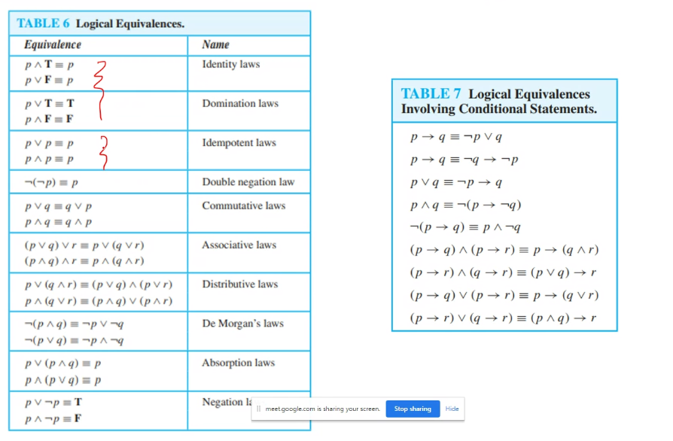
Summary – p.28
∑
Propositional logic
Logical equivalences
Predicates & Quantifiers
Rules of inference

Slide 32
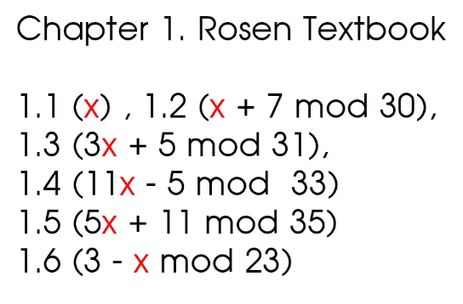
Assignment 1
THANKS

