Slide 1
CHAPTER 13 Specifying data requirements

Slide 2
Objectives
Student should enhance the ways to explore and represent the data
Student understand the ways to specify any reports or dashboards of application needs to generate.

Slide 3
Contents
Dialog map
Decision tree / table
Event-response table
Modeling data relationships
The data dictionary
Data analysis
Specifying reports
Dashboard reporting

Slide 4
Modeling data relationships
Purpose
ERD or Class diagram?
How to build ERD (remind) and class diagram

Slide 5
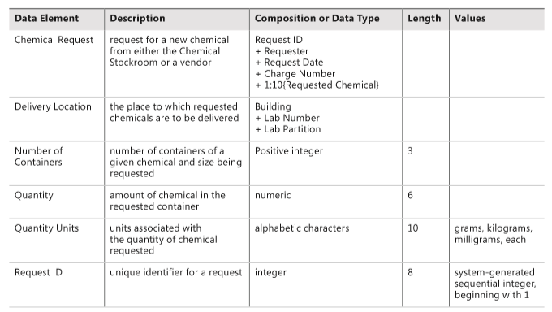
The data dictionary
Definition
Purpose
Example

Slide 6
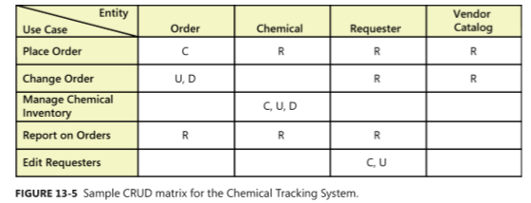
Data analysis
Purpose
CRUD matrix : Create, Read, Update, and Delete
Example

Slide 7
Specifying reports
Many applications generate reports from one or more databases, files, or other information sources.
Reports can consist of traditional tabular presentations of rows and columns of data, charts and graphs of all types, or any combination
Exploring the content and format of the reports needed is an important aspect of requirements development

Slide 8
Specifying reports
Eliciting reporting requirements
Report specification considerations
Consider other variations
Find the data
Anticipate growth
Look for similarities
Distinguish static and dynamic reports
Prototype reports
A report specification template: page 255

Slide 9
Dashboard reporting
Definition
A dashboard is a screen display or printed report that uses multiple textual and/or graphical representations of data to provide a consolidated, multidimensional view of what is going on in an organization or a process
Purpose
pull together information about sales, expenses, key performance indicators (KPIs), and the like.
Stock trading applications display a bewildering (to the novice) array of charts and data that the skilled eye can scan and process at a glance
How to build

