Slide 1
1. List Data Structure

Slide 2
Objectives
2
Describe List structures
Describe self-referential structures
Explain types of linked lists
Singly Linked Lists
Circular Lists
Doubly Linked Lists
Lists in java.util
Notes:
2

Slide 3
List Data Structures
A list is a sequential data structure, i.e. it is a sequence of items of a given base type, where items can be added, deleted, and retrieved from any position in the list.
A list can be implemented as an array, or as a dynamic array to avoid imposing a maximum size.
An alternative implementation is a linked list, where the items are stored in nodes that are linked together with pointers. These two implementations have very different characteristics.
The possible values of this type are sequences of items of type BaseType (including the sequence of length zero). The operations of the ADT are:
getFirst(), getLast(), getNext(p), getPrev(p), get(p), set(p,x), insert(p,x), remove(p),removeFirst(), removeLast(), removeNext(p), removePrev(p), find(x),size()
Notes:
RMIT Vietnam
COSC2082 - Programming 2
3

Slide 4
Drawbacks of Arrays
4
Array is a very useful data structure in many situations. However, it has some important limitations:
They require size information for creation
Inserting an element in the middle of an array leads to moving other elements around
Deleting an element from the middle of an array leads to moving other elements around
Other data structures are more efficient in such situations.

Slide 5
Self-Referential Structures
Many dynamic data structures are implemented through the use of a self-referential structure.
A self-referential structure is an object, one of whose elements is a reference to another object of its own type.
With this arrangement, it is possible to create ‘chains’ of data of varying forms:
Employee
String name;
int age;
Linked lists
trees
DataNode
DataNode
Employee info;
DataNode next;
Employee info;
DataNode left;
DataNode right;
Self-Referential Structures
Notes:
RMIT Vietnam
COSC2082 - Programming 2
5

Slide 6
Linked Lists
6
A linked structure is a collection of nodes storing data and links to other nodes
A linked list is a linear data structure composed of nodes, each node holding some information and a reference to another node in the list
Types of linked lists:
Singly-Linked List
Doubly-Linked List
In programming, linear means that they are described by one (single) series of data … ie. Each data item has at most one predecessor and at most one successor. And, Non-linear means anything else.
Linear are – Array, Linked List, Stack, Queue. Non Linear are – Tree, Graph
Notes:
Each data item has at most one predecessor (tiền nhiệm) and at most one successor (kế nhiệm).

Slide 7
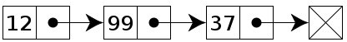
Singly Linked Lists
7
A singly linked list is a list whose node includes two datafields: info and next. The info field is used to store information, and this is important to the user. The next field is used to link to its successor in this sequence
The following image depicts a simple integer linked list.
head
tail
Singly Linked List

Slide 8
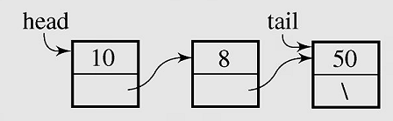
Singly Linked List Implementation
8
class Node
{int info;
Node next;
Node() {}
Node(int x, Node p)
{info=x;next=p;
}
}
class MyList
{Node head,tail;
MyList() {head=tail=null;}
boolean isEmpty()
{return(head==null);
}
void clear()
{head=tail=null;
}
void add(int x)
{ if(isEmpty())
head=tail=new Node(x,null);
else
{Node q =new Node(x,null);
tail.next=q; tail=q;
}
}
void traverse()
{Node p=head;
while(p!=null)
{System.out.print(" " + p.info);
p=p.next;
}
System.out.println();
}
Node search(int x) {...}
void dele(int x) {...}
}
Notes:
8

Slide 9
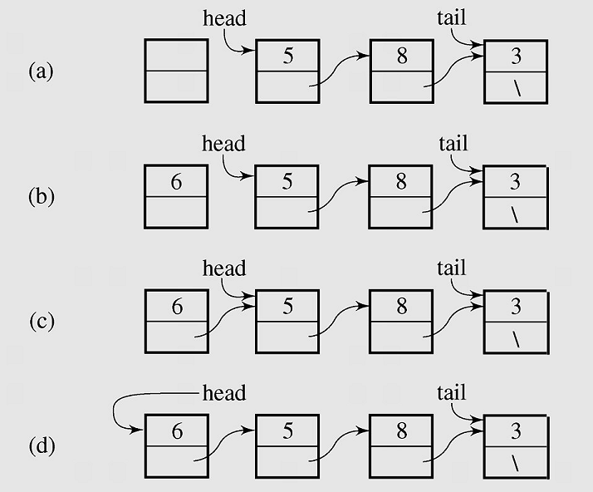
Singly Linked Lists - 1
9
Inserting a new node at the beginning of a list
Inserting a new node at the beginning of a Singly Linked List
Notes:
Image source: Drozdek
9

Slide 10
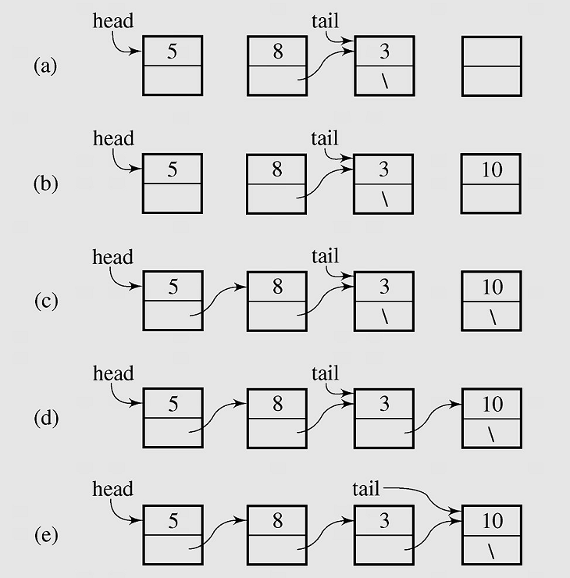
Singly Linked Lists - 2
10
Inserting a new node at the end of a list
Inserting a new node at the end of a Singly Linked List

Slide 11
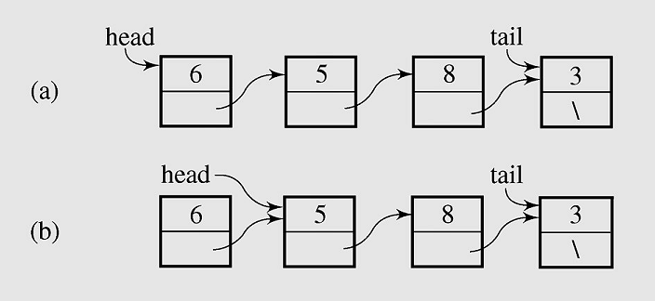
Singly Linked Lists - 3 Deleting a node from the beginning of a list
11
Deleting a node from the beginning of a Singly Linked List

Slide 12
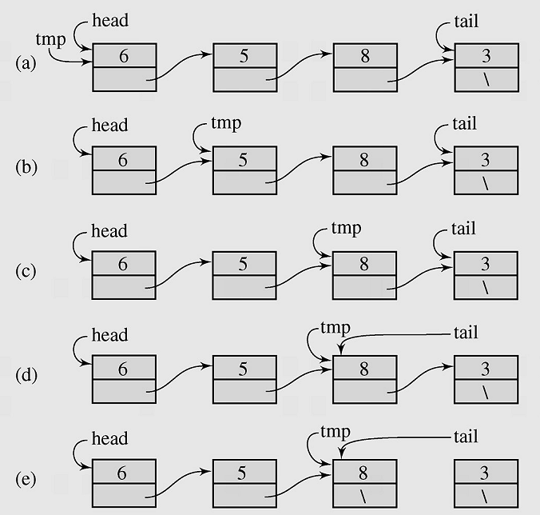
Singly Linked List - 4 Deleting element from the end of a list
12
Deleting a node from the end of a Singly Linked List

Slide 13
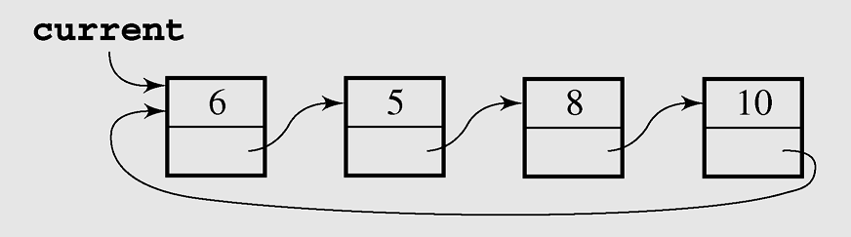
Circular Lists - 1
13
A circular list is when nodes form a ring: The list is finite and each node has a successor
Circular SIngly Linked List

Slide 14
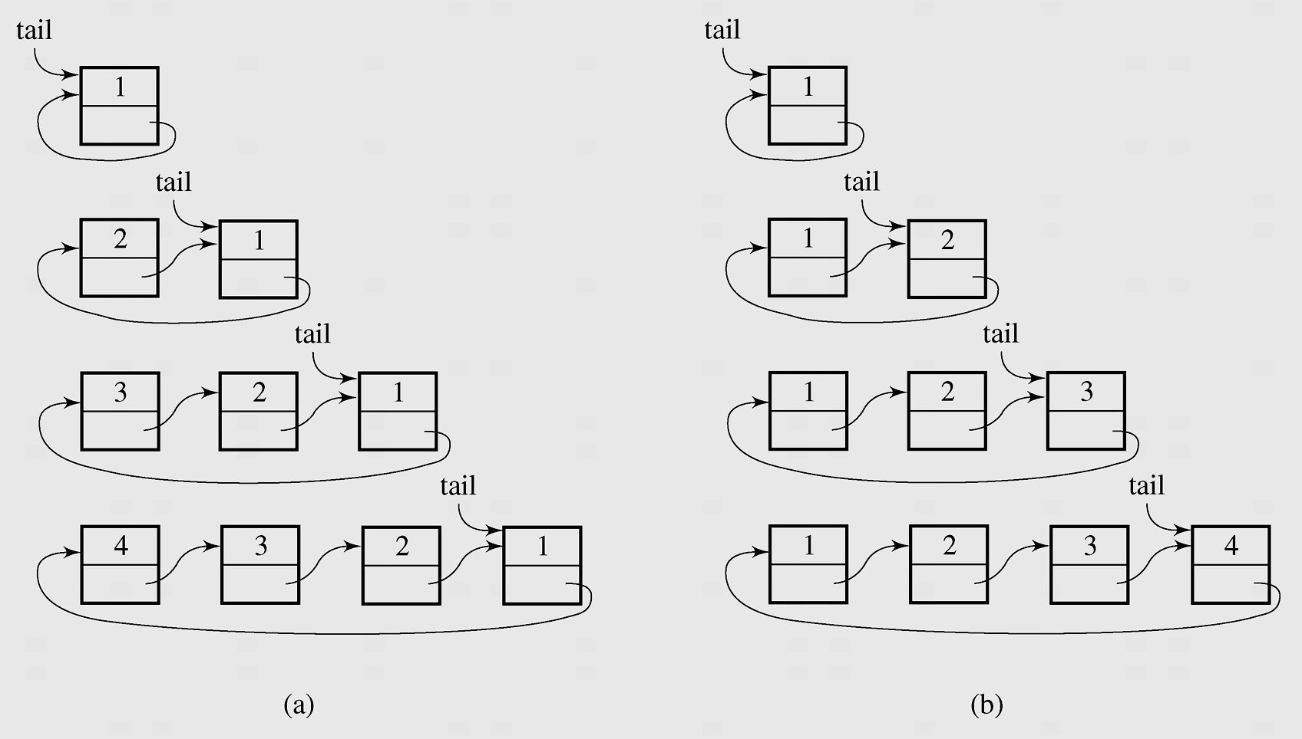
Circular Lists - 2 Inserting nodes
14
Inserting nodes at the front of a circular singly linked list (a) and at its end (b)

Slide 15
Circular List application
1. Round-Robin Scheduling
One of the most important roles of an operating system is in managing the many processes that are currently active on a computer, including the scheduling of those processes on one or more central processing units (CPUs). In order to support the responsiveness of an arbitrary number of concurrent processes, most operating systems allow processes to effectively share use of the CPUs, using some form of an algorithm known as round-robin scheduling. A process is given a short turn to execute, known as a time slice, but it is interrupted when the slice ends, even if its job is not yet complete. Each active process is given its own time slice, taking turns in a cyclic order.
2. Using circular linked list to implement Round-Robin Scheduling
We can use circular linked list to implement Round-Robin Scheduling by the following method: rotate( ): Moves the first element to the end of the list.
With this new operation, round-robin scheduling can be efficiently implemented by repeatedly performing the following steps on a circularly linked list C:
1. Give a time slice to process C.first( )
2. C.rotate( )
15

Slide 16
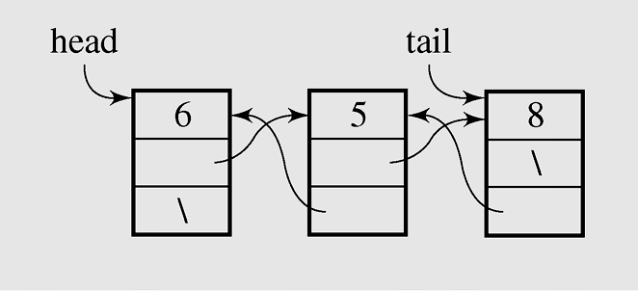
Doubly Linked Lists - 1
In a doubly linked list, each node has two reference fields, one to the successor and one to the predecessor
16
class MyList
{Node head,tail;
MyList() {head=tail=null;}
boolean isEmpty()
{return(head==null); }
void clear() {head=tail=null;}
void add(int x)
{if(isEmpty())
head=tail=new Node(x,null,null);
else
{Node q =new Node(x,tail,null);
tail.next=q;
tail=q;
}
}
...
}
Doubly Linked List
class Node
{int info;
Node prev,next;
Node() {}
Node(int x, Node p, Node q)
{info=x;prev=p; next=q;
}
}
Notes:
Image Source: Drozdek
16

Slide 17
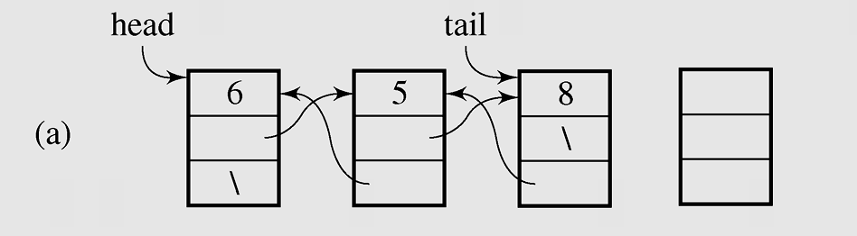
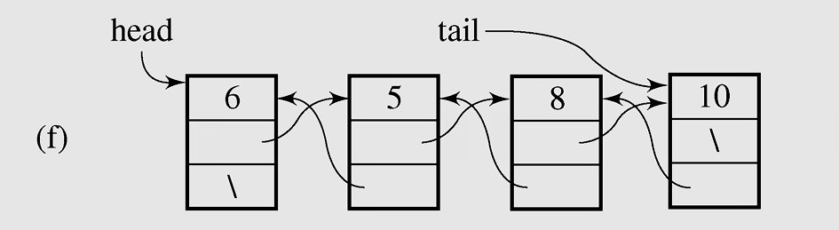
Doubly Linked Lists - 2 Adding a new node at the end
17
Adding new node at the end of Doubly Linked List

Slide 18
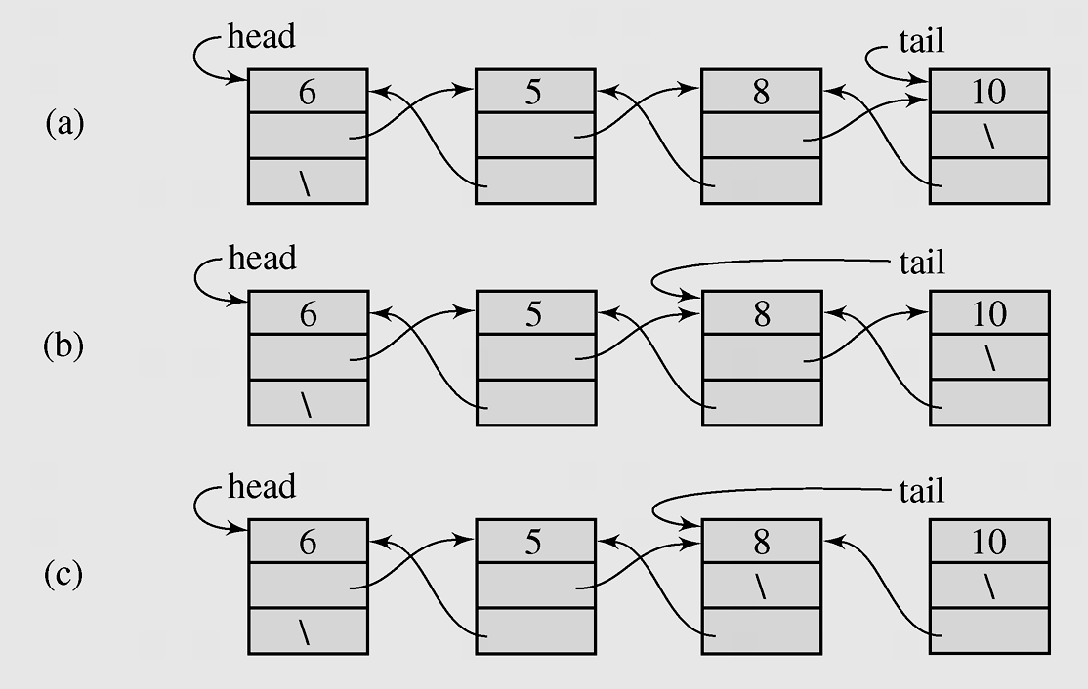
Doubly Linked Lists -3 Deleting a node from the end
18
Deleting a node from the end of Doubly Linked List

Slide 19
Lists in java.util - LinkedList class
boolean | add(E o) Appends the specified element to the end of this list.
void | addFirst(E o) Inserts the given element at the beginning of this list.
void | addLast(E o) Appends the given element to the end of this list.
void | clear() Removes all of the elements from this list.
E | get(int index) Returns the element at the specified position in this list.
E | getFirst() Returns the first element in this list.
E | getLast() Returns the last element in this list.
E | remove(int index) Removes the element at the specified position in this list.
E | removeFirst()Removes and returns the first element from this list.
E | removeLast() Removes and returns the last element from this list.
int | size() Returns the number of elements in this list.
Object[] | toArray() Returns an array containing all of the elements in this list in the correct order.

Slide 20
Lists in java.util LinkedList class example
import java.util.*;
class Node
{ String name;
int age;
Node() {}
Node(String name1, int age1)
{ name=name1; age=age1;
}
void set(String name1, int age1)
{ name=name1; age=age1;
}
public String toString()
{ String s = name+" "+age;
return(s);
}
}
class Main
{
public static void main(String [] args)
{
LinkedList t = new LinkedList();
Node x; int n,i;
x = new Node("A01",25); t.add(x);
x = new Node("A02",23); t.add(x);
x = new Node("A03",21); t.add(x);
for(i=0;i<t.size();i++)
System.out.println(t.get(i));
}
}

Slide 21
Lists in java.util - ArrayList class
boolean | add(E o) Appends the specified element to the end of this list.
void | add(int index, E o) Inserts the given element at the specified pos.
void | clear() Removes all of the elements from this list.
E | get(int index) Returns the element at the specified position in this list.
E | remove(int index) Removes the element at the specified position in this list.
int | size() Returns the number of elements in this list.
void | ensureCapacity(int minCapacity) Increases the capacity of this ArrayList instance, if necessary, to ensure that it can hold at least the number of elements specified by the minimum capacity argument.
void | trimToSize() Trims the capacity of this ArrayList instance to be the list's current size.
Object[] | toArray() Returns an array containing all of the elements in this list in the correct order.

Slide 22
Summary
A list is a sequential data structure, i.e. it is a sequence of items of a given base type.
A list can be implemented as an array, or as a dynamic array to avoid imposing a maximum size.
An alternative implementation is a linked list , where the items are stored in nodes that are linked together with pointers.
A singly linked list is when a node has a link to its successor (next node) only.
A circular list is when nodes form a ring: The list is finite and each node has a successor.
A doubly linked list is when a node has links to its previous and to the next nodes.

Slide 23
Reading at home
Text book: Data Structures and Algorithms in Java
3 Fundamental Data Structures 103
3.1 Using Arrays - . 104
3.2 Singly Linked Lists - 122
3.3 Circularly Linked Lists - 128
3.4 Doubly Linked Lists - 132

