Slide 1
2. Stack and Queue
Part 1: Stack

Slide 2
Stack
Objectives
Stacks
Array-based stack
Stack implemented by a singly linked list
Stack class in java.util

Slide 3
What is a stack?
3
A stack is a linear data structure that can be accessed only at one of its ends for storing and retrieving data
A stack is a Last In, First Out (LIFO) data structure
Anything added to the stack goes on the “top” of the stack
Anything removed from the stack is taken from the “top” of the stack
Things are removed in the reverse order from that in which they were inserted
Notes:
3

Slide 4
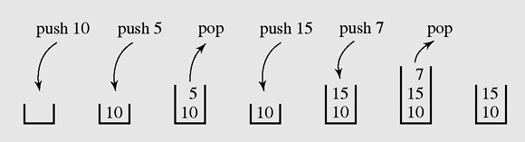
Operations on a stack
The following operations are needed to properly manage a stack:
clear() — Clear the stack
isEmpty() — Check to see if the stack is empty
push(el) — Put the element el on the top of the stack
pop() — Take the topmost element from the stack
top() — Return the topmost element in the stack without removing it
4
Operations on a stack

Slide 5
Stack Exceptions
Attempting the execution of an operation of ADT may sometimes cause an error condition, called an exception
Exceptions are said to be “thrown” by an operation that cannot be executed
In the Stack ADT, operations pop and top cannot be performed if the stack is empty
Attempting the execution of pop or top on an empty stack throws an StackEmptyException.
5

Slide 6
Applications of Stacks
Stacks are used for:
Any sort of nesting (such as parentheses)
Evaluating arithmetic expressions (and other sorts of expression)
Implementing function or method calls
Keeping track of previous choices (as in backtracking)
Keeping track of choices yet to be made (as in creating a maze)
Undo sequence in a text editor.
Auxiliary data structure for algorithms
Component of other data structures

Slide 7
Stack in computer memory
How does a stack in memory actually work?
Each time a method is called, an activation record (AR) is allocated for it. This record usually contains the following information:
Parameters and local variables used in the called method.
A dynamic link, which is a pointer to the caller's activation record.
Return address to resume control by the caller, the address of the caller’s instruction immediately following the call.
Return value for a method not declared as void. Because the size of the activation record may vary from one call to another, the returned value is placed right above the activation record of the caller.
Each new activation record is placed on the top of the run-time stack
When a method terminates, its activation record is removed from the top of the run-time stack
Thus, the first AR placed onto the stack is the last one removed
AR is also called Stack frame

Slide 8
Array-based Stack - 1
A simple way of implementing the Stack ADT (abstract data type) uses an array
We add elements from left to right
A variable top keeps track of the index of the top element
…
S
0
1
2
top
Array-based stack

Slide 9
Array-based Stack - 2
The array storing the stack elements may become full
A push operation will then throw a FullStackException
Limitation of the array-based implementation
Not intrinsic to the Stack ADT
…
S
0
1
2
top
Array-based stack may become full

Slide 10
Array implementation of a stack
class ArrayStack
{protected Object [] a; int top, max;
public ArrayStack()
{ this(50);
}
public ArrayStack(int max1)
{ max = max1;
a = new Object[max];
top = -1;
}
protected boolean grow()
{ int max1 = max + max/2;
Object [] a1 = new Object[max1];
if(a1 == null) return(false);
for(int i =0; i<=top; i++) a1[i] = a[i];
a = a1;
return(true);
}
public boolean isEmpty()
{ return(top==-1);}
public boolean isEmpty()
{ return(top==-1);}
public boolean isFull()
{ return(top==max-1);}
public void clear()
{ top=-1;}
public void push(Object x)
{ if(isFull() && !grow()) return;
a[++top] = x;
}
Object top() throws EmptyStackException
{ if(isEmpty()) throw new EmptyStackException();
return(a[top]);
}
public Object pop() throws EmptyStackException
{ if(isEmpty()) throw new EmptyStackException();
Object x = a[top];
top--;
return(x);
}
10

Slide 11
Linked implementation of a stack
class Node
{ public Object info;
public Node next;
public Node(Object x, Node p)
{ info=x; next=p; }
public Node(Object x)
{ this(x,null); }
};
Object top() throws EmptyStackException
{ if(isEmpty()) throw new EmptyStackException();
return(head.info);
}
public Object pop() throws EmptyStackException
{ if(isEmpty()) throw new EmptyStackException();
Object x = head.info;
head=head.next;
return(x);
}
11
class LinkedStack
{ protected Node head;
public LinkedStack()
{ head = null; }
public boolean isEmpty()
{ return(head==null);}
public void push(Object x)
{ head = new Node(x,head);
}

Slide 12
Implementing a stack using ArrayList & LinkedList classes in Java
12
import java.util.*;
class MyStack
{ArrayList h;
MyStack() {h = new ArrayList();}
boolean isEmpty()
{return(h.isEmpty());}
void push(Object x)
{h.add(x);
}
Object pop()
{if(isEmpty()) return(null);
return(h.remove(h.size()-1));
}
}
import java.util.*;
class MyStack
{LinkedList h;
MyStack() {h = new LinkedList();}
boolean isEmpty()
{return(h.isEmpty());}
void push(Object x)
{h.add(x);
}
Object pop()
{if(isEmpty()) return(null);
return(h.removeLast());
}
}

Slide 13
Convert decimal integer number to binary number using a stack
13
public class Main
{public static void decToBin(int k)
{MyStack s = new MyStack();
System.out.print(k + " in binary system is: ");
while(k>0)
{s.push(new Integer(k%2));
k = k/2;
}
while(!s.isEmpty())
System.out.print(s.pop());
System.out.println();
}
public static void main(String [] args)
{decToBin(11);
System.out.println();
}
}

Slide 14
Validate expression using stack - 1
We consider arithmetic expressions that may contain various pairs of grouping symbols, such as
• Parentheses: “(” and “)”
• Braces: “{” and “}”
• Brackets: “[” and “]”
Each opening symbol must match its corresponding closing symbol. For example,
a left bracket, “[,” must match a corresponding right bracket, “],” as in the following
expression
[(5+x)−(y+z)].
The following examples further illustrate this concept:
• Correct: ( )(( )){([( )])}
• Correct: ((( )(( )){([( )])}))
• Incorrect: )(( )){([( )])}
• Incorrect: ({[ ])}
• Incorrect: (
We leave the precise definition of a matching group of symbols to Exercise R-6.6.
14

Slide 15
Validate expression using stack - 2
15
An Algorithm for Matching Delimiters:
An important task when processing arithmetic expressions is to make sure their delimiting symbols match up correctly. We can use a stack to perform this task with a single left-to-right scan of the original string.
Each time we encounter an opening symbol, we push that symbol onto the stack, and each time we encounter a closing symbol, we pop a symbol from the stack (assuming it is not empty) and check that these two symbols form a valid pair. If we reach the end of the expression and the stack is empty, then the original expression was properly matched. Otherwise, there must be an opening delimiter on the stack without a matching symbol. If the length of the original expression is n, the algorithm will make at most n calls to push and n calls to pop.

Slide 16
Matching Parentheses and HTML Tags
16
Another application of matching delimiters is in the validation of markup languages such as HTML or XML. HTML is the standard format for hyperlinked documents on the Internet and XML is an extensible markup language used for a variety of structured data sets.
In an HTML document, portions of text are delimited by HTML tags. A simple opening HTML tag has the form “<name>” and the corresponding closing tag has the form “</name>”. For example, the <body> tag has the matching </body> tag at the close of that document.
Ideally, an HTML document should have matching tags, although most browsers tolerate a certain number of mismatching tags. We can use stack to check whether an HTML document is valid or not.

Slide 17
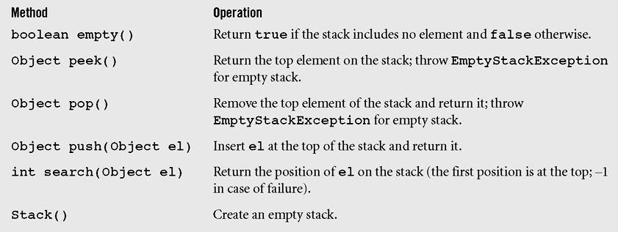
Stack class in Java
A Stack class implemented in the java.util package is an extension of class Vector to which one constructor and five methods are added.
Stack class in Java

Slide 18
Summary
18
A stack is a linear data structure that can be accessed at only one of its ends for storing and retrieving data.
A stack is called an LIFO structure: last in/first out.

Slide 19
Reading at home
Text book: Data Structures and Algorithms in Java.
6 Stacks, Queues, and Deques 225
6.1 Stacks - 226

