Slide 1
4. Trees
Part 1

Slide 2
Objectives
2
What is a Trees?
Tree Terminology
Tree examples
Ordered Trees
Tree Traversals
Binary Trees
Implementing Binary Trees
Binary Search Tree
Insertion
Deletion
Notes:
2

Slide 3
What is a Tree?
Trees, Binary Trees, and Binary Search Trees
In computer science, a tree is an abstract model of a hierarchical structure
A tree consists of nodes with a parent-child relation
Inspiration: family trees
Applications:
Organization charts
File systems
Programming environments
Every node except one (a root) has a unique parent.
Computers”R”Us
Sales
Manufacturing
R&D
US
International
Laptops
Desktops
Europe
Asia
Canada
Empty structure is an empty tree.
Non-empty tree consists of a root and its children, where these children are also trees.
Exact definition

Slide 4
Tree Terminology - 1
Root: unique node without a parent
Internal node: node with at least one child (A, B, C, F)
External (leaf) node: node without children (E, I, J, K, G, H, D)
Ancestors of a node: parent, grandparent, great-grandparent, …
Descendants of a node: child, grandchild, great-grandchild, etc.
Level of a node: The level of the root is 1. If a father has level i then its children has level i+1.
A
sub-tree
B
C
D
E
F
G
H
I
J
K
Sub-tree: tree consisting of a node and its descendants
(The level is known with other name: depth. In some documents a level of the root is defined as 0)
Height of a tree: maximum level in a tree, thus a single node is a tree of height 1. The height of an empty tree is 0.
Height of a node p is the height of the sub-tree with root p.
We can see that the height of a tree is the maximum number of nodes on a path from the root to a leaf node.
In text book and some other documents the height of a tree with single node is defined as 0

Slide 5
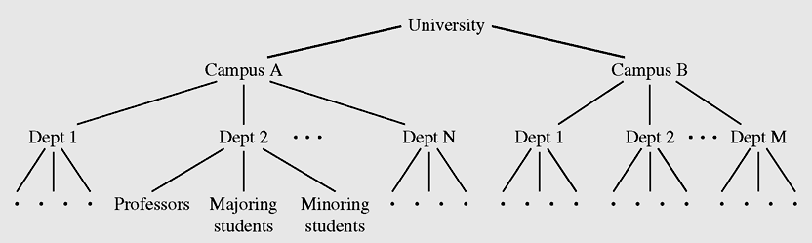
Tree Terminology - 2
Degree (order) of a node: number of its non-empty childrens.
Each node has to be reachable from the root through a unique sequence of arcs (edges), called a path
The number of arcs in a path is called the length of the path
Tree example: Hierarchical structure of a university shown as a tree
Data Structures and Algorithms in Java

Slide 6
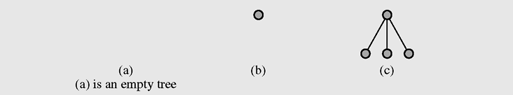
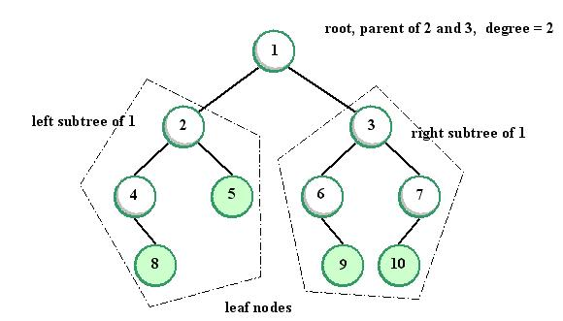
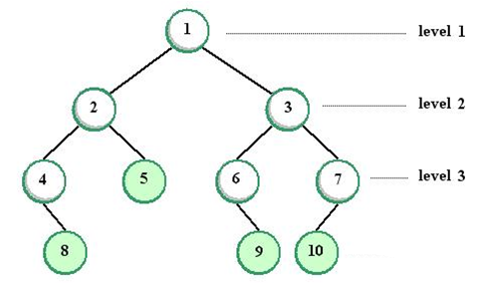
Tree examples
Image Source: JEDI
Notes:
Image Source: JED
Some books say: level of root = 0
6

Slide 7
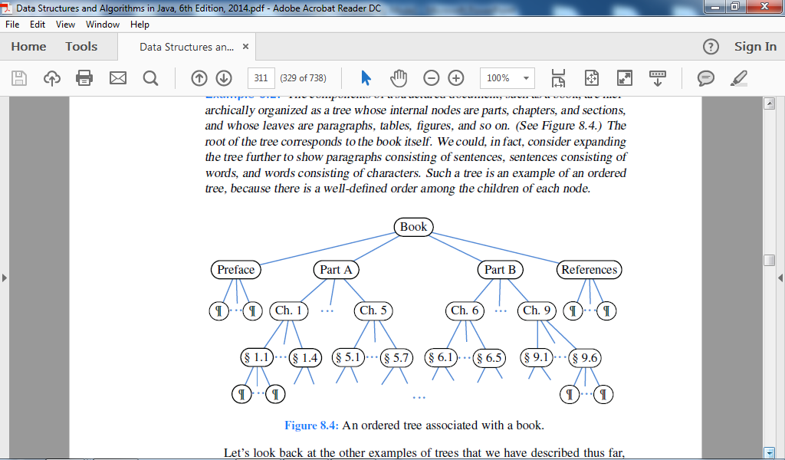
Ordered Trees
A tree is ordered if there is a meaningful linear order among the children of each node; that is, we purposefully identify the children of a node as being the first, second, third, and so on. Such an order is usually visualized by arranging siblings left to right, according to their order.
An ordered tree associated with a book.

Slide 8
Pre-order Traversal of a tree
Preorder and Postorder Traversals of General Trees
Tree traversal is the process of visiting each node in the tree exactly one time.
In a pre-order traversal, a node is visited before its descendants
Application: print a structured document
Algorithm preOrder(v)
visit(v)
for each child w of v
preorder (w)
1
Make Money Fast!
2
5
9
1. Motivations
2. Methods
References
3
4
6
7
8
1.1 Greed
1.2 Avidity
2.1 Stock Fraud
2.2 Ponzi Scheme
2.3 Bank Robbery
Data Structures and Algorithms in Java

Slide 9
Post-order Traversal of a tree
In a postorder traversal, a node is visited after its descendants
Application: compute space used by files in a directory and its subdirectories
Algorithm postOrder(v)
for each child w of v
postOrder (w)
visit(v)
9
cs16/
8
3
7
homeworks/
programs/
todo.txt 1K
1
2
4
5
6
h1c.doc 3K
h1nc.doc 2K
DDR.java 10K
Stocks.java 25K
Robot.java 20K
Data Structures and Algorithms in Java

Slide 10
Breadth-first Traversal of a tree
In a breadth-firth traversal, a node is visited first, then all its' children, then all its grandchildren,...
Application: visit family tree by generations.
Algorithm breadthOrder(v)
visit(v)
visit all childs v1,v2,.. of v
visit all childs of v1, then all childs of v2,..
1
Make Money Fast!
2
3
4
1. Motivations
2. Methods
References
5
6
7
8
9
1.1 Greed
1.2 Avidity
2.1 Stock Fraud
2.2 Ponzi Scheme
2.3 Bank Robbery
Data Structures and Algorithms in Java

Slide 11
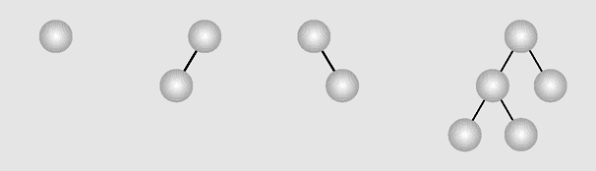
Binary Trees
A binary tree is a tree in which each node has at most two children. (Thus an empty tree is an binary tree). Each child may be empty and designated as either a left child or a right child
Examples of binary trees

Slide 12
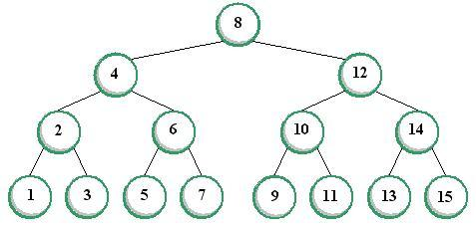
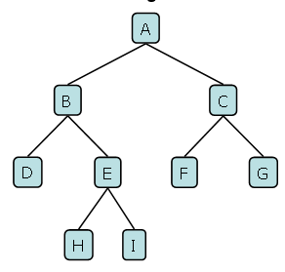
Types of Binary Trees
In a proper binary tree (sometimes full binary tree or 2-tree), every node other than the leaves has two children.
In a complete binary tree, all non-terminal nodes have both their children, and all leaves are at the same level.
A Full Binary Tree
A Complete Binary Tree
Notes:
Image source: JEDI (https://jedi.dev.java.net/)
12

Slide 13
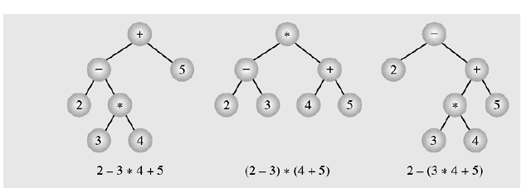
Binary Tree example – Expression Tree
Typical arithmetic expression tree is a proper binary tree, since each operator +, −, ∗, and / takes exactly two operands. Of course, if we were to allow unary operators, like negation (−), as in “−x,” then we could have an improper binary tree.
Notes:
Image Source: JED
Some books say: level of root = 0
13

Slide 14
Binary Tree Traversals
Breadth-first traversal is visiting each node starting from the lowest (or highest) level and moving down (or up) level by level, visiting nodes on each level from left to right (or from right to left)
Breadth-first traversal:
A, B, C, D, E, F, G, H, I

Slide 15
Depth-First Traversals
15
N = node, L = left, R = right
Pre-order (NLR)
Algorithm preOrder(v)
visit(v)
preOrder (left child of v)
preOrder (right child of v)
In-order (LNR)
Algorithm inOrder(v)
inOrder (left child of v)
visit(v)
inOrder (right child of v)
Post-order (LRN)
Algorithm postOrder(v)
postOrder (left child of v)
postOrder (right child of v)
visit(v)

Slide 16
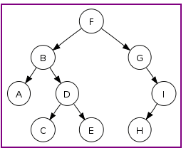
Binary Tree Traversal example
16
Preorder traversal: F, B, A, D, C, E, G, I, H (root, left, right)
Inorder traversal: A, B, C, D, E, F, G, H, I (left, root, right)
Postorder traversal: A, C, E, D, B, H, I, G, F (left, right, root)
Level-order traversal (breadth first): F, B, G, A, D, I, C, E, H

Slide 17
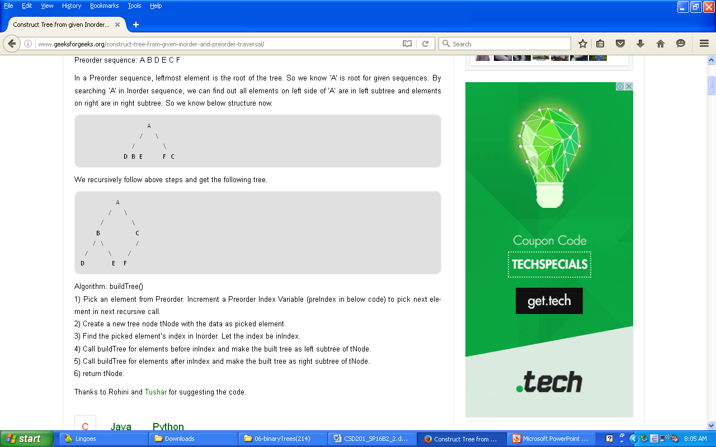
Construct Binary Tree from given traversals
17
From given traversals we can construct the tree. More exactly speaking, we can construct a tree from inorder&preorder or inorder&postorder traversals.
Let us consider the below traversals:
Inorder sequence: D B E A F C Preorder sequence: A B D E C F
In a Preorder sequence, leftmost element is the root of the tree. So we know ‘A’ is root for given sequences. By searching ‘A’ in Inorder sequence, we can find out all elements on left side of ‘A’ are in left subtree and elements on right are in right subtree. So we know below structure now:
We recursively follow above steps and get the following tree:

Slide 18
Implementing Binary Trees - 1
Binary trees can be implemented in at least two ways:
As arrays
As linked structures
To implement a tree as an array, a node is declared as an object with an information field and two “reference” fields. These reference fields contain the indexes of the array cells in which the left and right children are stored, if there are any.
However, it is hard to predict how many nodes will be created during a program execution. (Therefore, how many spaces should be reserved for the array?)

Slide 19
Implementing Binary Trees - 2
19
To implement a tree as a linked structure, a node is declared as an object with an information field and two “reference” fields.
Key (data)
left child right child
class Node
{int info;
Node left,right;
Node(int x)
{info=x;left=right=null;
}
}
class Node
{int info;
Node left,right;
Node(int x) { }
Node(int x, Node p, Node q)
{info=x;left=p; right=q;
}
Node(int x)
{this(x,null,null);
}
}
Different types of implementations of Binary tree node

Slide 20
Breadth-First Traversal code
20
void breadth()
{ if(root==null) return;
MyQueue q = new MyQueue();
q.enqueue(root);
Node p;
while(!q.isEmpty())
{ p = (Node) q.dequeue();
if(p.left !=null)
q.enqueue(p.left);
if(p.right !=null)
q.enqueue(p.right);
visit(p);
}
}
Top-down, left-to-right, breadth-first traversal implementation

Slide 21
Depth-First Traversal code
21
void preOrder(Node p)
{ if(p==null) return;
visit(p);
preOrder(p.left);
preOrder(p.right);
}
void inOrder(Node p)
{ if(p==null) return;
inOrder(p.left);
visit(p);
inOrder(p.right);
}
void postOrder(Node p)
{ if(p==null) return;
postOrder(p.left);
postOrder(p.right);
visit(p);
}

Slide 22
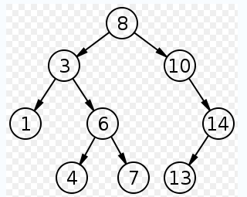
Binary Search Trees
In computer science, a binary search tree (BST) is a node based binary tree data structure which has the following properties:
The left subtree of a node contains only nodes with keys less than the node's key.
The right subtree of a node contains only nodes with keys greater than the node's key.
Both the left and right subtrees must also be binary search trees.
From the above properties it naturally follows that:
Each node (item in the tree) has a distinct key.
An inorder traversal of a binary search trees visits the keys in increasing order

Slide 23
Implementing Binary Search Trees
23
class BSTree
{Node root;
BSTree() {root=null;}
void insert(int x) {... }
void visit(Node p) {...}
void preOrder(Node p) {...}
void inOrder(Node p) {...}
void postOrder(Node p) {...}
Node search(int x) {...}
void deleteByMerging(int x) {...}
void deleteByCopying(int x) {...}
}
class Node
{int info;
Node left,right;
Node(int x)
{info=x;left=right=null;
}
}

Slide 24
Searching on Binary Search Trees
24
Node search(Node p, int x)
{ if(p==null) return(null);
if(p.info==x) return(p);
if(x<p.info)
return(search(p.left,x));
else
return(search(p.right,x));
}

Slide 25
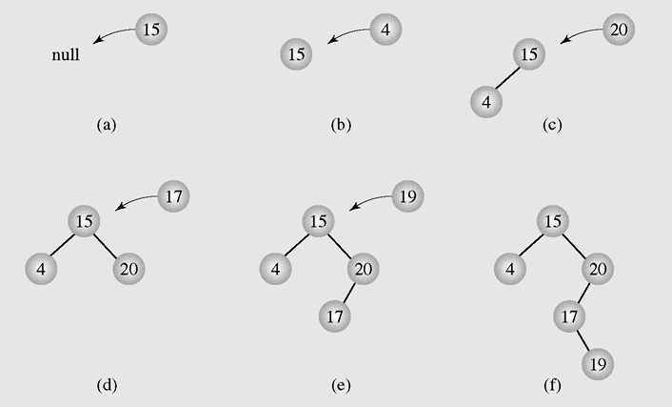
Insertion - 1
25
Inserting nodes into binary search trees

Slide 26
Insertion - 2
26
void insert(int x)
{if(root==null)
{root = new Node(x);
return;
}
Node f,p;
p=root;f=null;
while(p!=null)
{if(p.info==x)
{System.out.println(" The key " + x + " already exists, no insertion");
return;
}
f=p;
if(x<p.info)
p=p.left;
else
p=p.right;
}
if(x<f.info)
f.left=new Node(x);
else
f.right=new Node(x);
}

Slide 27
Deletion - 1
27
There are three cases of deleting a node from the binary search tree:
The node is a leaf; it has no children
The node has one child
The node has two children

Slide 28
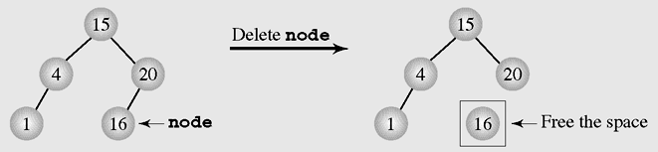
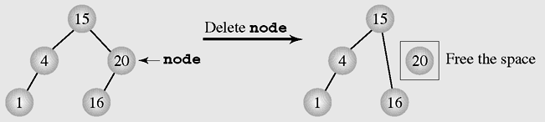
Deletion - 2
28
Deleting a leaf
Deleting a node with one child

Slide 29
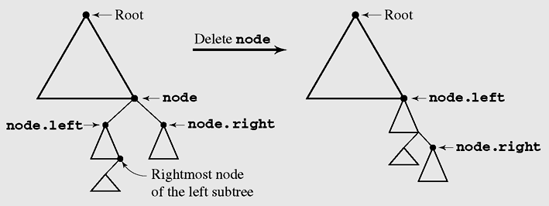
Deletion by Merging - 1
29
Making one tree out of the two subtrees of the node and then attaching it to the node’s parent is called deleting by merging
Deleting by merging

Slide 30
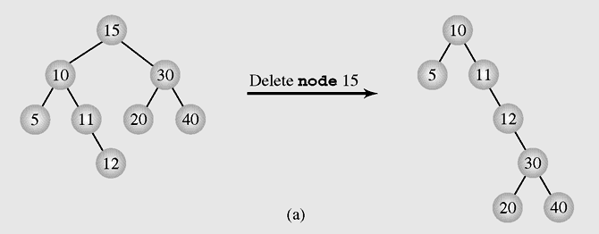
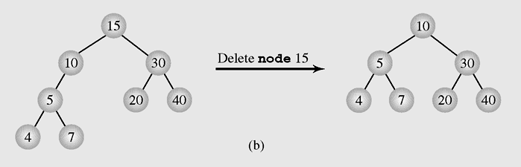
Deletion by Merging - 2
30
The height of a tree can be (a) extended or (b) reduced after deleting by merging

Slide 31
Deletion by Copying - 1
31
If the node has two children, the problem can be reduced to:
The node is a leaf
The node has only one non-empty child
Solution: replace the key being deleted with its immediate predecessor (or successor)
A key’s predecessor is the key in the rightmost node in the left subtree

Slide 32
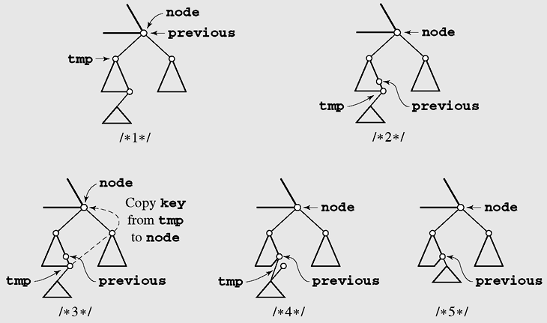
Deletion by Copying - 2
32
Deleting by copying

Slide 33
Summary
33
What is a Trees?
Tree Terminology
Tree examples
Ordered Trees
Tree Traversals
Binary Trees
Implementing Binary Trees
Binary Search Tree
Insertion
Deletion
Notes:
33

Slide 34
Reading at home
Text book: Data Structures and Algorithms in Java
8 Trees 307
8.1 General Trees - 308
8.1.1 Tree Definitions and Properties - 309
8.1.2 The Tree Abstract Data Type - 312
8.2 Binary Trees - 317
8.2.1 The Binary Tree Abstract Data Type - 319
8.2.2 Properties of Binary Trees - 321
8.3 Implementing Trees - 323
8.4 Tree Traversal Algorithms - 334
11.1 Binary Search Trees - 460
11.1.1 Searching Within a Binary Search Tree - 461
11.1.2 Insertions and Deletions - 463

