Slide 1
5. Graphs
Part 1

Slide 2
Objectives
2
Graph Introduction
Graph definition
Graph Terminology
Graph applications
Graph Representation
Graph Traversals
Shortest Paths
Dijsktra algorithm
Floyd algorithm

Slide 3
Graph Introduction
3
A graph is a way of representing relationships that exist between pairs of objects. That is, a graph is a set of objects, called vertices, together with a collection of pairwise connections between them, called edges. Graphs have applications in modeling many domains, including mapping, transportation, computer networks, and electrical engineering. By the way, this notion of a “graph” should not be confused with bar charts and function plots, as these kinds of “graphs” are unrelated to the topic of this chapter.
Data Structures and Algorithms in Java
3/36
Notes:
Graph = đồ thị
Vertex = đỉnh = node
Edge = arcs = cung = cạnh
3

Slide 4
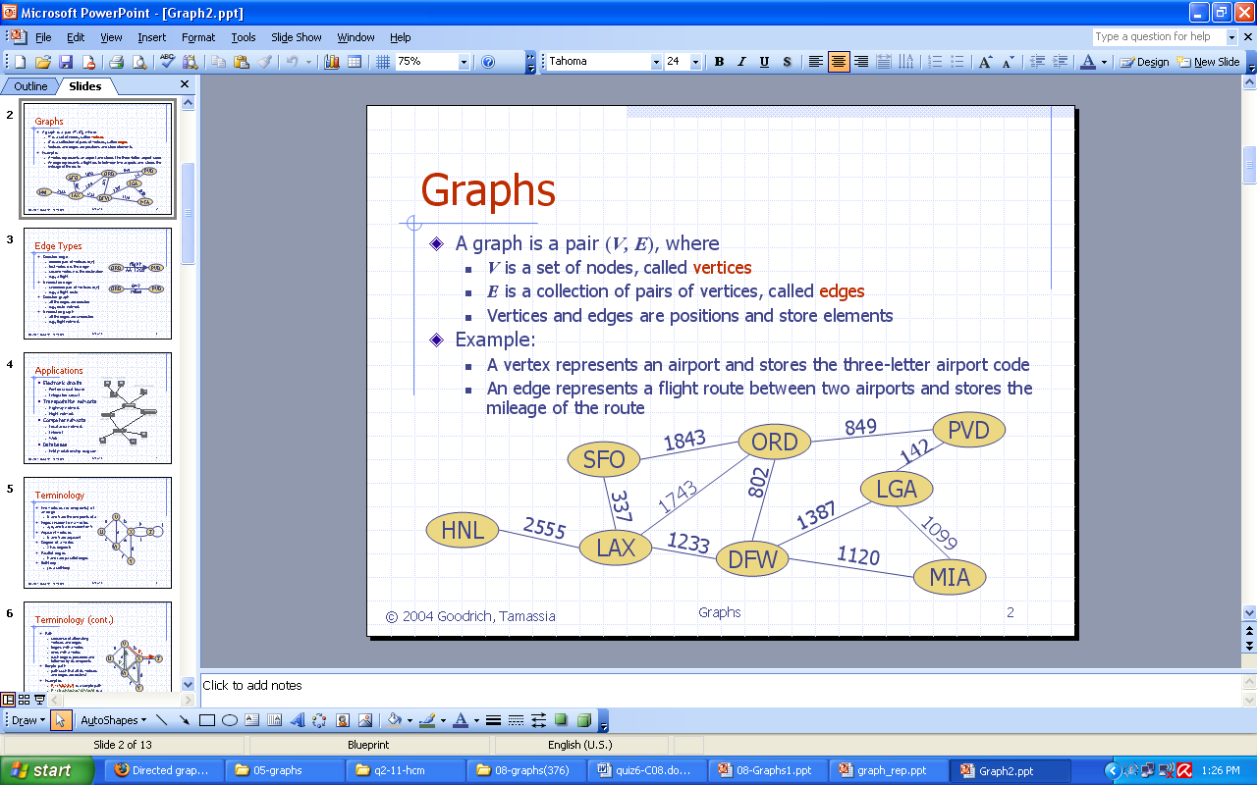
Graph definition
4
In briefly saying, a graph is a collection of
vertices and the connections between them
Notes:
Graph = đồ thị
Vertex = đỉnh = node
Edge = arcs = cung = cạnh
4

Slide 5
Graph Terminology - 1
Edges in a graph are either directed or undirected. An edge (u,v) is said to be directed from u to v if the pair (u,v) is ordered, with u preceding v. An edge (u,v) is said to be undirected if the pair (u,v) is not ordered. Undirected edges are sometimes denoted with set notation, as {u,v}.
If all the edges in a graph are undirected, then we say the graph is an undirected graph. Likewise, a directed graph, also called a digraph, is a graph whose edges are all directed. A graph that has both directed and undirected edges is often called a mixed graph.
5
Note that an undirected or mixed graph can be converted into a directed graph by replacing every undirected edge (u,v) by the pair of directed edges (u,v) and (v,u). It is often useful, however, to keep undirected and mixed graphs represented as they are, for such graphs have several applications.
Data Structures and Algorithms in Java
5/36
Notes:
Graph = đồ thị
Vertex = đỉnh = node
Edge = arcs = cung = cạnh
5

Slide 6
Graph Examples - 1
A city map can be modeled as a graph whose vertices are intersections or dead ends, and whose edges are stretches of streets without intersections. This graph has both undirected edges, which correspond to stretches of two-way streets, and directed edges, which correspond to stretches of one-way streets. Thus, in this way, a graph modeling a city map is a mixed graph.
Physical examples of graphs are present in the electrical wiring and plumbing networks of a building. Such networks can be modeled as graphs, where each connector, fixture, or outlet is viewed as a vertex, and each uninterrupted stretch of wire or pipe is viewed as an edge. Such graphs are actually components of much larger graphs, namely the local power and water distribution networks.
6
Data Structures and Algorithms in Java
6/36
Notes:
Graph = đồ thị
Vertex = đỉnh = node
Edge = arcs = cung = cạnh
6

Slide 7
Graph Terminology - 2
The two vertices joined by an edge are called the end vertices (or endpoints) of the edge. If an edge is directed, its first endpoint is its origin and the other is the destination of the edge. Two vertices u and v are said to be adjacent if there is an edge whose end vertices are u and v. An edge is said to be incident to a vertex if the vertex is one of the edge’s endpoints. The outgoing edges of a vertex are the directed edges whose origin is that vertex. The incoming edges of a vertex are the directed edges whose destination is that vertex. The degree of a vertex v, denoted deg(v), is the number of incident edges of v. If deg(u) = 0 then u is called isolated vertex. The in-degree and out-degree of a vertex v are the number of the incoming and outgoing edges of v, and are denoted indeg(v) and outdeg(v), respectively.
7
Data Structures and Algorithms in Java
7/36
Notes:
Graph = đồ thị
Vertex = đỉnh = node
Edge = arcs = cung = cạnh
7

Slide 8
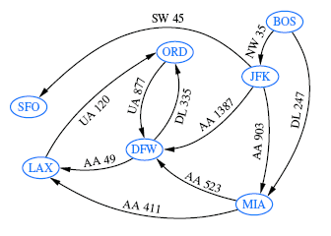
Graph Examples - 2
We can study air transportation by constructing a graph G, called a flight network, whose vertices are associated with airports, and whose edges are associated with flights. In graph G, the edges are directed because a given flight has a specific travel direction. The endpoints of an edge e in G correspond respectively to the origin and destination of the flight corresponding to e.
8
Two airports are adjacent in G if there is a flight that flies between them, and an edge e is incident to a vertex v in G if the flight for e flies to or from the airport for v.
Data Structures and Algorithms in Java
8/36
Notes:
Graph = đồ thị
Vertex = đỉnh = node
Edge = arcs = cung = cạnh
8

Slide 9
Graph Terminology - 3
The definition of a graph refers to the group of edges as a collection, not a set, thus allowing two undirected edges to have the same end vertices, and for two directed edges to have the same origin and the same destination. Such edges are called parallel edges or multiple edges. A flight network can contain parallel edges. A graph containing multiple edges but no loops is called multigraph.
Another special type of edge is one that connects a vertex to itself. Namely, we say that an edge (undirected or directed) is a self-loop if its two endpoints coincide. A self-loop may occur in a graph associated with a city map, where it would correspond to a “circle” (a curving street that returns to its starting point).
With few exceptions, graphs do not have parallel edges or self-loops. Such graphs are said to be simple. Thus, we can usually say that the edges of a simple graph are a set of vertex pairs (and not just a collection). A graph is considered simple unless otherwise specified.
9
Data Structures and Algorithms in Java
9/36
Notes:
Graph = đồ thị
Vertex = đỉnh = node
Edge = arcs = cung = cạnh
9

Slide 10
Graph Terminology - 4
A path is a sequence of alternating vertices and edges that starts at a vertex and ends at a vertex such that each edge is incident to its predecessor and successor vertex. A cycle is a path that starts and ends at the same vertex, and that includes at least one edge. We say that a path is simple if each vertex in the path is distinct, and we say that a cycle is simple if each vertex in the cycle is distinct, except for the first and last one. A directed path is a path such that all edges are directed and are traversed along their direction. A directed cycle is similarly defined.
If a graph is simple, we may omit the edges when describing path P or cycle C, as these are well defined, in which case P is a list of adjacent vertices and C is a cycle of adjacent vertices.
10
Data Structures and Algorithms in Java
10/36
Notes:
Graph = đồ thị
Vertex = đỉnh = node
Edge = arcs = cung = cạnh
10

Slide 11
Graph Terminology - 5
A undirected graph G is connected if, for any two vertices, there is a path.
A directed graph G is strongly connected if for any two vertices u and v, there is a directed path. A directed graph is called weakly connected if replacing all of its directed edges with undirected edges produces a connected (undirected) graph.
A subgraph of a graph G is a graph H whose vertices and edges are subsets of the vertices and edges of G, respectively. A spanning subgraph of G is a subgraph of G that contains all the vertices of the graph G. If a graph G is not connected,
its maximal connected subgraphs are called the connected components of G. A forest is a graph without cycles. A tree is a connected forest, that is, a connected graph without cycles. A spanning tree of a graph is a spanning subgraph that is a tree. (Note that this definition of a tree is somewhat different from the one given in Chapter 4, as there is not necessarily a designated root.)
11
Data Structures and Algorithms in Java
11/36
Notes:
Graph = đồ thị
Vertex = đỉnh = node
Edge = arcs = cung = cạnh
11

Slide 12
Graph Terminology - 6
If the vertex is removed from a graph (along with incident edges) and there is no way to find a path from a to b, then the graph is split into two separate subgraphs called articulation points, or cut-vertices
If an edge causes a graph to be split into two subgraphs, it is called a bridge or cut-edge
Connected subgraphs with no articulation points or bridges are called blocks
12
We can use depth first traverse to check the connectivity of a graph
Data Structures and Algorithms in Java
12/36

Slide 13
Graph Examples - 3
Perhaps the most talked about graph today is the Internet, which can be viewed as a graph whose vertices are computers and whose (undirected) edges are communication connections between pairs of computers on the Internet. The computers and the connections between them in a single domain, like wiley.com, form a subgraph of the Internet. If this subgraph is connected, then two users on computers in this domain can send email to one another without having their information packets ever leave their domain. Suppose the edges of this subgraph form a spanning tree. This implies that, if even a single connection goes down (for example, because someone pulls a communication cable out of the back of a computer in this domain), then this subgraph will no longer be connected.
13
Data Structures and Algorithms in Java
13/36
Notes:
Graph = đồ thị
Vertex = đỉnh = node
Edge = arcs = cung = cạnh
13

Slide 14
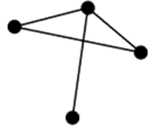
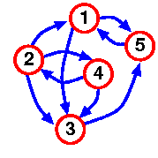
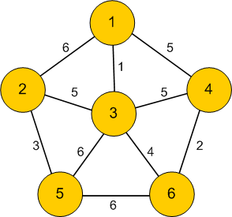
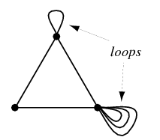
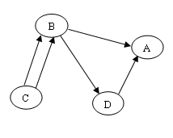
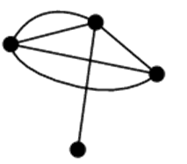
Graph Examples - 4
14
Single undirected graph
Weighted graph
Single Directed graph
It is also a simple graph because it has no mutiple edges and no loops
An undirected graph with multiple edges
An directed graph with multiple edges
An undirected graph with loops
Notes:
Graph = đồ thị
Vertex = đỉnh = node
Edge = arcs = cung = cạnh
14

Slide 15
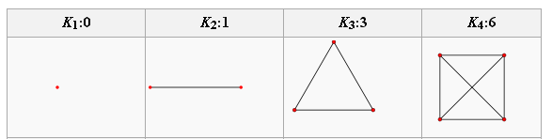
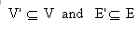
Graph Terminology - 7
15
A complete graph is a graph where every pair of vertices is connected by an edge.
A simple complete graph on n vertices has n vertices and n(n-1)/2 edges, and is denoted by Kn
A graph G'=(V', E') is a subgraph of another graph G=(V, E) iff V
Notes:
Cycle = chu trình
15

Slide 16
Summary for Basic Notions on Graph
16
Vertex, edge, (directed, undirected edge), (directed, undirected graph), adjacent vertices, incident edge,degree, isolated vertex, parallel edge or multiple edge, loop, simple graph, multigraph, path, simple path, cycle, connected, strongly connected, weakly connected, subgraph, spanning subgraph, forest, tree, spanning tree, complete graph, simple complete graph, cut-vertex (articulation point), bridge(cut-edge), block,...
Notes:
Cycle = chu trình
16

Slide 17
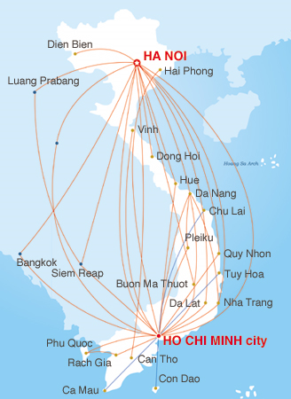
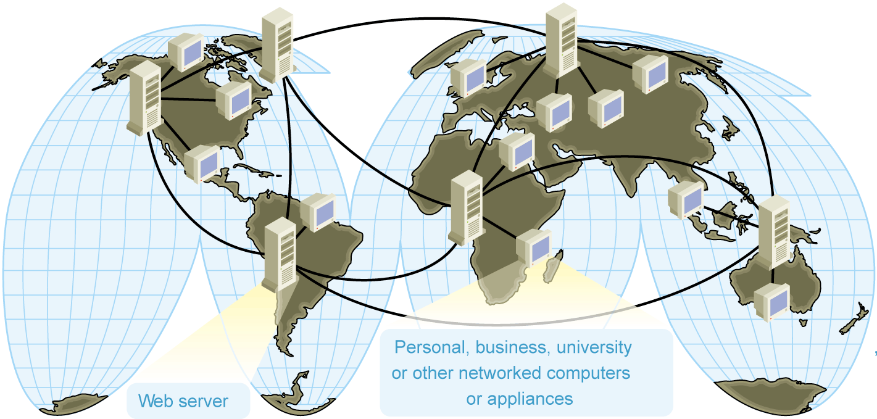
Graph applications
17
Electronic circuits
Transportation networks
Computer networks
Database
Entity-relationship diagram
Notes:
Image source:
Computer network:http://www.microsoft.com/mspress/books/sampchap/4800/0735611874-01.gif
Air Flight map: http://www.vietnamairlines.com.vn
17

Slide 18
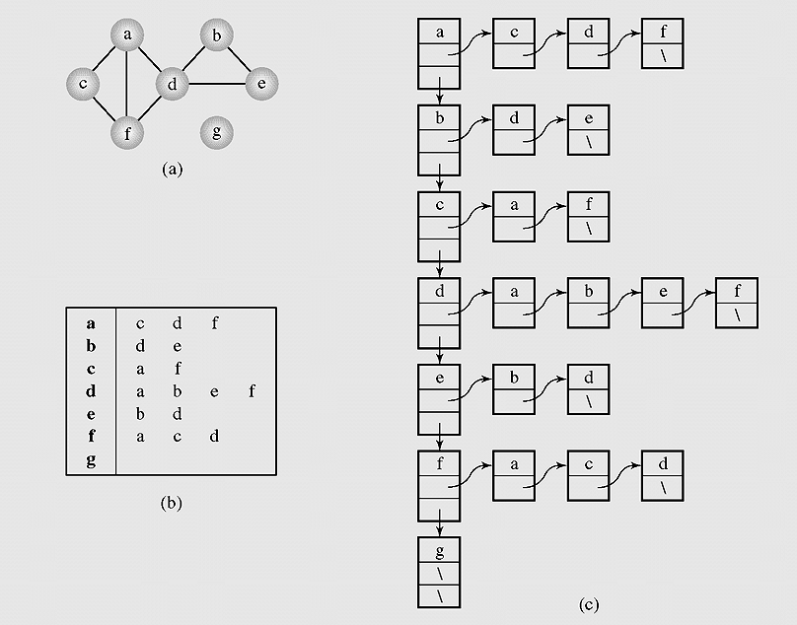
Graph Representation – 1
(Adjacency list)
18
Graph representations.
A graph (a) can be represented as
(b–c) an adjacency list.
Notes:
Let them discuss how to implement, try some lines
18

Slide 19
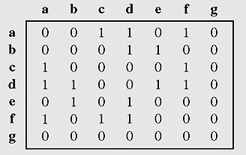
Graph Representation – 2
(Adjacency matrix)
19
Graph represented by an adjacency matrix
Notes:
Build on papers
More: incident matrix = ma tran lien thuoc
19

Slide 20
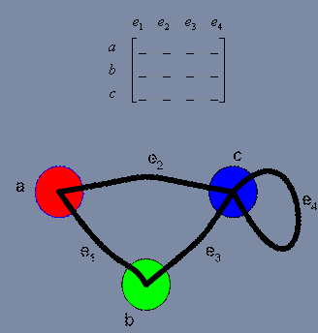
Graph Representation – 3
(Incident matrix)
A vertex is said to be incident to an edge if the edge is connected to the vertex.
Graph represented by incident matrix
Notes:
Build on papers
More: incident matrix = ma tran lien thuoc
20

Slide 21
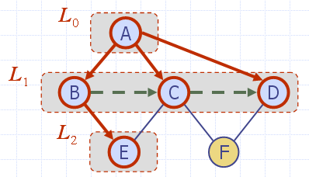
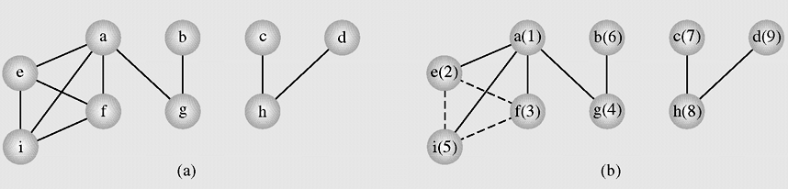
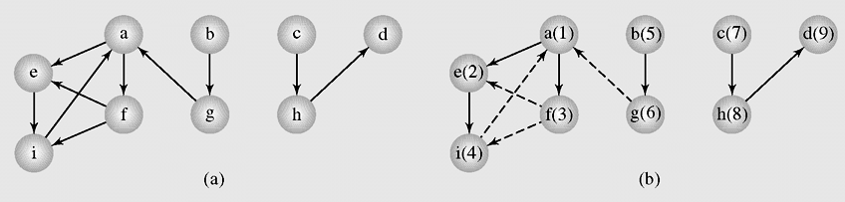
Breadth-first Search
Graph Traversals
In the breadth-first search algorithm, at first a selected vertex v is visited and then each unvisited vertex adjacent to v is visited. Suppose these adjacents are v₁ , v₂,… v_{k}. After all these vertices are visited, all adjacents of v₁ are visited, then all adjacents of v₂ are visited and so on. If there are still some unvisited vertices in the graph, the traversal continues restarting for one of the unvisited vertices.
21

Slide 22
Breadth-first Search Algorithm
Search a graph (directed or not) in breadth first, this is done by using a queue where the vertices found are stored.
22
BFS(Graph G)
{ all vertices of G are first painted white
the graph root is painted gray and put in a queue
while the queue is not empty
{ a vertex u is removed from the queue
for all white successors v of u
{ v is painted gray
v is added to the queue
}
u is painted black
}
}

Slide 23
Breadth-first Search code
// bread first traverse from vertex k
void breadthFirst(int k)
{MyQueue q = new MyQueue();int i,h;
boolean [] enqueued = new boolean[n];
for(i=0;i<n;i++) enqueued[i]=false;
q.enqueue(new Integer(k));enqueued[k]=true;
while(!q.isEmpty())
{h=Integer.parseInt((q.dequeue()).toString().trim());
visit(h);
for(i=0;i<n;i++)
if((!enqueued[i]) && a[h][i]>0)
{q.enqueue(new Integer(i));
enqueued[i] = true;
}
}
System.out.println();
}
23

Slide 24
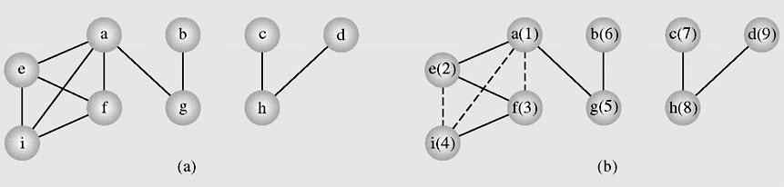
Depth-first Traversal
In the depth-first search algorithm, at first selected vertex v is visited and then each unvisited vertex adjacent to v is visited by depth-first search. If there are still some unvisited vertices in the graph, the traversal continues restarting for one of the unvisited vertices.
An example of application of the depthFirstSearch() algorithm to a graph

Slide 25
Depth-First Search algorithm
DFS-visit (Graph G, Vertex u)
{ the vertex u is painted gray
for all white successors v of u
{ dfs-visit(G, v)
}
u is painted black
}
DFS (Graph G)
{ all vertices of G are first painted white
DFS-visit(G, root of G)
}
The idea is the same, but we now use a stack instead of a queue. With recursion of course, so the stack management is all done by Java.
Here is a brief description of the DFS algorithm:
DFS on a graph with n vertices and m edges takes O(n + m ) time

Slide 26
Depth-First Traverse code
void visit(int i)
{System.out.print(" " + v[i]);
}
void depthFirst(boolean visited[], int i)
{visit(i);visited[i] = true;
int j;
for(j=0;j<n;j++)
if(a[i][j]>0 && (!visited[j]))
depthFirst(visited,j);
}
void depthFirst(int k)
{int i; boolean [] visited = new boolean[20];
for(i=0;i<n;i++) visited[i]=false;
depthFirst(visited,k);
for(i=0;i<n;i++)
if(!visited[i])
depthFirst(visited,i);
System.out.println();
}

Slide 27
Shortest Path problem
27
The problem: find the shortest path between a pair of vertices of a graph
The graph: may contain negative edges but no negative cycles
A representation: a weighted matrix where W(i,j) = 0 if i=j. W(i,j) = ∞ if there is no edge between i and j. W(i,j) = weight of the edge (i,j)
Notes:
27

Slide 28
Dijkstra's Algorithm - 1
28
The main idea in applying the greedy-method pattern to the single-source shortestpath problem is to perform a “weighted” breadth-first search starting at the source vertex s. In particular, we can use the greedy method to develop an algorithm that iteratively grows a “cloud” of vertices out of s, with the vertices entering the cloud in order of their distances from s. Thus, in each iteration, the next vertex chosen is the vertex outside the cloud that is closest to s. The algorithm terminates when no more vertices are outside the cloud (or when those outside the cloud are not connected to those within the cloud), at which point we have a shortest path from s to every vertex of G that is reachable from s. This approach is a simple, but nevertheless powerful, example of the greedy-method design pattern. Applying the greedy method to the single-source, shortest-path problem, results in an algorithm known as Dijkstra’s algorithm.
Data Structures and Algorithms in Java
28/36
Notes:
Image source: http://en.wikipedia.org/wiki/File:Dijksta_Anim.gif
28

Slide 29
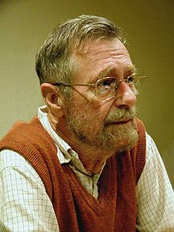
Dijkstra's Algorithm - 2
29
DijkstraAlgorithm(non-gegative weighted simple digraph, vertex first)
for all vertices v # first currDist(v) = ∞;
currDist(first) = 0;
toBeChecked = V (all vertices);
checked = empty;
while toBeChecked is not empty
u = a vertex in toBeChecked with min.currDist(u);
remove u from toBeChecked and add to checked;
for all vertices v adjacent to u and in toBeChecked
if (currDist(v) > currDist(u) + weight(edge(uv)))
{currDist(v) = currDist(u) + weight(edge(uv))
predeccessor(v) = u;
}
Notes:
Image source: http://en.wikipedia.org/wiki/File:Dijksta_Anim.gif
29

Slide 30
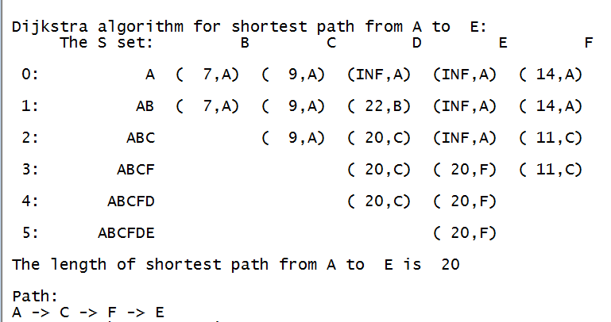
Dijkstra's Algorithm example - 1
30
A(1), B(2), C(3), D(4), E(5), F(6)
Dijkstra’s algorithm keeps two sets of vertices:
S Vertices whose shortest paths have already been determined V-S Remainder
Also
d Best estimates of shortest path to each vertex p Predecessors for each vertex
int [][] b = {
{ 0, 7, 9, 99, 99, 14},
{ 7, 0, 10, 15, 99, 99},
{ 9, 10, 0, 11, 99, 2},
{99, 15, 11, 0, 6, 99},
{99, 99, 99, 6, 0, 9},
{14, 99, 2, 99, 9, 0}
};
Notes:
Image source: http://en.wikipedia.org/wiki/File:Dijksta_Anim.gif
30

Slide 31
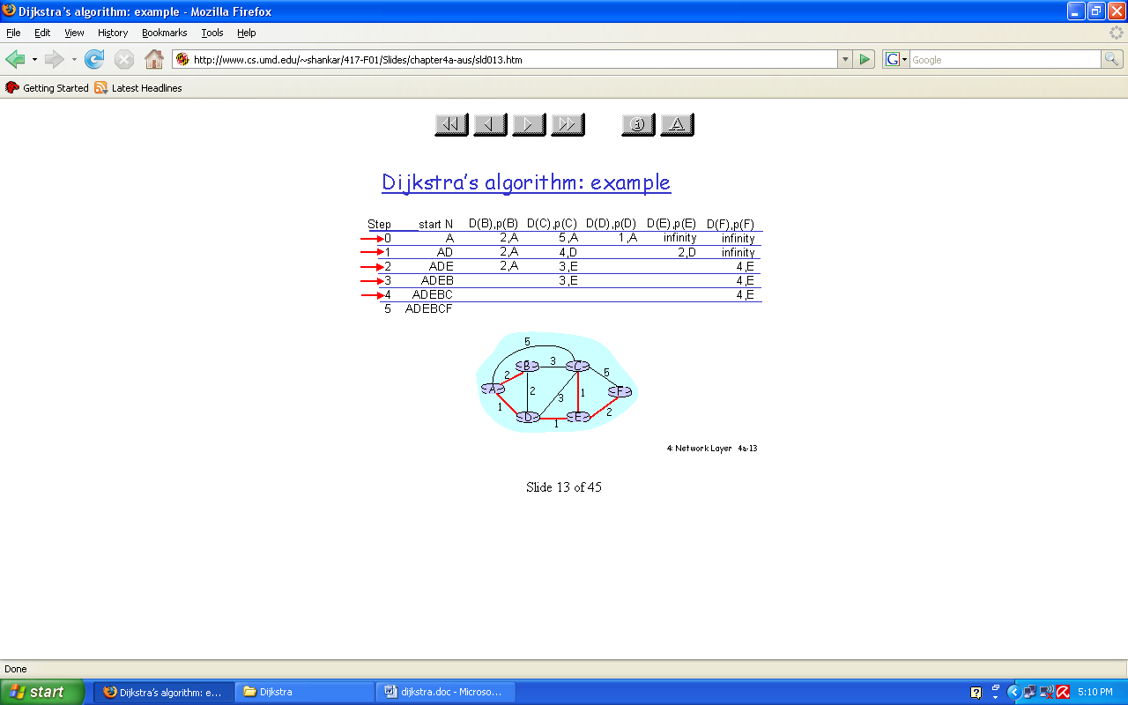
Dijkstra's Algorithm example - 2
The complexity of Dijkstra's algorithm is O(|V|²). This algorithm is not general enough in that it may fail when negative weights are used in graphs.

Slide 32
Floyd Algorithm
All pairs shortest path
32
The problem: find the shortest path between every pair of vertices of a graph
The graph: may contain negative edges but no negative cycles
1. D = W // initialize D array to W [ ] 2. P = 0 // initialize P array to [0] 3. for k = 1 to n 4. do for i = 1 to n 5. do for j = 1 to n 6. if (D[ i, j ] > D[ i, k ] + D[ k, j ] ) 7. then { D[ i, j ] = D[ i, k ] + D[ k, j ] 8. P[ i, j ] = P[k,j];
}
Complexity O(|V|³)
Notes:
This algorithm uses label-correcting method
32

Slide 33
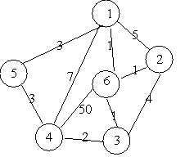
Floyd Algorithm example

Slide 34
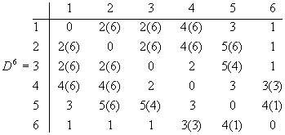
The final distance matrix and P
Floyd Algorithm example (cont.)
The values in parenthesis are the non zero P values.

Slide 35
Summary
35
Graph Introduction
Graph definition
Graph Terminology
Graph applications
Graph Representation
Graph Traversals
Shortest Paths
Dijsktra algorithm
Floyd algorithm

Slide 36
Reading at home
Text book: Data Structures and Algorithms in Java
14 Graph Algorithms 611
14.1 Graphs - 612
14.1.1 The Graph ADT - 618
14.2 Data Structures for Graphs - 619
14.2.1 Edge List Structure - 620
14.2.2 Adjacency List Structure - 622
14.2.4 Adjacency Matrix Structure - 625
14.3 Graph Traversals - 630
14.3.1 Depth-First Search - 631
14.3.3 Breadth-First Search - 640
14.6 Shortest Paths - 651
14.6.1 Weighted Graphs - 651
14.6.2 Dijkstra’s Algorithm - 653

