Slide 1
6. Sorting

Slide 2
Objectives
Elementary Sorting Algorithms
Selection Sort
Insertion Sort
Bubble Sort
Efficient Sorting Algorithms
Quick Sort
Merge Sort
Heap sort
Radix Sort
Sorting in java.util

Slide 3
Elementary Sorting Algorithms

Slide 4
Selection Sort
Selection sort is an attempt to localize the exchanges of array elements by finding a misplaced element first and putting it in its final place
selectionsort(data[])
for i = 0 to data.length-2
select the smallest (or largest) element data[k] among
data[i], . . . , data[data.length-1];
swap data[i] with data[k];
Complexity O(n²)

Slide 5
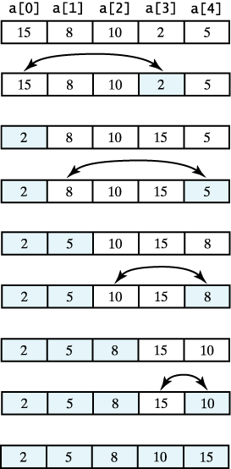
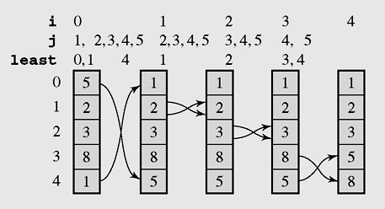
Selection Sort example
A selection sort of an array of integers into ascending order.
The array [5 2 3 8 1] sorted by selection sort

Slide 6
Selection sort code
void selectSort() //Simple Selection Sort
{ int i,j,k;int min;
for(i=0;i<n-1;i++)
{ min=a[i];k=i;
for(j=i+1;j<n;j++)
if(a[j]<min) {k=j;min=a[j];}
if(k!=i) swap(a,i,k);
}
}

Slide 7
Insertion sort algorithm
An insertion sort starts by considering the first elements of the array data, which is data[0]
Next, for i=1,2,…,n-1 insert data[i]into the sorted sub-array before i:
insertionsort(data[]) {
for i = 1 to data.length–1
tmp = data[i];
move all elements data[j] greater than tmp by one position;
place tmp in its proper position;
Complexity O(n²)
Best case O(n)

Slide 8
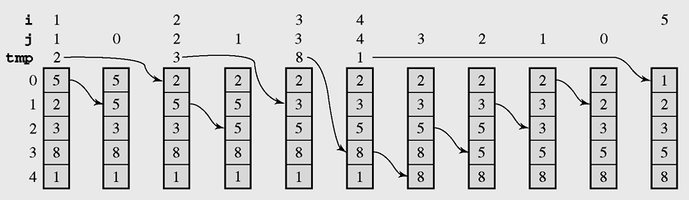
Insertion sort example
The array [5 2 3 8 1] sorted by insertion sort

Slide 9
Insertion sort code
void insertSort()
{ int i,j,x;
for(i=1;i<n;i++)
{ x=a[i]; j=i;
while(j>0 && x<a[j-1])
{ a[j]=a[j-1]; j--;
};
a[j]=x;
}
}
}

Slide 10
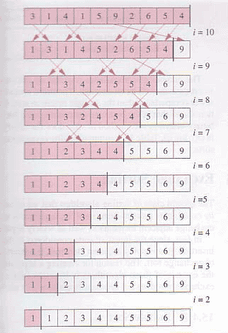
Bubble sort
void bubbleSort()
{ int i; boolean swapped;
do
{ swapped=false;
for(i=0;i<n-1;i++)
if(a[i]>a[i+1])
{ swap(a,i,i+1);
swapped=true;
}
}
while(swapped);
}
Complexity O(n²)
Best case O(n)

Slide 11
Efficient Sorting Algorithms

Slide 12
Quicksort - 1
Efficient sorting algorithm
Discovered by C.A.R. Hoare
Example of Divide and Conquer algorithm
Two phases
Partition phase
Divides the work into half
Sort phase
Conquers the halves!

Slide 13
Quicksort - 2
Partition
Choose a pivot
Find the position for the pivot so that
all elements to the left are less
all elements to the right are greater
≤ pivot
pivot
> pivot
Conquer
Apply the same algorithm to each half
≤ pivot
> pivot
≤ p’
p’
> p’
pivot
≤ p”
p”
> p”

Slide 14
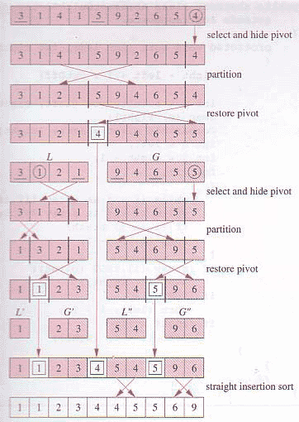
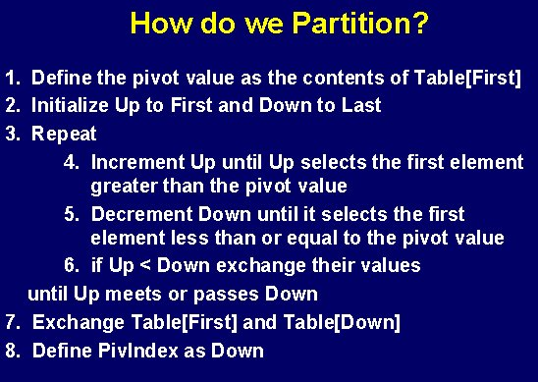
Quicksort - 3

Slide 15
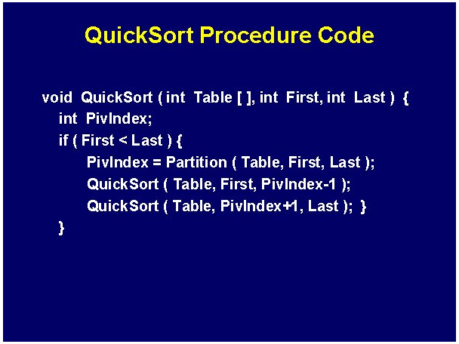
Quicksort code

Slide 16
Quicksort complexity
Quick Sort
In the best case and average case: O(n log n) but ….
Can be O(n²), the (rear) worst case. Moreover, the constant hidden in the O-notation is small.
Depends on pivot selection
Median-of-3
Random pivot
Better but not guaranteed

Slide 17
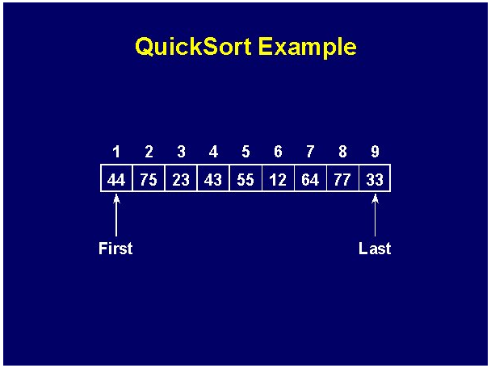
Quicksort example - 1

Slide 18
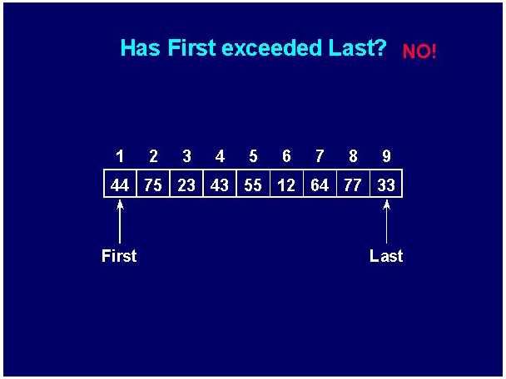
Quicksort example - 2

Slide 19
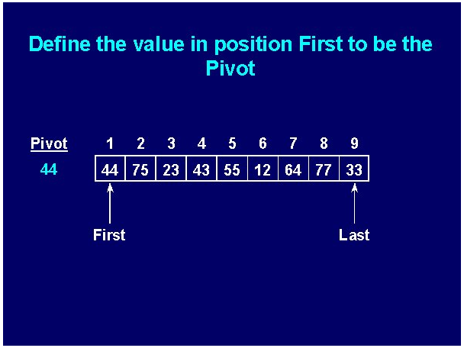
Quicksort example - 3

Slide 20
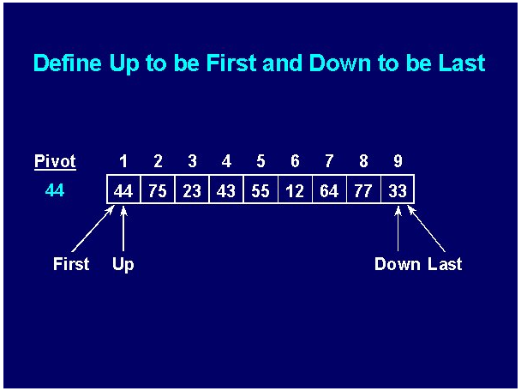
Quicksort example - 4

Slide 21
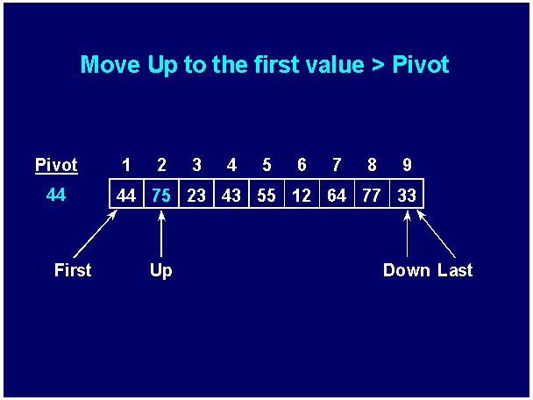
Quicksort example - 5

Slide 22
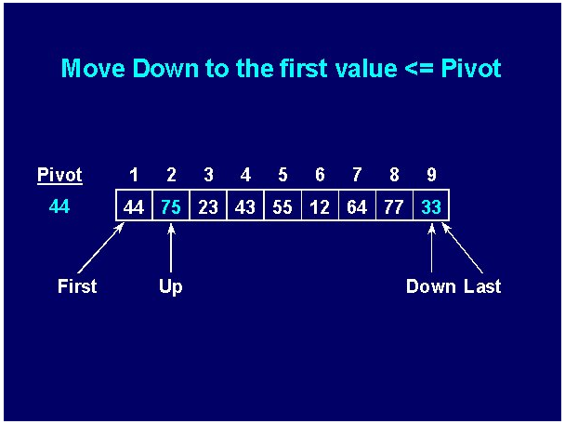
Quicksort example - 6

Slide 23
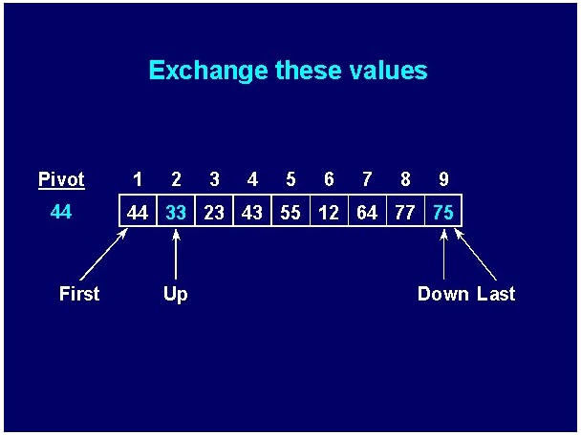
Quicksort example - 7

Slide 24


Quicksort example - 8

Slide 25
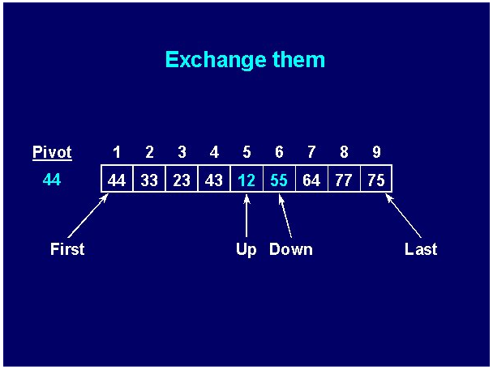
Quicksort example - 9

Slide 26


Quicksort example - 10

Slide 27
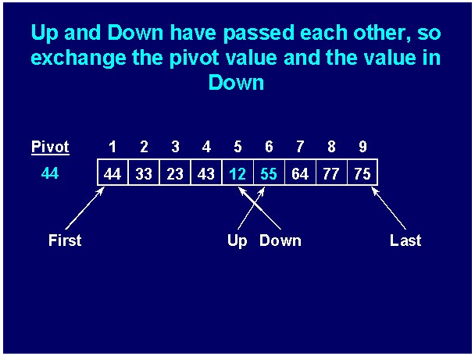
Quicksort example - 11

Slide 28
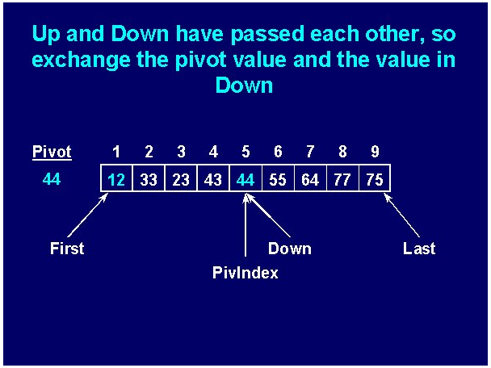
Quicksort example - 12

Slide 29
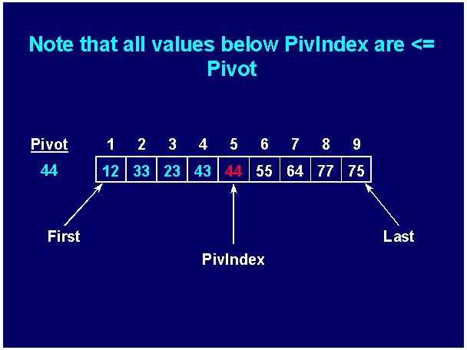
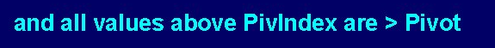
Quicksort example - 13

Slide 30
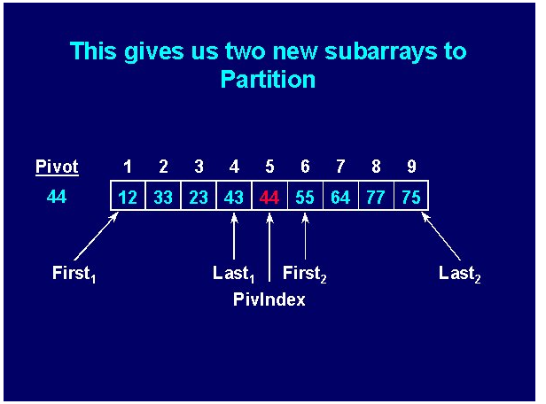
Quicksort example - 14

Slide 31
Mergesort
Mergesort makes partitioning as simple as possible and concentrates on merging sorted halves of an array into one sorted array
Complexity is O(nlogn)
It was one of the first sorting algorithms used on a computer and was developed by John von Neumann
mergesort(data)
if data have at least two elements
mergesort(left half of data);
mergesort(right half of data);
merge(both halves into a sorted list);

Slide 32
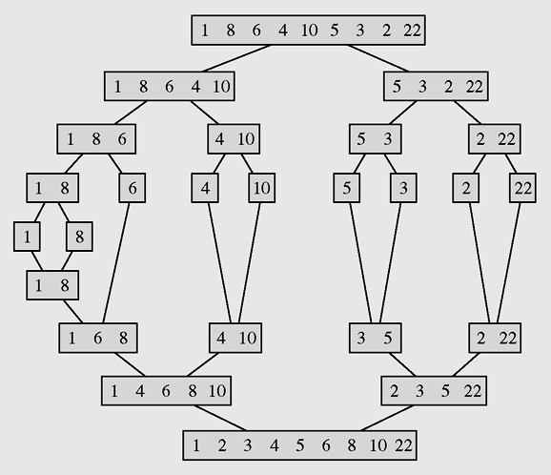
Mergesort example
The array [1 8 6 4 10 5 3 2 22] sorted by mergesort

Slide 33
Merge sort code
void mergeSort(int p, int r)
{if(p>=r) return;
int q = (p+r)/2;
mergeSort(p,q);
mergeSort(q+1,r);
merge(p,q,r);
}
void merge(int p, int q, int r)
{if(!(p<=q) && (q<=r)) return;
int n,i,j,k,x; n = r-p+1;
int [] b = new int[n];
i=p;j=q+1;k=0;
while(i<=q && j<=r)
{if(a[i]<a[j])
b[k++] = a[i++];
else
b[k++] = a[j++];
}
while(i<=q) b[k++] = a[i++];
while(j<=r) b[k++] = a[j++];
k=0;
for(i=p;i<=r;i++) a[i] = b[k++];
}
public class Main
{public static void main(String args[])
{int [] b = {7,3,5,9,11,8,6,15,10,12,14};
EffSort t = new EffSort(b);
int n=b.length;
t.mergeSort(0,n-1);t.display();
System.out.println();
}
}

Slide 34
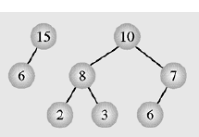
Heap data structure - 1
Heap is a particular kind of binary tree, which has two properties:
The value of each node is greater than or equal to the values stored in each of its children.
If the height of the tree is h, then the tree is complete at level d for d = 1, 2, ..., h-1, and the leaves in the last level are all in the leftmost positions
(This kind of binary tree is called nearly complete binary tree)
These two properties define a max heap
If “greater” in the first property is replaced with “less,” then the definition specifies a min heap

Slide 35
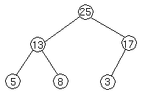
Heap data structure - 2
We can represent heap by array in level order, going from left to right. The array corresponding to the heap above is [25, 13, 17, 5, 8, 3].
The root of the tree a[0] and given index i of a node, the indices of its parent, left child and right child can be computed:
PARENT (i) return floor((i-1)/2) LEFT (i) return 2i+1 RIGHT (i) return 2(i + 1)

Slide 36
Heap Sort - 1
Heap sort consists of 2 steps:
Transform the array to a heap:
Suppose the array a to be sorted has n elements: a[0], a[1], ..., a[n-1]
At first the heap has only one element: a[0]. Then
for i =1 to n-1 we insert the element a[i] to heap so that the heap property is maintained.
Transform the heap to sorted array:
for k = 1 to n-1 do
remove and put the root (a[0]) to the position n-k, then rearrange elements to keep the heap property.

Slide 37
Heap sort code
Addition and deletion are both O(logn) operations. We need to perform n additions and deletions, leading to an O(nlogn) algorithm.
//Transform the array to HEAP
int i,s,f;int x;
for(i=1;i<n;i++)
{ x=a[i]; s=i; //s is a son, f=(s-1)/2 is father
while(s>0 && x>a[(s-1)/2])
{ a[s]=a[(s-1)/2]; s=(s-1)/2;
};
a[s]=x;
};
// Transform heap to sorted array
for(i=n-1;i>0;i--)
{ x=a[i];a[i]=a[0];
f=0; //f is father
s=2*f+1; //s is a left son
// if the right son is larger then it is selected
if(s+1<i && a[s]<a[s+1]) s=s+1;
while(s<i && x<a[s])
{ a[f]=a[s]; f=s; s=2*f+1;
if(s+1<i && a[s]<a[s+1]) s=s+1;
};
a[f]=x;
};
Complexity O(nlog₂n)

Slide 38
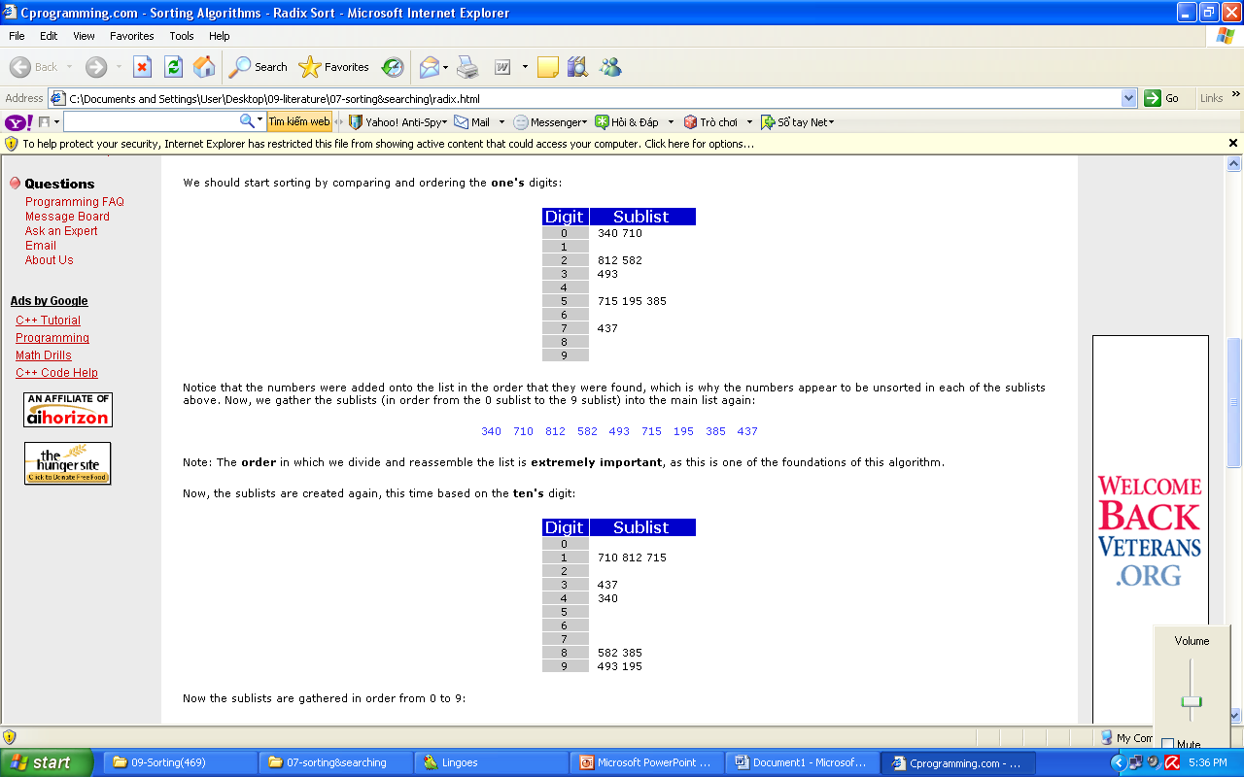
Radix sort - 1
Radix Sort is a clever and intuitive little sorting algorithm. Radix Sort puts the elements in order by comparing the digits of the numbers. We will explain with an example.
Consider the following 9 numbers:
493 812 715 340 195 437 710 582 385
We should start sorting by comparing and ordering the one's digits:
Notice that the numbers were added onto the list in the order that they were found, which is why the numbers appear to be unsorted in each of the sublists above. Now, we gather the sublists (in order from the 0 sublist to the 9 sublist) into the main list again:
340 710 812 582 493 715 195 385 437
Note: The order in which we divide and reassemble the list is extremely important, as this is one of the foundations of this algorithm.

Slide 39
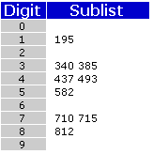
Radix sort - 2
Now, the sublists are created again, this time based on the ten's digit:
Now the sublists are gathered in order from 0 to 9:
710 812 715 437 340 582 385 493 195
Finally, the sublists are created according to the hundred's digit:
At last, the list is gathered up again:
195 340 385 437 493 582 710 715 812
And now we have a fully sorted array! Radix Sort is very simple, and a computer can do it fast. When it is programmed properly, Radix Sort is in fact one of the fastest sorting algorithms for numbers or strings of letters.
Disadvantages
Still, there are some tradeoffs for Radix Sort that can make it less preferable than other sorts.
The speed of Radix Sort largely depends on the inner basic operations, and if the operations are not efficient enough, Radix Sort can be slower than some other algorithms such as Quick Sort and Merge Sort. These operations include the insert and delete functions of the sublists and the process of isolating the digit you want.

Slide 40
Sorting in java.util - 1
Java provides two sets of versions of sorting methods: one for arrays and one for lists
The utility class Arrays includes a method for:
Searching arrays for elements with binary search
Filling arrays with a particular value
Converting an array into a list, and sorting methods

Slide 41
Sorting in java.util - 2
The sorting methods are provided for arrays with elements of all elementary types except Boolean
For each type of sorting method there are two versions:
One for sorting an entire array
One for sorting a subarray
public static void sort(int[] a);
public static void sort(int[] a, int first, int last);

Slide 42
Summary
Elementary Sorting Algorithms
Selection Sort
Insertion Sort
Bubble Sort
Efficient Sorting Algorithms
Quick Sort
Merge Sort
Heap sort
Radix Sort
Sorting in java.util

Slide 43
Reading at home
Text book: Data Structures and Algorithms in Java
12 Sorting and Selection 531
9.4.1 Selection-Sort and Insertion-Sort - 386
bubble-sort (see Exercise C-7.51)
12.2 Quick-Sort - 544
12.1 Merge-Sort - 532
9.4.2 Heap-Sort - 388
12.3.2 Linear-Time Sorting: Bucket-Sort and Radix-Sort - 558
12.4 Comparing Sorting Algorithms - 561

