Slide 1

SpaVia, A WEB APPLICATION
Software Engineering for Geoinformatics
Arli Ardiandy Nurseramika
Sahar Gholami Bourani
Phesto Osano
Felix Enyimah Toffah

Slide 2
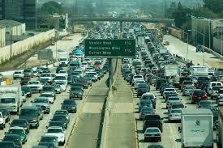
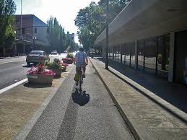
Introduction
Pedestrian level of service (PLOS) is a model that aims at indexing the level of safety of pedestrians on the roads.
Oftentimes, concerns of pedestrians are left out in road design.
However, regular interaction of road managers and local government authorities with pedestrians would provide valuable information that can facilitate planning to make the streets more useful for pedestrians.

Slide 3
PLOS
Vm = count of vehicles an hour
Nth = number of thorough lanes in the subject direction of travel
SR = vehicle speed (km/h)
Wv = sum of the width of the outside lane, bike lane and shoulder(metres).
W1 = sum of the width of the bike lane and the shoulder (metres).
ppk = proportion of parallel on-street parking occupied in the analysed period.
Wbuf = width of a buffer (meters)
WaA = sidewalk width(meters)
fsw = coefficient of the sidewalk width

Slide 4
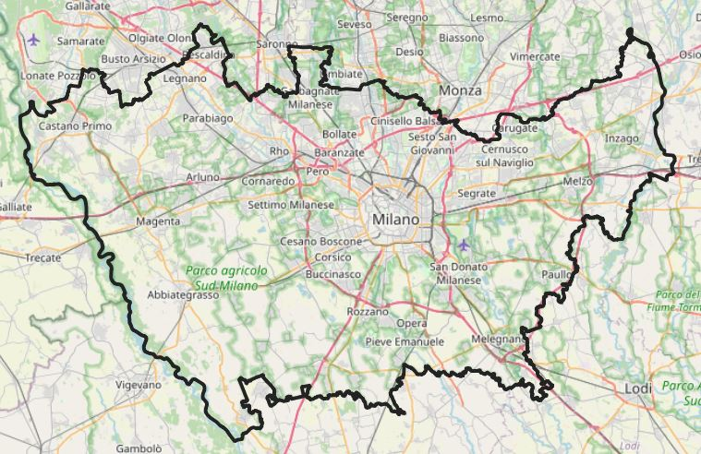
SpaVia
SpaVia is an web application intended to
provides a spatial interface for individuals to visualize the level of service of a street segment.
offer a PGIS environment for the people in an area to offer their views as an input for decision making by the authorities.
It is intended to be managed by the local authorities and road managers.
Spavia for visualization.

Slide 5
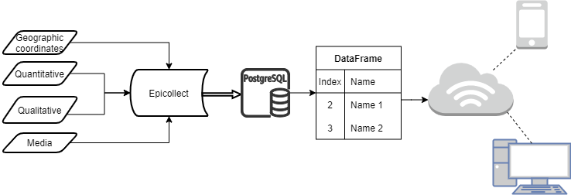
Data flow

Slide 6
Use Cases
UC1: User signs up
UC2: User logs in
UC3: User requests to visualize static analysis
UC4: User requests to visualize dynamic analysis
UC5:User inserts PLOS data
UC6: User sends comment
UC7: User logs out

Slide 7
Intended audience
Citizens
City managers.
Researchers
Local Government authorities
Professionals e.g. civil engineers, urban planners, transportation engineers
Interested Programmers for upscaling the web app

Slide 8
Data category
User data/ comment data (table of username, password/ table of comments)
Collected data (table of variables of road features/ geometry: points/ each variable is survived in a specific point)
PLOS data (table of variables of road features + PLOS quantity/ geometry: polylines)
New PLOS data by the user

Slide 9
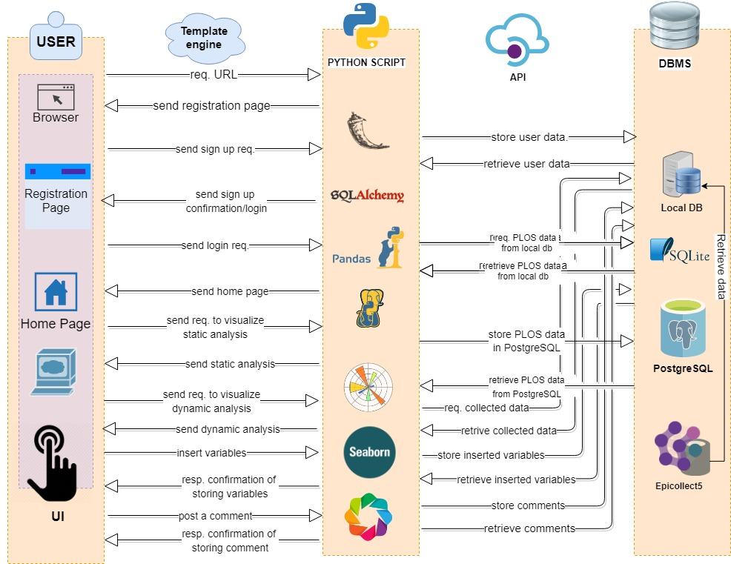
General overview

Slide 10
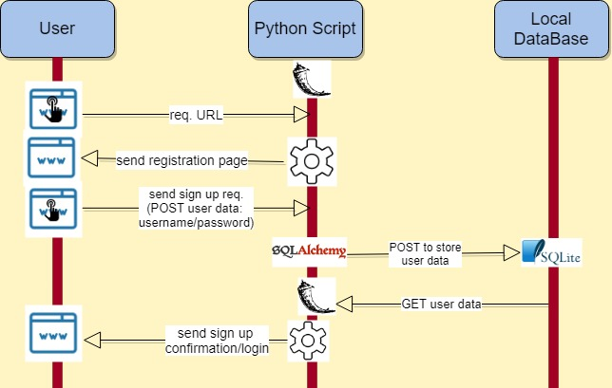
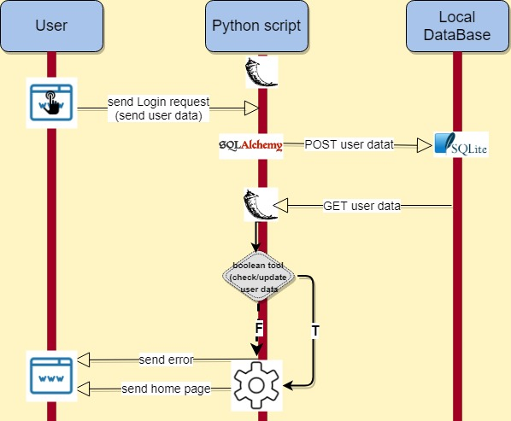
Sequence diagram
Sign up
Login

Slide 11
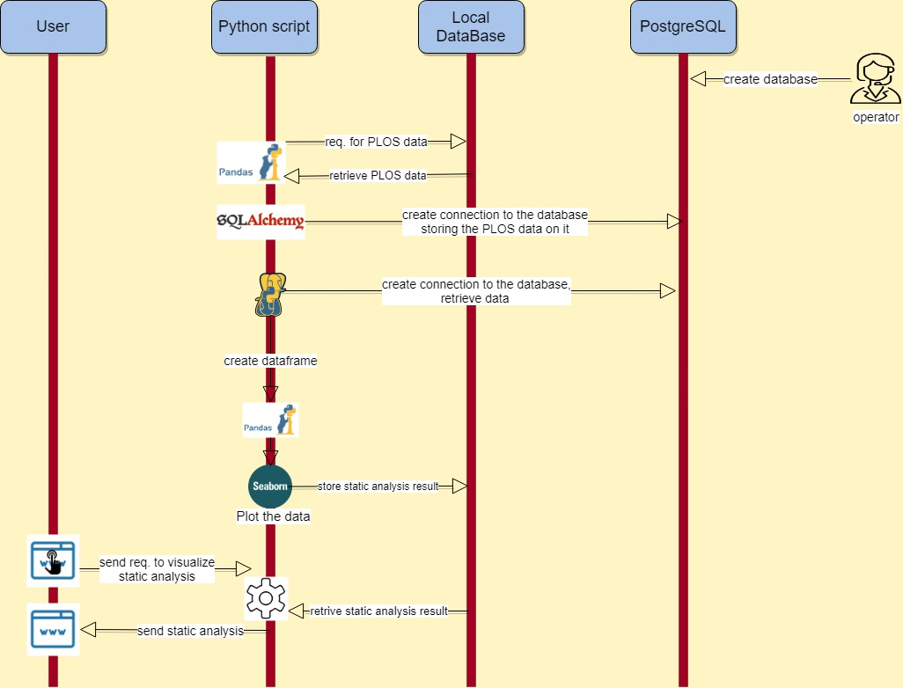
Sequence diagram
static analysis visualization

Slide 12
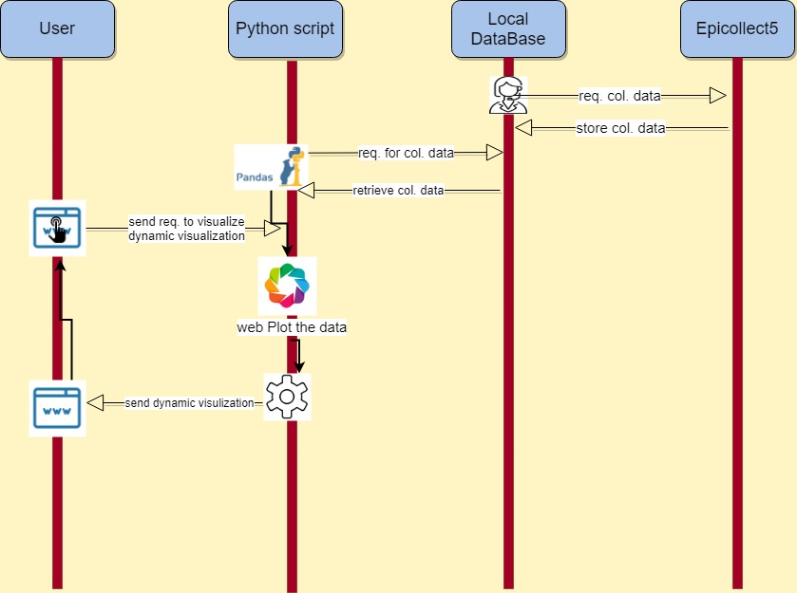
Sequence diagram
Dynamic analysis visualization

Slide 13
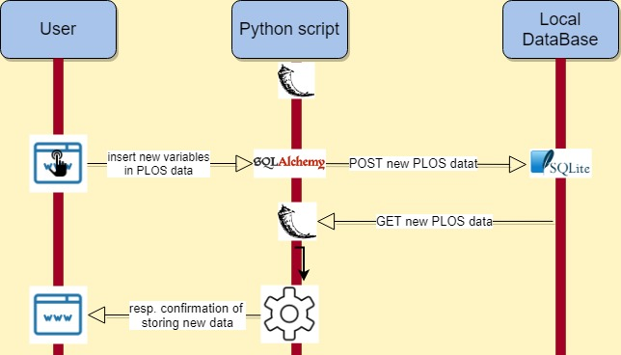
Sequence diagram
Inserting new PLOS data

Slide 14

Sequence diagram
Posting comment

