Slide 1
Change your mind about JavaScript with ECMASCRIPT 6 !
TOO
COMPLICATED
ES1
ES2
ES3
ES4
…?
ESharmony
ES5
ES3.1
ES5.1
ES6!!
Notes:
Hi, I’m X, (and I’m Y)
A lot of people think of Javascript as « uh, yeah, kind of a programmation language », a script language only good to hack together some animation on a webpage. In short: not-a-real-language.
Well things are going to change very soon, thanks to the next iteration of the standard behind the JavaScript language : ECMAScript 6
And now I’m sure you burn to know how this version came to life!
Well that’s easy:
First you got ES1, then ES2, then ES3. Then ES4, which was o complete revolution for the language… or not, actually, the version was deemed too complicated and a part of the ECMAScript commitee thought it would never be finished, so they started another, far smaller version called ES3.1.
As the same time ES4 was scaled down a notch, and renamed « ES Harmony »
Oh yeah, and ES 3.1 is now called ES5.
-SHORT PAUSE-
So after that, a new iteration was started… -SHORT PAUSE- … ES5.1 (which, despite being small on this slide is the version you’re probably using right now)
And since this history has already far overstayed its welcome, we finally arrive to ES6, that is ALSO called Esharmony because it includes concepts from the previous ESHarmony.
Simple right?

Slide 2
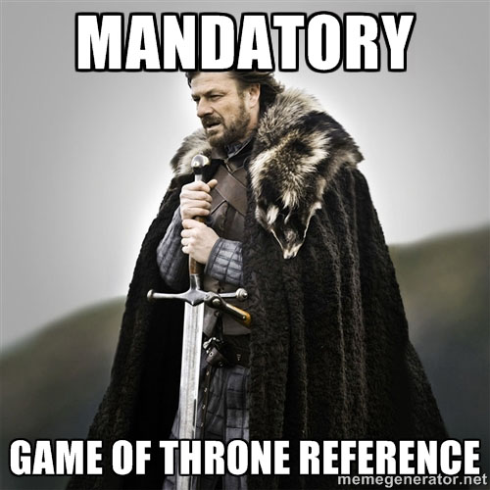


Come change your preconceptions about JavaScript, thanks to ECMAScript6!
In ROOM2
At 14:20
By Damien Simonin-Feugas
and Léo Gaillard
Notes:
But forget about all of this, and come see us talk about ES6 only, and how it will change the way you look at and use Javascript!
In Room 2, at 14:20
Thank you!

