Slide 1
Feven Abebe
Hailemichael Melese
Surafel Solomon
MACHINE LEARNING · TECHNICAL REPORT PRESENTATION
House Price Prediction
Prepared by
Using Machine Learning Regression Models
An end-to-end regression pipeline on the Ames Housing Dataset — from data cleaning and feature engineering to explainable AI and Streamlit deployment.
Group 1
1,460
80
Samples
Features

Slide 2
Introduction & Problem Statement
Why It Matters
Project Objectives
Property prices depend on interacting factors — location, size, quality, age, and facilities. Traditional valuation relies on manual inspection and expert judgment, which is time-consuming and subjective. Machine learning offers a data-driven alternative that learns these complex relationships directly from historical sales data.
1
Clean and preprocess housing data
2
Analyze patterns using EDA
3
Engineer meaningful features
4
Train multiple regression algorithms
Target Variable
5
Optimize via hyperparameter tuning
SalePrice
6
Evaluate and compare models
The final sale price of each residential property, in US dollars.
Explain predictions with SHAP
7
8
Deploy as an interactive web app
House Price Prediction — Ames Housing Dataset
2

Slide 3
Dataset Description
Ames Housing Dataset — a widely used regression benchmark
1,460
81
38
43
Training Samples
Original Features
Numerical Features
Categorical Features
What the Data Contains
●
Comprehensive property information: structural characteristics, quality ratings, neighborhood data, garage and basement details.
●
No duplicate records were found — every observation represents a unique residential property.
●
Several features contain missing values, mostly tied to optional characteristics such as pools, fences, alleys, fireplaces, garages, and basements.
House Price Prediction — Ames Housing Dataset
3

Slide 4
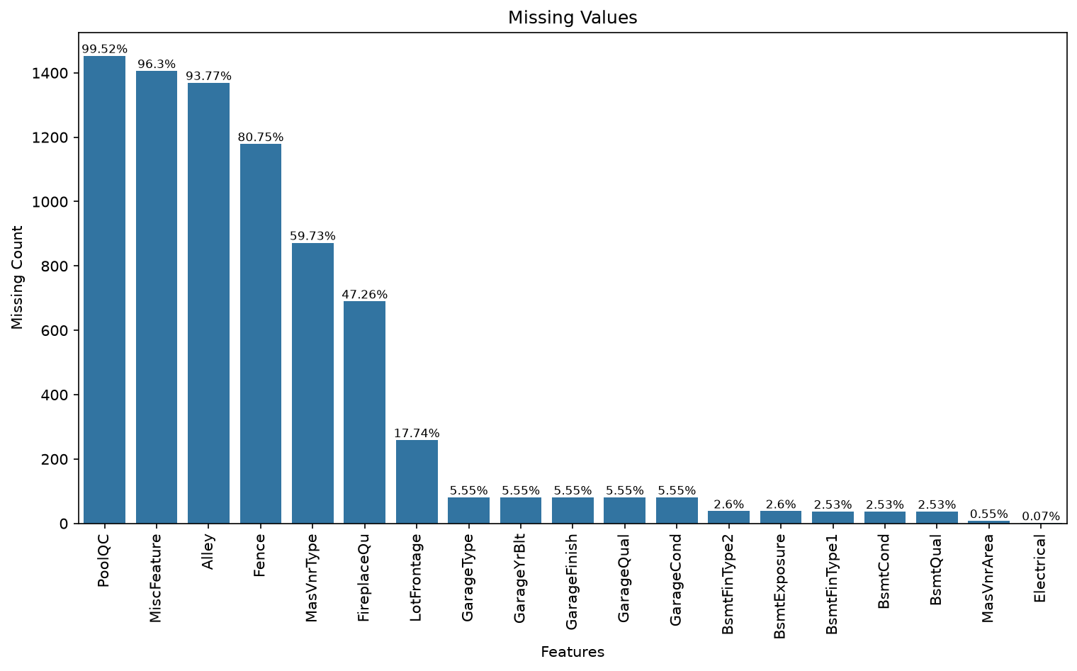
Data Cleaning — Missing Value Analysis
Key Findings
Alley, PoolQC, Fence, MiscFeature had more than 80% missing values and were removed — limited predictive value, insufficient data for imputation. This 4 features were removed
Handling Strategy
"None"
Categorical features where absence means the feature doesn't exist (BsmtQual, GarageType, FireplaceQu, etc.)
Median
LotFrontage, MasVnrArea, GarageYrBlt — robust to extreme values
Mode
Electrical — only a few missing values
House Price Prediction — Ames Housing Dataset
4

Slide 5
Data Cleaning
1
Low-Information Features Removed
2
Outlier Removal
Street, Utilities, Condition2, RoofMatl — near-zero variance with almost all values in a single category.
Removed properties with GrLivArea > 4,000 sq ft and SalePrice < $300,000 — unusually large homes sold at low prices that could distort regression models.
3
Feature Encoding
4
Feature Transformation Pipeline
One-Hot Encoding for categorical variables.
A Scikit-learn ColumnTransformer and Pipeline were used to perform median imputation and feature scaling for numerical features
House Price Prediction — Ames Housing Dataset
5

Slide 6
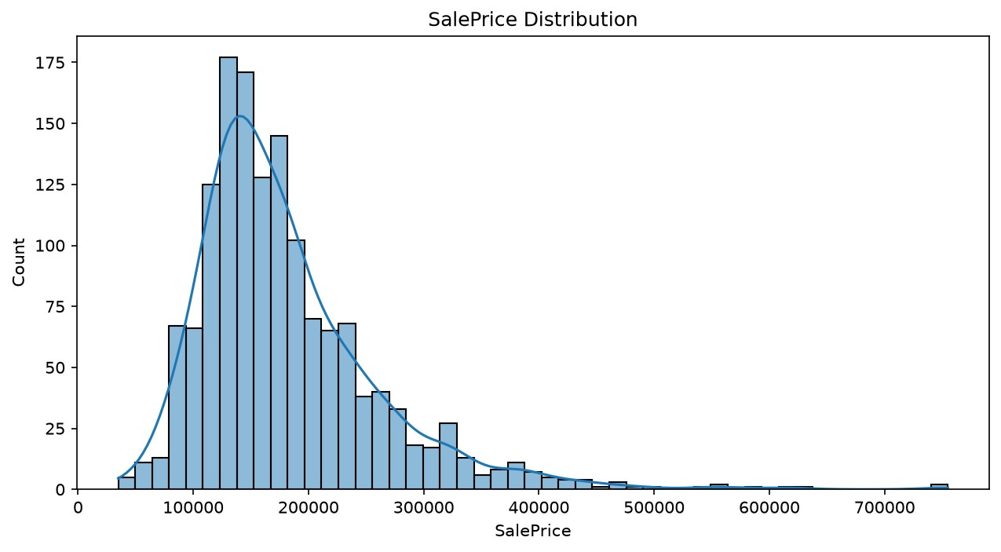
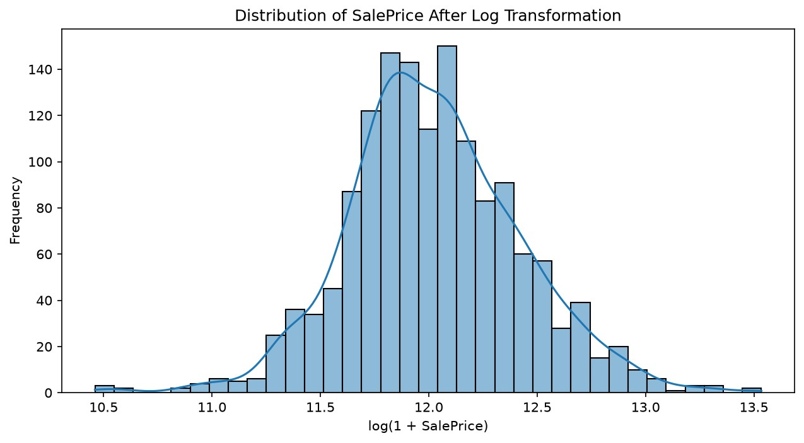
Exploratory Data Analysis — SalePrice Distribution
House prices are right-skewed
SalePrice shows a typical right-skewed distribution common to real-estate data. A log transformation, log(1 + SalePrice), was analyzed to normalize the distribution and better support model assumptions and visualization.
House Price Prediction — Ames Housing Dataset
6

Slide 7
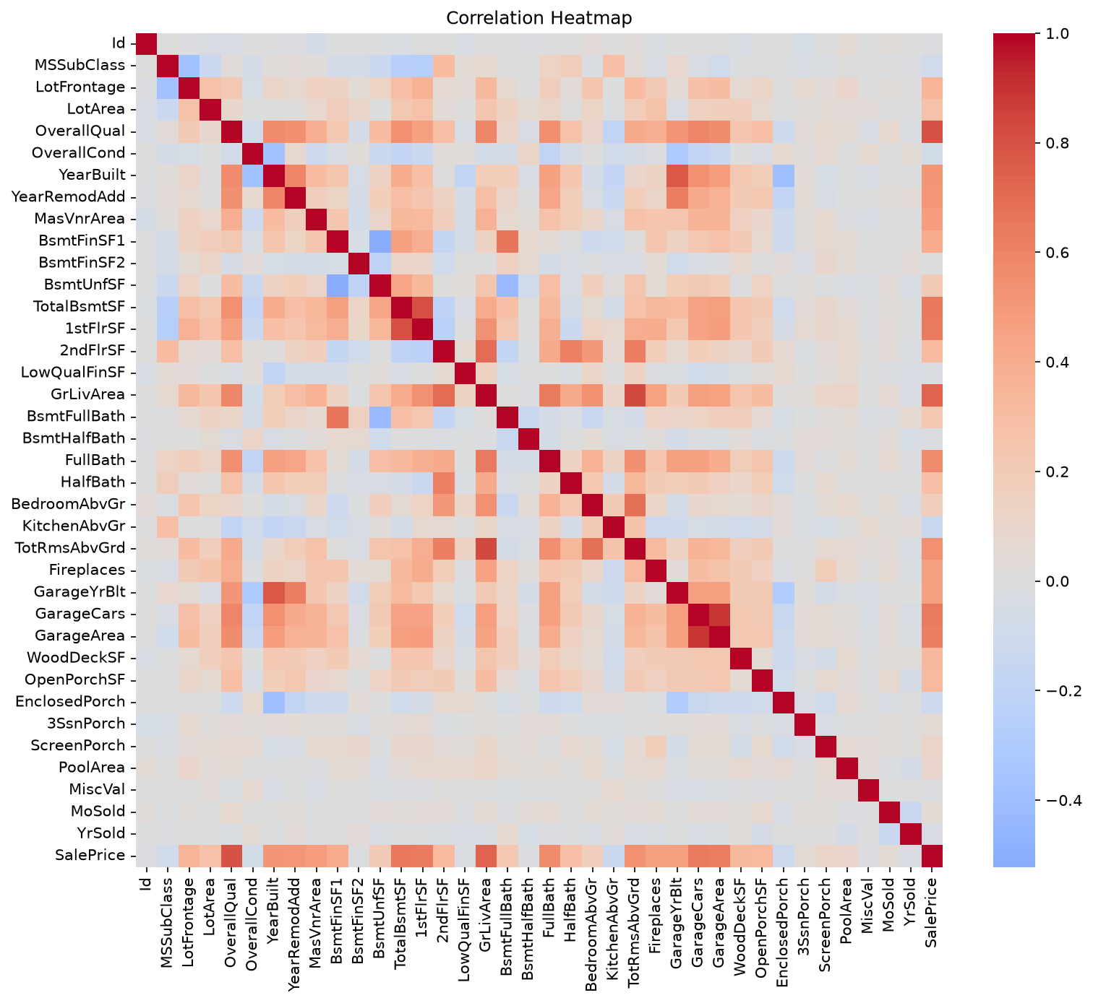
Exploratory Data Analysis — Correlation Analysis
Strongest Predictors
✓
OverallQual
Overall material & finish quality
✓
GrLivArea
Above-ground living area (sq ft)
✓
TotalBsmtSF
Total basement area
✓
GarageCars
Garage capacity (# of cars)
These features were prioritized during feature engineering and model training.
House Price Prediction — Ames Housing Dataset
7

Slide 8
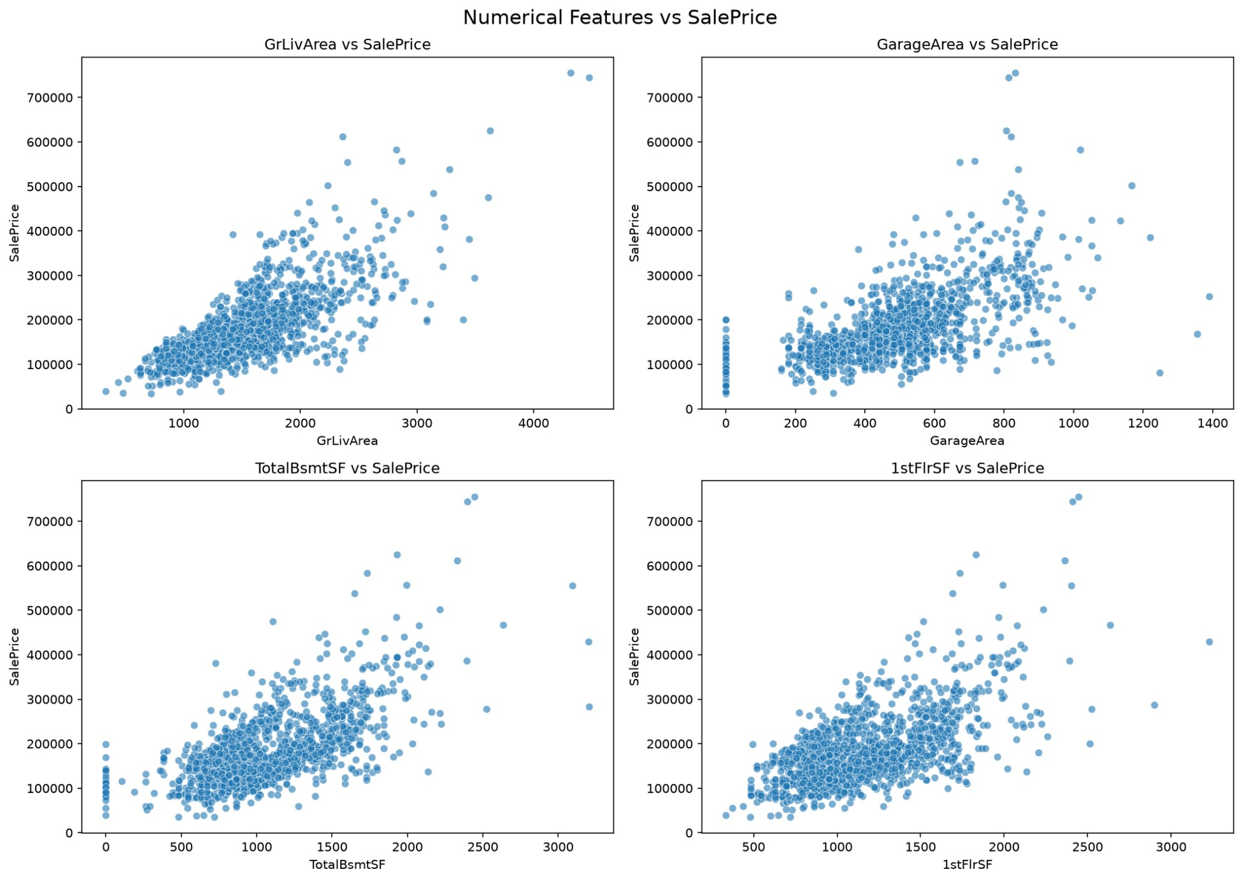
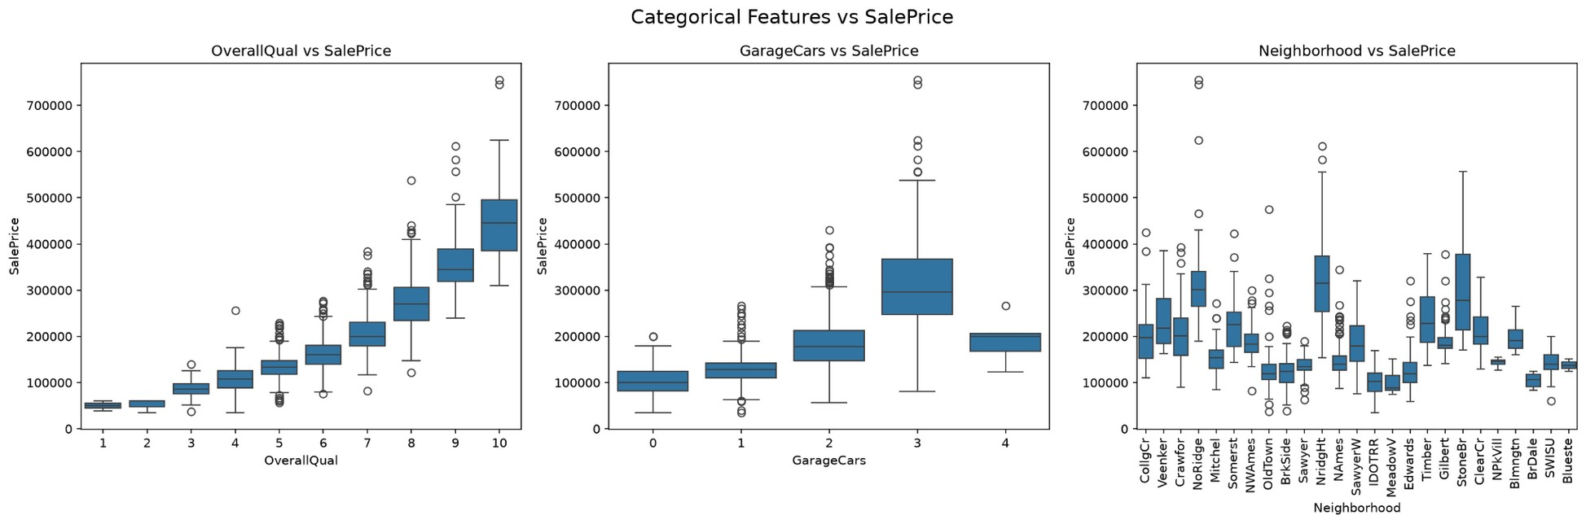
EDA — Numerical & Categorical Relationships
Categorical Features vs SalePrice
Numerical Features vs SalePrice
Scatter plots of GrLivArea, GarageArea, TotalBsmtSF, and 1stFlrSF revealed clear positive relationships with SalePrice. Box plots of OverallQual, GarageCars, and Neighborhood showed that quality indicators and location strongly affect price distributions — properties with better materials, garages, and finished basements tended to sell higher.
House Price Prediction — Ames Housing Dataset
8

Slide 9
Key EDA Findings
What the data told us
★
House quality is king
OverallQual was one of the strongest predictors of property value.
★
Size matters
Larger living areas generally corresponded to higher house prices.
★
Quality compounds
Better materials, garages, and finished basements meant higher selling prices.
★
Location & quality diverge
Neighborhood and quality attributes showed significant differences in price distributions.
House Price Prediction — Ames Housing Dataset
9

Slide 10
Feature Engineering
Turning raw attributes into higher-signal predictors
Original Features | Engineered Feature
TotalBsmtSF + 1stFlrSF + 2ndFlrSF | TotalSF — total square feet
FullBath + 0.5×HalfBath + Bsmt baths | TotalBathrooms — weighted bathroom count
YrSold − YearBuilt | HouseAge — age at time of sale
YrSold − YearRemodAdd | YearsSinceRemodel — time since renovation
Porch & deck features combined | TotalPorchSF — total outdoor living space
OverallQual × GrLivArea | QualityLivingArea — quality-size interaction
GarageCars × GarageArea | GarageScore — garage capacity & size combined
QualityLivingArea and TotalSF emerged as the two most influential engineered features in the final model.
House Price Prediction — Ames Housing Dataset
10

Slide 11
Regression Algorithms Evaluated
Linear, tree-based, ensemble, and gradient boosting approaches
Linear Regression
Ridge Regression
Lasso Regression
Baseline model
L2 regularization, α = 1.0
L1 regularization, α = 0.001
Decision Tree
Random Forest
Extra Trees
Recursive feature splitting
200 trees, ensemble variance reduction
Extra randomness for generalization
Gradient Boosting
AdaBoost
SVR
Sequential error correction
Focuses on difficult samples
HYperplane
XGBoost
LightGBM
400 estimators, tuned depth & subsampling
CatBoost ⭐
500 estimators, efficient tree boosting
Optimized for categorical & tabular data
11

Slide 12
Hyperparameter Tuning
GridSearchCV with 5-fold cross-validation on CatBoost
Parameter | Search Values
Iterations | 500(a chain of 500 trees )
Learning Rate | 0.03, 0.05, 0.07
Tree Depth | 3, 4
L2 Regularization | 3, 5
Selection Criteria
The best configuration was chosen based on the highest cross-validation R² score across all parameter combinations.
Result
Tuned CatBoost outperformed the default configuration
R² Score: 0.9363 → 0.9371 RMSE: 18,765.32 → 18,636.19 MAE: 13,721.36 → 13,680.99
Hyperparameter tuning improved performance by reducing prediction error and slightly increasing explained variance compared with the default CatBoost configuration.
House Price Prediction — Ames Housing Dataset
12

Slide 13
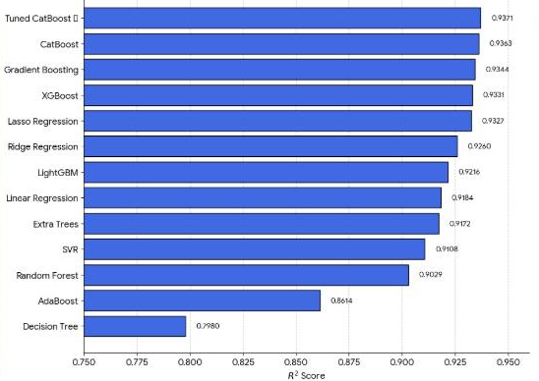
Model Comparison
R² Score across all 12 evaluated algorithms
House Price Prediction — Ames Housing Dataset
15

Slide 14
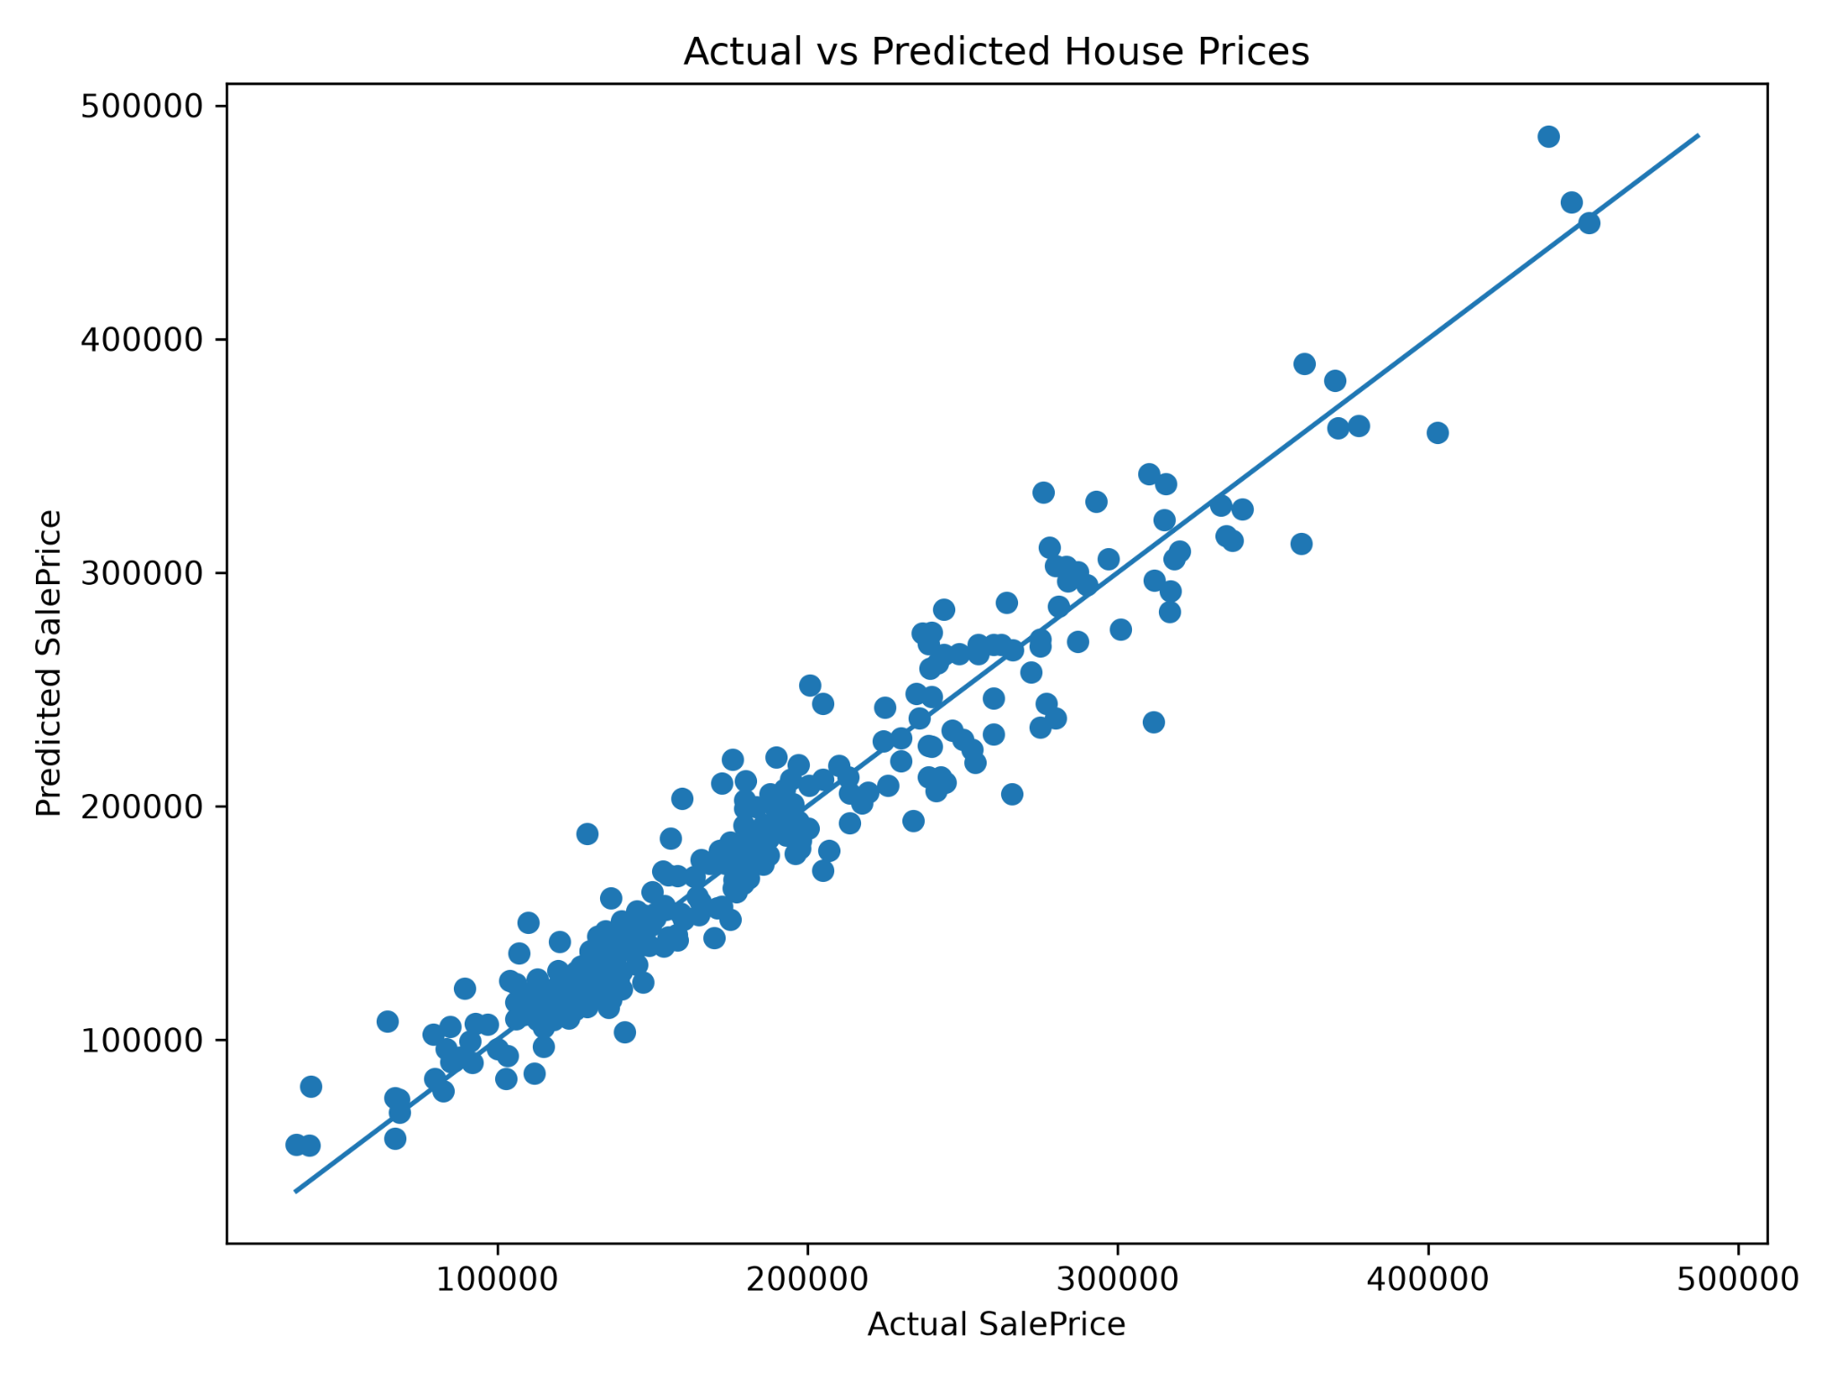
Model Evaluation
Four standard regression metrics guided model comparison
MAE
Mean Absolute Error — average absolute difference between actual and predicted prices.
MSE
Mean Squared Error — squared differences; penalizes larger errors more heavily.
RMSE
Root Mean Squared Error — prediction error in the original price scale.
R²
Proportion of variance explained; higher values indicate stronger predictive power.
Actual vs Predicted House Prices — tight clustering along the diagonal confirms strong agreement.
House Price Prediction — Ames Housing Dataset
13

Slide 15
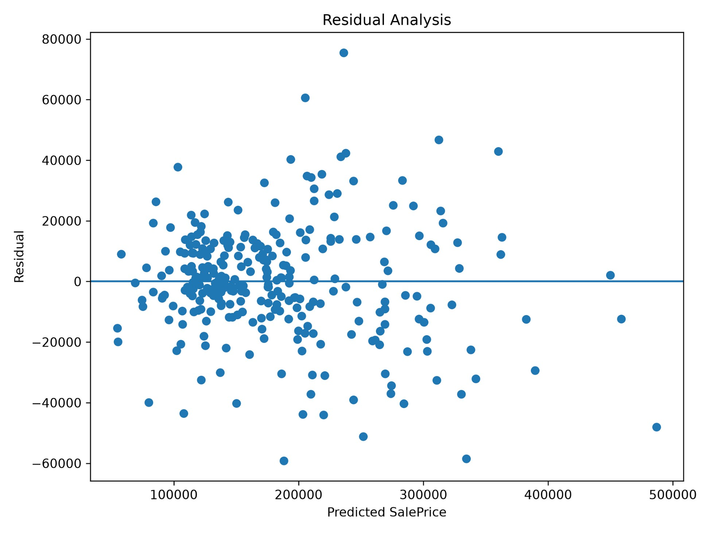
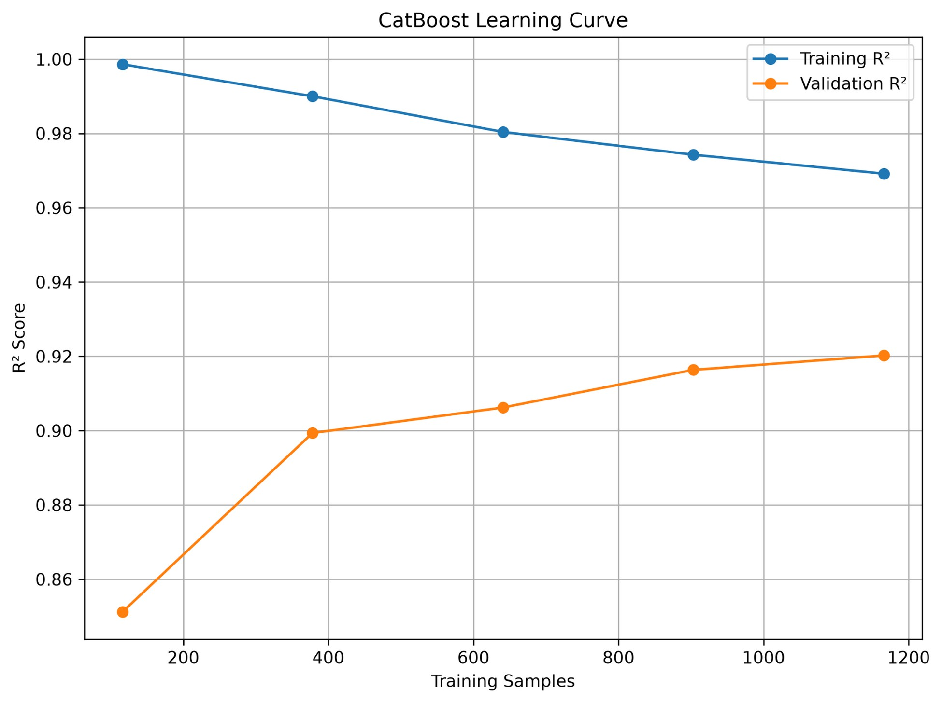
Residual & Learning Curve Analysis
Residuals are randomly distributed around zero — no systematic prediction bias.
Training and validation R² converge as sample size grows — good generalization, minimal overfitting.
House Price Prediction — Ames Housing Dataset
14

Slide 16
Best Model Selection
Tuned CatBoost Regressor — the final selected model
0.9371
13,680.99
18,636.19
R² Score
MAE (USD)
RMSE (USD)
Highest explained variance
Lowest mean absolute error
Lowest root mean squared error
Hyperparameter tuning improved the CatBoost model over its default configuration — reducing prediction error and slightly increasing explained variance. The final tuned model was saved and integrated into the Streamlit prediction application.
House Price Prediction — Ames Housing Dataset
16

Slide 17
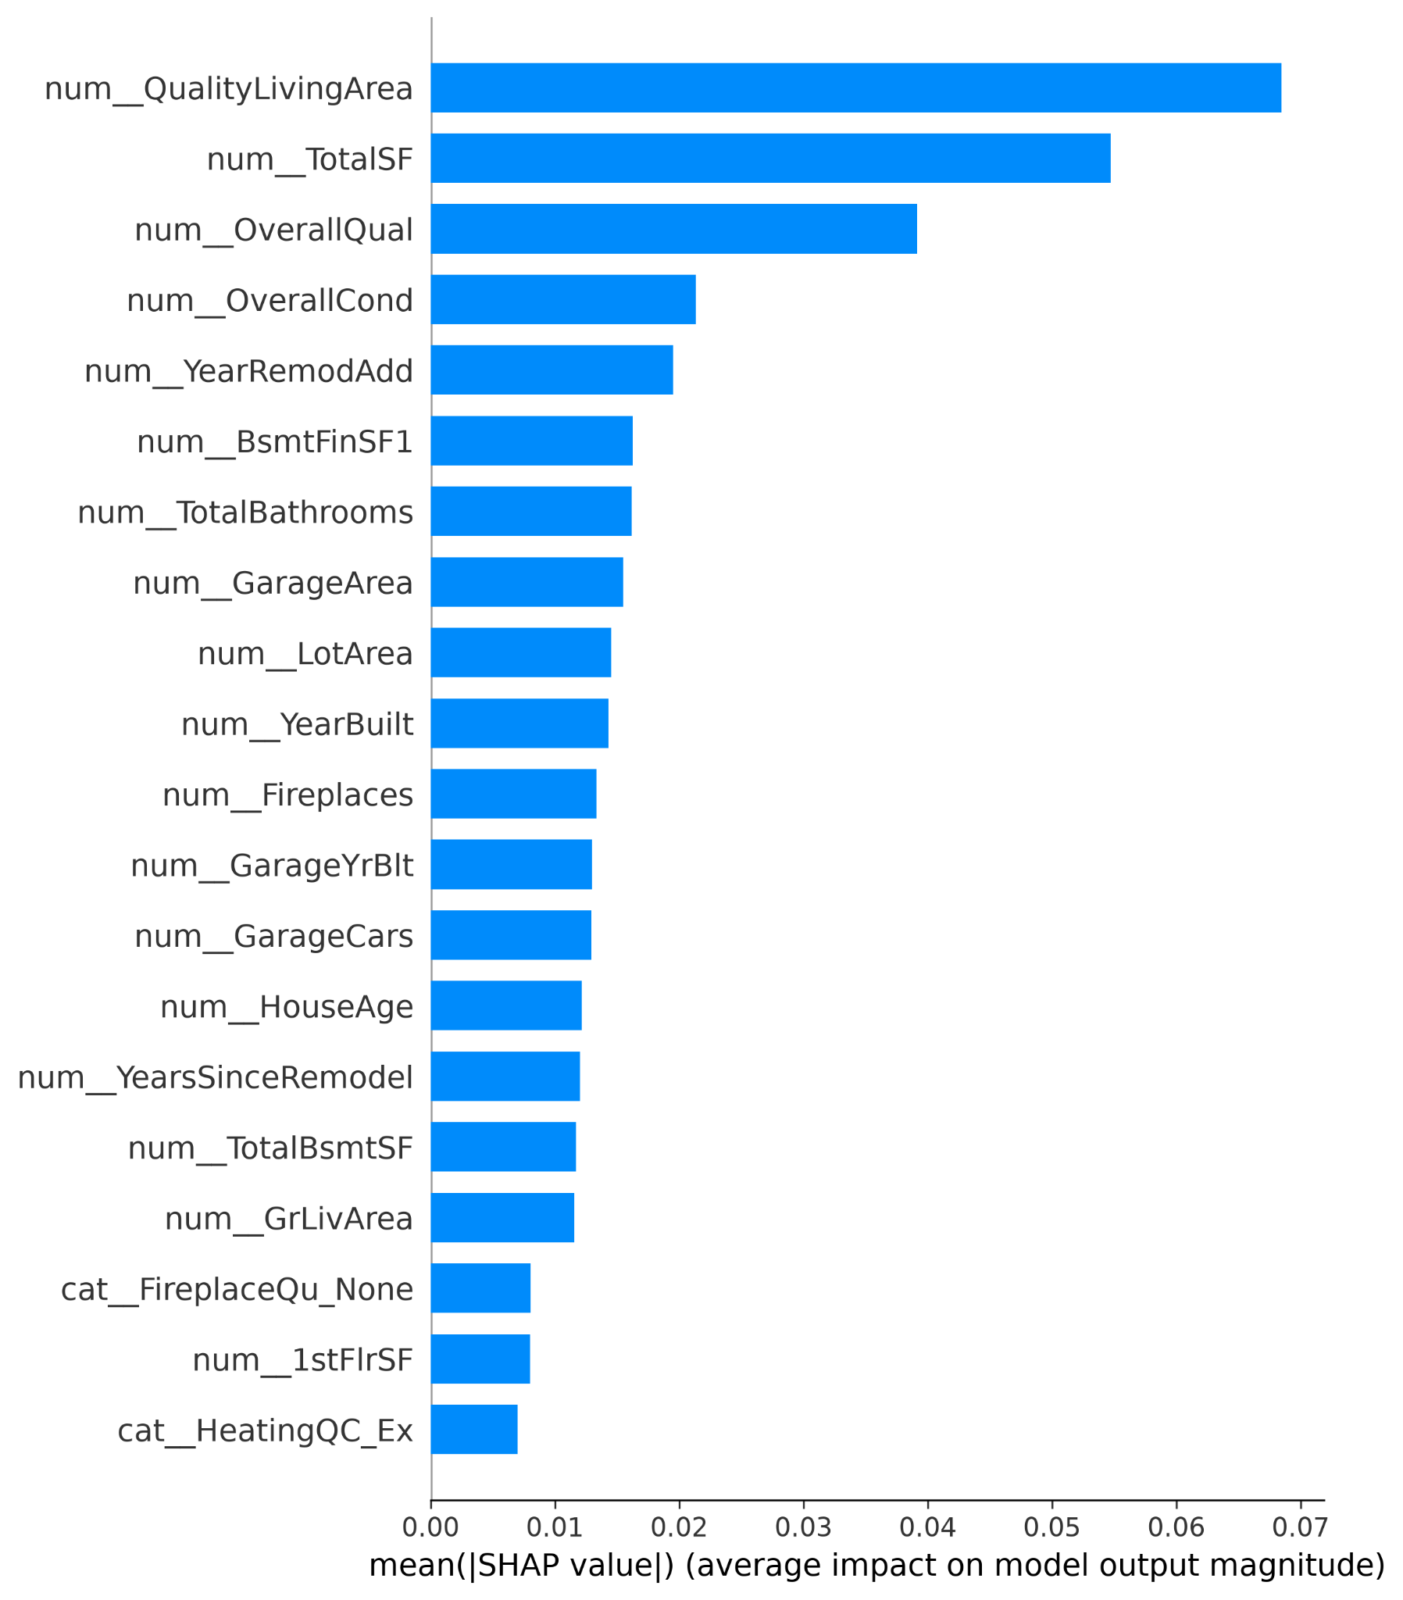
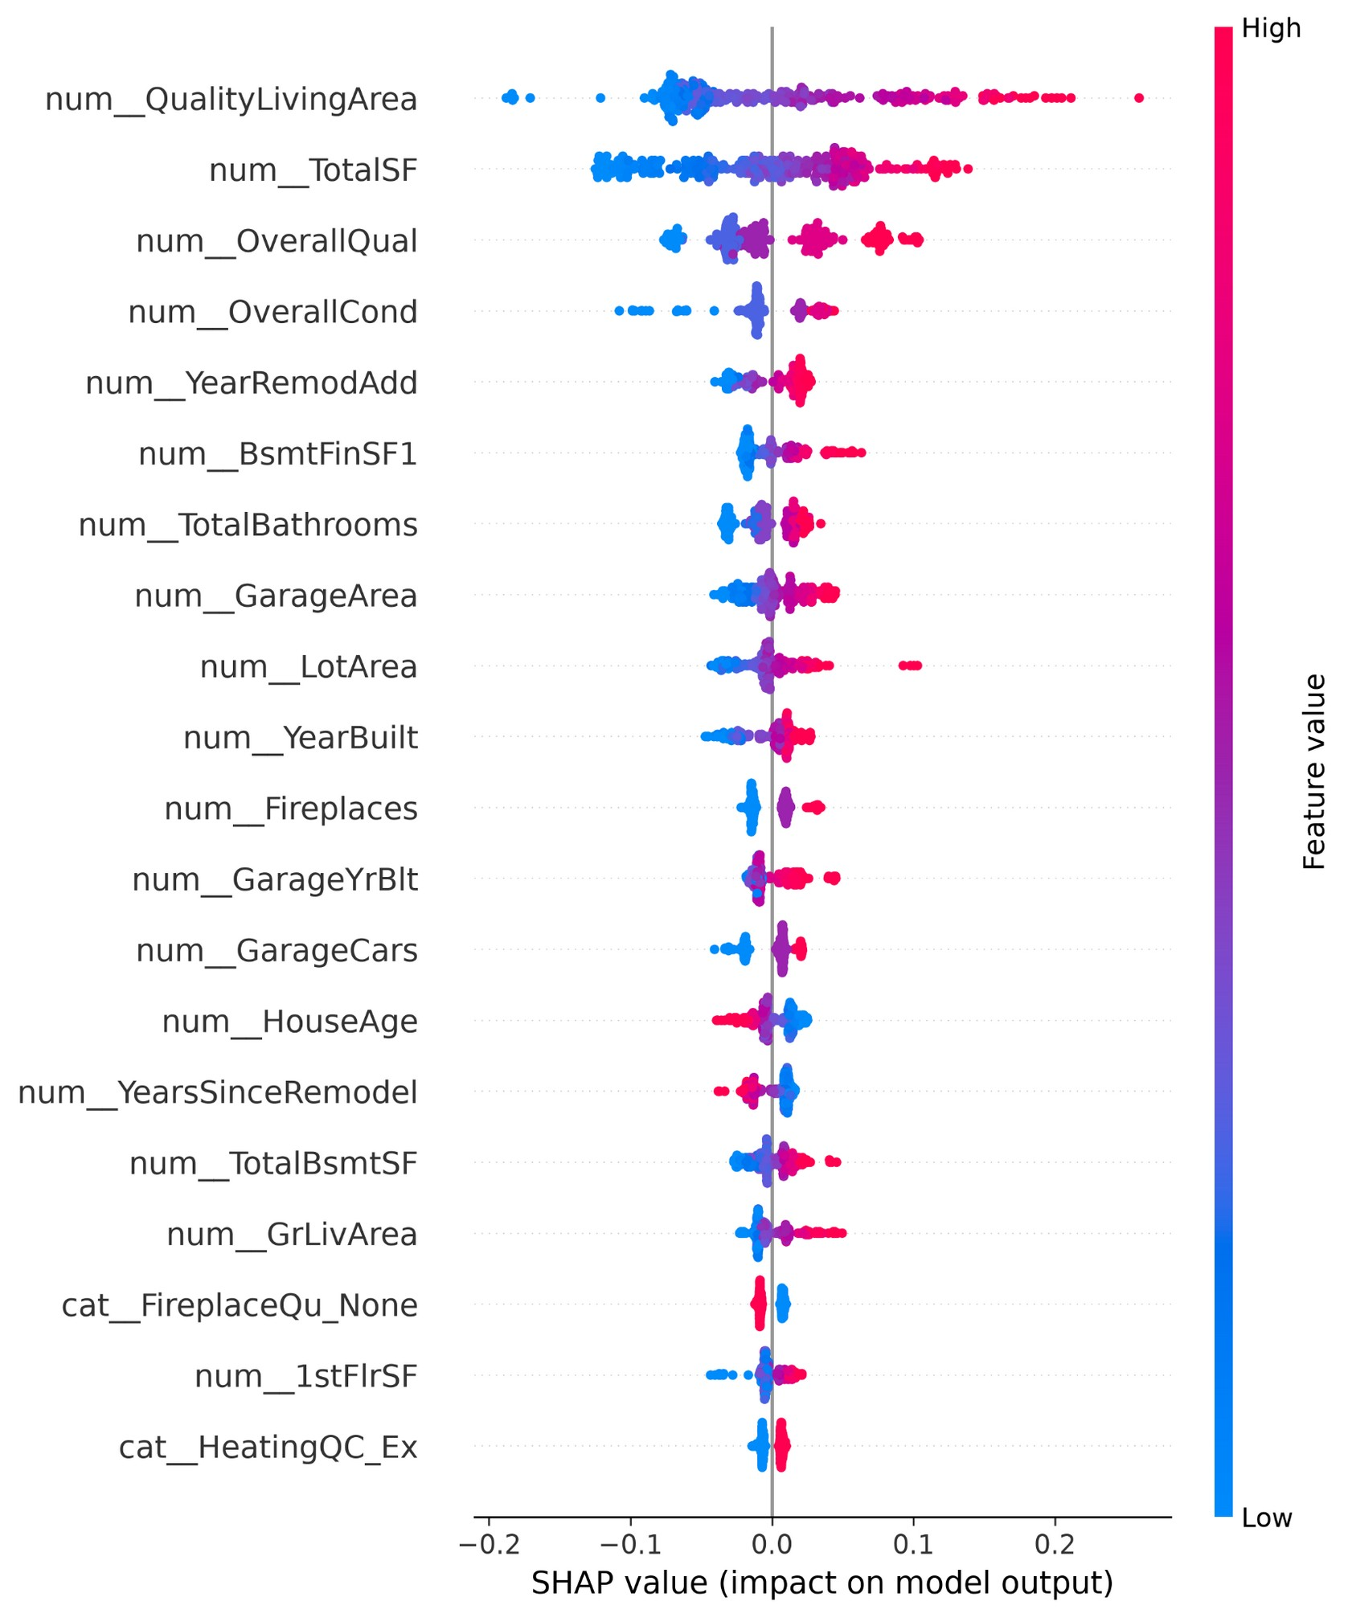
SHAP Explainability Analysis
Shapley Additive exPlanations — global feature impact & direction
SHAP Feature Importance — average contribution
SHAP Summary — direction of influence (red = high value)
House Price Prediction — Ames Housing Dataset
18

Slide 18
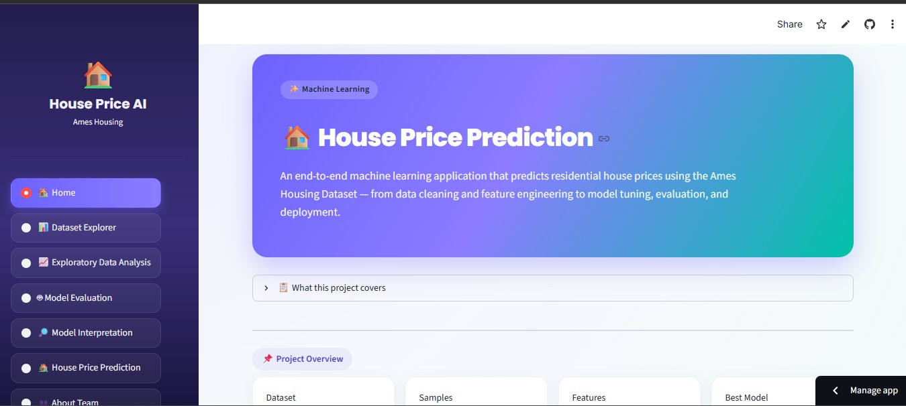
Deployment
Interactive Streamlit application, containerized with Docker
App Features
✓
Dataset Exploration
✓
Interactive EDA visualizations
✓
Model Evaluation Dashboard
✓
Feature Importance Analysis
✓
SHAP Explainability
✓
Interactive Price Prediction
Deployment Stack
Streamlit application — home screen
Streamlit Cloud (hosting) · Docker (containerization) · Docker Hub (image registry)
House Price Prediction — Ames Housing Dataset
20

Slide 19
Conclusion
This project successfully developed an end-to-end machine learning regression system for residential house price prediction using the Ames Housing Dataset — covering the complete workflow from data understanding to deployment.
1
2
3
Data Understanding
Cleaning & Preprocessing
Exploratory Analysis
4
5
6
Feature Engineering
Model Development
Hyperparameter Tuning
7
8
9
Evaluation & Comparison
Explainability
Deployment
The final system provides both accurate house price predictions and interpretable insights into model decision-making — a complete machine learning solution from data processing to deployment.
House Price Prediction — Ames Housing Dataset
21

Slide 20
Future Improvements
1
Advanced Hyperparameter Optimization
2
Cloud Deployment Expansion
Bayesian Optimization, Optuna, or automated search strategies for further gains.
Deploy via AWS, Microsoft Azure, or Google Cloud for scalability and accessibility.
3
Automated Machine Learning (AutoML)
4
Model Monitoring & Maintenance
Automatically explore preprocessing, feature engineering, and model selection.
Track performance, detect data drift, and schedule model updates.
5
Real-Time Market Integration
6
MLOps Implementation
Incorporate external housing market data to improve prediction accuracy.
Automated training, testing, version control, model registry, continuous deployment.
22

Slide 21
Thank You
House Price Prediction — Ames Housing Dataset
House Price Prediction — Ames Housing Dataset
23

