Slide 1




Un(utility) of Faddeev-Yakubovsky equations formalism
R. Lazauskas

Slide 2
Contents
Solution of the 3-5 body Faddeev-Yakubovsky equations for nuclear systems
Some applications
  N-³H scattering (effect of 3BF)
  n-⁴He scattering
  scattering beyond breakup thresholds: d-¹²C case
22/09/2021
2
2
R. Lazauskas
R. Lazauskas
Notes:
2

Slide 3
Introduction
Non-relativistic Collisions
How to take care of the boundary conditions?
  Conceptual difficulties to uncouple different particle channels, to impose proper constrains on the solutions of Schrödinger eq. in all directions, limiting them to physical ones
  It is ok, as long as there is single particle channel (elastic plus target/projectile excitations)
  Mathematically Ill-conditioned problem when several particle channels are open
Faddeev-Yakubovsky equations efficiently separates asymptotes of the binary channels
In configuration space wave functions extend to infinity!
Increasingly complex asymptotic behaviour for A>2 systems!!
…
L. D. Faddeev, Zh. Eksp. Teor. Fiz. 39, 1459 (1960). [Sov. Phys. JETP 12, 1014(1961)].
O. A. Yakubovsky, Sov. J. Nucl. Phys. 5, 937 (1967).
3
3
Notes:
3

Slide 4
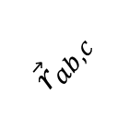

Properties of the rigorous scattering eq.
Should separate all the possible scattering channels in order to incorporate proper asymptotes! Number of binary channels increases ~2^{N}
Should be systematically reducible to smaller subsystems: to remain consistent with the solutions for the subsystems (reproduce proper thresholds & asymptotic states)
a
c
$${\vec{r}}_{ab,c}$$
$${\vec{r}}_{ab}$$
b
22/09/2021
4
4
R. Lazauskas
R. Lazauskas
Notes:
4

Slide 5
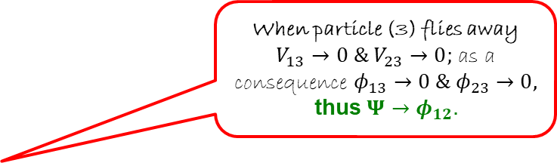




Faddeev-Yakubovsky eq
3-body
(Faddeev eq.)
When particle (3) flies away $V_{13}→0 \& V_{23}$ $→0;$ as a consequence $φ_{13}→0 \& φ_{23}$ $→0,$
thus $Ψ→φ_{12}.$
2
1
3
$$φ_{12}=G_{0}V_{12}Ψ$$
3
2
1
$$φ_{23}=G_{0}V_{23}Ψ$$
1
3
2
$$φ_{31}=G_{0}V_{31}Ψ$$
$$Ψ=φ_{12}+φ_{23}+φ_{31}$$
Equations for short-ranged pairwise interactions
22/09/2021
5
5
R. Lazauskas
R. Lazauskas
Notes:
5

Slide 6

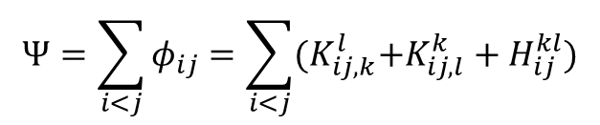
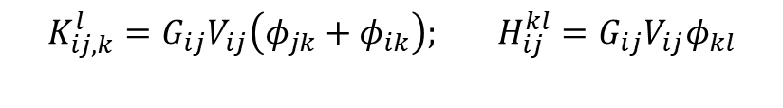
Faddeev-Yakubovsky eq
3-body
(Faddeev eq.)
4-body
(Faddeev-Yakubovsky eq.)
2
1
j
i
j
i
k
3
k
l
$$φ_{12}=G_{0}V_{12}Ψ$$
l
3
2
1
K-type
(12 components)
H-type
(6 components)
$$φ_{23}=G_{0}V_{23}Ψ$$
$$φ_{jk}=G_{0}V_{jk}Ψ$$
1
3
2
$$K_{ij,k}^{l}=G_{ij}V_{ij}\left(φ_{jk}+φ_{ik}\right); H_{ij}^{kl}=G_{ij}{V_{ij}φ}_{kl}$$
$$φ_{31}=G_{0}V_{31}Ψ$$
$$Ψ=\sum_{i<j}{φ_{ij}=\sum_{i<j}{{(K}_{ij,k}^{l}+{K_{ij,l}^{k}+H}_{ij}^{kl})}}$$
$$Ψ=φ_{12}+φ_{23}+φ_{31}$$
Equations for short-ranged pairwise interactions
22/09/2021
6
6
R. Lazauskas
R. Lazauskas
Notes:
6

Slide 7
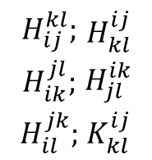
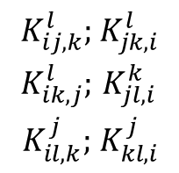
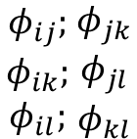
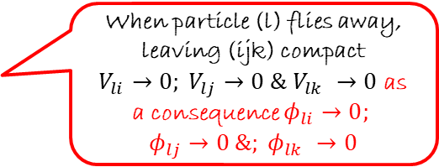
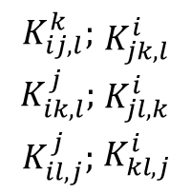
Faddeev-Yakubovsky eq
When particle (l) flies away, leaving (ijk) compact
$V_{li}→0; V_{lj}$ $→0 \& V_{lk} →0$ as a consequence $φ_{li}→0;$
$φ_{lj}$ $→0 \&; φ_{lk} →0$
4-body
(Faddeev-Yakubovsky eq.)
$$\begin{matrix}φ_{ij}; \\ φ_{ik}; \\ φ_{il}; \end{matrix}\begin{matrix}φ_{jk} \\ φ_{jl} \\ φ_{kl}\end{matrix}$$
j
i
j
i
k
k
l
l
$$\begin{matrix}K_{ij,k}^{l}; \\ K_{ik,j}^{l}; \\ K_{il,k}^{j}; \end{matrix}\begin{matrix}K_{jk,i}^{l} \\ K_{jl,i}^{k} \\ K_{kl,i}^{j}\end{matrix}$$
$$\begin{matrix}K_{ij,l}^{k}; \\ K_{ik,l}^{j}; \\ K_{il,j}^{j}; \end{matrix}\begin{matrix}K_{jk,l}^{i} \\ K_{jl,k}^{i} \\ K_{kl,j}^{i}\end{matrix}$$
K-type
(12 components)
H-type
(6 components)
$$φ_{jk}=G_{0}V_{jk}Ψ$$
$$K_{ij,k}^{l}=G_{ij}V_{ij}\left(φ_{jk}+φ_{ik}\right); H_{ij}^{kl}=G_{ij}{V_{ij}φ}_{kl}$$
$$\begin{matrix}H_{ij}^{kl}; \\ H_{ik}^{jl}; \\ H_{il}^{jk}; \end{matrix}\begin{matrix}H_{kl}^{ij} \\ H_{jl}^{ik} \\ K_{kl}^{ij}\end{matrix}$$
$$Ψ=\sum_{i<j}{φ_{ij}=\sum_{i<j}{{(K}_{ij,k}^{l}+{K_{ij,l}^{k}+H}_{ij}^{kl})}}$$
Equations for short-ranged pairwise interactions
22/09/2021
7
7
R. Lazauskas
R. Lazauskas
Notes:
7

Slide 8
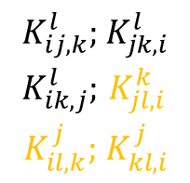
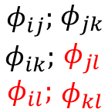

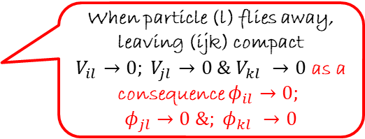

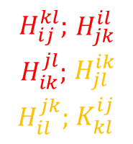
Faddeev-Yakubovsky eq
When particle (l) flies away, leaving (ijk) compact
$V_{il}→0; V_{jl}$ $→0 \& V_{kl} →0$ as a consequence $φ_{il}→0;$
$φ_{jl}$ $→0 \&; φ_{kl} →0$
4-body
(Faddeev-Yakubovsky eq.)
$$\begin{matrix}φ_{ij}; \\ φ_{ik}; \\ φ_{il}; \end{matrix}\begin{matrix}φ_{jk} \\ φ_{jl} \\ φ_{kl}\end{matrix}$$
j
i
j
i
k
k
l
l
$$\begin{matrix}K_{ij,k}^{l}; \\ K_{ik,j}^{l}; \\ K_{il,k}^{j}; \end{matrix}\begin{matrix}K_{jk,i}^{l} \\ K_{jl,i}^{k} \\ K_{kl,i}^{j}\end{matrix}$$
$$\begin{matrix}K_{ij,l}^{k}; \\ K_{ik,l}^{j}; \\ K_{il,j}^{j}; \end{matrix}\begin{matrix}K_{jk,l}^{i} \\ K_{jl,k}^{i} \\ K_{kl,j}^{i}\end{matrix}$$
K-type
(12 components)
H-type
(6 components)
$$φ_{jk}=G_{0}V_{jk}Ψ$$
$$K_{ij,k}^{l}=G_{ij}V_{ij}\left(φ_{jk}+φ_{ik}\right); H_{ij}^{kl}=G_{ij}{V_{ij}φ}_{kl}$$
$$\begin{matrix}H_{ij}^{kl}; \\ H_{ik}^{jl}; \\ H_{il}^{jk}; \end{matrix}\begin{matrix}H_{jk}^{il} \\ H_{jl}^{ik} \\ K_{kl}^{ij}\end{matrix}$$
$$Ψ=\sum_{i<j}{φ_{ij}=\sum_{i<j}{{(K}_{ij,k}^{l}+{K_{ij,l}^{k}+H}_{ij}^{kl})}}$$
thus $Ψ→K_{ij,k}^{l}$+$K_{jk,i}^{l}$+$K_{ik,j}^{l}$
Equations for short-ranged pairwise interactions
22/09/2021
8
8
R. Lazauskas
R. Lazauskas
Notes:
8

Slide 9


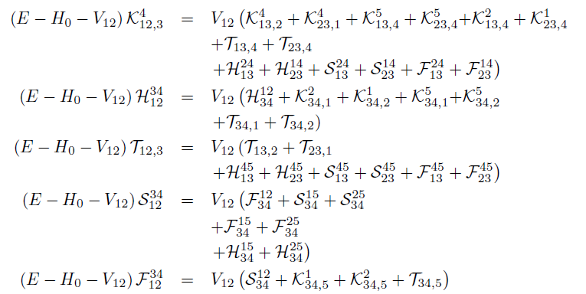
5-body Faddeev-Yakubovski eq
2
1
2
1
2
1
2
1
3
4
3
2
1
3
4
3
4
4
4
3
5
5
5
5
5
22/09/2021
9
9
R. Lazauskas
R. Lazauskas
Notes:
9

Slide 10

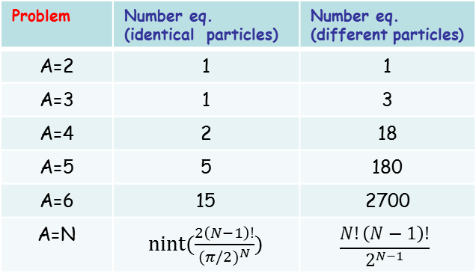
Faddeev-Yakubovsky eq
2
1
2
1
2
1
2
1
3
4
3
2
1
3
4
3
4
4
4
3
5
5
5
5
5
Merits:
Handling of symmetries
Boundary conditions for binary channels
Easy & proper reduction to subsystems
Price
Overcomplexity
Problem | Number eq. (identical particles) | Number eq. (different particles)
A=2 | 1 | 1
A=3 | 1 | 3
A=4 | 2 | 18
A=5 | 5 | 180
A=6 | 15 | 2700
A=N | nint($\frac{2\left(N−1\right)!}{{(π/2)}^{N}})$ | $$\frac{N!\left(N−1\right)!}{2^{N−1}}$$
J.W. Waterhouse : « Pandora »
22/09/2021
10
10
R. Lazauskas
R. Lazauskas
Notes:
10

Slide 11
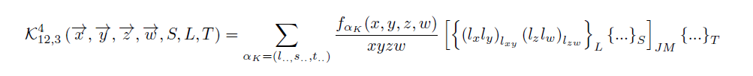
5-body Faddeev-Yakubovski eq
2
1
2
1
2
1
2
1
3
4
3
2
1
3
4
3
4
4
4
3
5
5
5
5
5
NUMERICAL SOLUTION
*R.L., PhD Thesis, Université Joseph Fourier, Grenoble (2003).
PW decomposition of the components K,H,T,S,F
Radial parts expanded using Lagrange-mesh method
D. Baye, Physics Reports 565 (2015) 1
Resulting linear algebra problem solved using iterative methods
Observables extracted using integral relations
22/09/2021
11
11
R. Lazauskas
R. Lazauskas
Notes:
11

Slide 12
Numerical costs
2
1
2
1
2
1
2
1
3
4
3
2
1
3
4
3
4
4
4
3
5
5
5
5
5
Problem | Number eq. (ident particles) | Number eq. (diff. particles) | PW basis. | Radial disc.
2N | 1 | 1 | 2 | ~N
3N | 1 | 3 | ~100 | ~N²
4N | 2 | 18 | ~10⁴ | ~N³
5N | 5 | 180 | ~10⁶ | ~N⁴
NUMERICAL SOLUTION
*R.L., PhD Thesis, Université Joseph Fourier, Grenoble (2003).
PW decomposition of the components K,H,T,S,F
Radial parts expanded using Lagrange-mesh method
D. Baye, Physics Reports 565 (2015) 1
Resulting linear algebra problem solved using iterative methods
Observables extracted using integral relations
22/09/2021
12
12
R. Lazauskas
R. Lazauskas
Notes:
12

Slide 13
Short overview of nuclear problems by FY eq’s
1970
1980
1990
2000
2010
2020
3N
1st solutions
Realistic
Full
4N
1st solutions
Realistic
Full
5N
3N-problem
(Faddeev eq.)
1st solution: A. Laverne and C. Gignoux: Nucl. Phys. A 203 (1973) 597
G. Gignoux, A. Laverne, and S. P. Merkuriev Phys. Rev. Lett. 33 (1974) 1350
Review: W. Glockle et al., Physics Reports 274 (1996) 107-285
Full: H. Witała et al.,Phys. Rev. C 59, 3035 (1999)
A. Deltuva et al., Phys. Rev. C 72, 054004 (2005)
4N-problem
(Faddeev eq.)
1st solution: S. P. Merkuriev, S.L. Yakovlev, C. Gignoux, Nucl. Phys. A 431 (1984) 125.
Benchmarks: A. Nogga, et al., Phys. Rev. C 65 (2002) 054003 (bound state)
R. Lazauskas et al.,Phys. Rev. C 71 (2005) 034004 (n³H scattering)
M. Viviani et al., Phys. Rev. C 84 (2011) 054010 (p³He scattering)
M. Viviani et al., Phys. Rev. C 95 (2017) 034003 (p³H,n³He scattering)
Full: A. Deltuva and A. C. Fonseca, Phys. Rev. C 87, 054002(2013), Phys. Rev. C 95, 024003 (2017)
R. Lazauskas, Phys. Rev. C 91, 041001(R) (2015)
22/09/2021
13
13
R. Lazauskas
R. Lazauskas
Notes:
13

Slide 14
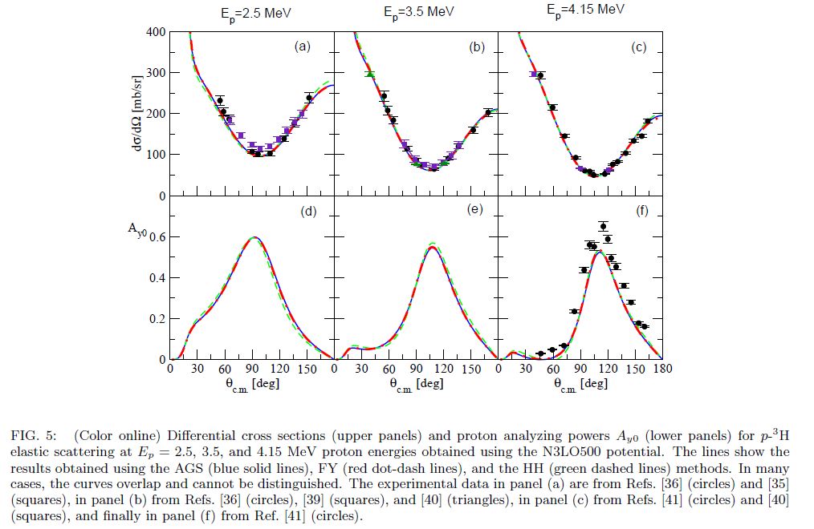

Short overview of nuclear problems by FY eq’s
$$p+^{3}H↔n+^{3}He$$
M. Viviani et al., Phys. Rev. C 95 (2017)
22/09/2021
14
14
R. Lazauskas
R. Lazauskas
Notes:
14

Slide 15
4N problem: n-³H scattering
23/09/2021
15
15
R. Lazauskas
R. Lazauskas
Notes:
15

Slide 16
4N problem: n-³H scattering
Data: T.W. Phillips et al., PRC 22 (1980) 384
N2LO 3BF parametrizations:
(500 Gazit) D. Gazit et al., PRL 103 (2009) 102502
(400 Roth) R. Roth et al., PRC 90 (2014) 024325
(500 Pisa): L. Marcucci et al, to appear in PRL
Effect of 3BF:
M. Viviani, L. Girlanda, A. Kievsky, and L. E. Marcucci
Phys. Rev. Lett. 111 (2013) 172302
22/09/2021
16
16
R. Lazauskas
R. Lazauskas
Notes:
16

Slide 17
5N problem: n-⁴He scattering
NCSMC: P. Navratil et al., Physica Scripta 91 (2016) 053002
22/09/2021
17
17
R. Lazauskas
R. Lazauskas
Notes:
17

Slide 18
n-⁴He scattering
NCSMC: P. Navratil et al., Physica Scripta 91 (2016) 053002
22/09/2021
18
18
R. Lazauskas
R. Lazauskas
Notes:
18

Slide 19
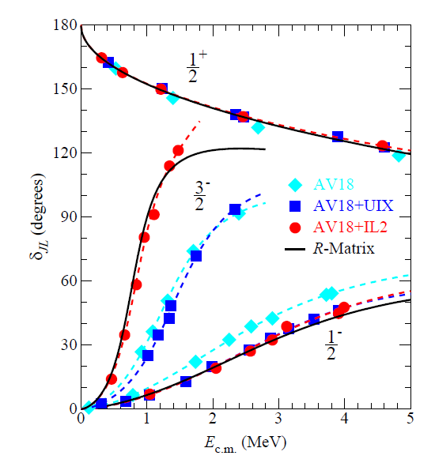
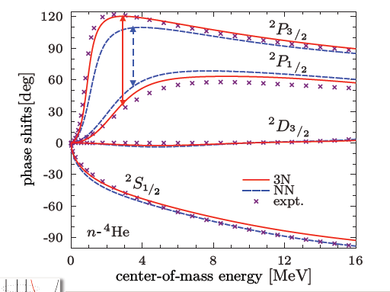
n-⁴He scattering
Idaho N3LO pot.
P. Navratil et al., Physica Scripta 91 (2016) 053002
K.M. Nollett et. al., Phys.Rev.Lett.99:022502,2007
22/09/2021
19
19
R. Lazauskas
R. Lazauskas
Notes:
19

Slide 20

Case of little interest: S-wave
22/09/2021
20
20
R. Lazauskas
R. Lazauskas
Notes:
20

Slide 21
Case of little interest: S-wave
Experimental n-⁴He scattering length …
nothing should be as easy to measure…
NIST (Neutron News 3, 1992)
 | Coh a (fm) | Inc b (fm)
¹H | -3.7406(11) -3.79406(11) | 25.274(9)
²H | 6.671(4) | 4.04(3)
³H | 4.792(27) | -1.04(17)
³He | 5.74(7)-1.483(2)i | -2.5(6)+2.568(3)i
⁴He | 3.26(3)
TUNL: D.R. Tilley et al., Nucl. Phys. A708 (2002) 3
NIST: https://www.ncnr.nist.gov
Experimental data:
D.C.Rorer et al., Nucl. Phys. A 133 (1969) 410
S.F.Mughabghab, Atlas of Neutron Resonances (2006)
R.Genin et al., Journal de Physique 24 (1963) 21
22/09/2021
21
21
R. Lazauskas
R. Lazauskas
Notes:
21

Slide 22
Case of little interest: S-wave??
TUNL: D.R. Tilley et al., Nucl. Phys. A708 (2002) 3
NIST: https://www.ncnr.nist.gov
S. Ali PSA: S. Ali et al., Rev. Mod. Phys. 57 (1985) 923
NCSMC: P. Navratil et al., Physica Scripta 91 (2016) 053002
GFMC: K.M. Nollett, PRL99, 022502 (2007)
22/09/2021
22/09/2021
22
22
22
22
R. Lazauskas
R. Lazauskas
Notes:
22

Slide 23
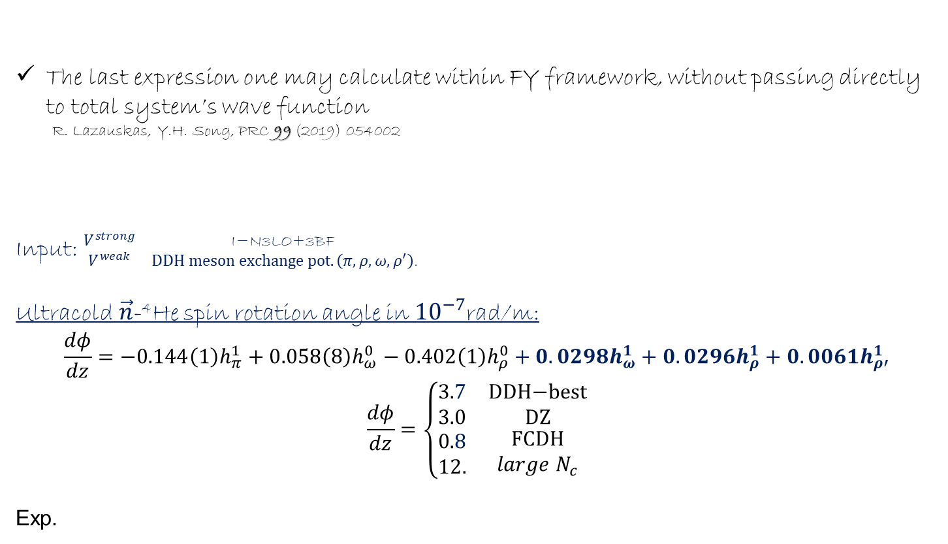

PV violation for $\vec{n}$-⁴He
Slow $\vec{n}$ spin rotation studyt at NIST $\frac{dφ}{dz}=2.1±8.3(stat.)\begin{matrix}+2.9 \\ −0.2\end{matrix}(sys)×{10}^{−7}$rad/m
E. Swanson et al. PRC 100 (2019) 015204
1st order perturbation:
Weak process $V^{weak}≪V^{strong}$
The last expression one may calculate within FY framework, without passing directly to total system’s wave function
R. Lazauskas, Y.H. Song, PRC 99 (2019) 054002
Input: $\begin{matrix}V^{strong} & \text{I}\text{−}\text{N}\text{3}\text{LO}\text{+3}\text{BF} \\ V^{weak} & DDH meson exchange pot. \left(π,ρ,ω,ρ^{′}\right)\text{.}\end{matrix}$
Ultracold$\vec{n}$-⁴He spin rotation angle in ${10}^{−7}$rad/m:
$$\frac{dφ}{dz}=−0.144\left(1\right)h_{π}^{1}+0.058\left(8\right)h_{ω}^{0}−0.402\left(1\right)h_{ρ}^{0}+0.0298h_{ω}^{1}+0.0296h_{ρ}^{1}+0.0061h_{ρ′}^{1}$$
$$\frac{dφ}{dz}=\left\{\begin{matrix}3.7 & \text{DDH}\text{−}\text{best} \\ 3.0 & \text{DZ} \\ \begin{aligned}0.8 \\ 12.\end{aligned} & \begin{aligned}\text{FCDH} \\ {large N}_{c}\end{aligned}\end{matrix}\right.$$
Exp.
B. Desplanques et al, Ann.Phys. 124 (1980) 449 .
R. Lazauskas, Y.H. Song, PRC 99 (2019) 054002.
S. Gardner et al., Ann. Rev. Nucl. Part. Sci. 67 (2017) 69
22/09/2021
22/09/2021
23
23
23
23
23
23
R. Lazauskas
R. Lazauskas
Notes:
23

Slide 24
Complexity of the boundary conditions rises rapidly with number of particles participating in the scattering process, becoming almost as complex as wave function (solution) of the underlying problem itself.
One is not able to impose proper breakup asymptotes beyond A=3 case
Nevertheless if boundary conditions are trivial (bound state case): very efficient techniques exist to solve the same diff. equations
22/09/2021
22/09/2021
24
24
24
24
24
24
R. Lazauskas
R. Lazauskas
Notes:
24

Slide 25


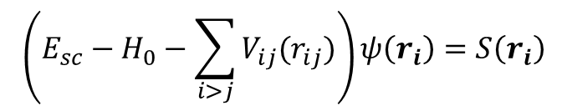
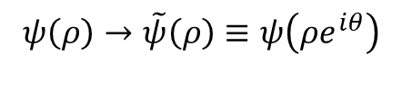

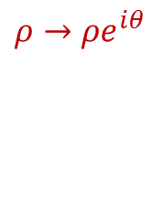

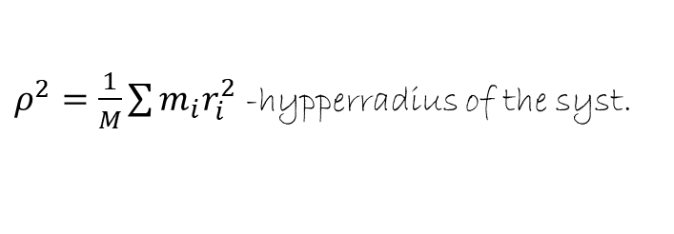

The CS method
Most of the QM problems may be formulated in time-independent frame by Schrödinger equation:
Untrivial behavior is due to particle contact(s). It is described by outgoing waves propagating from the common mass-center:
If we were able to handle outgoing waves…
$$k_{I}$$
Bound states
$$\left(E_{sc}−H_{0}−\sum_{i>j}{V_{ij}(r_{ij})}\right)ψ\left(r_{i}\right)=S\left(r_{i}\right)$$
$$k_{R}$$
Resonances
$k_{res}= k_{R}− ik_{I}$= ${|k}_{res}|e^{−iη_{res}}$
$$ψ\left(ρ→∞\right)∝e^{iKρ}$$
$ρ^{2}=\frac{1}{M}\sum{{m_{i}r}_{i}^{2}}$ -hypperradius of the syst.
Complex scaling:
$ρ→$ $ρe^{iθ}$
$$ψ\left(ρ\right)→\tilde{ψ}\left(ρ\right)≡ψ\left(ρe^{iθ}\right)$$
exp. bound
  D. Hartree, 1940’s
  J. Nuttal and H. L. Cohen,
  Phys. Rev. 188 (1969) 1542
$\tilde{ψ}\left(ρ→∞\right)∝e^{iKρe^{iθ}}$=$e^{iKρcos⁡(θ)}e^{−Kρsin⁡(θ)}$
22/09/2021
22/09/2021
25
25
25
25
25
25
R. Lazauskas
R. Lazauskas
Notes:
25

Slide 26


The CS method
Collisions
Complex scaling:
$r→$ $re^{iθ}$
$${\tilde{Ψ}}^{sc}\left(r→∞\right)∝e^{ikre^{iθ}}∝e^{−krsin⁡(θ)}$$
Driven radial Schrödinger equation:
exp. bound if 0<θ<π
exp. bound if V^{S}
is bound exponentially
22/09/2021
22/09/2021
26
26
26
26
26
26
R. Lazauskas
R. Lazauskas
Notes:
26

Slide 27
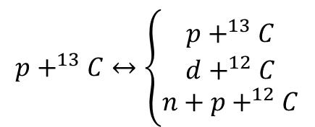
Selected results: scattering
Study of
$$p+^{13}C↔\left\{\begin{aligned}p+^{13}C \\ d+^{12}C \\ n+p+^{12}C\end{aligned}\right.$$
reactions, employing three-body model:
p
Optical CH89 pot.
AV18
¹²C
n
Problem which involves optical potentials, repulsive Coulomb interaction and multiple reaction chanels, …
22/09/2021
22/09/2021
27
27
27
27
27
27
R. Lazauskas
R. Lazauskas
Notes:
27

Slide 28
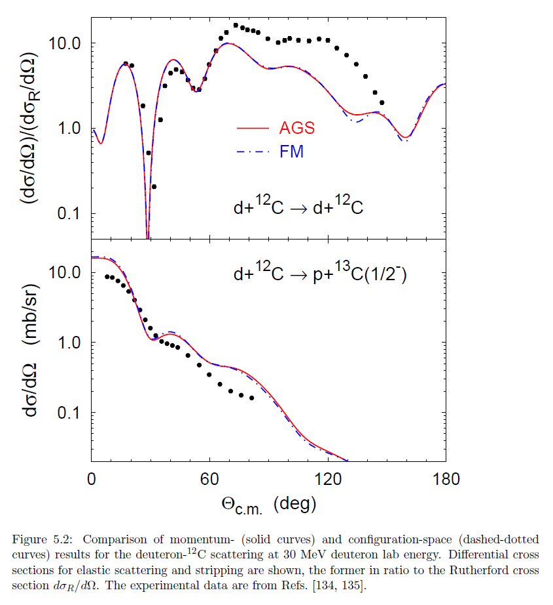
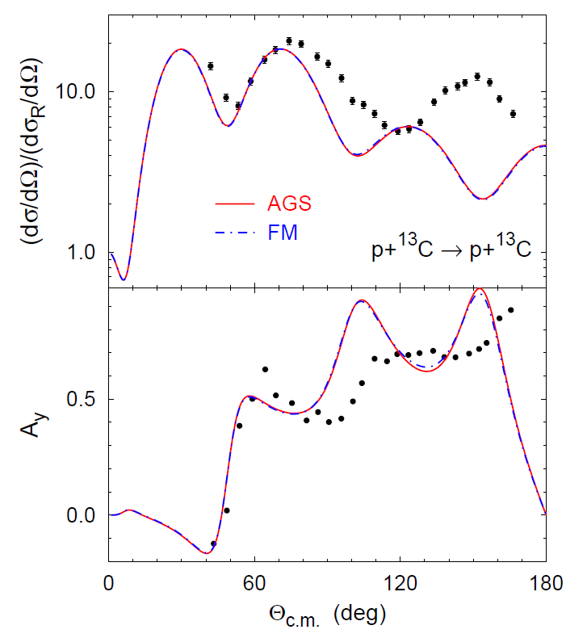
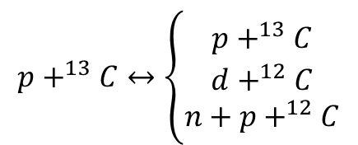
Selected results: scattering
$$p+^{13}C↔\left\{\begin{aligned}p+^{13}C \\ d+^{12}C \\ n+p+^{12}C\end{aligned}\right.$$
A. Deltuva et al., Lect.Notes Phys. 875 (2014) 1
22/09/2021
22/09/2021
28
28
28
28
28
28
R. Lazauskas
R. Lazauskas
Notes:
28

Slide 29
Conclusion
FY eq. formalism remains reference in few-body scattering calculations. Four-nucleon scattering problem approaches fixed status. The first solution of 5-body FY equations is presented.
Due to numerical complexity, FY eq. formalism will remain limited to few-body domain: rigorous implementations beyond 5-body extremely difficult, impossible beyond 6-body
Complex-scaling method has been revived in nuclear physics. This method enables to solve few-body scattering problem employing standard bound state techniques (feasible by almost any config. space bound state technique and requires very limited effort to be implemented)
Very accurate results are already obtained for 3-body and 4-body elastic and breakup scattering
Possibility to extend CS formalism to many-body scattering case
Acknowledgements: The numerical calculations have been performed at IDRIS (CNRS, France). We thank the staff members of the IDRIS computer center for their constant help.
29
R. Lazauskas
Notes:
29

