Slide 1

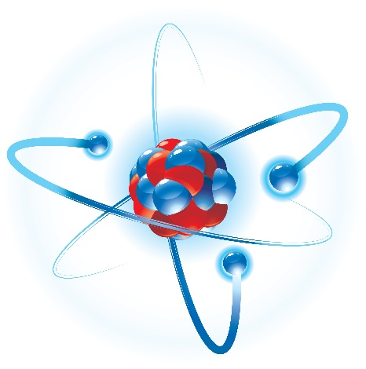
协变密度泛函理论 对原子核电磁性质的研究
“The Tangram Nuclear Theory Collaboration”Seminar(2022.11.25，同济大学)
李 剑
吉林大学物理学院
E-mail: jianli@jlu.edu.cn

Slide 2


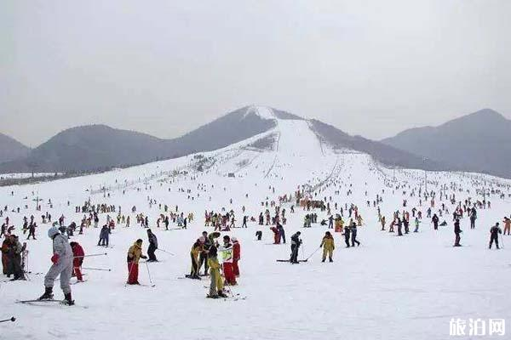
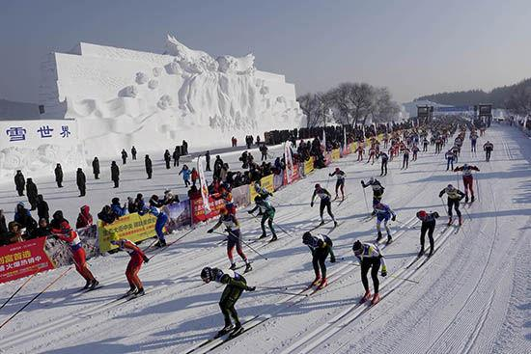
欢迎来长春！
长春冰雪新天地
天定山滑雪场
净月谭（国家森林公园）国际滑雪节

Slide 3
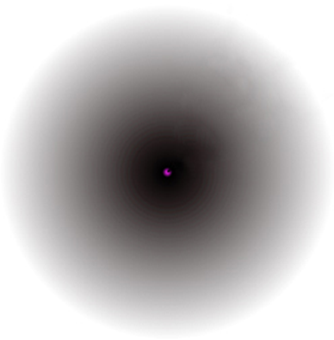
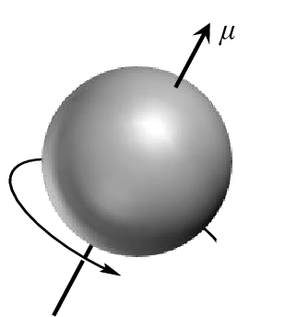
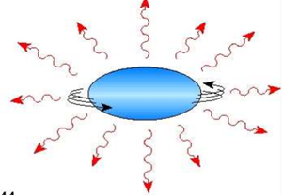
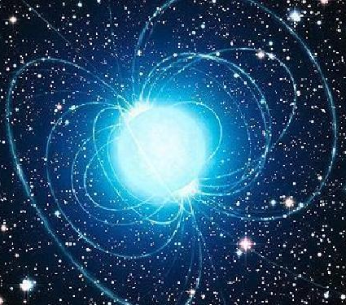
原子核电磁性质
电磁性质是物质世界中从微观基本粒子、介观尺度的材料到大尺度天体的基本属性。
原子核电磁学性质：内部核子轨道运动和自旋运动的电磁流密度，包括磁多极矩和跃迁、电荷密度和半径等。
原子核电磁性质敏感依赖于核多体波函数，已成为检验和发展完善原子核理论模型的重要依据。
Notes:
电磁相互作用是自然界基本相互作用之一，物质世界各层次均表现出磁学性质。磁性是物质世界中从微观基本粒子、介观尺度的材料到大尺度天体的基本属性。
原子核这一复杂的量子多体问题，其磁学性质源于原子核内部核子轨道运动和自旋运动的电磁流，最典型的表现是静态的核磁矩和动力学的磁偶极(M1)跃迁(激发)等。
反映了包括壳结构，核力等在内丰富的核结构信息，磁性质的描述已成为检验和发展完善原子核理论模型的重要依据。
氘核磁矩3S 3D态混合

Slide 4
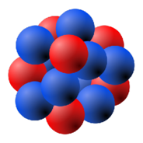
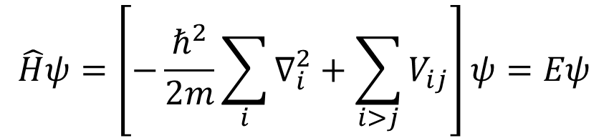
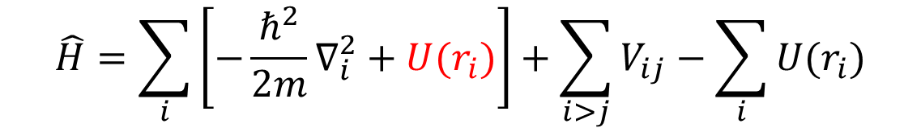
多体问题：从经典多体到量子多体
$$\hat{H}ψ=\left[−\frac{ℏ^{2}}{2m}\sum_{i}{∇_{i}^{2}+\sum_{i>j}{V_{ij}}}\right]ψ=Eψ$$
多体问题
$$\hat{H}=\sum_{i}{\left[−\frac{ℏ^{2}}{2m}∇_{i}^{2}+U(r_{i})\right]}+\sum_{i>j}{V_{ij}}−\sum_{i}{U(r_{i})}$$
平均势场
剩余相互作用

Slide 5
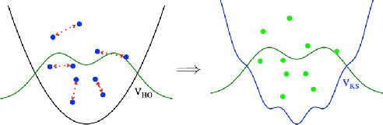
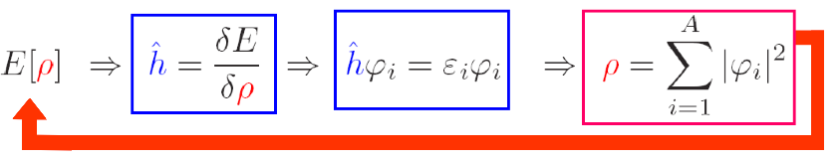
Density functional theory(密度泛函理论)
The many-body problem is mapped onto a one-body problem
Kohn-Sham DFT
Hohenberg-Kohn Theorem
The exact ground-state energy of a quantum mechanical many-body system is a universal functional of the local density.
Figure from Drut PPNP 2010
The practical usefulness of the Kohn-Sham theory depends entirely on whether an Accurate Energy Density Functional can be found!
Notes:
The many-body problem is mapped onto a one-body problem in the kohn-sham DFT as shown in the figure. It is guaranteed by the Hohenberg-Kohn theorem that the exact ground-state energy of a quantum mechanical many body system is a universal functional of the local density.
Energy functional as function of local density, variational principle, get hamilition, dirac equation, wavefunction, local density. Self-consistent convergent process.
霍恩贝格,科恩。 ['θiərəm] [ʃæm] [,ɡærən'ti]

Slide 6
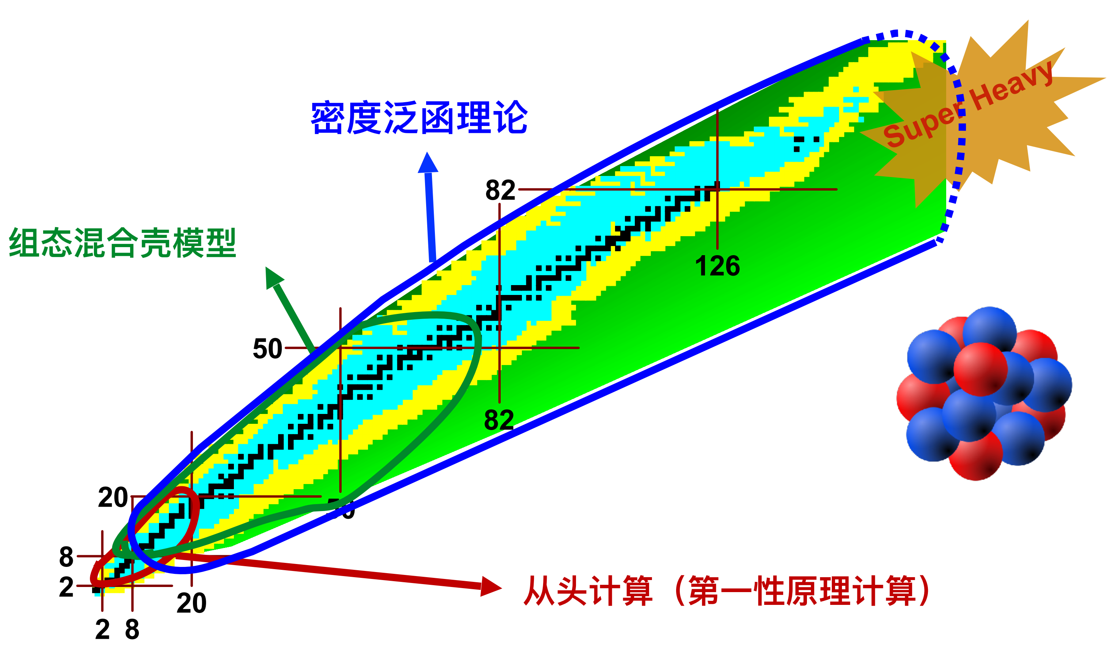
核理论方法的前沿热点
密度泛函理论(DFT)：量子多体系统最成功的方法之一，包含有限个数参数，非常成功地描述核素图上近乎所有原子核基态和激发态性质。
Notes:
Comparing with ab initio and configuration interaction shell model, DFT ……
[,æbi'niʃiəu]

Slide 7
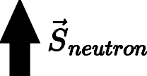
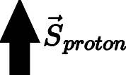

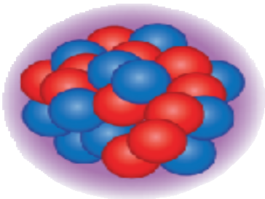
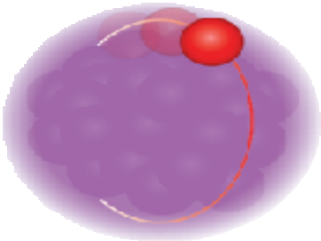
原子核的密度泛函理论
The nuclear force is complicated
More degrees of freedom: spin, isospin, pairing, …
Nuclei are self-bound systems DFT for the intrinsic density
At present, all successful functionals are phenomenological not connected to any NN- or NNN-interaction
Adjust to properties of nuclear matter and/or finite nuclei, and (in future) to ab-initio results
Nowadays, the ansatz for E(ρ) is phenomenological:
Skyrme: non-relativistic, zero range
Gogny: non-relativistic, finite range (Gaussian)
CDFT: Covariant density functional theory (relativistic functional)
Notes:
When the density functional theory was applied in the nuclei. Force, degrees of freedom.
Three kinds of energy functional
[fəˌnɑmənoʊˈlɑdʒɪkəl]

Slide 8


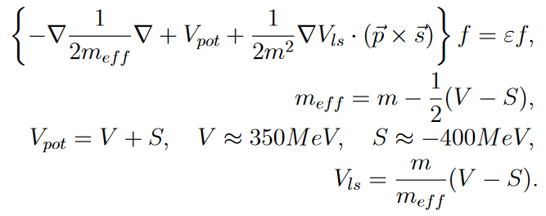

为什么“协变”？
Large mean fields S≈-400 MeV, V≈350 MeV
Large spin-orbit splitting automatically included
Pseudo-spin Symmetry
Success of Relativistic Brueckner
Consistent treatment of time-odd fields
Relativistic saturation mechanism
Strong spin-orbit interaction
Notes:
Dirac equation, wavefunction two components f and g.
Second order differential equation for component f. Can be compared with mass.
[ɔːtə'mætɪklɪ] ['sætʃə'reʃən] ['dɪfə'rɛnʃəl]

Slide 9
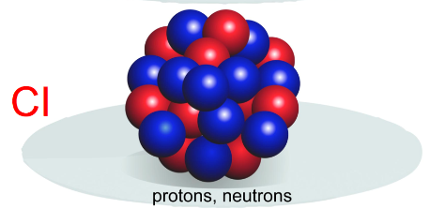
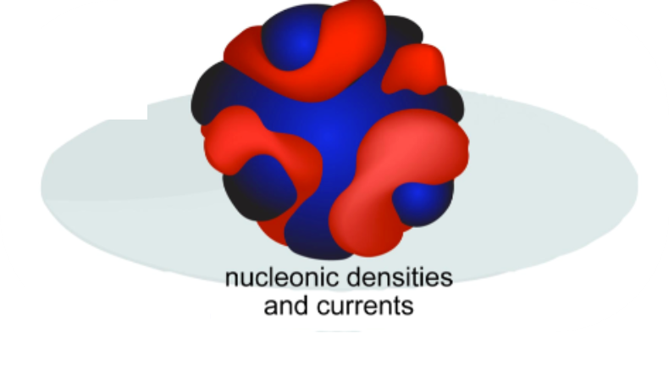



协变密度性泛函理论描述核电磁性质的优势
能更好描述核电磁性质的微观起源
自洽描述奇时间场：原子核内部磁场
统一描述电磁性质，包括电荷分布、磁场、磁矩和磁跃迁等
$${\hat{J}}_{μ}\left(ρ,−\vec{J}\right)=γ_{μ}F_{1}\left(q^{2}\right)+i\frac{μ}{2M}F_{2}\left(q^{2}\right)σ_{μν}q^{ν}$$
$$μ=\left\langle g_{l}\overset{⃑}{L}+g_{s}\overset{⃑}{S}\right\rangle$$
$$μ=\frac{1}{2}\int{d\overset{⃑}{r}\overset{⃑}{r}×\overset{⃑}{j}}$$
Notes:
计算原子核磁矩，从电流这一更基本定义出发。
电磁流：统一了电磁效应，包含核子形状因子贡献，自动含有密度和电磁流的结果。
电流或者运动的电荷产生磁场

Slide 10
主要内容
原子核磁矩和磁偶极转动
原子核电荷密度和半径
类氢离子中的核结构效应

Slide 11
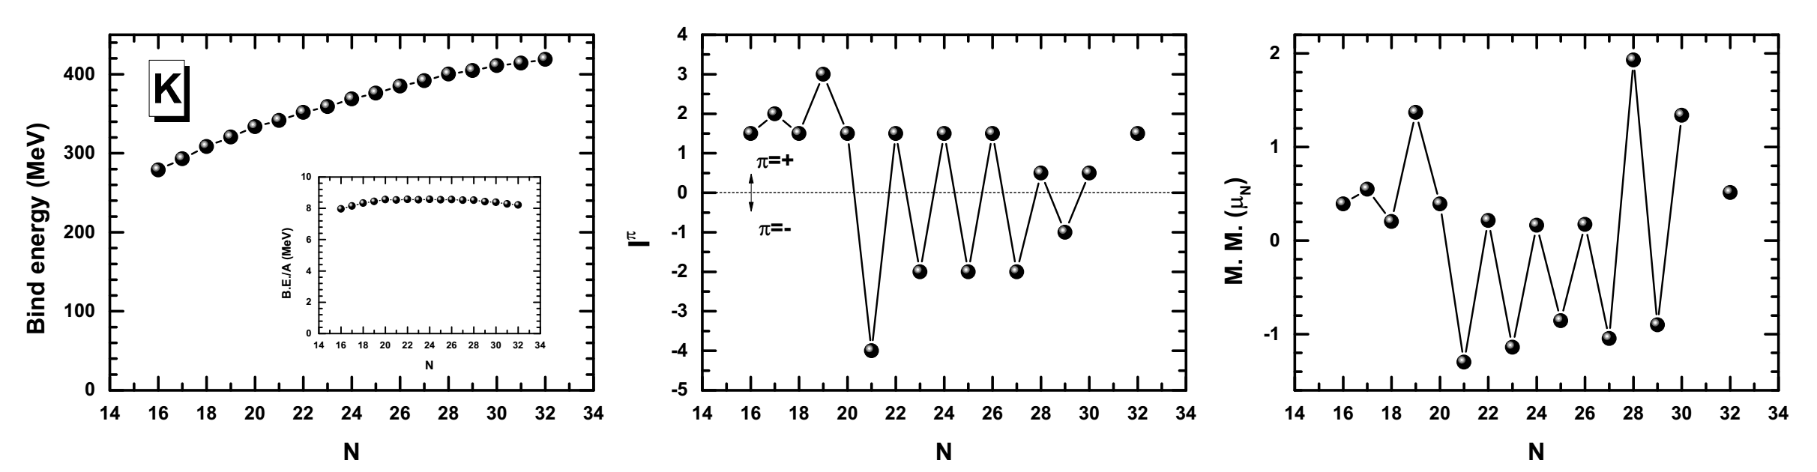

原子核磁矩
核磁矩：核子固有自旋及在核内的运动
最重要核观测量之一，反映丰富的核结构信息，如壳结构演化等；
联系原子谱学的精细结构信息
核磁矩的理论描述非常困难：(1)首先正确再现自旋和宇称；(2)对原子核波函数非常敏感
$$μ={\left\langle IM\left|{\hat{μ}}_{z}\right|IM\right\rangle }_{M=I}$$
K同位素链原子核结合能，自旋、宇称和磁矩

Slide 12
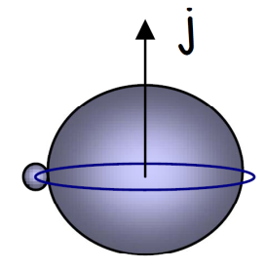
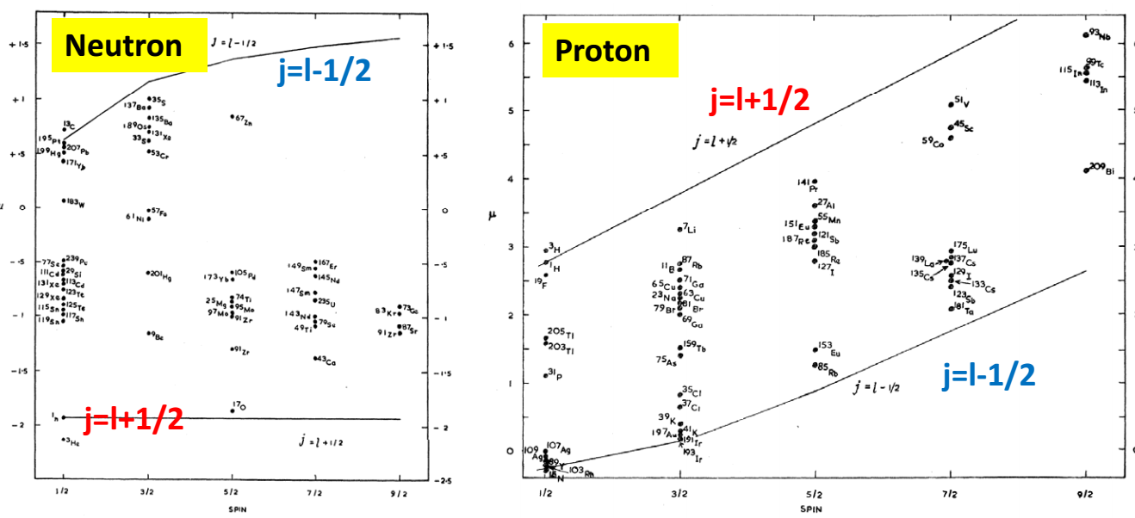
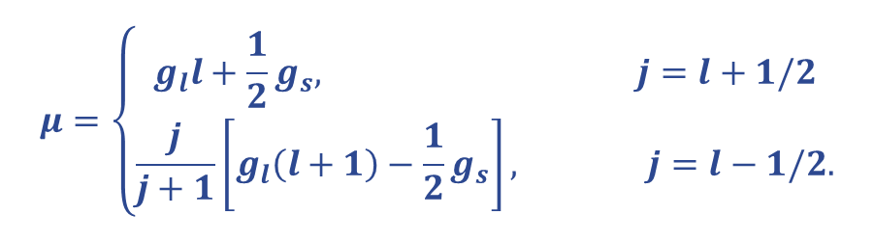
Schmidt磁矩——极端单粒子壳模型
原子核的磁矩仅由最后一个未配对价核子决定
几乎所有奇A核实验磁矩值都在两条Schmidt 线之间
$$μ=\left\{\begin{aligned}g_{l}l+\frac{1}{2}g_{s}, j=l+1/2 \\ \frac{j}{j+1}\left[g_{l}\left(l+1\right)−\frac{1}{2}g_{s}\right], j=l−1/2.\end{aligned}\right.$$
质子(中子)轨道和自旋g因子: $g_{l}=1\left(0\right), g_{s}=5.587(−3.826)$
Blin-Stoyle, Rev. Mod. Phys. (1956)
介子交换流效应
组态混合效应
Arima, Adv. Nucl. Phys. (1987), Towner, Phys. Rep. (1987)

Slide 13
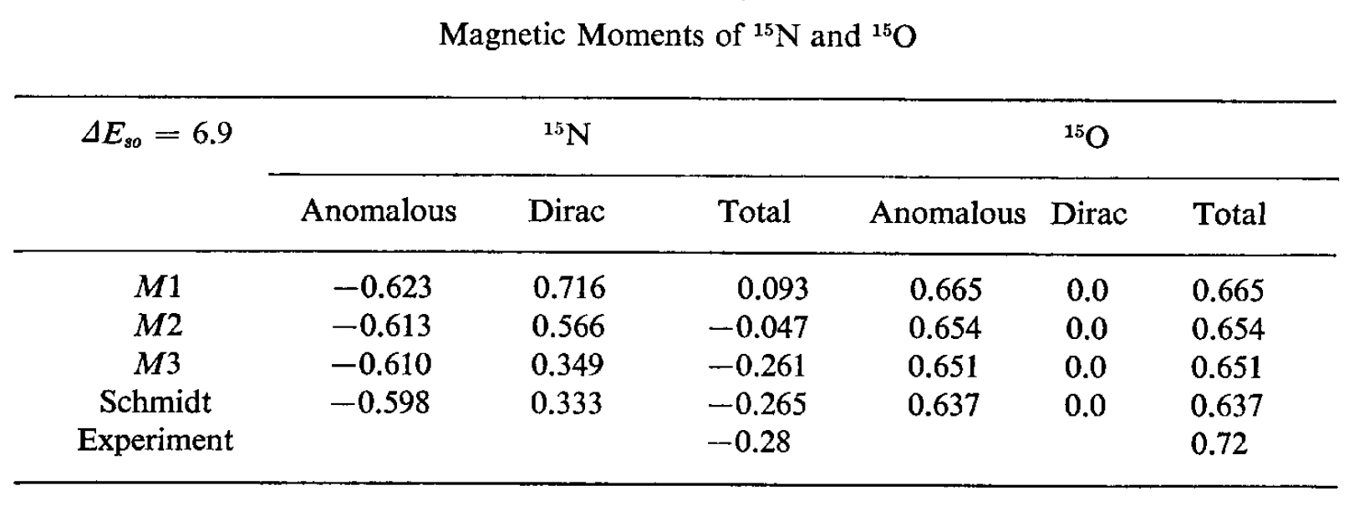
协变密度泛函理论中的磁矩问题
Covariant density functional theory (CDFT), i.e., Relativistic mean-field (RMF) theory: great success in describing nuclear properties but not for nuclear magnetic moments. Ring, PPNP(1996), Vretenar, Phys. Rep. (2005), Meng, PPNP (2006).
It was a surprise and for a long time an open problem, that relativistic theories containing only a scalar potential (σ) and the time-like component of a Lorentz vector field ω could not reproduce the corresponding Schmidt values. Miller_Ann. Phys.(1975), Serot_PLB_(1981).

Slide 14
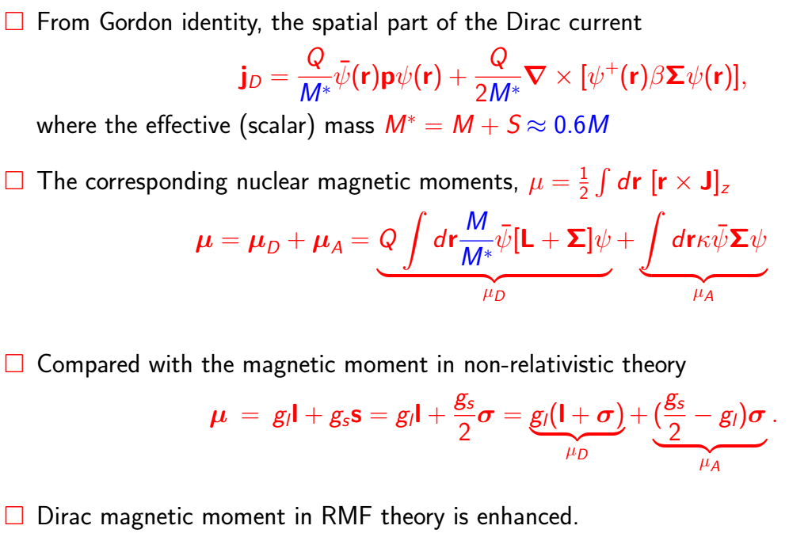
Dirac磁矩增强——协变密度泛函理论
The problem is easy to understand: the large scalar potential required by the spin-orbit force significantly reduces the effective mass of valence nucleon, thus increasing its electromagnetic current and the (Dirac) magnetic moment.

Slide 15
磁矩问题解决方法
Although the valence-particle approximation is reasonable in a non-relativistic calculation, it is simply wrong in a relativistic calculation. This puzzle can be resolved by including the polarization of the core by external particle.
Random Phase Approximation (RPA) and the corresponding linear response theory Mcneil(1986), Furnastahl(1987),Ichii(1987), Shepard(1988)
Self-consistent deformed RMF theory with the baryon currents of both valence nucleon and the core. Hofmann(1988), Furnstahl(1989), Yao(2006) The spatial components of vector meson field V, (i.e., time-odd fields or magnetic potential), break the time-reversal symmetry of wavefunctions in the core, thus producing a non-zero contribution to the Dirac current.
Finally, agreement with Schmidt values and the isoscalar magnetic moments are also well reproduced.

Slide 16
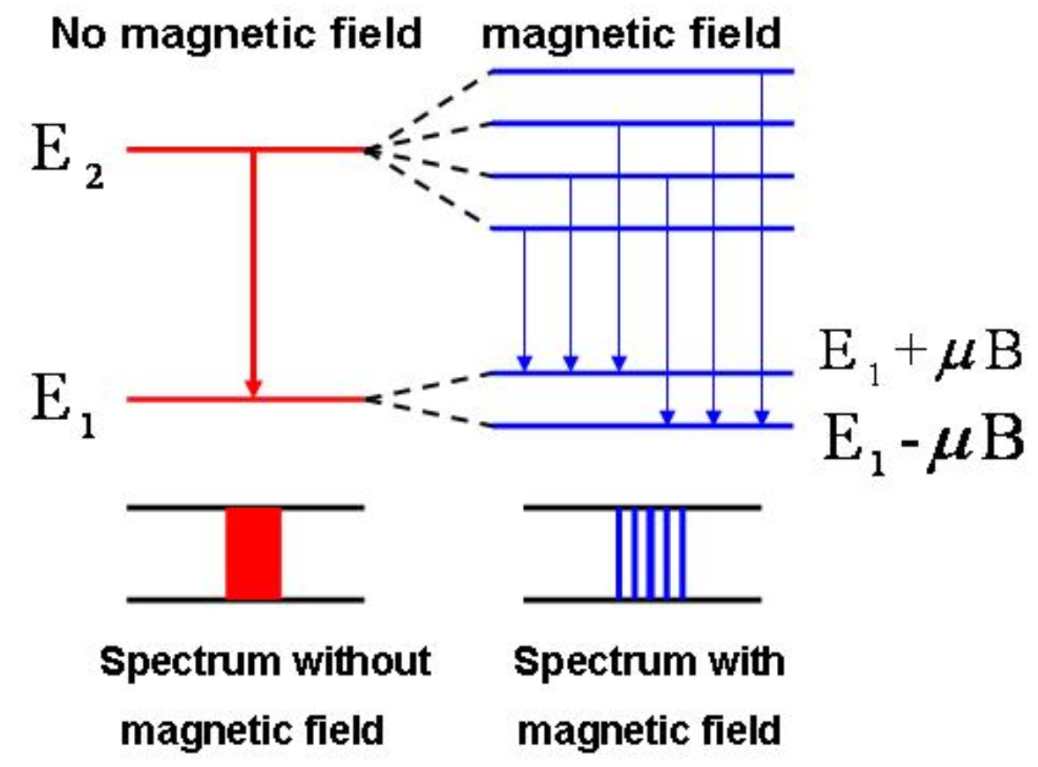
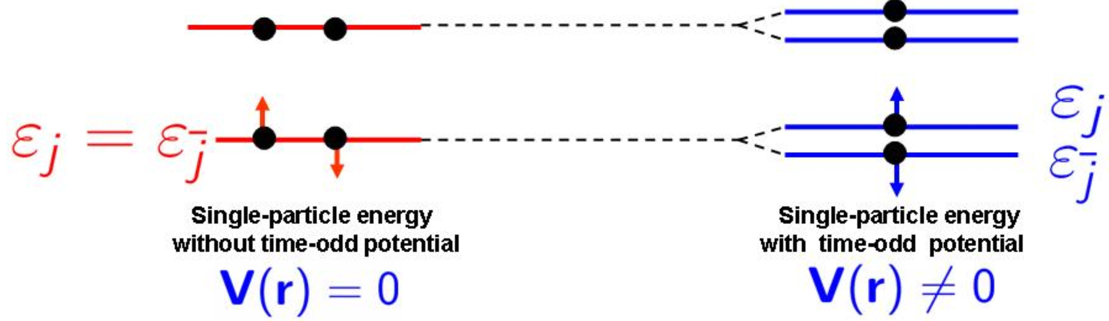
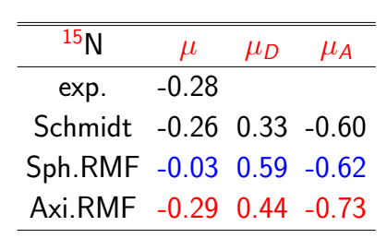
奇时间场效应
Time-odd field V ($\hat{T}V{\hat{T}}^{−1}=−V$) :important in atomic and nuclear physics: zeeman effect, hyperfine structure.
Dirac equation with time-odd field V(r)
Sph. RMF: Without polarization
Def. RMF: With polarization
Dirac M.M is reduced.
Total M.M: in agreement with the Schmidt value & greatly improved.

Slide 17
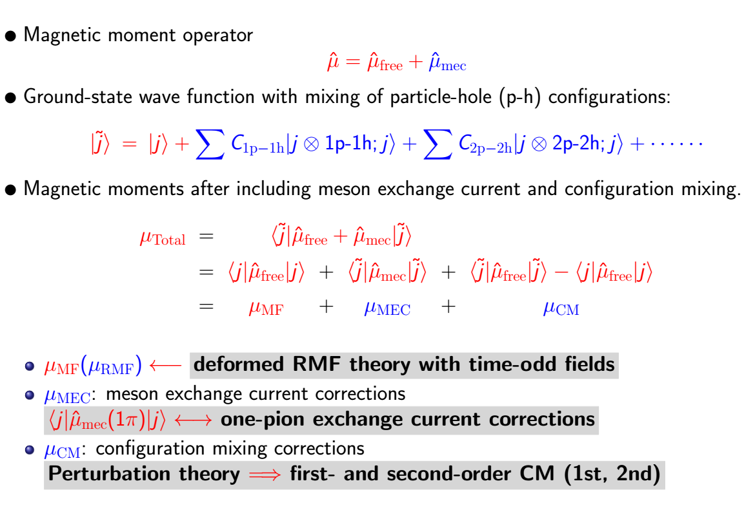
磁矩：包含介子交换流和组态混合效应

Slide 18
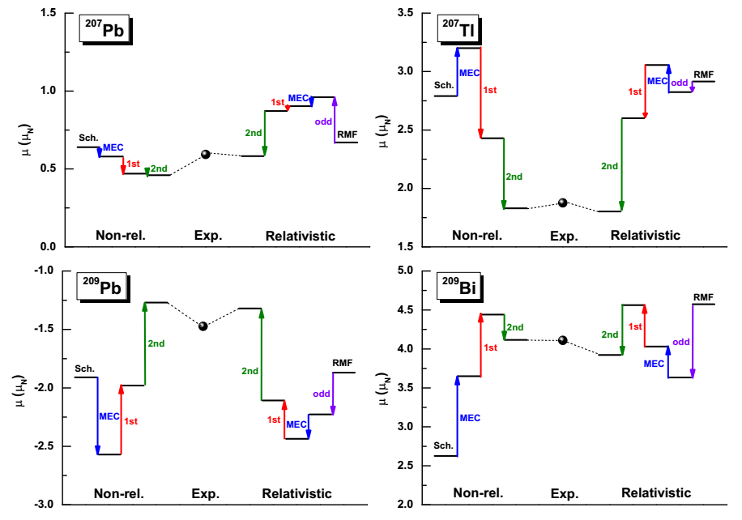
²⁰⁸Pb附近原子核的磁矩
考虑单π介子交换流、一阶和二阶核芯极化效应后, 协变密度泛函理论很好磁矩描述，误差6.1%也好于非相对论理论结果13.2%. Jian Li, et. al., PRC 88(064307)

Slide 19
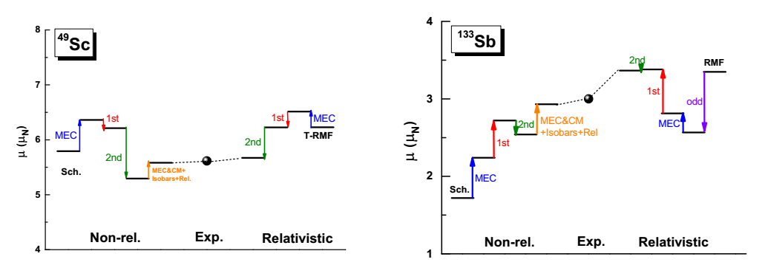
⁴⁹Sc和¹³³Sb磁矩

Slide 20
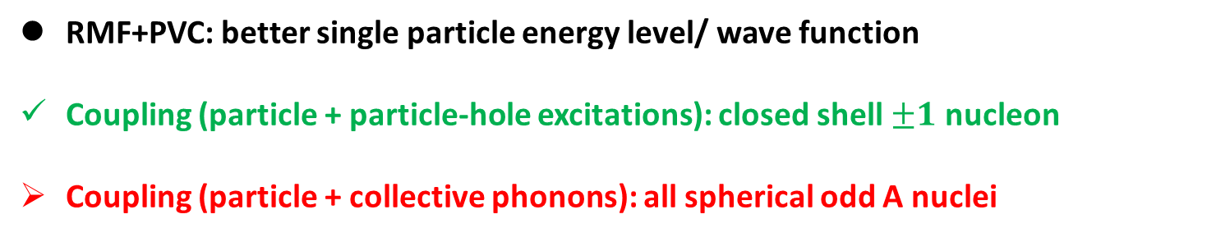
磁矩：考虑粒子声子耦合效应(PVC)
RMF+PVC: better single particle energy level/ wave function
Coupling (particle + particle-hole excitations): closed shell $±1$ nucleon
Coupling (particle + collective phonons): all spherical odd A nuclei

Slide 21
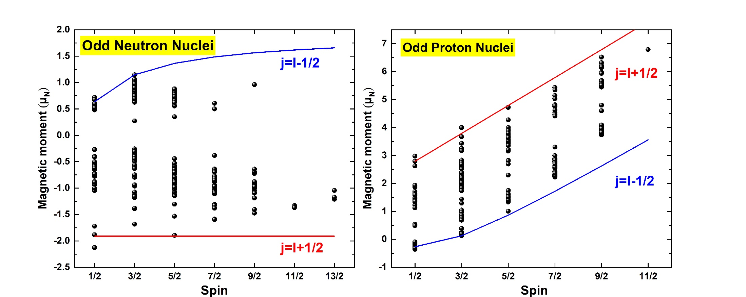
基于BNN的奇A核磁矩的预测
实验数据：221个奇中核和227个奇质核的磁矩、自旋和宇称。
极端单粒子模型能够解释自旋、宇称，并能定性解释实验磁矩值。
均方根偏差较大：奇中子核0.949µ_{N}，奇质子核1.272µ_{N}
Z. L. Yuan, D. C. Tian, J. Li and Z. M. Niu
Notes:
价核子近似有效

Slide 22
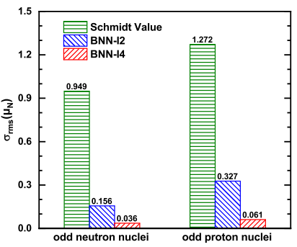
不同输入量的比较
输入量：
BNN-I2：质子数、中子数
BNN-I4：质子数、中子数、自旋、Schmidt值
BNN-I2： 明显减小均方根偏差。
BNN-I4：参数个数不变，多两个输入量， 均方根偏差显著减小，奇中子核从 0.255µ_{N} 变为 0.105µ_{N}，奇质子核从 0.402µ_{N}减为 0.142µ_{N}。
考虑重要的物理效应, BNN方法提供可靠的方式去改善核磁矩描述的精度。
Notes:
参数数量：𝑯∗(𝑰+𝟐)+𝟏
参数个数相同，神经元数量：H=45/30

Slide 23
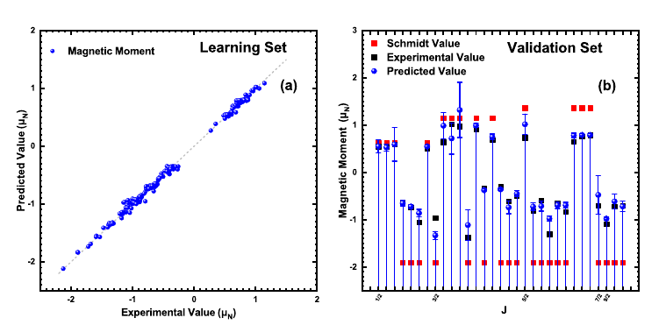
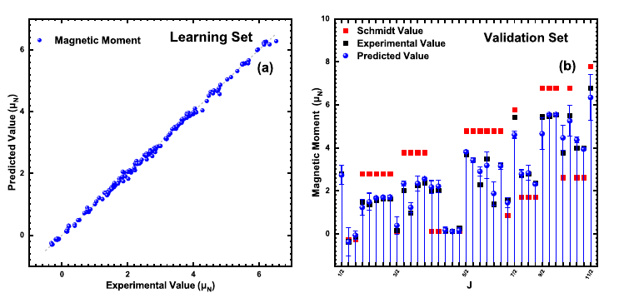
验证神经网络(BNN-I4)的可靠性
 | 个数 | 偏差µ_{N}
学习集 | 190 | 0.048
验证集 | 37 | 0.173
奇中子
核
验证集绝大多数小于0.1µ_{N}
验证集部分结果偏差较大，实验结果也包含在考虑不确定度的预言范围内。
奇质子
核
 | 个数 | 偏差µ_{N}
学习集 | 190 | 0.067
验证集 | 31 | 0.304
Notes:
Most points are on the function y = x, which means predictions of the BNN-I4 are very close to the experimental values.
The predictions in the validation set are roughly consistent with the experimental results as well.
The Rms devations of the predictions of odd-neutron nuclei and odd-proton nuclei are 0.048μN and 0.067μN in the learning set and 0.173μN and 0.304μN in the validation set, respectively.
The BNN-I4 approach significantly improves the precision of predictions, and the results are much better than Schmidt values in the validation set as well.
Nearly all the experimental values are contained in the range of predictions
with uncertainties in Figure. 2(b) and 3(b), which proves that the extrapolation ability of
the BNN-I4 approach is also promising.

Slide 24
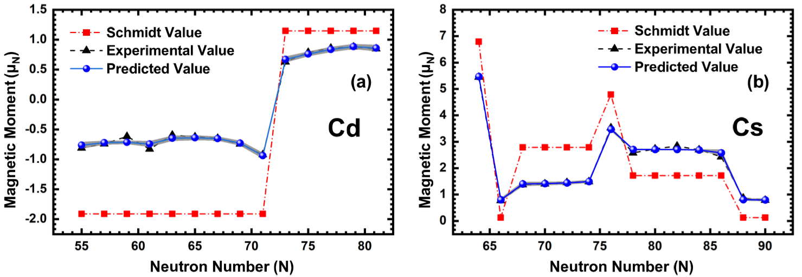
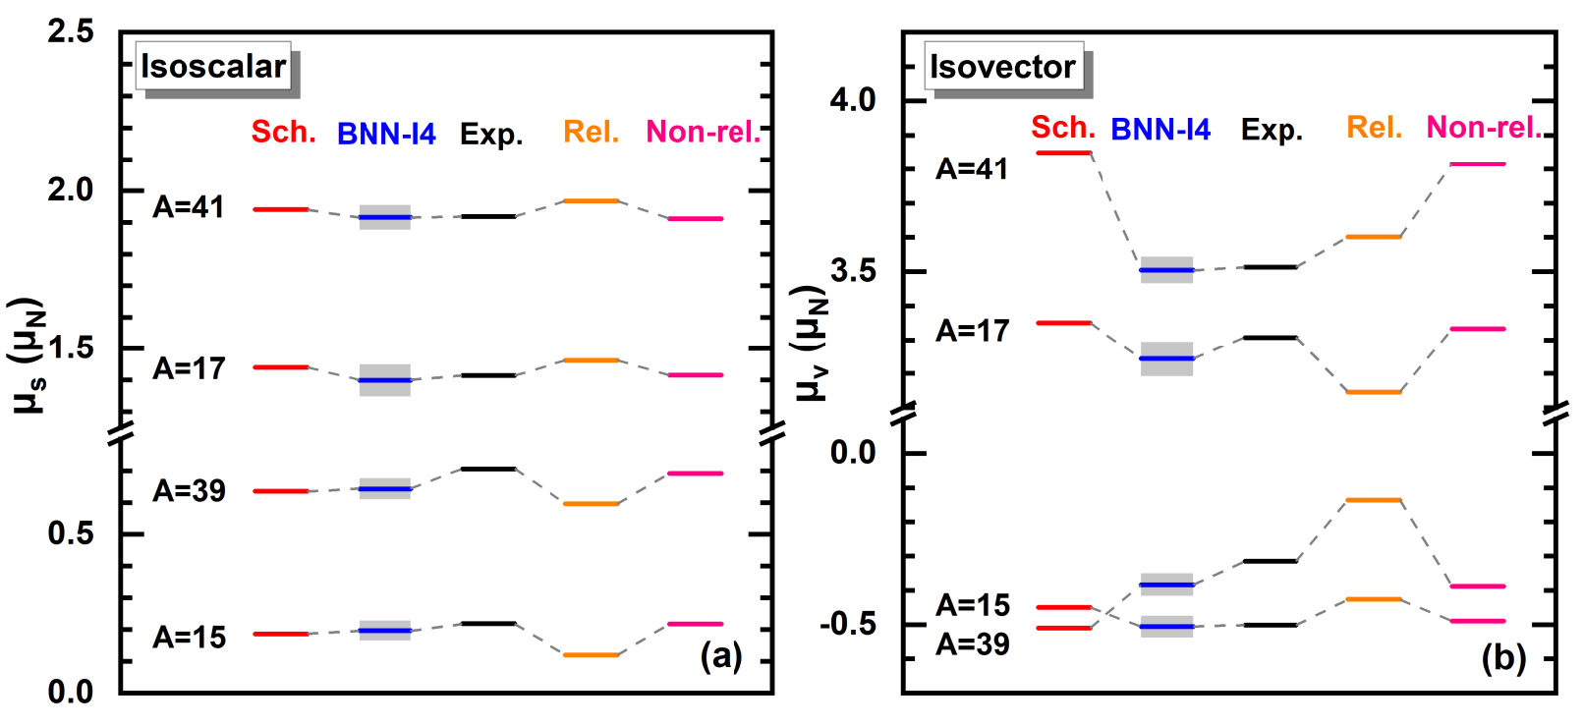


Cd、Cs同位素链和同位旋标量、矢量磁矩
$$σ=0.043μ_{N}$$
$$σ=0.07μ_{N}$$
Notes:
From Figs. 4(a) and 4(b), it is clearly seen that the BNN-I4 both performed well in the nearly whole range of odd neutron nuclei and odd proton nuclei.
Taking ₄₈Cd and ₅₅Cs two groups of isotopes as examples, both groups contain 14 isotopes. Even if the spins of isotopes varied with the increase of the number of neutrons, the total RMS of the predictions of 48Cd and 55Cs are still only 0.043μN and 0.07μN respectively.
It is also to be noted that the BNN-I4 approach can learn the trend how magnetic moments
changes in the same isotope group well.
Nearly half thousand nuclear magnetic moments are integrally predicted by the BNN-I4 approach with high accuracy, which is achieved for the first time.
It shows that for the nuclei with doubly closed shells plus or minus one nucleon, the BNN-I4 can also learn the isospin effect.
From the TABLE 1, it is obvious that the predictions of the BNN-I4 approach
are also better corresponding to the experimental values compared to the results of
other three theoretical models both in the isovector magnetic moments and the isoscalar
magnetic moments respectively.

Slide 25



考虑有效g因子的结果
$$\overset{⃑}{μ}=g_{l}\overset{⃑}{L}+g_{s}\overset{⃑}{S}$$
其中自由g因子，中子$g_{l}=0$, $g_{s}=−3.826，$质子$g_{l}=1$, $g_{s}=5.586$
采用广泛使用的有效g因子$0.7g_{s}$
$${\overset{⃑}{μ}}_{eff}=g_{l}\overset{⃑}{L}+0.7g_{s}\overset{⃑}{S}$$
单粒子磁矩 | 自由g因子 | 有效g因子
奇质子核 | 1.272 | 0.71
奇中子核 | 0.949 | 0.51
BNN-I4 | 自由g因子 | 有效g因子
奇质子核 | 0.061 | 0.076
奇中子核 | 0.036 | 0.038
采用描述实验磁矩更好的有效单粒子磁矩，BNN并未改善磁矩描述。

Slide 26
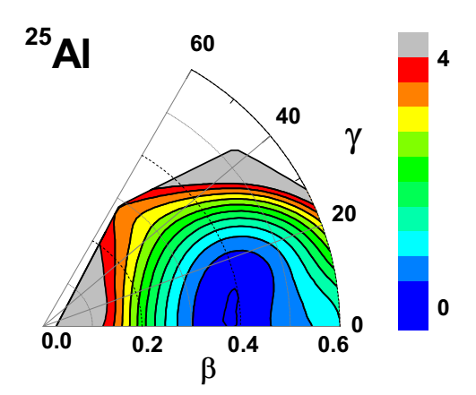
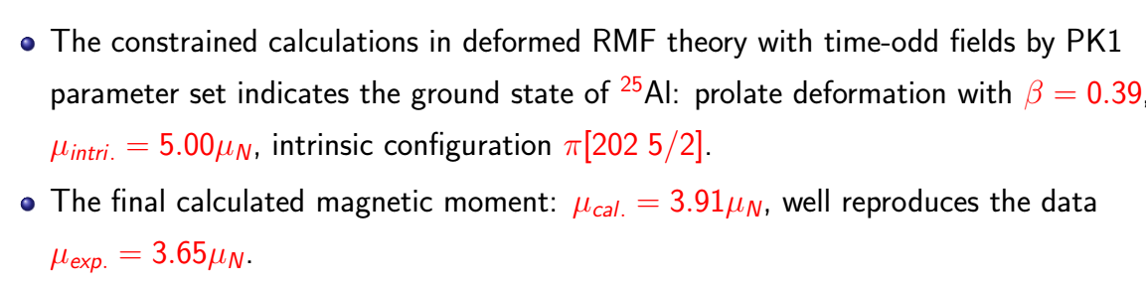
奇质量数Al核的磁矩

Slide 27
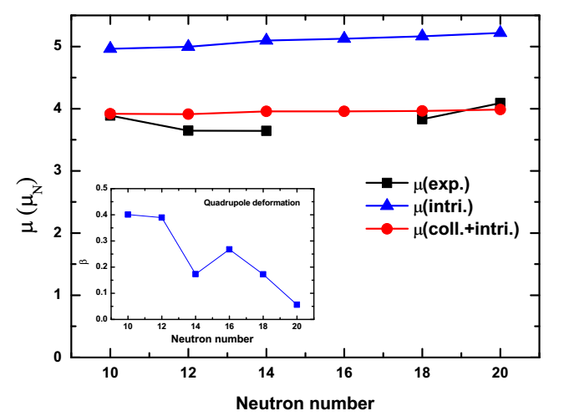
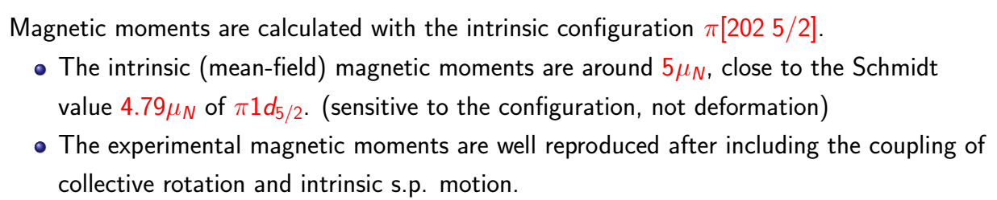
奇质量数Al核的磁矩

Slide 28
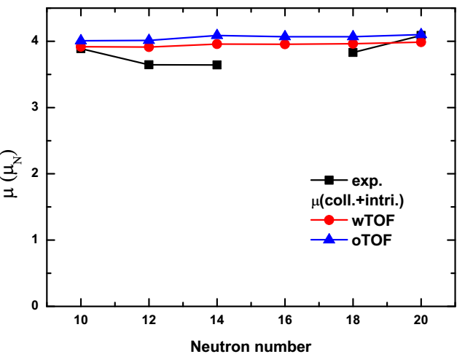
奇质量数Al核的磁矩

Slide 29
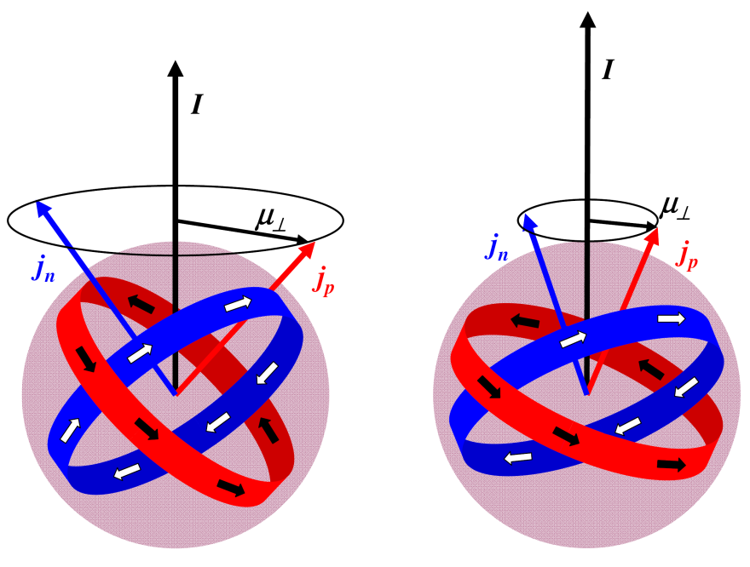
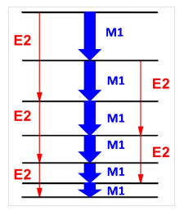
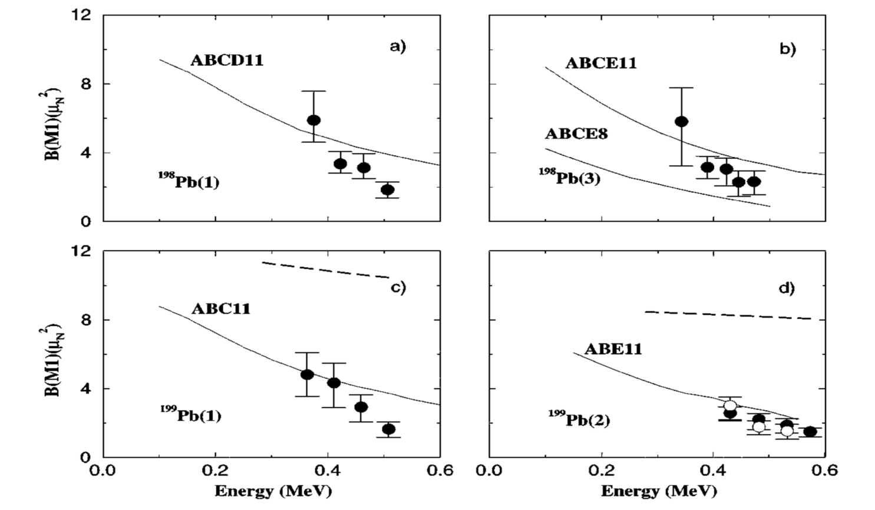
集体转动激发中的磁偶极跃迁——磁转动
In earlier 1990s, the rotational-like sequences of strongly enhanced M1 transitions were surprisingly observed in several light-mass Pb isotopes, which are known to be spherical or near-spherical.
The explanation of such bands was given in terms of the shears mechanism.
Frauendorf NPA557, 259 (1993)
Frauendorf_Meng_Reif, Proceedings of the Conference on Physics From Large γ -Ray Detector Arrays p.52 (1994).
rotational bands with ΔI = 1
near spherical or weakly deformed nuclei
strong M1 and very weak E2 transitions
B(M1) decreases with the increase of spin
Experimental confirmation
Clark_et al, PRL78, 1868(1997)
Evidence for “Magnetic Rotation” in Nuclei: Lifetimes of States in the M1 bands of 198,199Pb

Slide 30
磁转动实验进展
So far, nearly 200 MR candidates in around 100 nuclei have been found in A ~ 60,80,110,140 and 190 regions.
Clark & Macchiavelli, Annu. Rev. Nucl. Part. Sci., 50 (2000) 1,Frauendorf, Rev. Mod. Phys., 73 (2001) 463, Meng, et al., Front. Phys. 8 (2013) 55, Relativistic Density Functional for Nuclear Structure, Edited by Jie Meng Singapore: World Scientific, (2016)

Slide 31
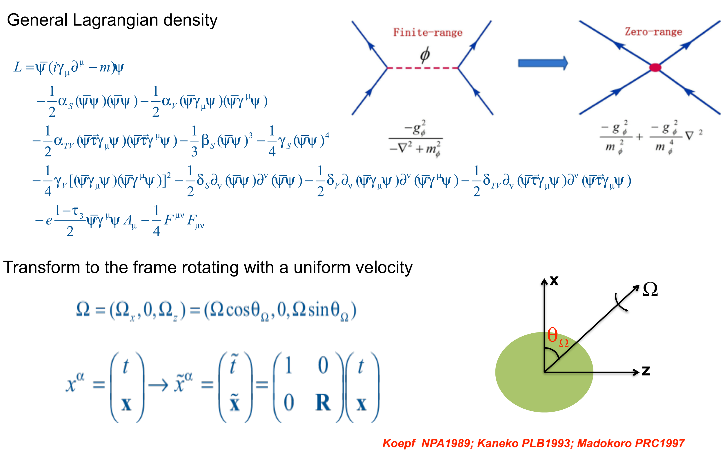
Tilted axis cranking CDFT

Slide 32
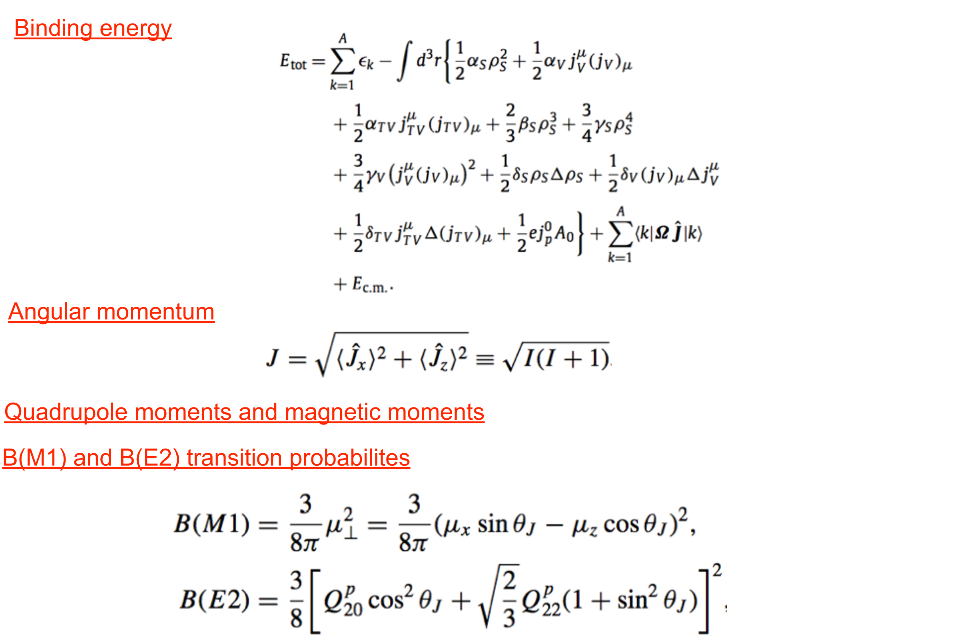
观测量计算

Slide 33



Candidate magnetic rotation sequence in ⁸⁶Sr
Y. Zhen, J. Li, et. al., J. Phys. G: Nucl. Part. Phys. 42 (2015) 085108

