Slide 1
原子核 的简单规律
赵玉民
上海交通大学

Slide 2
很早就渴望有机会到同济大学访问：
王占山 （1985、擦肩而过的南开学长)
羊亚平 (1990、大连会议 同龄朋友)
于祖荣 (1991、长辈老师，潘峰答辩主席)
任中洲 （1993、参加了我博士论文答辩会)
傅冠健 （2009、学术新秀）
谢双媛 （2018、学术新秀）
金 磊 （2019、学术新秀）

Slide 3
提纲
1、配对理论：简单概要 和 新进展 [5分钟]
2、关于 delta 相互作用矩阵元的最近结果[5分钟]
3、随机相互作用的原子核结构[5分钟]
4、壳模型组态的维数问题 [5分钟]
5、镜像核质量关系[10分钟]
6、经验的中子-质子相互作用及其应用[30分钟]
7、原子核质量经验关系的意见 [5分钟]

Slide 4
壳模型的重要性
在很大程度上，在考虑比较低的激发态结构时，我们可以只考虑满壳层以外的价核子的贡献，在激发态能和跃迁计算中忽略哪些满壳层内核子的贡献。
[第一个]系统的微观模型理论

Slide 5
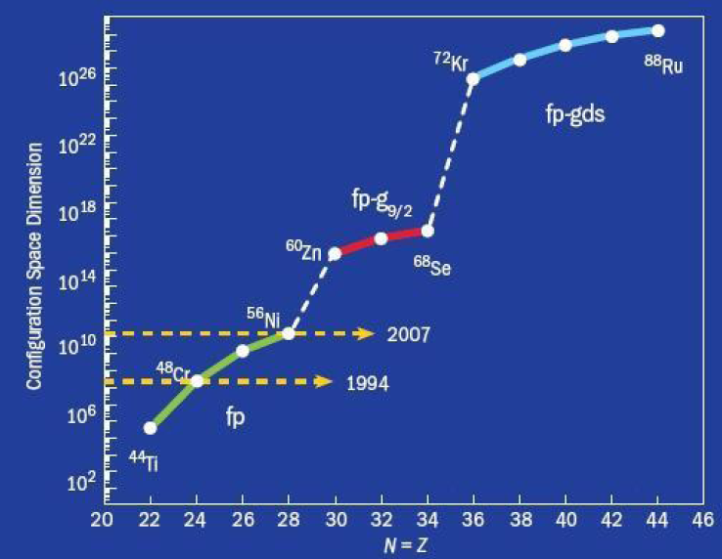

Slide 6
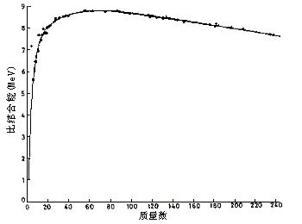
短程吸引的核力
结合能近似地正比于质量数，而不是质量数的平方。这说明
核力中居于主导成分的是短程吸引的相互作用。与此相应的，
长程库仑力的能量正比于质子数的平方。

Slide 7
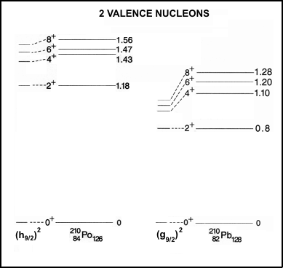
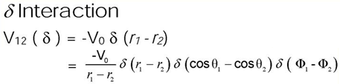
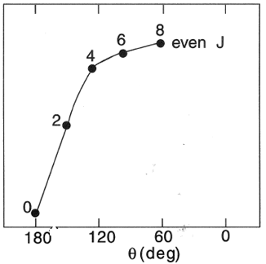
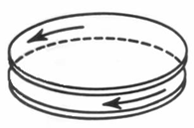
Why we use Pair Approximation?
Nuclear force: attractive and short range
J=2 pair (D pair)
J=0 pair (S pair)
j = 9/2
壳模型刚建立之初，Mayer 便有了以上计算结果。见
Y. M. Zhao, A. Arima, Phys. Rep. 545, page 1 (2014).

Slide 8
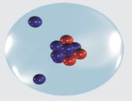
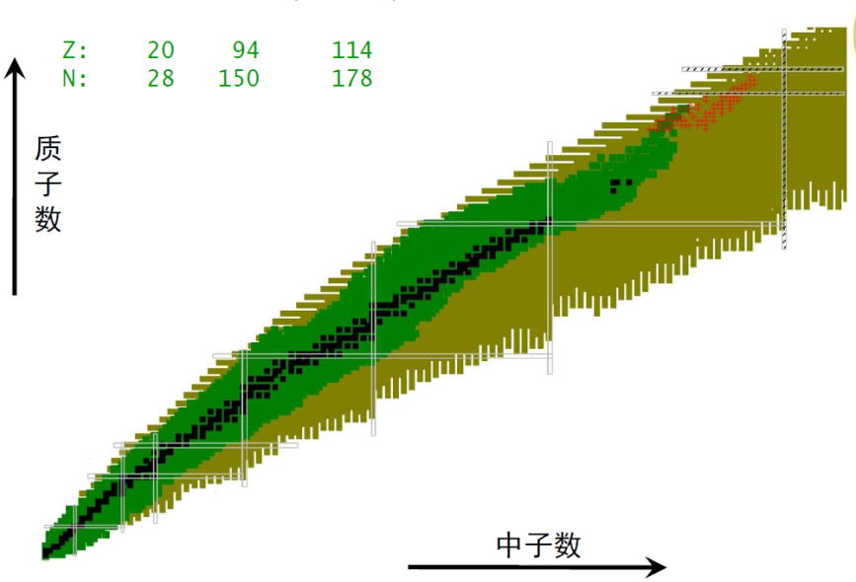
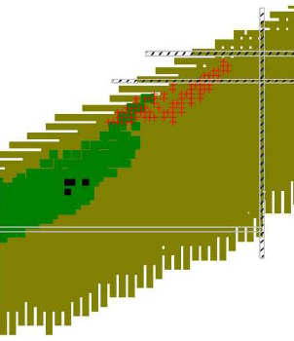
配对图象及其关键作用：决定核素图边界
✗
✓
核内核子配对图象
锂-10 假象图
锂-11 核示意图

Slide 9
Nucleon-pair approximation
Shell-model basis:
nucleon pair：
pair basis:
Considering all possible nucleon pairs :
the NPA space = the SM space
Hamiltonian and transition operators:
same as those in the SM

Slide 10
Pair truncation
pair basis:
1. A VERY few pairs with good spin and parity
S pair ---- spin zero and positive parity
D pair ---- spin two and positive parity
2. Using collective pairs
collective S pair
j₄
j₃
Dimension does not change with the number of single-j orbits.
j₂
j₁

Slide 11
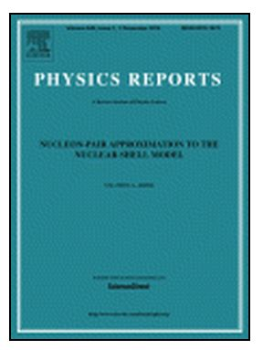
自1949年建立壳模型，人们一直不懈努力，发展壳模型配对近似理论，已经 60 余年：
1952年 单轨道S 配对理论(Racah)
1971年 多轨道S 配对理论 (Talmi)
1981年 考虑1个到2个配对破坏贡献的理论 (Allart 等)
1982-87年 带有对称性的配对理论
(Ginocchio、吴成礼、陈选根、陈金全、冯达旋)
1992年 偶数核子配对方法，包含 SD 配对 (陈金全)
2000年 同类核子配对统一方法 (赵玉民、陈金全、有马朗人等)
2013年 质子中子配对的方法 (傅冠健、赵玉民、有马朗人等)
2018年 粒子-空穴的配对理论 （程奕源、赵玉民、有马朗人）
2020年 J-基矢的M-表象 (何秉承、罗延安、潘峰、Draayer 等)
2021年 配对理论的矩阵表示 (雷杨、路毅、赵玉民)
2023年 配对理论的混合表象 (马畅、尹鑫、赵玉民)
用配对近似理论作完整的多体计算主要困难来源于多粒子耦合。
Zhao and Arima,
Phys. Rep. 545, 1 (2014).

Slide 12
一个进展
2000年 同类核子配对统一方法 (赵玉民、陈金全、有马朗人等)：比原来效率高，表象简单
2013年 质子中子配对的方法 (傅冠健、赵玉民、有马朗人等)： 考虑同位旋自由度
2018年 粒子-空穴的配对理论 （程奕源、赵玉民、有马朗人): 考虑粒子-空穴激发
2020年 J-基矢的M-表象 (何秉承、罗延安、潘峰、Draayer 等)
配对有好角动量、基矢非耦合表象 【计算提高一个量级】
2021年 配对理论的矩阵表象 (雷杨、路毅、赵玉民)
没有角动量的全部非耦合表象 【比J-基矢M表象计算效率再提高一个量级】
2023年 配对理论的混合表象 (马畅、尹鑫、赵玉民)
用J-scheme 的基矢、用M-scheme 的技术【比矩阵表象计算效率再提高一个量级，三级跳】
我们的目标是基于壳模型近似研究重核结构，现在配对理论越来越
具有现实意义。

Slide 13
横看成岭侧成峰，远近高低各不同
这些配对态：在配对空间非常简单，
对于这些状态，配对的分类基矢是
很好的基矢。
在其它观点看这些状态还是很复杂。

Slide 14
2、关于 delta 相互作用矩阵元的最近结果
非对角元是两个Clebsch-Gordan 系数，
如果包含同位旋，则有四个Clebsch-Gordan 系数

Slide 15
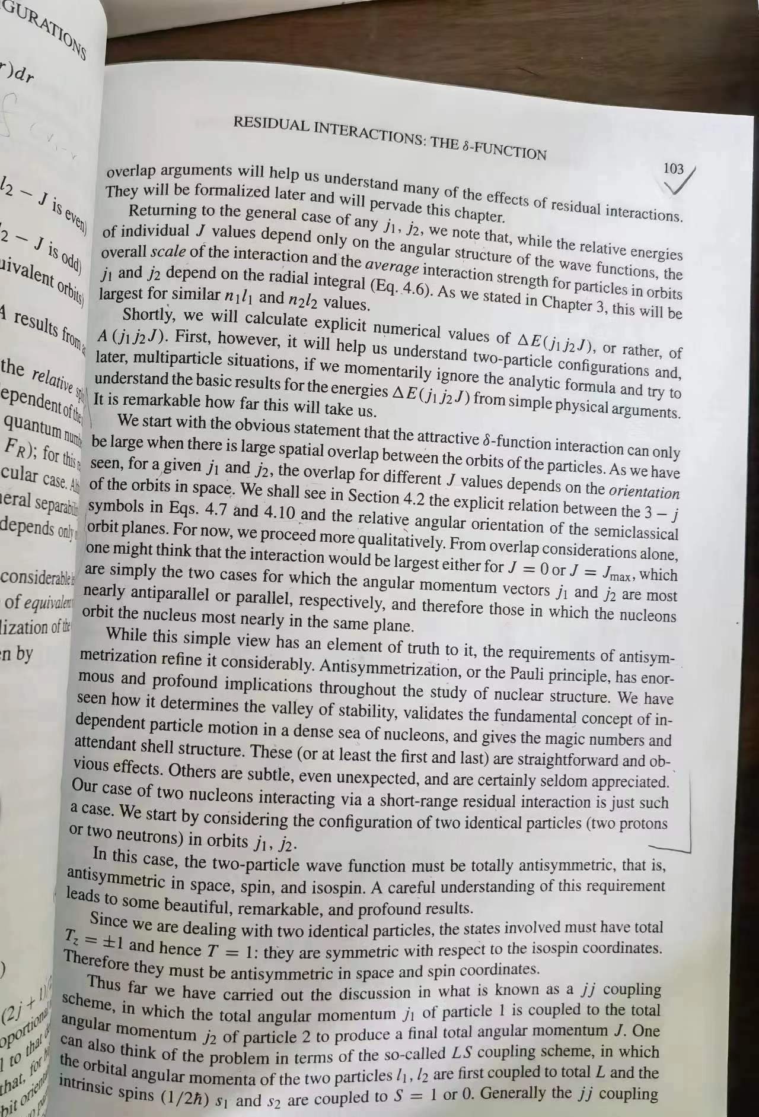
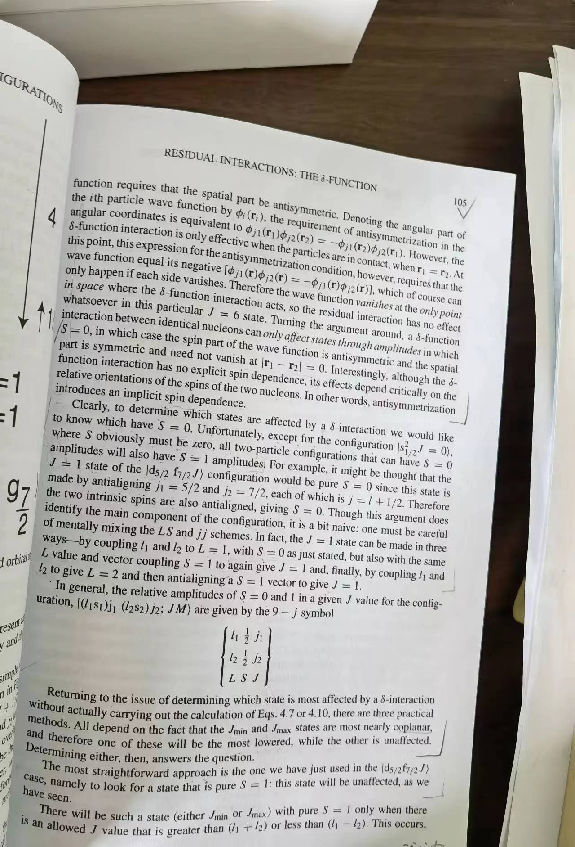

Slide 16
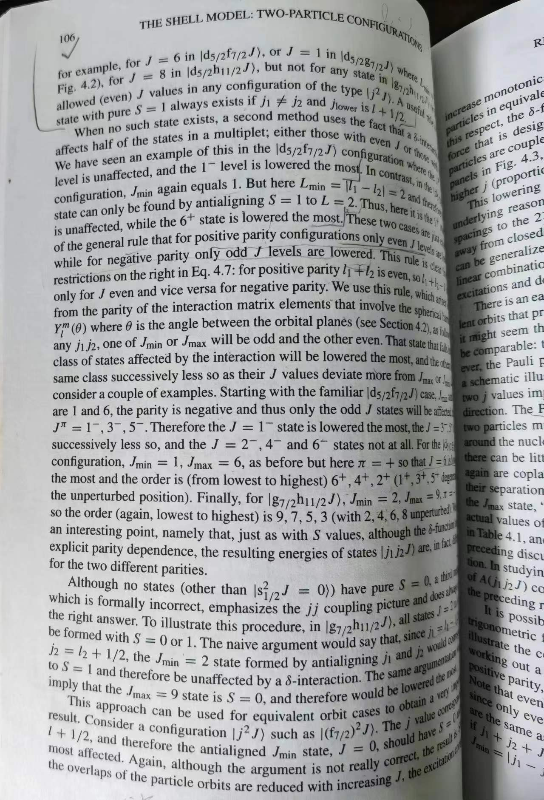
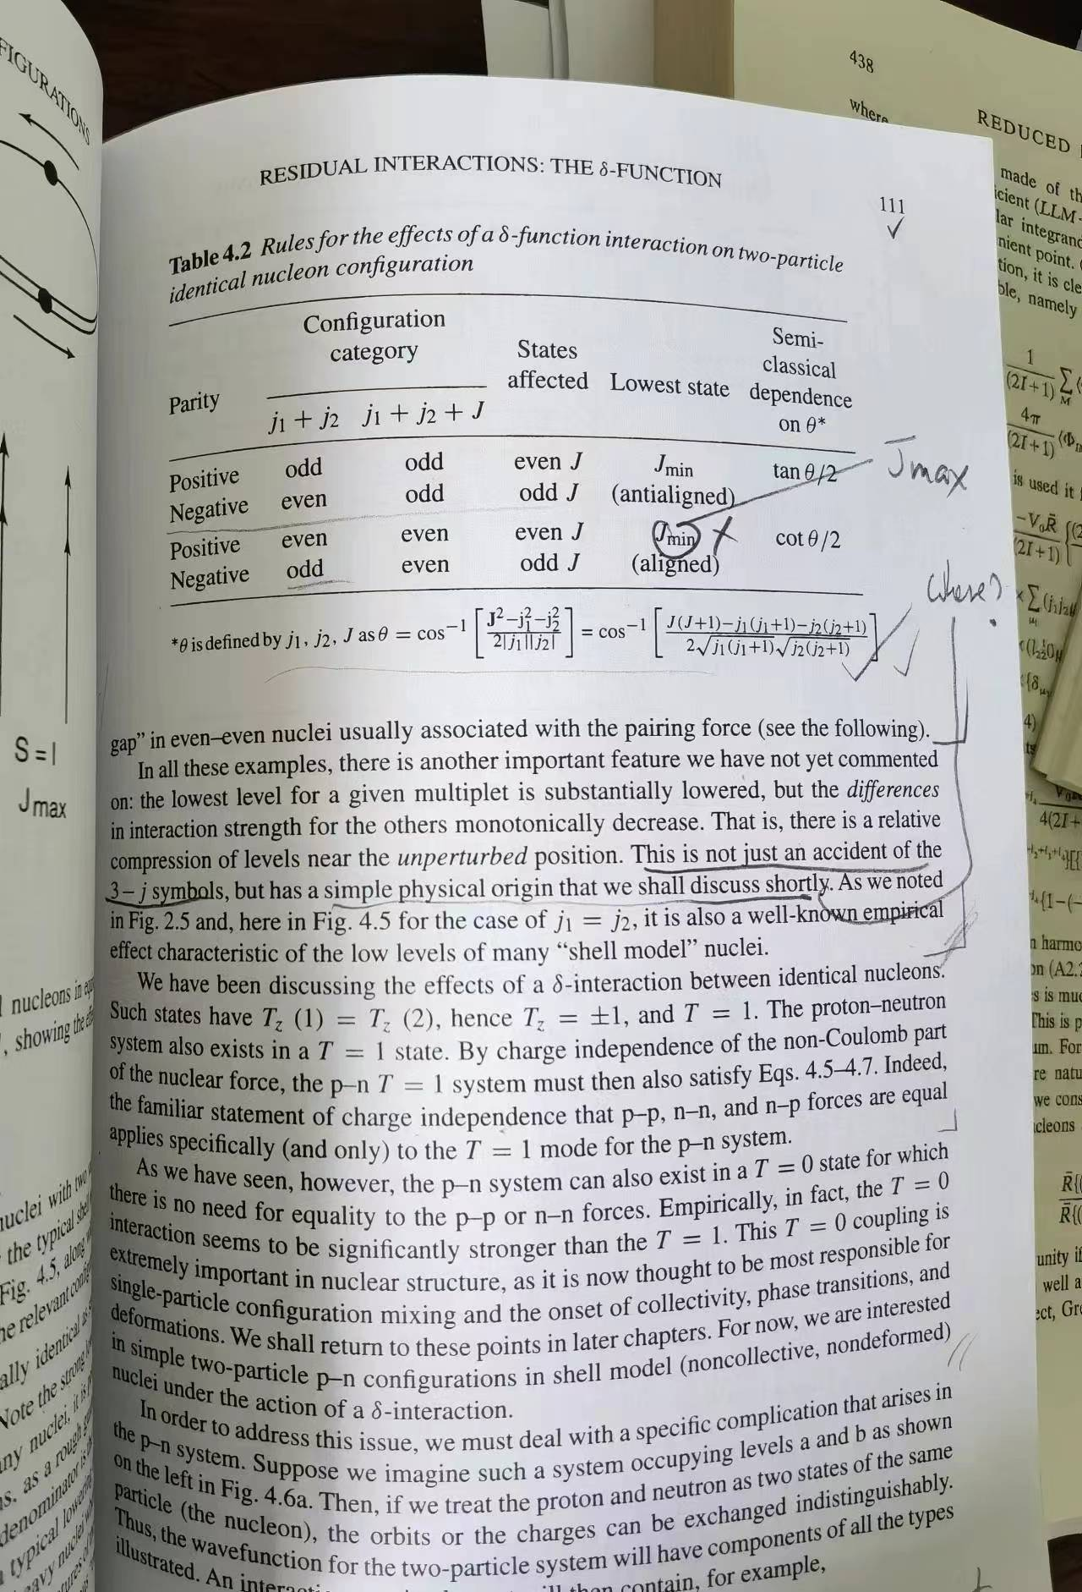

Slide 17
Casten 非常漂亮地关于这个量的经验规律，但是为什么能够
有这样漂亮的规律以及能级次序、很大能隙，则没有很好的解释；
同时这种“解释”还有很大漏洞(他没有讲、因为他只想告诉大家结果
是什么，有什么可能的直观图像 //Casten 经验规则) --- 很遗憾，这个
直观图像不完整。Casten 的图象是短程吸引—他把这一点作为这本书
强调的核心内容之一，非常好。在这个地方他也用同样的图象。
问题是：假如 J-min 最低，次低的能级应该是J-max, 然后是 J-min+2, 再次是
J-max – 2， 以此类推。但是他的结果是 J-min 最低，那么 J-max 则最高！
这与他的图像不符。至于能隙则是observation !!!

Slide 18
我说明一下：
迄今为止关于这个量规律的讨论只有Casten 书上才有，
其它人没有讨论过！
假如一个东西被理解了而且又简单又舒服，
所有教科书都愿意讲。
这个物理量推导得最好的是Talmi书，但是Talmi 也是停留
在 Clebsch-Gordan 系数那里。其它的数值计算就可以了。
We know the facts, but without simple understandings.
这是目前我们的情况！
为什么没有人继续讲下去？？？

Slide 19
因为解析解是
这个样子：
It seems that there is nothing more we can say !

Slide 20
这些是所有人都知道的结果，Talmi、Arima、Cohen、Lawson、Wildenthal、郭子斯、Brown
甚至 Casten 等对此一定非常熟悉！！ 但是我们能从中看出任何 E versu J 的关系吗？ 当然不能！
Casten 善于总结，因此他总结出了漂亮的经验规律，但是他的结果也只能是经验的。

Slide 21
我向大家报告一下：我们从根本上完整地解决了这个问题。
为什么能够解决？其实还是看到了Casten 的经验规则。既然E_J 与 J 的变化是单调的，那么
我们计算一下r_J= E(J)/ E(J-2) 就可以把那些阶乘消去！！！ 就可以极大化简这个结果。

Slide 22
容易证明二者都大于1 ！这样就会存在一个很大能隙！
现在一切都变得那么自然、
那么美妙了！！！
其实是受Casten 启发的… …

Slide 23
另一个例子是关于 j^n 组态空间的维数问题。
我其实也只是 Lawson 的信徒，但是我比他走得远。这为我挣了
不少作为理论工作者的面子。Lawson 书第一章，我play the game.

Slide 24
3、随机相互作用的原子核结构理论

Slide 25
In many-body systems such as molecules and atomic nuclei, the interactions by themselves have no trace of symmetry groups for vibrational or rotational modes. However, the low-lying states often exhibit a pattern suggestive of symmetries for these modes. One may ask to what extent the low-lying states acquire order from the basic properties of interactions such as rotational invariance and possibly other symmetries such as isospin invariance. In other words, some properties such as vibration or rotation might dominantly occur in the low-lying states of many-body systems while the others might occur only with small probabilities.

Slide 26
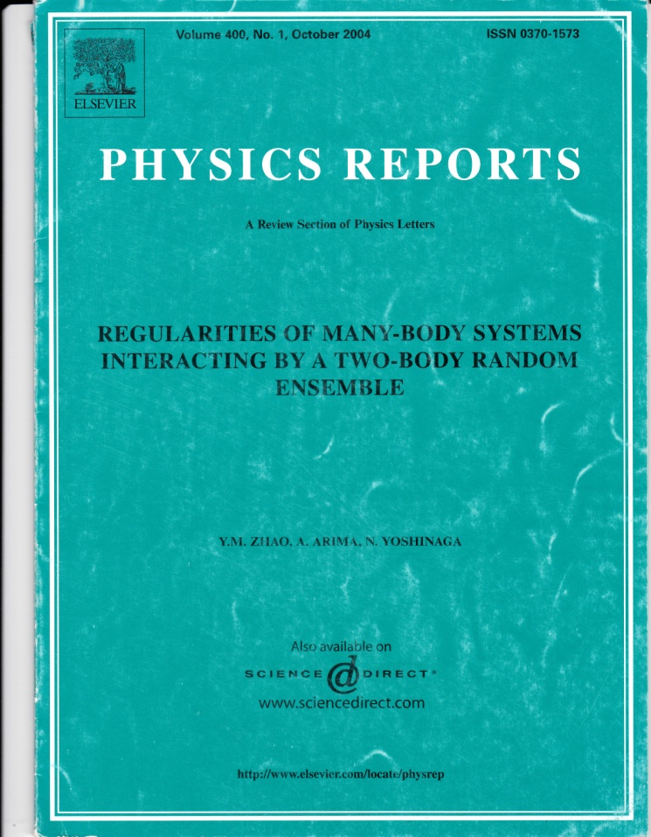
随机相互作用的原子核结构理论
？？？
随机的输入量
随机的输出量？？？
简单结果：基态自旋、能级次序、宇称、集体运动
& why ???
知道许多结果和问题，而对于这些
计算结果规律性的理解还很肤浅。

Slide 27
Spin-zero & parity-plus ground states for even-even nuclei, odd-even staggering of binding energies, collective motion, …
One can ask whether these features are robust for general many-body systems. This can be studied by permitting interactions to be more and more arbitrary.

Slide 28
II. Two examples
(open questions)

Slide 29
1、 A famous puzzle
spin zero ground state dominance
(still an open problem)

Slide 30
What does 0 g.s. dominance mean ?
In 1998, Johnson, Bertsch, and Dean discovered that spin zero ground state dominance can be obtained by using random two-body interactions (Phys. Rev. Lett. 80, 2749)．
This result is called the 0 g.s. dominance.
Similar phenomenon was found in other systems, say, sd-boson systems.

Slide 31
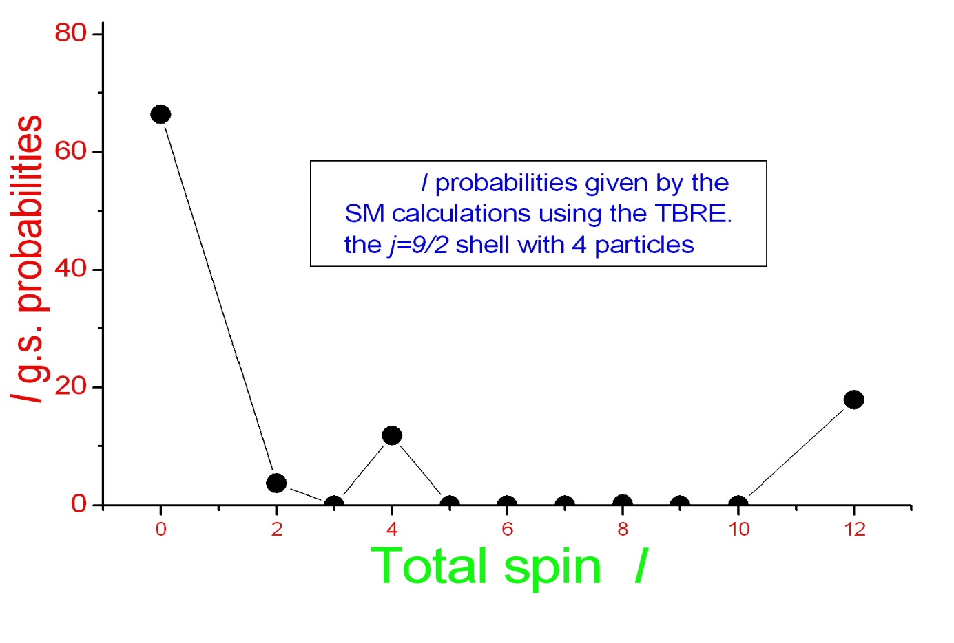
Why is this result interesting?

Slide 32
Available Results
Empircal method Zhao&Arima&Yoshinaga (2002)
Mean-field method Bijker-Frank (2003)
Geometrid method Chau et al. (2003)
Spectral Radius Papenbrock & Weidenmueller (2004)
------------------------------------------------------------
Time reversal invariance (TRI) Zuker et al. (2002);
Time reversal invariance? Bijker&Frank&Pittel (1999);
Width ? Bijker&Frank (2000);
off-diagonal matrix elements for I=0 states Drozdz et al. (2001)
Highest symmetry &Time Reversal Otsuka&Shimizu(2004-2007)
Semi-empirical formula Shen, Zhao, Arima, and Yoshinaga(2006-2010)

Slide 33
2、 A simple and similar pattern
Positive parity dominance
(an open problem)

Slide 34
Let us choose ANY configuration spaces in which we have a few single-particle levels, some of them have positive parity, the other have negative parity.
Then the number of states with positive parity and that with negative parity are very close to each other, roughly 50%-50%.

Slide 36
The worst case is P(+)=67%，the best case is 99.9%。
On average P(+)~86%。
No counter example has been found ！

Slide 37
Review Articles:
Y. M. Zhao, A. Arima, and N. Yoshinaga,
Physics Reports Vol. 400, 1 (2004).
Y. M. Zhao, Frontiers of Physics Vol. 13, Issue 6,
132114 (2018).

Slide 38
4、壳模型组态的维数问题

Slide 39
关于 j^n 组态空间的维数问题 & 角动量求和规则。
我其实也只是 Lawson 的信徒，但是我比他走得远。这为我挣了
不少作为理论工作者的面子。Lawson 书第一章，我play the game.

Slide 40
Introduction -1
The enumeration of states of the nuclear shell model configurations with given spin (and isospin) is a fundamental practice in the shell model theory. Usually this is done by computer by iterations.
Can we know the number of states with given spin by simple formulas [without computer enumerations]?
Answer: yes，sometimes !

Slide 41
Introduction -2
Seniority scheme simplifies greatly the problem for single-j systems with only monopole pairing interaction.
Can we generalize this for other cases [non-monopole pairing interactions]?
Answer: yes, sometimes!

Slide 42
Introduction -3
Can you imagine, somehow, matrix elements of J-pairing interaction, sum rules of angular momentum coupling coefficients, and number of states in the shell model configurations, are related closely ?
The answer is yes, sometimes !

Slide 43
We would like to reply the above questions, including what these “sometimes”mean.
[1] Number of states for n<=5, single-j;
[2] The Jmax-pairing interaction;
[3] three-j and four-j recoupling coefficients.
(i.e., 6-j and 9-j symbols)

Slide 44
Part II Number of states for identical particles in a single-j shell
We actually came to this problem very accidentally:
In summer of 2000, Prof. Arima gave a talk in American-Japanese joint nuclear physics symposium on random interactions. In that conference Prof. Arima showed a figure as follows.

Slide 45
A fax from Joe Ginocchio:
Akito, Nice to see you in Hawaii.
I know why there is a staggering for your P(0). This coincides with the number of states for J=0. I derived the formulas for n=4 when I studied the fractional quantum hall effect with Wick Haxton. Igal used this in his book. Joe

Slide 46
At that time, we actually had known this fact (also Zelevinsky and collaborators knew this coincidence). However, I did not know the Ginocchio-Haxton formula:
The number of states with spin J=0 for four fermions in a single-j shell is [(2j+3)/6], where “[ ]” means to take the largest integer inside. It is nice !

Slide 47
After some time I thought of something naive, which is as follows. We all know for n=2, the number of states is 1 for J=even and 0 for J=odd. One might be able to construct simple formulas for n=3, 4, 5, for single-j shells. Probably one gets some hint by simply looking at the systematics of those numbers.
Then I tried and found the empirical formulas for them. I could not prove them at that time, however, I made numerical experiments by computers as much as possible.
Zhao and Arima, Phys. Rev. C68, 044310 (2003)
They must be correct, yet without mathematical proof.

Slide 48
Empirical formulas
For n=4 and 5, results are more complicated (omitted).

Slide 49
A simple method in the text-book

Slide 50
A new method
I0=Imax-I
m1,m2,m3, m4
k1,k2,k3,k4

Slide 51
Conjugates of

Slide 52
We can look at this problem in terms of Young boxes. We need the number of Young boxes in n columns. In each column, the maximum of boxes is 2j+1-n for fermions or L for bosons.
The number of Young diagrams always equals the number of their joint Young diagrams, apparently. Now in this case, the number of boxes in each column becomes n, while the maximal number of columns is 2j+1-n for fermions and 2L for bosons.

Slide 53
k1 k2 k3 k4
k1
k2
k3
k4
n=4, j or L
# row: 2j+1-n, 2L
# column: n
n = 2j+1-n or 2L
# row: n
# column: 2j+1-n or 2L
One-to-one correspondence !

Slide 54
First, one sees immediately
the number of states with given spin J for n fermions
in a single-j shell equals the number of states with spin J for n
bosons with spin L, if 2L=2j+1-n. [If 2L=2j+1-n, Imax(j^n) =
Imax (L^n) ]
Second, one transforms a problem of n fermions in a single-j
shell (or n bosons with spin L) to
the problem of n’=2j+1-n bosons with spin n/2.
i.e., SU(2j+1) SU(n+1).

Slide 55
Examples of this identity

Slide 56
An example: n=4
Here we should study bosons with SU(5) symmetry, i.e., d bosons. The number of states for d bosons has been studied in the interacting boson model.
By using results of the IBM, we were able to obtain dimension for d bosons. Then we quickly get the number of states for n=4 of fermions and bosons.
Zhao and Arima, Phys. Rev. C 71, 047304 (2005).

Slide 57
Other works
Number of states for
Zamick et al. Phys. Rev. C71, 054308 (2005).
Talmi obtained some recursion formulas
He proved our results for n=3.
I. Talmi, Phys. Rev. C72,037302(2005) .
Talmi’s method can be used to prove any formulas (in principle) but it can not be used to find new formulas.

Slide 58
Part III J-pairing interaction
Fermions in a single-j shell:

Slide 60
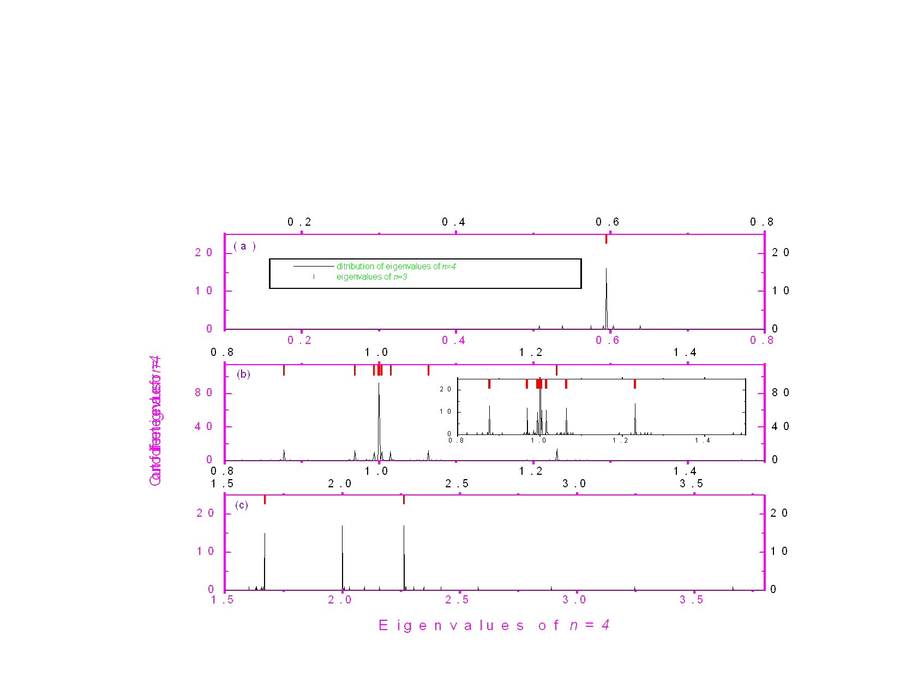

Slide 61
Asymptotic behavior: (j^3)Imax, j J, j=31/2

Slide 62
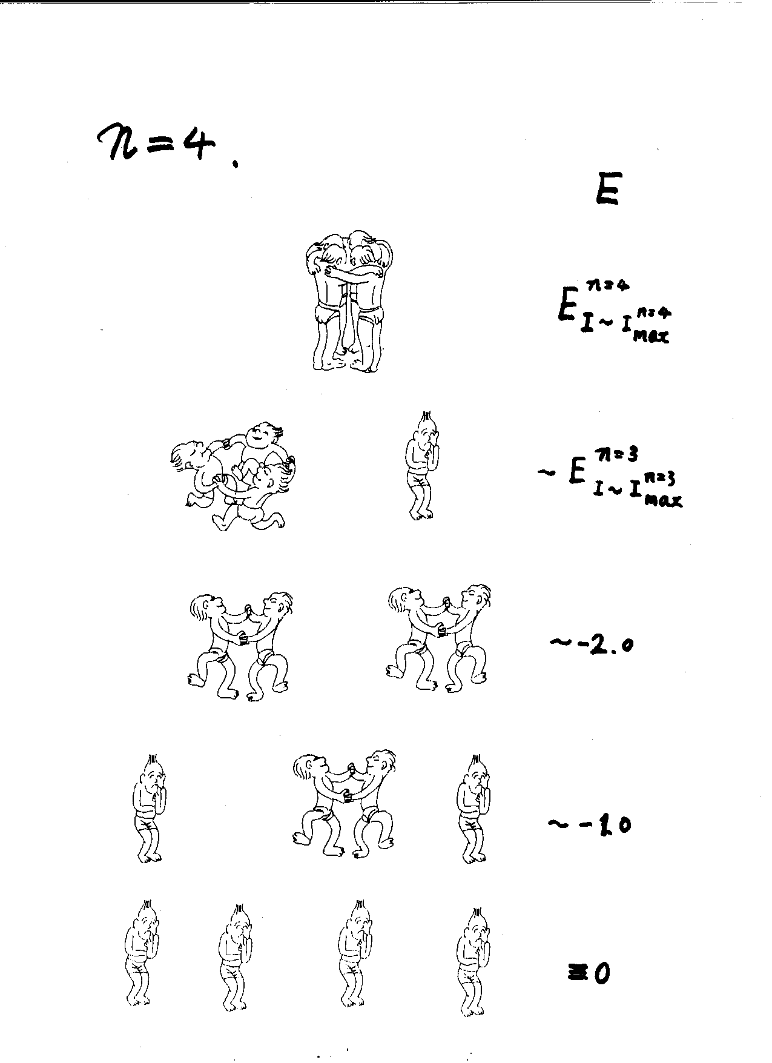
Picture was drawn by N. D. Dang in 2004, RIKEN & Hanoi,Vietnam

Slide 63
J –pair truncation of the shell model
Empirically we find that J-pair truncation is good for J-pairing interaction.

Slide 64
Part IV Sum rules of angular momentum recoupling coefficients
For n=3, J-pair truncation gives exact solution.

Slide 66
Some examples

Slide 67
Similar things can be done for n=4
Ref.: YMZ & AA (Physical Review C72, 054307 (2005)
Here we obtain sum rules of 9-j symbols.
The difference is that here situation is more complicated. Generally speaking, the number of nonzero eigenvalues is not always one for J pairing interaction and each of these eigenvalues is unknown.
However, the trace of eigenvalues for each I states with only J-pairing interactions is always a constant with respect to orthogonal transformation:

Slide 68
Proof
6 * # states

Slide 69
Sum rules
Summing over J, we obtain sum rules of 9-j symbols

Slide 70
Sum rules with odd J and odd K

Slide 71
Sum rules with both even and odd J,K

Slide 72
Two examples

Slide 73
Part V Number of states for nucleons in a single-j shell [An application of these sum rules]
References:
L.Zamick et al., Physical Review C72, 044317 (2005);
Y.M.Z. and A.A., Physical Review C72, 064333 (2005).

Slide 74
JT-pairing interaction
Nucleons in a single-j shell:

Slide 75
Similarly,

Slide 77
The case of T=0

Slide 79

Summary
Number of spin I states for a single-j shell
J-pairing interaction
Sum rules of angular momentum recoupling coefficients

Slide 80
Part VII Summary & prospect
Number of states with given spin (&isospin), sum rule of 6j and 9j symbols
J-pairing interactions

Slide 81
5、镜像核质量关系

Slide 82
核力的同位旋对称性
同位旋: 质子-中子(核子)的内禀对称性， 其实隐藏得并不深，质子-中子的质量相近、自旋相同；因此海森堡猜想它们是同一种粒子(核子)的不同同位旋态，就像电子有两个自旋态(朝上、朝下)，核子的同位旋朝上为质子、朝下为中子。 【核力电荷无关(同位旋守恒)】
在标准模型中被借用这个概念，同位旋对称性源于ud 夸克的质量与核子质量相比都很小(两个数量级的差异)。
完全抽象的、假想的概念！

Slide 83
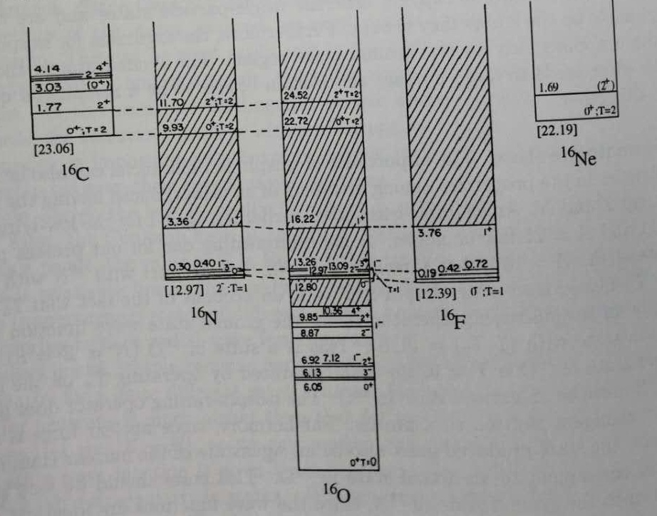
精微玄妙之美 例1：同位旋

Slide 84
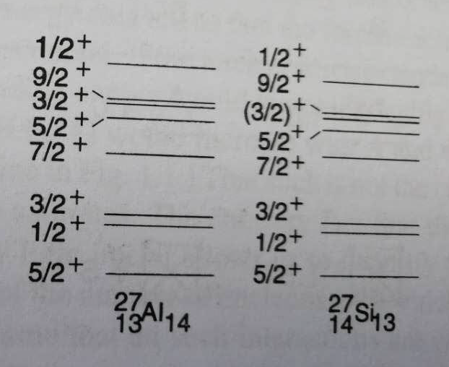
精微玄妙之美 例1：同位旋
镜像核(质子数和中子数交换的两个原子核)的能级结构

Slide 85
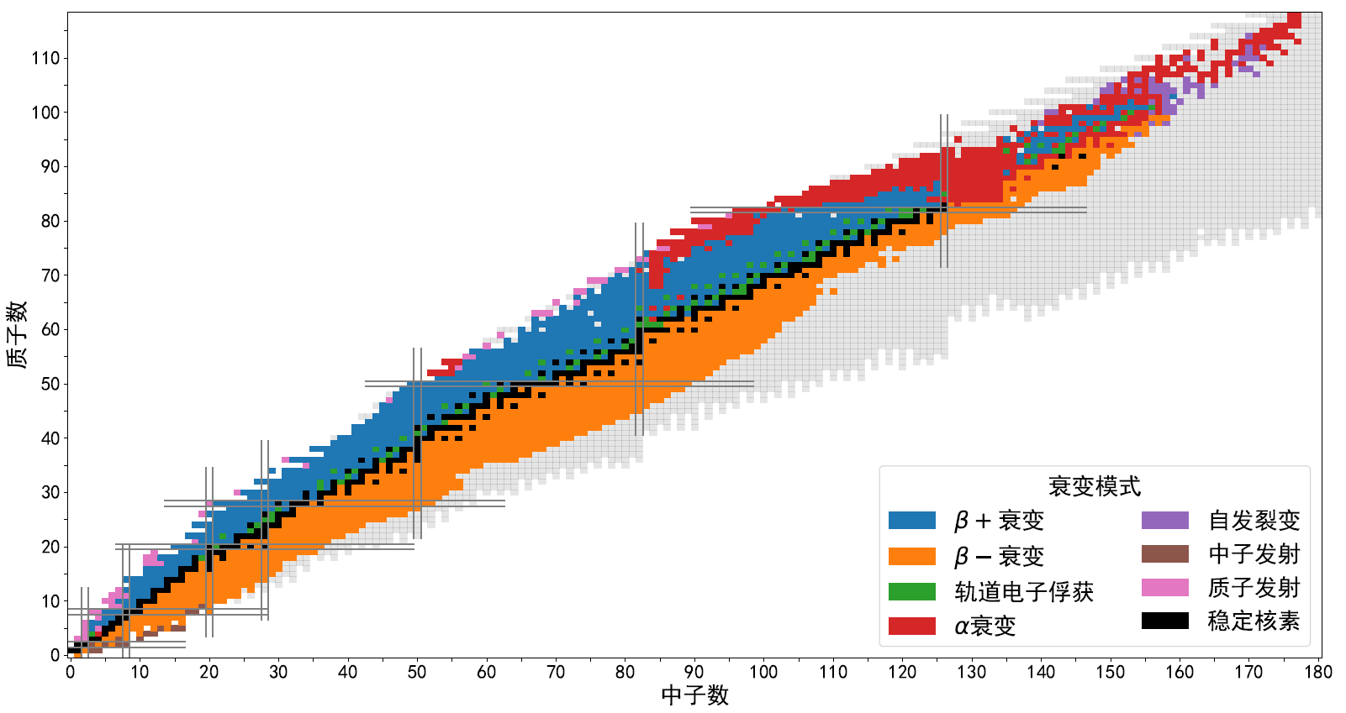
精微玄妙之美 例1：同位旋
中子数等于质子数
价镜像核

Slide 86
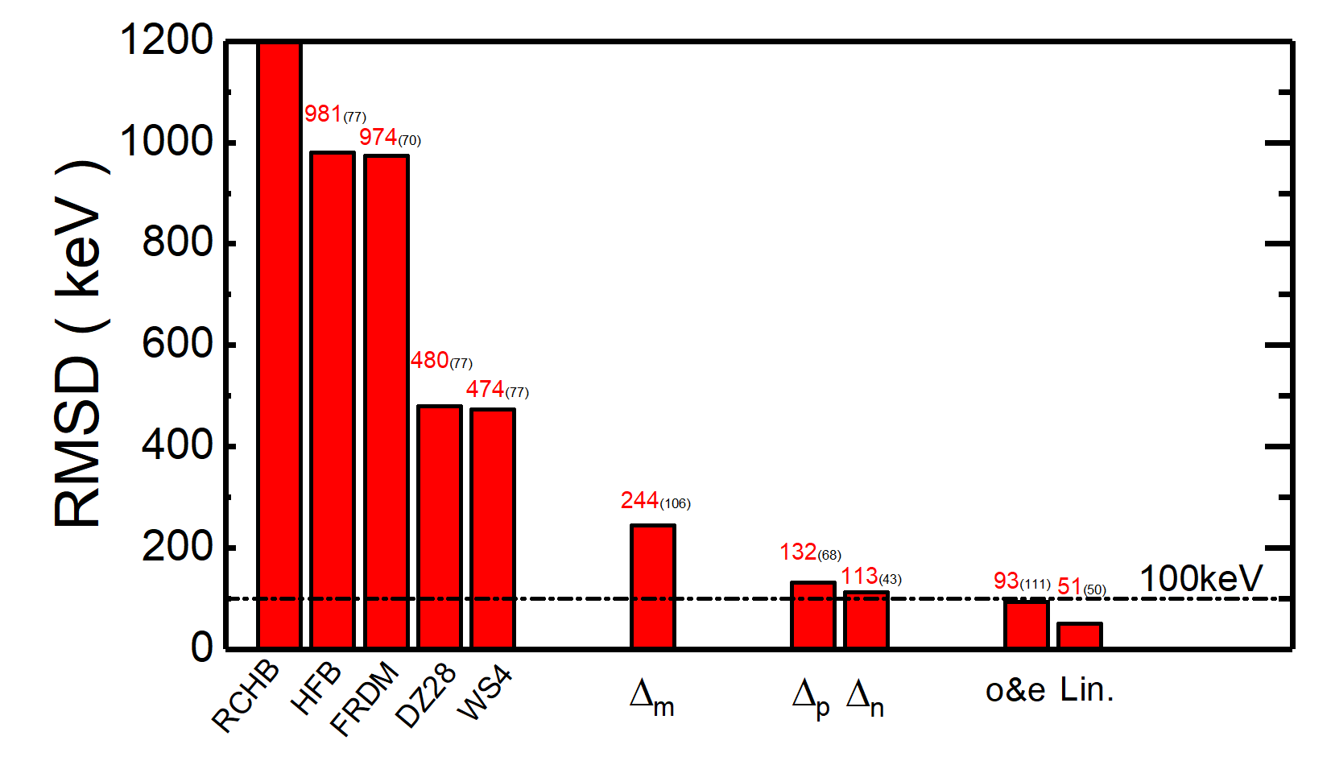
镜像核质量关系：质量描述
假如清楚知道静电能，就应该完整地
精确描述镜像和质量关系。如果不成功，
则说明:要么库仑能计算不好、要么
是同位旋守恒破缺少。
---→ 我们对于库仑能描述不好呀！

Slide 87
精微玄妙之美 例1：同位旋
中子数等于质子数
价镜像核

Slide 88
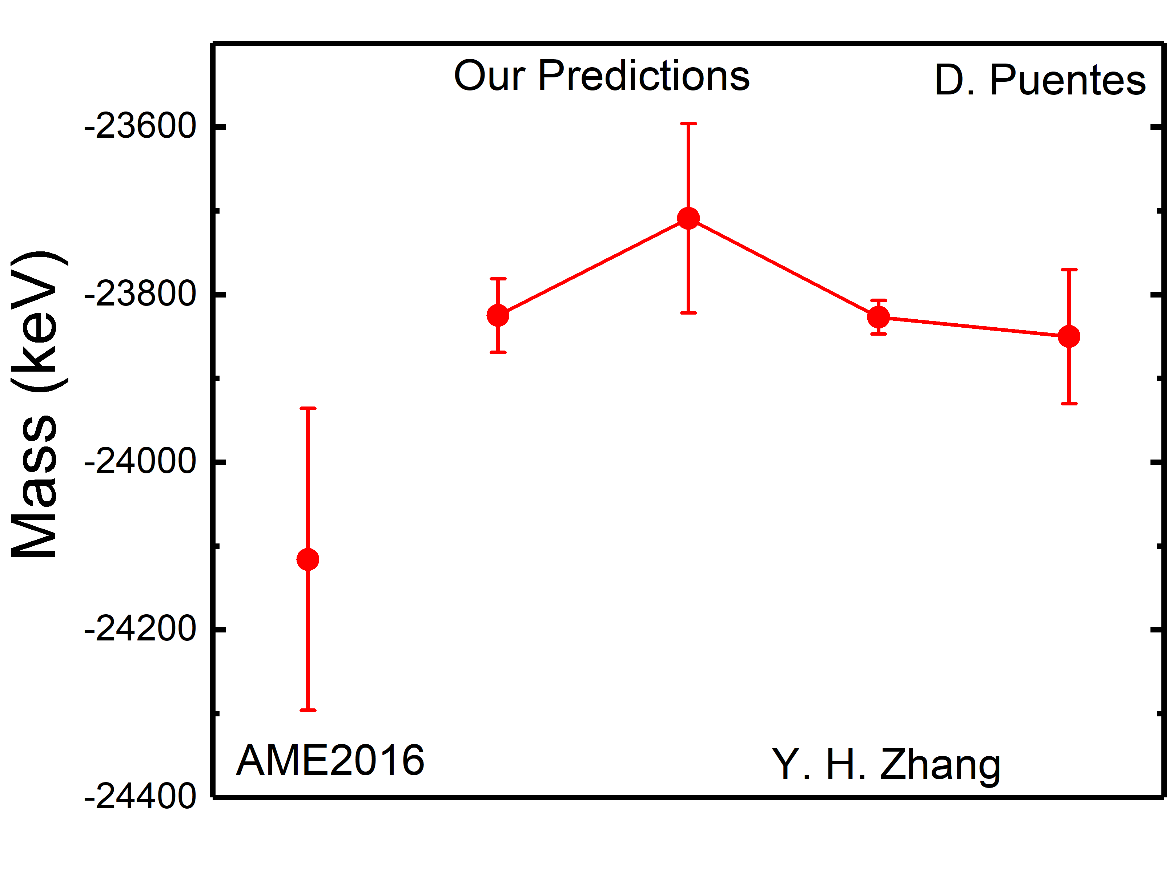
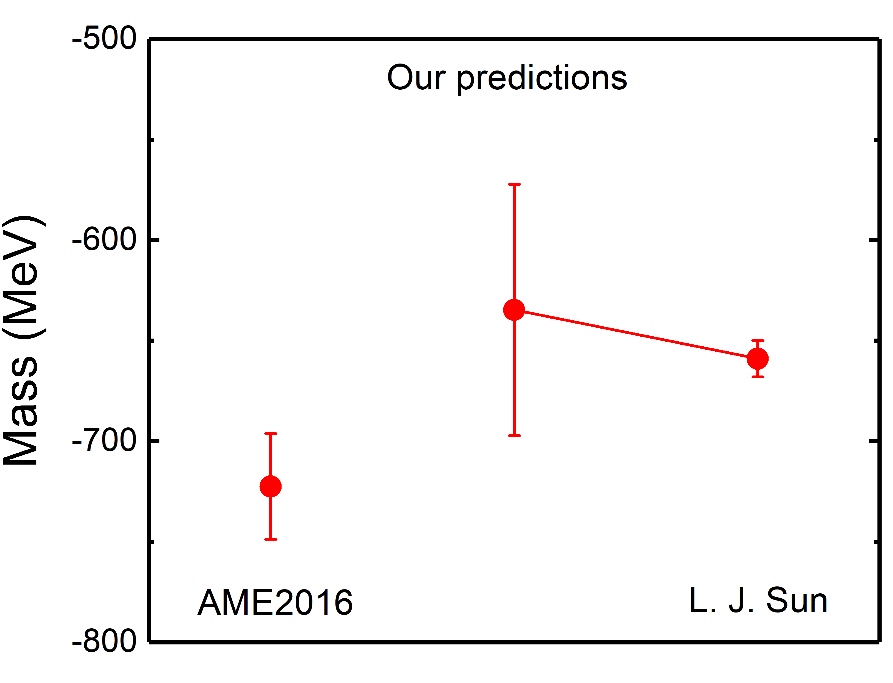


丰质子核质量预言
${}_{ }^{44}V$ 的质量修正
${}_{ }^{27}P$ 的质量修正
 |  | Mass
AME2016 |  | -24116 (180)
Our Predictions |  | -23825 (44) -23709 (113)
Zhang2018 |  | -23827 (20)
Puentes2020 |  | -23805 (80)
 |  | Mass
AME2016 |  | -722.5(26.3)
Our Predictions |  | -634.7(62.5)
Sun2020 |  | -659(9)
Y. H. ZhangPRC2018, PuentesPRC2020
L. J. SunPLB2020

Slide 89
6、质子-中子相互作用简单规律 什么物理量有用、什么方便，我们就干什么。

Slide 90
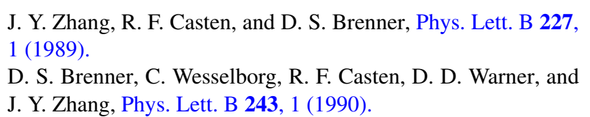
G. J. Fu, H. Jiang, Y. M. Zhao, and A. Arima, Phys. Rev. C82,
014307 (2010).

Slide 91
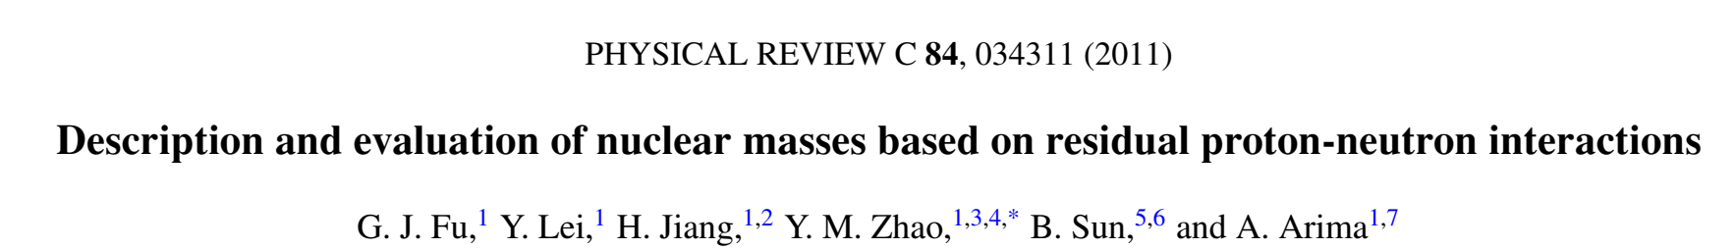
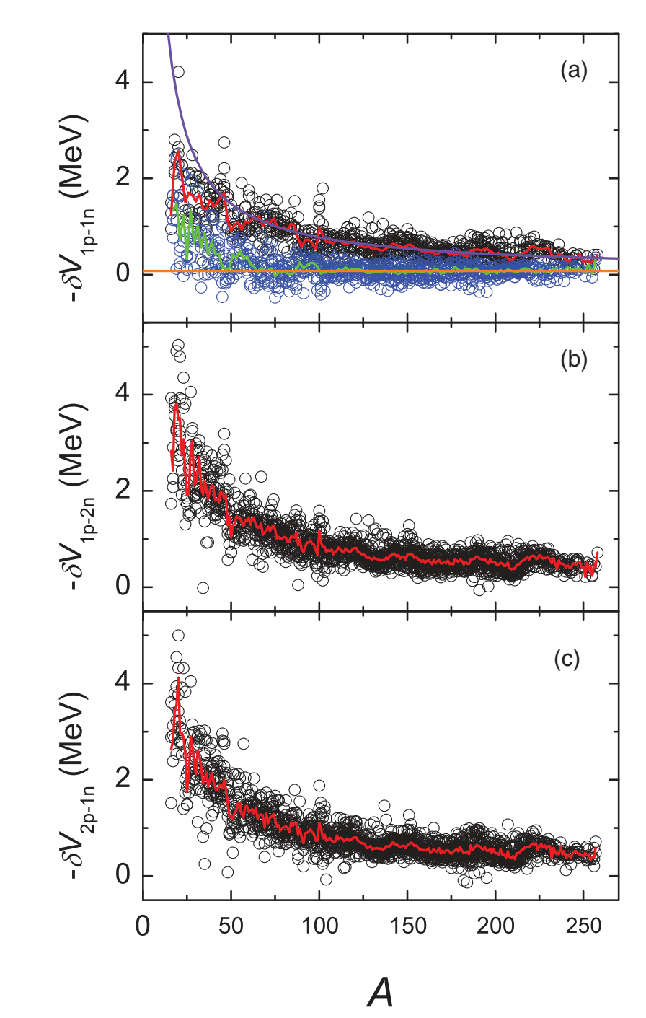

Slide 92
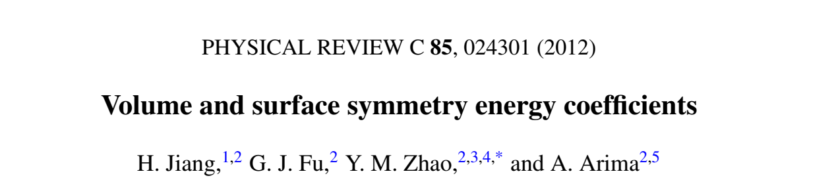
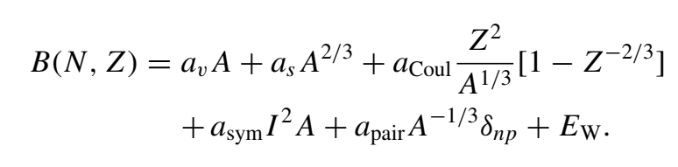
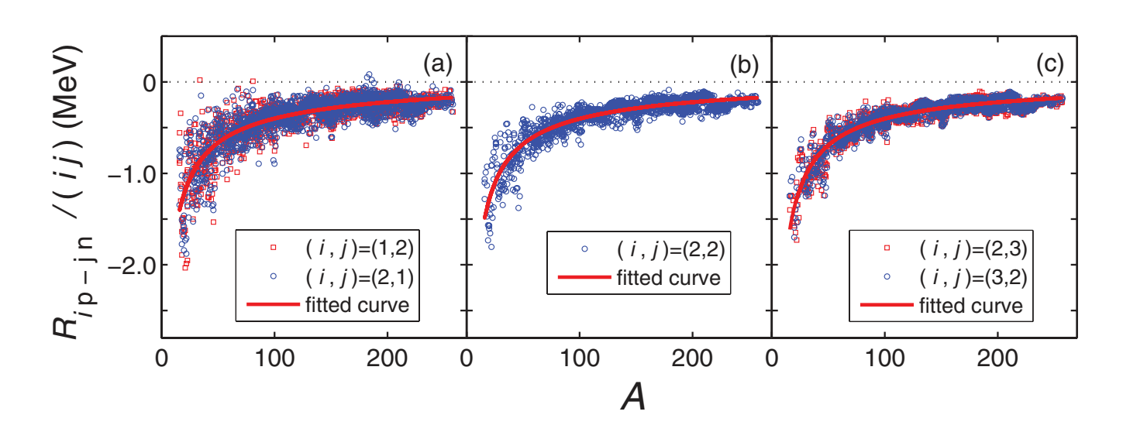
+ 壳修正项？？？

Slide 93
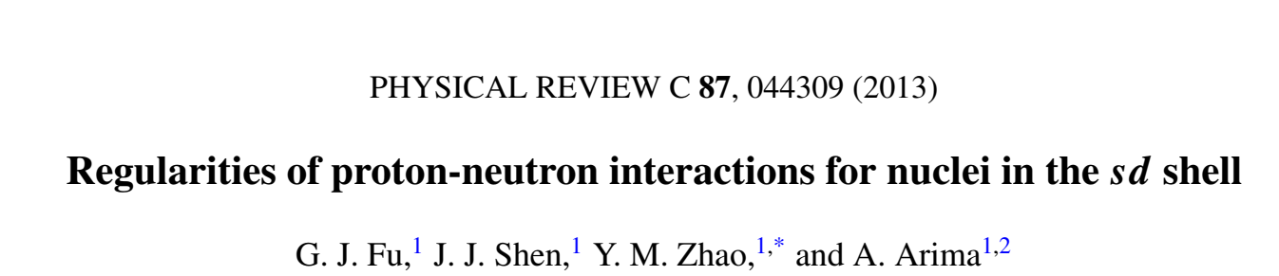
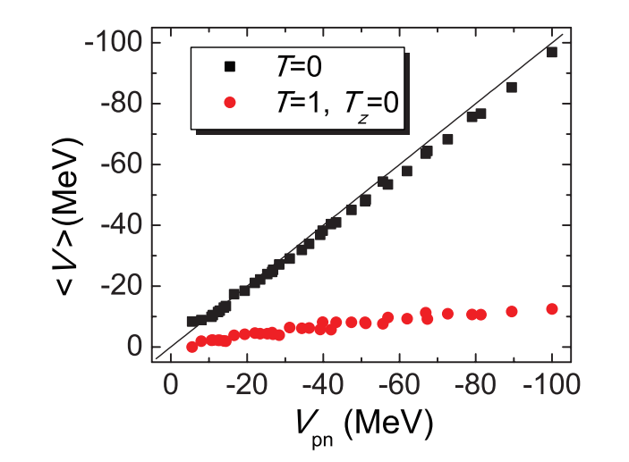

Slide 94
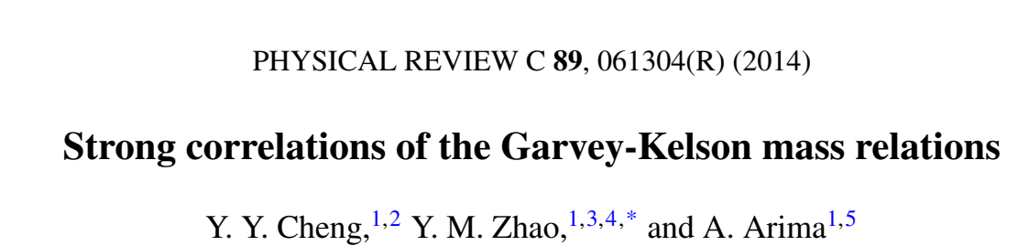
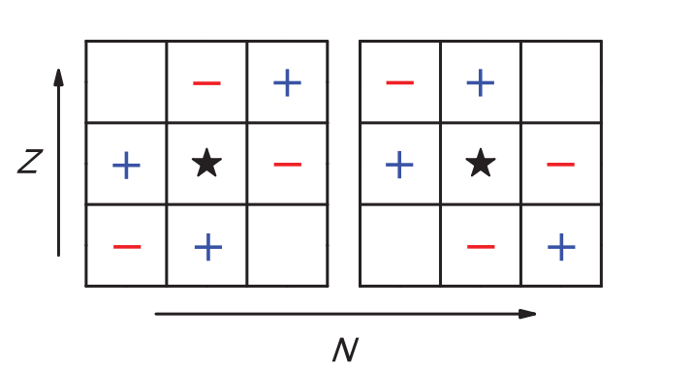
相关相长、相干相消。

Slide 95
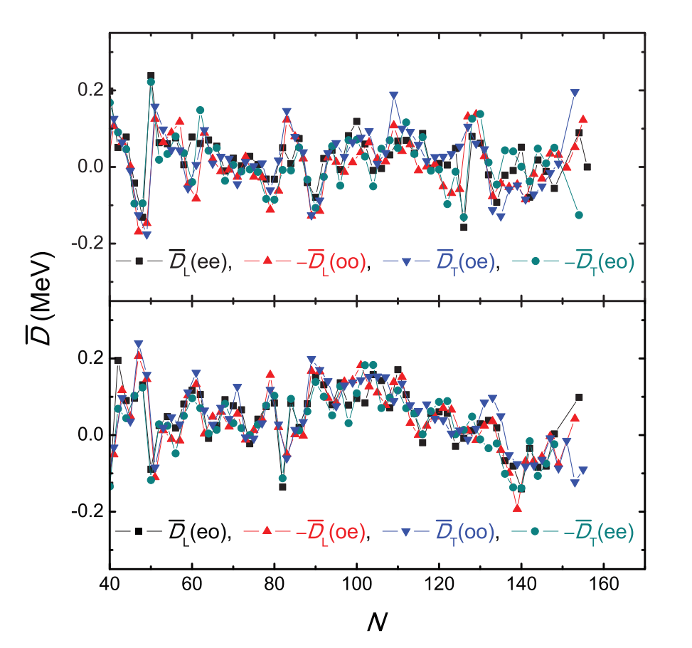
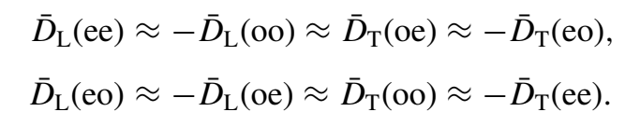

Slide 96
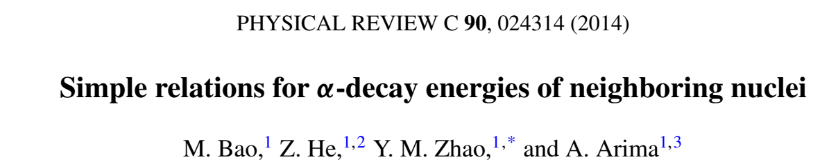
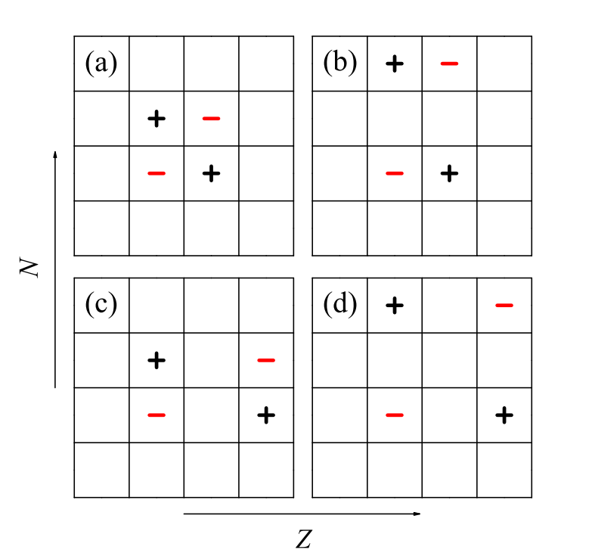

Slide 97
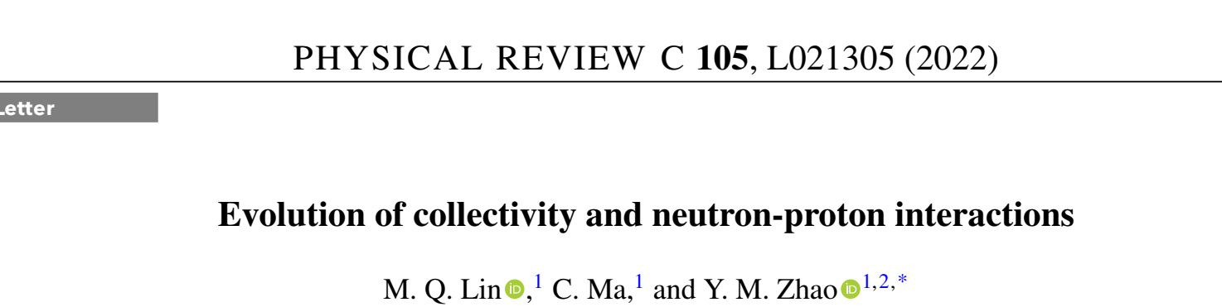
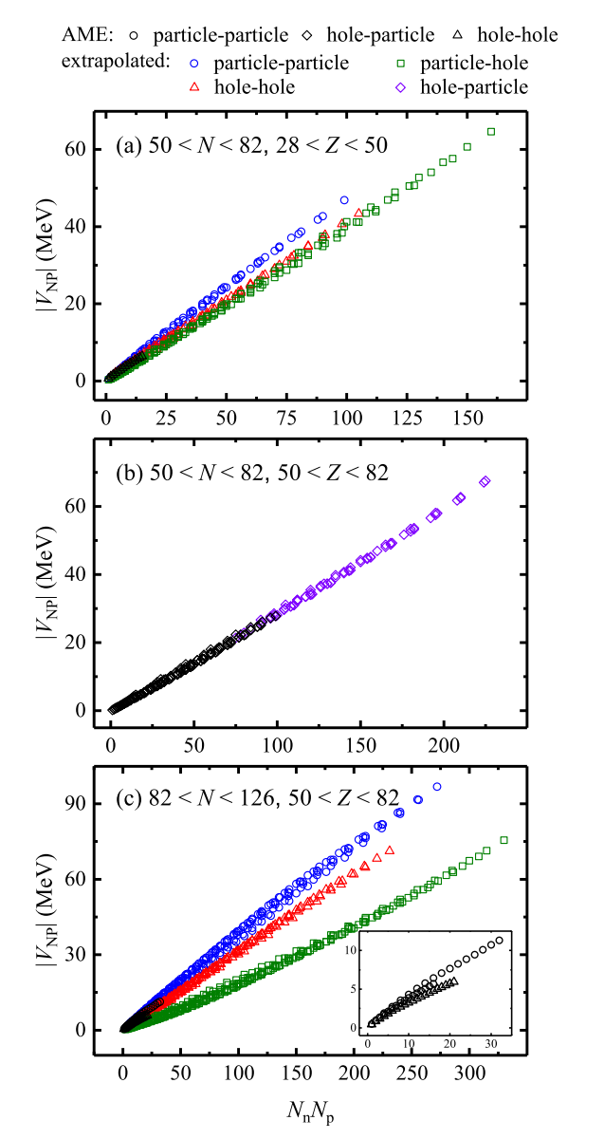
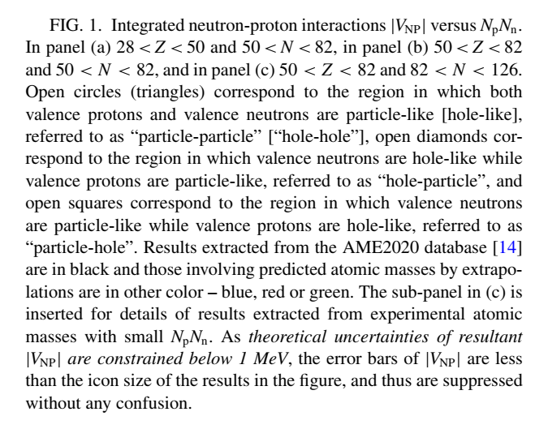

Slide 98
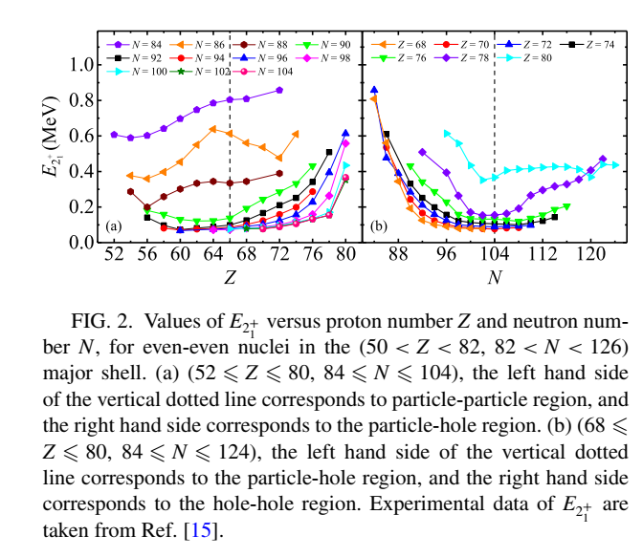

Slide 99
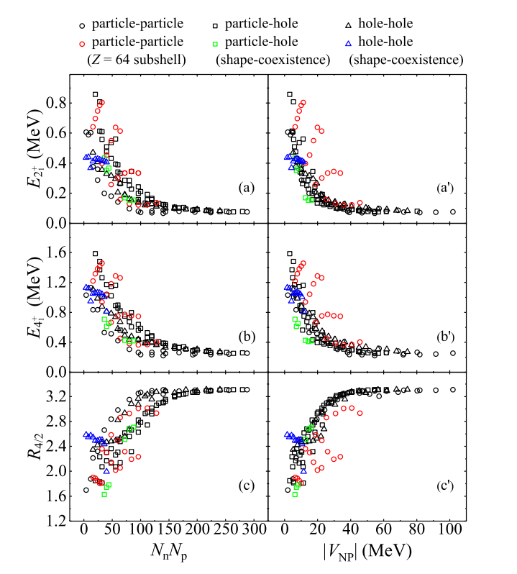

Slide 100
有两个不是 质子-中子相互作用，
但是很愿意说。

Slide 101
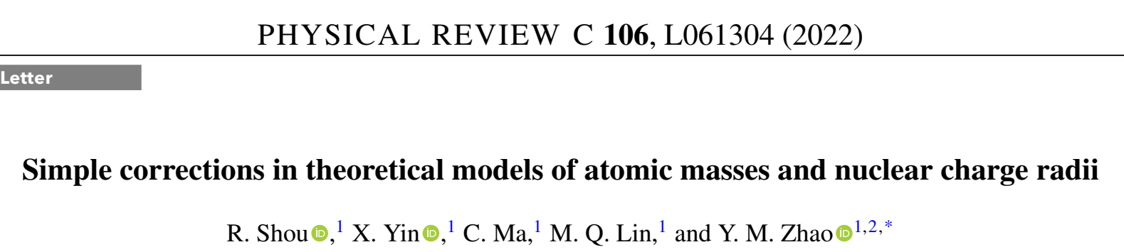

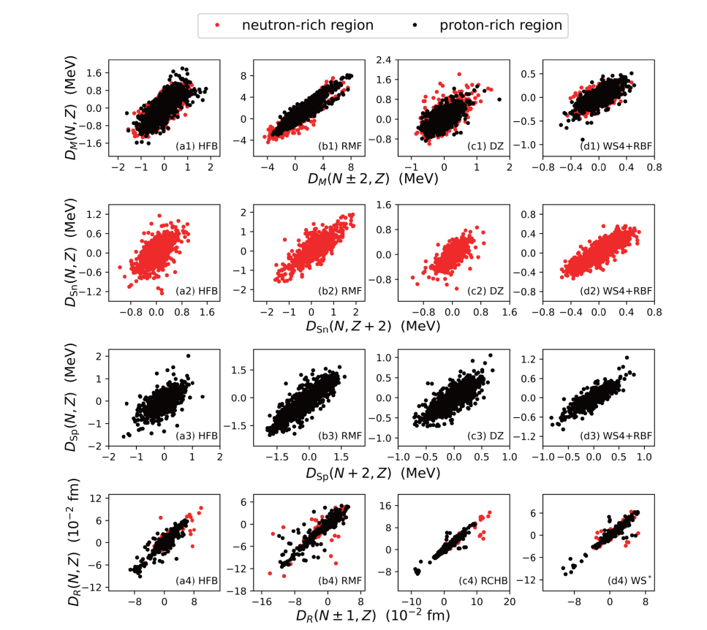

Slide 102
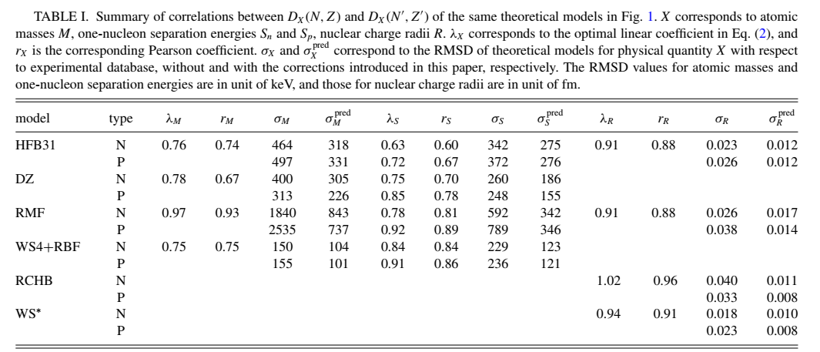

Slide 103
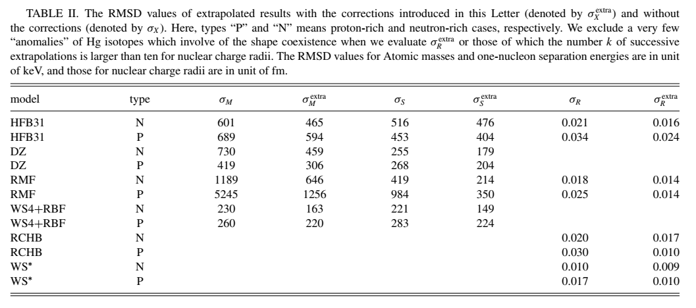

Slide 104
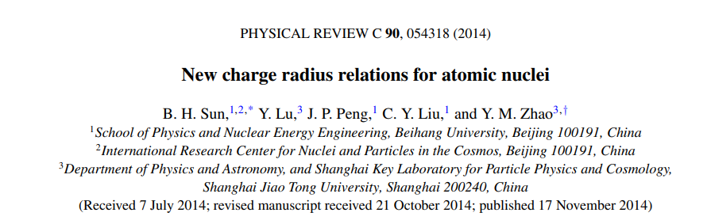




孙保华等
鲍曼等

Slide 105




鲍曼等
马畅等
这类游戏的窍门：细节、细节、不能只看方均根偏差

Slide 106
7、几点意见

Slide 107
原子核太复杂… … 没有什么是完全清楚的。库仑相互作用清楚，但是库仑能是不清楚的，估计永远不可能清楚，因为库仑能精确值没有实验值。
还有一个小能量：磁场能量，也是不可能找到校准的方法。磁场能与自旋相互作用重叠，形式一样。我们只知道总能量，各种来源无法脱耦合。
磁场能量有没有可观测效应？
这是我们在唯象模型中的困境！
不过我们只能与魔共舞。

Slide 108
提纲
1、配对理论：简单概要 和 新进展 [5分钟]
2、关于 delta 相互作用矩阵元的最近结果[5分钟]
3、随机相互作用的原子核结构[5分钟]
4、壳模型组态的维数问题 [5分钟]
5、镜像核质量关系[10分钟]
6、经验的中子-质子相互作用及其应用[30分钟]
7、原子核质量经验关系的意见 [5分钟]

Slide 109
谢谢大家！

