Slide 1
从手征核力到核物理第一性原理计算
许甫荣
手征有效场论核力（三体力）
第一性原理计算：含共振和连续谱
把手征核力、重整化、ab initio多体方法推广到复能量空间
弱束缚原子核
同济大学 2023.05.25

Slide 2
低能核理论的二个最基本问题：
Nuclear force（核力）
Many-body correlations（多体量子关联）
什么叫核结构第一性原理计算 (ab initio, first principles) ？
1）从 realistic nuclear forces出发
2) “严格”处理量子多体关联 (“严格”— 数值计算收敛)

Slide 3
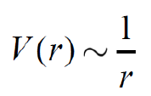
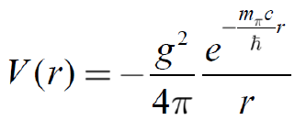

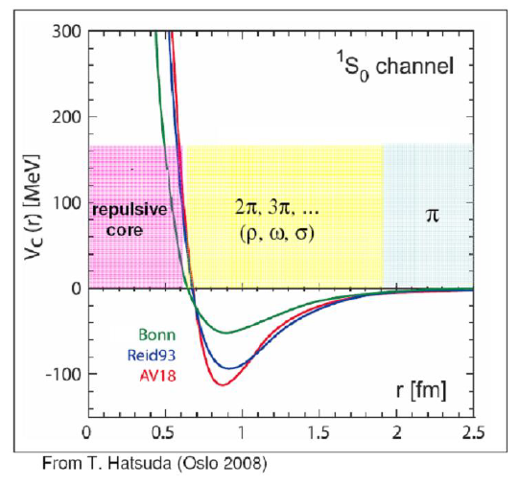
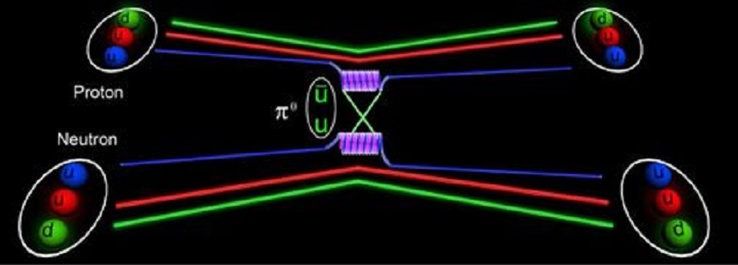
Yukawa nuclear force by π meson exchange
I. Realistic nuclear forces
Electromagnetic force has an infinite range!
(交换光子，m_{γ}=0)
交换π介子
Long-range attractive，no short-range repulsive

Slide 4

Chadwick (1932): Neutron
Heisenberg (1932): First phenomenology (Isospin)
Yukawa (1935): Meson hypothesis
1930’s
1940’s
Discovery of the pion in cosmic ray (1947) and in the
Berkeley Cyclotron Lab (1948).
Nobel prize awarded to Yukawa (1949).
One-Pion-Exchange (OPE): o.k.
Taketani, Nakamura, Sasaki (1951): 3 ranges.
Taketani, Machida, Onuma (1952);
Brueckner, Watson (1953).
Multi-pion exchanges: Problems!
1950’s
“Pion Theories”

Slide 5
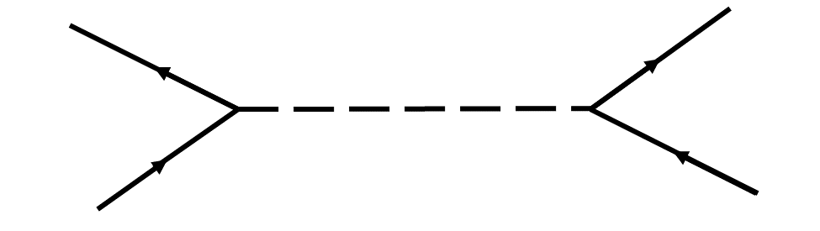
Many pions = multi-pion resonances:
One-Boson-Exchange Model
1960’s
1970’s
— 80’s
Refined Meson Theories
Paris Potential (Lacombe et al., PRC 21, 861 (1980))
Bonn potential (Machleidt et al., Phys. Rep. 149, 1 (1987))

Slide 6

1990s: 高精度核力
high-precision modern nuclear forces
(about 6000 NN Data below 350 MeV)
1993 Nijmegen: high-precision phase shift analysis
1994-2001: High-precision NN potentials:
Nijmegen I, II, AV18，CD-Bonn，N³LO …

Slide 7
Chiral EFT
1970s-1980s
QCD: Quark cluster model
从QCD做核结构计算？
Effective Field Theory (EFT):
Weinberg (1990); Ordonez, Ray, van Kolck (1994/96)
成功的pion theory， 拥有QCD一样的底层对称性
特别是 chiral symmetry and broken spontaneously
1990 –
today

Slide 8
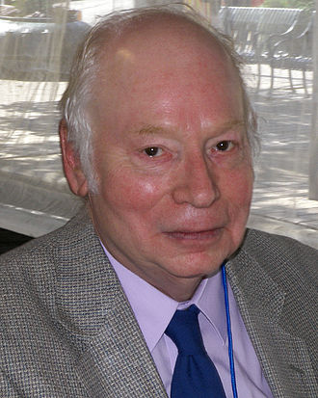
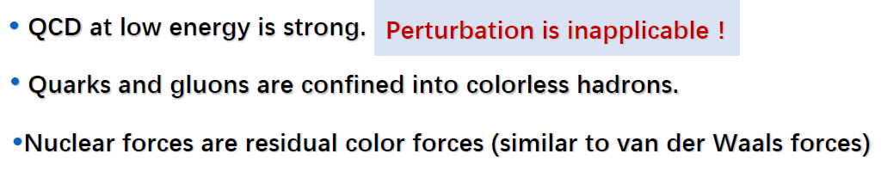
QCD=quarks + gluons (symmetries: spin, isospin, parity, chiral symmetry broken spontaneously)
Chiral EFT=nucleon + pion (symmetries: spin, isospin, parity, chiral symmetry broken spontaneously)
50s: multi-pion exchange 失败， Why?
因为当时还不知道如何表达手征对称性及其破缺！写出的场论拉氏量不合适！
Weinberg (1990’s)
At low energy, the effective degrees of freedom are nucleon and pion, rather than quark and gluon!
Notes:
Hamiltonian可能包含的对称性：I, T, parity? CP symmetry? In Chiral EFT （手征有效场理论），由于pion的质量不为零，所以手征对称性是破缺的,但是具有CP对称性？正像QCD中，由于u和d夸克的质量不为零，所以QCD强相互作用的手征对称性是破缺的，但具有CP对称性（CP=手征×宇称），弱相互作用又破坏CP对称性。
理论方法要好。
第二项公式的第一项是质心系动能，但（p_i-p_j)不是相对动量，如果两个物体质量相同，则相对动量是(p_i-p_j)/2，具体推导见笔记。

Slide 9

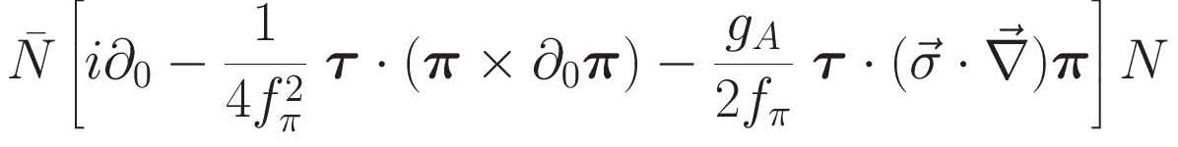
Chiral EFT：
π- π Lagrangian:
π -N Lagrangians:
N-N Lagrangian (“Contacts” N³LO ): 24 essentially free parameters.
No free parameters.
no free parameters.
4 parameters.
In principal fixed by pi-N data
4 parameters.
R. Machleidt, D.R. Entemb, Phys. Rep. 503, 1 (2011)

Slide 10
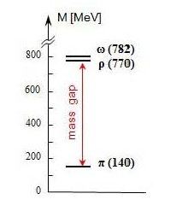
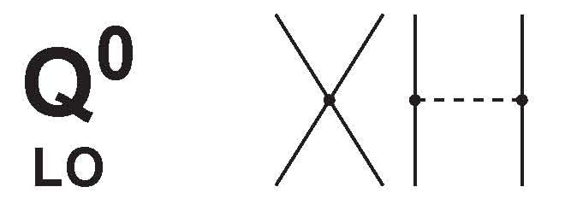
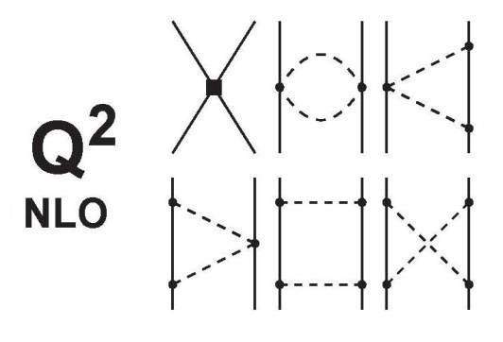
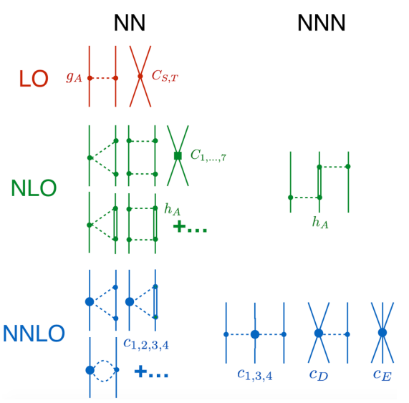

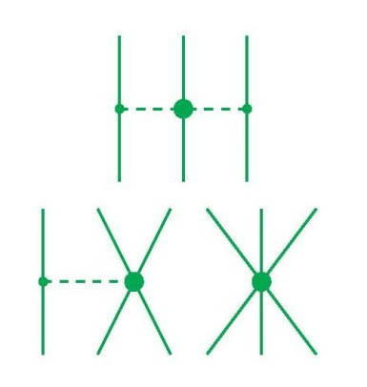
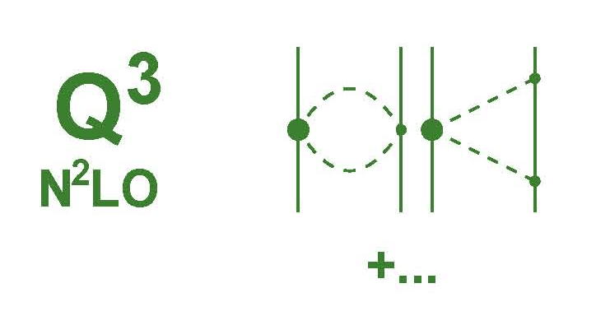
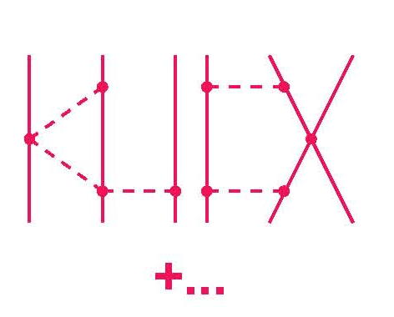
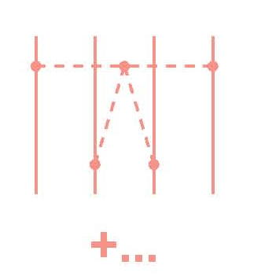
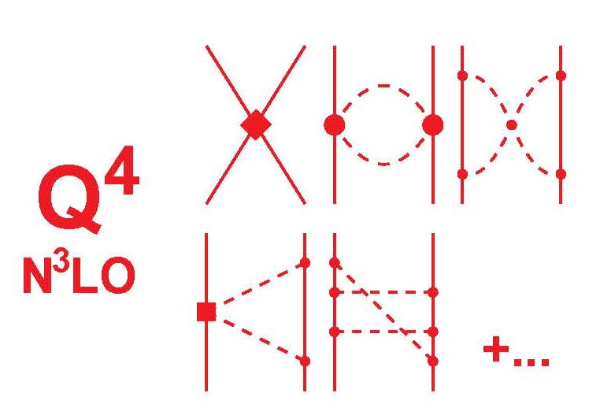
2N forces
3N forces
4N forces
Leading Order
Chiral EFT
2000年以后才开始EFT核物理计算
Next-to Leading Order
Advantages:
Gives hierarchy of nuclear force;
Naturally generates 3NF, 4NF…
Control the uncertainty of each hierarchy.
……
Power counting ：
Next-to-Next-to Leading Order
(Q/Λ_{χ})^{ν}
Next-to-Next-to-Next-to Leading Order

Slide 11
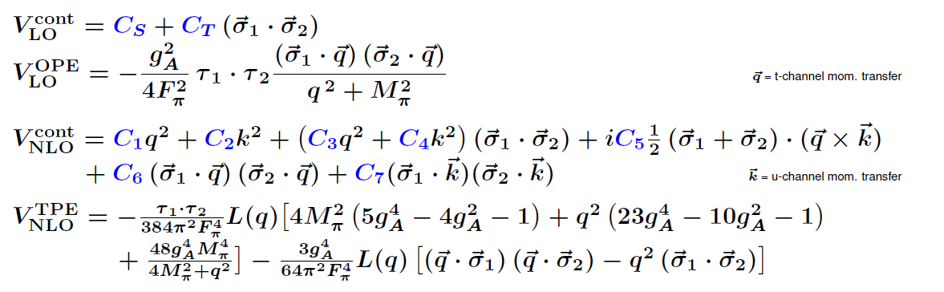
NLO or NNLO, only 9 parameters
2003 N³LO : Entem and Machleidt,, PRC 68, 041001(R) (2003);
R. Machleidt, D.R. Entem, Physics Reports 503, 1 (2011)

Slide 12
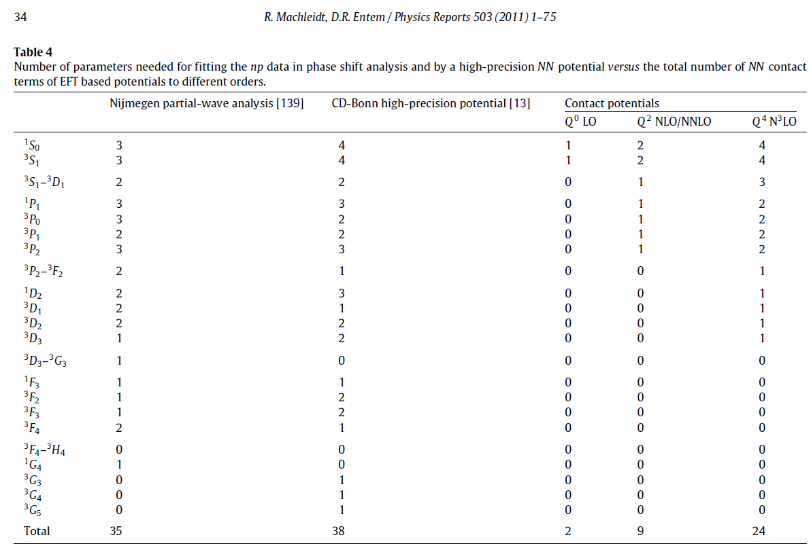

Slide 13
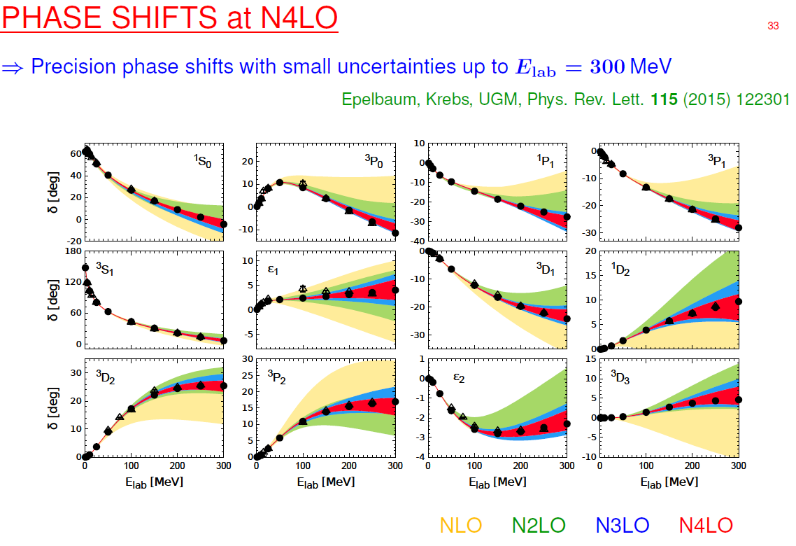
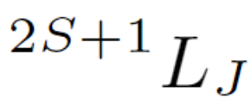
ChPT Lagrangian 的合理性
现实核力的最大特点：势参数由核子二体散射数据确定（和²H），而不是核结构实验数据！

Slide 14
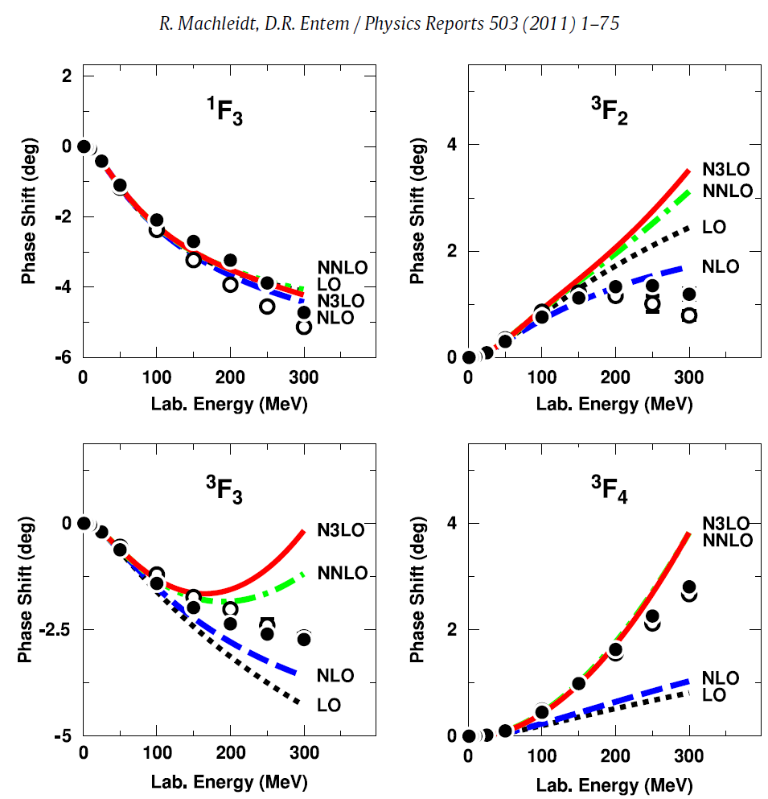
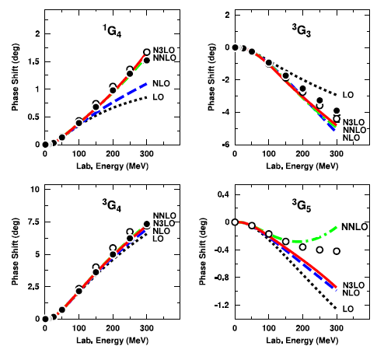

Slide 15
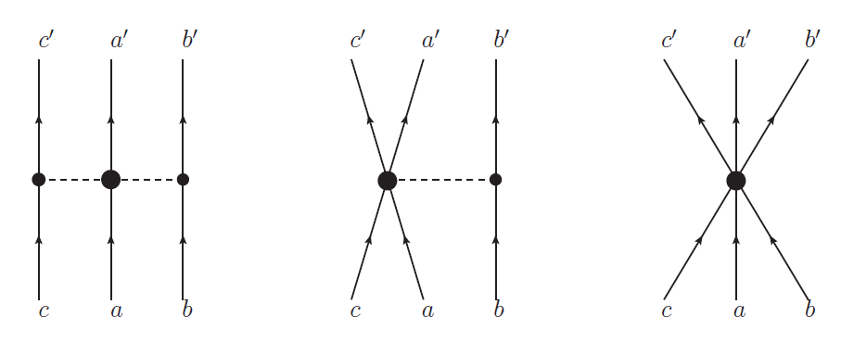
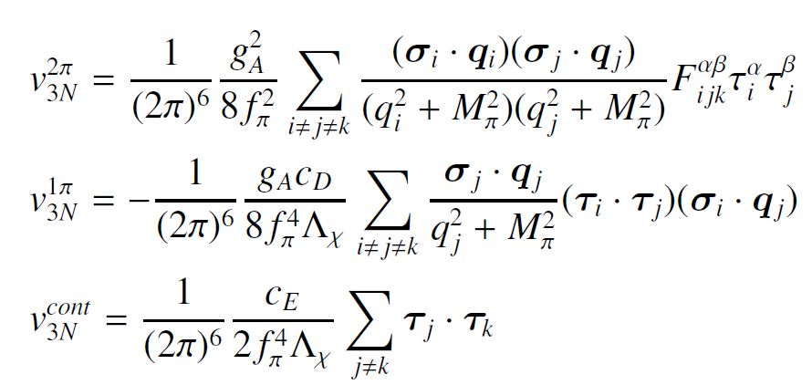
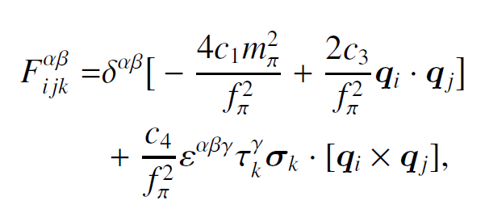
三体力 （3NF）

Slide 16
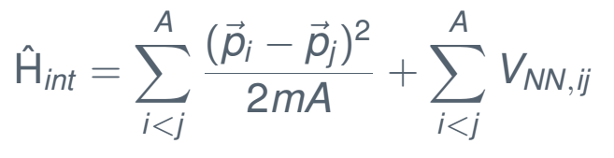
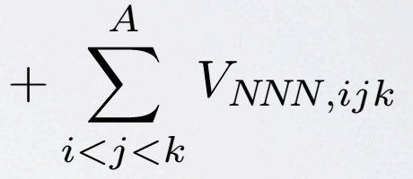
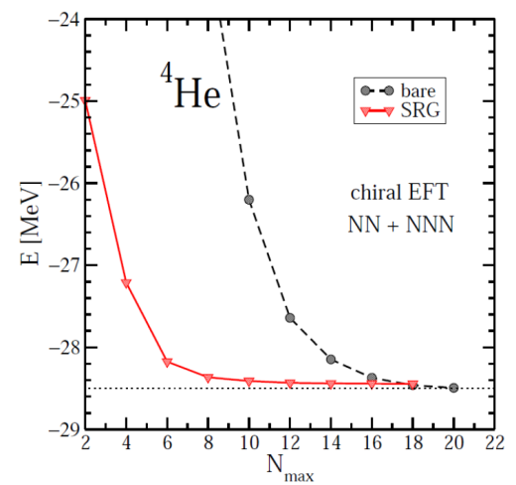
II. Renormalizations (softening) : G-matrix, V_{low-k,} OLS, SRG, UCOM…
自由空间的核力软化，目的是加速数值“量子强关联多体系统”计算的收敛性
“无限”空间转化到有限空间，目的是缩小模型空间
No-Core Shell Model (NCSM)

Slide 17
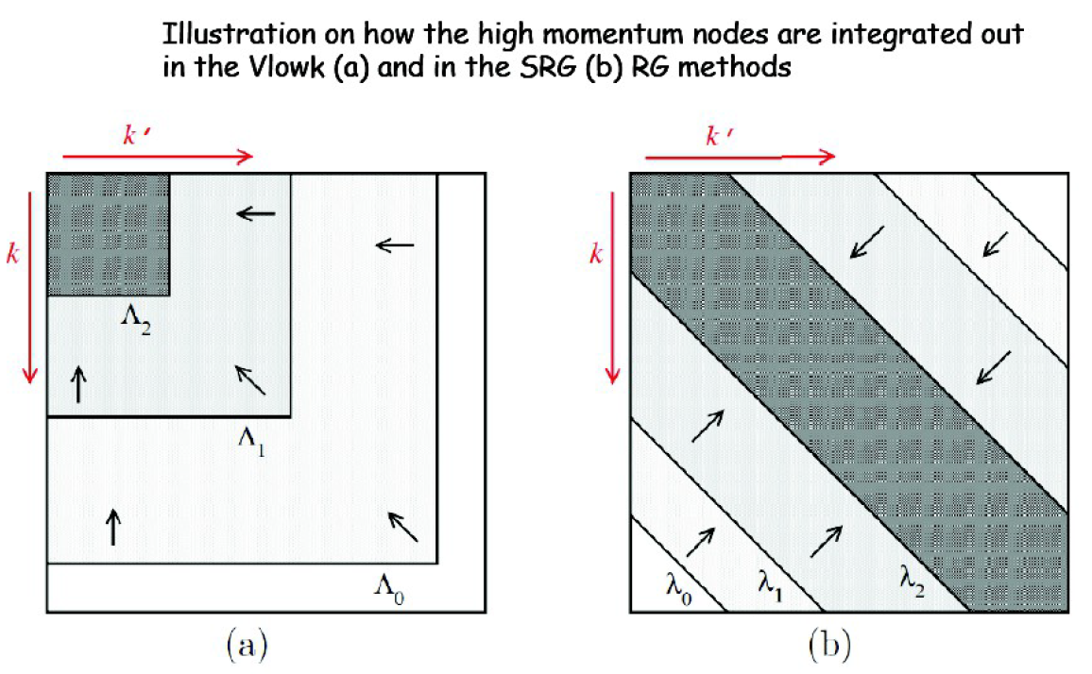
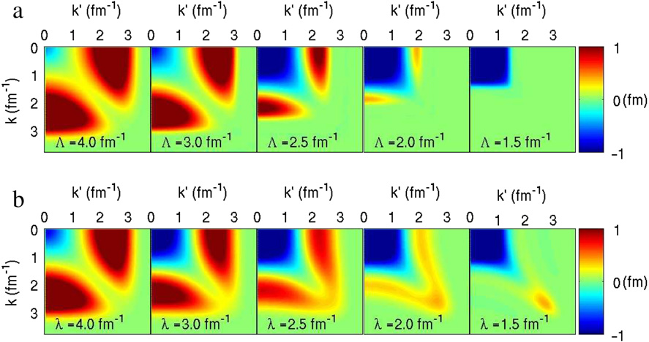
软化核力
SRG
V_{low-k}
V_{low-k}
SRG

Slide 18
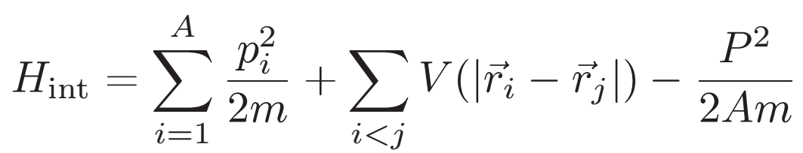
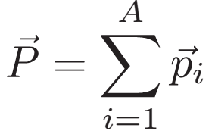
III. 如何“严格”求解强关联量子多体体系？Ab initio many-body methods

Slide 19

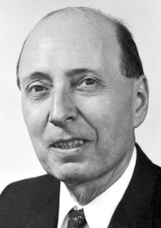
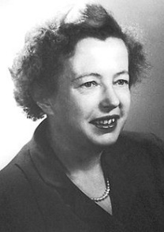
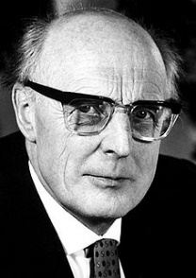
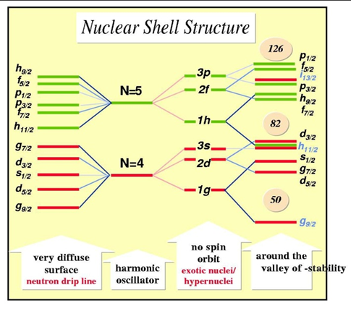
Nuclear shell model
（概念1932年由D. Ivanenko and E. Gapon提出，1949年主要由下面三人独立发展，Nobel prize 1963 ）
Eugene Paul Wigner
Maria Goeppert-Mayer
J. Hans D. Jensen
Spin-orbit coupling
幻数
单粒子壳层轨道实验可观测吗？
（定量）
Single-particle orbits (shell)
(configuration-mixing; configuration-interaction) shell model
1950年代开始，Igal Talmi et al.
Many-body nucleus
原子核性质实验可观测吗？（定量）

Slide 20
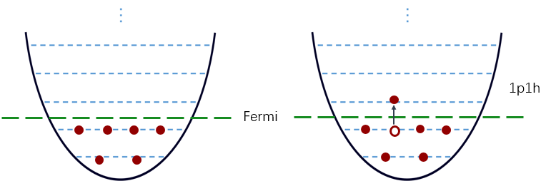
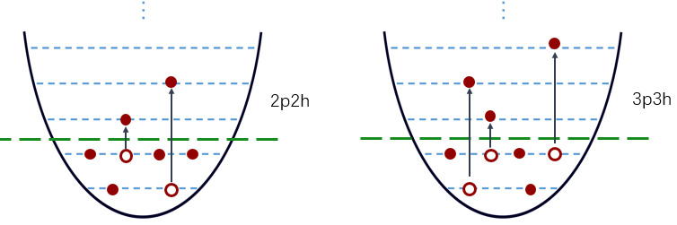
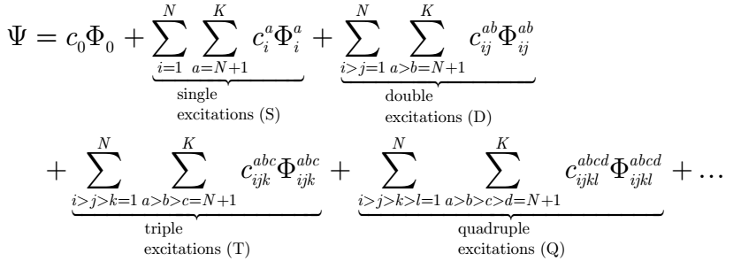
N_{max}

Slide 21
我们组：
1）Nuclear forces
NNN done √
NN 进行中
2）核力重整化
V_{low-k}, Similarity Renormalization Group (SRG)
3) Many-Body methods
a) Configuration-interaction Gamow shell model
b) In-medium Similarity Renormalization Group (IM-SRG) (Gamow and conventional)

Slide 22
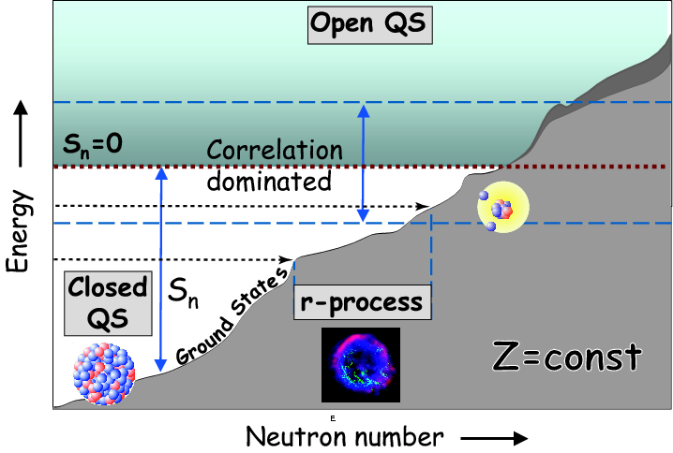
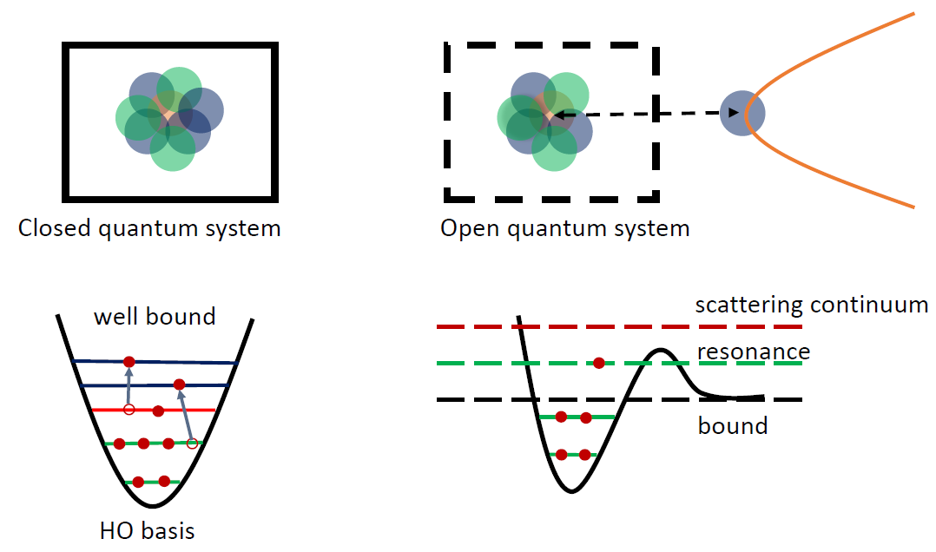
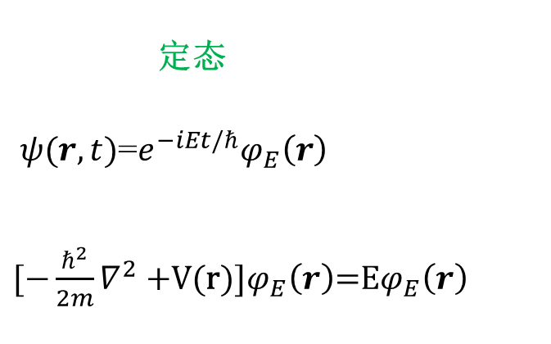
Resonance and continuum
定态
$ψ(r,t)$=$e^{−iEt/ℏ}φ_{E}\left(r\right)$
$[−\frac{ℏ^{2}}{2m}∇^{2}+$V(r)]$φ_{E}\left(r\right)$=E$φ_{E}\left(r\right)$

Slide 23
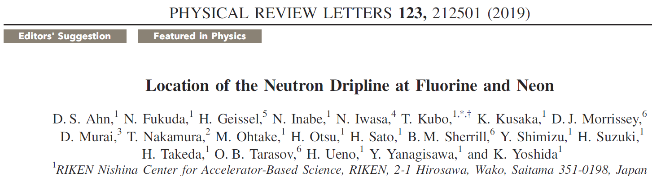
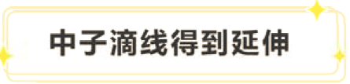
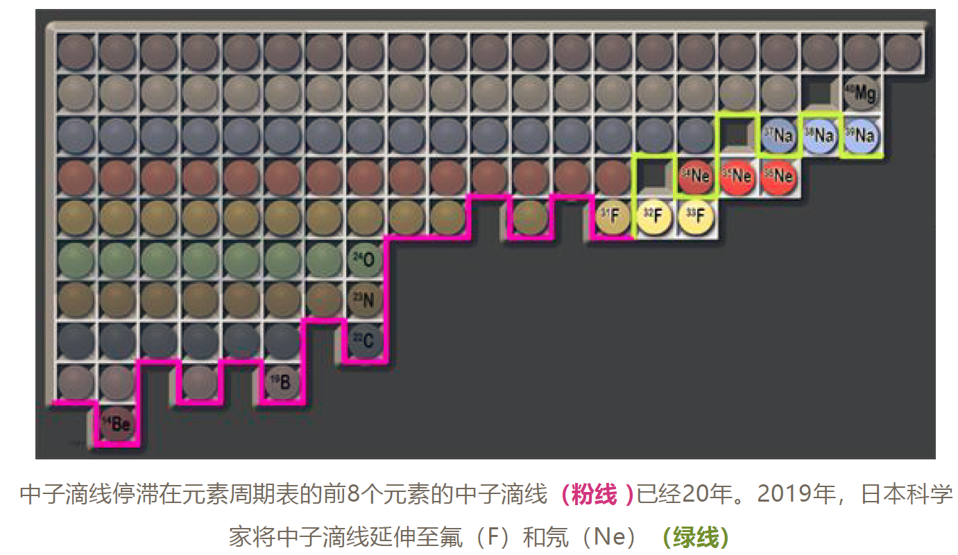
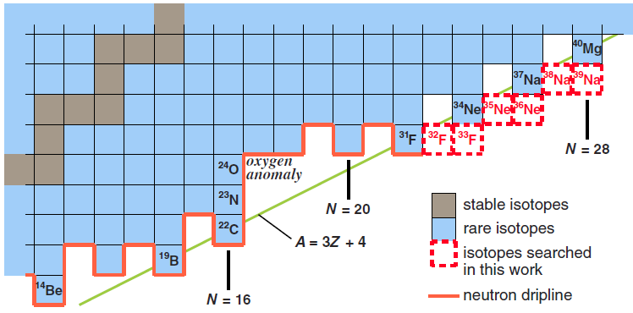
滴线区原子核
美国物理学会选出的“2019年物理学发生的十大事件”
4.
物理学家希望下一个元素的滴线不要再等上20年。下一代稀有同位素装置计划在两年内投入使用，可能会将滴线延伸至镁元素，即元素周期表中的第12号元素。

Slide 24
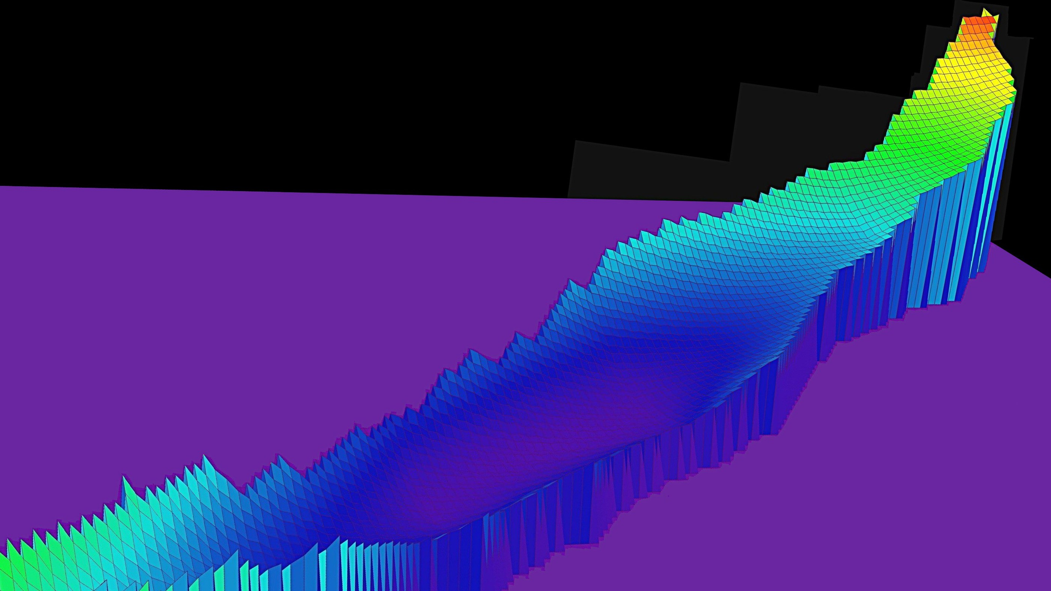
核素版图 Nuclear Landscape
走向核素版图的边缘
Z →
稳定谷
N →

Slide 25
核天体物理：Element production

Slide 26
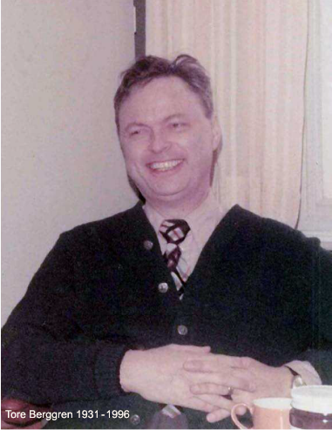

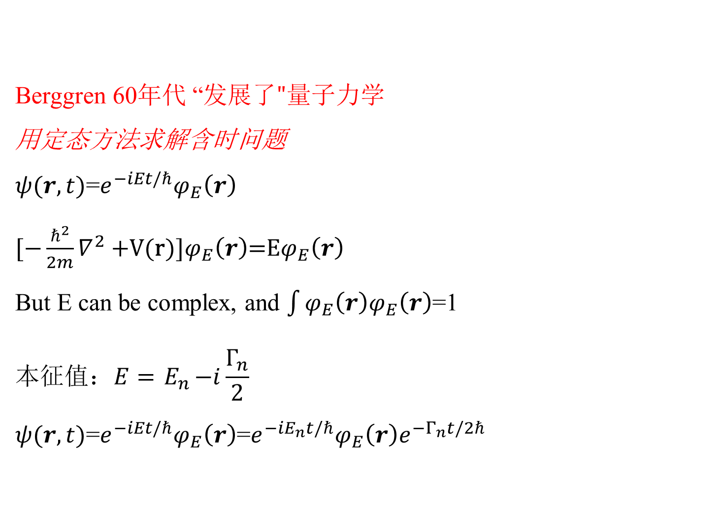
Berggren 60年代 “发展$了"量子力学$ 用定态方法求解含时问题 $ψ(r,t)$=$e^{−iEt/ℏ}φ_{E}\left(r\right)$ $[−\frac{ℏ^{2}}{2m}∇^{2}+$V(r)]$φ_{E}\left(r\right)$=E$φ_{E}\left(r\right)$ But E can be complex, and $\int{φ_{E}\left(r\right)φ_{E}\left(r\right)}$=1 $$本征值：E={ E}_{n}−i\frac{Γ_{n}}{2}$$ $ψ(r,t)$=$e^{−iEt/ℏ}φ_{E}\left(r\right)$=${e^{−iE_{n}t/ℏ}φ}_{E}\left(r\right)e^{−Γ_{n}t/2ℏ}$
Berggren basis: T. Berggren, Nucl. Phys. A109 (1968) 265
T. Berggren, PhD in 1966 (Lund)
（Berggren方法的一个关键）
核态有衰变寿命，decay width:
复空间求解量子力学问题要比实空间困难得多！
Notes:
conjugate ['kɒndʒʊgeɪt]

Slide 27








Complex-momentum space: bound, resonance and continuum
Woods-Saxon in complex-k space

Slide 28



ab initio Gamow Shell Model
我们发展了基于现实核力的 ab initio Gamow Shell Model
Bare forces:
Strong repulsion，slow convergence
$V_{low k}$ or SRG
To remove hard core,
but still keep good descriptions of NN scattering phase shifts
Q-box folded diagrams
Non-degenerate extended Kuo-Krenciglowa folded-diagram method (EKK) by Takayanagi, NPA 852, 61 (2011)

Slide 29


S-, Q-box folded diagrams in complex-k Berggren basis

Slide 30


60年代以前，现实核力研究主要局限于核力本身的研究或用于一些少体问题研究，很难用于真正的核物理计算（计算核结构问题定量很差）
G.E. Brown 60’s: 从现实核力出发计算核结构问题，
Q-box folded diagrams, V_{low-k}
核芯极化的重要性！
使得用现实核力计算原子核成为可能！

Slide 31



⁶He halo
density
⁶He correlated density distribution
0⁺
⁶He halo

Slide 32



The continuum coupling is important to make the correct orders of levels in odd-A carbons
CD Bonn GSM with ¹⁴C core
d_{3/2,} d_{5/2}
_{continua}
V
3.56 − i0.87
0d_{3/2}
s_{1/2}
_{continuum}
Calculations without the coupling to the continuum cannot the correct ground states and the level order！
0.0
−0.48
0d_{5/2}
−1.22
1s_{1/2}
中子
−60.0
GSM space:
0d_{5/2}, 1s_{1/2}+s-continuum, 0d_{3/2} (resonance)+d_{3/2}-continuum
Y. F. Geng, J. G. Li, Y. Z. Ma, B. S. Hu, Q. Wu, Z. H. Sun, S. Zhang, and FRX, PRC 106, 024304 (2022)

Slide 33


Chiral EFT 3NF (NNLO) Gamow 3NF
Chiral EFT 3NF
E. Epelbaum et al., PRC 66, 064001 (2002);
P. Navratil et al., PRL 99, 042501(2007)
Phenomenological 3NFs:
- Urbana (1995)
- Tucson-Melbourne (1975-1999)
- Illinois (2001-2010)
- CD-Bonn + Δ (Deltuva, Sauer, 2003)
Δ-resonance (m ~1232MeV, t ~10⁻²⁴ s)
isobar degrees of freedom贡献很小，在Lagranian中可以不考虑
(m_{n}=939.6 MeV; m_{p}=938.3 MeV)

Slide 34



GSM with ¹⁶O core: N³LO(NN) + N²LO(NNN)
Ma, Xu, Coraggio, Hu, Li, Fukui, Angelis, N.Itaco, Gargano, PLB 802, 135257 (2020)
[3] Otsuka, Suzuki, Holt, Schwenk, Akaishi, PRL 105 (2010) 032501.
[31] Hagen, Hjorth-Jensen, Jansen, Machleidt, Papenbrock, PRL108 (2012) 242501.
N³LO(NN): Entem and Machleidt, PRC 66, 014002 (2002).
N²LO(NNN): c_{D}=-1, c_{E}=-0.34, Navrátil, Gueorguiev, Vary, Ormand, A. Nogga, PRL 99, 042501 (2007).

Slide 35


IM-SRG
1. Tsukiyama, Bogner, Schwenk, PRL106, 222502 (2011).
2. Hergert, Bogner, Morris, Schwenk, Tsukiyama, Physics Reports 621, 165 (2016)
We have developed Gamow IM-SRG
Complex-momentum Berggren space Gamow IM-SRG

Slide 36









Real-energy IM-SRG
Complex-energy Gamow IM-SRG
Continuous similarity transformation
Flow equation
White generator η(s) is used
Directly gives g.s. energies for close-shell nuclei.
Notes:
Conjugate ['kɒndʒʊgeɪt]

Slide 37

Hu, Wu, Sun, Xu, PRC 99, 061302(R) (2019)

Slide 38


For open-shell nuclei

Slide 39

Summary
Berggren complex space
Ab initio nuclear structure calculations with resonance and continuum considered
1. Complex EFT 3NF at N²LO
2. Ab initio Gamow shell model with a core
calculating complex S-box and Q-box folded diagrams
3. Ab initio Gamow IMSRG
Both the continuum coupling and 3NF are important for nuclei near driplines

Slide 40


同济 2023.05.25
李健国, 胡柏山, 马远卓, 孙中浩, 吴强, 张爽, 袁琪…
Michel, 左维
Coraggio, Fukui，…

Slide 41

Thomas-Ehrman shift (TES) in mirror pair
Both continuum effect and 3NF are important to make the observed TES
Continuum effect
If no 3NF, calculation cannot give the correct order of the levels.
CIB: charge independence breaking, a violation of rotation invariance in isospin space.
T=1 NN interaction: Tz=+1 (pp), 0 (np) and -1 (nn)
The main reasons: m_{p}≠m_{n}, π⁰, π± mass splitting
CIB is more significant than CSB
CSB: charge symmetry breaking, a violation of rotation invariance by 180°
Only for pp and nn
S. Zhang, Y.Z. Ma, J.G. Li, B.S. Hu, Q. Yuan, Z.H. Cheng, F.R. Xu, PLB 827, 136958 (2022)
Notes:
sodium

Slide 42






Q-box folded diagrams
Full space 本征值问题
One-body
Residual two-body

Slide 43











求解无限空间$→$有限空间多体问题
$$H_{eff}\left(E_{v}\right)P\left|Ψ_{v}\right\rangle =E_{v}P\left|Ψ_{v}\right\rangle$$
$$H_{eff}\left(E_{v}\right)=P\left(H_{0}+H_{1}\right)P+P\left(H_{0}+H_{1}\right)Q\frac{1}{E_{v}−H_{QQ}}Q\left(H_{0}+H_{1}\right)P$$
$$=PH_{0}P+PH_{1}P+\left(PH_{0}Q+PH_{1}Q\right)\frac{1}{E_{v}−H_{QQ}}\left(QH_{0}P+QH_{1}P\right)$$
$$=$$
$$H_{0}PQ$$
$$=$$
$$\left(∵P, Q与H_{0}对易\right)$$
$$0$$
unperturbed one-body
$$V_{eff}\left(E_{v}\right)=PH_{1}P+PH_{1}\frac{Q}{E_{v}−QH_{0}Q}H_{1}P+PH_{1}\frac{Q}{E_{v}−QH_{0}Q}H_{1}\frac{Q}{E_{v}−QH_{0}Q}H_{1}P+⋯$$
2nd order perturbation
3rd order perturbation

