Slide 1



Reactions of weakly-bound nuclei
at near-barrier energies
Chengjian Lin (cjlin@ciae.ac.cn)
China Institute of Atomic Energy, P.O. Box 275(10), Beijing 102413, China

Slide 2
Contents
OMPs of weakly-bound nuclear systems
⁶He+²⁰⁹Bi, ⁶Li+²⁰⁸Pb
Breakups of weakly-bound stable nuclei
^{6,7}Li+²⁰⁸Pb
Reactions with proton-rich unstable nuclei
¹⁷F+⁵⁸Ni, ⁸B+¹²⁰Sn
Summary and outlook
Apr. 10, 2024
C.J. Lin @ TJU

Slide 3
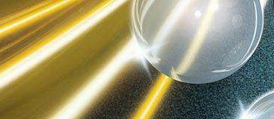
Optical Model Potential
Optical Model is a successful model to explain the nuclear scattering and reaction, which resembles the case of light scattered by an opaque glass sphere.
phenomenological potential, independent on energy.
A basic task in nuclear reaction study is to understand the nuclear interaction potential.
Optical Model Potential (OMP):
U = V(r) + iW(r)
attractive absorptive
Cf: 1) S. Fernbach, R. Serber, and T. B. Taylor, Phys. Rev. 73, 1352 (1949).
2) H. Feshbach, “The optical model and its justification”, Ann. Rev. Nucl. Sci. 8, 49 (1958).
Apr. 10, 2024
1.1 Introduction

Slide 4
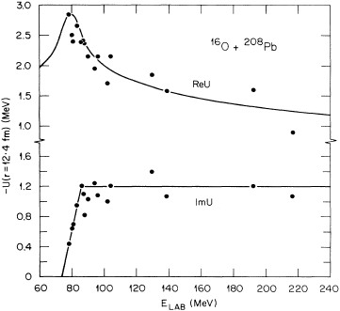
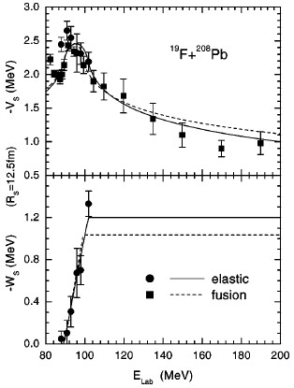


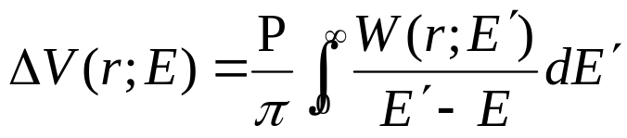
Tightly-bound Nuclei
Threshold Anomaly
A universal phenomenon
at energies around the Coulomb barrier
Anomaly
Space Time
Nonlocality
V_{B}
Dispersion relation
Dynamic Polarization Potential:
C.J. Lin et al.,
PRC 63, 064606 (2001).
Threshold
Dispersion Relation
(results from the causality)
Cf: 1) M. A. Nagarajan, C. C. Mahaux, and G. R. Satchler, Phys. Rev. Lett. 54, 1136 (1985).
2) C. Mahaux, H. Ngo, and G. R. Satchler, Nucl. Phys. A449, 354 (1986).
3) G. R. Satchler, Phys. Rep. 199, 147 (1991).
Apr. 10, 2024
1.1 Introduction

Slide 5


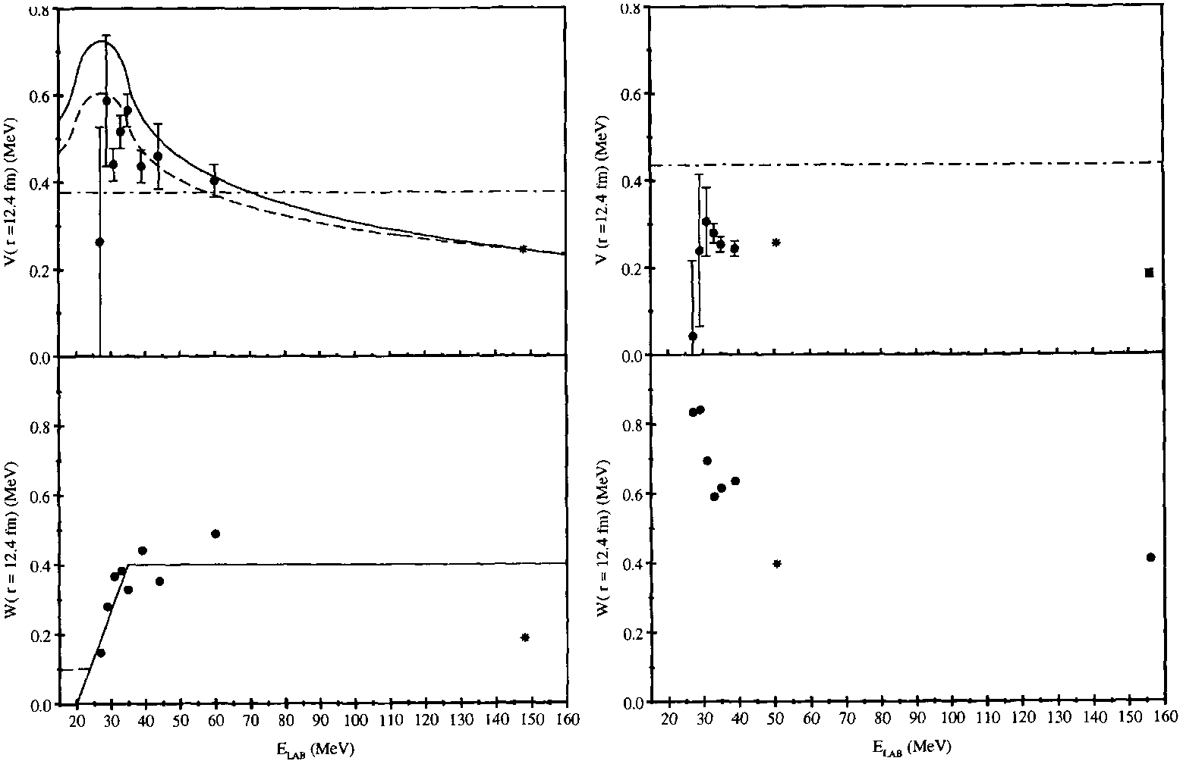
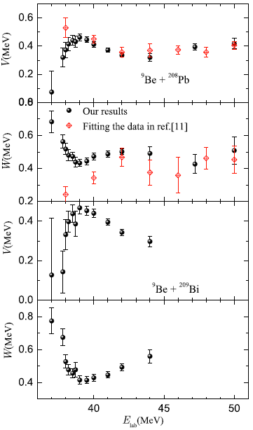
Weakly-bound Stable Nuclei
Threshold Anomaly
Abnormal Threshold Anomaly
⁷Li (α+t)
S_{α} = 2.47 MeV
⁶Li (α+d)
S_{α} = 1.47 MeV
⁹Be (α+n+α)
S_{n} = 1.66 MeV
⁷Li+²⁰⁸Pb
⁶Li+²⁰⁸Pb
⁹Be+²⁰⁸Pb
decrease
increase
⁹Be+²⁰⁹Bi
N. Keeley et al., Nucl. Phys. A 571, 326 (1994).
N. Yu et al., JPG 371, 075108 (2010).
Apr. 10, 2024
1.1 Introduction

Slide 6

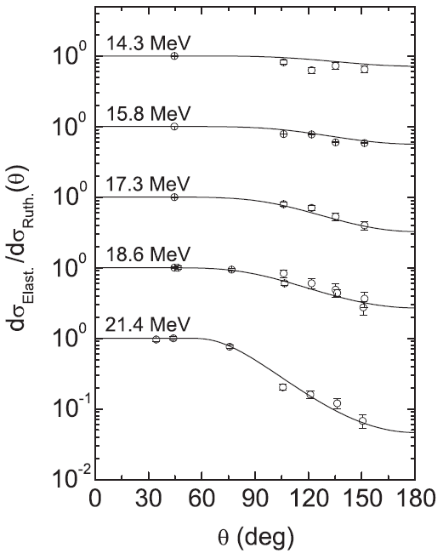
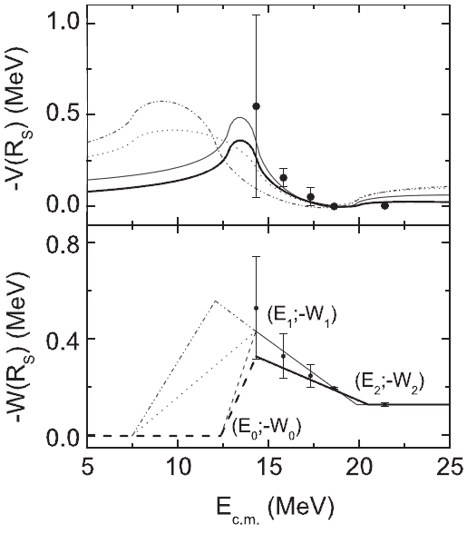
Halo Nuclei
⁶He (α+2n)
S_{2n} = 0.98 MeV
Abnormal Threshold Anomaly
⁶He+²⁰⁹Bi
Δθ =6 -11°
ΔE=1.2 -1.5 MeV
OMPs are usually extracted from elastic scattering.
★ Impossible to extract effective OMPs at energy far below the barrier.
Cf: 1) E.F. Aguilera et al., PRL 84, 5058 (2000); PRC 63, 061603R (2001).
2) A. R. Garcia et al., Phys. Rev. C 76, 067603 (2007).
Apr. 10, 2024
1.1 Introduction

Slide 7
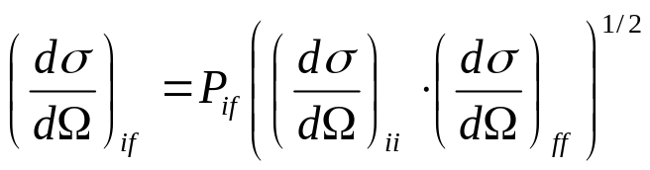

OMPs from Transfers
x
x
+
A
+
A
b
b
a = b+x
B = A+x
Transfer reaction A(a,b)B
elastic scatting cross sections
Transition amplitude:
4 wave functions are needed,
two bound states: b+x & A+x (single-particle potential model)
two scattering states: incoming & outgoing (optical potentials)
First presented at the FUSION06, Venice; C. J. Lin et al., AIP Conf. Proc. 853, 81 (2006).
¹⁶O(¹⁴N,¹³C)¹⁷F：Chin. Phys. Lett. 25, 4237 (2008).
¹¹B(⁷Li,⁶He)¹²C：Chin. Phys. Lett. 26, 022503 (2009). Phys. Rev. C 87, 047601 (2013).
²⁰⁸Pb(⁷Li,⁶He)²⁰⁹Bi：Phys. Rev. C 89, 044615 (2014), Il Nuovo Cimento C 39, 367 (2016),
Chin. Phys. Lett. 31, 092401 (2014), Phys. Rev. C 96, 044615 (2017),
Phys. Rev. Lett. 119, 042503 (2017).
⁶³Cu(⁷Li,⁶He)⁶⁴Zn：Phys. Rev. C 95, 034616 (2017).
Apr. 10, 2024
1.2 OMPs of ⁶He+²⁰⁹Bi

Slide 8
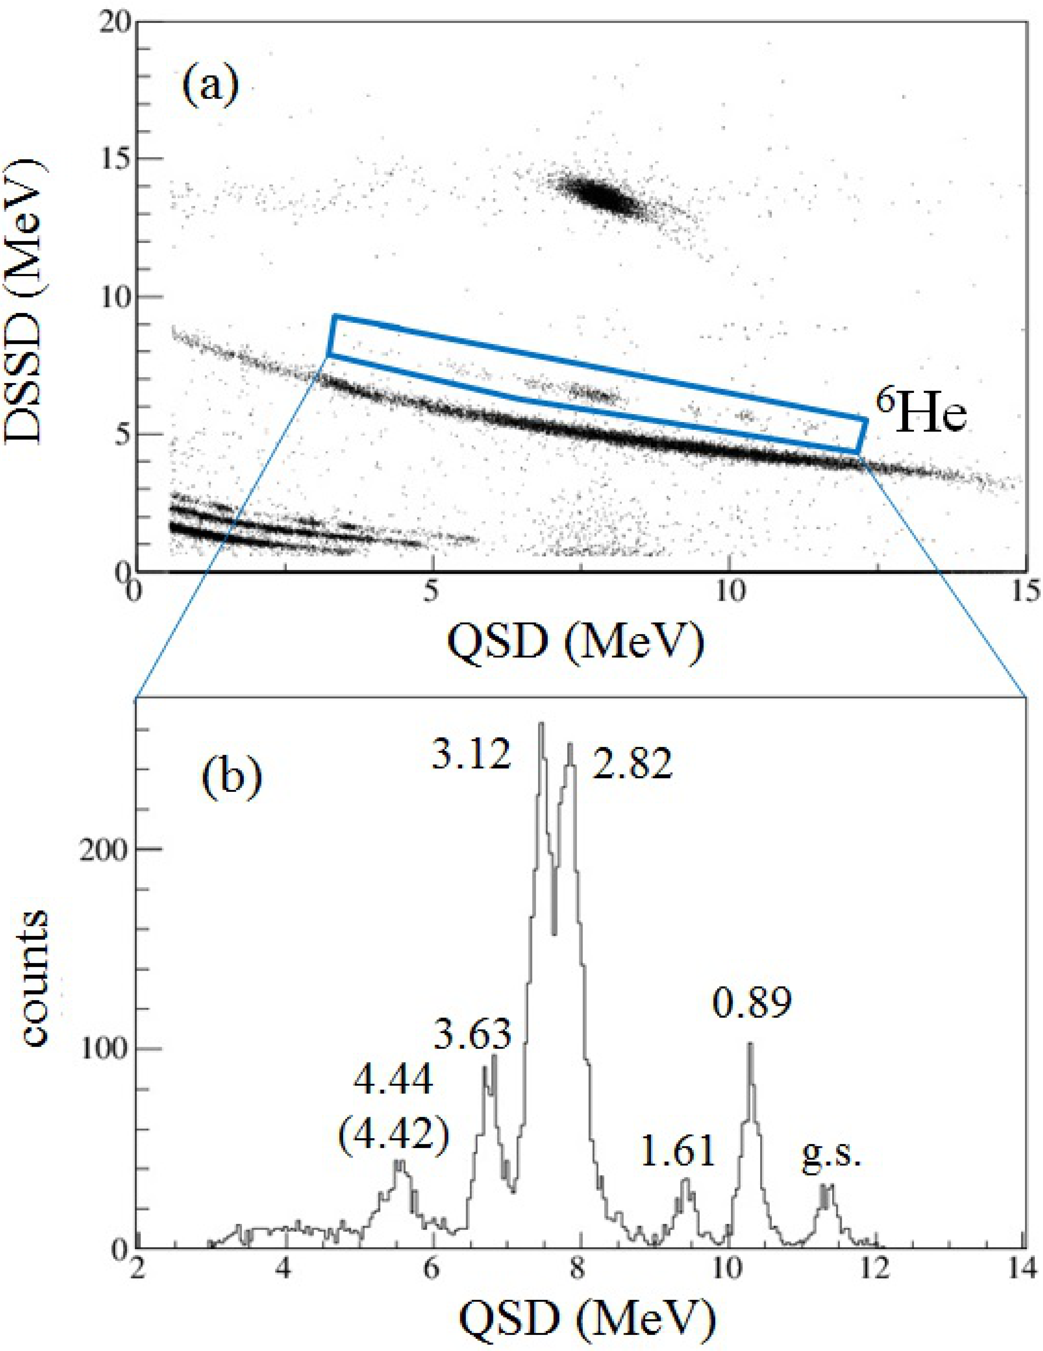
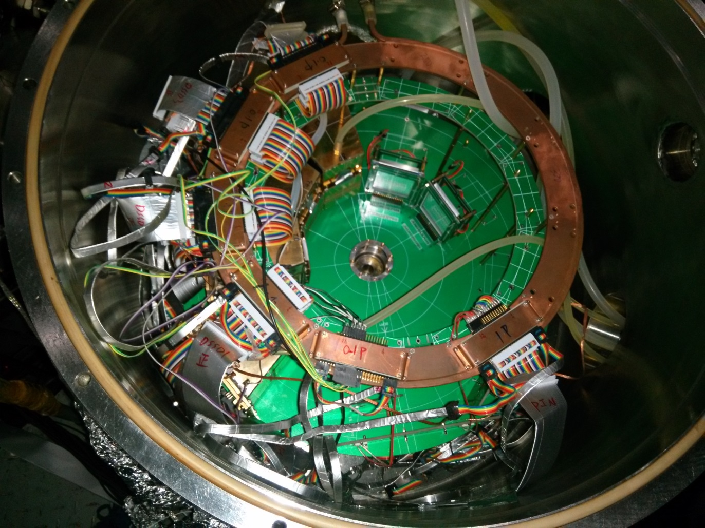
Experiment of ²⁰⁸Pb(⁷Li,⁶He)²⁰⁹Bi
Two experiments have been done at HI-13 tandem accelerator @ CIAE
Exp1: E_{beam} = 42.55, 37.55, 32.55, 28.55, 25.67 MeV – high energies 【2004.8】
Exp2: E_{beam} = 28.55, 25.67, 24.3, 21.2 MeV -- low energies 【2016.4】
Angular distributions of both elastic scattering and transfer were measured.
2 Telescopes: SSSD(20μm) + DSSD(60μm) + QSD(100μm)
Single-particle states
S-factors are well known
Apr. 10, 2024
1.2 OMPs of ⁶He+²⁰⁹Bi

Slide 9
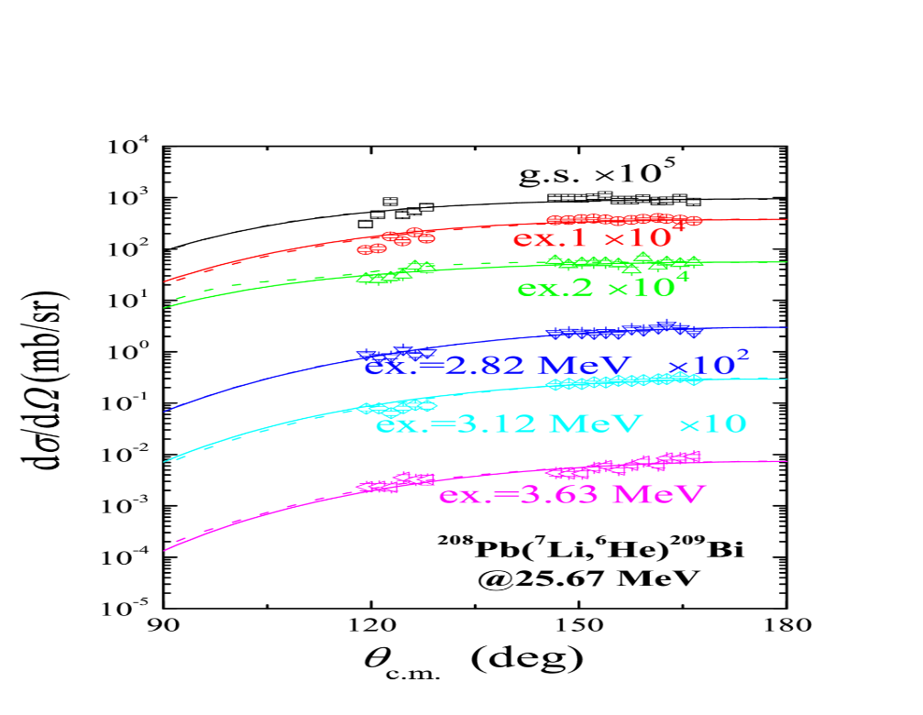
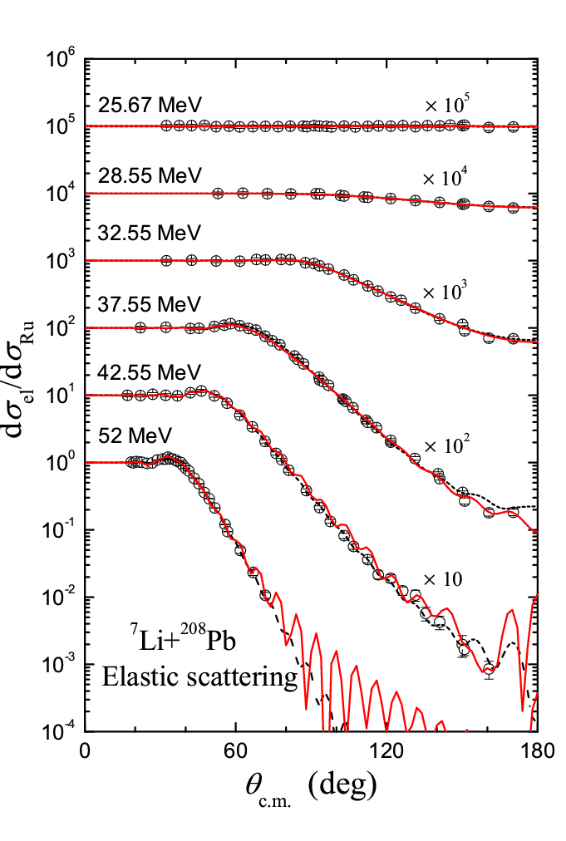
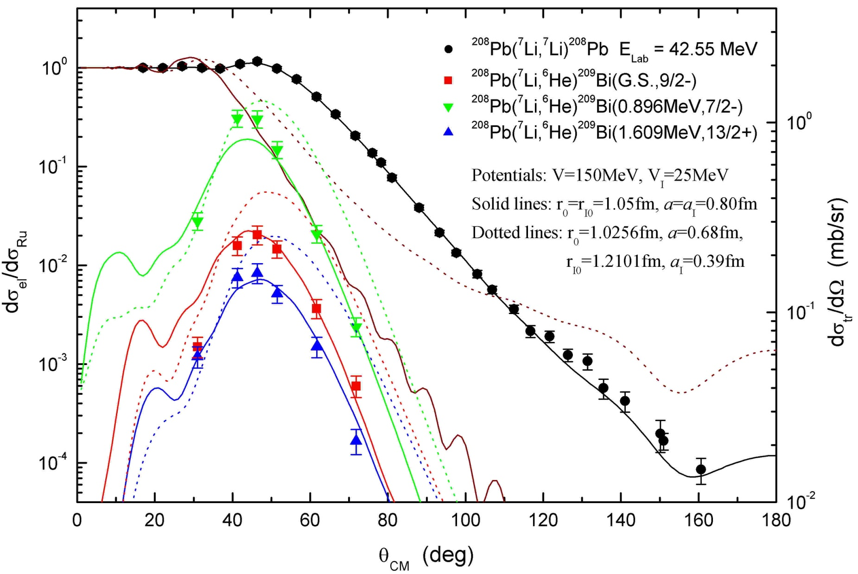
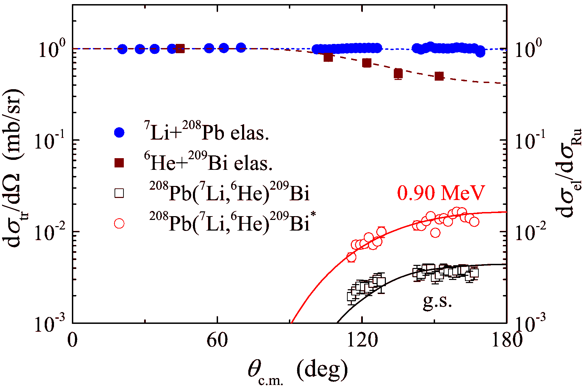
Data Analysis of ²⁰⁸Pb(⁷Li,⁶He)²⁰⁹Bi
DWBA & CRC analyses
Elas.
Tran.
42.55 MeV
24.30 MeV
Apr. 10, 2024
1.2 OMPs of ⁶He+²⁰⁹Bi

Slide 10
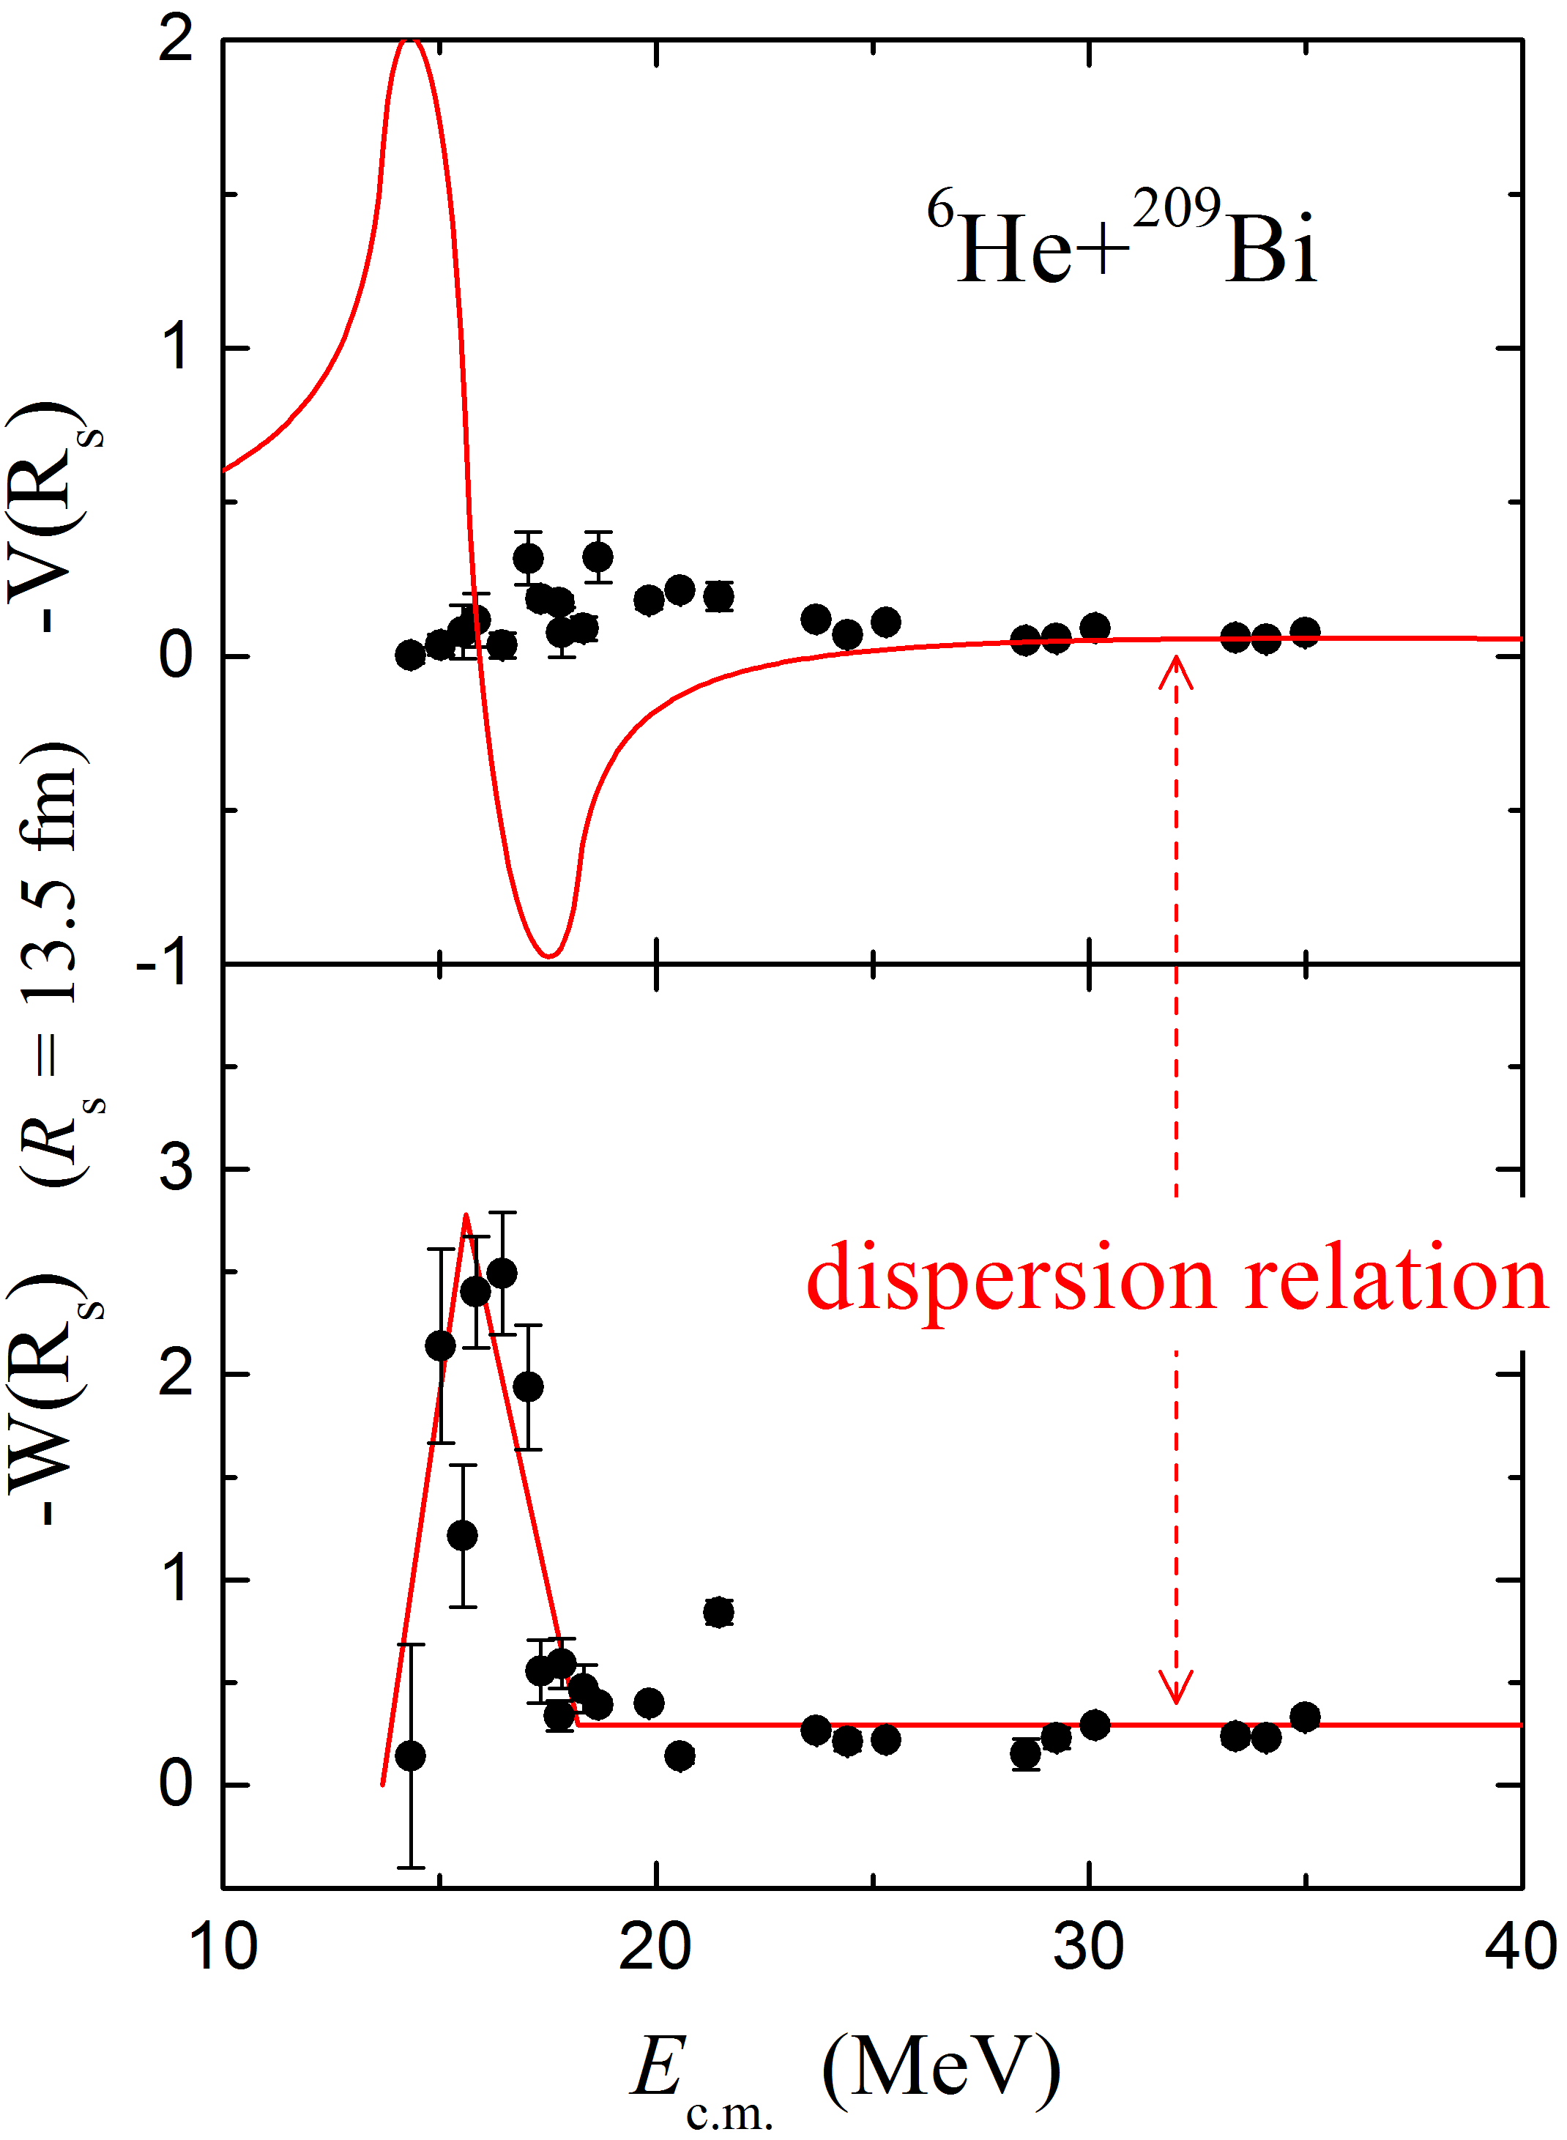
OMPs of ⁶He+²⁰⁹Bi
★ OMPs of the ⁶He+²⁰⁹Bi system are determined precisely;
★ The decreasing trend in the imaginary part is observed, and the threshold energy is about 13.73 MeV (~0.68V_{B});
★ The dispersion relation cannot describe the behavior between the real and imaginary part.
L. Yang, C.J. Lin*, H.M. Jia et al.,
Phys. Rev. Lett. 119, 042503 (2017);
Phys. Rev. C 96, 044615 (2017).
Apr. 10, 2024
1.2 OMPs of ⁶He+²⁰⁹Bi

Slide 11
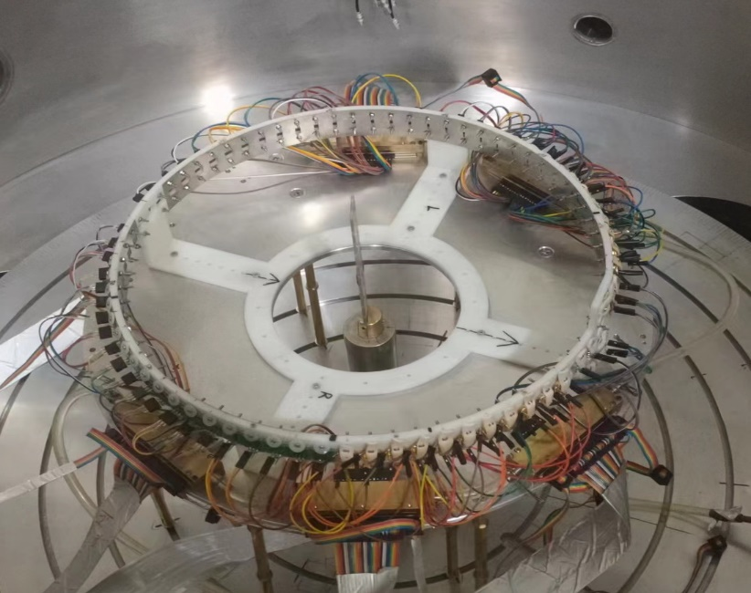
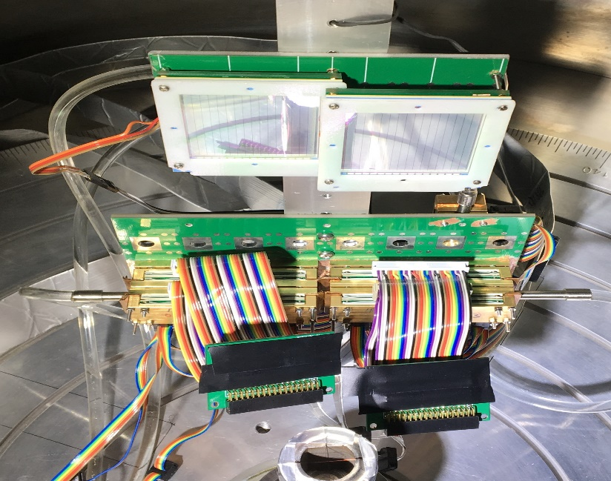
Experiment of ⁶Li+ ²⁰⁸Pb
Motivation: to extract the OMPs of ⁶Li+²⁰⁸Pb with high precisions,
especially at sub-barrier energies.
Tow experiments have been done by the HI-13 tandem accelerator at CIAE.
1. ⁶Li+²⁰⁸Pb elastic scattering
64 Si-PIN detectors have been installed around the target, covering 20°-175° in step of 5°.
2. ²⁰⁷Pb(⁷Li,⁶Li)²⁰⁸Pb transfers
2 ΔE-E₁-E₂ telescopes have been installed, consisting of 40 μm DSSD, 300 μm and 1500 μm QSD.
Apr. 10, 2024
1.3 OMPs of ⁶Li+²⁰⁸Pb

Slide 12
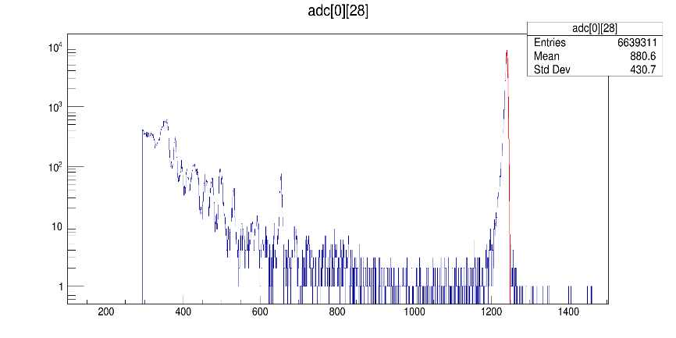
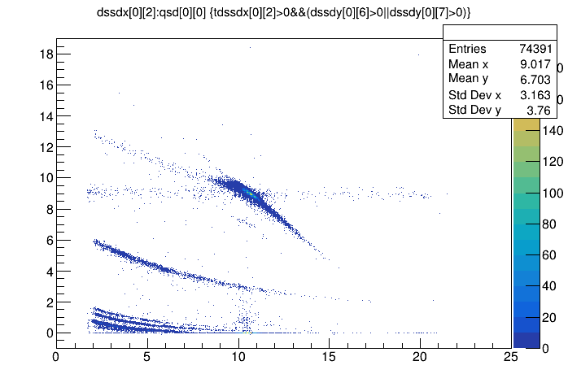
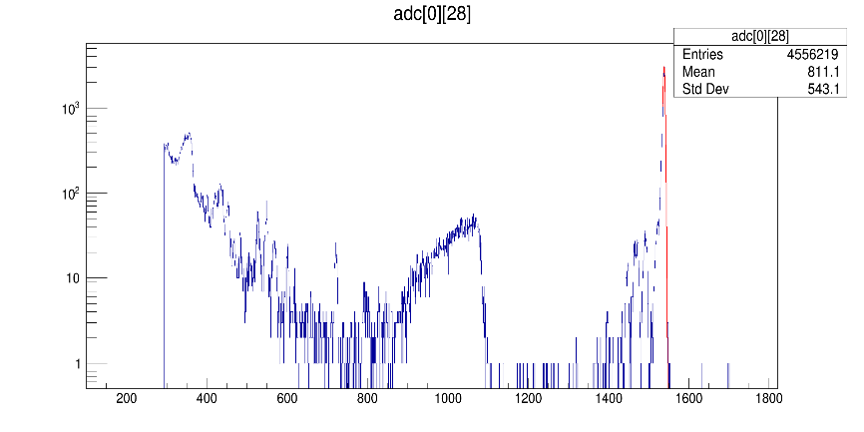
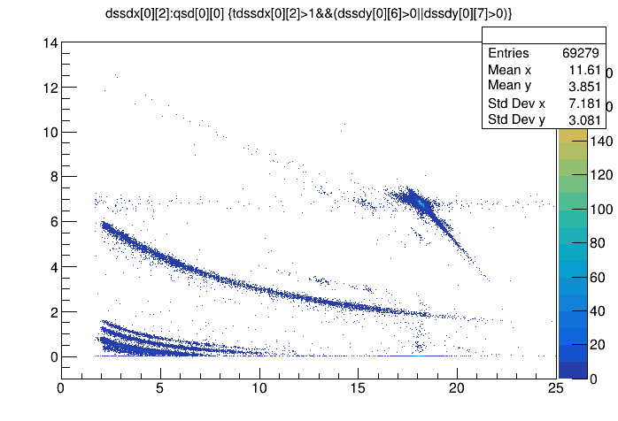
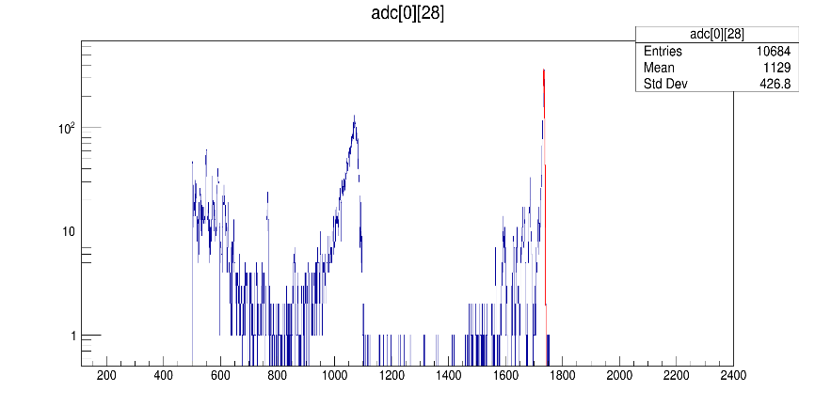
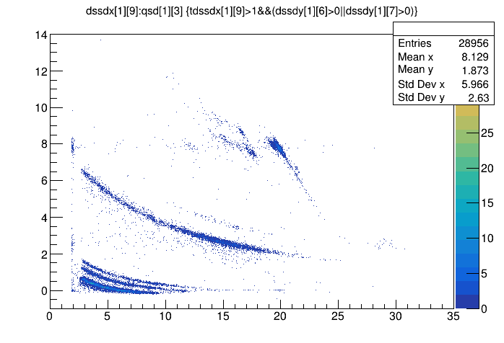
Experimental Spectra
⁶Li+²⁰⁸Pb elastic scattering
²⁰⁷Pb(⁷Li,⁶Li)²⁰⁸Pb transfers
22.0 MeV, 160°
22.0 MeV, 130°
27.7 MeV, 160°
⁶Li
27.7 MeV, 130°
Breakups
31.5 MeV, 160°
31.5 MeV, 130°
Apr. 10, 2024
1.3 OMPs of ⁶Li+²⁰⁸Pb

Slide 13
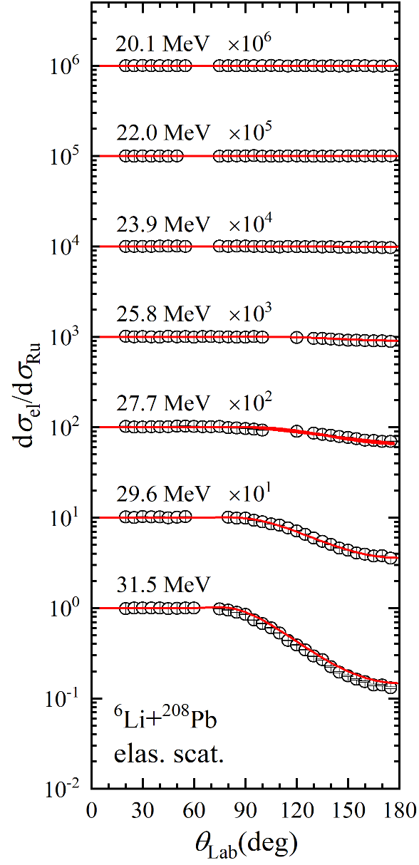
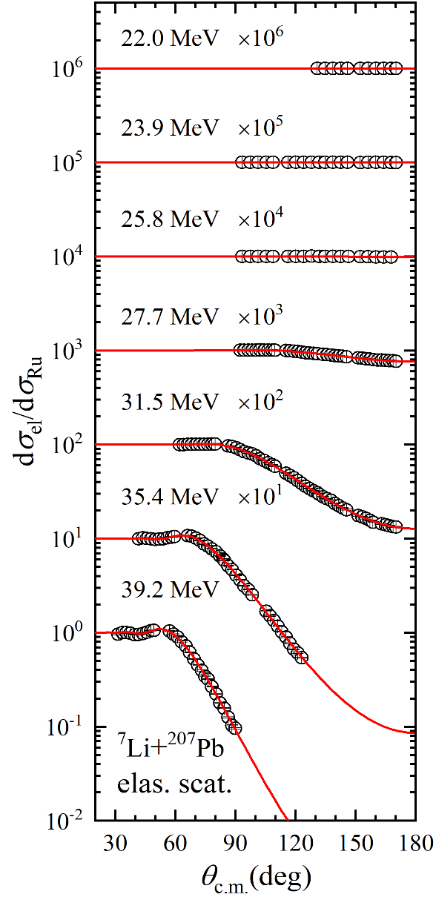
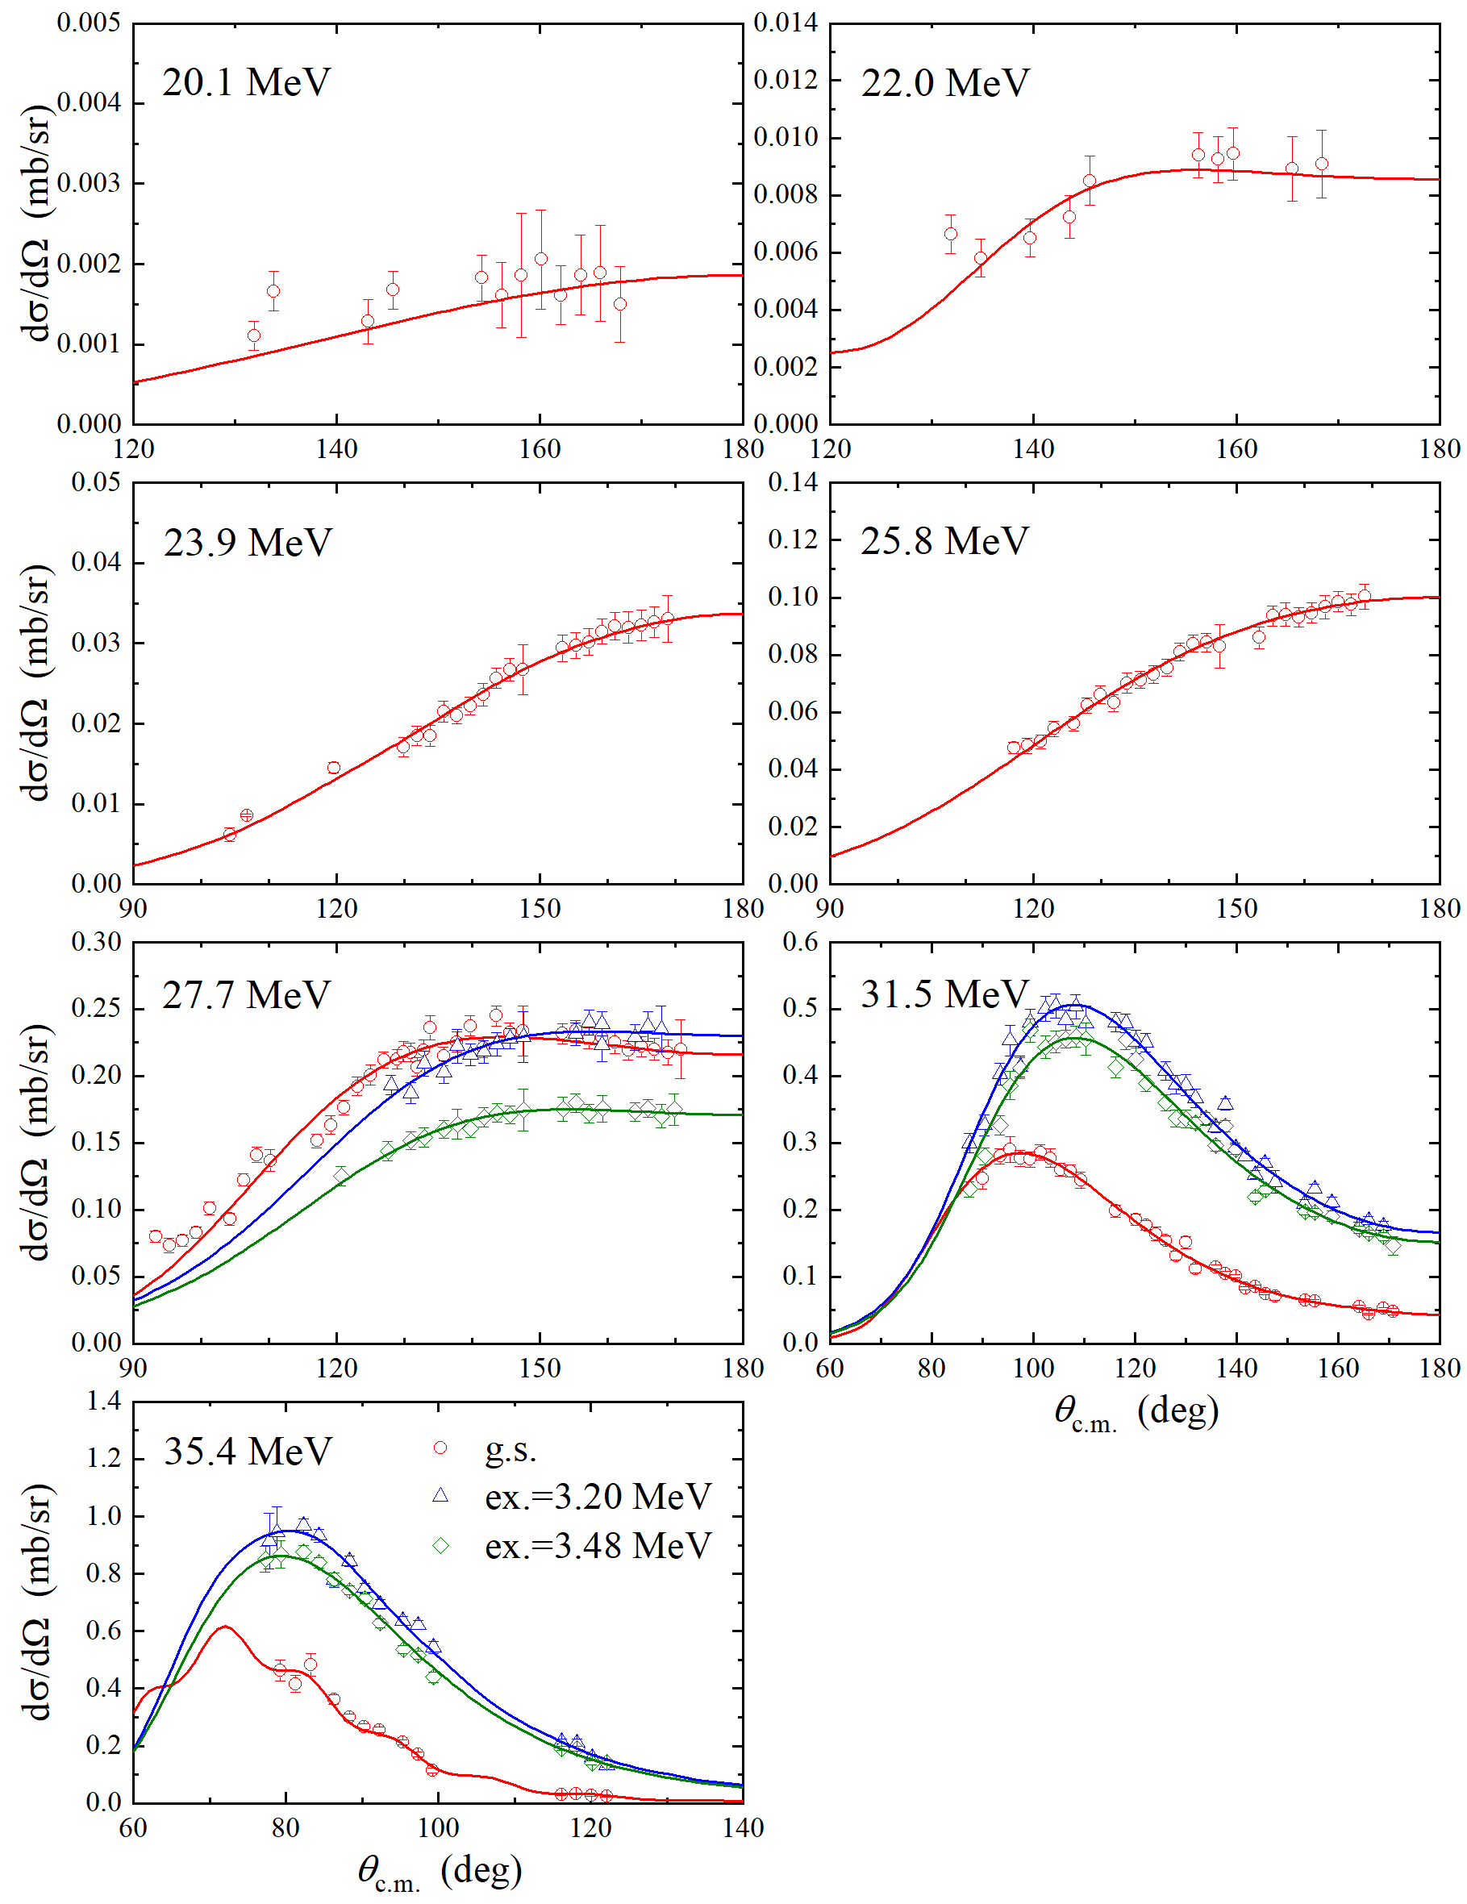
Angular Distributions
⁶Li+²⁰⁸Pb elas. ⁷Li+²⁰⁷Pb elas. ²⁰⁷Pb(⁷Li,⁶Li)²⁰⁸Pb tran.
DWBA & CRC calculations
by FRESCO
Apr. 10, 2024
1.3 OMPs of ⁶Li+²⁰⁸Pb

Slide 14
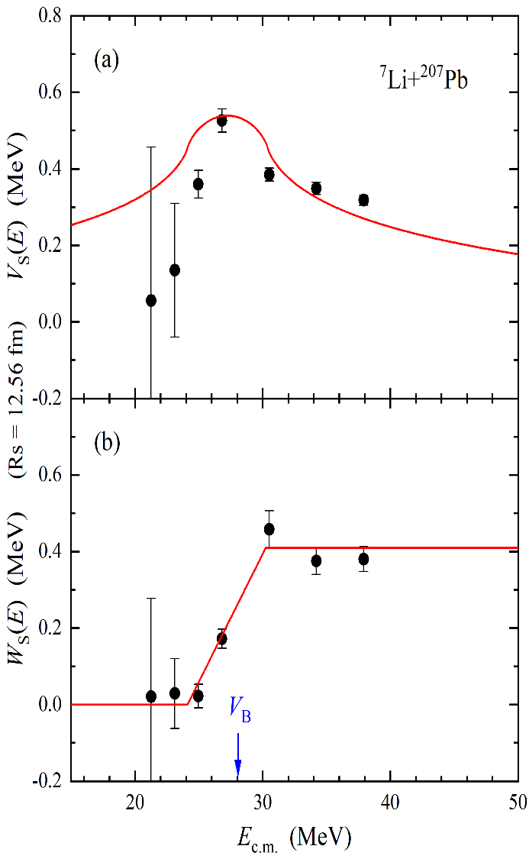
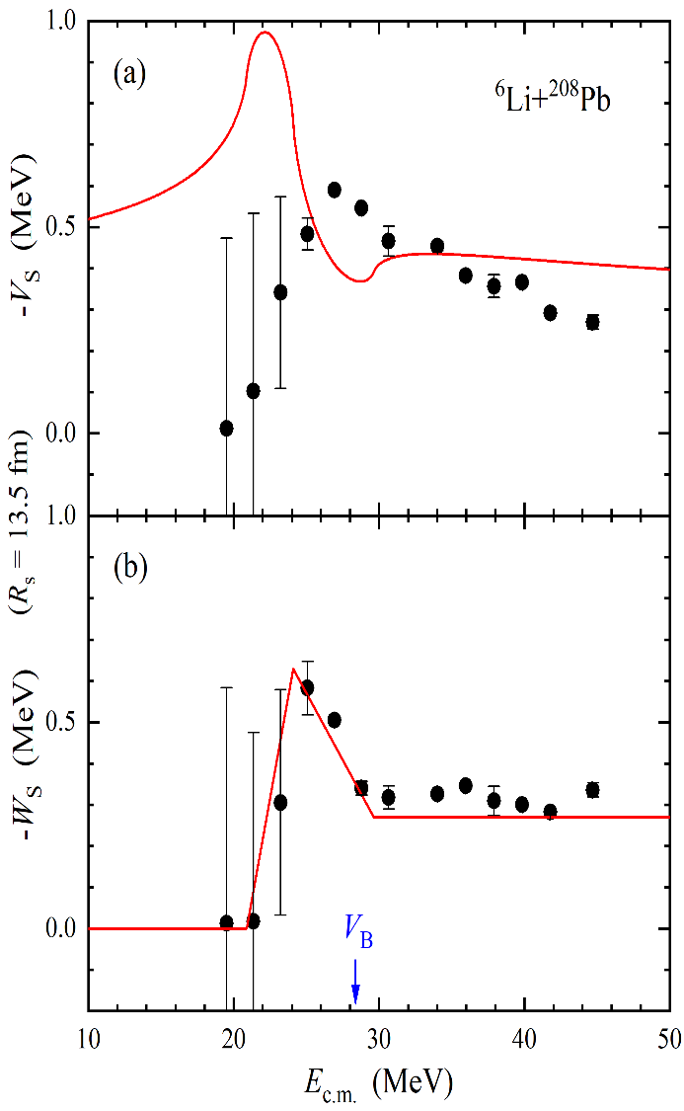
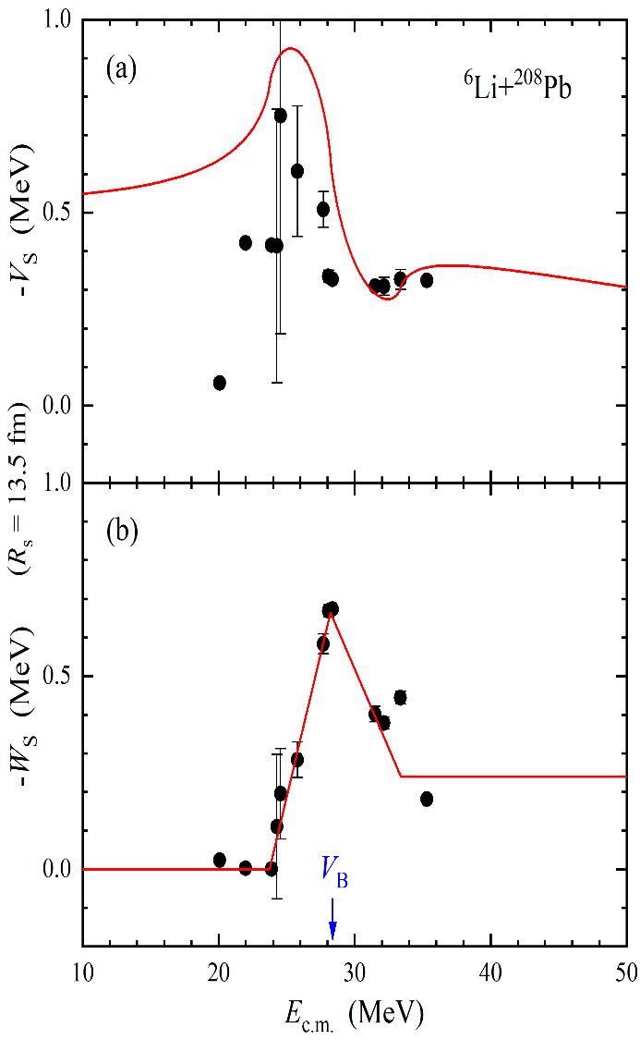
OMPs
⁷Li+²⁰⁷Pb
from elastic
⁶Li+²⁰⁸Pb
from elastic
⁶Li+²⁰⁸Pb
from transfer
PRELIMINARY
Apr. 10, 2024
1.3 OMPs of ⁶Li+²⁰⁸Pb

Slide 15

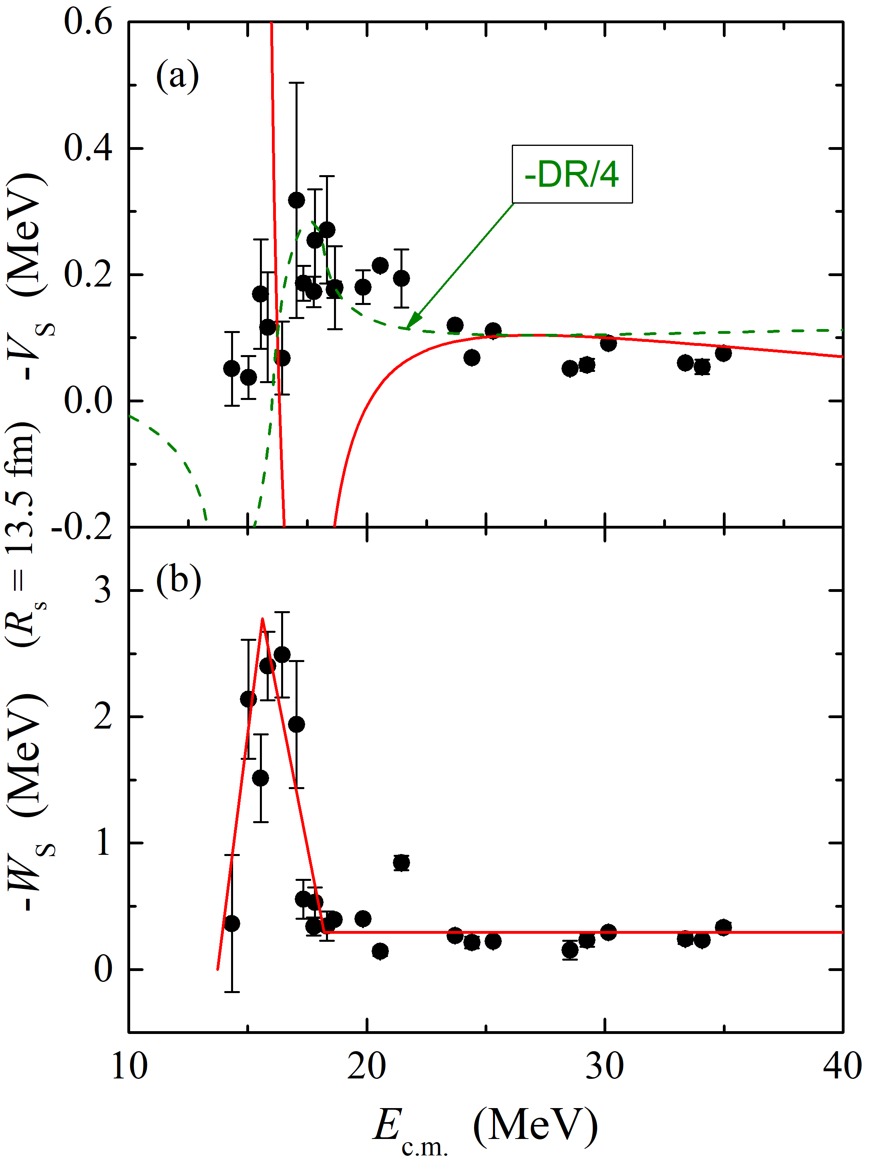
Dispersion Relation
★ Dispersion relation results from causality, connecting real and imaginary part;
★ Any wave/particle should follow this rule when it passes through a media;
★ The classical dispersion relation is not applicable for ⁶He+²⁰⁹B and ⁶Li+²⁰⁸Pb.
Possible reasons:
• Causality → dispersion relation
stable systems: causality ↔ analyticity
• Cauchy integration
infinity poles (breakup) & off-axis (multi-process)
• Negative Index of Refraction
causality based criteria must be used with care
[Phys. Rev. Lett. 101, 167401 (2008).]
• Locality vs. non-locality
equivalent local potential in
Schrödinger equation
⁶He+²⁰⁹Bi
Negative Index
of Refraction?
Metamaterials?
+
3/4-body
Apr. 10, 2024
1.4 Discussions

Slide 16
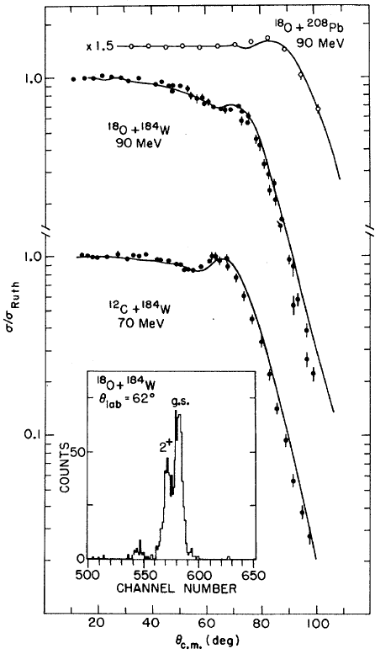
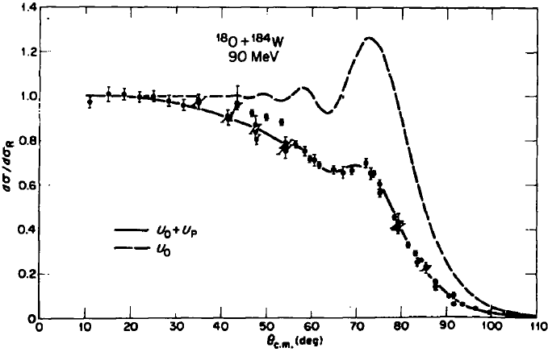
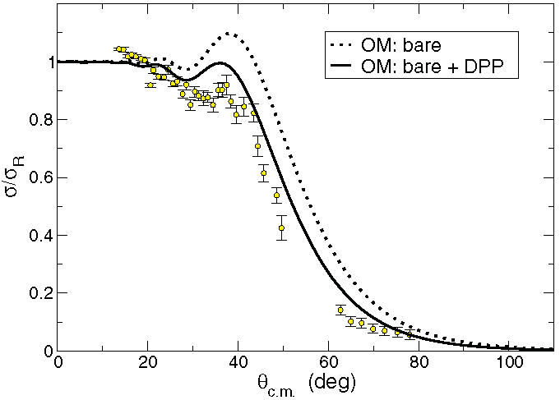
Effects of Strong Absorption
¹⁸O,¹²C+¹⁸⁴W
(deformed)
¹⁸O+¹⁸⁴W
¹¹Be+⁶⁴Zn
¹¹Be+⁶⁴Zn
¹⁸⁴W: β₂ = 0.234
E_{x}(2⁺) = 0.112 MeV
NPA 291, 183 (1977).
PRC 85, 054607 (2012).
The strong suppressions are induced by the strong Coulomb excitations of deformed nuclei, which are typical strong absorption effects.
It is interesting to study the OPM behaviors of these systems.
Phys. Rev. Lett. 38, 384 (1977).
Apr. 10, 2024
1.4 Discussions

Slide 17
Contents
OMPs of weakly-bound nuclear systems
⁶He+²⁰⁹Bi, ⁶Li+²⁰⁸Pb
Breakups of weakly-bound stable nuclei
^{6,7}Li+²⁰⁸Pb
Reactions with proton-rich unstable nuclei
¹⁷F+⁵⁸Ni, ⁸B+¹²⁰Sn
Summary and outlook
Apr. 10, 2024
C.J. Lin @ TJU

Slide 18
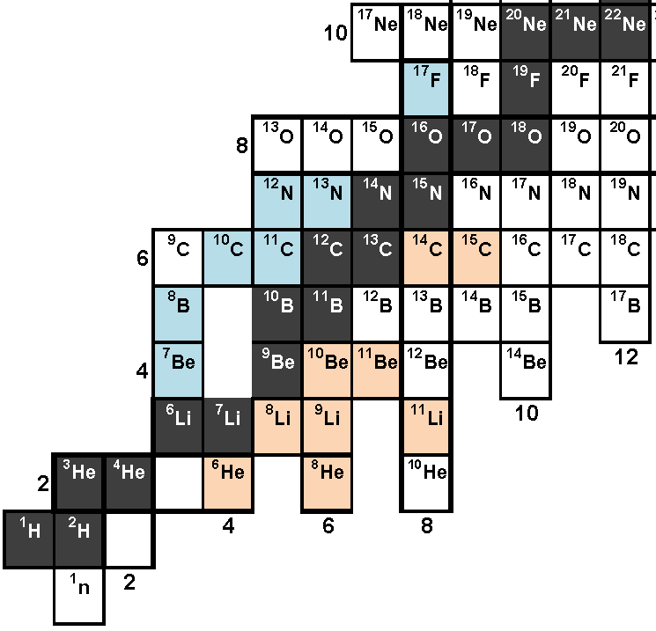
Researches in NRG@CIAE
Reactions with weakly-bound nuclei (A<20)
Elastic, fusion, breakup …
Stable: ^{6,7}Li, ⁹Be
p-rich: ⁷Be, ⁸B, ¹⁷F,
¹⁰C, ¹²N, ^{17,18}Ne …
Complete-kinematics measurement
(particle identification &
large solid-angle covered)
Apr. 10, 2024
2.1 Introduction

Slide 19

Reactions with Weakly-bound Nuclei
Elastic & Inelastic
Transfer
⁶Li
Complete Fusion
+
breakup
Sequential
Complete Fusion
Incomplete Fusion
multi-step processes
Breakup
Apr. 10, 2024
2.1 Introduction

Slide 20
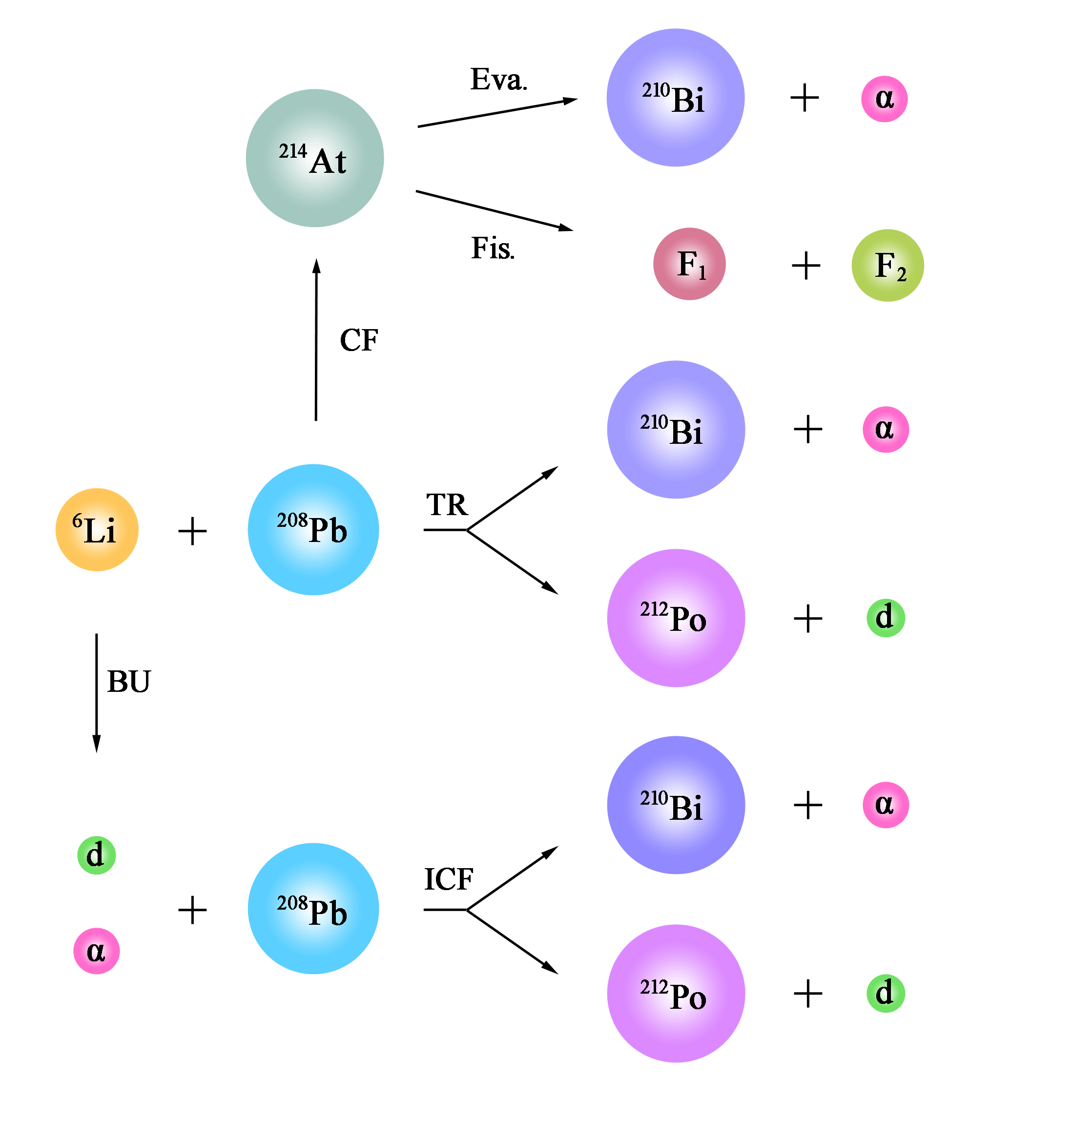
Complicated Processes
★ How to identify different reaction processes in a experiment?
complete-kinematics
measurement
2-body kinematics 
3-body kinematics 
Same products
Apr. 10, 2024
2.1 Introduction

Slide 21
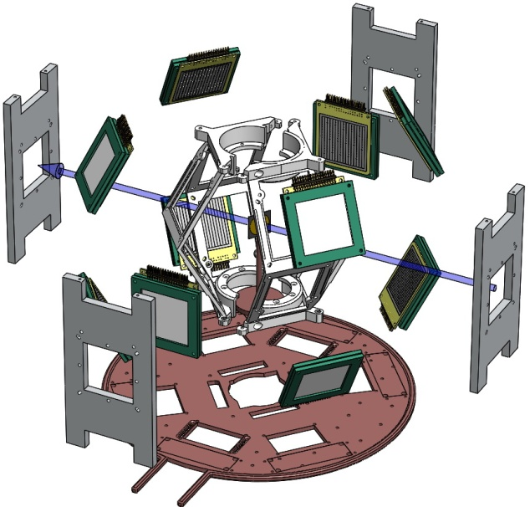
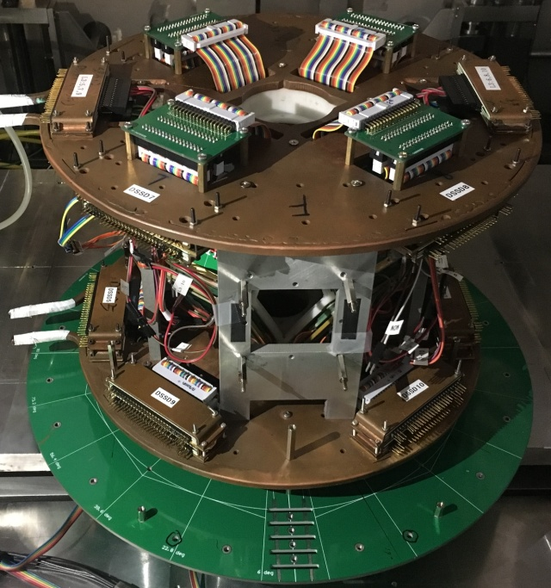
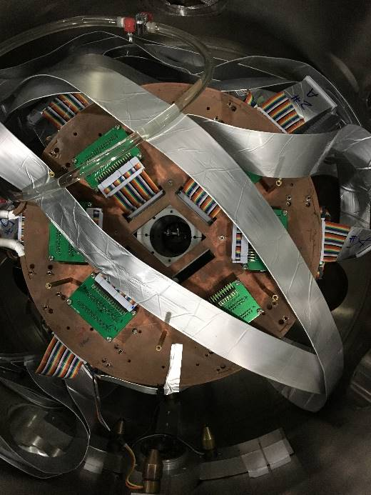
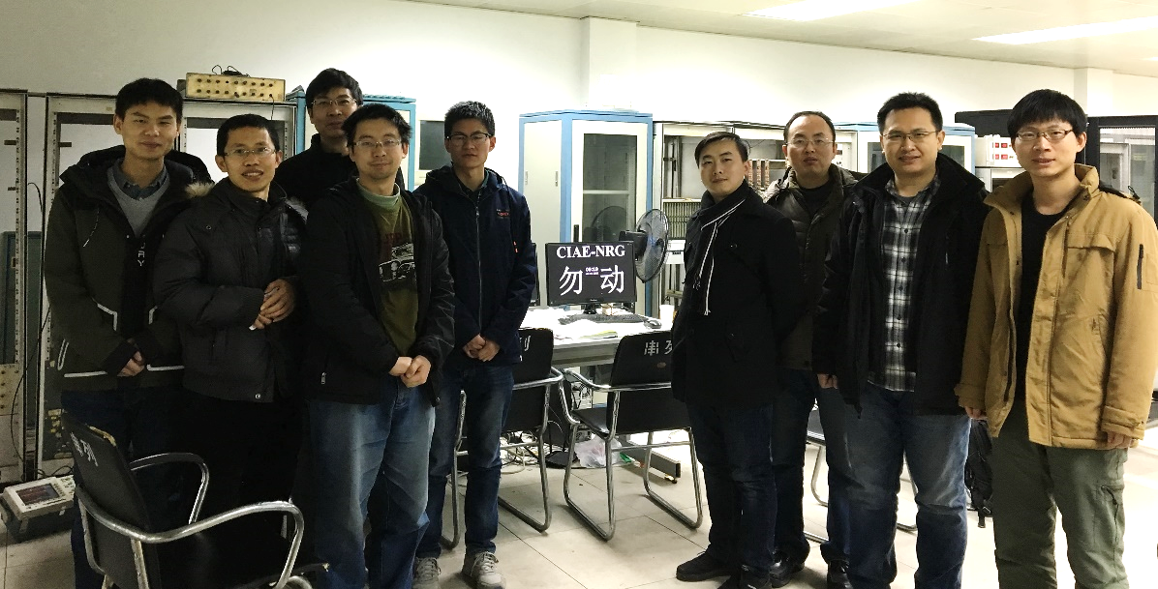
^{6,7}Li+²⁰⁹Bi Experiment
STARE array
• 10 sets of telescope
• 3 layers in each set
20 μm SSSD / 40 μm DSSD
300 μm SSSD / QSD
1000−1500 μm QSD
• 40% 4π, 2560 pixels
Apr. 10, 2024
2.2 Experiment

Slide 22
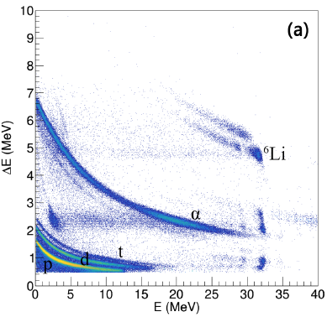
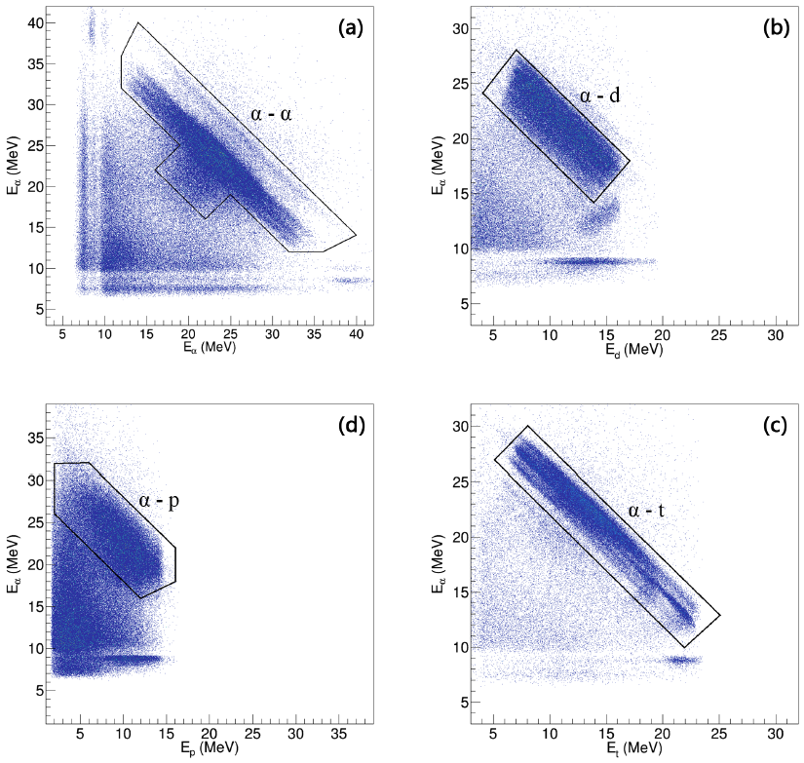
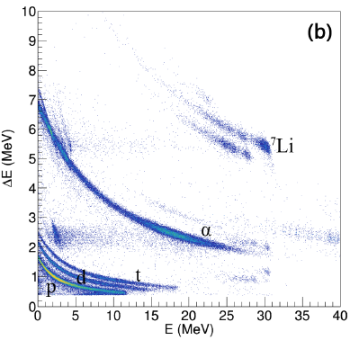
Experimental Spectra
Energy correlations of breakup fragments
ΔE-E Spectra of ^{6,7}Li+²⁰⁹Bi @ 40 MeV
Apr. 10, 2024
2.2 Experiment

Slide 23
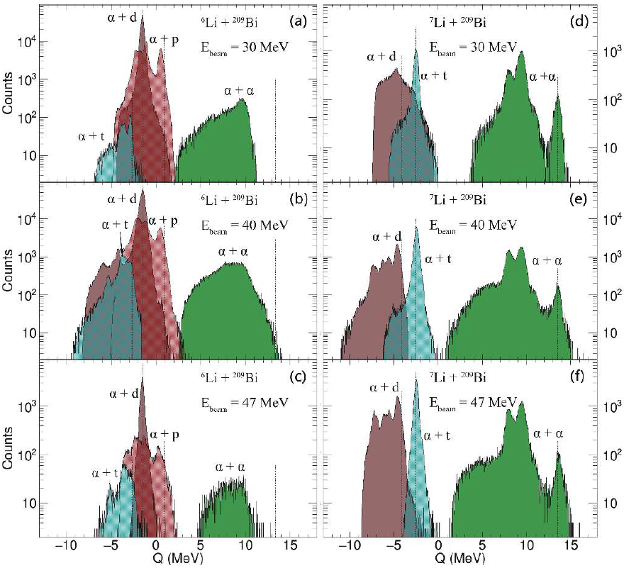
Q-value Spectra
new
Y.J. Yao et al., Nucl. Sci. Tech. 32, 14 (2021); Chin. Phys. C 45, 054104 (2021).
Apr. 10, 2024
2.3 Results

Slide 24
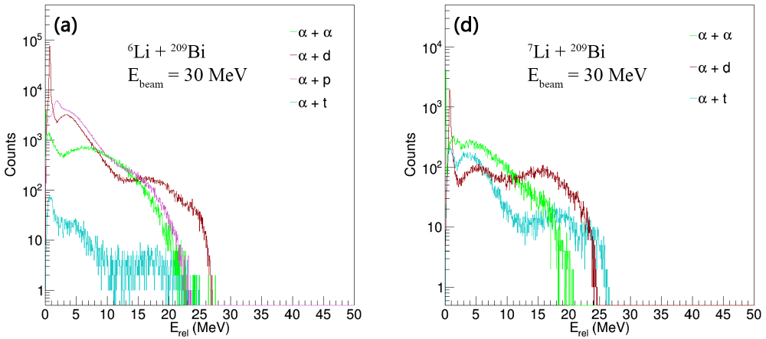
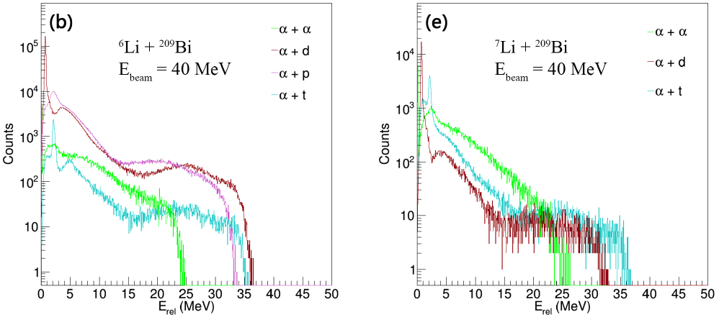
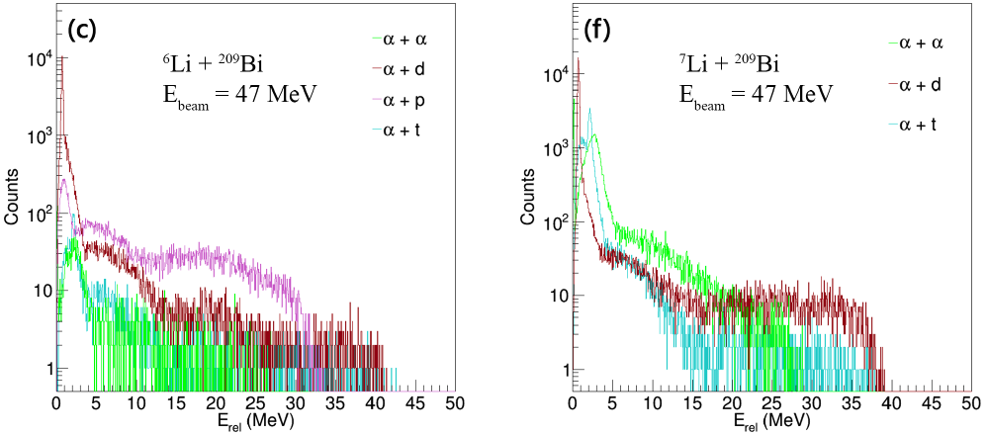
Relative Energies
Apr. 10, 2024
2.3 Results

Slide 25
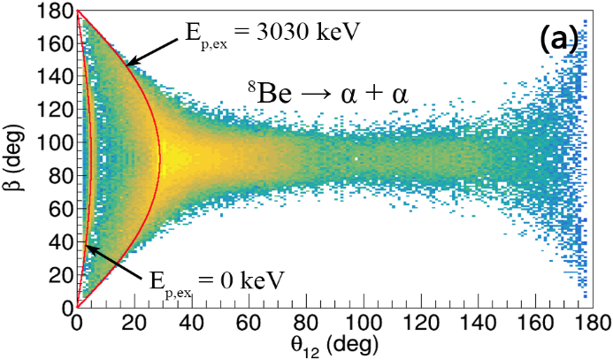
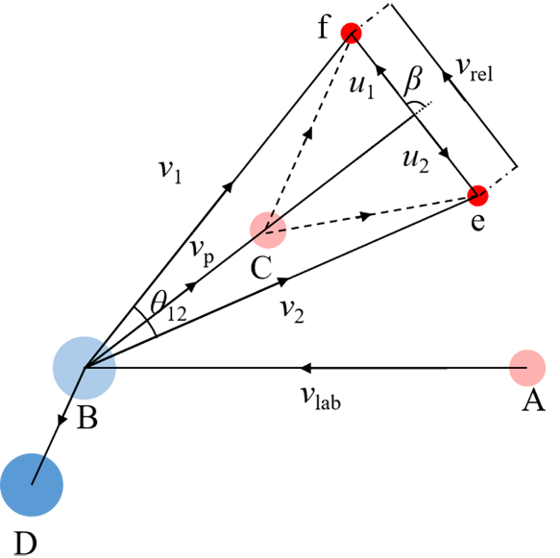
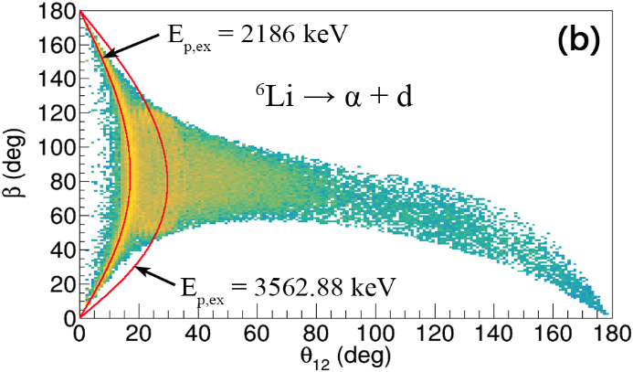

Angular Correlations
⁷Li+²⁰⁹Bi @ 40 MeV
3.030 MeV, 3.02×10⁻²² s
g.s., 8.19×10⁻¹⁷ s
2.186 MeV, 1.90×10⁻²⁰ s
3.563 MeV, 5.56×10⁻¹⁷ s
4.630 MeV, 4.91×10⁻²¹ s
Apr. 10, 2024
2.3 Results

Slide 26


Branch Ratios of Breakups
L. Yang et al., Fundamental Research, in press.
Apr. 10, 2024
2.3 Results

Slide 27
关键核数据
★ 破裂及其强耦合机制
α + d
破裂
n + ⁶Li
α
热核反应
⁷Li*
α
t + d
+17.6 MeV
n
^{6,7}Li的破裂机制及其破裂分支比等
连续态的强耦合机制
后续反应 (包括⁸Li, ⁷Be, ⁸B等) 及反应网络
运动学
完全测量
Apr. 10, 2024
2.4 Discussions

Slide 28
Contents
OMPs of weakly-bound nuclear systems
⁶He+²⁰⁹Bi, ⁶Li+²⁰⁸Pb
Breakups of weakly-bound stable nuclei
^{6,7}Li+²⁰⁸Pb
Reactions with proton-rich unstable nuclei
¹⁷F+⁵⁸Ni, ⁸B+¹²⁰Sn
Summary and outlook
Apr. 10, 2024
C.J. Lin @ TJU

Slide 29


Breakup → Open Quantum System
★ Reactions with weakly-bound nuclei:
easily breakup, and leading to continuum state
...
ex.s.
g.s.
(bound states)
CDCC
Continuum Discretized Coupled Channels
From sei-open quantum system
to open quantum system
Strongly couplings of low-lying states
to continuum states
Apr. 10, 2024
3.1 Introduction

Slide 30








Overview of Experiments
★ Complete-kinematics measurement ;  Reactions induced by ⁷Be, ⁸B, ¹⁷F …
RIBLL: ¹⁷F+⁸⁹Y,²⁰⁸Pb,⁷Be+²⁰⁹Bi,¹²⁰Sn
CRIB: ¹⁷F+¹²C,⁵⁸Ni, ⁸B+¹²⁰Sn
at CNS
RIBLL1 separator at IMP
⁷Be+²⁰⁹Bi, 2018@RIBLL1
⁸B+¹²⁰Sn, 2019@CRIB
⁷Be+¹²⁰Sn, 2021@RIBLL1
¹⁷F+¹²C
2007@CRIB
¹⁷F+⁸⁹Y
2015@RIBLL1
¹⁷F+²⁰⁸Pb, 2015@RIBLL1
¹⁷F+⁵⁸Pb, 2015@CRIB
EPJA 48, 65 (2012); PRC 97, 044618 (2018); EPJA 57, 143 (2021); PLB 813, 136045 (2021); NC 13, 7193 (2022) …
Apr. 10, 2024
3.2 Experiments

Slide 31






Detector Arrays
MITA
IC
20 μm SSSD / 40 μm DSSD
300 μm SSSD / QSD
1000-1500 μm QSD
N.R. Ma et al., EPJA 55, 87 (2019).
10 sets of IC-based telescope, 4 layers, solid angle 8% 4π
MITA2
EvR
Apr. 10, 2024
3.2 Experiments

Slide 32



¹⁷F+¹²C, ⁸⁹Y, ²⁰⁸Pb Elastic
¹⁷F+⁸⁹Y
No obvious coupled-channels effects were observed.
Eur. Phys. J. A 48, 65 (2012); Phys. Rev. C 97, 044618 (2018); Eur. Phys. J. A 57, 143 (2021).
Apr. 10, 2024
3.3 Results

Slide 33

¹⁷F+⁵⁸Ni: Nonelastic Breakup
Quasielastic, inclusive & exclusive breakup, total fusion have been obtained by the
complete-kinematics
measurement
for the first time.
Quasi-elastic:
CC effects are
not significant
Breakup:
EBU — CDCC
NEB — IAV
TBU — EBU+NEB
NEB is dominant
L. Yang, C. J. Lin, H. Yamaguchi et al., Phys. Lett. B 813, 136045 (2021).
Apr. 10, 2024
3.3 Results

Slide 34


¹⁷F+⁵⁸Ni: Cross Sections
Total reaction
Marco
Total fusion
Cross section of total fusion is enhanced below the barrier, mainly due to the couplings to the continuum states.
L. Yang, C. J. Lin, H. Yamaguchi et al.,
Phys. Lett. B 813, 136045 (2021).
Apr. 10, 2024
3.3 Results

Slide 35


⁸B+¹²⁰Sn: Elastic Breakup
Couplings to the continuum cannot be neglected;
The yield of ⁷Be is almost exhausted by breakup reaction;
EBU is dominant, the contribution of NEB is ∼18%.
L. Yang, C.J. Lin, H. Yamaguchi et al., Nat. Commun.13, 7193 (2022).
Apr. 10, 2024
3.3 Results

Slide 36



⁸B+¹²⁰Sn: Energy Correlations
CDCC
(1.30×10⁻²¹ s)
(1.28×10⁻²⁰ s)
★ Contributions of the 1st ex. state is ∼ 4%, indicating prompt breakups are dominant.
L. Yang, C.J. Lin, H. Yamaguchi et al., Nat. Commun.13, 7193 (2022).
Apr. 10, 2024
3.3 Results

Slide 37

⁸B+¹²⁰Sn: Angular Correlations
Breakup of ⁸B occurs predominantly on the outgoing trajectory, close to the target.
The continuum of ⁸B breakup may not significantly influence the complete fusion.
L. Yang, C.J. Lin, H. Yamaguchi et al., Nat. Commun.13, 7193 (2022).
Apr. 10, 2024
3.3 Results

Slide 38




In Progress: ⁷Be+²⁰⁹Bi,¹²⁰Sn
⁷Be
⁷Be
⁷Li
1.2×10⁶ pps, 90%
⁴He
Beam
PID
³He
p(⁷Li, ⁷Be)n
⁷Li: 8.8 MeV/u, 1.5 euA
H₂ gas: 1000 mbar, 8 cm, 90 K
20/40μm SSD + 300μm QSD + 1.5mm QSD
ΔE-ΔE spectrum
by 40μm DSSD & 300μm QSD
(1 strip, 1 run, 2 hours)
10 group of ΔE₁-ΔE₂-E telescopes
40% of 4π
1. Exclusive breakup: ⁷Be → ³He+⁴He (coin. Eff. ~10% by MC simulations);
2. ⁴He stripping: ⁷Be+²⁰⁹Bi → ³He+²¹³At;
3. ³He stripping: ⁷Be+²⁰⁹Bi → ⁴He+²¹²At;
4. 1n stripping: ⁷Be+²⁰⁹Bi → ⁶Be(→⁴He+p+p)+²¹⁰Bi;
5. 1n pickup: ⁷Be+²⁰⁹Bi → ⁸Be(→⁴He+⁴He)+²⁰⁸Bi;
6. 1p striping: ⁷Be+²⁰⁹Bi → ⁶Li(→⁴He+d)+²¹⁰Po;
8. 1p pickup: ⁷Be+²⁰⁹Bi → ⁸B(→???)+²⁰⁸Pb;
9. Fusion: ⁷Be+²⁰⁹Bi → ²¹⁶Fr → α, p, n eva. & decay (energy & angular distr.)
ICF (Ene-Ang corr.)
Apr. 10, 2024
3.3 Results

Slide 39

p-rich v.s. n-rich Nuclei
¹¹Li
¹¹Be
⁸B
⁶He
¹⁷F
Comparison of breakup probabilities
between n-halo and p-halo systems
Apr. 10, 2024
3.4 Discussions

Slide 40
Summary and Outlook
Optical potentials of both ⁶He+²⁰⁹He and ⁶Li+²⁰⁸Pb show a phenomenon of abnormal “threshold anomaly”, where the dispersion relation is NOT applicable. Further investigations are strongly desired to explore the underlying physics (e.g. the tightly-bound but well-deformed nuclei).
Rich information on breakups of ^{6,7}Li+²⁰⁹Bi has been obtained experimentally (e.g. energy & angular correlations), waiting for a fully understanding.
For ¹⁷F, NEB is dominant, and total fusion is enhanced below the barrier;
for ⁸B, EBU is dominant, occurring promptly on the outgoing trajectory.
More system with exotic nuclei are required to understand the
dynamics of open quantum systems.
Apr. 10, 2024
4 Summary & outlook

Slide 41



Dynamics of Open Quantum System
An open quantum systems approach to proton tunnelling in DNA
Comm. Phys. 5, 109 (2022).
Science Bulletin 68, 2 (2023).
终有一天，人们将会理解“生命是什么”
Apr. 10, 2024
4 Summary & outlook

Slide 42
Thank you for your attention!

Slide 43



Negative Index Metamaterial
R.A. Shelby, D.R. Smith, S. Schultz, “Experimental Verification of a Negative Index of Refraction”, Science 292, 77 (2001).
Negative refractive index metamaterials offer the possibility of revolutionary applications, such as subwavelength focusing [1], invisibility cloaking [2], and ‘‘trapped rainbow’’ stopping of light [3].
PRL 105, 127401 (2010).
Apr. 10, 2024
C.J. Lin @ TJU

