Slide 1
RPA PROJECT CODE HR WIZARD
Hafeezah Binte Abdul Kasim (2201536F)

Slide 2
Background
Problem statement
The onboarding process is a critical juncture in an employee's journey within any organization. However, in many instances, traditional HR onboarding procedures are plagued by inefficiencies and manual tasks that lead to delays, errors, and a negative impact on both new employees and operational effectiveness.
The HR onboarding process across companies often suffers from suboptimal efficiency, resulting in extended onboarding periods and an increased administrative workload. Despite previous attempts to improve the process, the average time for a new employee to successfully navigate through the onboarding journey, from initial application to full integration, takes many days, adversely affecting candidate experience and overall operational agility.

Slide 3
01
Resume screening and record creation
02
Fills in google employee form, Emails employee to send resume in pdf if its in invalid format
03
Generate contracts and Benefit forms for employees
04
Schedules training and orientation in MS teams calendar
Overview Process of the Application
Filter out resumes in PDF format to send for processing and moves word resumes to ‘not processed’ folder. Extracts important data of employee and inserts into excel sheet
Used Parallel activity. Reads employee data from excel and fills up employee forms on browser. Emails the employees of invalid resumes to send resume again in PDF format. ( Gets the email add. from the word doc )
Uses sample contract and benefit forms and generates for each employee by replacing placeholders in the resume with the employee’s name, email etc (WORD) Send the contracts and forms to employees and manager’s emails for signature
Schedules training using MS calendar and adds the different employees and sends a reminder email for them to join

Slide 4

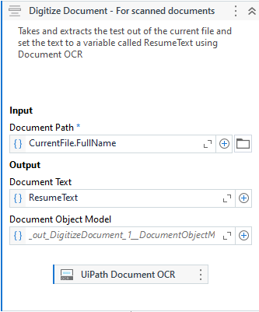

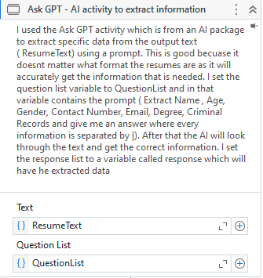
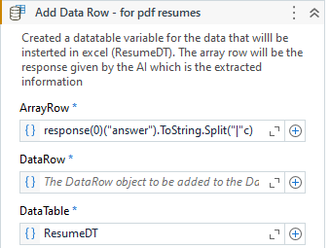
Packages used (For PDF and WORD data extraction)
Digitize screened PDF resumes
Overview of PDF extraction
I made use of the IntelligenceOCR package to digitize the scanned PDF resumes and extract the resume text to a variable. I then provided the ResumeText variable to GPT (An AI feature) and assigned a variable called QuestionList which holds the prompt: Extract name, Age, Gender, Email etc from the resume text variable. The AI will get the specific data that I asked and give me a response (stored in var: Response). After getting the response , I stored them in a data table and append the columns in excel
Use of AI packages like GPT to ask GPT to extract information from PDF accurately
( Name, Age etc )
Digitizes a document, extracting its Document Object Model (DOM) and text and storing them in their corresponding variable types.

Slide 5

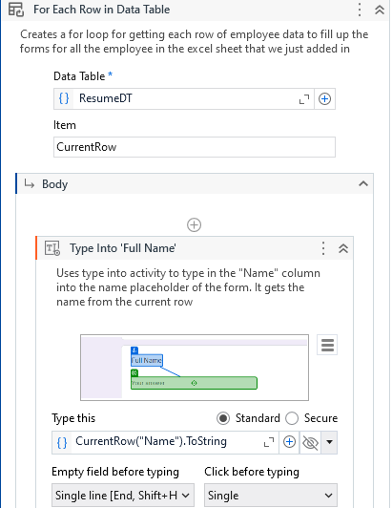
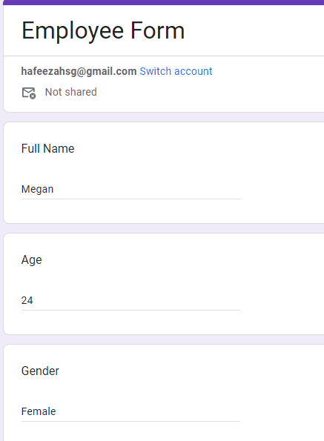
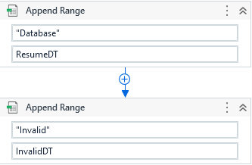
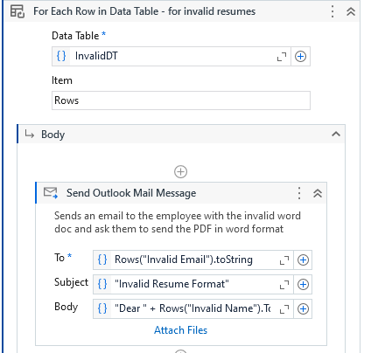
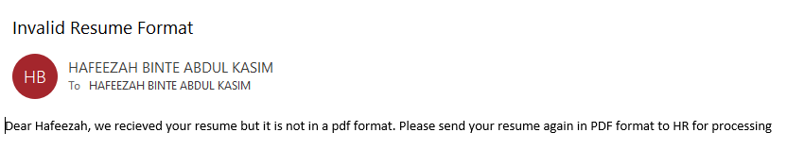

Appends range in the excel sheet for PDF data with the information below ( sheet: ‘Database’)
Uses a for each row in DT and types the employee information in the correct fields in the google forms
This is done by using excel application scope and
Append range
Sends an email to the invalid resume employee, asking them to send the resume in pdf format
Outlook mail message
Appends only the name and email for non pdf resumes
In excel (sheet: ‘invalid’)

Slide 6

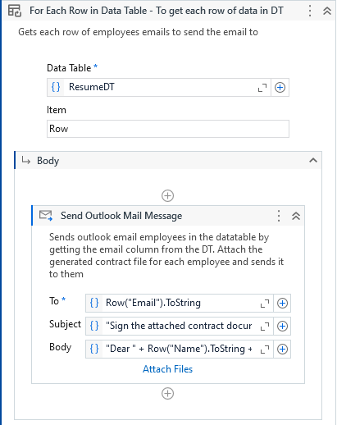
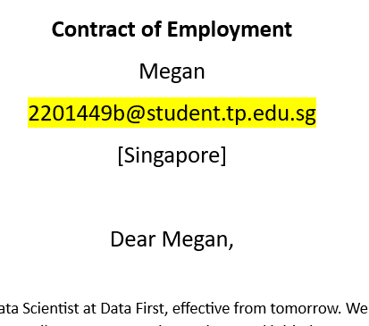
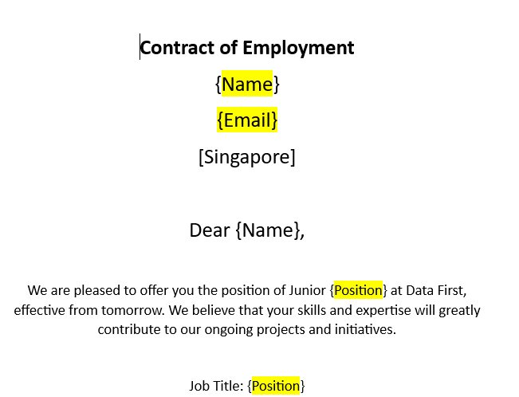
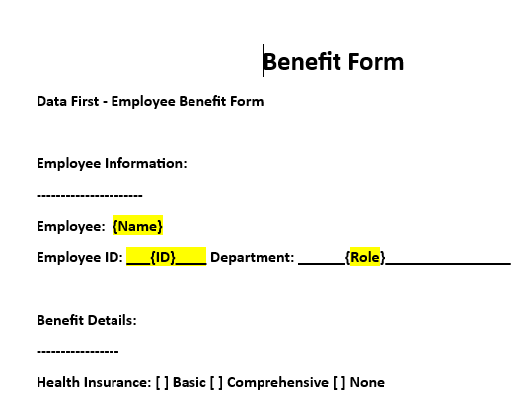
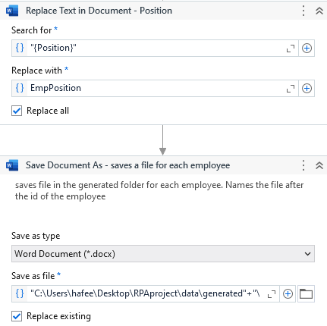
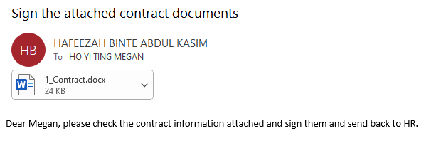
Reads the excel sheet again to generate contracts and benefit forms
After generating contracts, it will send the contract to the correct employee based on their id and email via outlook for signatures
Sample contracts and benefit forms (WORD)
Placeholders correctly changed
Creates a for each row in data table loop again and uses word application scope to open the sample forms and find placeholders like “name”, “position” and replace the text in document with the correct columns in excel. ( stored in variables). It then saves the new generated contract in a folder
Saves after emp id
Outlook message with the attached contract

Slide 7
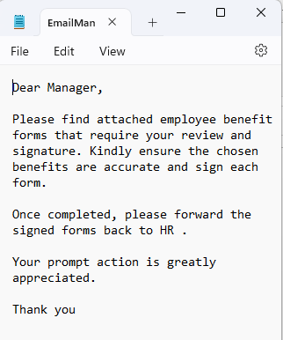
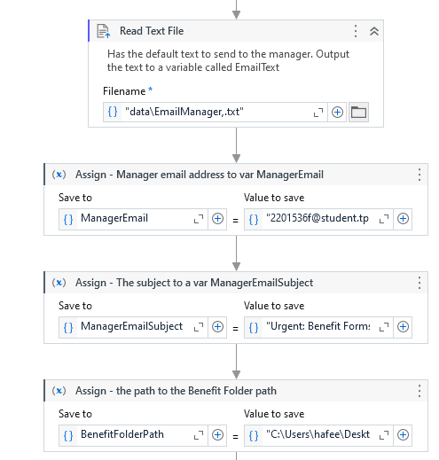
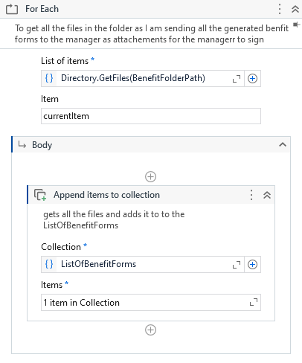
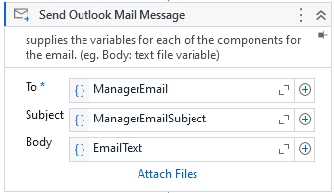
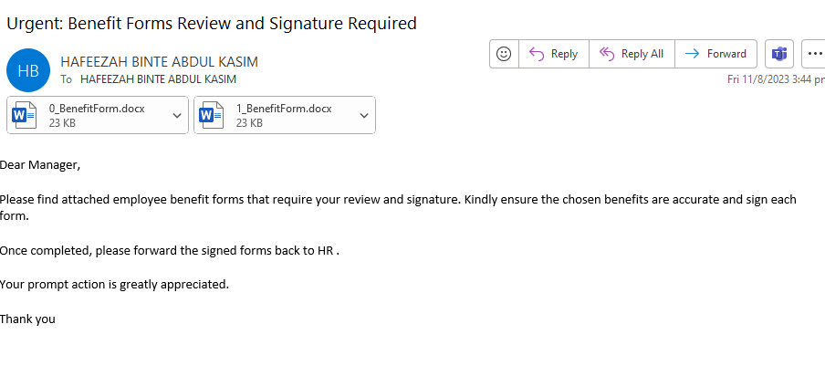
Reads text file with email body that needs to be sent to the manager asking them to sign the benefit forms for employees and saves the output text to a variable
Sends the outlook email to the manager with all the attached files
Assigns a bunch of variable for the manager emails and email subject. Reads text file with email body
For every file in the generated benefit folder, it adds the item to the list so that we can attach the whole list of benefit forms to the email
Email sent to the manager with the attached forms for all the employees. Correctly has the email body extracted from text file

Slide 8
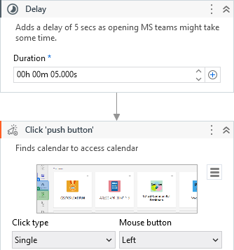
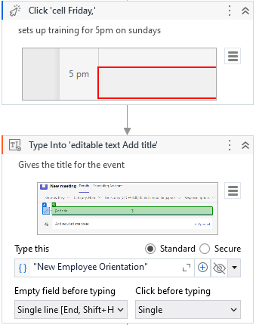
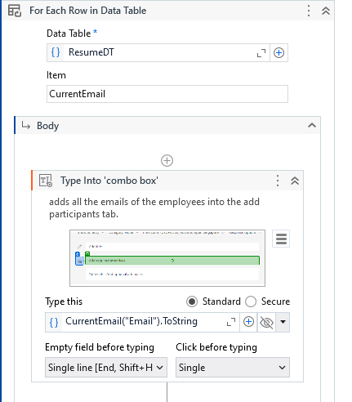
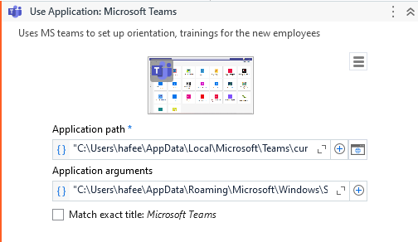
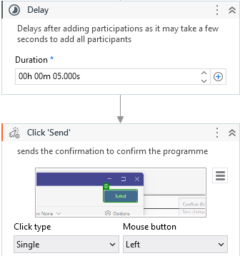
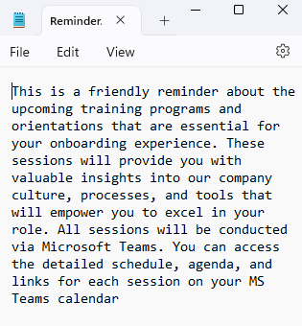
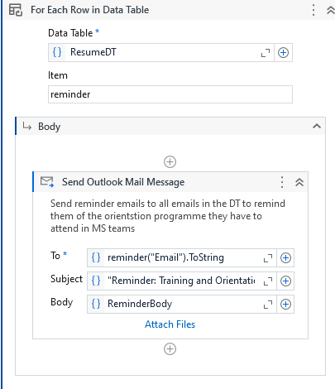
To set up training sessions, it reads the excel sheet again and opens up MS teams using use application
Sets a 5 second delay before clicking calendar as it might take some time for MS teams to load and open up
Chooses 5pm as default and types in title and description of the orientation and training programmes
Uses a for each loop and for each email in datatable and types it into the add participants tab. It then delays 5 seconds as it might take some time to get the email to pop up
Clicks and adds every participant in data table and then clicks send to set up the training session
Finally get text from text file( sample body) to remind employees to attend the training sessions. Loops through datatable and sends to everyone’s outlook email

Slide 9
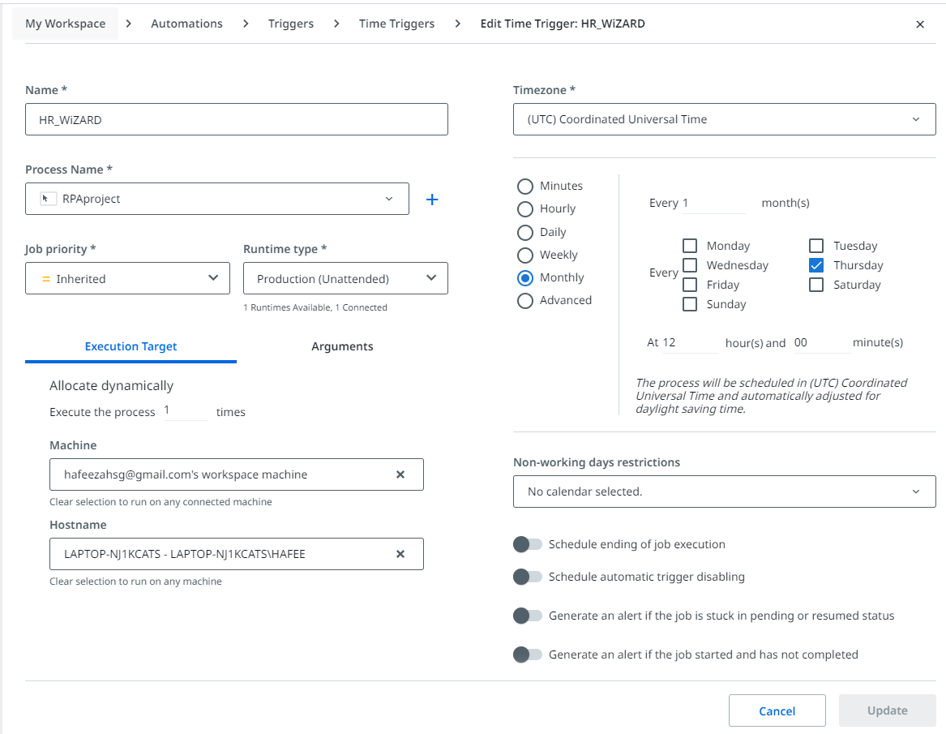
Orchestrator Scheduling
Finally, I uploaded the uipath application to the cloud and set a time trigger for this unattended bot where it’ll automate the tasks monthly on a certain day. This is so that the new employees tasks are done without the HR having to trigger or start anything. They would only have to clear the old resumes and put in the new resumes for the month to be sent for processing the resume folder and the rest would be automated.

Slide 10
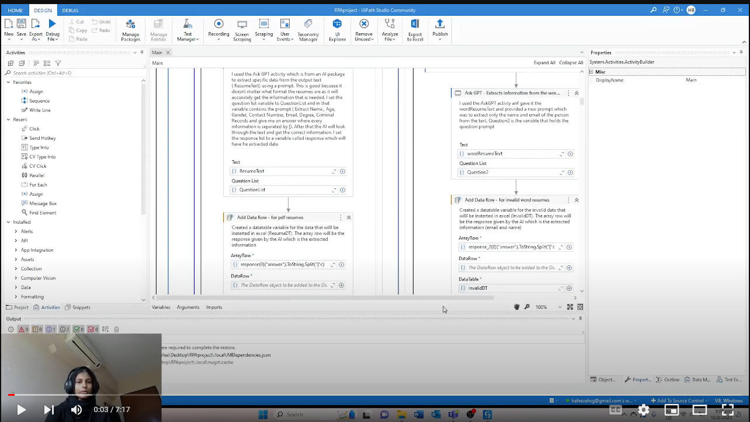
Product Demo Video
https://www.youtube.com/watch?v=_smQPnnwbzw&ab_channel=Gru

Slide 11
Thanks!
Does anyone have any questions? addyouremail@freepik.com 620 421 838
Please keep this slide for attribution

Slide 12
References
https://www.youtube.com/watch?v=vbElqDB73vA&list=PL8Y0Lf4geQ6O5ShljDSOOsQCzv_TtMtog&index=49&ab_channel=RedaMarzouk
https://www.youtube.com/watch?v=bJlHsWzfwHY&list=PL8Y0Lf4geQ6O5ShljDSOOsQCzv_TtMtog&index=50&ab_channel=RedaMarzouk
https://www.youtube.com/watch?v=2p84IH6vpfU&list=PL8Y0Lf4geQ6O5ShljDSOOsQCzv_TtMtog&index=51&ab_channel=MikeYippeeBlog
https://www.youtube.com/watch?v=uCdBC2pXPyY&list=PL8Y0Lf4geQ6O5ShljDSOOsQCzv_TtMtog&index=47&ab_channel=AndersJensen
https://www.youtube.com/watch?v=ZnpQgcwvAOY&list=PL8Y0Lf4geQ6O5ShljDSOOsQCzv_TtMtog&index=44&ab_channel=CameronMcKenzie
https://www.youtube.com/watch?v=D9pqt4UtF_s&list=PL8Y0Lf4geQ6O5ShljDSOOsQCzv_TtMtog&index=42&ab_channel=Tom%27sTechAcademy
https://www.youtube.com/watch?v=F2BLLlUbiSc&list=PL8Y0Lf4geQ6O5ShljDSOOsQCzv_TtMtog&index=40&ab_channel=CodehuntersHere
https://docs.uipath.com/activities/other/latest/document-understanding/digitize-document
https://docs.uipath.com/activities/other/latest/productivity/about-the-word-activities-pack
https://forum.uipath.com/t/how-to-schedule-a-process-to-run-in-a-specific-time-daily/350559

