Slide 1
DLOR SEA CREATURES CLASSIFIER REPORT
HAFEEZAH BINTE ABDUL KASIM | 220153F | P03

Slide 2
Introduction
About the dataset
Problem Statement
Summarised Details
Sea Animals Image Dataset is a collection from Kaggle containing diverse images of 23 sea animal classes, curated for image classification tasks. 🌊
To Develop an interactive and user-friendly image classifier that enables young children to identify various types of sea creatures through a mobile app
Classes: 23 sea animal classes, extensible.
Image Sizes: Of different sizes

Slide 3
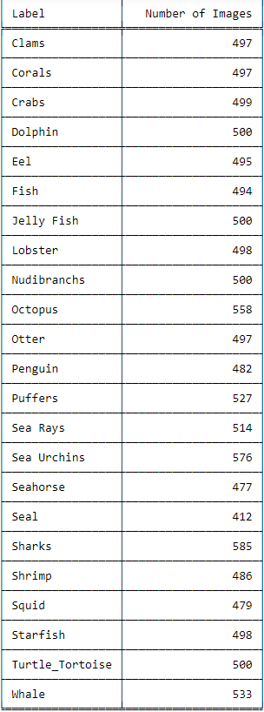
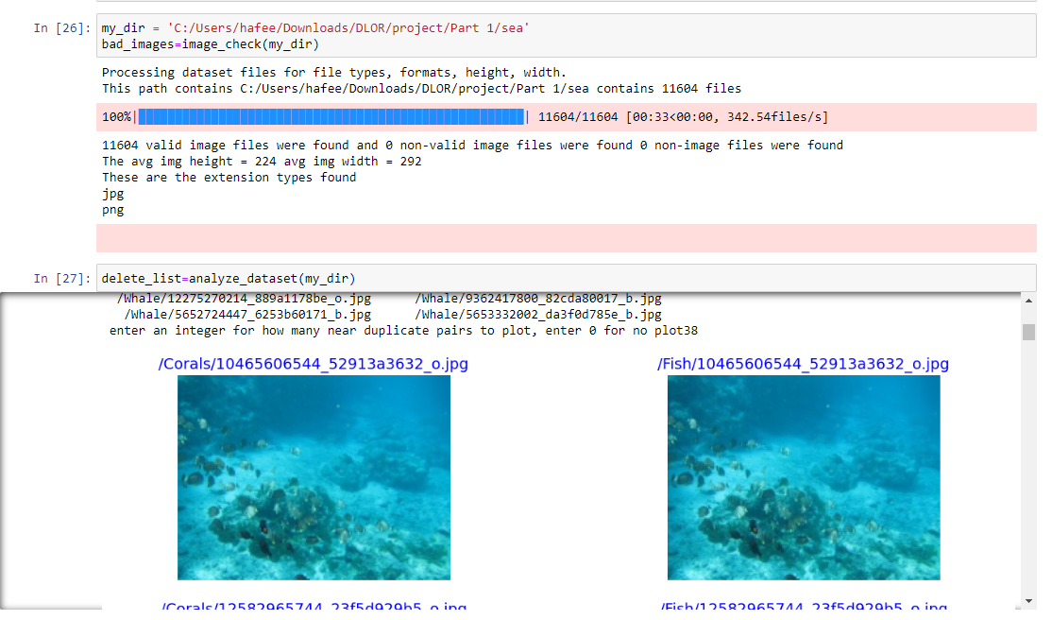
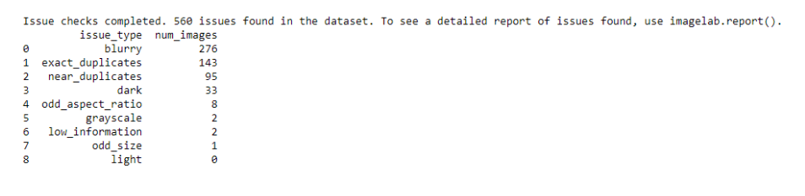
Part 1: Data Exploration & Cleaning
For checking the quality of the images, I decided to use a github python package called ‘cleanvision’. Cleanvision identifies image file issues pre-machine learning. It's great for finding problems like blurry images or duplicates quickly. I used it to clean up my dataset before model building. It is also open source which allows for free distribution and modification
Classes and Number of Images per class. This was taken after performing data sampling as there were come classes which were very unbalanced as compared to others (turtle_tortoise, dolphin)
This was the final image lab report which shows the issues detected in the dataset.
While the dataset is generally good, it needs improvement. It contains 143 exact duplicate image pairs, with 49 crossing classes, and 143 “near duplicate" pairs, 19 crossing classes. Uneven distribution of duplicates in sets may impact accuracy. There are also 33 "too dark" and 276 "blurry" images, with one "low information" image, which are considered minor concerns

Slide 4
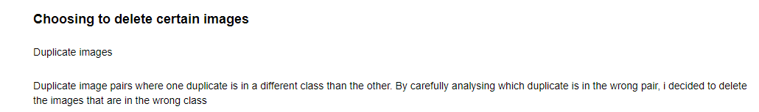
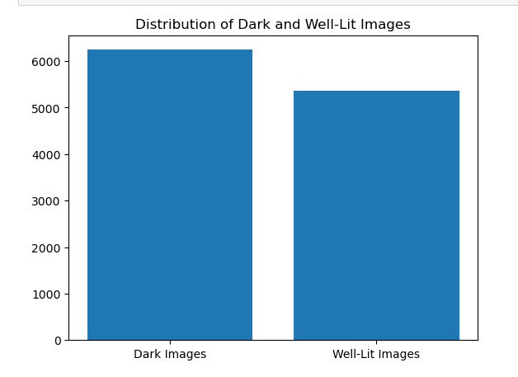
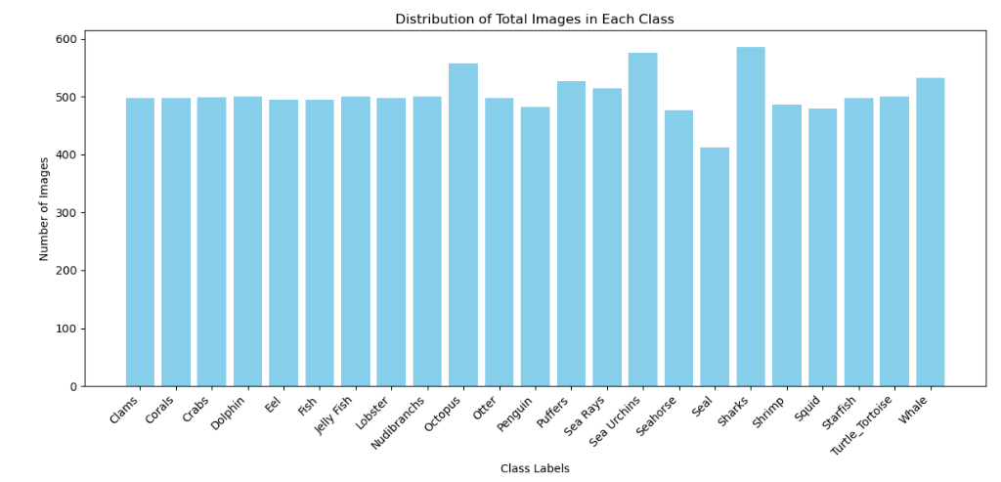
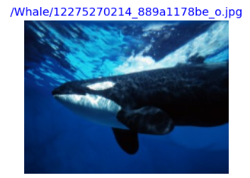
Data Exploration & Cleaning
I decided to delete duplicate images across different classes as it will confuse the model and give inaccurate predictions
I had quite an imbalanced dataset for some of the classes and I decided to do data sampling to balance out the classes
An example of a dark image.
I think it is still important to keep such images so that the model can generalise better
I chose to examine the ratio of dark and light images and decided to keep them because it is normal for sea creature images to be dark as they are under the sea
After data sampling, more balanced classes

Slide 5
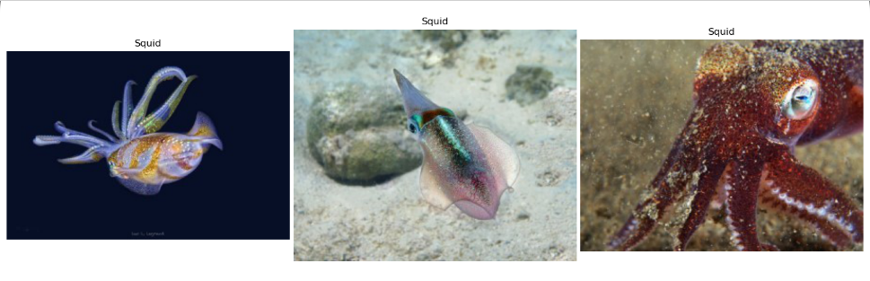
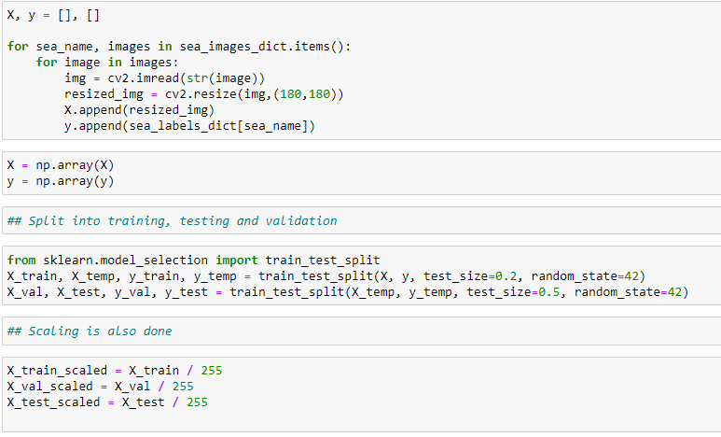
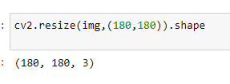
Normalisation, Splitting, Scaling
The images were of different sizes so I decided to resize the images so that they are of a consistent size before training a CNN
After all the pre-processing steps, I progressed to use train_test_split to split my dataset into training, testing and validation sets. Also scaled my images to 255. Scaling ensures that the optimization algorithm converges faster.

Slide 6
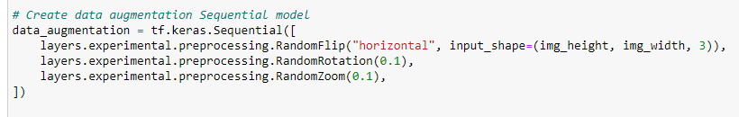
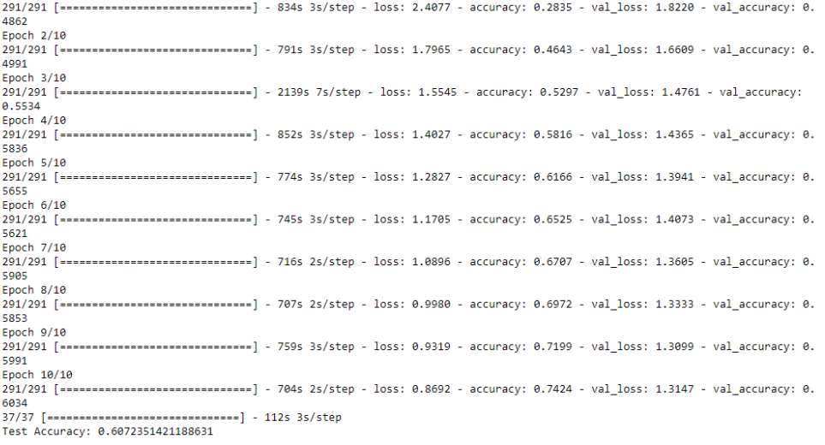

Building Baseline Model (CNN)
Data Augmentation
Trying a Different Model
Implemented data augmentation to boost model accuracy. The technique involves applying diverse transformations to existing images, expanding the training dataset.
Lenet 5
I opted to switch from LeNet-5 to VGG-19 due to the size of my dataset. LeNet-5, being less intricate, could struggle with the multitude of details in a large dataset. In contrast, VGG-19, with its more complex architecture, excels in comprehending diverse information.
The first baseline model I decided to build was the lenet 5 cnn model. The architecture is straightforward, with three convolutional layers, max-pooling, and dense layers. Training uses Adam optimizer and sparse categorical cross-entropy loss. The model exhibits overfitting, with a training accuracy of 99.6% and a lower validation accuracy of 28.97%. Test set accuracy aligns with validation at 29.11%, but a high loss value (7.96) indicates challenges in predicting unseen data.
The model still has a low accuracy after implementing data augmentation (training accuracy: 61%)
The VGG-19 model showed substantial improvement in the test accuracy which reached around 60.72% compared to the lower 20% accuracy achieved with lenet 5

Slide 7

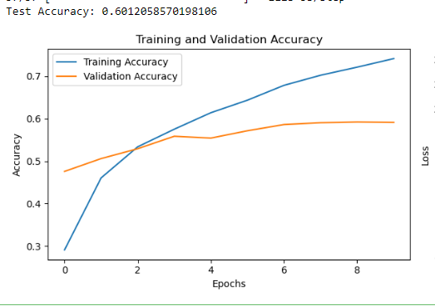

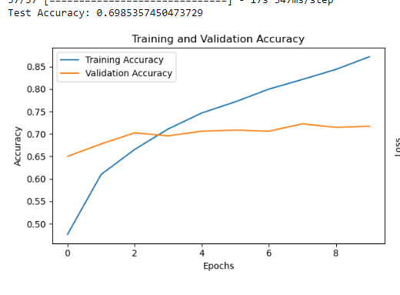
Boosting Accuracy For Baseline Model
Adding Regularisation
Data Augmentation for VGG-19
Batch Normalisation and Early Stopping
The test accuracy decreases from 60% to 57% when data augmentation is applied, indicating that, in this particular scenario and dataset, data augmentation may not contribute significantly to improvement and could possibly impede the model's performance. This outcome is not unusual for larger datasets
I decided to try adding regularisation but the accuracy was still lower than the initial model (57%)
Inception V3
After adding batch normalisation and early stopping, the model’s accuracy was 60%. There were still signs of overfitting
I decided to try one last model (Inception V3), in hopes of better generalisation and accuracy for my baseline model. The Inception v3 performed way better with a test accuracy of about 70% which is a good improvement from VGG-19. This was my final selection for model selection

Slide 8
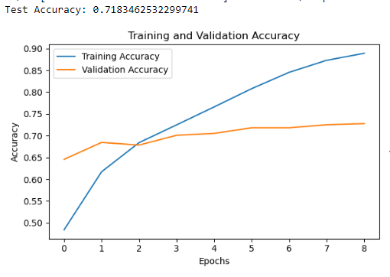
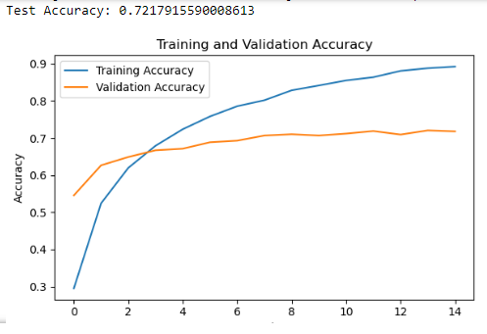
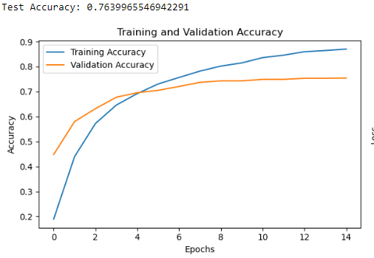
Part 2: Fine-Tuning , Exploration
Further Adjustments
Transfer Learning
(Inception v3)
Unfreeze more layers in inceptionV3 model
Replaced Flatten() with GlobalAveragePooling2D() for better performance.
Increased the number of unfrozen layers to 250. This can an enhance performance by reducing the number of parameters, helping prevent overfitting and promoting better generalization (accuracy went up to 76%)
Adding the learning rate did increase the training and testing accuracy, the test accuracy went from the initial 0.69 to 0.71
By unfreezing more layers, it allows the model to learn more complex features from the specific dataset. Accuracy only went up by 1% (72%)

Slide 9
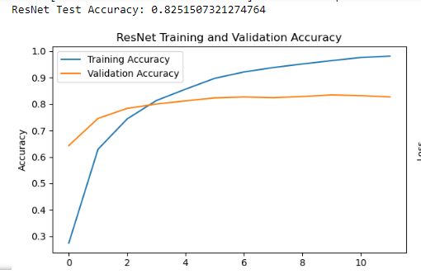
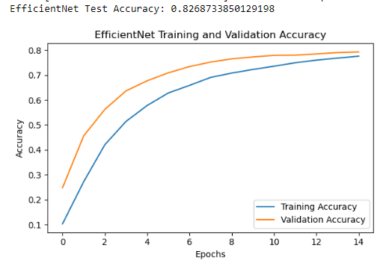
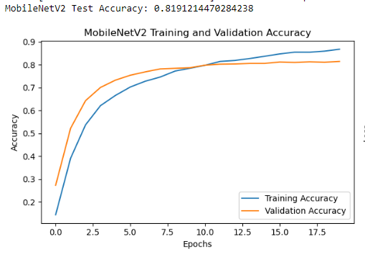
Trying Different Algorithms
ResNet / 152
EfficientNet
MobileNet
Initial Training Accuracy: 27.46%
Final Training Accuracy: 98.13%
Initial Validation Accuracy: 64.31%
Final Validation Accuracy: 82.67%
Test Accuracy: 82.52%
For version 152:
Test Accuracy: 84%
Initial Training: 10.35%
Final Training: 77.54%
Initial Validation: 24.83%
Final Validation: 79.22%
Test Accuracy: 82.69%
Training Accuracy:
Initial Epoch: 14.35%
Final Epoch: 86.70%
Validation Accuracy:
Initial Epoch: 27.24%
Final Epoch: 81.38%
Test Accuracy: 81.91%

Slide 10
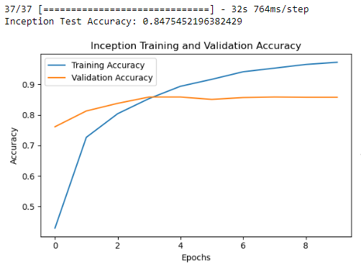
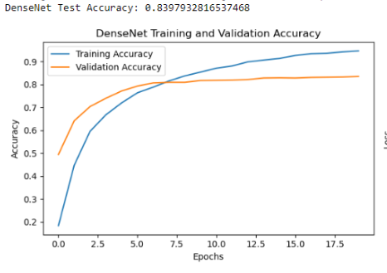
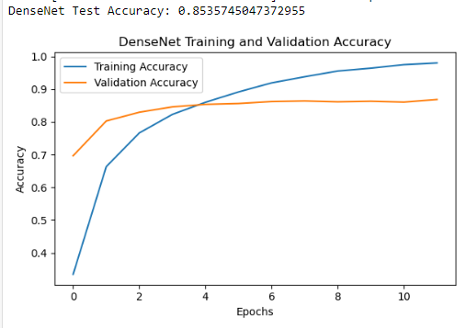
Trying Different Algorithms
Inception
DenseNet ver 121
DenseNet ver 201
Final Training Accuracy: 0.9724
Final Validation Accuracy: 76.12%
Test Accuracy: 84.75%
shows some signs of overfitting as training accuracy is way better than the testing accuracy
Final training accuracy: 92%
Final Validation accuracy: 84%
Test Accuracy: 83%
Training Accuracy (Epoch 12): 97.97%
Validation Accuracy (Epoch 12): 86.81%
Test Accuracy: 85.36%
So far DenseNet version 201 seems to be the best performing model

Slide 11
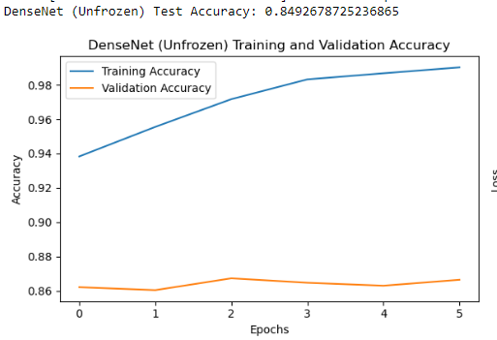
Fine-Tuning (DenseNet Ver201)
DenseNet Model (Before Unfreezing):
Training Accuracy: Started at approximately 33.46% and increased over epochs.
Validation Accuracy: Started at approximately 69.66% and increased over epochs.
Test Accuracy: Achieved approximately 85.36%.
Fine-Tuned DenseNet Model (After Unfreezing):
Training Accuracy: Started at approximately 93.43% and increased over epochs.
Validation Accuracy: Started at approximately 86.55% and slightly increased over epochs.
Test Accuracy: Achieved approximately 84.76%.
Unfreeze the layers for the
DenseNet ver 201 model ,
adjust learning rate,
re-train without weights
Training Accuracy Improvement: Unfreezing layers significantly improved training accuracy, showing the model's ability to adapt to the new data.
Test Accuracy Change: The test accuracy slightly decreased after unfreezing layers. This might be due to overfitting to the training set, but the difference is not substantial.

Slide 12
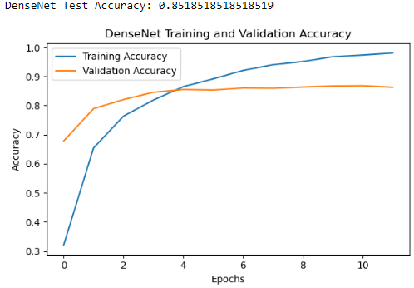
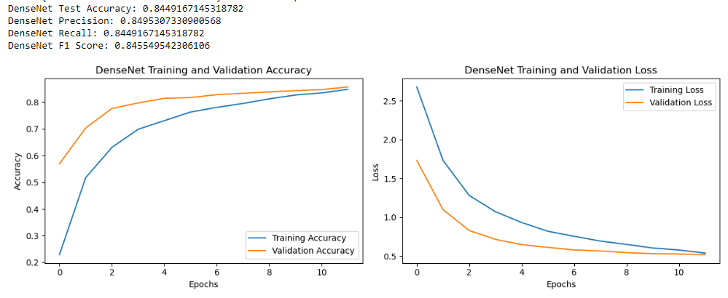
Dropout Rates, Data Augmentation
Adding Dropout Rates
Data Augmentation
Training Progress:
The training accuracy started at 32.10% and reached 98.05% by the end of training.
The validation accuracy started at 67.84% and reached 86.29% by the end of training.
The test accuracy achieved was 85.19%.
I experimented with various other values of dropout rates and 0.4 was the best performing one compared to the rest.
Data Augmentation did not help to improve the model's performance, in fact it made it worse. I’m assuming excessive augmentation techniques introduced noise or distortions that hinder the model's ability to learn meaningful features.
Accuracy: 84%

Slide 13
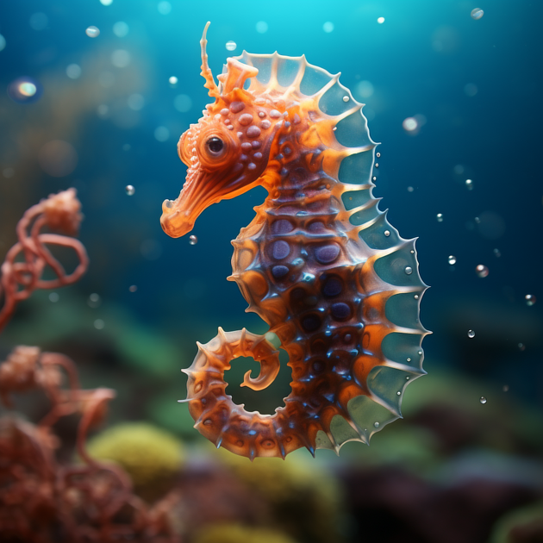
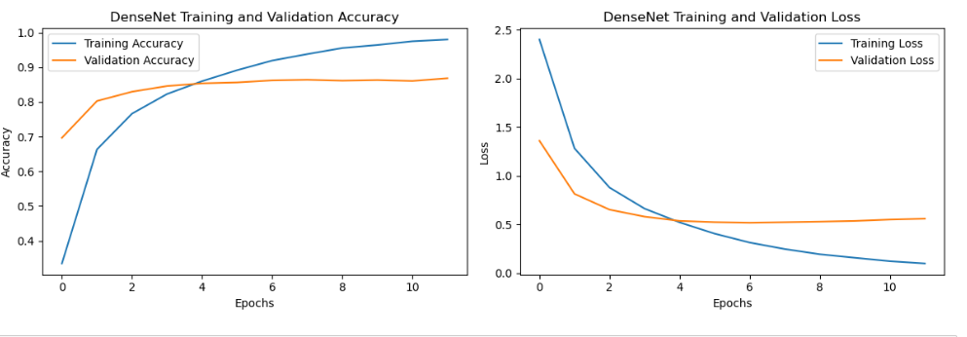

Final Model Selection
The analysis of various deep learning models for sea creature classification, including InceptionV3, ResNet152, EfficientNet, MobileNetV2, and DenseNet201, revealed that DenseNet201 stood out as the most promising choice due to superior performance and low overfitting risk. Throughout the 12 epochs of training, DenseNet201 demonstrated exceptional accuracy, achieving 97.97% in training and 86.81% in validation. In contrast, InceptionV3 showed signs of overfitting, while DenseNet201 maintained a balanced performance.
Upon evaluation on the test dataset, DenseNet201 confirmed its effectiveness with a test accuracy of approximately 85.36%.

Slide 14
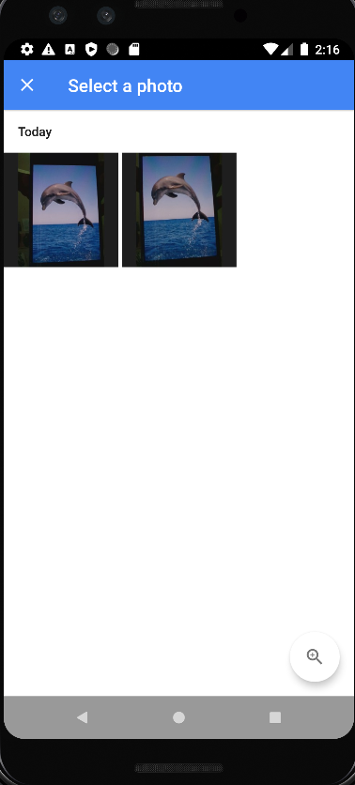
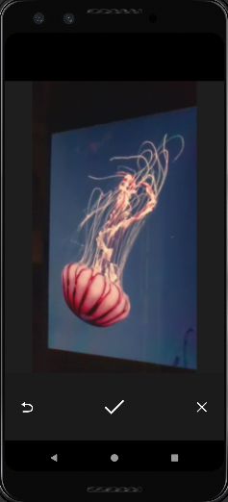
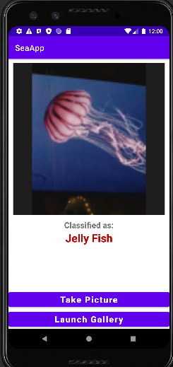
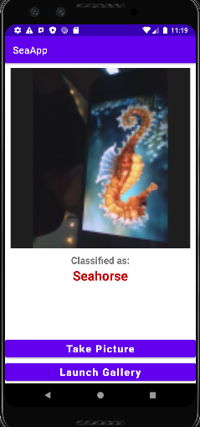
Android App Deployment
Finally I deployed the Dense Net model onto an app using android studio. Users can either pick and image from their gallery to classify or take a picture on the spot
The output will be shown via this user friendly UI of the predicted class of sea creature

Slide 15
THANK YOU

