Slide 1
PERTH HOUSE PRICE PREDICTION (Machine Learning Project)
2201536F | Hafeezah Binte Abdul Kasim

Slide 2

INTRODUCTION
In recent years, the real estate market has witnessed unprecedented growth and transformation. As the demand for housing continues to rise, both homebuyers and sellers seek more accurate and reliable methods to estimate property prices. This is where the power of machine learning comes into play.
So, I have decided to explore a dataset on Perth house prices and information found in the kaggle website. It encompasses data from 322 suburbs in Perth and build a model that would predict house prices based on certain features.

Slide 3
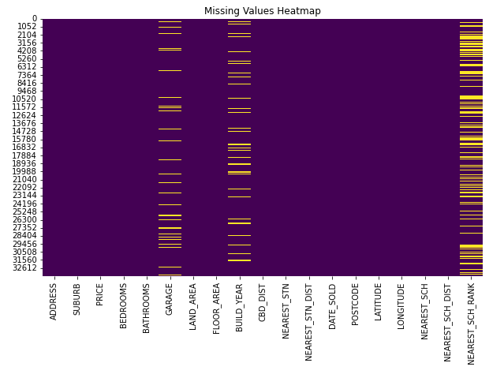
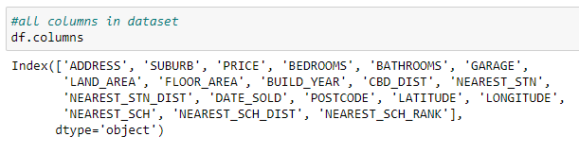

DATA EXPLORATION AND PRE-PROCESSING
The dataset was pretty messy and complex with many different columns and rows.
There was many missing values and outlier values
There was also a lot of categorical features like ‘Suburbs, address and nearest school’.
There were a lot of unique values in the categorical data
Notes:
I did more EDA using boxplots, histograms to view data as it is essential for understanding the distribution, identifying patterns, and gaining insights about the data. From the above, we can see that the most number houses have 4 bedrooms and less than 5 bathrooms. Most of the houses were also built on the year 2000.
I also tried to see if there was any correlation between the numerical features. The correlation values were quite low between the values so I decided not to remove values based of correlation.

Slide 4
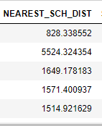
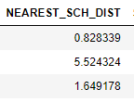
DATA CLEANING
Missing Values
- There were too many missing values for the nearest school rank column so I just dropped it and I thought it did not really have much value to the model
- For missing values in ‘BUILD-YEAR’ and ‘GARAGE’, I imputed them with median values using fillna() as the median would not be influenced by any extreme outliers.
Standerdisation
'NEAREST_SCH_DIST' column is in 'Kilo Meters' and other distances are in 'Meters'. And the standard unit is 'Meters'.
Therefore, 'NEAREST_SCH_DIST' column needed to be converted in to 'Meters'
Notes:
The NEAREST_SCH_DIST was originally in kilometers while the other distances columns were in in meters so I decided to convert the values to meters. Converting distances to a common unit (meters) allows for better standardization of data. Standardization is crucial for algorithms that rely on distance metrics or those sensitive to feature scales, like K-nearest neighbors or gradient descent-based methods.

Slide 5
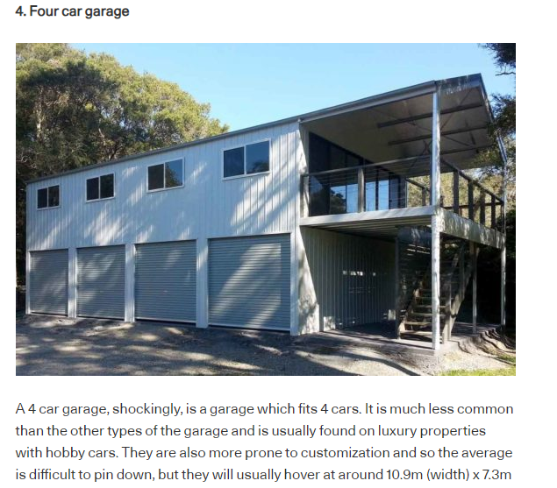
Outliers
For the outlier values, I calculated the z-score values and used a threshold value and dropped them.
However, I realised in the ‘GARAGE’ column there was odd values like 31 garages and I think it was definitely a mistake so I decided to drop all columns with over more than 4 garages as its uncommon according to an article I read.
Notes:
Outliers can have a disproportionate impact on model training. They can introduce noise and bias, leading the model to learn from extreme values that may not be representative of the majority of the data.
I decided to calculate the Z-score for each value in the numerical columns as A z-score tells us how far away each data point is from the average mean value in terms of standard deviation. The code finds the rows in the DataFrame that have at least one outlier and records their row numbers (indices). I later on dropped the outlier columns. Outliers can have a disproportionate influence on statistical models, leading to biased results. By removing outliers, the model can focus on the majority of data points and produce more accurate and reliable predictions.
I found it kind of odd for a house to have more than 4 garages. Values like 31 garages has got to be a mistake as it is not possible for a home to have that many garages. So i decided to remove all the outliers and keep values from 1-4 as it is still common in australia to have a house with 4 garages.

Slide 6
FEATURES
To improve the house price model's effectiveness, I dropped several columns. The 'ADDRESS' column was removed to avoid redundancy with the 'SUBURB' column. 'NEAREST_STN' and 'NEAREST_SCH' were removed as they may not directly impact house prices. The 'DATE_SOLD' column, 'POSTCODE,' 'LATITUDE,' and 'LONGITUDE' were dropped to avoid overfitting and focus on more relevant predictors. Additionally, the 'NEAREST_SCH_RANK' column with many missing values and weak correlation to house prices was removed. These changes aim to enhance the model's performance by prioritizing meaningful data and reducing dimensionality.
Chosen features
House price model considers key features like bedrooms, bathrooms, garage, land area, floor area, build year, CBD distance, nearest train station distance, and nearest school distance to predict prices. These factors impact property desirability and value.
Notes:
BEDROOMS: The number of bedrooms in a house is a crucial factor that affects its size, capacity to accommodate occupants, and overall appeal. Houses with more bedrooms generally have higher prices as they offer more living space and potential for larger families.
BATHROOMS: The number of bathrooms is another critical feature that impacts a house's desirability and price. More bathrooms provide convenience and comfort, making a property more attractive to potential buyers and leading to higher prices.
GARAGE: The presence of a garage is highly valued, especially for homeowners with vehicles. Houses with garages offer secure parking space, protection from the weather, and additional storage, all of which contribute to higher property values.
LAND_AREA: The land area of a property directly influences its overall size, outdoor space, and potential for landscaping or development. Larger land areas often command higher prices.
FLOOR_AREA: The floor area represents the interior living space of a house. Larger floor areas provide more room for living and storage, making a property more appealing and valuable to potential buyers.
BUILD_YEAR: The year the house was built can impact its condition, design, and architectural style. Older homes may have historical value or unique features, while newer homes may have modern amenities, both of which can influence the price.
CBD_DIST: The distance to the Central Business District (CBD) is crucial for many homebuyers who seek accessibility to workplaces, amenities, and city life. Houses closer to the CBD often have higher prices due to their desirable location.
NEAREST_STN_DIST: Proximity to the nearest train station is significant for commuters and those relying on public transportation. Houses closer to train stations may attract higher prices as they offer convenience for daily travel.
NEAREST_SCH_DIST: The distance to the nearest school is crucial for families with school-aged children. Houses in close proximity to good schools tend to be more in demand and command higher prices

Slide 7
DEALING WITH THE SUBURB COLUMN
The suburb column is an important feature when predicting house prices as certain suburbs may have higher value then the other. However, there was over 200 unique suburbs and I needed to find a way to deal with it properly.
I initially thought to drop the suburb column altogether but when I tried that the accuracy was really low so I thought it was better to keep it
I tried one hot-encoding the column but it ended up with too many features which led to the curse of dimensionality and even though the accuracy was relatively high, the model gave too much importance to the suburb feature and the price only changed if the suburb changed regardless of the number of rooms, bathrooms etc.
So I finally decided to perform cluster analysis based using the K-means algorithm to group together suburbs based on their geographical location and identified potentially expensive suburbs within each cluster.
I then created a ‘Suburb_status’ column hold the price group of each suburb based on whether it is considered "Luxury" or "Standard" relative to the calculated threshold and then label encoded them.
Notes:
The "suburb" column is important in predicting house prices because the location of a property is a critical factor in determining its value. Suburbs can vary significantly in terms of amenities, infrastructure, safety, schools, proximity to city centers, and other important attributes that influence housing prices. If I drop the "suburb" column, your model will treat all properties as if they are from the same location, leading to incorrect predictions. In other words, it will ignore the location effect, which is a critical factor in determining house prices. However, since the suburb column has over 300 unique values, i had to find a way to deal with them properly.
Firstly, I decided to drop the suburbs that were rare and only had an occurrence of less than 15 times throughout the dataset. Suburbs with very few occurrences may not have enough data points to make meaningful predictions. I tried plotting graphs and bar charts to see if I could stream down the most expensive suburbs. I didn’t want to one hot encode the Suburb column at first because it would lead to the curse of dimensionality and may result in overfitting the model due to the number of features increasing. However, I tried many different methods to group the suburbs columns in a different way. I wanted to do label encoding but label encoding introduces numerical values to different suburbs, which might be interpreted by the model as having a specific magnitude. For example, if suburb A is encoded as 1 and suburb B as 2, the model might infer that suburb B is "twice" as significant as suburb A, which is not the case as seen below the prices for the most expensive suburbs are only different by a little bit. I also thought to completely drop the suburb column which I initially did but the model’s performance and accuracy was much lower as compared to when I one hot encoded them
Initially that is what I thought of doing but I realised after I built the model and tried predicting the values, the model heavily depended on the suburb features only to predict the price which was not a good thing even if the accuracy was high. Regardless of the number of rooms or lot size, the price only changed when the suburb was different and I thought this was a major issue. So I traced back my process to find an alternative solution to use the suburb column. So this was my solution:
I performed cluster analysis using K-means algorithm to group suburbs based on their geographical locations ( latitude and longitude) and then identifying potentially expensive suburbs within each cluster based on the average house prices. Overall, this analysis helps me group suburbs into clusters based on their geographical proximity and identify clusters of suburbs with potentially higher house prices. The "suburb_groups" Series provides information about which suburbs belong to each cluster, and the "expensive_suburbs" Series allows me to understand which clusters contain suburbs with higher average house prices.
I then created a new column called SUBURB_STATUS to hold the price group of each suburb based on whether it is considered "Luxury" or "Standard" relative to the calculated threshold. This "SUBURB_STATUS" column can be used as a feature in the machine learning models instead of the suburb columns. It provides a simplified representation of the expensive and cheaper suburbs in the dataset. I finally label encoded it and this whole process eliminated the fear of the curse of dimensionality and huge increase in the number of features.

Slide 8
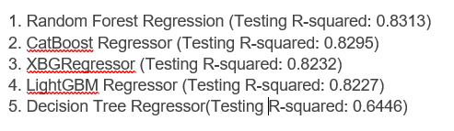
MODEL BUILDING AND EVALUATION
I built and trained the model on various algorithms such as linear regression , ridge, decision tree, svm, gradient boosting regressor, random forest, lightgbm, Xgbregressor, Catboost.
After thorough testing these were the top performing models. The models are ordered from the highest to the lowest R-squared value on the testing dataset. It's essential to focus on the testing R-squared value as it measures the model's performance on unseen data, which is a better representation of its true generalization ability.
I decided to do hyperparameter tuning to get better results and boost accuracy.
Notes:
For my machine learning model, accuracy was a primary concern as compared to interpretability. Models like LightGBM, CatBoost, and Gradient Boosting are often preferred for these cases. These models have demonstrated higher predictive accuracy compared to Linear Regression and Ridge Regression in this case, making them better suited for tasks where precise predictions are essential. In the context of housing price prediction, ensemble methods like Random Forest, LightGBM, CatBoost, and Gradient Boosting offer several advantages that are particularly relevant for handling the complexities and challenges associated with housing data such as handling noisy data, capturing non linear relationships, reducing overfitting and handling high dimensional data. In summary, while Linear Regression and Ridge Regression are interpretable and suitable for simple linear relationships, the more complex models like LightGBM, CatBoost, and Gradient Boosting demonstrate superior accuracy and the ability to capture complex patterns.

Slide 9
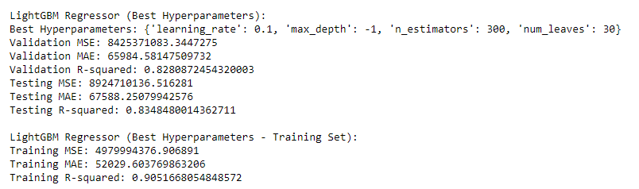
FINAL SELECTION AND JUSTIFICATION
I used RandomizedSearchCV to perform randomized hyperparameter search and select the best combinations of hyperparameters defined and selects the best combination based on cross-validated performance using negative mean squared error. I did this for all the chosen models. After evaluating all the models I decided to go with the LightGBM Regressor
The LightGBM Regressor with the best hyperparameters exhibits consistent and excellent performance across all datasets. The validation R-squared value of 0.8281 indicates that the model explains approximately 82.81% of the variance in house prices on the validation data. The testing R-squared value of 0.8348 suggests that the model explains approximately 83.48% of the variance in house prices on the testing data.
Notes:
The LightGBM algorithm is known for its efficiency and ability to handle large datasets with high dimensionality. With the best hyperparameters, the model achieves accurate predictions and demonstrates strong generalization capabilities on unseen data. The training R-squared value of 0.9052 further validates the model's ability to capture underlying patterns in the training data.

Slide 10
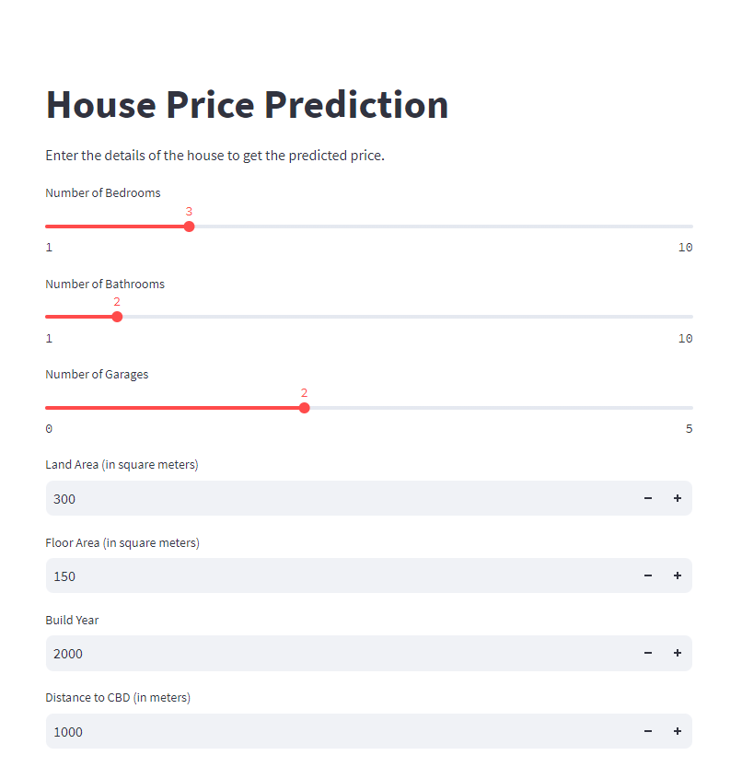

DEPLOYMENT ON STREAMLIT
After model selection, I decided to deploy the model on streamlit as I thought the interface was relatively easy to use was aesthetically pleasing.
Users can easily key in the relevant information and would give the predicted price as shown below !

Slide 11
THANKS
Please keep this slide for attribution

