Slide 1
elf.Crochets
This is my website

Slide 2
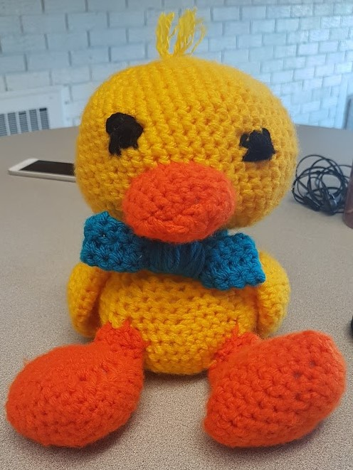

Slide 3
Introduction to the topic
I chose the topic an invention.
My invention is a new crochet hat pattern. I chose this because I crochet and all the pictures of crocheting on my website are my own works. The duck is one that I kind of followed a pattern for, but I adjusted the pattern somewhat. All the hats were made without a pattern I just started crocheting them and this is how they turned out.

Slide 4
Creative Direction
Based on this topic I wanted to make a website that is easily accessible for people of all ages. So, I made a super basic design. I added a small amount of color to the header and footer, and a few text boxes on one page. I chose a color that I thought would help make the page pop a little more and also compliment the colors in the pictures.

Slide 5
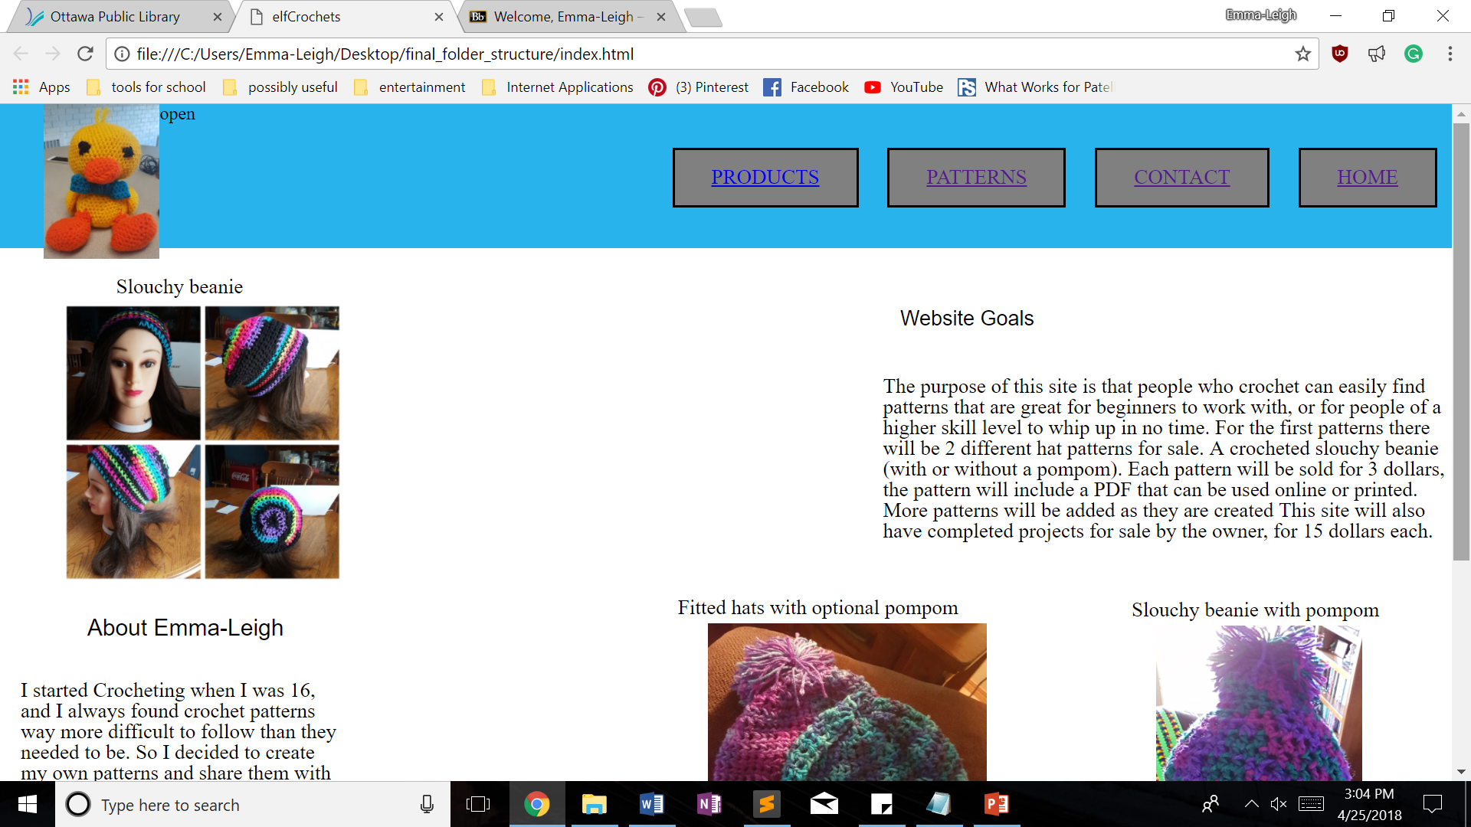

Slide 6
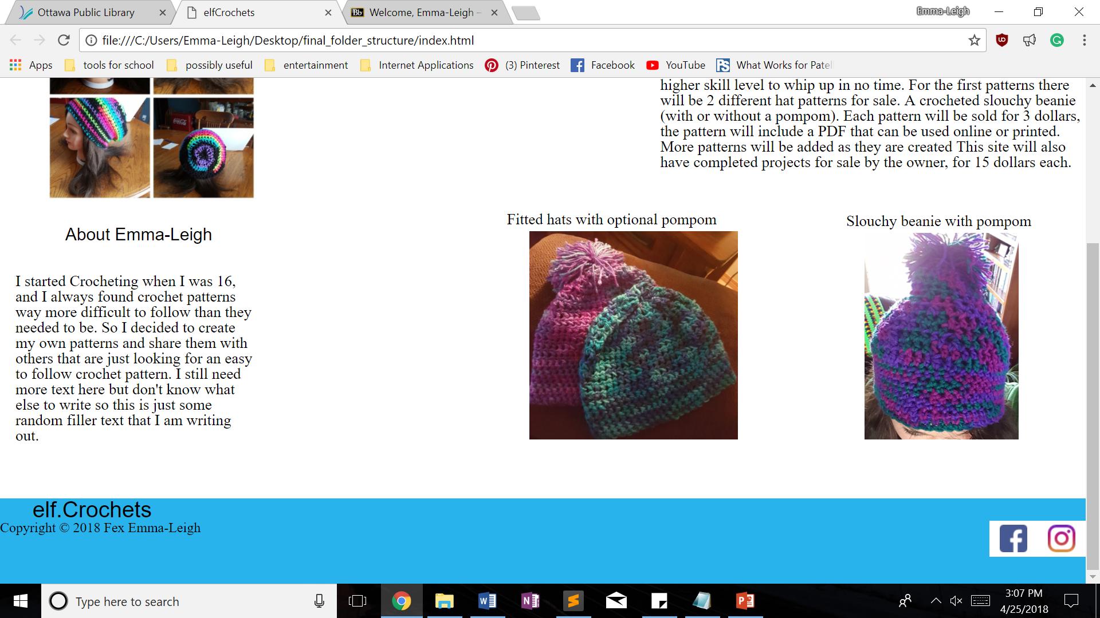

Slide 7
Homepage
My home page has pictures of some of the hats that patterns can be purchased for. It also has a little bit about what I want from the website, as well as an about the creator section. I added this stuff to the homepage because I figured it is a good way for people to be able to see why the website was created and encourage them to purchase a pattern from this website as opposed to the many others like it.

Slide 8
Animations
This site currently has 3 functioning pages. One of them has a slide show.
My slide show fades in and out when changing between pictures!

