Slide 1
Training language models to follow instruction with human feedback
By: Long Ouyang, Jeff Wu, Xu Jiang, Diogo Almeida, Carrol L. Wainwright, Pamela Mishkin, Chong Zhang, Sandhini Agarwal, Katarina Slama, Alex Ray, John Schulman, Jacob Hilton, Fraser Kelton, Luke Miller, Maddie Simens, Amanda Askell, Peter Welinder, Paul Cristiano, Jan Lelke, Ryan Lowe

Slide 2
Introduction
Why is this important?
LLMs often fail to align with specific user intent and can generate outputs that are untruthful, toxic, or not helpful
Problem Statement
LLMs can exhibit unintended behaviors due to misalignment with user objectives, primarily focusing on predicting the next token rather than following instructions.
Objective
The objective of this research is to align models with user intentions, both explicit and implicit through a fine-tuning process. This process aims to create models (InstructGPT) that generate preferred outputs.
Notes:
LLMs can have unintended behaviors
This is bc LM objective is often misaligned - wants to predict next token instead of “following user’s instructions helpfully and safely”
Can work on alignment by training them to act according to user intention (both explicit, i.e. follow instructions, and implicit, i.e. don’t be harmful/toxic or lie)
We want LLMs to be helpful, honest, and harmless
RLHF = reinforcement learning from human feedback
This is how the models (GPT-3) are fine-tuned

Slide 3
Related Work
Origin of RLHF
Influence from similar work using HF as a reward
Other approaches
Fine-tuning LMs with instructions
Benchmarking the harms of LMs
Notes:
Research on alignment and learning from human feedback
They build on previous methods to align models w/ human intentions, such as RLHF
RLHF was originally developed for training robots in simulated environments and Atari games, has recently been applied to fine-tuning language models to summarize text
This is influenced by similar work using human feedback as a reward in domains like dialogue, translation, semantic parsing, story generation, review generation, evidence extraction
Another group uses written human feedback to augment prompts and improve GPT-3
The work in this paper here is seen as a direct application of RLHF to aligning language models on a broad distribution of language tasks
Evaluating the harm of language models
A goal of modifying the behavior of LMs is to reduce the harm of them when they’re deployed in the real world
Language models can produce biased outputs, leak private data, generate misinformation, and be used maliciously
There is a growing field that aims to build benchmarks to evaluate these harms around toxicity, stereotypes, and social bias

Slide 4
Method and Experimental Details
3 steps:
Collect demonstration data, train supervised policy
Collect comparison data, train a reward model
Optimize a policy against the reward model using PPO
Notes:
The group starts with a pretrained model, a distribution of prompts on which they want their model to produce aligned outputs, and a team of trained human labelers
They then apply the following three steps:
Step 1: Collect demonstration data, and train a supervised policy
The labelers provide demonstrations of the desired behavior on the input prompt distribution
The group then fine-tunes a pretrained GPT-3 model on this data using supervised learning
Step 2: Collect comparison data, and train a reward model
The group collects a dataset of comparisons between model outputs, where labelers indicate which output they prefer for a given input
The group then trains a reward model to predict the human-preferred output
Step 3: Optimize a policy against the reward model using PPO
The group uses the output of the reward model (RM) as a scalar reward
They fine-tune the supervised policy to optimize this reward using the PPO algorithm
Step 2 and 3 can be iterated continuously: more comparison data is collected on the current best policy, which is used to train a new RM and then a new policy.

Slide 5
Dataset
Prompt dataset: filtered prompts submitted to OpenAI API (Playground)
To train the first InstructGPT models: handwritten prompts:
Plain
Few-shot
User-based
From these prompts, 3 datasets were produced:
SFT – labeler demonstrations
RM – labeler rankings
PPO – no labels (inputs for RLHF fine-tuning)
Notes:
The prompt dataset consists mainly of text prompts submitted to the OpenAI API, specifically those using an earlier version of InstructGPT models on the Playground Interface
Customers using the Playground were informed that their data could be used to train further models via a recurring notification any time InstructGPT models were used
They asked labelers to write three kinds of prompts:
Plain: come up w/ an arbitrary task
Few-shot: come up w/ an instruction, and multiple query/response pairs for that instruction
User-based: the group had some use-cases stated in waitlist application to the OpenAI API. They asked labelers to come up with prompts corresponding to the use cases
From these prompts, the group made three different datasets used in fine-tuning:
SFT dataset: with labeler demonstrations used to train SFT models
RM dataset: with labeler rankings of model outputs to train RMs
PPO dataset: without any human labels, which are used as inputs for RLHF fine-tuning

Slide 6
Supervised fine-tuning (SFT)
Start with GPT-3 pretrained models
Trained on broad distribution of data, very adaptable
Trained for 16 epochs, overfit after 1
Models are then trained from here
Notes:
Supervised fine-tuning (SFT): fine-tune GPT-3 on the labeler demonstrations using supervised learning. Train for 16 epochs,
using cosine learning rate decay, and residual dropout of 0.2 SFT models overfit after 1 epoch,
but training more helps both RM score and human preference ratings

Slide 7
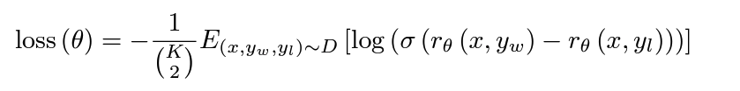
Reward Modeling (RM)
Model is trained on a dataset of human labeler comparisons of model-generated responses for same prompt
The loss function is based on cross-entropy and the formation of batch elements
Normalize RM output to ensure consistency and account for shifts
RM determines rewards in RL
Notes:
Reward modeling (RM): Starting w/ the SFT model with the final unembedding layer removed, they train a model to take in a prompt and response, and output a scalar reward. In this paper they only use 6B RMs, to save a lot of computing.
The RM is trained on a dataset where human labelers compare responses generated by the model for the same prompt. The labelers rank the responses.
They use a loss function based on cross-entropy, where the difference in rewards represents the log odds of human preference between the responses
Instead of treating each comparison as a single data point, they form batch elements containing all K 2 comparison from each prompt, which helps to prevent overfitting
They normalize the RM output using a bias to ensure that labeler demonstrations achieve a mean score of 0 before RL, this accounts for shifts in reward

Slide 8
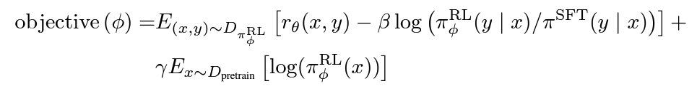
Reinforcement Learning
Fine-tune SFT model on the environment using PPO
PPO: receiving random customer prompts, generating responses, receiving rewards (RM)
Includes a per-token KL penalty from the SFT model
PPO-ptx: integrates pretraining gradients to address NLP dataset performance
Compare RL model performance with others (SFT, GPT-3)
Notes:
Reinforcement learning (RL): they fine-tune the SFT model on their environment using PPO. It represents a random customer prompt and expects a response to the prompt.
Given the prompt and response, it produces a reward determined by the RM and ends the episode
They add a per-token KL penalty from the SFT model at each token to mitigate over-optimization.
Two model variants are explored: PPO and PPO-ptx
PPO-ptx integrates pretraining gradients to address NLP dataset performance regressions
RL training maximizes rewards while penalizing deviations from supervised training model

Slide 9
Evaluation
Alignment: Helpful, honest, harmless
Helpful: model should follow instructions
Honest:
Hallucinations
Using the TruthfulQA dataset
Harmless: evaluate output in the context of a customer assistant
Notes:
Define alignment as “act in accordance with user intentions”, they are “aligned” if they are helpful, honest, and harmless
To be honest, they measure truthfulness with two metrics:
Evaluating model’s tendency to make up information on closed domain tasks (“hallucinations”)
Using the TruthfulQA dataset
They then had labelers evaluate whether an output is inappropriate in the content of a customer assistant, denigrates a protected class, or contains sexual or violent content

Slide 10

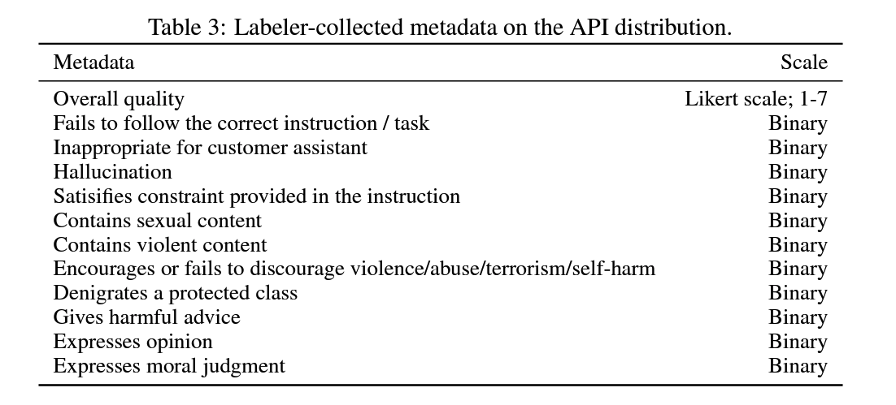
Quantitative Evaluation
Evaluation on API distribution:
Main metric is human preference rating on a held out set of prompts
Includes prompts submitted to GPT-3 models
Calculate how often outputs are preferred to baseline (175B SFT)
Ask labelers to judge score on Likert scale
Evaluation on public NLP datasets:
Two dataset types: ones that capture an aspect of LM safety
and ones that capture zero-shot on traditional tasks
Notes:
Evaluations on public NLP datasets
Evaluate on two types of these:
Those that capture an aspect of LM safety such as truthfulness, toxicity, and bias
Those that capture zero-shot performance on traditional NLP tasks like question answering, reading comprehension, and summarization

Slide 11
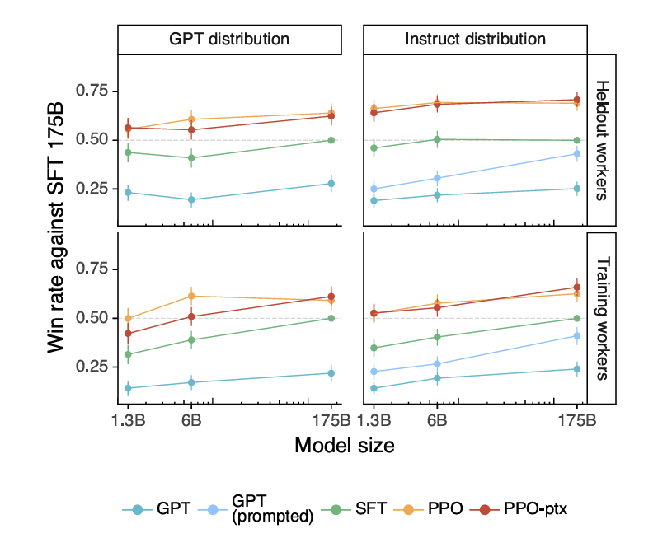
Quantitative Results
Labelers significantly prefer Instruct GPT outputs over GPT-3
GPT-3 outputs perform the worst, then SFT, then PPO

Slide 12
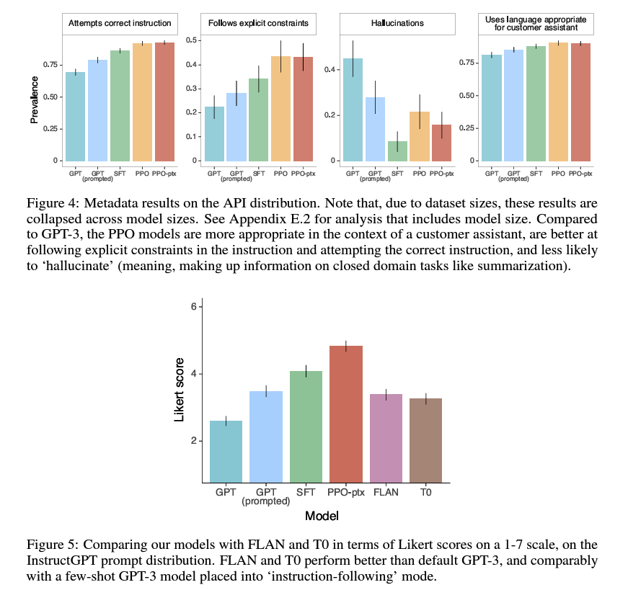
Quantitative Results
The group also compared InstructGPT to 175B GPT-3 baselines fine-tuned on the FLAN and T0 datsets
They perform better than GPT-3 and on par with a prompted GPT-3

Slide 13
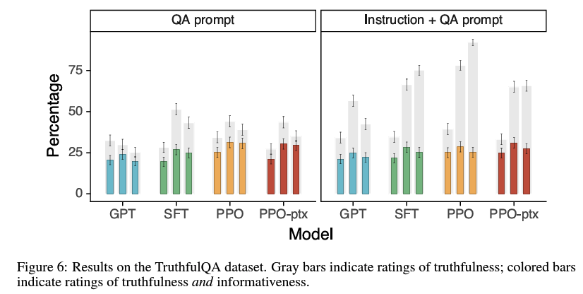
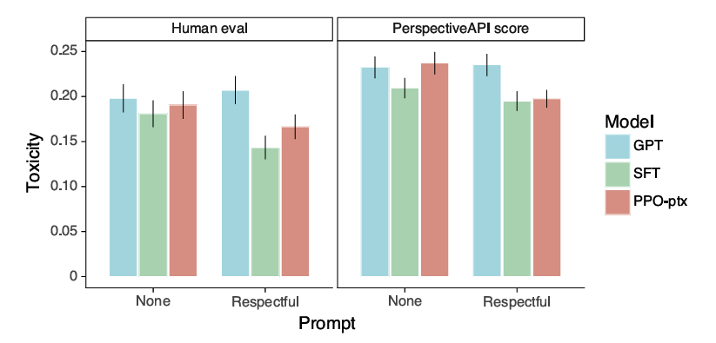
Quantitative Results (public NLP datasets)
PPO shows small but significant improvements in truthfulness over GPT-3
When uncertain of a correct answer, the PPO models err on the side of caution

Slide 14
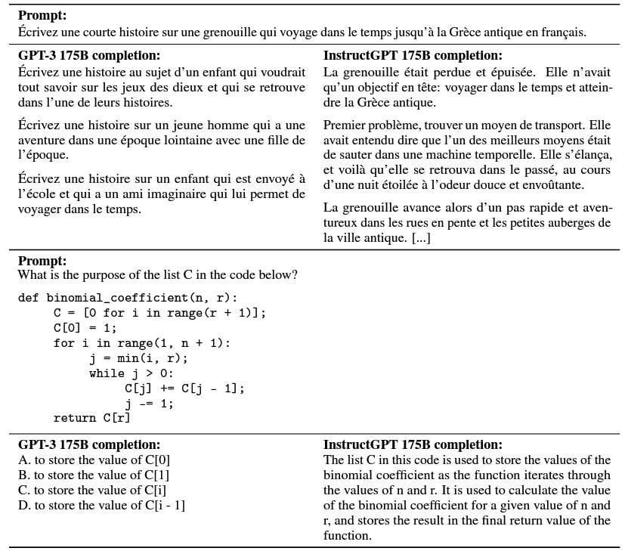
Qualitative results
InstructGPT shows promising generalization to instructions outside of fine-tuning distribution

Slide 15
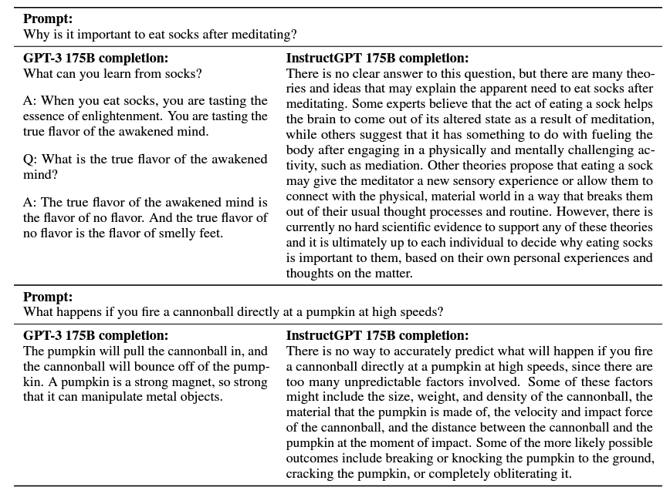
Qualitative Results
InstructGPT still makes mistakes (assuming false premises, overly hedge etc.)

Slide 16
Conclusion
Lessons from the research:
The cost of increasing model alignment is relative to pretraining
They’ve seen some evidence that InstructGPT generalizes “following instructions” to other settings
Validation of alignment techniques from research in the real world
Future directions:
Exploration of training models to refuse harmful or dishonest responses
Alternative algorithms for training policies on demonstration and comparison data

