Slide 1
ANALYSTLAB AFRICA — WEEK 4 INTERNSHIP
Superstore Sales Dashboard
A business intelligence report analyzing sales performance,
profitability, and product trends using Microsoft Power BI.
Tool: Microsoft Power BI | Dataset: Superstore Sales | Tool: Microsoft Power BI

Slide 2
Dataset Overview
The Superstore dataset is a widely used retail sales dataset that simulates the operations of a fictional US-based store. It covers orders placed between 2016 and 2019 across furniture, technology, and office supplies.
9,994
21
2016 – 2019
Total Records
Columns
Date Range
What the dataset covers:
Order Details — Order ID, Order Date, Ship Date, Ship Mode
Customer Information — Customer ID, Name, Segment (Consumer / Corporate / Home Office)
Geography — Country, City, State, Postal Code, Region
Product Information — Product ID, Category, Sub-Category, Product Name
Financials — Sales, Quantity, Discount, Profit
Order Details — Order ID, Order Date, Ship Date, Ship Mode
Customer Information — Customer ID, Name, Segment (Consumer / Corporate / Home Office)
Geography — Country, City, State, Postal Code, Region
Product Information — Product ID, Category, Sub-Category, Product Name
Financials — Sales, Quantity, Discount, Profit

Slide 3
Business Problem
The Superstore has years of sales data, but without proper analysis, it's impossible to know what's actually working and what isn't. This dashboard was built to answer the following questions:
Which regions and states are generating the most revenue and profit — and which are underperforming?
Which product categories and sub-categories are losing money despite healthy sales volumes?
Is the business actually growing year-over-year, or are we hitting a plateau?
Are the discounts being offered helping drive sales, or silently killing profit margins?
Which customer segments offer the most value, and where should the business focus its effort?

Slide 4
KPIs Defined
Eight key performance indicators were defined to drive the analysis:
Total Revenue
Average Order Value
SUM(Sales)
Total Revenue ÷ Total Orders
Shows the total money generated from all orders
Shows how much a typical customer spends per transaction
Total Profit
Sales Growth %
SUM(Profit)
YoY comparison via SAMEPERIODLASTYEAR
What the business actually keeps after all costs are deducted
Tracks whether the business is improving year-over-year
Total Orders
Top Performing Region
DISTINCTCOUNT(Order ID)
TOPN(1) ranked by Sales
Measures business volume and overall activity levels
Quickly surfaces the strongest geographic market
Profit Margin %
Best Selling Category
Total Profit ÷ Total Revenue
TOPN(1) ranked by Sales
How much of every dollar earned becomes actual profit
Identifies which product type drives the most revenue

Slide 5
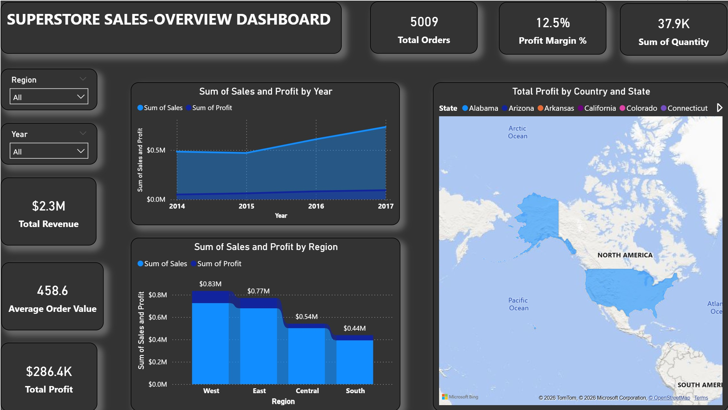
Dashboard — Page 1
Superstore Sales Overview
[ Insert Page 1 Dashboard Screenshot Here ]
Page 1 includes: 6 KPI Cards • Sales Trend Per YearLine Chart • Profit by Region Bar Chart • Sales by State Map • Year / Region/ Slicers

Slide 6
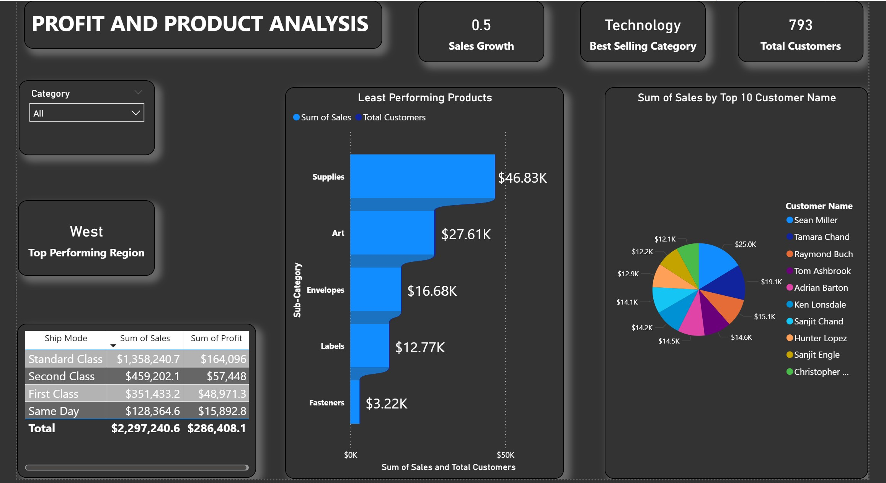
Dashboard — Page 2
Profit & Product Performance Analysis
[ Insert Page 2 Dashboard Screenshot Here ]
Page 2 includes: 3 KPI Cards • Worst Performing Products • Sales by Customer (Pie Chart) • Sales by Ship Mode • Category/ Slicer

Slide 7
Key Insights
What the data revealed:
The West Region leads in both revenue and profit
Despite having similar order volumes to other regions, the West consistently outperforms, pointing to stronger product mix or higher-value customers in that market.
Tables and Bookcases are actively losing money
Both sub-categories show negative profit despite reasonable sales volumes. Deep discounting appears to be the cause as they are being sold below cost.
Higher discounts directly hurt profitability
The scatter chart shows a clear negative correlation. Once discounts exceed 20%, profit drops sharply. Not all discounts are driving value.
Consumers dominate volume, but Corporate buyers spend more
The Consumer segment places the most orders, but Corporate customers consistently have higher average order values per transaction.

Slide 8
Recommendations
Based on the analysis, here are four actionable next steps for the business:
01
Cap discounts on Furniture products
Tables and Bookcases should have a discount ceiling of 10–15%. The current levels are eroding margins and the products need immediate pricing review.
02
Invest more in the West Region
The West generates the highest returns. Increasing marketing spend and inventory allocation there, while studying what makes it work, can help replicate success elsewhere.
03
Build a targeted Corporate sales strategy
Corporate buyers spend significantly more per order. A focused B2B outreach program could improve average order value without increasing order volume.
04
Audit and reprice underperforming sub-categories
Tables, Bookcases, and Supplies consistently underperform. A product profitability review should determine whether to reprice, reduce discounts, or phase these out.

Slide 9
Challenges Faced
Honest reflections on what was difficult along the way:
Date column format errors
The Order Date column was stored as text in MM/DD/YYYY format, which caused errors when changing data types. This was fixed by using Change Type, and then using Locale set to English (United States).
Writing DAX measures from scratch
Building the Sales Growth measure with VAR, CALCULATE, and SAMEPERIODLASTYEAR was confusing at first. Understanding that these work together as a unit and not individually helped.
Map visual not Visualising
The map visual did not load initially. This required enabling map visuals under File, Options, Security in Power BI, which is turned off by default.
Avoiding a cluttered layout
Fitting all KPIs, charts, and slicers on one page made things feel cramped. Splitting into two focused pages with one for overview, one for deep analysis solved the problem.

