Slide 1
Term Deposit Subscription Analysis
Bank Marketing Dataset

Slide 2
Business Problem Statement
What factors drive customers to subscribe to a term deposit
which customer segments should the bank prioritize in future marketing campaigns to improve response rates?
Previous campaign success was the strongest predictor of term deposit subscriptions, with a subscription rate of 91.3%.
Customers aged 60 and above were the most likely to subscribe to a term deposit, recording a subscription rate of 82.2%.

Slide 3
Dataset Overview
11,162 customer records, 17 features
Target variable: deposit (yes/no) - 47.4% subscribed, 52.6% did not
No missing values or duplicates found
Demographics: age, job, marital status, education
Financial: account balance, housing loan, personal loan
Campaign: contact method, day/month, number of contacts, previous outcome
Note: several columns use "unknown" as a placeholder for missing information rather than a blank cell - most notably previous campaign outcome, where most customers have no prior record. There is also no unique customer identifier in this dataset.

Slide 4
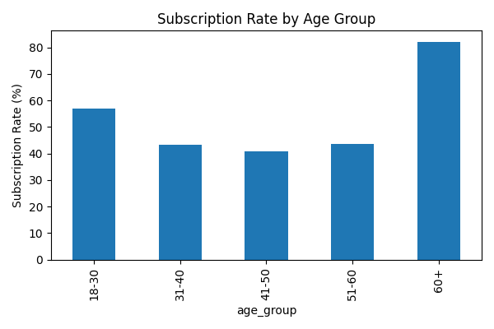
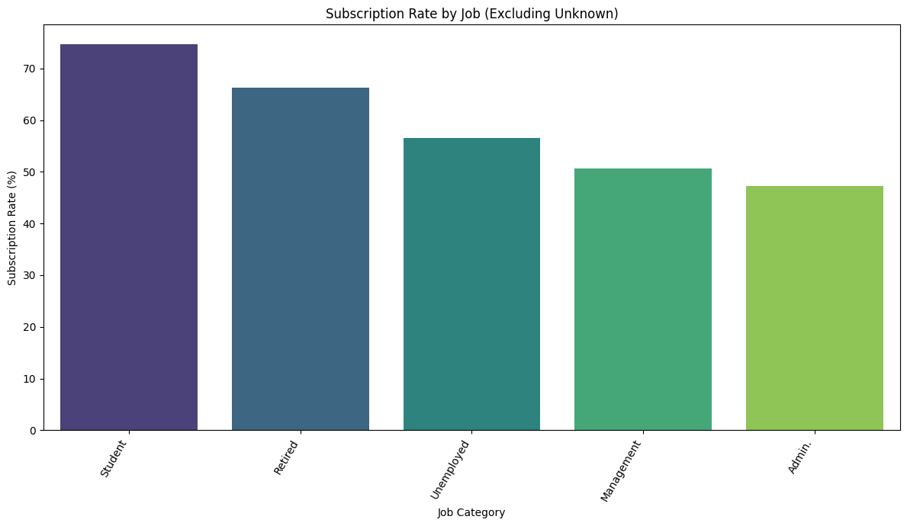
Subscription Rate by Job and Age Group
Students (74.7%) and retirees (66.3%) recorded subscription rates well above the overall average, suggesting they were more likely to subscribe to a term deposit than working-age customers. Similarly, customers aged 60 and above achieved the highest subscription rate (82.2%), nearly double that of every other age group.

Slide 5
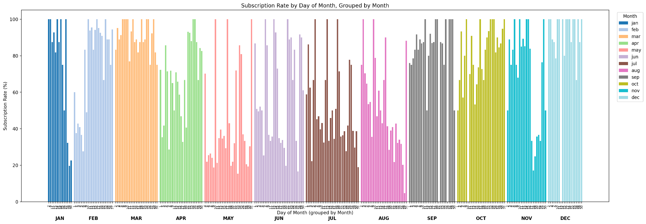
Subscription Rate by Day of Month, Grouped by Month
Several campaign days in March, September, October, and December achieved exceptionally high subscription rates, often ranging between 80% and 100%. By comparison, May consistently recorded lower subscription rates despite having the highest number of customer contacts. These findings indicate that effective campaign timing and targeted customer engagement contribute more to successful term deposit subscriptions than increasing the volume of customer contacts.

Slide 6
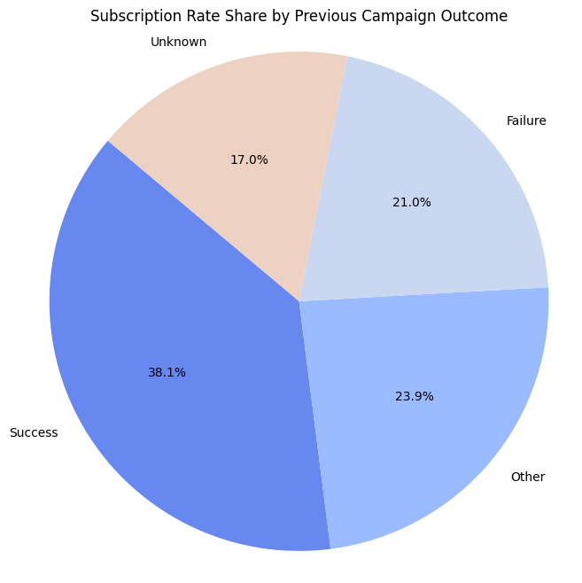
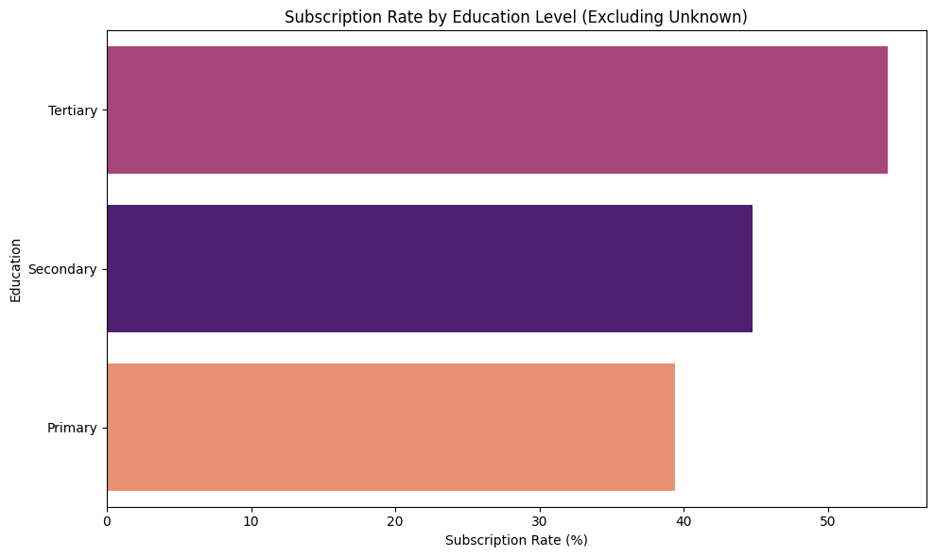
Subscription Rate by Previous Outcome and Education
Customers with a successful previous campaign outcome recorded the highest subscription rate (91.3%), compared with 40.7% for customers with no previous campaign history. Tertiary educated customers also recorded the highest subscription rate (54.1%) among all education levels.

Slide 7
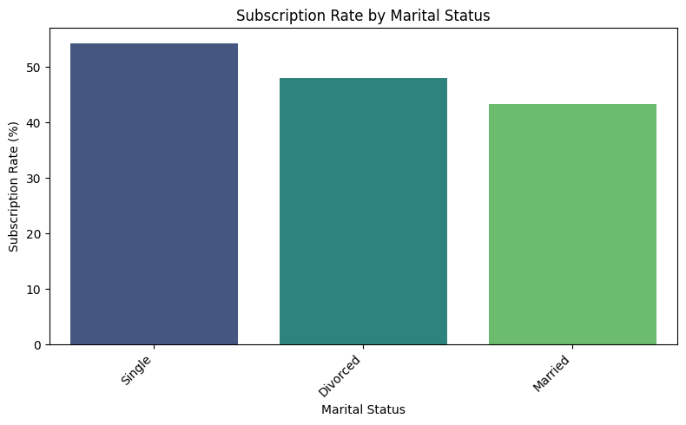
Subscription Rate by Contact Method and Marital Status
CONTACT METHOD
54.3%
Cellular subscription rate
Cellular is the most effective contact channel, clearly outperforming telephone and other contact types for term deposit subscriptions.
Single customers subscribe at the highest rate (around 54%), ahead of divorced (about 48%) and married (about 43%) customers. Paired with cellular being the most effective contact channel, these findings point to prioritising cellular outreach toward single, unattached customers when targeting term deposit campaigns.

Slide 8
Subscription Rate vs. Sum of Balance
The group with the highest subscription rate is rarely the group holding the most total money:
Variable | Highest Subscription Rate | Highest Sum of Balance
Job | Student (74.7%) | Management (£4.6M)
Education | Tertiary (54.1%) | Secondary (£7.1M)
Marital Status | Single (54.3%) | Married (£10.2M)
Previous Outcome | Success (91.3%) | Unknown (£12.0M)
Contact Method | Cellular (54.3%) | Cellular (£12.4M)
Total account balance reflects the size of a customer segment rather than its likelihood of subscribing. For example, the Management group held the highest total account balance due to its larger customer base, despite not recording the highest subscription rate. Contact Method was the only variable where the same category (Cellular) ranked highest for both measures.

Slide 9
Major Findings
Customer life stage has a greater influence on term deposit subscriptions than occupation. Students and retirees recorded significantly higher subscription rates than the overall average, suggesting they were more likely to subscribe to a term deposit.
Previous campaign success is the strongest predictor of future subscriptions. Customers who responded positively to a previous marketing campaign recorded a subscription rate of 91.3%, almost twice the overall subscription rate of 47.4%.
Campaign timing has a greater impact than contact volume. Marketing campaigns conducted during March, September, October, and December consistently achieved higher subscription rates than those conducted in May, despite May having the highest number of customer contacts.
Higher account balances do not necessarily lead to higher subscription rates. Customer segments holding the largest total account balances were rarely the most likely to subscribe to a term deposit, demonstrating that subscription rate is a more effective metric for identifying target customer segments than total account balance.

Slide 10
Recommendations
Prioritise customers with successful previous campaign outcomes. Customers who responded positively to previous marketing campaigns recorded the highest subscription rate (91.3%), making them the most promising segment for future marketing efforts.
Increase marketing efforts towards high performing customer segments. Customers aged 60 and above, as well as students and retirees, consistently recorded the highest subscription rates and should be prioritised in future campaigns.
Optimise campaign timing. Review the strategies used during March, September, October, and December, when subscription rates were consistently highest, and apply these best practices to future campaigns rather than relying solely on increasing customer contact volume.
Prioritise effective communication channels. Cellular contact achieved the highest subscription rate and should remain the preferred communication method for future marketing campaigns.
Use subscription rate as the primary targeting metric. Marketing decisions should be guided by customer subscription rates rather than total account balance, as higher financial value does not necessarily correspond to a greater likelihood of subscribing to a term deposit.

