Slide 1
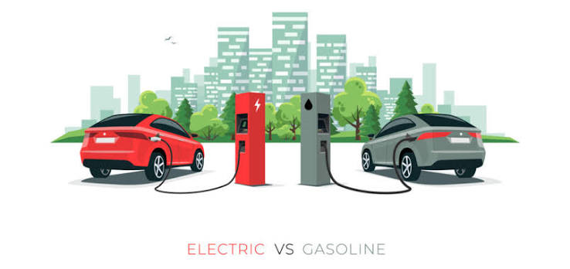

Washington Electric Vehicle
Population Analysis
Current registration patterns, geographic concentration and stakeholder implications

Slide 2
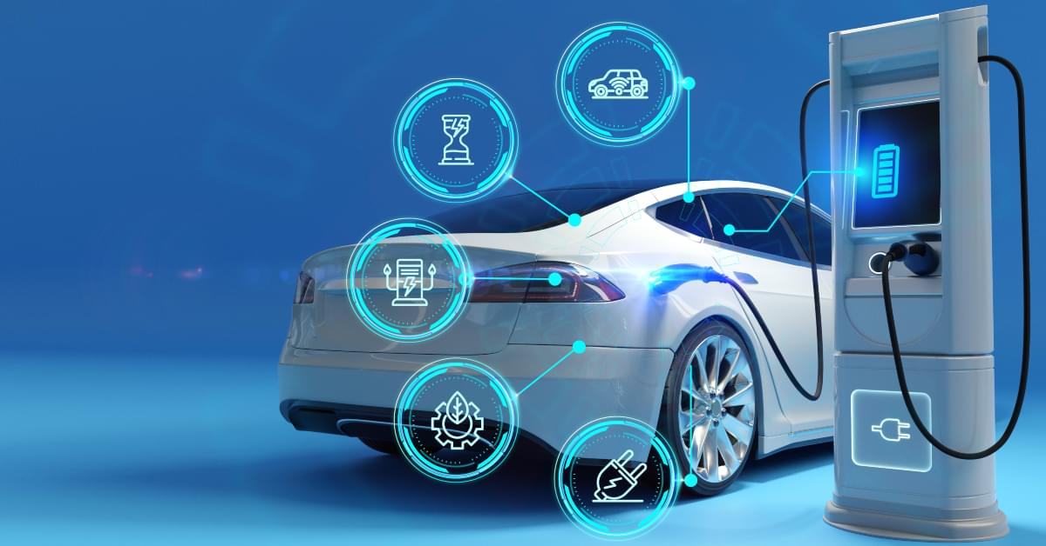

Executive summary
What the current registration snapshot tells stakeholders
80.7%
41.0%
79.2%
Battery electric share
Tesla share
Top five WA counties
Overview
Three findings for decision makers
The registered fleet is predominantly battery electric, while PHEVs account for 19.3%.
Registrations are highly concentrated. King County alone represents nearly half of Washington records.
The registered EV population is heavily represented by recent model years. Among the model years displayed, 2023 has the largest number of vehicles.

Slide 3
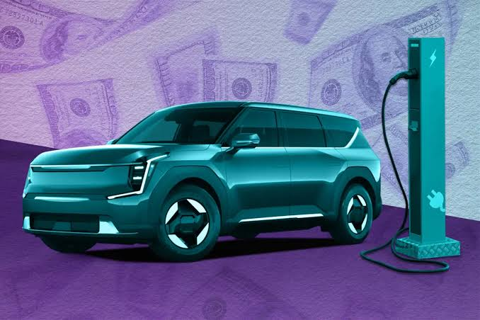

Overview
The project analyzes registered EV (Electric-Vehicle) population distributed across manufacturers, models, vehicle types, geography, model years, electric range, and clean-fuel eligibility.

Slide 4
Battery electric vehicles dominate the registered fleet
BEVs account for four of every five records in the current extract
241,724 | 80.7%
Battery Electric Vehicles
57,981 | 19.3%
Plug-in Hybrid Electric Vehicles
05
Notes:
Source: WA DOL Electric Vehicle Population Data, extracted 23 September 2026. BEV = 241,724; PHEV = 57,981; total = 299,705. BEV share = 80.65%, rounded to 80.7%.

Slide 5
Tesla represents 41% of current registrations
The top five manufacturers account for 63.5% of the dataset
41.0%
Tesla share
63.5%
Top five makes
Counts describe registrations, not new-vehicle sales.
Manufacturer counts include all current records in the extract
06
Notes:
Source: WA DOL dataset f6w7-q2d2, extracted 23 September 2026. Counts: Tesla 122,981; Chevrolet 20,236; Ford 16,118; Nissan 16,053; Kia 14,776; Toyota 13,998; BMW 12,356; Hyundai 12,351.

Slide 6
Model Y and Model 3 lead the vehicle mix
Tesla's two leading models account for 105,936 registrations
35.3%
Model Y + Model 3
share of all records
202
distinct models
Make and model grouped together to avoid ambiguous model names
07
Notes:
Source: WA DOL dataset f6w7-q2d2, extracted 23 September 2026. Top make-model counts shown. Model Y plus Model 3 = 105,936, or 35.35% of 299,705 records.

Slide 7

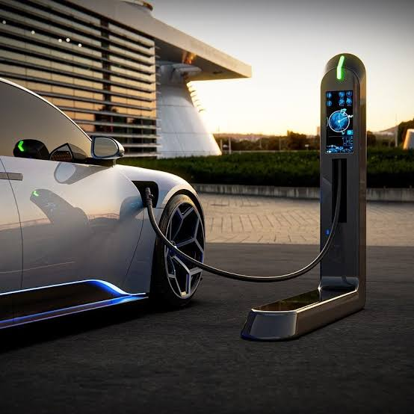
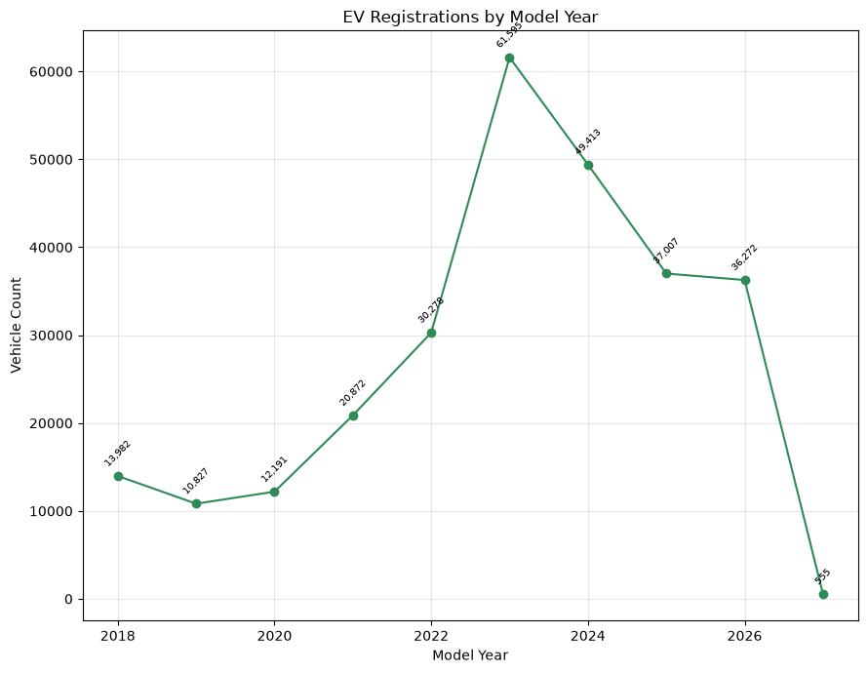
The registered EV population is heavily represented by recent model years. Among the model years displayed, 2023 has the largest number of vehicles

Slide 8
Five counties contain 79.2% of Washington EV records
King County accounts for 48.3% of records with state = WA
79.2%
Top five counties
Use rates for comparison
Raw counts reflect population size. Add county population or total registered vehicles before comparing adoption.
Base: 298,916 records where state = WA
08
Notes:
Source: WA DOL dataset f6w7-q2d2, extracted 23 September 2026. WA-only county counts shown. Top five share = 236,884 / 298,916 = 79.25%. King share = 144,257 / 298,916 = 48.26%.

Slide 9

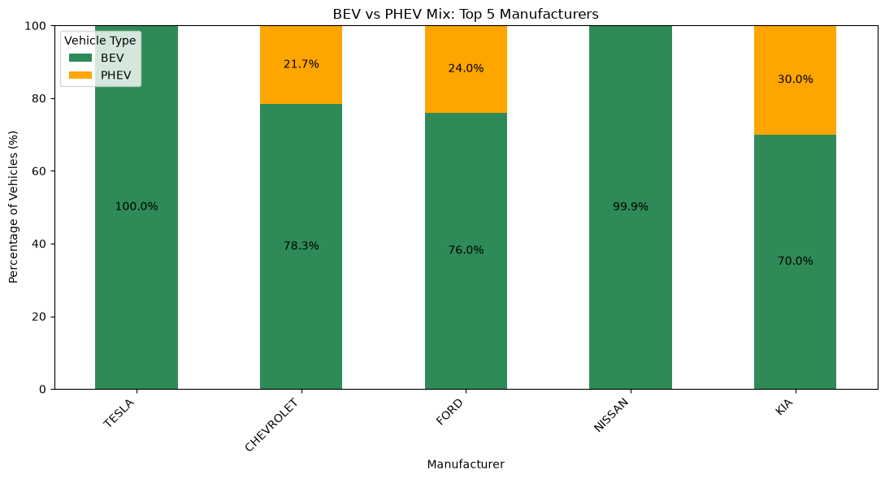
The top manufacturers do not have the same EV mix. Tesla and Nissan are almost entirely represented by BEVs, while Chevrolet, Ford, and Kia have a more mixed BEV/PHEV presence.

Slide 10
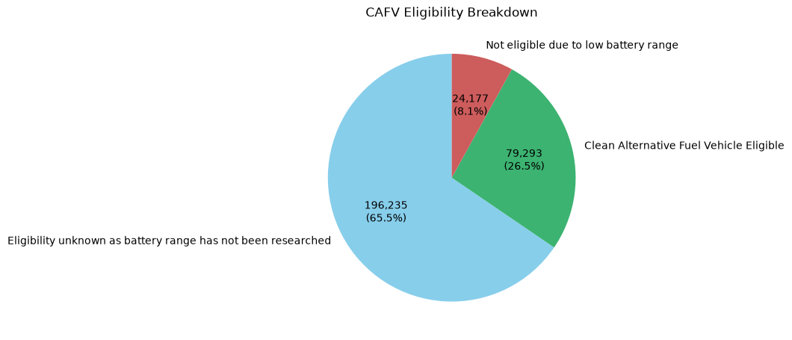
CAFV eligibility
196,235
Unknown because range has not been researched
79,293
Eligible
24,177
Not eligible due to low battery range
10
Notes:
Source: WA DOL dataset f6w7-q2d2, extracted 23 September 2026. Electric range: 103,444 positive; 196,235 zero; 26 missing. Positive-range medians: BEV 215 miles based on 45,492 records; PHEV 32 miles based on 57,952 records. CAFV categories shown exactly as published.

Slide 11
Key Insights
• Tesla has a very large presence in the dataset.
• The Model Y, Tesla alone represents approximately 22.2% of the entire dataset. The Model Y and Model 3 combined represent approximately 35.3%.
• BEV dominate the dataset, representing 80.65% of registrations, compared with 19.35% for PHEVs.
• The top manufacturers do not have the same EV mix. Tesla and Nissan are almost entirely represented by BEVs, while Chevrolet, Ford, and Kia have a more mixed BEV/PHEV presence.
• Nearly half of the EV records are associated with King County, showing a strong geographic concentration, the county accounted for 48.1 % of the entire dataset.
• The registered EV population is heavily represented by recent model years. Among the model years displayed, 2023 has the largest number of vehicles.

Slide 12
