Slide 1
Flask Socket IO and D3
Building a chat app with real time visualization of chat metrics in D3.js

Slide 2
About Me
Hafizul Azeez (Azeez)
Work with an IT MNC – OFSS Ltd
Security Compliance, Quality Management - Job
Dabble with Python Web Development – Nights
Self appointed Python Evangelist
Occasionally Mentor Engineering grads on Python

Slide 3
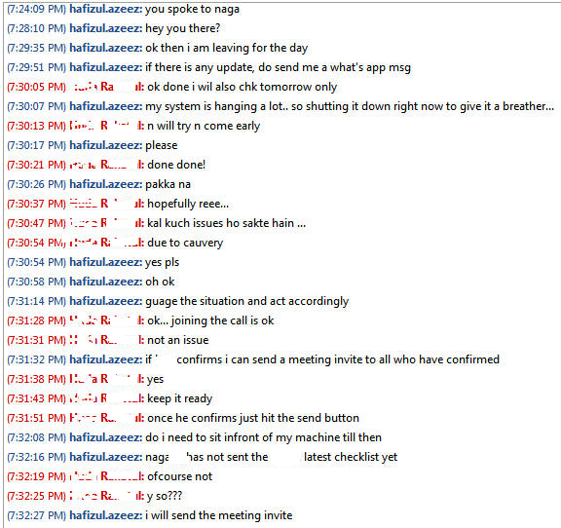
Problem Fun Statement
Sample Chat log between me and my colleague
Need to find out the % of messages interchanged between us
Real time % computation and putting it in a graph (like bar chart etc)
Sounds Cool Eh?

Slide 4
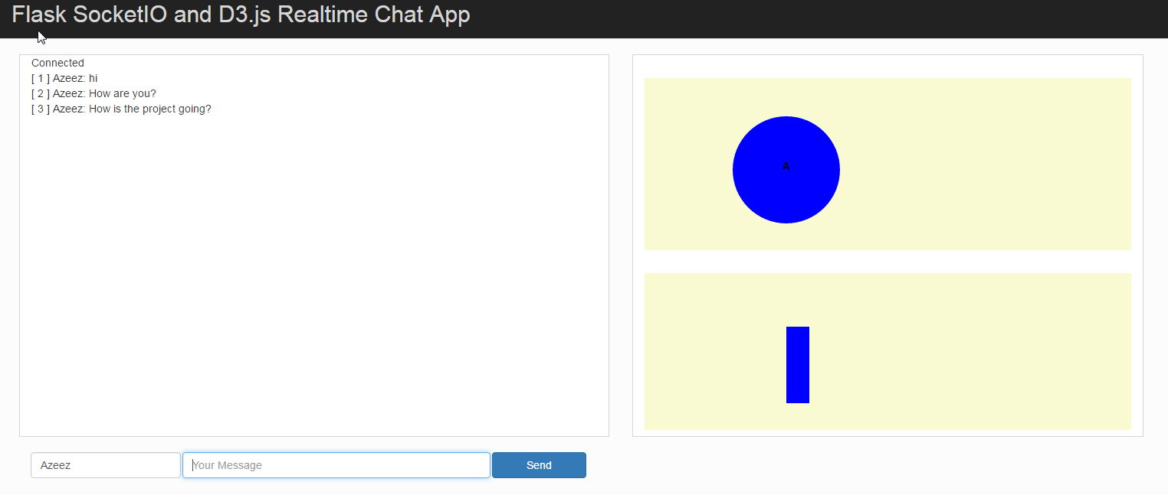
What would the program look like?

Slide 5
Building Blocks
Chat application
Web Preferably
Client Side (HTML, CSS, JS, Jquery, Bootstrap etc)
Server Side (Of course Python)
Flask (Web Micro framework)
Realtime communication with low latency (WebSockets)
Server should send the message to both the users who are chatting (broadcast)
Charting Framework
D3

Slide 6
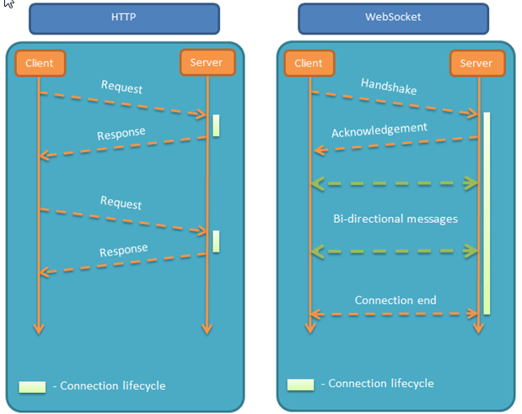
Diff between a Normal App (Web) and Chat App
Notes:
Image Source: http://www.xoriant.com/blog/wp-content/uploads/2015/02/img4-webS.png

Slide 7
Sockets
A socket is one endpoint of a two-way communication link between two programs running on the network.
An endpoint is a combination of an IP address and a port number.
A socket is bound to a port number so that the TCP layer can identify the application that data is destined to be sent to.
Web Sockets: A transport layer built-on TCP that uses an HTTP friendly Upgrade handshake.
WebSocket connections are bi-directional, full-duplex and long-lived.
Notes:
Full Duplex : Full duplex communication means that both ends of the communication can send and receive signals at the same time

Slide 8
Socket IO and Flask-Socket IO
Client Side
Socket.IO is a JavaScript library for realtime web applications.
<script type="application/javascript" src="../static/js/socket.io.js"></script>
Server Side
Flask (Python) implementation of Socket IO
pip install Flask-SocketIO
Notes:
Socket IO and Flask Socket IO

Slide 9
Client and Server Side Arch
Both should talk a common language – to establish connection and work with each other with persistent communication
It’s all event based message communication
4
My_Response
receives
emits
My_Response
3
Flask-SocketIO
SocketIO
receives
My_Event
2
1
My_Event
emits
Server
Client
Notes:
Architecture of the chat app – events and responses diagram

Slide 10
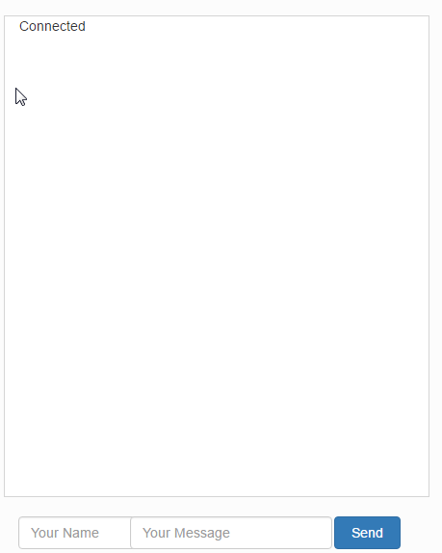
Let’s start coding (Front end)
<div class="container col-sm-6" id="chat-container"> <div class="container col-sm-12" id="chat-log"></div> <div class="container col-sm-12"> <form class="form-inline" id="chat-form"> <div class="form-group col-sm-2"> <input type="text" class="form-control" id="chat-user" placeholder="Your Name"> </div> <div class="form-group col-sm-7 col-sm-offset-1"> <input type="text" class="form-control col-sm-12" id="chat-message" placeholder="Your Message"> </div> <button type="submit" class="btn btn-primary col-sm-2" id="btn-submit">Send</button> </form> </div> <!-- end of form --> </div> <!-- end of chat container -->
Notes:
Put html code here

Slide 11
Client emits an event (client side)
Index.html
// Establish a connection to the socket
var namespace = ‘/test’;
var socket = io.connect("http://" + document.domain + ":" + location.port + namespace);
// emit an event to the server on form submission
$("form#chat-form").submit(function(event){
var chatuser = $("#chat-user").val();
var chatmessage = $("#chat-message").val();
// create a javascript object with the username and message var dataobj = { 'user': chatuser, 'message': chatmessage } // send the data obj to the server with custom message socket.emit("my_broadcast_event", {data: dataobj});
return false;
});
1
My_Event
emits
Client
1
Notes:
Emit is a method to send custom messages

Slide 12
Server receives and emits back a response
# necessary imports and creating a Socket app
from flask import Flask, render_template from flask_socketio import SocketIO, emit app = Flask(__name__) socketio = SocketIO(app)
# when the server receives the event from server, execute the below
# function
@socketio.on('my_broadcast_event', namespace='/test') def broadcast_message(message): emit('my_response', {'data': message['data']}, broadcast=True)
# running the server
if __name__ == '__main__': socketio.run(app)
app.py
emits
My_Response
3
receives
My_Event
2
2
Server
3
Notes:
Broadcast = True will ensure that messages will be sent to all connected clients

Slide 13
Client receives the response
Index.html
// client receives the response and takes action
socket.on('my_response', function(msg){
$("#chat-log").append(msg.data.user + ": " + msg.data .message + "</br>"); });
4
4
My_Response
receives
Client

Slide 14
Demo Time
Notes:
Git tag v1.1

Slide 15
Chat Metrics
Find the number of messages from each user
Increment the number of messages by 1
for the user who sends the latest message
Create a “dictionary” of number of messages for each user (in the server) and send it back to the client
Example dictionary below
[{"user": {"msg_count": 2, "name": "Azeez"}}, {"user": {"msg_count": 2, "name": "Mini"}}]
Notes:
git tag v2.0

Slide 16
Demo Time
Notes:
Git tag v2.0

Slide 17
Visualizing the Chat Metrics

Slide 18
D3.js
Data Driven Documents
JavaScript library for manipulating documents based on data
Graphing framework
Does not give ready-made graphs
Everything needs to be coded
Visualizing using HTML, SVG, and CSS.
SVG
Scalable Vector Graphics, Open standard format, scalable across multi resolutions
Element within html <svg> </svg>

Slide 19
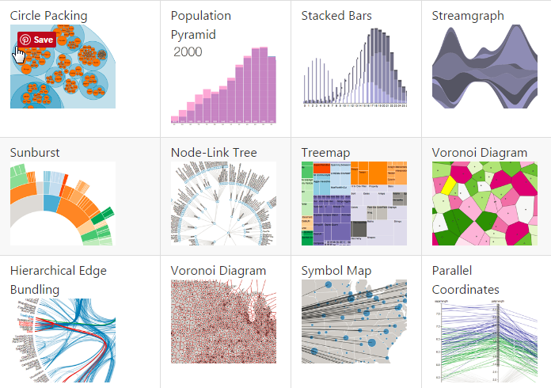
What you can do with D3?

Slide 20
SVG element basics
<svg height=“200” width=“400”><svg>
(400,0)
(0,0)
y
(0,200)
(400,200)
x

Slide 21
SVG shapes
Supports various shapes
Line
Rect
Circle
Ellipse
Polygon
Polyline
path
Notes:
https://www.tutorialspoint.com/svg/svg_shapes.htm

Slide 22
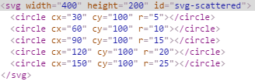
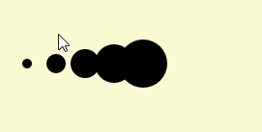
D3 Bare Basics
x = [1,2,3,4,5]
var svg = d3.select(“#svg-scattered”).selectAll(“circles”).data(x);
svg.enter().append("circle").attr("cx",function(d){return d * 30}).attr("cy", 100).attr("r",function(d){return d * 5})
Memorize : selectAll, data, enter, append
Notes:
SelectAll – will return empty selection if no circles are present in the DOM already
Data – takes a dataset
Enter – creates a placeholder for each data in the data set – in this case will create a placeholder for 5 circles
Append – will draw the circle to the DOM
Attr – will set attributes to the circles
Cx – plot a circle along the x axis
Cy – plot a circle along the y axis
r – radius of the circle

Slide 23
D3 – Important Things to Remember
No need to loop over the dataset – D3 will magically do it for you
D3 supports chaining – execution from left to right
enter() will work only with new nodes entering the DOM – will not work with existing nodes in the DOM
For existing nodes , use transition() to change the attributes
duration() will delay the transition by x seconds
text() can be used to place a text node anywhere in the graph
Notes:
Some topics not covered due to lack of time:
Domains
Ranges
Axis

Slide 24
Demo Time
Notes:
Git tag v2.5 and tag v2.8

Slide 25
Questions!?
Thank you for your time!

Slide 26
References
http://blog.miguelgrinberg.com/post/easy-websockets-with-flask-and-gevent
https://flask-socketio.readthedocs.io/en/latest/
D3
http://pothibo.com/2013/09/d3-js-how-to-handle-dynamic-json-data/
https://medium.com/@c_behrens/enter-update-exit-6cafc6014c36#.psa955o54

