Slide 1

System Price Forecasting

Slide 2
Objectives
VİSUALİZE DATA WITH A VARIETY OF GRAPHS AND PLOTS TO GAIN SOME INSIGHT
Perform data pre-processing, cleaning. Add external data, make ready to feed ınto ml
TEST DIFFERENT MODELS AND FINE TUNE ONE TO FORECAST PRICE EFFECTIVELY

Slide 3
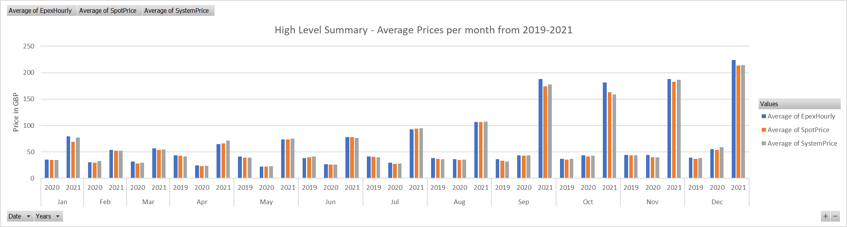
Overall Histogram
Seasonality within the same year observed in 2020
Increasing Prices with Year (peculiarities of the past three years)
Similar averages despite some major spikes

Slide 4
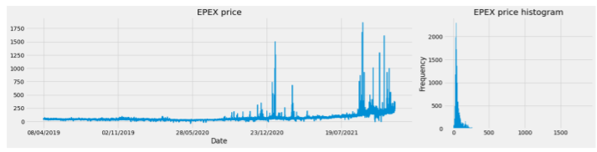
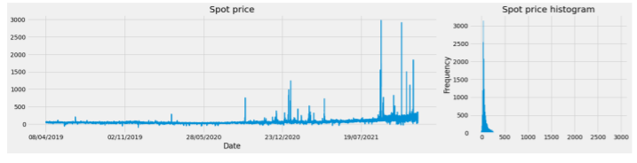
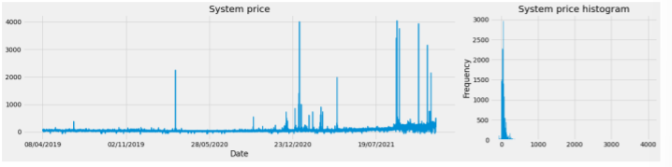
Data Visualization
Differing Volatility
Range of system and spot prices much higher
Increasing energy price with time
Major spikes at times of market stress

Slide 5
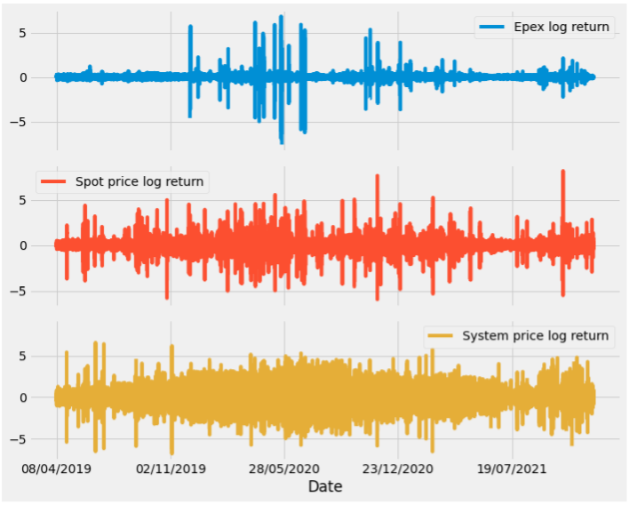
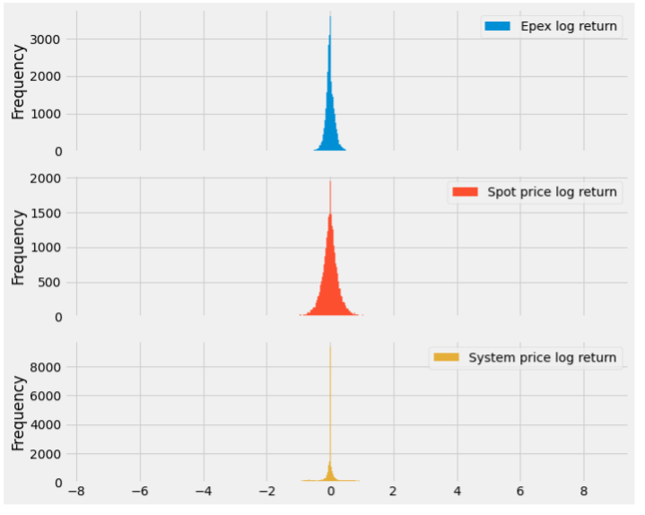
Data Visualization: Log Returns

Slide 6
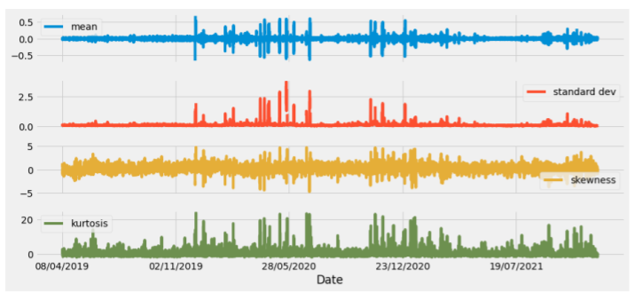
Moving Statistics: EPEX Price

Slide 7
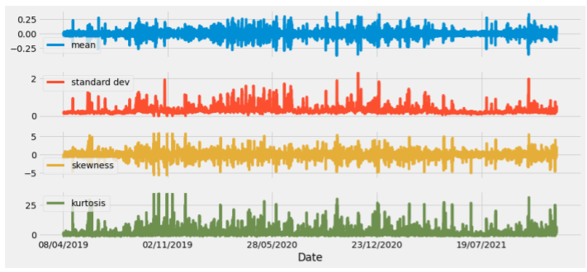
Moving Statistics: Spot Price

Slide 8
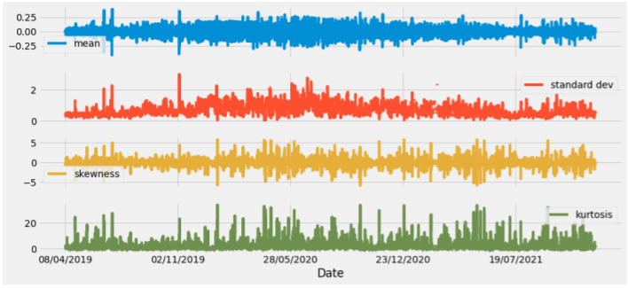
Moving Statistics: System Price

Slide 9
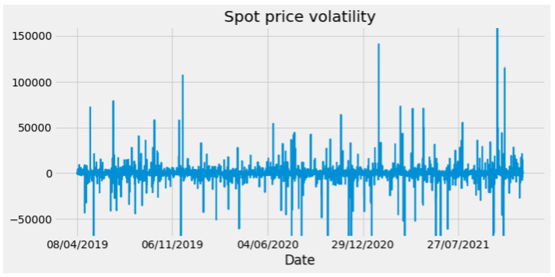
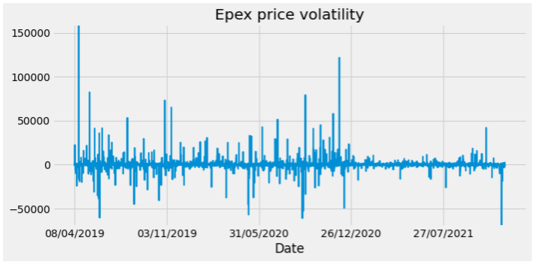
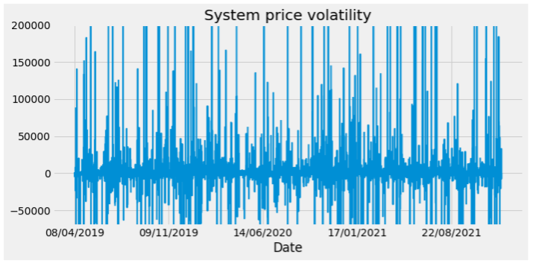
Volatility Plots

Slide 10
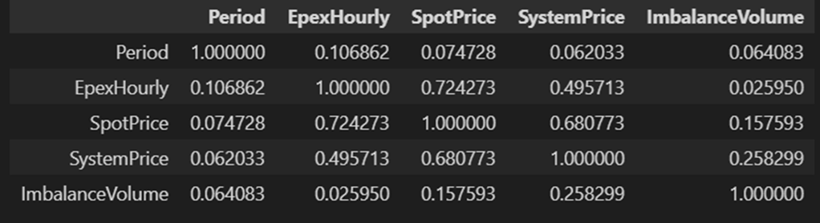
Data Preparation Steps
- Cut data so all prices range from 08/04/2019- 15/12/2021
Inspect all data frames to detect anomalies
Remedy errors in the system prices data frame: unmatching row count
Locate the missing and extra data
Remove duplicate/erroneous values with SP=49,50
Fill in missing data with SP = 47,48 (using SP=46 and SP=1 data)
Merge the data frames
Drop spot price’s erroneous SP column
Drop duplicate columns (time, buy price)
How do our data correlate with each other

Slide 11
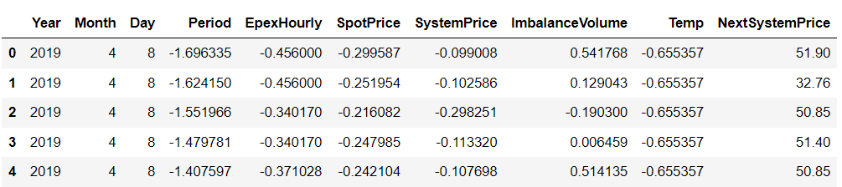
Data Preparation Steps
Add in Average Temperature Data for each day ( assume same temperature every half hour)
Used API request to get rolling system demand and wind and solar generation forecasts
Could not add this to the data frame yet
Separate time data to Year, Month, Day
Scale data with Standard Scaler
Impute missing values with Sci-Kit Imputer (Median)
Create target prediction row ( next System Price)
Random train test split (80-20)

Slide 12
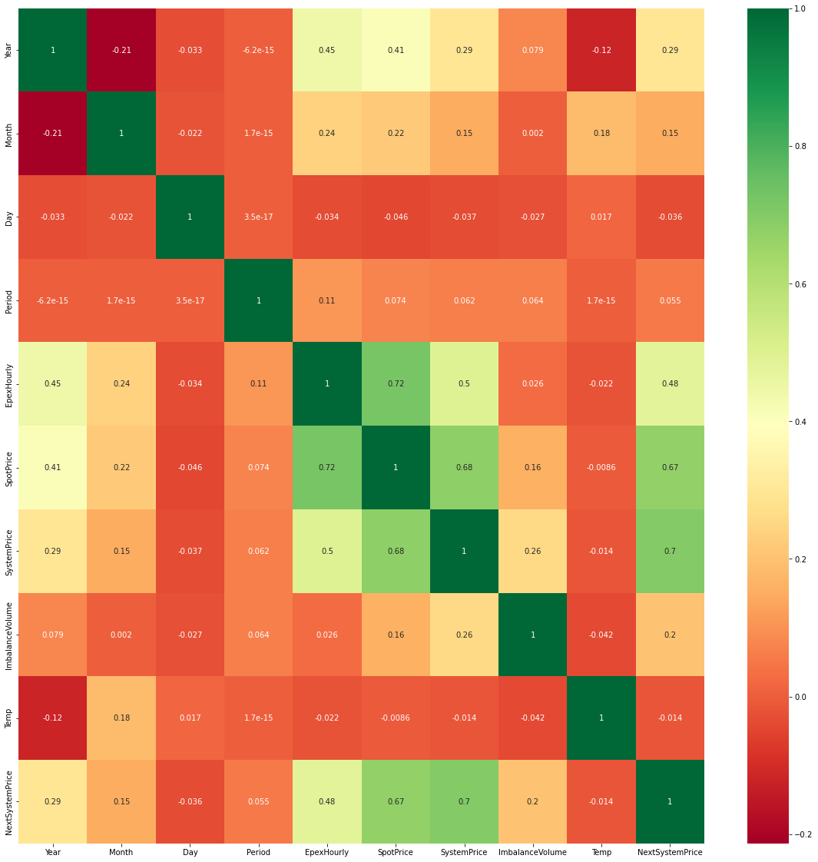
Correlation Matrix

Slide 13
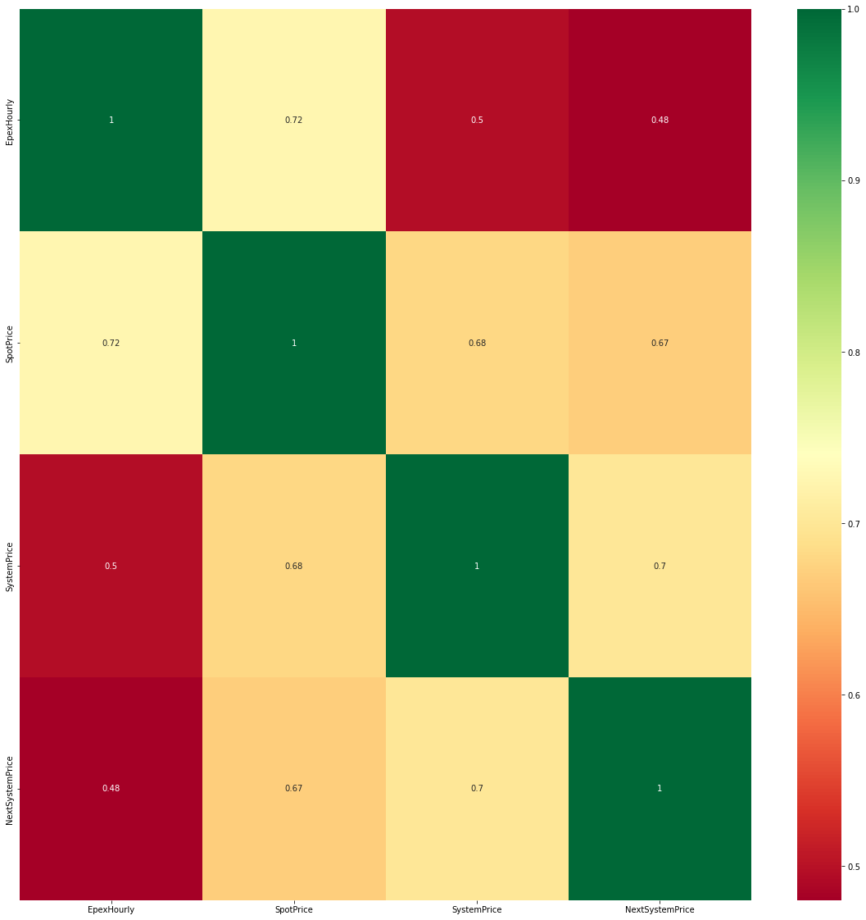
Correlation Matrix for prices

Slide 14
Apply ML
Did not have adequate time for this step, so failed
Just wanted to demonstrate overfitting and bias in the dataset with two stock algorithms
Linear Regression
RMSE:63, 70 (train, test)
Decision Tree
RMSE: 0, 11000 (train, test)

Slide 15
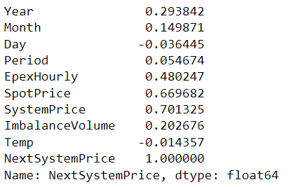
Recommendations for the future I
Drop:
Day data
Replace:
Temperature data with solar irradiation data
Month with a seasonality factor
Add data on:
Cloudiness
Renewable generation forecast
Rolling system demand
Rolling averages of past prices
Combine features that contain “duplicate” info and are correlated with eachother
SP and Spot price
Epex and spot price
Perform:
Regularization
Use features that are forecasts rather than current
Correlations with our Output

