Slide 1
Feyzi Can Eser – Brief Explanation of Program
Deliverable: A Priority Queue for managing flight details using a linked list.
I implemented all the methods suggested one by one, fixing implementation errors by testing via the code in main.c
Key Elements Used:
While Loops: Traverse the queue until we reach the end node
Used for adding elements, printing, maintaining priority, counting, etc. in most methods
Not using for loops since the length of the queue is variable
If-Statements: To check for invalid inputs when creating new flights, compare priority, compare flight characteristics, and, crucially to check which is the last node (i.e., if it points to Null) so we can stop our while loop
Initialize(): Return null if there is insufficient memory
Add() : Check for invalid flight numbers and priorities, determine the correct place to insert a new flight by comparing priorities
All Count..() methods: Check if a given flight matches the desired flight property
Malloc: Dynamic memory allocation used when creating new nodes, which are freed upon deletion

Slide 2
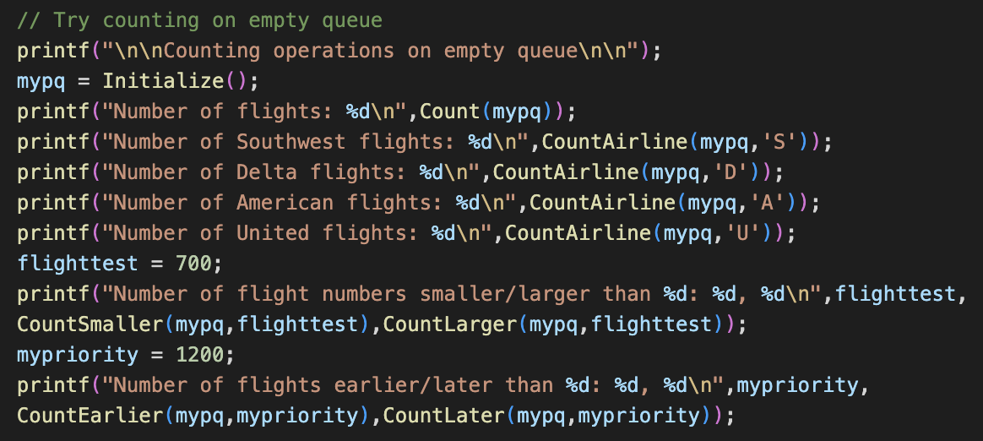
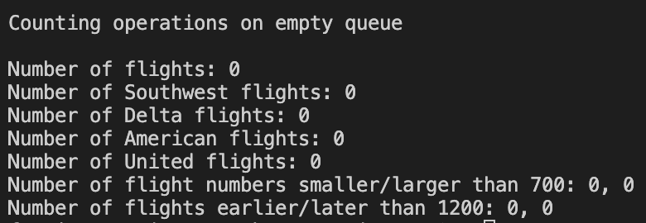
Important Tests I
In this and the next slide you can see the output of sample code I have written to cover all specified test cases in the pdf, in addition to passing the auto grader test.
Counting operations on empty queue always returns 0

Slide 3
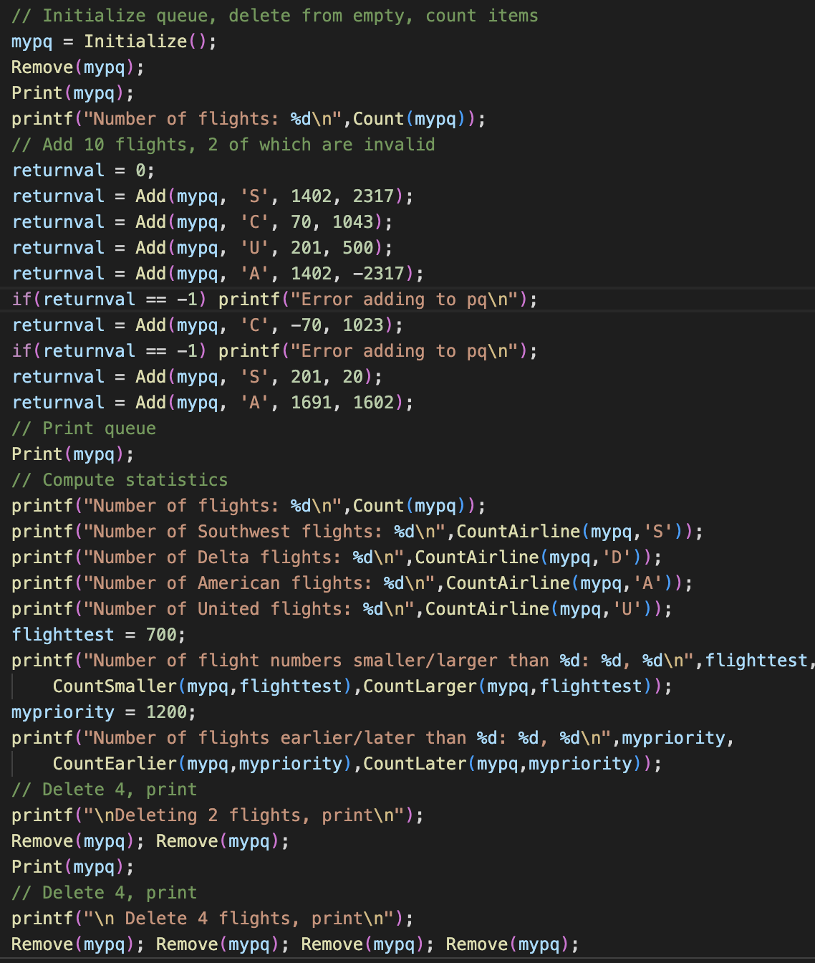
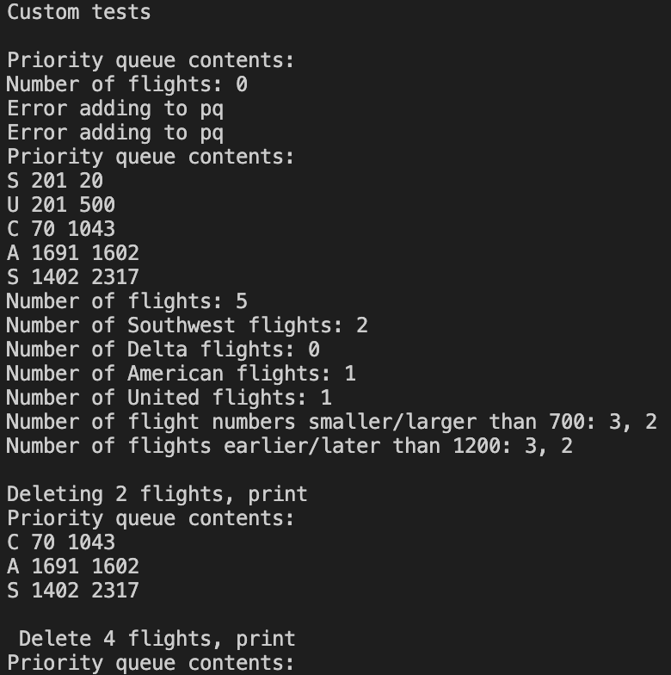
Important Tests II
Cant remove from empty queue
Does not print anything for empty queue
Cant add flight with negative priority
Cant add flight with negative flight no
All counting operations are accurate
Again see that the deletion operation stops once the queue is empty

