Slide 1
Feyzi Can Eser – Brief Explanation of Program
Program Structure:
Main.c reads the particle information, allocates memory for the particle and collision array, implements the main loop, and prints out all particle information before freeing up all dynamically allocated memory
Collisions.h includes declarations for the functions defined in Collisions.c, which handle all aspects of updating particles and collisions. Collisions.h also declares the global variables initialized in Main.c
Key Elements Used:
Structs: Collision and Particle structs hold the information specified in the prompt
Arrays: Arrays of pointers to collision and particle structs with dynamically allocated memory
File Input: Reads initial particle data from a specified file.
Dynamic Memory Allocation: Arrays for particles and potential collisions are dynamically allocated, as well as the particle and collision structs themselves
Collision Detection: At t=0, calculate all potential collision times initially, sort them, and process the earliest collision each time
Event-Driven Simulation: Event-driven approach to handle collisions and update particle states efficiently
Only particles affected by a collision see their collision times updated.
Final Position Update: At the simulation end time, I updated all particle positions and outputted the final data.

Slide 2
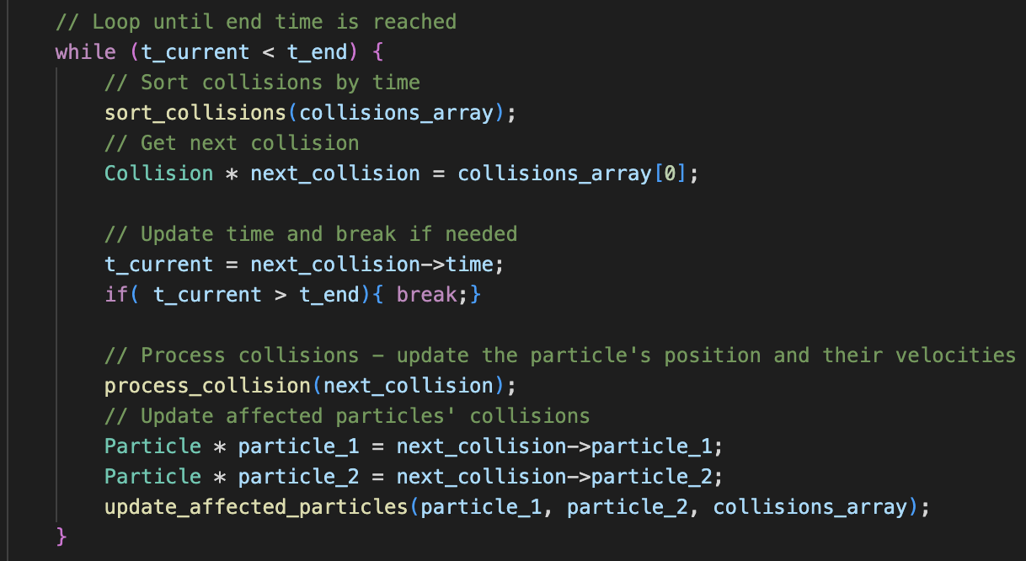
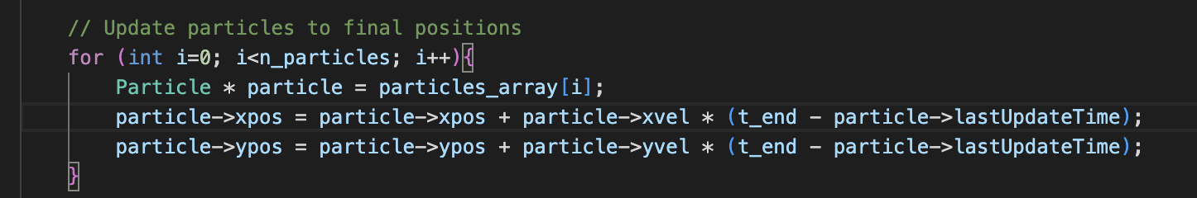
Why IT WORKS I: Main Program Flow
Program Flow in Main.c
Read particle information from file and create particles_array
Particles_array filled using the createParticle() func, which dynamically allocates memory for a single particle and returns a pointer to the struct filled with correct initial positions, velocities, and collision counts set to 0
Collisions_array is filled by calling calculate_all_particle_collisions(), which appends all possible particle-particle collisions, and then by calling calculate_all_wall_collisions(), which appends all possible particle-wall collisions for each of the 4 walls
Thus, the collisions_array includes all possible collision combinations
Main Loop:
sort_collisions(): sort array in place using insertion sort
Select first element in the sorted collision array, update the current time to that collision’s time – break if end time exceeded
Process_collision(): Update kinetic energies of the particle(s) accordingly
Update_affected_particles(): Loop through the collisions_array, update the times of collisions including either of the two particles ( particle 2 is null if we just had a particle-wall collision)
Function terminates early when the expected number of collisions is updated
4. Update all particle’s positions to the end time positions before printing final outputs and freeing the memory

Slide 3
Why IT WORKS II: Design nOTES
Correctness of Results:
Compared the outputs of program to the model outputs of the test files
Used printf() to print intermediate results to ensure each step was correct ( print statements since removed)
Modular Design:
Built the program in a modular fashion, making it easier to test, debug, and extend upon
Unit Testing:
Performed tests on individual functions to ensure they operated correctly in isolation
Error handling:
Put checks to raise flags when any dynamic memory allocation failed
Making functions robust to errors:
Collision times: Collision_time is set to end_time +1 for infeasible collisions ( those that appear to be in the past )
Particle structs:
Correctly updating the last update time in Particle structs ensures that any extraneous update operations in the same timestep do not change anything
Particle structs have a variable wall: 0 for no walls involved, 1 for left, 2 for right, 3 for top, and 4 for bottom walls
Collision structs have particle_2 pointer set to Null for wall collisions - ensuring that each collision is handled appropriately
Current time: A global variable is used to keep track of current time, making sure every function uses up-to-date information

