Slide 1
Keeping Amtrak on Track
James Stapleton (js2gd@virginia.edu), Anna Crockett (aec2mc@virginia.edu), Ashwin Sundaram (ams7nf@virginia.edu), Fan Feng (ff9sd@virginia.edu), Michael Trepte (mat2yr@virginia.edu)

Slide 2
Overview
Technical strategies
Fixing human error
Mechanical solution
Procedural strategies
Political changes
Setbacks

Slide 3
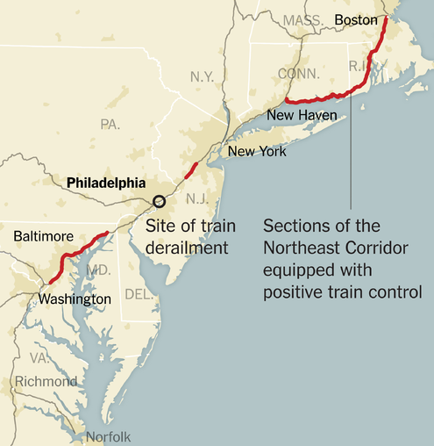
Technical Strategy: Human Error
Positive train control at all locations
Eliminate neglect of potential risks caused by speed
Personnel training
Picture from:
www.nytimes.com
Stapleton, Crockett, Sundaram, Feng, Trepte 3

Slide 4
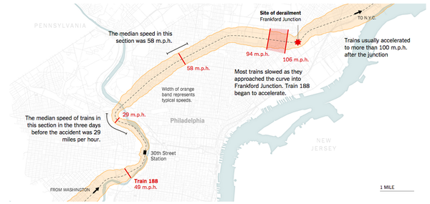
Technical Strategy: Mechanical
Updated trains: faster braking systems
Magnetic
Hydraulic
Safer railroads
SpaceX Hyperloop
Pre-curve brakes on railroad
Photo from:
www.nytimes.com

Slide 5
Procedural Strategy: Political Changes
Lobbying for safety
Hard-set deadline for technological implementation
Federal/state assistance: allocate funds for faster implementation
Satisfy the eight large resistant rail companies
Better public understanding
“Congress [does] not grasp the complexity and expense of its mandate for positive train control” (nytimes.com)

Slide 6
Setbacks
Cost
To government
To railroad industry
Bureaucratic Latency
Union lobbying
Industry lobbying
Stapleton, Crockett, Sundaram, Feng, Trepte 6

Slide 7
Questions?
http://www.nytimes.com/2015/05/19/us/amtrak-crash-illuminates-obstacles-to-plan-for-controlling-train-speeds.html
http://www.nytimes.com/2015/05/14/us/amtrak-train-derails-crash-philadelphia.html

