Slide 1
Charlottesville Transportation Options
Case 3: Group 9, SYS 2001 (Sec. 2)
10 November 2015
Fan Feng (ff9sd), Dylan Hazlett (dah4cm), Colette Merrill (cdm8pf), Virginia Wordsworth (vkw4pd)

Slide 2
Executive Summary
Client: Professor Fleming
Problem: Determining a mode of transportation
Environment: Charlottesville, VA
Recommendation:
If there is risk for considerable uncertainty in the values provided, then using Zipcar is recommended as it is consistently a strong option in the face of relatively large attribute fluctuations.
If safety and robustness must be prioritized, even at the expense of a higher monthly cost, purchasing a car is the best choice.
If low monthly cost and high efficiency are to be prioritized, even at the expense of lower safety ratings, then the bike is a good option for commuting to work in Charlottesville.

Slide 3
Problem Description
Objective: To select an effective and desirable mode of transportation
To commute quickly between home and work
To have numerous feasible transportation scenarios
To travel to and from destinations safely
To secure the mode of transportation from thefts and vandalism
To maintain a manageable monthly cost
To be able to initiate a trip quickly
Indices of Performance:
Transit Time: average time from house to office
Robustness: number of destination types & environmental conditions accessible
Safety: rating (0 - 100) of included safety features
Security: ordinal rank of the options based on their vulnerability
Convenience: average time waiting for transport to begin + time remaining to destination after transport ends
Cost: expected monthly spending

Slide 4
Assumptions
Attribute data provided is correct within reason
Attributes and alternatives given are complete
Robustness attribute accounts for cargo size, number of passengers, etc.
Monthly cost estimates account for parking fees, gas, etc.
The bike ride to/from work is feasible and is representative of the general distances Professor Fleming can travel on bike (~15 minutes)

Slide 5
Alternatives Considered
ZipCar (car share)
Maserati Granturismo (car)
1985 Raleigh Prestige (bike)
Charlottesville Area Transit System (bus)
Also Considered:
Walking (no vehicle)
Notes:
Despite initially being considered as an option, walking was immediately eliminated because it had extremely low robustness (both in weather and distance/needing sidewalks), extremely low safety (risk of injury), low security (most vulnerable when moving slowly and not inclosed in a vehicle), and an extremely high transit time compared to the other options. The cost would have been the best, but it was clearly dominated by the other options.

Slide 6
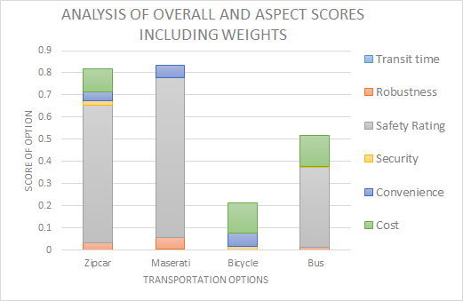
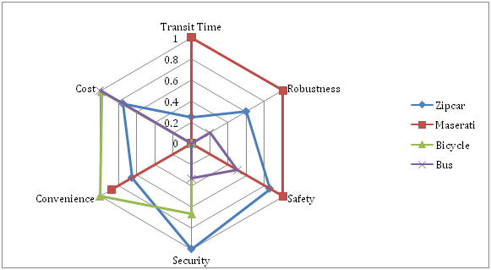
Using Given Values As-Is
Notes:
Using the given values, the rank of alternatives is 1.) Maserati 2.) Zipcar 3.) Bus 4.) Bike. The chart to the right displays the advantage of each attribute without weights or marginal value (only based on the normalized values of the data).

Slide 7
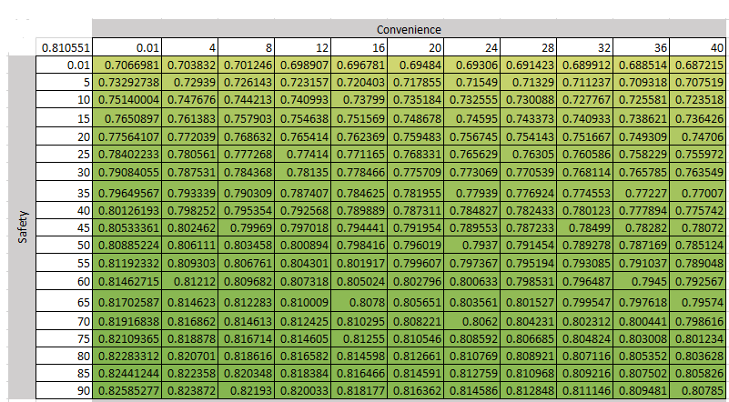
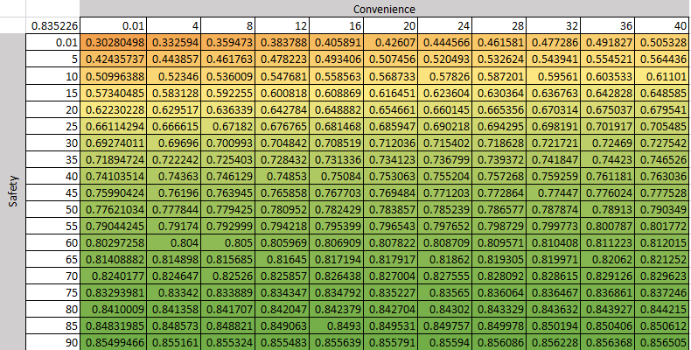
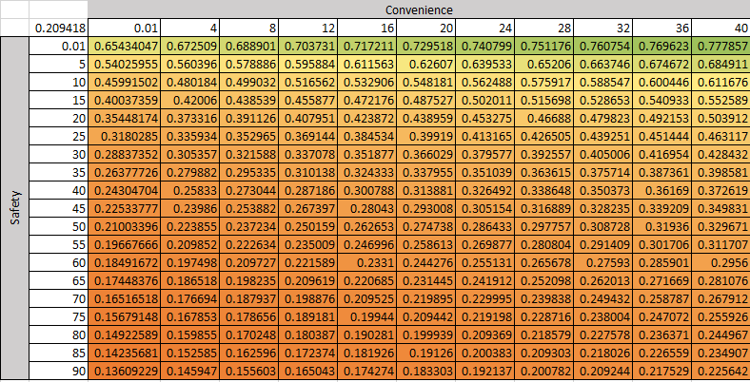
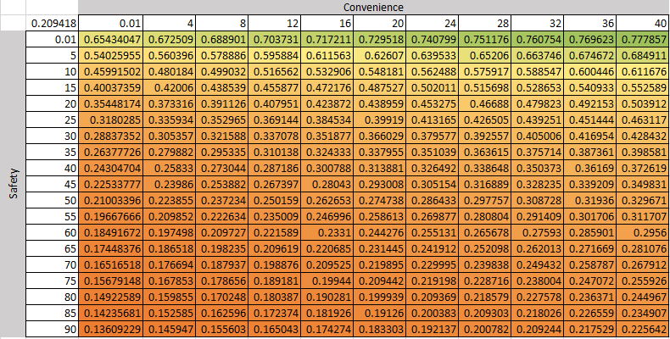
($/Convenience) vs. ($/Safety)
Zipcar
Maserati
Bike
Bus
Notes:
Regardless of convenience, the bike and bus are dominated by the Zipcar and Maserati at nearly all safety levels. The Maserati’s strength begins to degrade as safety MRS decreases and convenience MRS decreases.

Slide 8
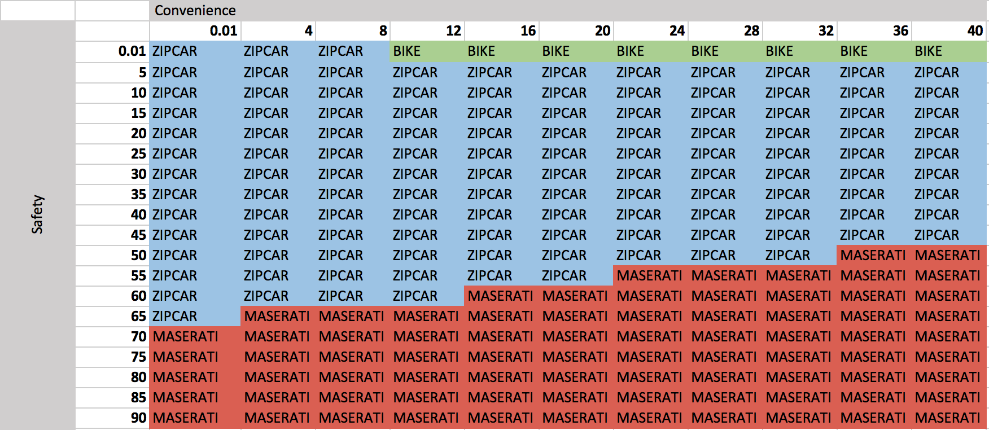
Sensitivity Analysis
Varying the Marginal Rates of Substitution for Convenience and Safety
Notes:
This chart displays the best option at each convenience/safety coupled value.

Slide 9
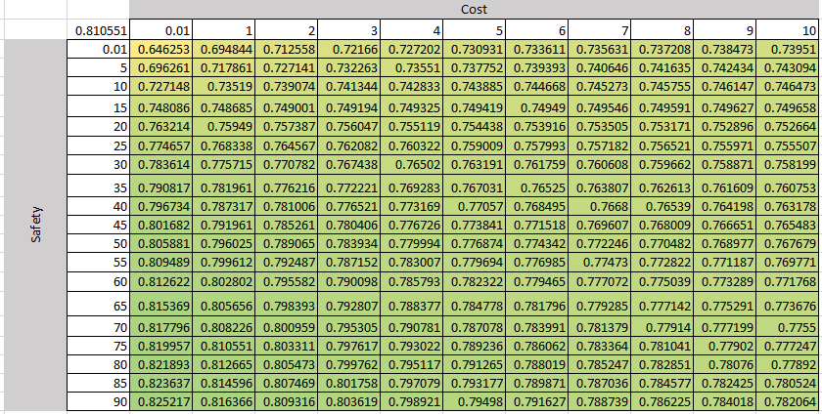
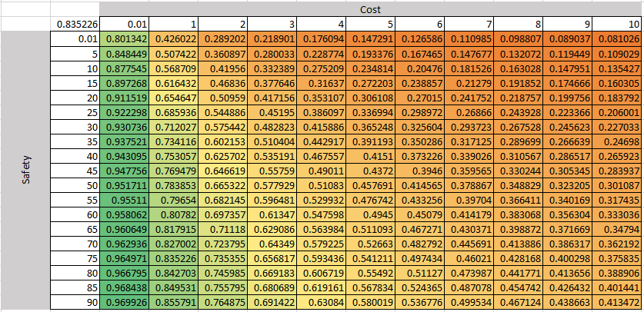
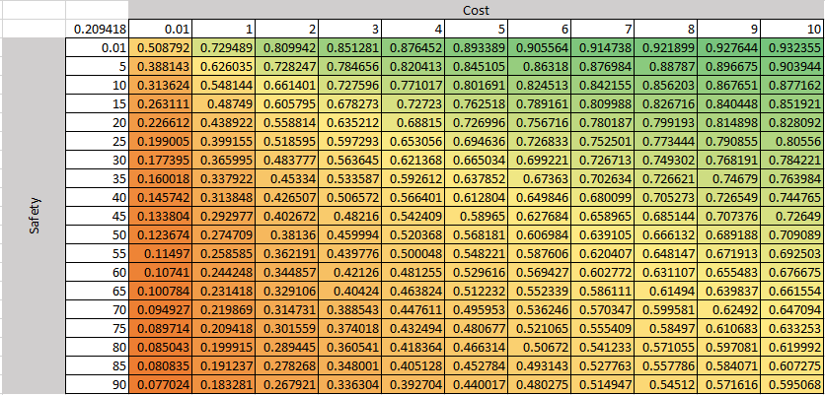
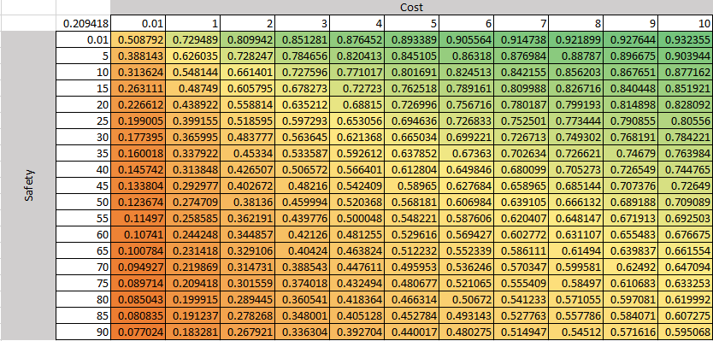
Cost vs. ($/Safety)
Zipcar
Maserati
Bike
Bus

Slide 10
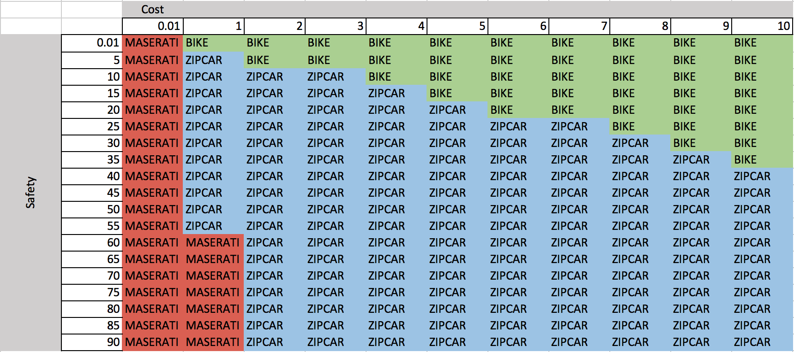
Sensitivity Analysis
Varying the Marginal Rates of Substitution for Cost and Safety
Notes:
This chart displays the best option at each cost/safety coupled value.

Slide 11
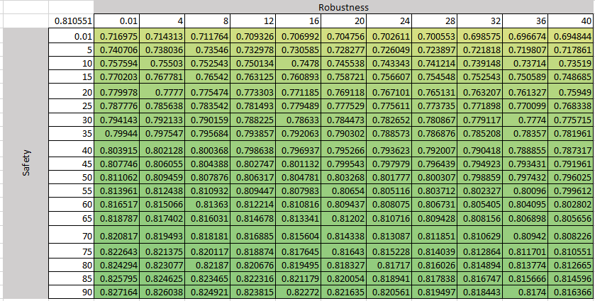
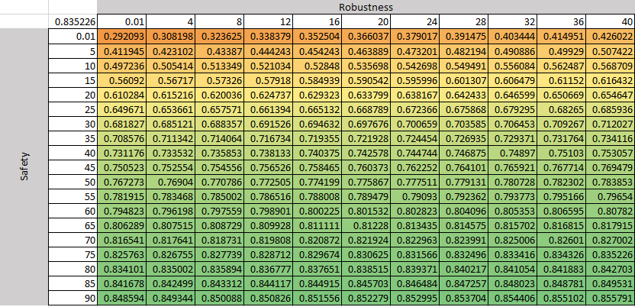
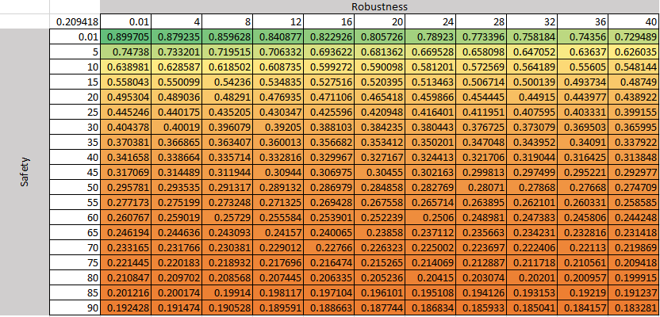
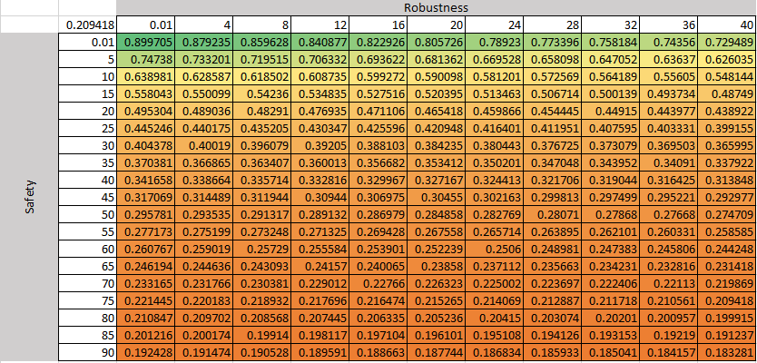
($/Robustness) vs. ($/Safety)
Zipcar
Maserati
Bike
Bus

Slide 12
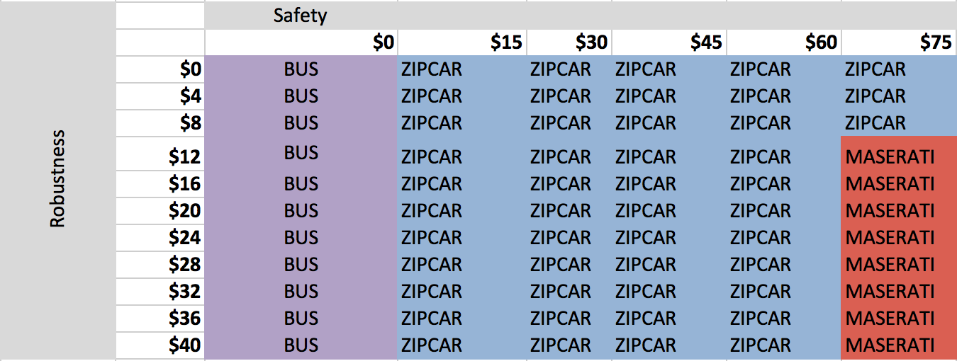
Sensitivity Analysis
Varying the Marginal Rates of Substitution for Robustness and Safety

Slide 13
Additional Considerations
Longevity of the transportation need
Paying as-you-go for Zipcar is low-commitment for short-term needs
Reallocating Zipcar monthly fees to pay off car over time → ownership of vehicle, warranties
Vehicle accidents/damages
Fees & Zipcar membership suspension → eliminates transportation option for period of time
Full responsibility when vehicle is owned → insurance & maintenance fees may increase with time

Slide 14
Recommendation
We recommend Zipcar if you are not sure about the value each attribute as the Zipcar option the best option across a wide range of safety, convenience, and cost values.
If you are quite sure that you highly value your personal safety and convenience, and you feel that one safety rating point is worth paying at least an extra $65, we recommend the Maserati.
If you want to keep your monthly cost as low as possible while still maintaining an efficient method of transportation around Charlottesville within a 15 minute travel radius, we recommend a bicycle.
A combined option would be to buy a bicycle for use over small ranges (i.e. your daily commute) and rent a Zipcar as-needed in bad weather, for longer trips, etc.

