Slide 1
Group Assignment 5: GETaJOB
Team 16: Team 16: Dylan Hazlett (dah4cm), Elise Brosnan (ecb4ad), Fan Feng (ff9sd), Jordan Lopez (jpl2fz), William Snipes(wfs2gm)

Slide 2
Introduction
Our task: Construct a mobile device application to enable users to request jobs and to be hired for jobs, making the two types of users, Consumers and Suppliers
Important concepts for application
Consumer-Supplier communication and schedule sharing
Issues of Privacy between parties
Timeline of response and order of operations
Our Solution: GETaJOB

Slide 3
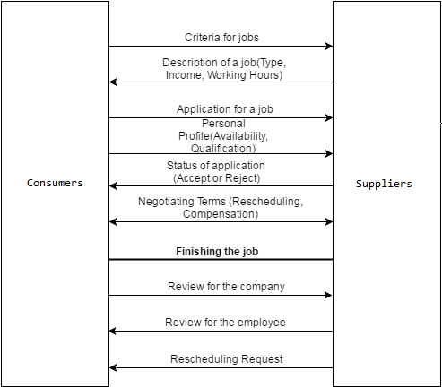
Concept of Operation
The diagram on the left represents the basic timeline for operation between the Consumers and Suppliers for the lifecycle of a job
An extensive list of user tasks are located in the notes
Notes:
Tasks
Consumers Tasks
Search for jobs
Narrow down suppliers based on criteria
Sort by ______(distance,company rating, industry, timing, salary(paid or unpaid))
Make profile
Show/choose their availability
Rating(Not 1-5 scale; lower-scored consumer will have an incentive to leave the app. Require a review or reason for the rating)
History of work and rating
Notifications
New Rating
New Offer or Decline
New Message
Contact suppliers
Send a personal message/request for information
Send resume/relevant documents - apply for job
Create and share calendar
View calendar
Future scheduled jobs
Mark availability/unavailability
Managing applications and offers
View application status
Send a Message Supplier
Write a Review of supplier(would you recommend, would you work for them)
Comment
Rating
Supplier Tasks
Contact Consumers
Send a personal message/request for information
Send job details
Post Job Opportunities
Set budget/salary information/job duration/job responsibilities
Review applicants’ basic information
See Calendar
See Profile
Make and Manage profile
View postings
View applicants for each posting
View Past consumer
Reschedule/ask for availability (sending a message about job)
Viewer personal ratings
Offer Job
Rescheduling
Write a Review of consumer

Slide 4
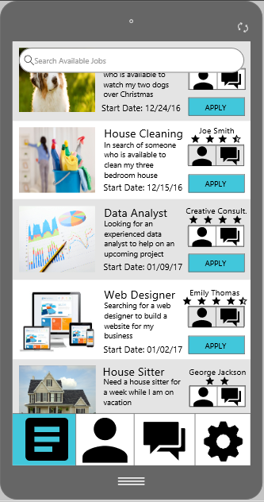
Consumer Job Feed
Information Requirements: Display Recent Job Postings with associated Job Summaries, Job Start Dates, and Employer Information
Most Relevant Information: Job Posting
Most Salient Information: Job Posting
Design Principles: Minimizing Information Access Cost, Proximity Compatibility Principle, Principle of Multiple Resources, Replacing Memory with Visual Information, Principle of Consistency, etc.
Navigation Strategies: Bottom Bar, Employer Contact Buttons, and Detailed Job Description
Notes:
In our interface, we put the navigation tab at the bottom of each page so that users could easily find it. Four icons are the symbol representation for four main pages in the app. To help users better navigate themselves, we give them feedbacks by highlighting what the current page belongs to with color contrast from other icons. Therefore the distance on the gulf of evaluation is decreased and users are less likely to make errors. We apply these settings to every page for the consistency principle.

Slide 5
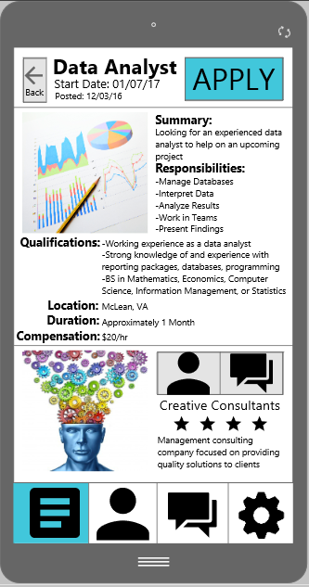
Consumer Detailed Job Description
Information Requirements: Job Summary, Responsibilities, Qualifications, Location, Duration, Compensation and Employer Information
Most Relevant Information: Apply Button
Most Salient Information: Apply Button
Design Principles: Redundancy Gain, Minimizing Information Access Cost, Proximity Compatibility Principle, Replacing Memory with Visual Information, Principle of Consistency, etc.
Navigation Strategies: Bottom Bar, Employer Contact Buttons, Back Button, and Apply Button
Notes:
When the users go to this page to view the details about a job, they want to make sure if this job fits their expectations, and if they meets the requirements for this job. So we include only related descriptions on this page to minimize information access cost. The Apply Button is made most salient because once that button is clicked, that means the user is making a decision and we want to minimize the possibility of making an error.

Slide 6
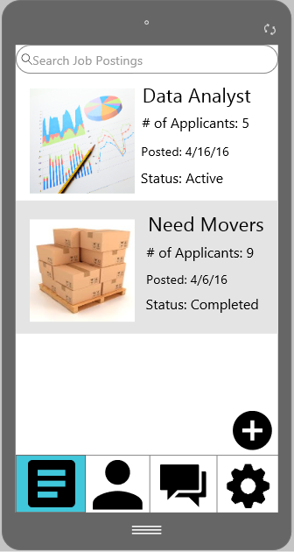
Supplier Job Postings
Most important information is the largest and placed at top - job name
Information requirements: Most recent job postings are displayed and whether they have been completed or not. # of applicants is shown second on the list right under the most important thing, the title
Navigation: Clicking on job allows for more details. Create new job posting is in bottom right with a symbol that displays clearly adding a job. Search bar to look for specific job posting. Navigation at bottom of page that shows you where you are in the app and which pages you can go to

Slide 7
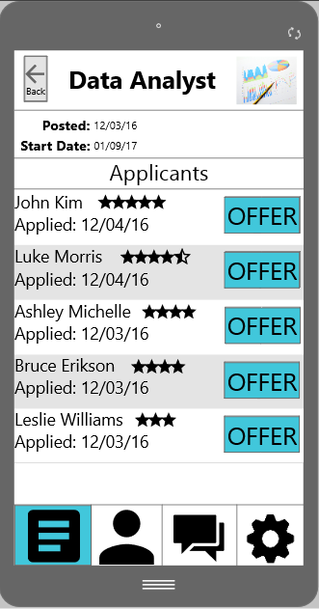
Job Applications Page
Information Requirements: Applicants are ordered by the highest ratings first. Along with the applicant’s name, suppliers may view their ratings as well
Navigation: The back button allows the supplier to return to their postings page. “Offer” button allows for suppliers to advance and extend a job offer. Tapping on individual consumers allows for the supplier to view their individual profiles

Slide 8
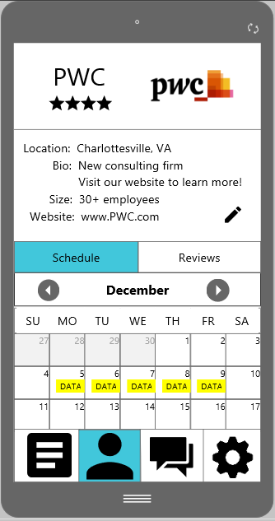
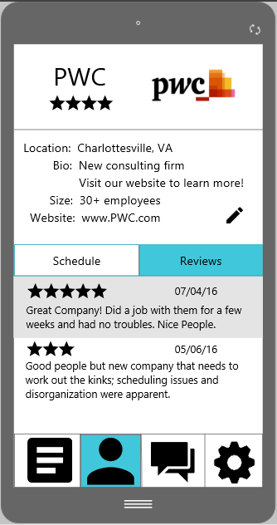
Supplier Profile Justification
(as seen by supplier)
Information Requirements: Allow supplier to edit bio and input schedule of jobs; allow supplier to view overall rating, list of ratings
Most Relevant Information: Supplier name, rating
Most Salient Information: Supplier name, rating
Design Principles: Minimizing Information Access Cost, Proximity Compatibility Principle, Principle of Consistency, and more listed in the comments
Navigation Strategies: Bottom Bar, Schedule and Reviews Access Tabs
Notes:
Here is the supplier’s profile page as viewed by the supplier. The first thing the we wanted to be visible and salient is the name of the supplier (PWC), their rating and their logo/chosen picture. This design represents clear user feedback to indicate that the previous action of tapping the profile button was successful. There is redundancy gain with this feedback with both the name of the supplier and the supplier’s profile picture, highlighting that both the feedback of previous action and the supplier’s title and picture are the most important information. This information is located at the top of the application page because it is rarely, if ever, changed. The significance of this location is that the user’s thumb would have difficulty reaching that high, but the eyes of the users will see it and shorten the gulf of evaluation. It is important for the supplier to see this information at the top of their profile page because it will most likely be the most salient information for any consumer, and, because the supplier also wants to look good and professional for the consumers, this is thus the most important visual information for the supplier. Proximity is used for these pieces of information as they are enclosed, also the rating is very close to the name of the company to eliminate any confusion.
Underneath the title is the supplier’s filled-in basic information. The different fields of information are in alignment and in proximity to each other. None of this information is necessarily more important than the next attribute and is the same font size. This information will be viewed by consumers to simply learn more about the supplier and does not serve a functional purpose past providing details that would help the consumer narrow down their choices. The supplier is given the option to edit their personal information since typing errors are common and easily made, especially with a phone keyboard. The edit pencil embraces the recover from error usability dimension. The edit pencil uses design principles of pictorial realism and proximity, since the pencil is close to the information it will edit and more easily indicating its function purpose.
Note: The area for personal information is not definite in dimensions. If the supplier wants to add more fields of personal information, the “Schedule” and “Reviews” ber will lower. This page is scrolling-embracing indicated by the partially cut-off schedule.
For the bottom half of the page, the supplier has a selection option to view either their schedule or their past reviews. The top half of the page remains the same using the consistency design principle. This was used because we did not want to give the user the impression that they were navigating out of their profile page since these fields are piece of information that directly refer to their profile’s current state. We thought the system would be less efficient to have a separate page for these fields, removing the possibility of getting lost with navigation issues. The selected field is indicated by the teal selection, providing user feedback and increasing salience of current location. This design also is consistent with the navigation bar on the bottom, minimizing information access cost.
To start with the schedule, it marks the date of jobs that the supplier has posted, using multiple source into one comprehensive and comparable source and replacing the supplier’s memory with visual information. The yellow bars indicate when the “DATA” job is scheduled (the yellow on black passed all color contrast tests). The schedule creates a mental model that matches the supplier’s mental model of when to think about scheduling jobs and minimizes the required memory load with this feature. Other principles to note is 1+1=3 with the blocks for each day, user feedback to reduce scheduling errors (presentation of information to reduce possibility of memory lapse), small multiples with the blocks for each day and muting the past number and dates with light gray.
Next, the reviews tab provide the given rating, which is the most important and most salient information in each review, the date and the review. For privacy purposes, all of these reviews are provided anonymously. This display uses proximity with alternating gray shading to enclose the information that belongs to a single review, without using a bunch of lines to confuse the user.
In closing, this design provide usability freedom to explore your own profile without getting lost through navigation confusion.

Slide 9
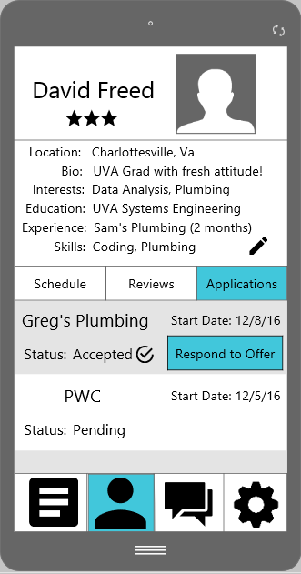
Consumer Profile Justification
(as seen by consumer)
Information Requirements: Display employee profile with relevant bio, schedule, overall rating, list of ratings
Most Relevant Information: Employee name, rating
Most Salient Information: Employee name, rating
Design Principles: Minimizing Information Access Cost, Proximity Compatibility Principle, Principle of Consistency, Strong Data-to-Ink Ratio, Redundancy Gain, Use of Simple Language
Navigation Strategies: Bottom Bar, Calendar and Schedule Access Tabs
Notes:
This the consumer profile page. Please refer to the previous slide to see all of the explanation as I will only discuss the difference of having the application tab. All of the previous explanation is applicable to the consumer profile page, only that it is in the applicable information to this particular consumer, David Freed.
The application tab shows the current applications that the consumer has sent to suppliers, the starting date of the job and the status of the application. There is a strong data-to-ink ratio because, given that the consumer has so little information about their application, the consumer can very quickly see whether the status has changed and to which supplier. Redundancy Gain with the “accepted” text, check mark, and increased functionality button to “respond to the offer”. Also, the salience of the “respond to offer” increasing the importance of responding to the offer, which we agreed makes sense as a design since finding a job is one of the main goals of a consumer. Proximity with shading is also used, like it is used on the “Reviews” page, to capture the information relevant to one application.
On both profile pages, the use of simple language, “Schedule”, “Reviews”, “Applications”, decreases the chance of confusion and user error through misinterpretation, ultimately making this app quicker to use and efficient with ink.

Slide 10
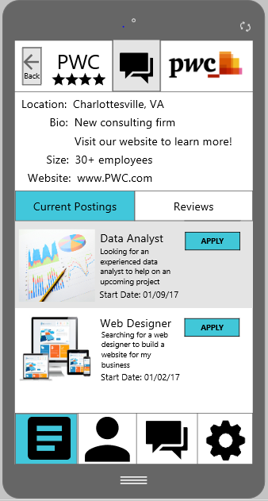
Supplier Profile Justification
(as seen by consumer)
Information Requirements: Allow consumer to view supplier bio, ratings, and current job postings; allow consumer to apply to jobs and directly message company
Most Relevant Information: Supplier name, rating, Direct Message Button
Most Salient Information: Supplier name, rating, Direct Message Button
Design Principles: Minimizing Information Access Cost, Proximity Compatibility Principle, Principle of Consistency, Strong Data-to Ink Ratio
Navigation Strategies: Bottom Bar, Schedule and Reviews Access Tabs, Apply Button, Back Button, Direct Message Supplier Button

Slide 11
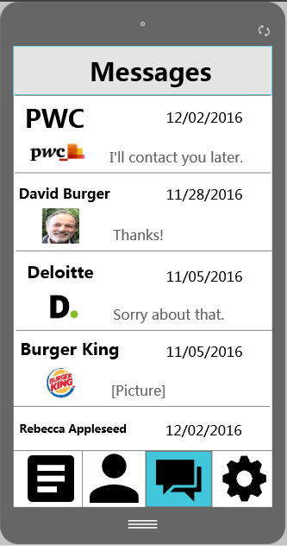

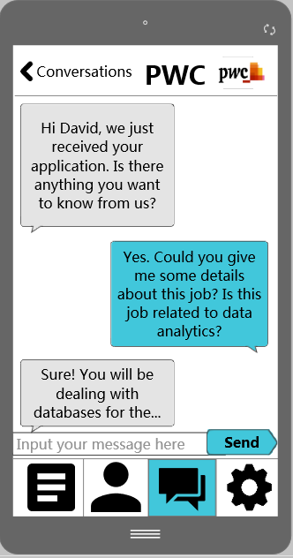
Message List &
Messages
Justification
Information Requirements: Display Recent Contacts/ Messages with suppliers / consumers
Most Relevant Information: Messages
Most Salient Information: Contact Name
Design Principles: Minimizing Information Access Cost, Principle of Multiple Resources, Replacing Memory with Visual Information, Color Contrast, Principle of Consistency, etc.
Navigation Strategies: Bottom Bar, Messages Button, Click to see all messages from one contact
Notes:
In the Message List page, what the user needs is to quickly identify the employer he/she wants to contact. So the name of employer is the most salient information on the list, and to remind the user of the employer better, the most recent message, a photo of the employer and the latest chat time was also included in the list page. Also, to help the user navigate the pages quickly, the Message button on the bottom tab will be highlighted into grey color. With those memory aids made, the system requires less mental workload from the users.
In the Messages page, we differentiate message bubbles from job seekers and employers by color. In the black-grey side, the color contrast ratio is 13.08:1, and the black-blue side has a ratio of 7:1. Both pass all text tests so that the users are able to read in most use cases and the messages are able to draw users' attention. Users’ foveal view will focus on the messages, which is certainly the most salient part of this page.

Slide 12
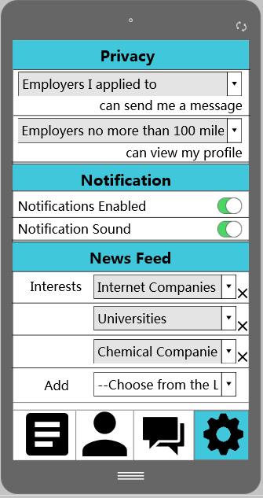
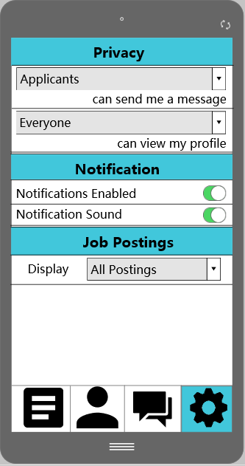
Consumer & Supplier Settings Justification
Information Requirements: Display different type of settings
Most Salient Information: Settings Type
Design Principles: Principle of Redundancy Gain, Replacing Memory with Visual Information, Color Contrast, Minimizing Visual Units, Principle of Proximity, etc.
Navigation Strategies: Bottom Bar, Settings Button
Notes:
The settings page for job seekers and job posters are very similar, except that job seekers can choose their preference in the news feed, and job posters can choose what kinds of postings they want to look at. They both can choose their privacy level to make sure unrelated messages are filtered, and they can turn notifications on and off by clicking the “switch” icon. On this page, we also make sure color contrast of combo boxes pass the text tests.

Slide 13
Use Case 1: Consumer
Notes:
Consumer Side: David Freed is a university student trying to find a short term job during his winter break. He is interested in finding a job related to data analytics within 100 miles from his house, so he used GETaJOB App to search and apply for a job. He plans on using the App to contact his potential employers and get more details on the jobs.

Slide 14
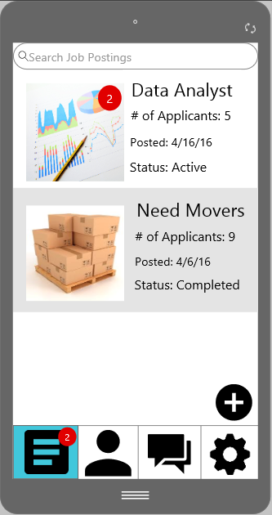
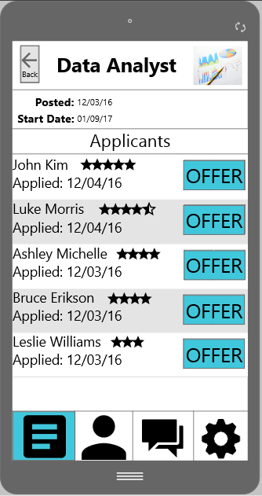
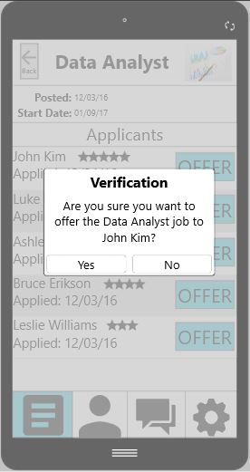
Use Case 2: Supplier
Notes:
Supplier Side: PWC posted an internship position during the winter break. Since the start date is coming up and 2 new applications are received, the employers wanted to be able to view all the applicants’ basic information to know if they are qualified for the program, or if their schedules fit the positions. After reviewing all the applicants, they decided to extend their offer for the top one. A confirmation message appears before extending the offer.
The Verification page appears to avoid user error of tapping incorrectly when they meant to scroll or go to the user profile, forcing the user to slow down and focus on the action on the screen. This was a necessary design because of the weight of sending an applicant an offer and the severity of that error.

