Slide 1
Group Project 1
Group 19: Fan Feng, Connor Hagan, Ann Clare Levy, William Rainey, Safir Serhatli

Slide 2
Part 1:
Task Analysis on Infant Optics DXR-8

Slide 3




User Groups
User Group | New Parents | Seasoned Parents | Babysitters | Grandparents
Familiarity of Technology | Medium to high | High | Medium to high | Low to medium
Free Time | Low | Low | Moderate | High
Caretaking Ability | Moderate | Experienced | Low-Moderate | Experienced
Likelihood of Time Away from Infant | High | Moderate | Moderate | Low
Notes:
Free time/prior experience decide whether the machine shows instructions on what to do in certain situations, and technology familiarity decides how we should make the operations of this machine simple and efficient.

Slide 4
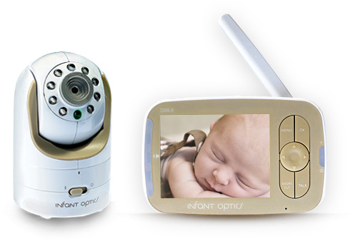
Resources
Tools
3.5” LCD screen, full color
Lithium ion battery
6 hours charge with screen on, 10 hours with screen off
Interchangeable lens for varying view
Remote panning ability via monitor
Sound-sensitive LED lights
USB charge port
Electricity
Light
RF frequency
Retrieved from http://infantoptics.com/dxr-8-baby-monitor/

Slide 5

Properties of the information transferred
Environmental constraints
Resolution
Storage Size
Color
Sound Volume
House design
2.4 mhz system
Poor range
External Light
Temperature
Notes:
Environmental Constraints
Monitor can’t stand when it’s charging, which disables it from lasting the night (battery life is approx. 3hrs)
Walls, stairwells, and floor levels interfere with the monitor’s range, causing loud warning beeps to emit from the device
Wifi, bluetooth, radio waves, and other electronic signals cause interference with the monitor and camera’s communication shortening the range or blocking it completely

Slide 6

Key Relationships/Trade-offs within the System
LCD Screen size vs. Battery Life
Vision (i.e.: night/day) vs. Battery Life
Screen size vs. compactness
Viewing angle vs. room design
Light intensity vs. image resolution
Transmission range vs. house design (thickness of the walls etc.)
Notes:
Trade-offs also exist between:
Screen brightness and battery life
Screen resolution and battery life
RF frequency and range
Range and battery life
Resolution(especially), color and sound volume determines the quality of information transferred to the users. However, resolution relates directly to storage size. So there is a tradeoff between the quality of information and accessibility of files saved.

Slide 7
User’s Functional Needs
Being able to operate the machine and adjust the camera efficiently
Remote control
Via buttons
Add touching sensing on the screen
Add voicing sensing
Motion/light sensing camera
Charging functionality: overnight use of monitor
Wireless charging pad
Charging stand
Low power night mode
Audio only
Replaying the recording
RAM memory
Memory Card
Wireless upload to computer
Ease of mobility
Light weight
Pocket size
Notes:
The user will need to be able to control the camera while away. He/she will need the camera len’s direction, focus, and mode (i.e. day v night vision) to change as variables in the environment come into play. The user will also need to make of use of the monitoring system during all times of the day, therefore they will need a charging system and battery life that allows them to use the monitor overnight and for extended hours on end. The user will also have the potential need to re-play portions of the video, therefore a recording system is required. The user will also need to be mobile while monitoring his/her baby, therefore the monitor itself must be mobile.
How will the user control the camera?
How long will the battery last?
Will variables change this battery life?
How will the camera adjust for changing light?
How will the device record data?
How will the user access that data?
Will the user need mobility?
How is this achieved?

Slide 8
Three scenarios of interacting with the system
Sara walks across the street to borrow sugar
Sarah is a babysitter, caring for multiple children and an infant. She uses the night vision and motion controls to better her view of the baby
Serra is a single mom sitting in her living room watching TV on the floor below her nursery. The monitor beeps telling her she is out of range.
Notes:
Scenarios:
Sara walks across the street to borrow sugar from her neighbor. She needs a baby monitor that is portable and with a high quality and large range so that she can continue to watch her baby.
Sarah is a babysitter for three young children, two of them toddlers and one an infant. As she has to entertain and care for the two toddlers outside of the infant’s room, she needs a monitor that will continue to work in other rooms of the house (through walls, considerable range, electronic interference). The monitor will be kept in her pocket, so it can’t be capable of changing volume or turning off by accident in her pocket. When she hears the baby cry over the monitor, she turns on the visual display and night vision and moves the camera to refocus on the baby’s crib.
Serra is a single mom who is watching Downton Abbey in the downstairs living room, which is on the other side of her house and a floor below the baby’s room. The monitor continues to go out of range due to distance and interference from the electron devices around her, so she has to move closer to the baby’s room to finish watching her show while continuing to monitor her baby.

Slide 9
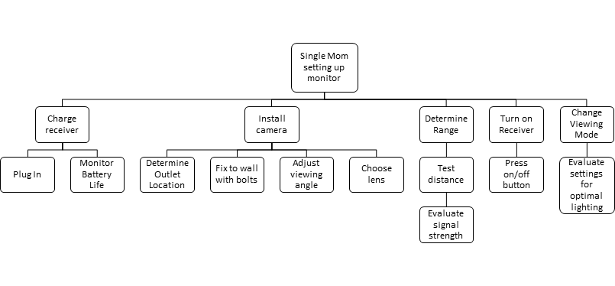
System Installation

Slide 10
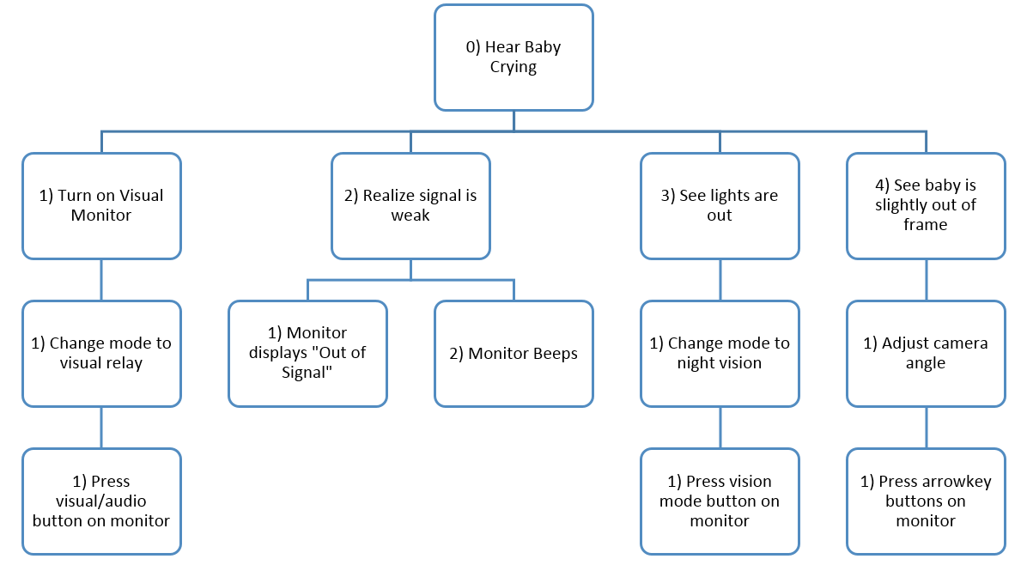
Complex Scenario Task Analysis

Slide 11
Part 2:
Work Domain Analysis on a Proposed System

Slide 12
Overview for a Smart Home
A Smart Home will use existing technology to :
Provide Comfort
Enhance Security
Increase Sustainability
Current Problems:
Human Nature
Loss of Energy
Lack of Security
Notes:
While remote-controlled blinds, air conditioning units, fans, and lights do exist, seldom are these all integrated to communicate with one another. To increase efficiency for a homeowner or resident, we want to design a smart-home remote that can engage and automate various components of their home. Currently the majority of these tasks are done by hand. Due to human nature, often we fail to turn off the lights, locks the doors, or turn the AC on or off to coincide with residential power demand. A smart home would help mediate these risks by applying analytical data a create an internet of things within the home. The internet of things will give a second eye to any human nature follies and in turn help save energy and keep the homeowner safer.

Slide 13
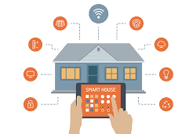


User Population Analysis
User Group | Budget Conscious | Home Security Minded | Gadget Geek
Familiarity of Technology | Low-Medium | Medium-High | High
Desired level of system autonomy | High | Self-determined | Medium
Self-Installation Ability | Low | Low | High
Price Range | Medium | High | Medium-High
Notes:
Environmentally Conscious: Desire system that will monitor and adjust home systems to make house more environmentally sustainable. System should be highly autonomous, making determinations of resource usage control. Most likely unable to install system without professional aid, as the system will be highly invasive into the home
Case Scenarios:
The Environmentally Conscious User wants their Smart Home System to automatically lower the shades in her home during the sunniest hours of the day as to decrease the house’s internal temperature and lower the electricity used to cool the house with air conditioning.
The Home Security Minded User wants their Smart Home System to lock their doors wirelessly when they are away on vacation when a button is pressed on their smart phone
The Gadget Geek is obsessed with any new technology and wants to create an internet of things within his home. He wants everything in his home to share data and be wirelessly controlled from his smart phone wherever he goes.
Interactions:
The different user groups may have interactions with one another in the same home, for instance there could be a husband who cares about keeping the house climate under control, and therefore wants the blinds shut and windows closed automatically if the temperature outside is warmer than the temperature the house is set to. In addition, there may be a wife or child that wants to feel safe, and therefore wants security cameras and motion sensors to be very responsive.

Slide 14
User Scenarios for Smart Home System
Greg closes the window remotely to save on AC costs, but little Timmy was actually sitting on the window sill
Ann Clare leaves her lights on, and the house turns them off to conserve energy
Safir triggers security after being alerted of an unwelcomed visitor at the back door
Notes:
The house temperature is set to 70 degrees, but the house is currently 85. The air conditioning is working at full capacity, but nothing seems to be working. Greg, the energy/budget conscious husband, receives a notification on his smart home remote, alerting him that the house air conditioning unit is struggling. It then alerts him that the window is open, and asks if this was done intentionally. Greg selects the “No, run autotask”. The window shuts, as do the blinds. Greg initiates the window closing, but doesn’t know his son Timmy was actually catching a lizard on the window sill. The window begins to close.
Ann Clare rushes to work in the morning, unaware that she left every single light on in the house, especially the 15 high powered halogen bulbs that surround her bathroom mirror. The house, recognizing that no one is home, turns off the lights.
Safir is sitting in her living room, when she hears a disturbance outside. On her smart house remote, she selects the security tab, and sees that the backdoor camera has detected movement. Recognizing that it is a person, she initiates the house alarm preemptively.

Slide 15
Task Analysis

Slide 16
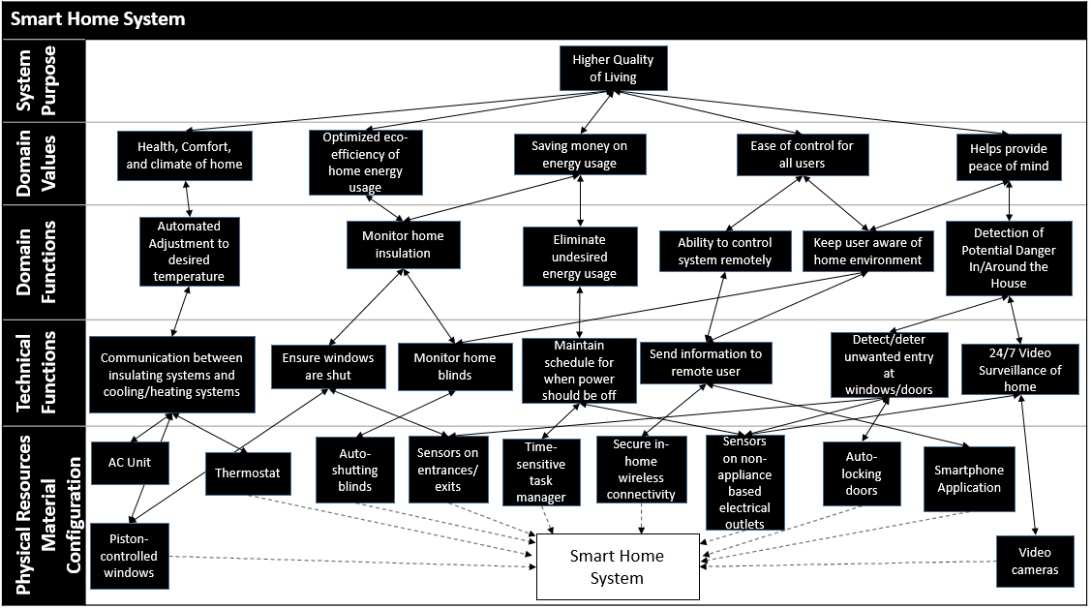
Work Domain Analysis

Slide 17
Branch Decomposition
Smart Home System
 | System | Unit | Component | Part
System Purpose
Domain Values
Domain Functions
Technical Functions
Physical Resources Material Configuration
High Quality of Living
Health, Comfort and Climate at home
Automated Adjustment to desired temperature
Communication between insulating systems and cooling/heating systems
AC Unit
Thermostat
Piston-controlled windows

Slide 18
Any questions?

