Slide 1
SYS 3023 Assignment 2
Group 19: Fan Feng, Connor Hagan, Ann Clare Levy, William Rainey, Safir Serhatli

Slide 2
Objectives the client stated
Objective Name: | Explanations:
Top level objective: | To make the system usable for all kind of users
System objective: | To allow users to increase efficiency, comfort and to reduce costs
Re-design objective: | To make the monitor functions intuitive and to allow user to add more function
User case objective: | To allow users to control comfort index which is an optional mode of control in addition to temperature
1 Fan Feng, Connor Hagan, Ann Clare Levy, William Rainey, Safir Serhatli
Notes:
All of the objectives are taken from the assignment description sheet on Collab
We assumed that there is not any other objectives rather than the ones that are stated at the assignment sheet

Slide 3
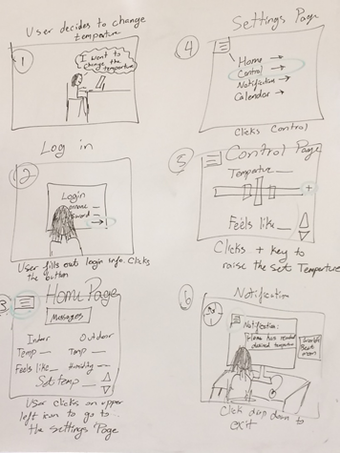
Storyboard
2 Fan Feng, Connor Hagan, Ann Clare Levy, William Rainey, Safir Serhatli

Slide 4
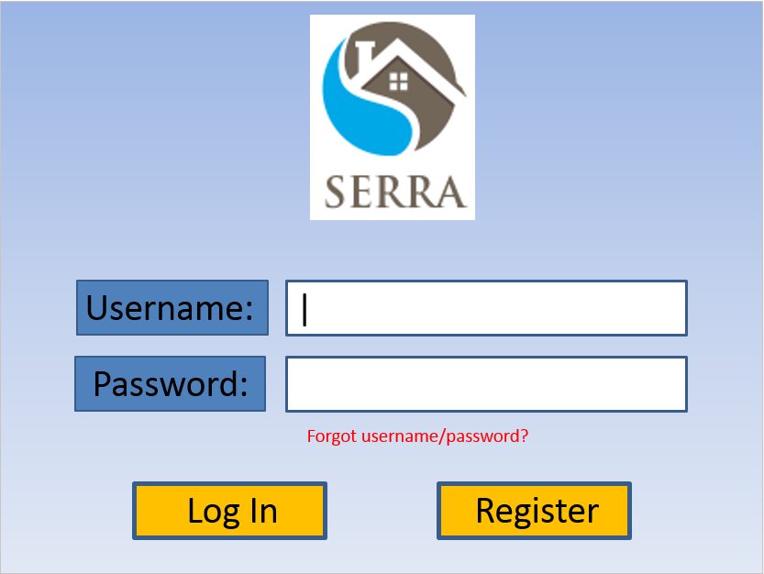
Login Page
3 Fan Feng, Connor Hagan, Ann Clare Levy, William Rainey, Safir Serhatli
Notes:
Proximity: Username and Password box placed closer to and in line with the insert information boxes that correspond with them

Slide 5
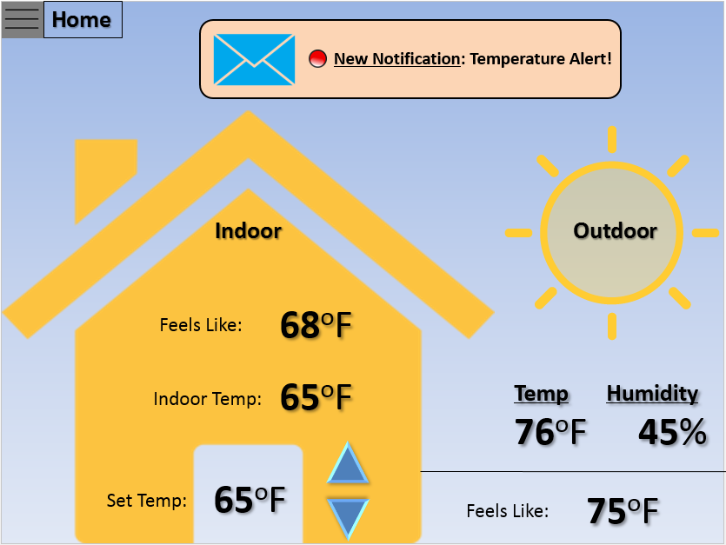
Home Page
Implement Alignment Principle by using Breadcrumb to help users navigate
Make use of Redundancy Gain to better illustrate the indoor & outdoor conditions
4 Fan Feng, Connor Hagan, Ann Clare Levy, William Rainey, Safir Serhatli
Notes:
The main ideas we had behind the homepage was minimizing information access cost and redundancy gain. The latter was the primary reason that we decided to go with a layout of the home in contrast to the outside scene. The goal was that the highly contrasting background of the house would draw the user’s attention first, and their focus will be drawn to those numbers. We wanted to keep consistency with the three big numbers that the user may care about both indoors and outdoors. The “Feels Like” and “Temperature” numbers are aligned for both indoors and outdoors to show both consistency and contrast because of the varying backgrounds (the house vs. the outdoor sun). We chose to include “Set Temperature” in the indoors pane because that is a number the user would most likely care about next, and it seems rather intuitive that if the user feels cold or warm then changing this number would help resolve their discomfort. Humidity was included in the outdoor pane because it is probably the third most significant number a user would want to know about outside, and the outdoor humidity is probably more important than the indoor humidity because we cannot change indoor humidity in this system. Additionally, the “Feels Like”, “Temperature” and “Humidity” hierarchy might help the user become more acquainted with the idea of a comfort index, as it is determined by temperature and humidity. The notifications in the notifications pane will be ordered by level of urgency, signaled by the color of the alert symbol, which is intended to give some discriminability between them. This also incorporates the principle of top-down processing, as users will have physical evidence of what is most important and needs to be addressed now.

Slide 6
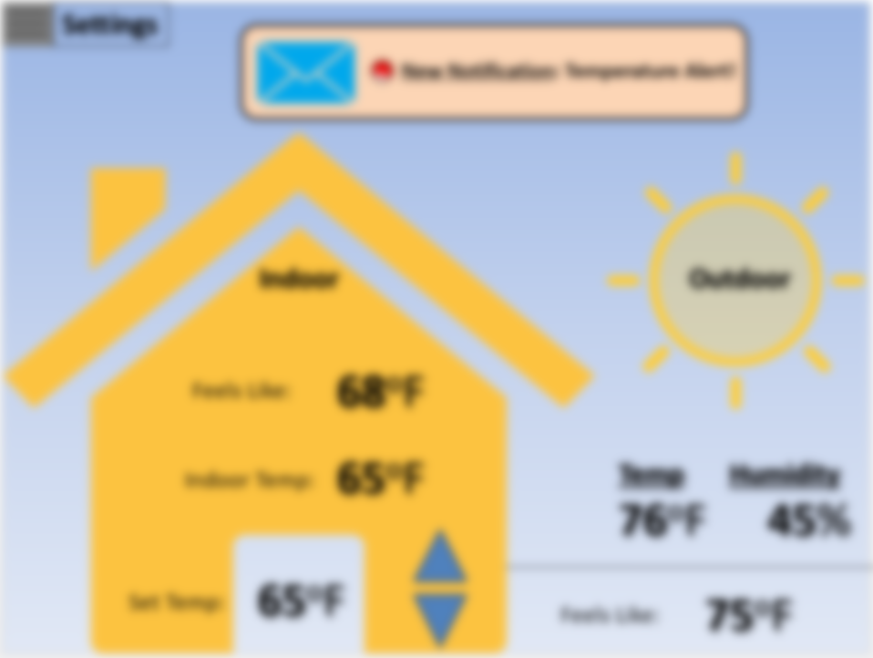

Settings
Settings Page
Home
Notifications
Mute the framework to highlight the settings options
Control
Calendar
Account Settings
Logout
5 Fan Feng, Connor Hagan, Ann Clare Levy, William Rainey, Safir Serhatli
Notes:
The main objective with the menu button was to draw the user’s attention to the various headings. We chose to use the well-known 3 line menu icon because users are most likely familiar with that particular visual unit. In order to create more contrast we implemented the blurred background effect. The muting highlights the setting options and impedes with the user’s eyes becoming distracted with the background.

Slide 7
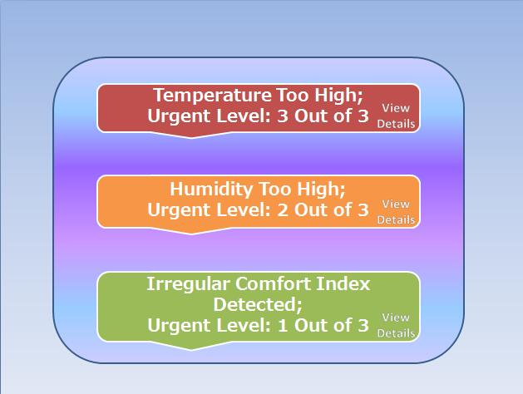
Notification List
Notifications Page
Use of Small Multiples and Redundancy Gain to illustrate different urgency levels
6 Fan Feng, Connor Hagan, Ann Clare Levy, William Rainey, Safir Serhatli
Notes:
It was decided that the best way to discriminate between 3 levels of urgency was to use some conditional formatting with red, yellow, and green coloring. Each notification will also include a clickable “View Details” icon that will provide the user with more information. It was strategically placed in the right hand corner, with the rationale that once the user finishes reading the notification their eyes will naturally continue to pan from left to right, and the “View” part of this icon is aligned with the last line of the notification text. Additionally, the use of small multiples added a level of consistency to the page which will enhance the user’s experience and overall readability. Furthermore, the implementation of the design principle of redundancy gain helps to illustrate the different urgency levels. The use of color and location is similar to the extremely familiar and user friendly stoplight. The colors and location will help invoke the similarities and assist in the readability of the page and the system.

Slide 8
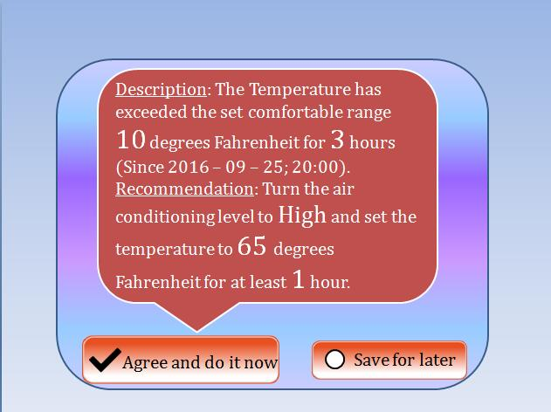
Notification
Urgent Level Notifications Page
Urgent
Use Contrast Principle to highlight the important information in the notification page
7 Fan Feng, Connor Hagan, Ann Clare Levy, William Rainey, Safir Serhatli
Notes:
The Urgent notification example shown was colored red to imply maximum urgency. A tricky obstacle in designing this was that we wanted to provide users with enough information that they would know how to address the issue but also not overwhelm them with a large chunk of text. Therefore we chose to add some extra salience to certain words or numbers, such as “10”, “3”, “High”, and “65”. Also provided below the notification are two options, whether to “Agree and do it now” or “Save for later”. The first includes a checkmark next to the text, which users will associate with addressing the problem (top-down processing and redundancy gain). The “save for later” icon includes an empty circle, which hopefully will be associated in their minds as a task that still needs to be completed. In order to subtly guide users to the “Agree” box, the notification window is tapered towards it, so that it almost looks like an arrow that the eye wants to follow.

Slide 9
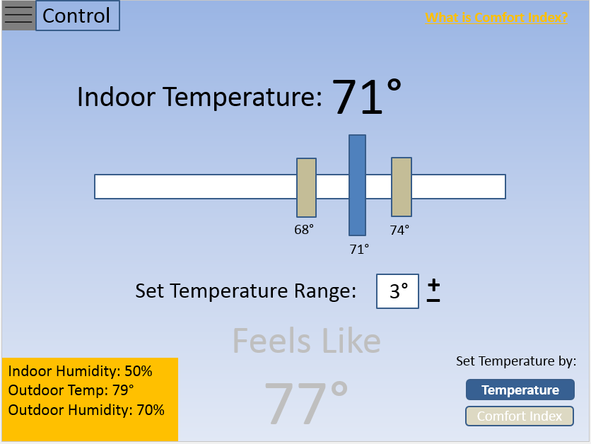
Control Page
Temperature
Use Principle of Moving Parts to illustrate the process of setting temperatures
8 Fan Feng, Connor Hagan, Ann Clare Levy, William Rainey, Safir Serhatli
Notes:
Since it was decided that rather than force the user to control their settings in terms of solely comfort index, we made this page filterable by both Temperature and comfort index. This option to switch between the two is located in the bottom right corner, and by design the more salient of the two options is the one selected. In order to keep the design simplistic and discriminable with both, we faded out the options for controlling via comfort index. Therefore the most legible number is the value next to “Indoor Temperature”, and the most highly contrasting object (perhaps besides the bottom left corner’s information is the interactive bar used to set the temperature. The blue bar represents the actual temperature setting and the gray bars represent the range of temperatures that are acceptable, so that the AC unit is not constantly working to try and maintain the exact value. As one drags this bar the range bars will move to maintain their spacing, so if a user realizes that a possible range value is too high they can reduce the potential range. This range value is also in a white box to provide high contrast and draw attention. The high-contrast pane in the left corner was added in order to minimize information access cost for the user, as it would be tedious to switch between different windows to recall what the temperature outside may be.

Slide 10
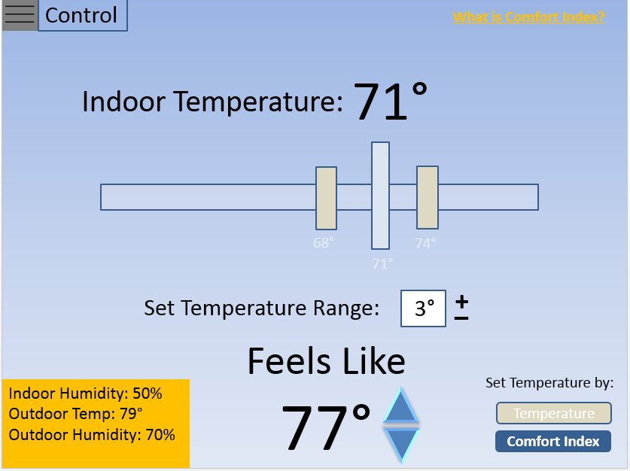
Control Page
Comfort Index
Use Proximity Principle to remind the user of the switch between two control modes
9 Fan Feng, Connor Hagan, Ann Clare Levy, William Rainey, Safir Serhatli
Notes:
The comfort index control page is the same as the temperature control page for consistency, but as mentioned before the filtering technique essentially mutes the controls that aren’t manipulable based on the given selection. Since the user in this case is controlling by comfort index, the temperature bar is no longer as salient, and the Feels Like options have been made more salient. Since one of the worries in the design of this entire system was the user’s familiarity with comfort index, we included a small clickable icon in the top right that provides more information about comfort index.

Slide 11
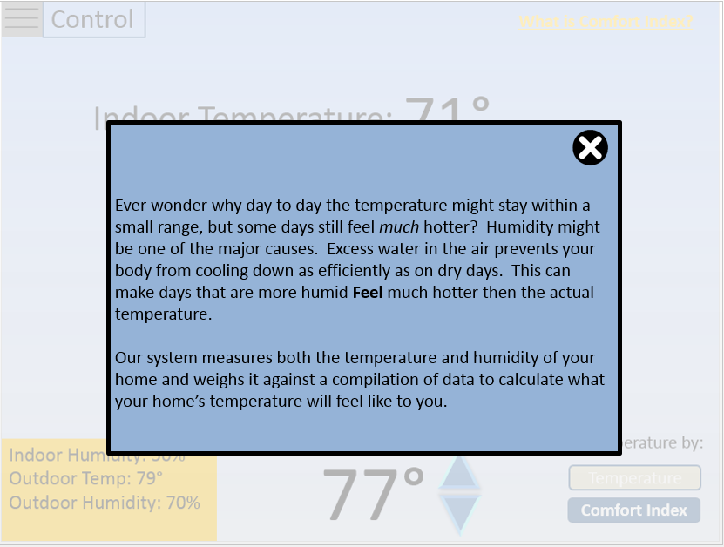
What is Comfort Index
What is Comfort Setting?
Implement the Memory Principle to make sure users not familiar with comfort index can understand how this system works
10 Fan Feng, Connor Hagan, Ann Clare Levy, William Rainey, Safir Serhatli
Notes:
The comfort index control page is the same as the temperature control page for consistency, but as mentioned before the filtering technique essentially mutes the controls that aren’t manipulable based on the given selection. Since the user in this case is controlling by comfort index, the temperature bar is no longer as salient, and the Feels Like options have been made more salient. Since one of the worries in the design of this entire system was the user’s familiarity with comfort index, we included a small clickable icon in the top right that provides more information about comfort index.

Slide 12
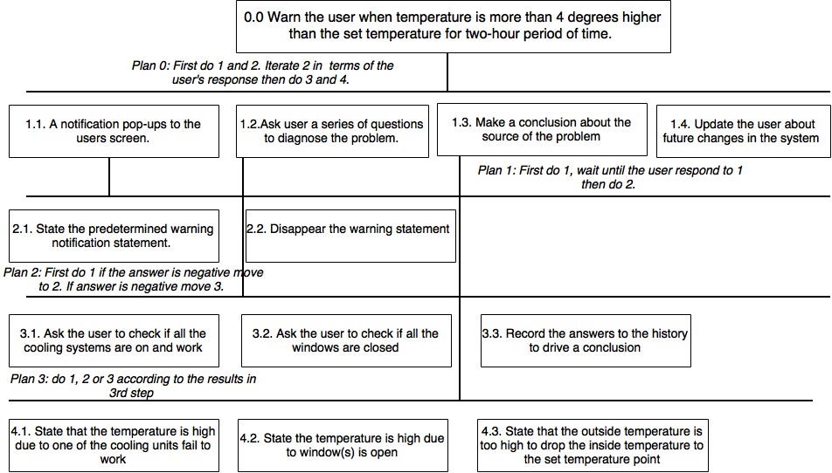
Urgent Issue:
11 Fan Feng, Connor Hagan, Ann Clare Levy, William Rainey, Safir Serhatli
Notes:
Top level objective: The system warns the user about higher temperature that last more than 2-hour period of time.
Assumptions:
The user wants to see this information rigorously since it may cause high costs or extra energy consumption
The user is willing to answer couple of “yes/no” questions to figure out what is wrong in the system
The cooling unit has limitations and it is not always strong enough to lower the temperature to the set point
The changes need to be done by user manually. The system cannot change the physical objects in the house (e.g. closing the window by itself)
In words how the user interacts with the system:
The system pop ups a notification saying ““ The indoor temperature is detected to be more than 4 degrees higher than the set point. It may cause potential overhead cost and extra energy usage in your house.”
The pop up stays in the page until the user clicks “OK”
Then the system asks user a series of questions to diagnose the problem.
First question would be:
“ Did every cooling unit in the apartment on?”
User selects “YES” or “NO” after checking all the cooling units in the apartment.
If the answer stated “NO”. If the user says “YES” and then the system stops asking question.
The system asks the second question:
“Are all the windows and doors are closed?”
User selects “YES” or “NO” after checking all the windows in the apartment.
If the user says “NO” system stops. If the user says “YES” then the system interprets that this situation is due to extremely high outside temperatures ans the cooling systems are not strong enough to cool the house.
The system states the following notification:
“ The cooling system is not powerful enough to drop the temperature to the set point. The cooling system can drop the temperature to _____ F with ____ outside temperature and ____ humidity.”
The system notifies user (without pop-ups) when the temperature drop the set point again.

Slide 13
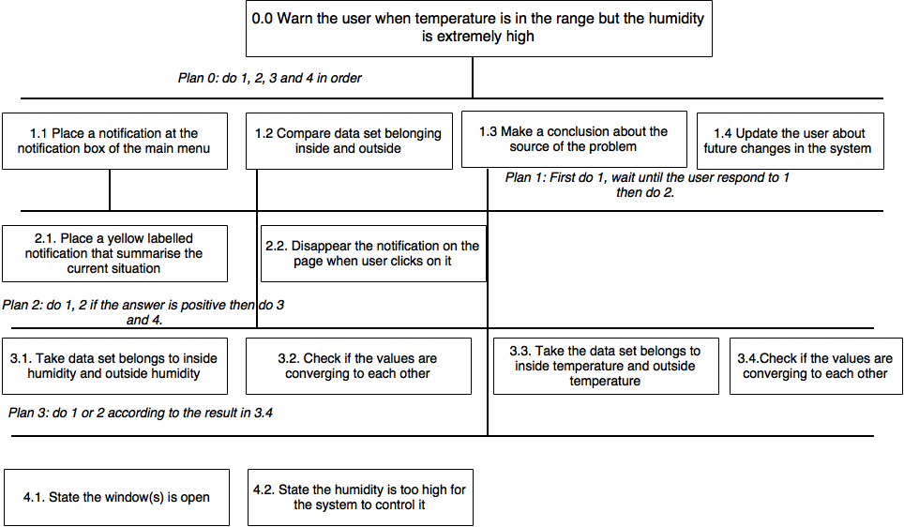
Less Urgent Issue:
12 Fan Feng, Connor Hagan, Ann Clare Levy, William Rainey, Safir Serhatli
Notes:
Top level objective: The system tries to identify the source of high humidity even though the temperature is in set range.
Assumptions:
The high humidity can be caused by not closing a window or an extreme outside humidity level.
If inside and outside temperatures and humidity both converging to each other, it is safe to assume that a window is open.
The situation is not considered as urgent situation so there is no need to use pop ups.
In words how the user interacts with the system:
The system puts a notification to the notification box. → states if the window is open by looking at the driven data
The user sees the notification when s/he logs into his account.
The user clicks the notification, then the notification disappears.
The user closes the windows to drop the humidity down, if it the source of humidity is an opening in the window.
The user get another notification when the humidity is down to normal levels. (when the user clicks the notification, the notification dissepears.)

Slide 14
Controlling Comfort Index Rather than Temperature
Top level objective: The user can choose to control how s/he will feel like instead of temperature itself.
Assumptions:
The user can control only temperature or how s/he will feel like (comfort index). S/he cannot control both of them.
There is range the user can set “Feels Like” value since the cooling units have limited working capacity.
The user can see what would be the temperature when s/he uses “Feels like” option and vise-versa.
The user cannot control humidity
User Interface:
The user is at the home menu
Go to settings → Click control → Go control page → Click “Control Index” → Click the arrows make “Feels like” higher or lower feels like temperature.
13 Fan Feng, Connor Hagan, Ann Clare Levy, William Rainey, Safir Serhatli
Notes:
Details about the system:
When the user clicks the “Comfort Index” option instead of “Temperature”, the temperature change button will fade, hindering the user to control the temperature.
The user will still see the temperature the the house will have when s/he sets the “Feels Like” index to a given point.
The user cannot change the feels like to the any given value. The system stops changing the “Feels Like” when the user is out of “Feels like” temperature limit range. There is a limitation that a user can change the feels like value since the user cannot control the humidity and the cooling units have limitations of how much that they can cool the room down.

Slide 15
Technical Description
In this case, the user presets his or her preferred comfort index from personal experience. After the user commands the system to start working beforehand, the system will do the calculation before operating the air conditioner. Since the humidity cannot be changed by the system, the system makes use of the Psychrometric Chart and find the room temperature needed corresponding to the current room humidity. Afterwards, the system automatically set the temperature and air conditioner starts operating. By the time the user steps into the house, the room temperature and humidity will go to the level that satisfies the user’s preferred comforting level.
14 Fan Feng, Connor Hagan, Ann Clare Levy, William Rainey, Safir Serhatli
Notes:
The technical part of the Control index happens behind the scenes. The user does not have access to the Psychrometric chart. For example the user cannot see the Enthalpy value since the the user have no control of that values. The only information that the user have access to is stated at the previous slide (user interface with the system to change the controlling way of the system.)

