Slide 1
NOVA Lifestyle
Team 22
Jonathan Bugg, Fan Feng,
Andrew Gerin, Luke Shoebotham
jtb3ay@virginia.edu, ff9sd@virginia.edu,
ag2ce@virginia.edu, lms4cu@virginia.edu
Bugg, Feng, Gerin, Shoebotham ‹#›

Slide 2
Executive Summary
Based on Andrew’s preferences, we recommend he rents a one bed, one bath apartment from Avalon the Albemarle.
If Andrew changes his preferences to value price significantly more, we recommend he rents the Huntington apartment.
If Andrew changes his preferences to value accessibility to urban environment more, we recommend he rents the Capitol Yards apartment.
Bugg, Feng, Gerin, Shoebotham ‹#›
Notes:
Executive summary should stand alone
State how much it costs, it’s distance, etc.
Do not use fluff, garbage words that do not say anything → example “low price”, “proximity”, “high”, “a lot” words like those
Needs to be the recommendation and why

Slide 3
Background and Preferences
Andrew has just been hired as a consultant working in Washington D.C
His base salary per year will be $78,000
With his signature comes a $15,000 bonus
Has the potential to obtain a yearly performance bonus of up to $25,000
Budget: Andrew prefers to spend approximately 30% of his annual income on housing
About $24,000 per year
Therefore, the search can be limited to places in which per month rent is $2000 or less
Preference: He prefers to live in an apartment rather than a house
Therefore, eliminate any options that are not apartments
Bugg, Feng, Gerin, Shoebotham ‹#›
Notes:
Source: Bloom, E. (2017, September 27). See how your spending compares with that of the average American-and the US government. Retrieved February 11, 2018, from https://www.cnbc.com/2017/09/27/how-your-spending-compares-to-the-average-american-and-us-government.html

Slide 4
Attributes and Assumptions
Price
Keep monthly price within desired budget (no more than $2000)
Daily Commute Time
Desire to have total traveling time per day be at most 90 minutes (to and from Dupont Circle)
Amenities
Prefer places in there are a wider range of total amenities offered
Aesthetics
Have the client explicitly state the options in which he prefers based on the apartment’s aesthetic appeal (evaluated using external and internal photographs of buildings and apartments)
Desire to be closer to an urban environment
Prefer options in which the client has food, entertainment, and other attractions within a relatively close commute (walk or public transportation)
Assumptions
Only looking into 1 bed, 1 bath apartments
Assume the client does not have a car and therefore prefers public transportation
The client’s preferences are the main drivers of this subjective decision
The daily commute refers to the time spent going to and from Dupont Circle
Move in/Signing date is as close to current date as possible
Bugg, Feng, Gerin, Shoebotham ‹#›

Slide 5
Consideration of Options
Initial Elimination of Options
Remove both the Reston Townhouse and the Catholic University House from contention due to the fact that the client specifically states that he is not interested in living in a house
Do not consider the Milestone Apartments based on the affordable housing requirements that are noted under property details
Consideration of the 9 remaining housing options
Client prefers those options that have the lowest per month price
Client prefers those options that have the lowest per day commute time
Client prefers those options that have the shortest public transportation commute to the Capitol Building (the center of D.C.)
Client has ranked preferences with respect to aesthetics from 1 to 9 (with 1 being the most aesthetically appealing)
The top 5 desired amenities, as noted by the client, are to be labelled with either “no” or “yes” depending on if the option has that amenity or not
Bugg, Feng, Gerin, Shoebotham ‹#›

Slide 6
Potential Options
Apartment | 1 bed, 1 bath price | Transit to work (mins) | Transit to D.C (mins) | Aesthetics | Gym | Controlled Access | Balcony | Elevator | AC
Northgate | $1680 | 45 | 55 | 1 | yes | yes | yes | yes | yes
Courthouse | $1921 | 24 | 33 | 5 | no | yes | yes | no | no
The Elms | $1599 | 85 | 90 | 6 | yes | no | yes | no | yes
Ravensworth | $1391 | 70 | 80 | 8 | yes | no | yes | yes | yes
AVA | $1625 | 41 | 50 | 9 | yes | yes | yes | no | yes
Avalon | $1668 | 15 | 39 | 7 | yes | no | no | no | yes
Clarendon | $1995 | 30 | 36 | 2 | yes | no | no | no | no
Capitol Yards | $1967 | 34 | 15 | 3 | yes | yes | no | yes | yes
Huntington | $1502 | 60 | 58 | 4 | yes | yes | yes | yes | yes
Bugg, Feng, Gerin, Shoebotham ‹#›
Notes:
By “Transit to D.C.” we when the total transit time it takes to get to the center of the city.

Slide 7
Determining the Significance of each Attribute
The relevance of each of the attributes that have previously been discussed can be measured quantitatively by understanding Andrew’s preferences
Andrew highly values the total amount of money he will be spending each month on housing
He also highly values the commute time each day due to both transportation costs and the potential stress that long commutes can cause
As a 21 year old, Andrew cares not only about being close to his work location, but also being close to the center of D.C. and having the chance to enjoy living a “city life”
Although not as significant in comparison to the other three attributes, Andrew would like an aesthetically appealing apartment complex that is able to provide him with certain amenities such as air conditioning, a gym, security, a balcony, and an elevator
Bugg, Feng, Gerin, Shoebotham ‹#›

Slide 8
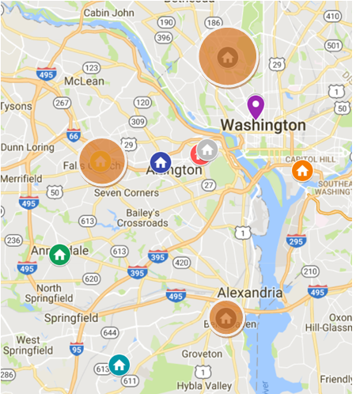
How much does each Attribute matter to the client?
Attribute | % Weight in making the decision
Transit Time | 30%
Price | 30%
Urban Environment | 20%
Aesthetics | 5%
Air Conditioning | 5%
Gym | 3%
Controlled Access | 3%
Balcony | 2%
Elevator | 2%
Bugg, Feng, Gerin, Shoebotham ‹#›

Slide 9
Results and Rankings
Apartment | Ranking
Avalon | 1
Northgate | 2
Huntington | 3
AVA | 4
Capitol Yards | 5
Courthouse | 6
Ravensworth | 7
Clarendon | 8
The Elms | 9
Based on Andrew’s preferences, we recommend he rents a 1 bed/1 bath apartment from Avalon the Albemarle. If his preferences change, this ranking would be affected.
Bugg, Feng, Gerin, Shoebotham ‹#›

Slide 10
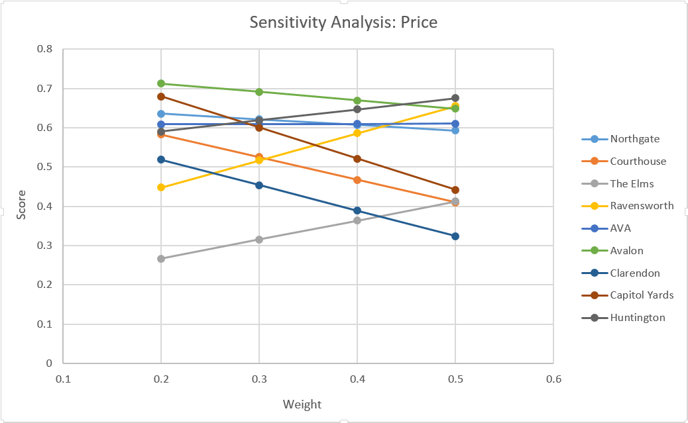
Sensitivity Analysis with respect to Price
Bugg, Feng, Gerin, Shoebotham ‹#›
Notes:
As Andrew values price more and more, Huntington rises to the top.

Slide 11
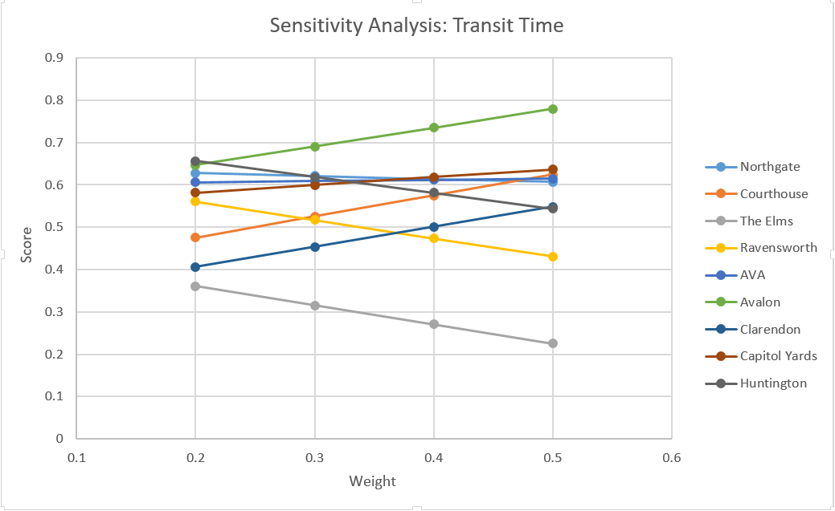
Sensitivity Analysis with respect to Transit Time
Bugg, Feng, Gerin, Shoebotham ‹#›
Notes:
Avalon maintains its top ranking as Andrew values Transit Time more.

Slide 12
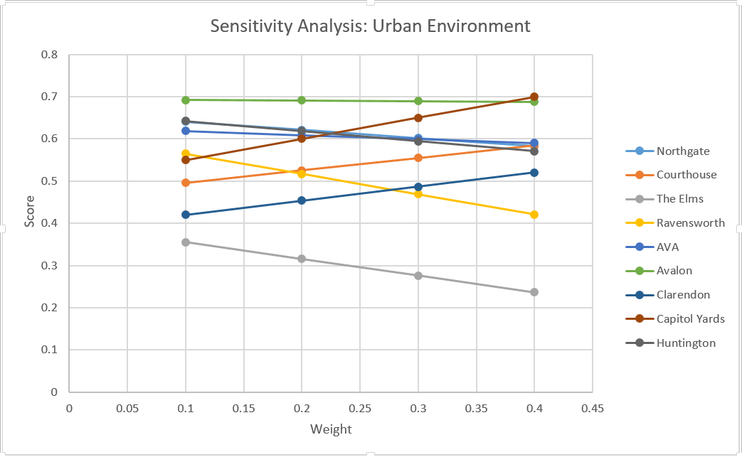
Sensitivity Analysis with respect to Urban Environment
Bugg, Feng, Gerin, Shoebotham ‹#›
Notes:
As Andrew values his proximity to the capitol more and more, Capitol Yards becomes his top choice.

Slide 13
Outscoping
Andrew could consider the possibility of living with a roommate. This would open up our analysis to not only looking at 1 bed, 1 bath options, but also looking at 2 bed, 2 bath options.
Having a roommate and splitting the 2 bed, 2 bath price between the two people has the potential to lower our client’s overall monthly housing cost. For example, if a 2 bed, 2 bath apartment was selected (price divided by 2) at the Avalon the Albemarle as compared to a 1 bed, 1 bath apartment, our client could be saving approximately $460 per month.
However, this option was not fully considered for analysis due to the fact that we are unsure of our client’s specific situation and whether or not he would have someone in which he would be comfortable living with.
Bugg, Feng, Gerin, Shoebotham ‹#›

Slide 14
Outscoping
It is noted that Andrew will mostly be working on client sites rather than at the corporate office (Dupont Circle).
Therefore, Andrew could consider temporarily staying in a hotel or obtaining a short sublease for the first couple of weeks of July (until his project is assigned) instead of locking himself into a 3+ month lease.
As an example, if Andrew’s first client site was at Fort Belvoir, VA, the site of several military and defense agencies, his commute from our top option, Avalon the Albemarle, would be 57 minutes longer each way than the third and closest option, Huntington Gateway. With the 12-month leases Avalon offers, this would equate to roughly 450 hours of extra commute time. Andrew would need to weigh the extra cost of a hotel or sublease with this potential cost.
Bugg, Feng, Gerin, Shoebotham ‹#›

Slide 15
Summary
Andrew was able to provide the following information…
He prefers to live in an apartment rather than a house
He desires to spend a maximum of $2000 per month on housing
He wants to live as close as possible to both Dupont Circle (location of work) and the U.S. Capitol Building (the center of D.C.)
He prefers an apartment that has an aesthetic appeal to his liking
He would like to live in a building that had the following: a gym, controlled access, a balcony for his apartment, an elevator, and air conditioning
Based on these preferences and the apartments options presented, we recommend that Andrew rents a one bed, one bath apartment from Avalon the Albemarle.
Bugg, Feng, Gerin, Shoebotham ‹#›

