Slide 1
Glass Ceiling Case
Jarett Cestaro, Fan Feng, Kal Fernlund, Luke Leidy, Hälsing Nordin
jmc3jc@virginia.edu, ff9sd@virginia.edu, kaf4ce@virginia.edu, lwl3mt@virginia.edu, lhn2rz@virginia.edu

Slide 2
Executive Summary
Controlling for Role Title and Years at UVA, the average female faculty make $11,045/year less than male faculty
Men make significantly more than women for 7 out of 11 major role titles
For each additional year at UVA, faculty can expect to make $1,880 more per year
Men earn higher salaries than women even for comparable time at UVA

Slide 3
Background
On average across the United States, women earn 78% of what men earn
This wage gap is highly controversial and has led to a movement for “equal pay for equal work”
In 2014, the University of Virginia commissioned a task force to examine this issue at the University
The task force found that when controlling for several key factors, women still made an average of 2.7% less than men
It was found that several role titles did not have equal pay between men and women
Notes:
Possible explanations:
Men and women gravitate towards different careers

Slide 4
Walkthrough of the Data
2016 FOIA Data Set:
3037 UVA employees,
1187 female
1850 male
Includes data on annual salary, role title, role code, and time working at UVA.
Avg salary is $113,114/ year:
$96,172 for females
$124,034 for males
2014 Cavalier Daily:
2811 UVA employees
964 female
1847 male
Includes annual salary and role titles at UVA.
Avg salary is $108,475/ year
$92,410 for females
$116,861 for males

Slide 5
Limitations of Our Analysis
A lot of the data required for a truly detailed analysis was confidential and unavailable during the timeframe
Cannot account for race, age, or other demographic factors besides gender
Cannot compare within College, SEAS, McIntire, or individual departments
Not all assumptions for statistical tests were met
No access to advanced performance measures
Rating by students, research money brought in, etc

Slide 6
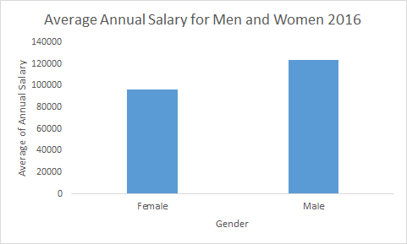
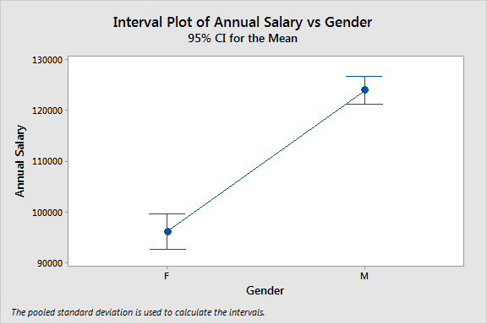
Men Make Higher Salaries than Women
Using only gender as predictor, men make significantly more money than their female counterparts.
However, this model only explains 4.7% of variances in salary, meaning there are other predictors that influence salary.

Slide 7
Men Still Ahead When Controlling for Years and Role Title
Years at UVA, Role Title, and Gender together account for 48.82% of the variation in Salary
Controlling for Years at UVA and Role Title, Men still make $11,045 per year more than women

Slide 8
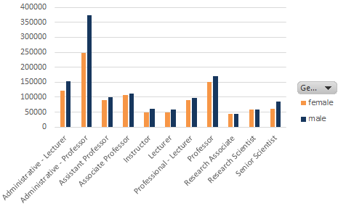
Men Have a Higher Salary in Almost All Roles
This seems to indicate unequal pay for equal work, but not causality
Male faculty on average have worked for UVA longer and thus seniority may account for this difference
7 of these 11 differences are statistically significant
Roles shown constitute 98.8% of all faculty
Mean of Annual Salary
Boxed roles are statistically significant (p<0.05)
Notes:
men : 14 yrs vs 11 yrs for female

Slide 9
The Impact of Gender Has Become More Complex
We ran one-way ANOVA on the differences between salaries in 2014 and 2016, with gender as the only predictor
Under this analysis gender itself is no longer significant, but the interaction between gender and role title is significant after piecewise selection.
In terms of salary increase, the problem becomes more complicated.
Male research associates had a $13,694 larger increase over the 2 year timeframe than females, but female administrative professor had a $44,581 larger increase than males, both on a significance level less than 0.05.

Slide 10
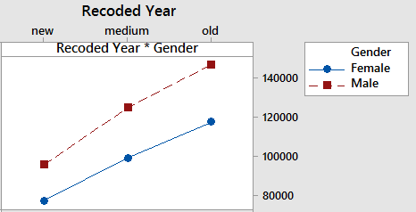
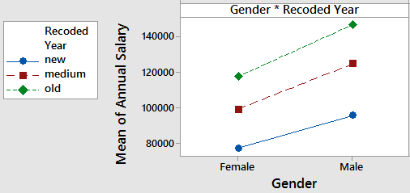
Men Make More for the Same Levels of Seniority
With years at UVA binned into 3 quantiles, men have a higher average salary for all three
These differences are all statistically significant and amount to tens of thousands of dollars in annual salary

Slide 11
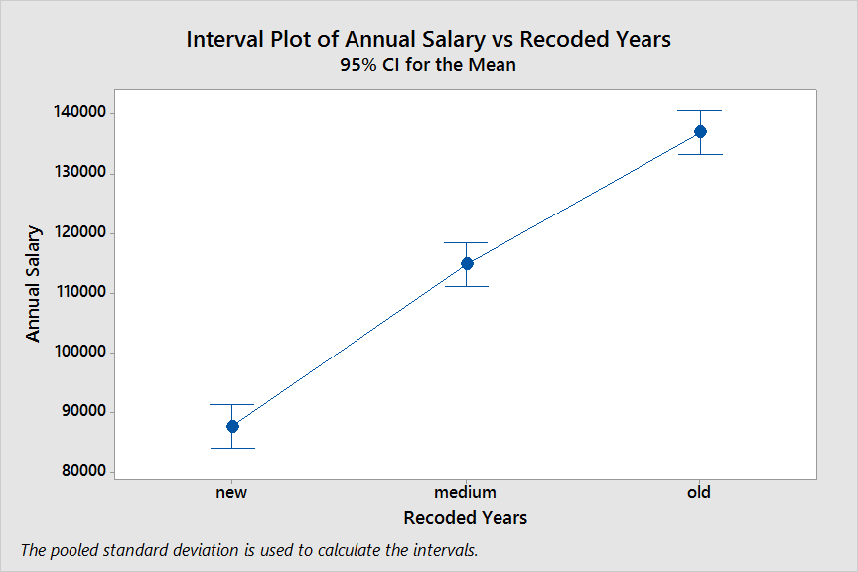
Seniority is a significant predictor for salary
The longest serving faculty earn significantly more than those in the middle, who also earn more than the newest employees
The variation in years worked accounts for 11% of the variation in salary, which is higher than gender’s 4.7%. UVA faculty make $1880 more on average per additional year of experience.

Slide 12
Conclusion
Controlling for Role Title and Years at UVA, the average female faculty make $11,045/year less than male faculty
Men make significantly more than women for 7 out of 11 major role titles
For each additional year at UVA, faculty can expect to make $1,880 more per year
Role Title accounts for the largest variation in salary among all predictors, as would be expected (R-sq = 48%)
Men earn higher salaries than women even for comparable time at UVA
When looking at the change in salaries over time, the impact of gender becomes more complicated

Slide 13
Questions?

Slide 14
APPENDIX

Slide 15
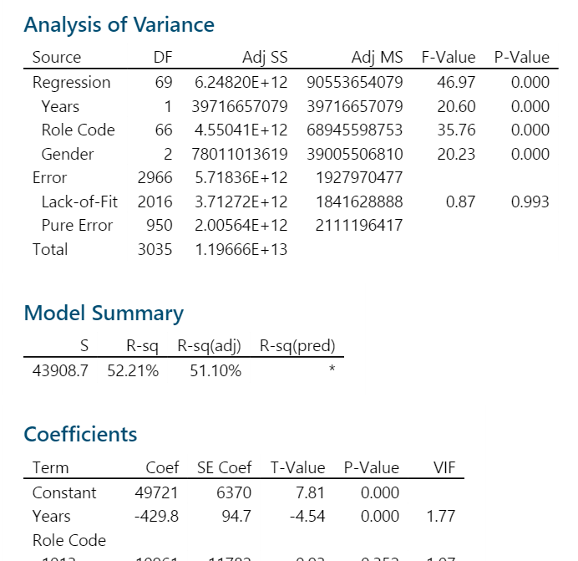
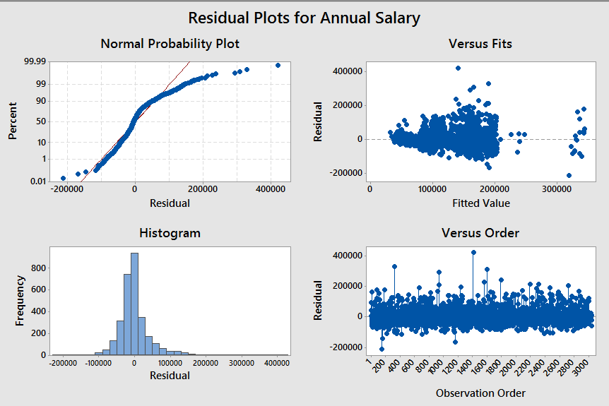

Slide 16

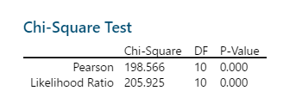
Men and women not equally distributed to job titles
A greater proportion of men are professors compared to women which contributes significantly to the higher average salary, as professor is one of the higher paying roles

Slide 17
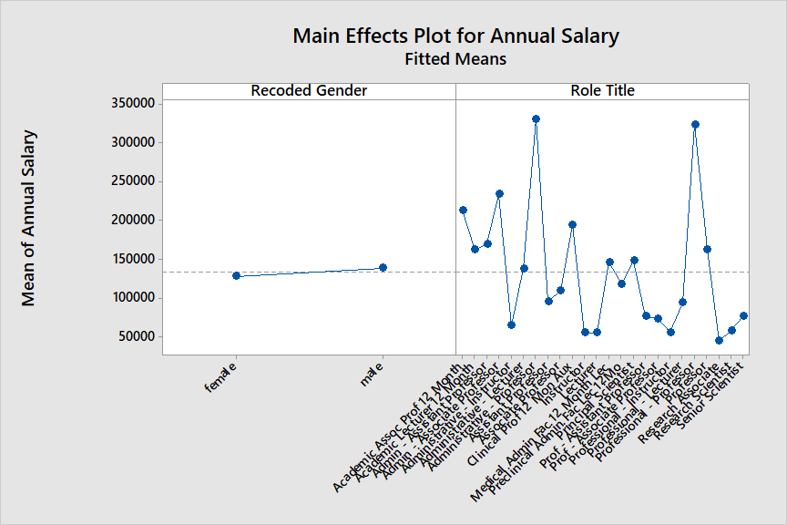
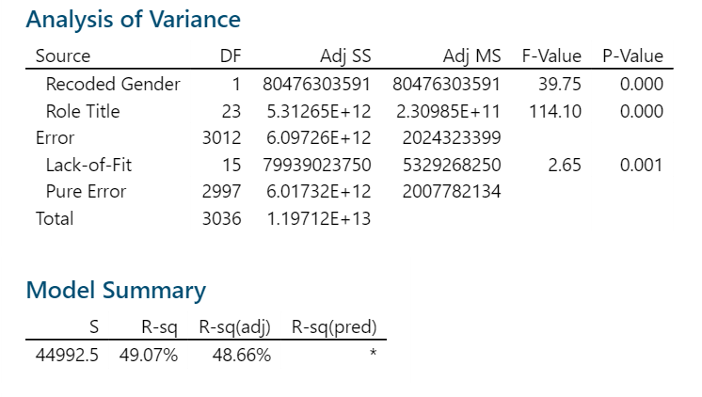

Multi-ANOVA Gender and Role
Average salary between genders varies little compared to between titles

Slide 18
Average of Salary | Column Labels
Row Labels | Female Salary | Male Salary | Grand Total | Statistical Significance (ind samples t test)
Administrative - Lecturer | 121569.1304 | 153491 | 137869.6596 | Yes
Administrative - Professor | 246700 | 372400 | 333118.75 | Yes
Assistant Professor | 90692.29839 | 100468.9988 | 95683.56121 | Yes
Associate Professor | 106265.5349 | 112275.1124 | 109867.7412 | Yes
Instructor | 48866.66667 | 60739.33333 | 56172.92308 | No
Lecturer | 49525.01165 | 59906.25 | 53886.07982 | Yes
Professional - Lecturer | 89300 | 97443.18182 | 92847.52475 | No
Professor | 151839.8907 | 169745.6988 | 165877.0295 | Yes
Research Associate | 43769.1358 | 45279.80392 | 44611.14754 | No
Research Scientist | 59622.91837 | 57828.26405 | 58543.20764 | No
Senior Scientist | 61190.5 | 85636.36364 | 79117.46667 | Yes
Grand Total | 95826.10707 | 123660.7306 | 112729.0114 | 7 Yes, 4 No

Slide 19
Row Labels | Female Count | Male Count | Female Std Dev | Male Std Dev
Administrative - Lecturer | 46 | 48 | 48923.30825 | 70204.25017
Administrative - Professor | 5 | 11 | 89074.2387 | 96764.10491
Assistant Professor | 279 | 291 | 26702.81931 | 27512.2413
Associate Professor | 272 | 407 | 34247.36425 | 37797.9701
Instructor | 15 | 24 | 17110.1752 | 25520.72134
Lecturer | 127 | 92 | 17233.36767 | 34030.35927
Professional - Lecturer | 114 | 88 | 30803.2236 | 37892.02383
Professor | 183 | 664 | 58399.87928 | 68736.7834
Research Associate | 81 | 102 | 8836.69398 | 9956.307517
Research Scientist | 49 | 74 | 13918.97818 | 13421.86602
Senior Scientist | 8 | 22 | 15751.42739 | 24515.50618
Grand Total | 1179 | 1823

Slide 20
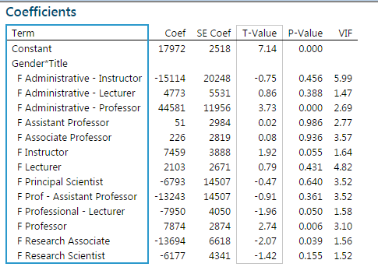

Slide 21
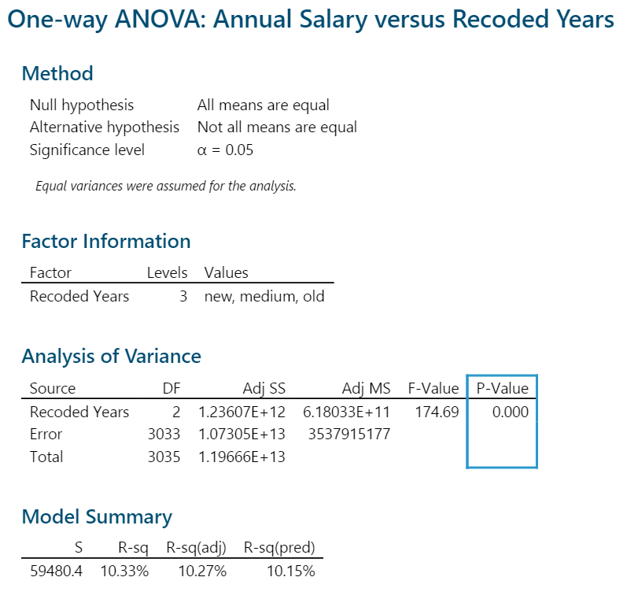
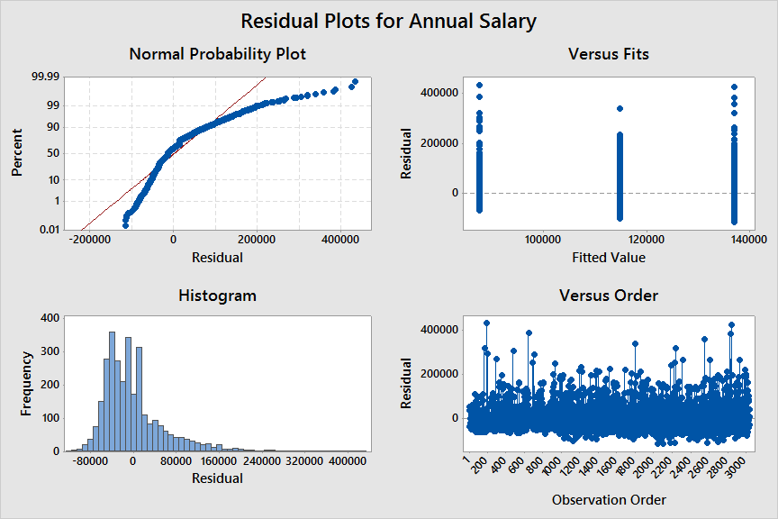
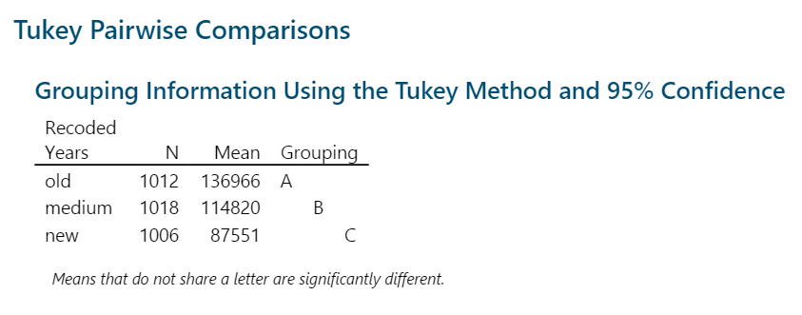
Years

Slide 22
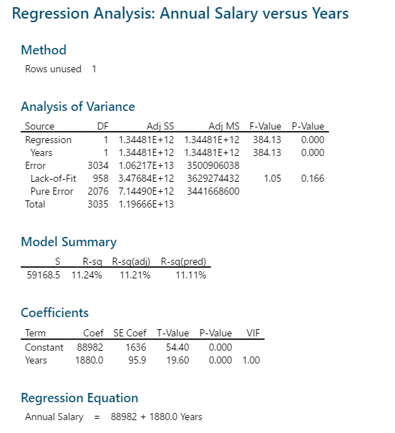
Years
Regression between years and salary

