Slide 1
Coupon Mailing Strategy
Kal Fernlund, Luke Leidy, Halsing Nordin, Jarett Cestaro, and Fan Feng
kaf4ce@virginia.edu, lwl3mt@virginia.edu, lhn2rz@virginia.edu, jmc4jc@virginia.edu, ff9sd@virginia.edu
Notes:
https://www.youtube.com/watch?v=4cyvmF7GD8o

Slide 2
Chose to Participate in the Profit Sharing Option
Our Strategy is to send all 20,000 catalogs to Females who are in STEM and live in the South
Our expected share would be $101,795
The 95% confidence interval for our share is ($49,998, $118,286)
This group has the highest profit per catalog
$10.18 per Catalog
They have the highest response rate
86% response rate,
(42.1%, 99.6%) is our 95% CI for the true response rate
Notes:
Goal is to achieve random sampling of customer base according to the proportion falling into each category in order to reduce the effect of selection bias
We need data from all demographics to combine with outside research to determine most profitable groups
Coupons will be distributed evenly by region and gender (50 total to each region, 100 total to each sex)
Different numbers of catalogs mailed are determined by the different proportions of males and females in STEM

Slide 3
Background
Objective: To maximize expected profit with the coupon mailing campaign
Metrics for Consideration
Profit per Catalog
Profit per Order
Response Rate
The client is a company selling high tech products to college students
They are offering $25 coupons in a product catalog as a promotion to grow their brand
Their average product margin is 50%, so an order of $25 has a cost of $16.67

Slide 4
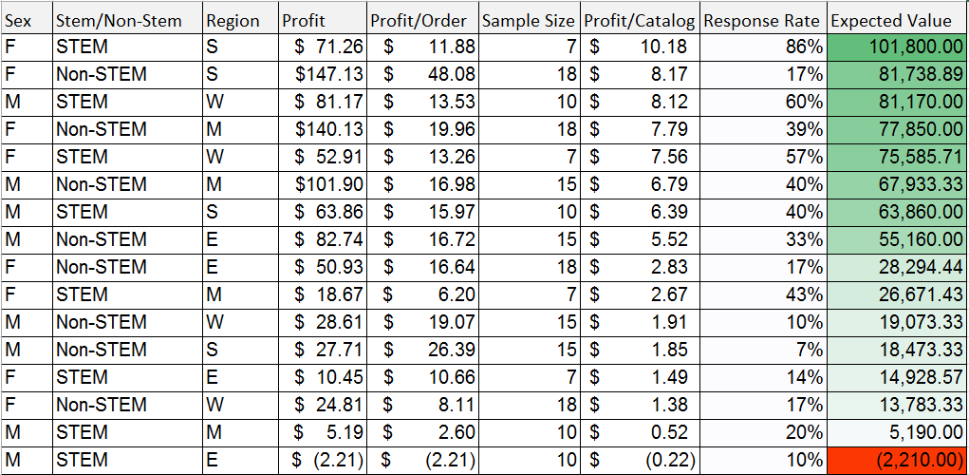
Results from Phase 1

Slide 5
Assumptions
Normality was not met for profit, both including and excluding non-responses
Quantification of risk comes from confidence intervals of group response rates
The average purchase per catalog and response rate reflects the true distribution of how frequently people from each class will purchase and how much they spend
There are at least 20,000 females in STEM in South to mail to

Slide 6
Limitations
Profit data were not normally distributed, limiting the scope and effectiveness of statistical tests we could run
Small sample sizes for each grouping lead to a high degree of uncertainty in our projections
Could not “pretest” customers to gauge the efficacy of the coupon campaign
No control group for comparison

Slide 7
Key Insights
Gender, Region, and Discipline (STEM vs Non-STEM) individually were all found to have statistically similar average profits
Held true for both profit per order and profit per catalog sent
Possible factors to consider in future studies are family income, and race
The interaction between discipline and region had the biggest effect but was still statistically insignificant

Slide 8
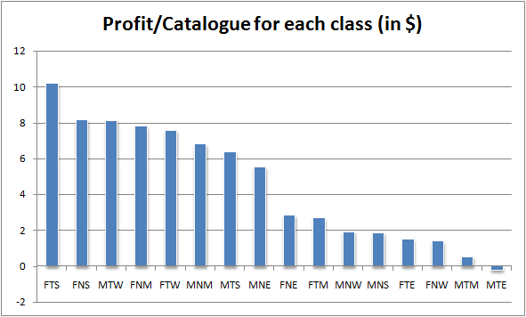
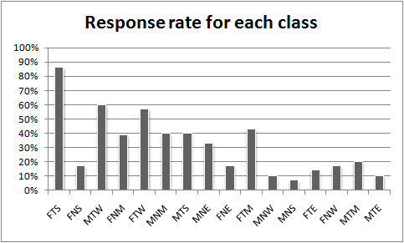
FTS Has Highest Profit per Catalog and Response Rate
* FTS - Females, Stem, South

Slide 9
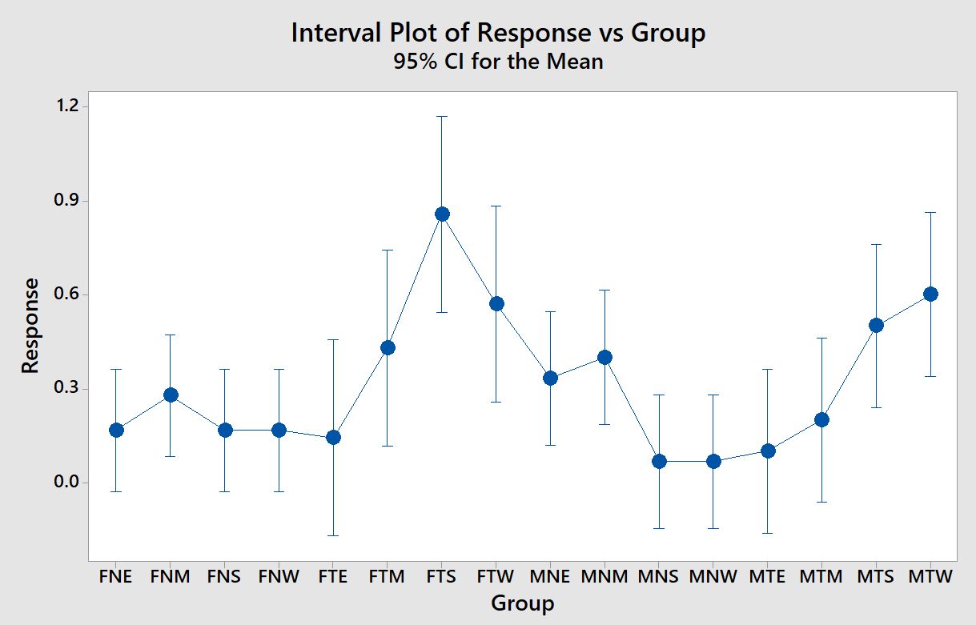

FTS Has a Significantly Higher Response Rate
Response rate cannot go above 1.0, however to make this comparison graph we had to make a binary variable “response”, and ran an ANOVA comparison on that. This information serves as more of a visualization of the spread of response rate.
Notes:
Response rate cannot go above 1.0, however to make this comparison graph we had to make a binary variable “response”, and ran an ANOVA comparison on that.

Slide 10
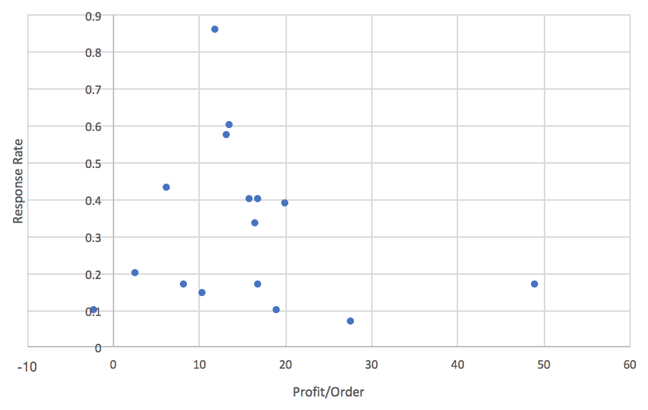
FTS Has the Highest Response Rate and a Mid-Level Profit per Order

Slide 11
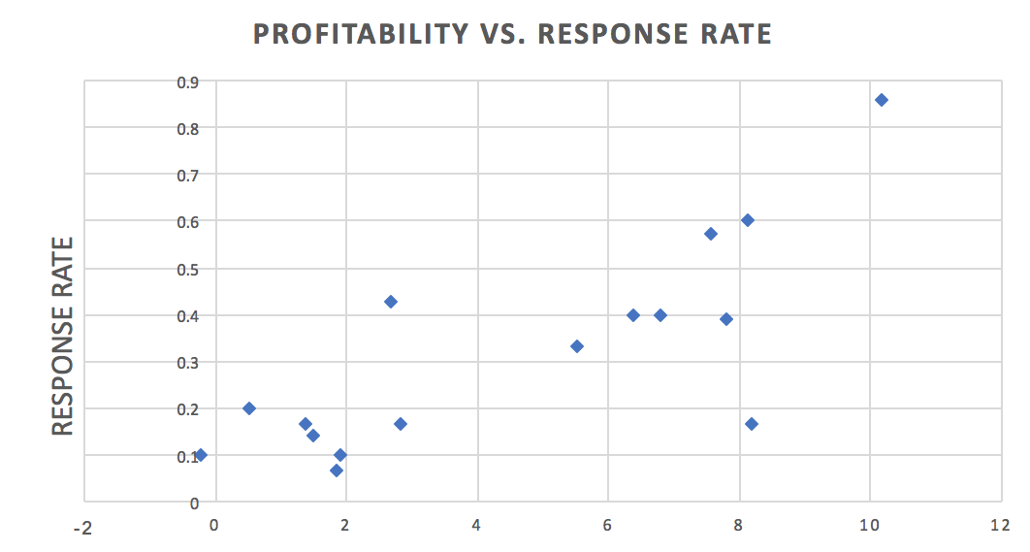
Want to Target High Profit per Catalog and High Reponse Rate
FTS-Females in STEM in the South
General Target Region
Profit per Catalog

Slide 12
Participate in the Profit Sharing Option
Send all 20,000 catalogs to Females who are in STEM and live in the South
Our expected share is $101,795
The 95% confidence interval for return is ($49,998, $118,286)
FTS has the highest response rate at 86%
The 95% confidence interval for response rate (42.1%, 99.6%)
FTS has the highest profit per catalog at $10.18

Slide 13
Questions?

Slide 14
Appendix

Slide 15
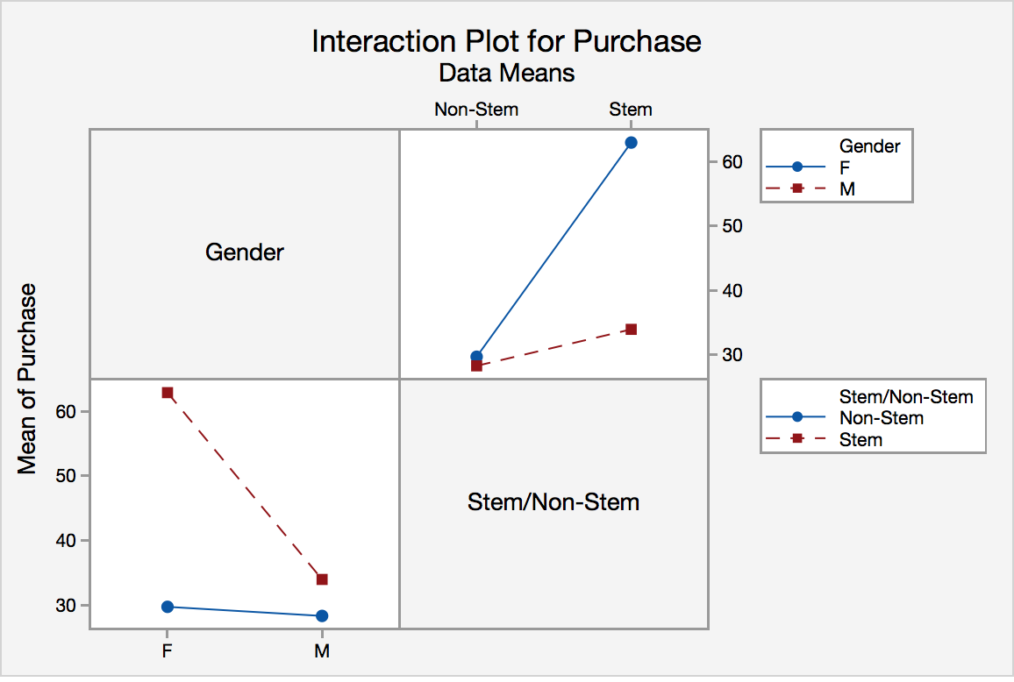
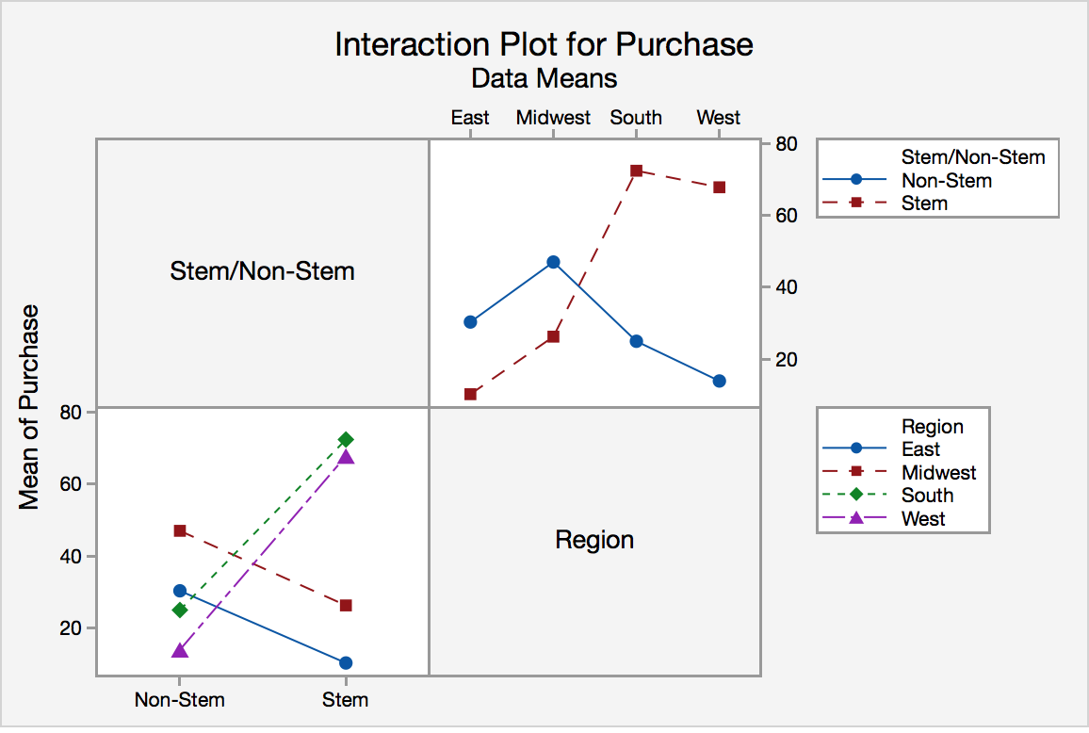
Interaction Plot (Including Zeros)

Slide 16
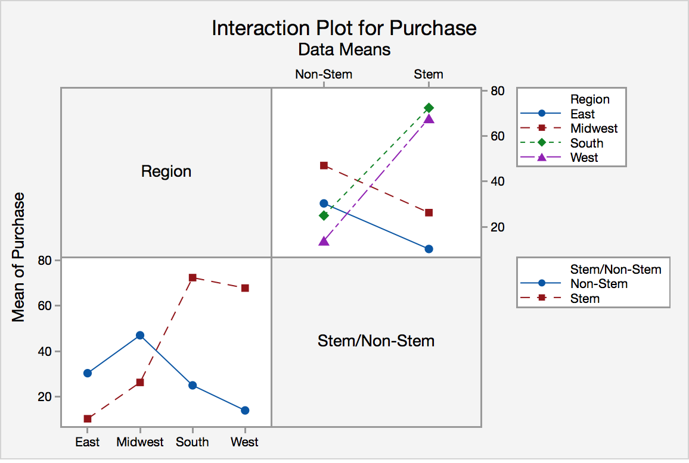
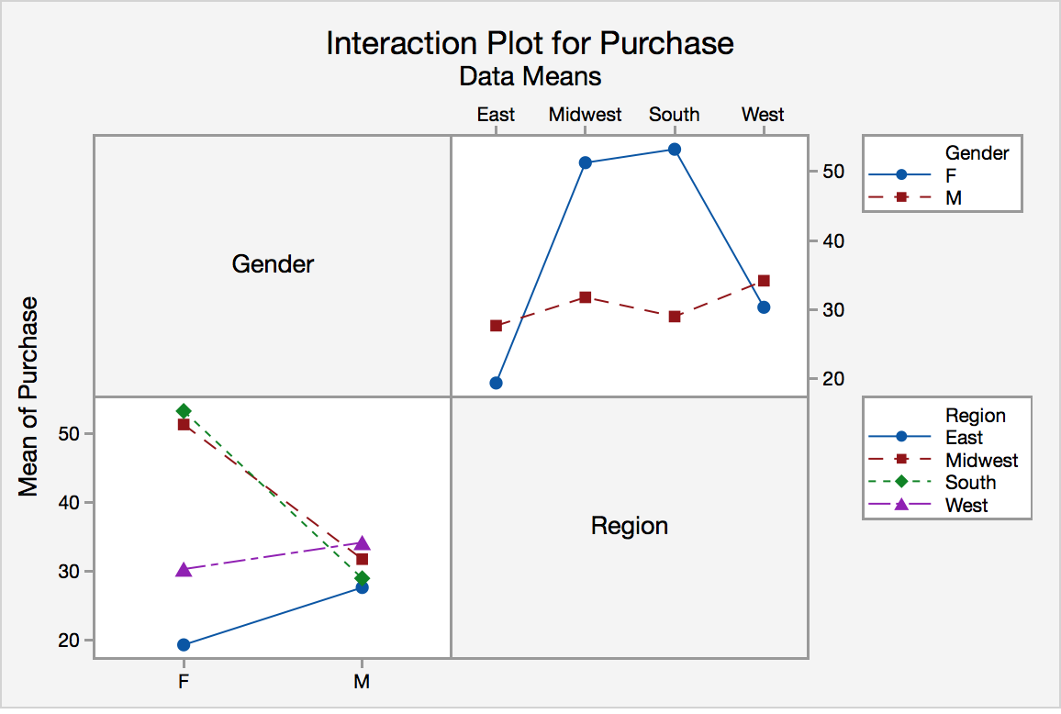
Interaction Plot (Including Zeros)

Slide 17
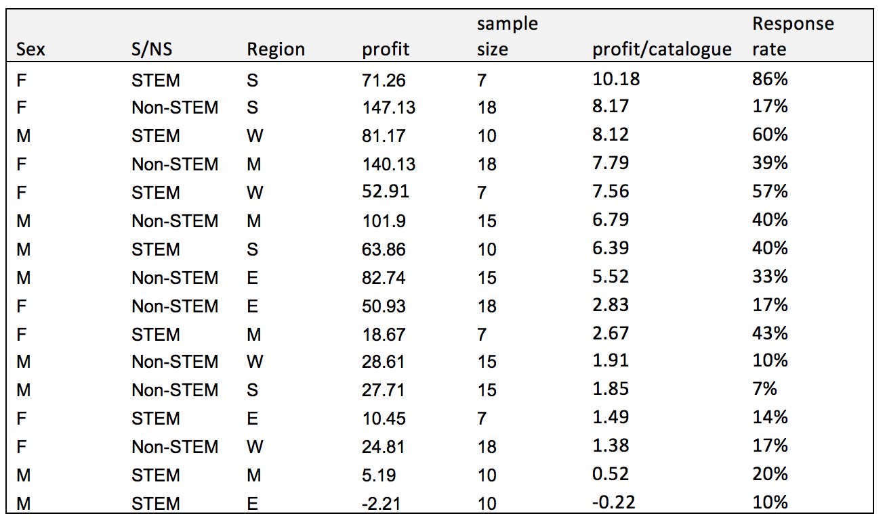
Profit among different classes

Slide 18
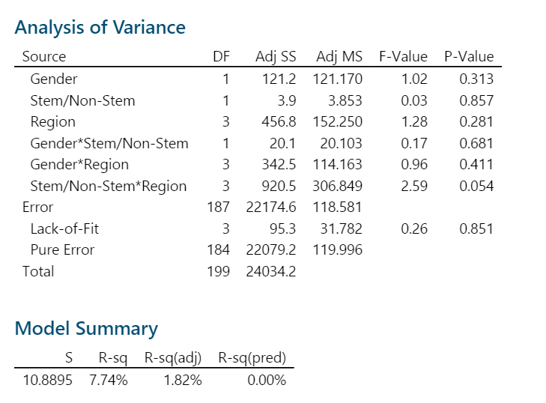
Multi-Factor ANOVA

Slide 19
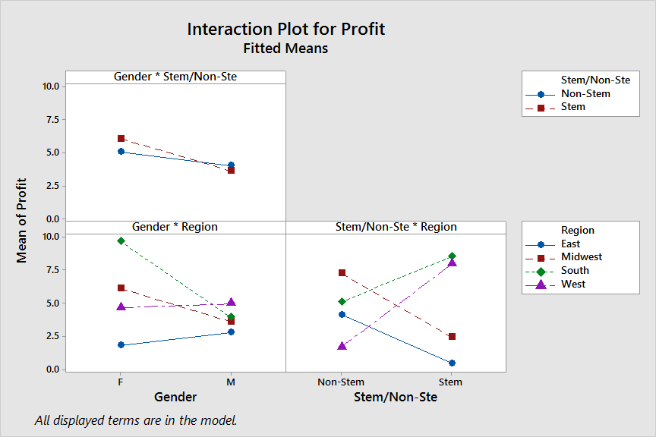
Multi-Factor ANOVA

Slide 20
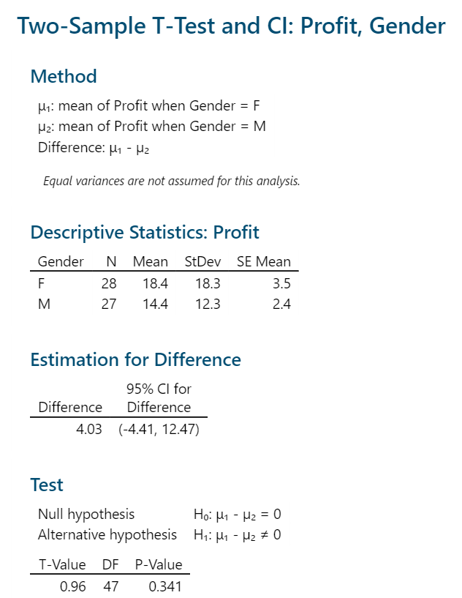
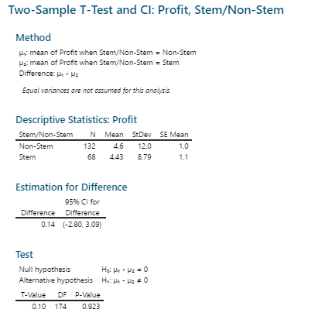

Slide 21
