Slide 1
Blue Steele Apparel, Inc. Case
Jack Chang, Ashif Chowdhury, Fan Feng, Sophia Lam, Edmund Pan
jac6dn@virginia.edu ac2cv@virginia.edu ff9sd@virginia.edu ssl2ja@virginia.edu ep8pm@virginia.edu
Chang, Chowdhury, Feng, Lam, Pan ‹#›

Slide 2
Executive Summary
Of all 3 promotion strategies, $50 off of $100 or more of jeans is recommended as it has the highest profit margin.
Of all stores, we recommend promotion strategies on stores with more competitors within 3 miles and zip codes with a greater % population under 18.
Overall, profit is reduced if a promotion strategy is used in the short term. However, it does increase the transaction amounts even after the promotion, and we think promotion strategies is effective in getting a higher market share. It may also develop a customer group among population, which gives more profitability in the long run.
Chang, Chowdhury, Feng, Lam, Pan ‹#›

Slide 3
Background/Objective
Blue Steele Apparel, Inc. (BSA) wishes to determine the most effective promotion strategy in driving overall profit
Options considered are 50% off Jeans, BOGO free Jeans, or $50 off of $100 or more in Jeans
In Fall 2013 (July 27th - August 30th), BSA conducted a 50% off promotion on Jeans in 40 stores
The same promotion was conducted at those stores in 2012
Objective:
To create tangible business benefits by recommending improvements to current business decisions, and to act as a trial for further work with our firm
Chang, Chowdhury, Feng, Lam, Pan ‹#›

Slide 4
Data Walkthrough
BSA Master
390 Stores in 24 states
40 Stores targeted for promo in 11 states
2 in CT, 2 in MA, 1 in NC, 4 in NH, 1 in NJ, 9 in NY, 7 in OH, 4 in PA, 1 in TN, 8 in VA, 1 in WV
60% In Mall, 40% Free Standing
BSA Financial
Transaction Count with and without Jeans
121 weeks of weekly transaction data per store
Chang, Chowdhury, Feng, Lam, Pan ‹#›

Slide 5
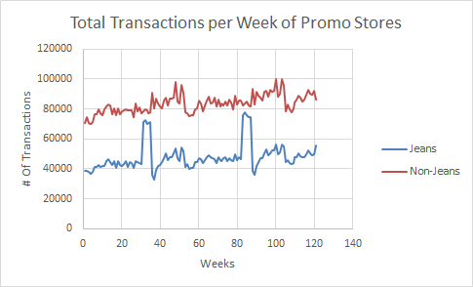
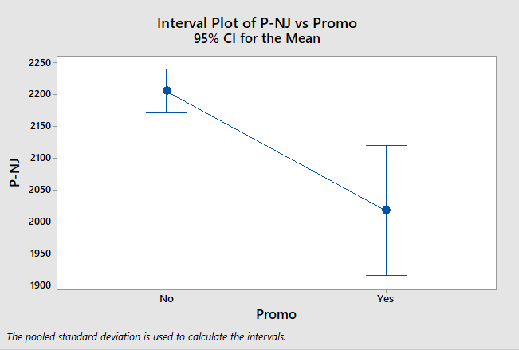
Number of jean transactions increase while non jean transactions decrease during promotional strategy

Slide 6
Assumptions & Limitations
We assume that three types of promotion strategy have the same effects on number of transaction
Assumption is based on the previous promotion strategy in 2012.
Since we do not have information to estimate the distribution of different types of customer on different kinds of stores, we have to assume an even distribution.
Same situation on the effects of different promotion types so we have to assume equal effects of BOGO and $50 off per $100 with 50% off strategy.
We also assumed equal effects on non-jeans items of different promotion strategies.
Chang, Chowdhury, Feng, Lam, Pan ‹#›

Slide 7
Profit Calculation Methodology
Profits were calculated based on average transaction costs and customer type distribution data from the survey
A pair of jeans is sold for $60 with a 66.67% profit margin
Average transaction price is $75 of non-jean items with an 80% profit margin
For non-promotion jean purchases, profit is $86.43
For non-promotion non-jean purchases, profit is $60 per transaction
For promotion jean purchases, profit is $53.76 per transaction
Chang, Chowdhury, Feng, Lam, Pan ‹#›

Slide 8
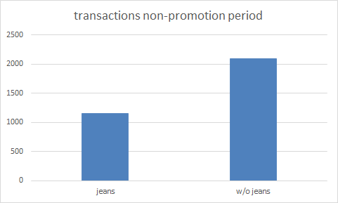
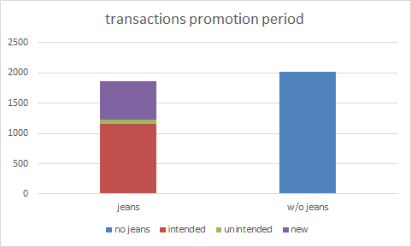
Customer type breakdown for promotion stores
Non-jeans: only one customer type
Jeans:
Intended customers (61.95%): original jeans transactions during NP
Unintended customers (3.94%): transactions lost from w/o jeans transactions from NP to P
New customers (34.12%): new jeans transactions not accounted for by intended/unintended
Chang, Chowdhury, Feng, Lam, Pan ‹#›

Slide 9
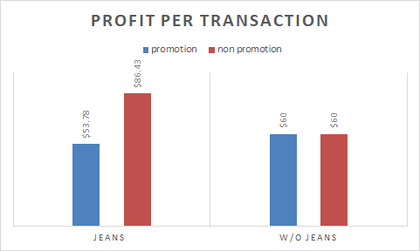
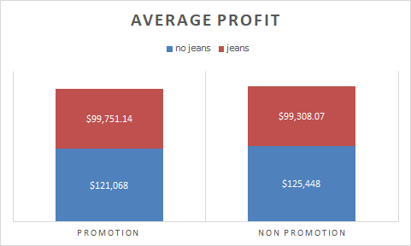
Profit breakdown
Chang, Chowdhury, Feng, Lam, Pan ‹#›

Slide 10
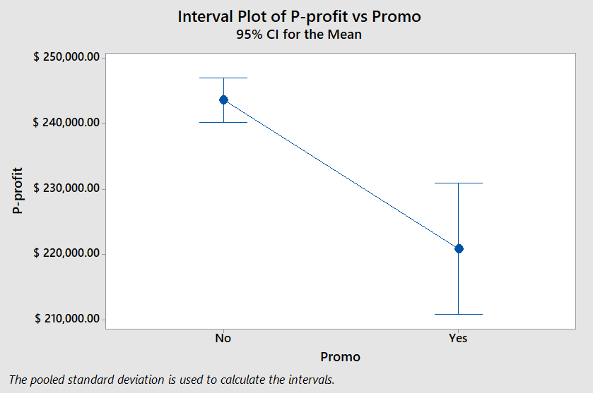
Profit for promo stores during the promo period is $20k lower on average
Non-promotional stores make a profit of $243,603 during the promo period
Promotional stores make a profit of $220,825 during the promo period

Slide 11
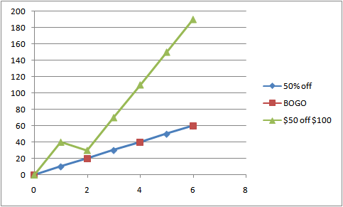
Comparison between 3 promotion strategies
50% off has the least profit margin, but offers more flexibility to customers
BOGO helps to get rid of less popular inventories
$50 off $100 or more gives the most profit
Profit with respect to the number of jeans in each bucket
Chang, Chowdhury, Feng, Lam, Pan ‹#›

Slide 12
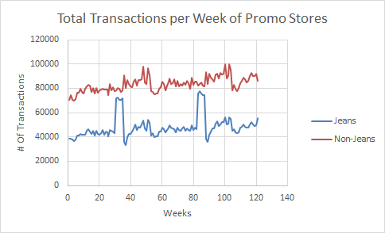
Total transactions increase after promotional periods

Slide 13
Significant indicators for number of transactions from promotions
With Jeans Transactions
Number of competitors within 3 miles
Average for Promotion Stores: 2.8 competitors
% Population under 18
Average % of population under 18: 20.47%
Total
Number of competitors within 3 miles
Average for Promotion Stores: 2.8 competitors
Chang, Chowdhury, Feng, Lam, Pan ‹#›

Slide 14
Recommendation
Of all 3 promotion strategies, $50 off of $100 or more of jeans is recommended as it dominates in profit margins.
Of all stores, we recommend promotion strategies on stores with more competitors within 3 miles and zip codes with a greater % population under 18.
Overall, profit is reduced if a promotion strategy is used in the short term. However, it does increase the transaction amounts, and we think promotion strategies is good in getting a higher market share. It may also develop a customer group among population, which gives more profitability in the long run.
Chang, Chowdhury, Feng, Lam, Pan ‹#›

Slide 15
APPENDIX
Chang, Chowdhury, Feng, Lam, Pan ‹#›

Slide 16
Top stores recommended for promotion plan
Store ID | City | State | Zip
205 | Raleigh | NC | 27616
115 | Cleveland | OH | 44115
388 | Fredericksburg | VA | 22407
386 | Springboro | OH | 45066
55 | Hebron | KY | 41048
337 | Columbus | OH | 43240
328 | Greenville | SC | 29609
54 | Tilton | NH | 3276
Chang, Chowdhury, Feng, Lam, Pan ‹#›

Slide 17
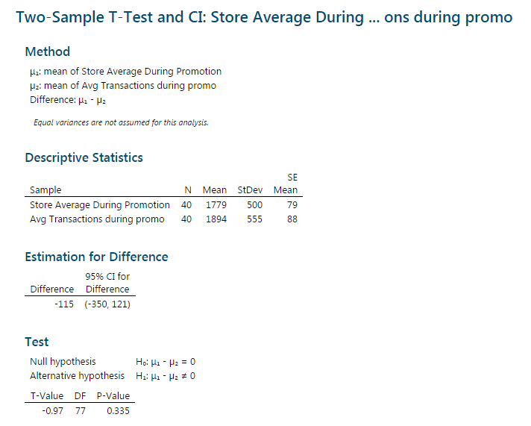
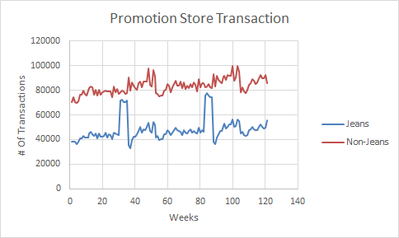
Assumption of Promotion Strategy having similar response to transaction amount
Chang, Chowdhury, Feng, Lam, Pan ‹#›

Slide 18
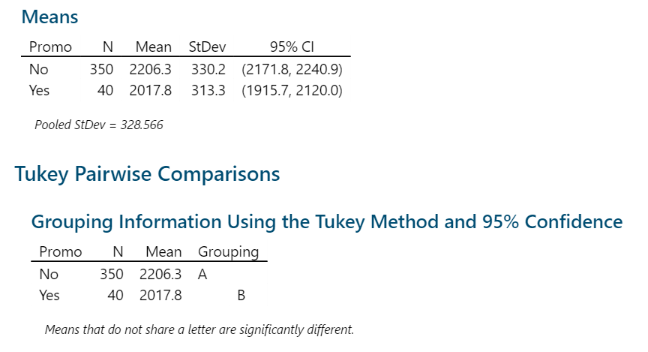
# of transactions without jeans is lower for promotion stores during promotion periods
118.5 fewer non jeans transactions for on average for promotions stores during promotion periods
Chang, Chowdhury, Feng, Lam, Pan ‹#›

Slide 19
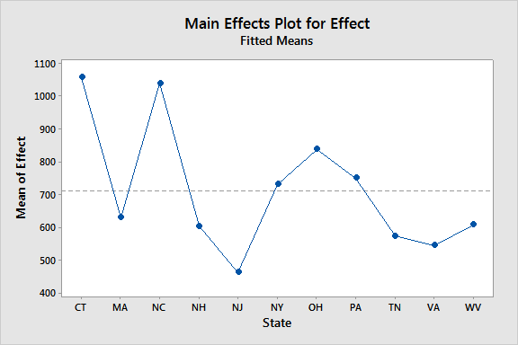
Promotion effects on stores in different states
Chang, Chowdhury, Feng, Lam, Pan ‹#›

Slide 20
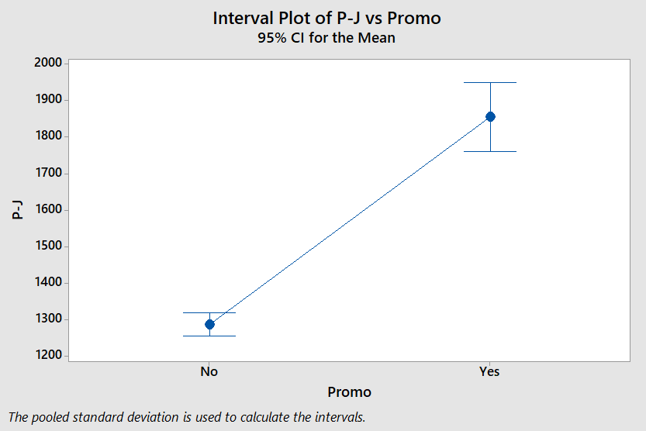
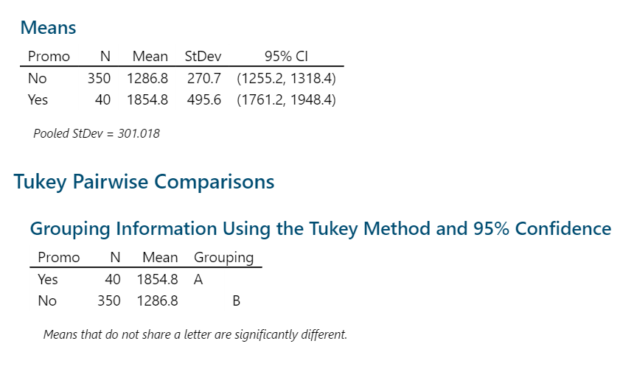
Number of transactions for jeans is higher for promotion stores during promotion periods
Chang, Chowdhury, Feng, Lam, Pan ‹#›

Slide 21
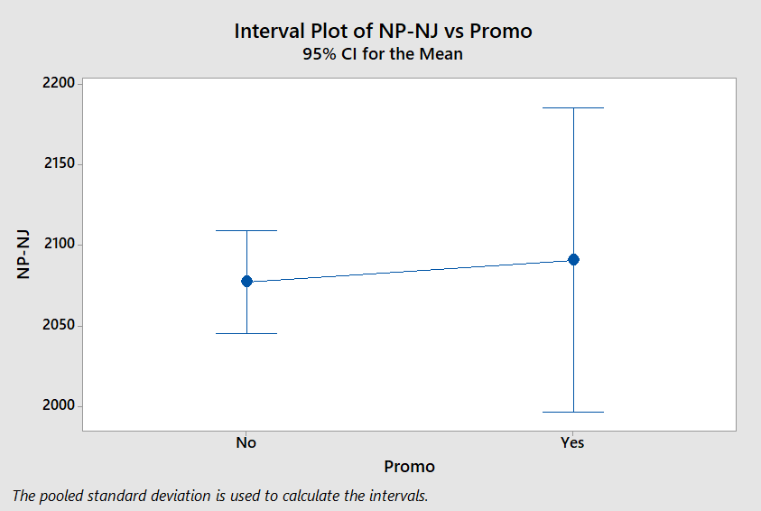
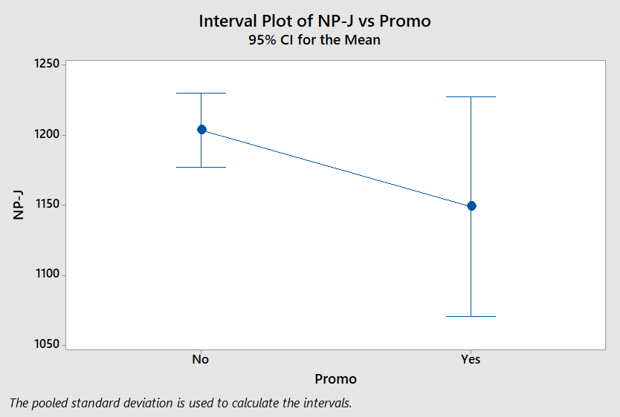
# of transactions does not differ between P/NP stores during non promotion periods
Chang, Chowdhury, Feng, Lam, Pan ‹#›

Slide 22
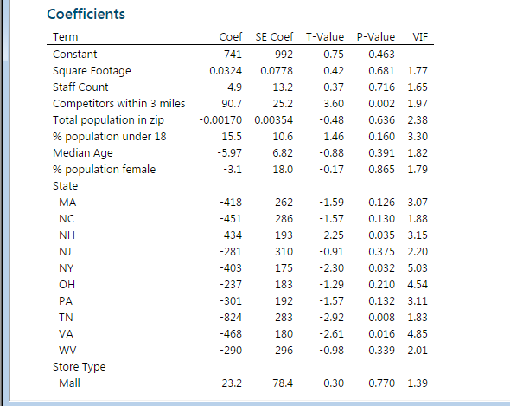
Model on effects of promotion
Chang, Chowdhury, Feng, Lam, Pan ‹#›

Slide 23
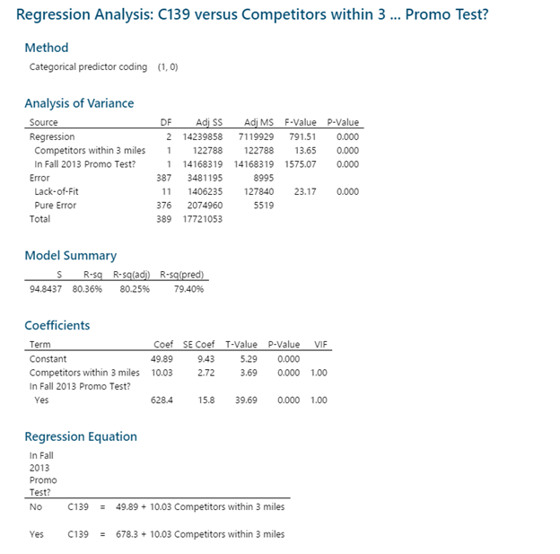
Significant Indicators: Number of competitors
Chang, Chowdhury, Feng, Lam, Pan ‹#›

Slide 24
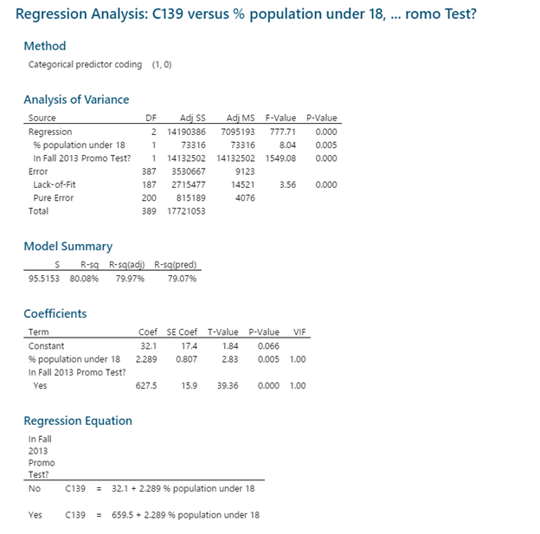
Significant Indicator: Under 18 Population
Chang, Chowdhury, Feng, Lam, Pan ‹#›

