Slide 1
Bird Case
Team 28
Brian Andris (bca2r@virginia.edu),
Emma Boland (efb5ys@virginia.edu),
Jonathan Bugg (jtb3ay@virginia.edu),
Fan Feng (ff9sd@virginia.edu),
Matt Gummersbach (jmg8vq@virginia.edu)
Due: 3/1/18

Slide 2
Executive Summary
After analyzing a total of 46,500 total bird strikes with 3,200 damaging strikes to commercial aircraft from 2009-2015, we recommend the following:
If you primarily value reducing the number of total bird strikes, investigate the following factors:
Phase of flight (approach and climb), Time of year (July-October), Time of day (Daytime), Altitude of strike (~800 ft), Size of Plane (2700-270,000 kg)
If you primarily value reducing the number of damaging bird strikes, investigate the following factors:
Phase of flight(approach and climb), Time of year (January-April), Size of bird (Medium and Large), Altitude of strike (~1500 ft), Species of bird (Ducks and geese)

Slide 3
Problem Statement and Objectives
Team objective: “Determine any factor or combination of factors that influence bird strikes on commercial aviation.”
Various potential objectives for FAA (reduce total strikes, reduce damaging strikes, minimize cost)
FAA Mission: “Our continuing mission is to provide the safest, most efficient aerospace system in the world...Safety is our passion. We work so all air and space travelers arrive safely at their destinations.”
Optimal is reducing all bird strikes, but in accordance with the FAA’s mission focus on minimizing aircraft damaging bird strikes
Notes:
Why focus on damage?
Impetus for case is Hudson landing (damaged plane)
FAA top priority is safety
Limited budget for government organization, want to make dollars count and focus on smaller problem than all bird strikes
Already seems to be a lot of data on general bird strikes in the FAQ on the website
Potential objectives
\\Reduce absolute number of strikes
Reduce number of strikes with damage
Reduce Economic costs associated with bird strikes
Reduce number of injuries/fatalities

Slide 4
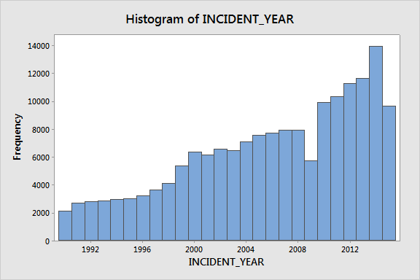
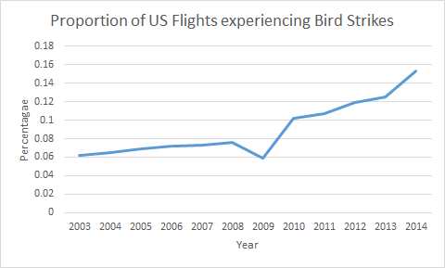
A Growing Problem
Bird strikes increasing both on an absolute and proportional basis over the past decade
~6% of flights in 2003 to ~15% of flights in 2014
Notes:
Data for proportion of US flights determined by using supplementary data from US gov
https://www.transtats.bts.gov/TRAFFIC

Slide 5
Data Walkthrough: Stats
52% of bird strikes occur from July to October
62% of bird strikes occur in day, 9% at dawn or dusk, 29% occur at night
About 92% of bird strikes Occur at or below 3,500 feet above ground level
8.64% reports showed indicated damage
84.12% of reports showed only 1 bird struck. 12.55% of reports showed 2-10 birds struck.
55% of birds small, 33% medium, 7% large, rest unknown
If more than 1 bird struck, size is large
26% of pilots were warned of birds in area

Slide 6
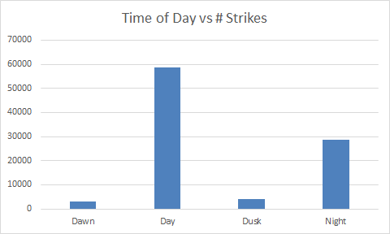
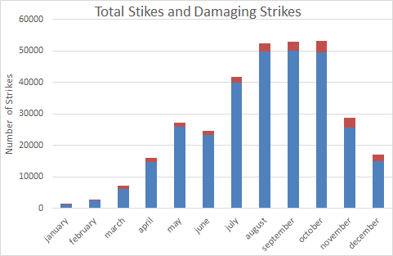
Data Walkthrough: Graphs

Slide 7
Data Processing
Data Cleaning
Started with 169,201 reports of wildlife incidents
Considered data post-2009
Choose to focus on the data from 2009-2015 based the incident of the Hudson strike
Remove all non-commercial flights, non-bird strikes, non airplane reports (helicopter, glider, etc.)
Narrowed down to ~48,000 reports of commercial aviation bird strikes
Narrowing Factors
Stepwise logistic regression of all possible factors on damage helped us brainstorm factors to consider:
Aircraft Mass, Incident Month, Incident Year, Phase of flight, Precipitation
We have analyzed the most important factors in this presentation (see Appendix for additional factors)

Slide 8
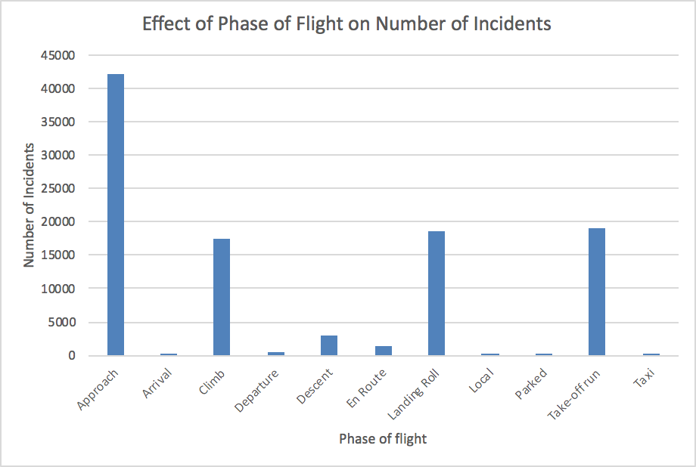
Analysis: Phase of Flight
Goal: Determine which phase of flight should be tested
Main takeaways:
A majority of strikes occur during the approach, take off, climb, approach, or landing phases of flight
Approach and climb appear to be particularly important for both total strikes and damaging strikes
Conclusion
Focus analysis on approach and climb phases of flights

Slide 9
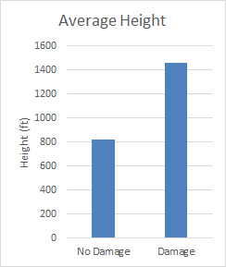
Analysis: Altitude of Plane
Goal: Determine if the average height of the plane when struck differs for strikes causing damage
Main takeaways:
Average altitude for damaging strikes: 1457 ft
Average altitude for non-damaging strikes: 824
Synthesis: Comparison of phase and altitude revealed approach (~1200 ft) and climb (~1400 ft) squarely within the above range
Conclusions:
Damaging strikes tend to occur at higher altitudes (almost double)
However, these still only account for about 7% of total strikes
Notes:
Add some visualization

Slide 10
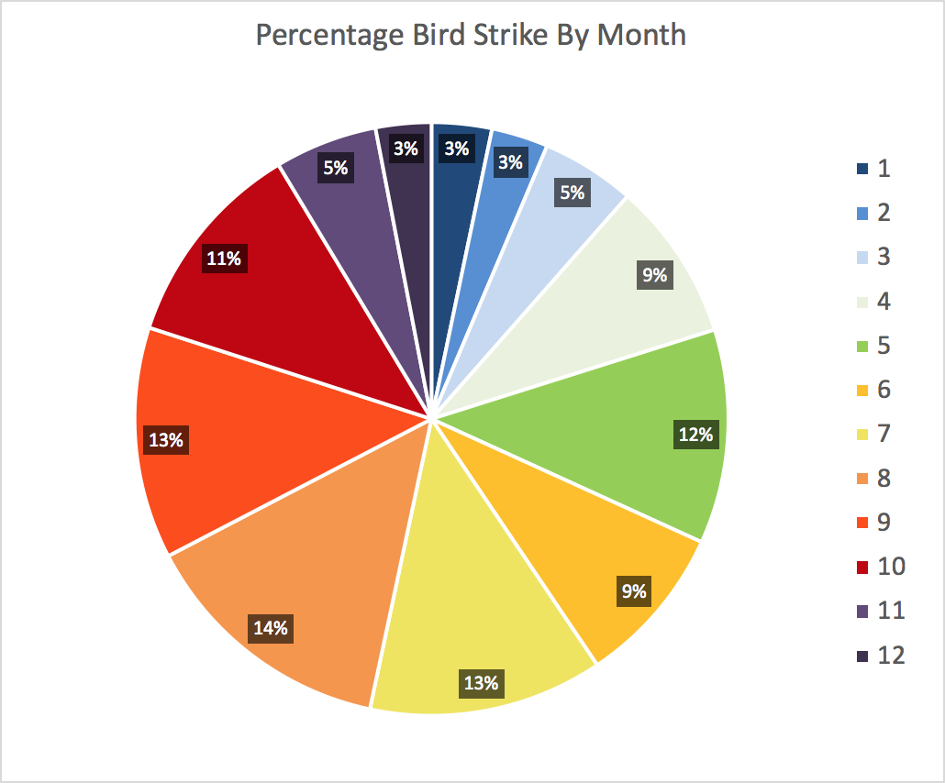
Analysis: Time of Year
Goal: Determine best time of year for test (month range)
Main takeaways:
Peak bird strikes occur between July and October (52%)
As a proportion of total bird strikes, damaging strikes happen more often in January-April
More likely to strike multiple birds in August, November-February
Conclusions
If interested in studying times of peak strikes, focus on summer months (young birds starting to take flight)
If interested in studying times of most damaging strikes, focus on winter months (20% of total strikes, 32% of damaging strikes)

Slide 11
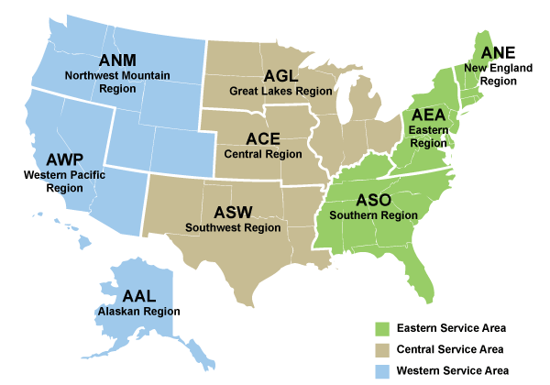
Analysis: Time of Year and Region
Goal: Determine best location for testing during specific times of year
Main takeaways:
Disproportionate amount of strikes in January-April happen in the American South and Southwest
Disproportionate amount of strikes in July-October happen in the northeast and Great Lakes region
Synthesis
If interested in studying times of peak strikes, focus on summer months in Northeast and Great Lakes region
If interested in studying times of most damaging strikes, focus on winter months in American South and Southwest

Slide 12
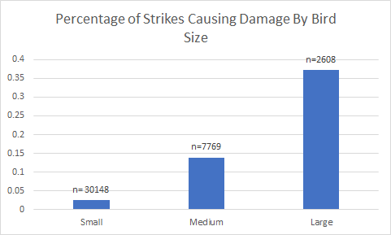
Analysis: Size of Bird
Goal: Determine size of bird most commonly causing damage
Main takeaways:
Large birds causing disproportionate number of damaging incidents (35%, compared to 6% of total strikes)
Large and medium birds together account for 73% of damaging strikes, but are just 26% of total strikes
Conclusions:
Focus on large birds for damage minimization, and expand to medium if possible

Slide 13
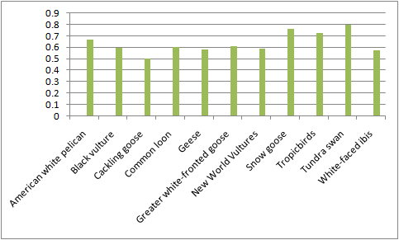
Analysis: Bird Species
Top 10 species of birds with the highest percentage of damaging incidents (within species).
These bird species have more than 50% of all incidents involved.

Slide 14
Analysis: Species, Altitude and Size
Goal: Determine if the most common and damaging species tend to strike planes at the same height
Main takeaways:
The average altitude struck varied between the seven species analyzed
Lowest altitude: Gulls (315 feet, most common bird in data set)
Ducks and geese (~1500 ft, cause disproportionate amounts of damage)
Conclusion:
Ducks and geese tend to strike planes at higher elevations than other common birds and cause more damage
Synthesis: More damaging strikes occur at higher elevations (previous analysis), which is consistent with strikes on larger birds such as ducks and geese

Slide 15
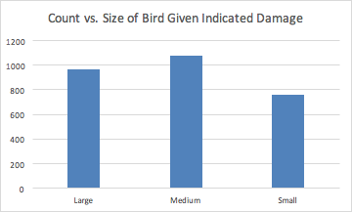
Analysis: Number of Birds Struck
Goal: Determine if larger amounts of birds struck correspond to higher rates of damage
Main Takeaways:
Larger number of birds struck leads to higher rate of damage reported
Conclusions:
Focus on reducing large flocks of birds in close proximity to airports

Slide 16
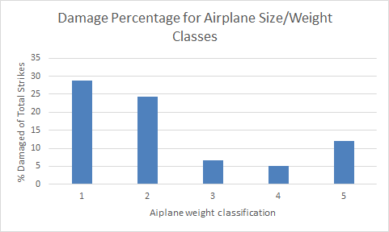
Analysis: Airplane Size
Goal: Determine if airplane size determines probability of damage
Main takeaways:
Statistically significant difference between different sizes
Larger planes tend to be damaged less often than expected
Conclusion:
Larger planes are less likely to be damaged by a bird strike than smaller planes (makes intuitive sense, confirmed with statistical analysis), but also correspond to most of the planes that are struck
Focus on smaller planes to make the largest per-strike difference, but larger planes for a larger total difference

Slide 17
Analysis: Time of Day
Goal: Determine the relationship between time of day and bird strike damage
Main takeaways:
There is a difference between different times of day, but only significant at 0.05 level
Slightly more damaging strikes than expected at night or dusk
Conclusions:
Time of day does not play a practical role in damaging strikes
64% of all strikes occur during the day, with roughly 31% at night
Focus on a mix of night and day when analyzing bird strikes
Notes:
Fan

Slide 18
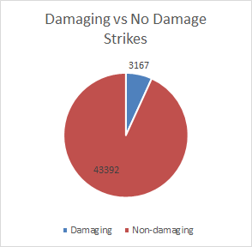
Recommendation
If you value reducing number of total bird strikes, investigate the following factors:
Phase of flight (approach and climb), Time of year (July-October), Time of day (Daytime), Altitude of strike (~800 ft), Size of Plane (2700-270,000 kg)
If you value reducing number of damaging bird strikes, investigate the following factors:
Phase of flight(approach and climb), Time of year (January-April), Size of bird (Medium and Large), Altitude of strike (~1500 ft), Species of bird (Ducks and geese)

Slide 19
Next Steps
Develop RFP and begin to investigate the proposed factors in more detail
Expand analysis to bird strikes in other countries to determine common factors
Investigate impact of climate change on bird migration patterns

Slide 20
We changed:
Consolidated data walkthrough slides to increase effectiveness
Simplified data cleaning slide
Reorganized objectives, removed wordiness
Conducted more statistical tests focused on synthesis between factors that we identified
Added next steps after recommendation
Removed text and replaced with more visualizations
Combined slides leading to a more concise presentation

Slide 21
Appendix

Slide 22
Questions to Consider
Is a plane more likely to get damaged by birds at a specific phase of flight?
Are certain species of birds more damaging to flights than others?
Do damaging bird strikes happen more on a certain month of year, or time of day?
Are bird strikes and their damage related to the size of airplanes? If so, what effect does the size of airplanes have?
Are bird strikes and their damage more often with respect to certain precipitation condition?

Slide 23
Analysis: Region of Strike
Goal: Determine if certain geographic regions in the United States have disproportionate amounts of strikes causing damage
Main takeaways:
Analyzed 8 separate FAA regions
Statistically significant difference in distributions (Chi-square test, p=0.0), but little practical difference
Conclusions:
Recommend using other factors (cost, convenience, etc) to choose region if focused on damaging strikes
American Southwest has largest overall percentage of bird strikes (27%) so strikes may be easiest to study here

Slide 24
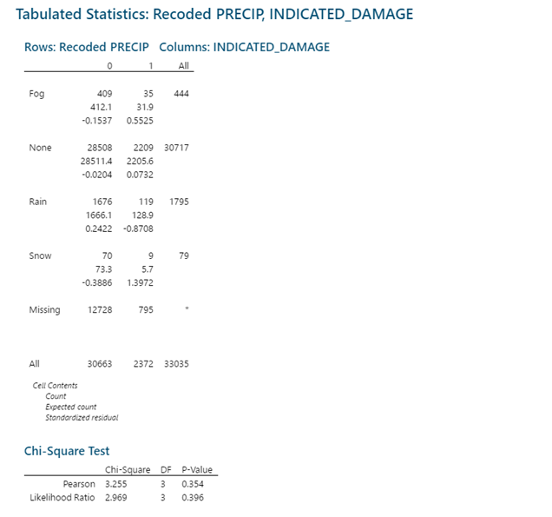
Analysis: Precipitation
Goal: Determine if precipitation plays a role in damaging strikes
Main takeaways:
Distributions appear to be similar
Chi-square test (p=0.354)
No precipitation is the vast majority of cases (93%)
Conclusion:
Precipitation does not appear to be a significant factor in determining overall bird strikes or damaging strikes

Slide 25
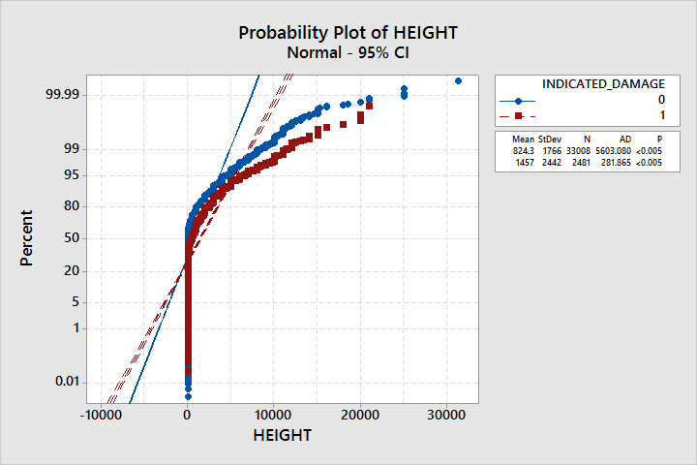
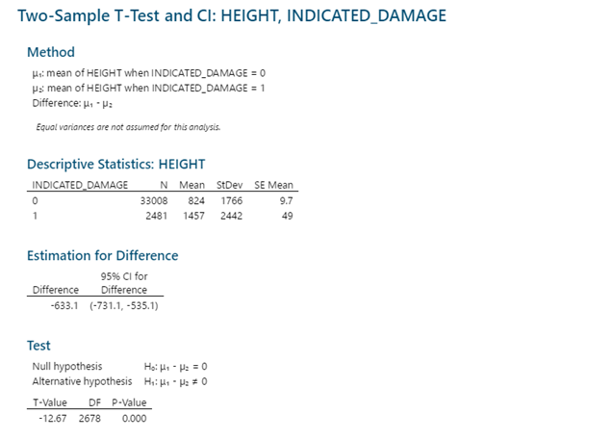
Appendix- Height
We first ran a two sample t-test. However, when checking assumptions we realized the data is not at all normally distributed. We instead ran a Mann-Whitney test (next slide).

Slide 26
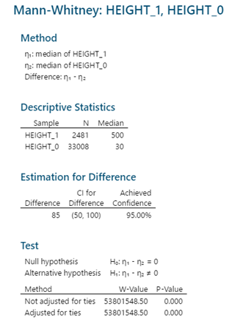
Height Mann-Whitney
Distributions have the same shape (evident on prior normal probability plot)
Two samples are independent
We assume this, and have no reason to believe otherwise
Data are independent
The data do appear to be independent (time series plots appear random for each, see next slide)
Population size of sample 1 is less than or equal to the population size in sample 2

Slide 27
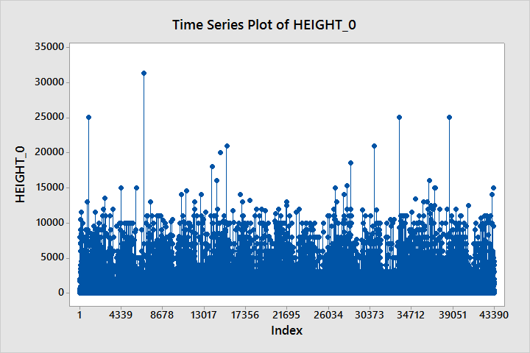
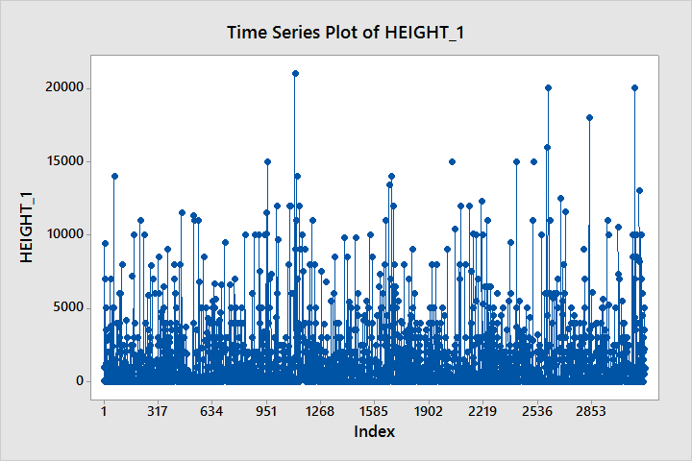
Mann-Whitney Time Series Plots

Slide 28
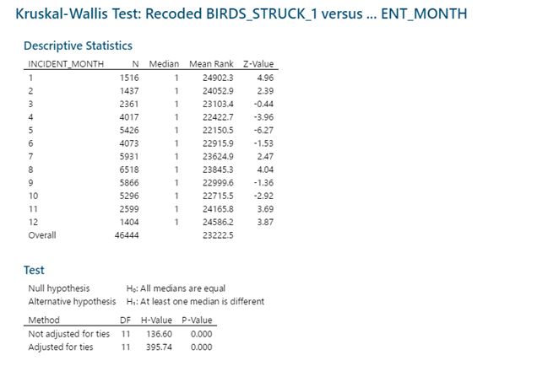
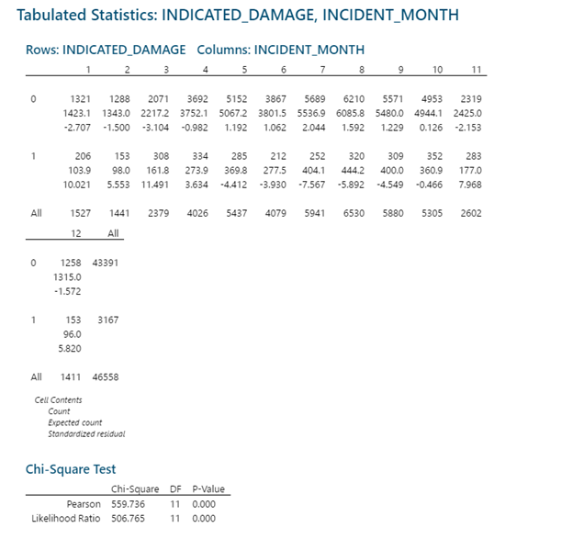
Appendix-Months

Slide 29
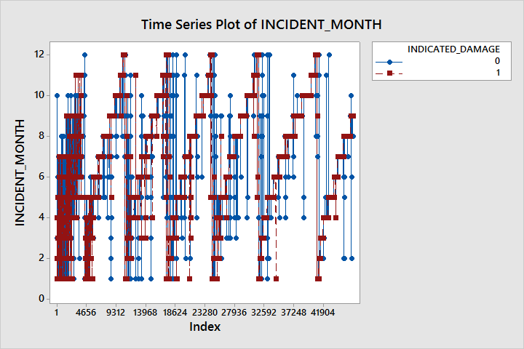
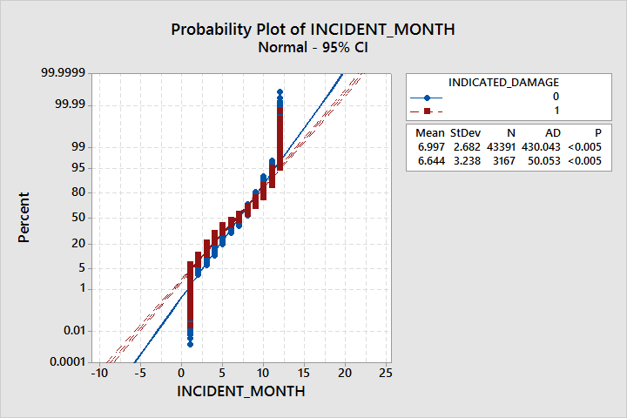
Kruskal Wallis Assumption Checking
Sample sizes of 5 or greater
This is true in this case
Data are independent
This appears to be correct based on the time series plot
Samples are independent
Assume this is true, no reason to believe otherwise
Distributions have the same shape
This appears to be true based on the plot to the right

Slide 30
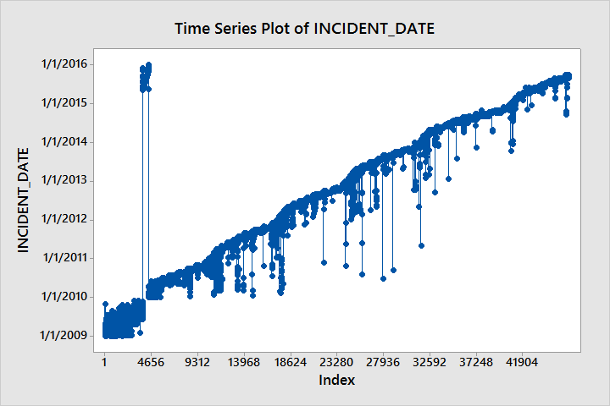
Assumption Checking All Chi-Square Tests
Expected cell count of 5 or greater in every cell
This was ensured for every test, and certain categories were eliminated if necessary
Data are independent
We assume in this case that the data is independent. The data is self-reported and there is no reason to believe that one report would be dependent on another report. The geographic region covered by the data is vast, with reports coming in from hundreds of miles apart.
All samples are independent
No test for this, but we know in this case that all samples are independent

Slide 31
Initial Factors Considered
Aircraft Type
Aircraft Mass
5 Categories based on kg
Airport
Number of Engines
Month Strike Occurred
Year Strike Occurred
Time of Day
Day, Dawn, Dusk, Night
State
Height
Feet above ground level
Speed
Knots
Distance From Airport
Miles from airport
Phase of Flight
Approach, Takeoff, Climb, En Route, Landing Roll
Species
MOST ARE UNKNOWN & Some are not birds
Type of Cloud Cover
Precipitation
Birds Seen
Birds Struck
Size
Small, Medium, Large
Pilot Warned
Cost of repairs
Number of injured people
Number of fatalities
Indicated Damage
True/False
Notes:
-Aircraft Mass, +Number of Engines, -Incident Month & -Year, +Speed, +Distance, +Phase_of_flight = Climb, +Precipitation (especially rain and snow)

Slide 32
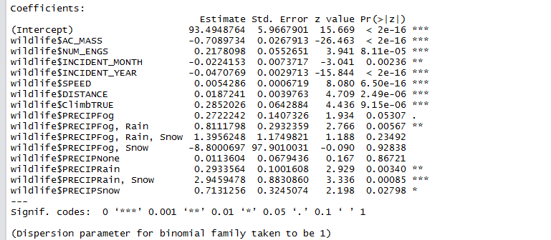
We used stepwise logistic regression in R to narrow down the selection of predictors that need to be collected.

Slide 33
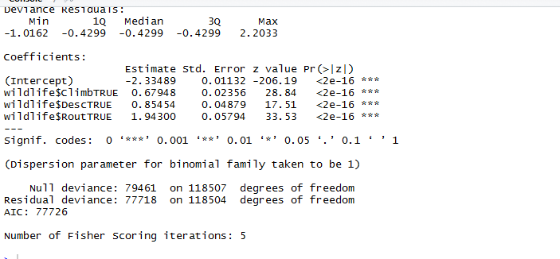
Logistic regression gives En Route, Descent, and Climb as top 3 significant phases of flight that contribute the most to damage. A positive coefficient indicates a positive effect on odds of damage.

Slide 34
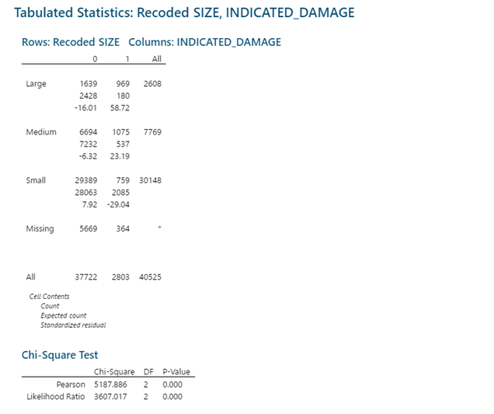
Statistical Test: Size and Damage

Slide 35
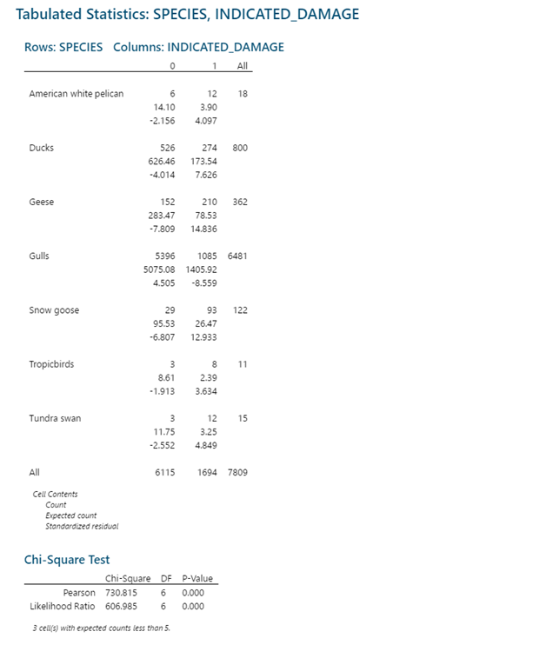
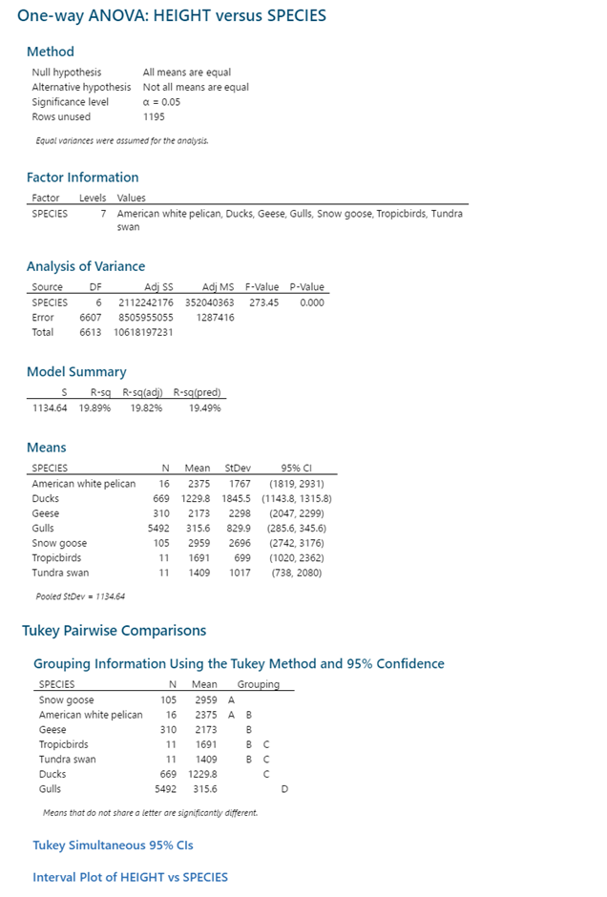
Statistical Test: Species, Height, and Damage

Slide 36
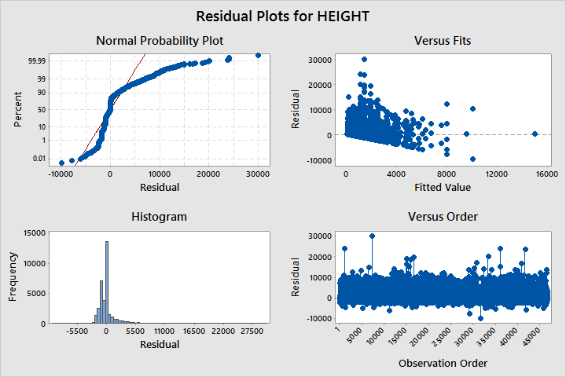
ANOVA Assumptions
Residuals are normally distributed
Anderson-Darling test
This appears dubious, so we will take results with a grain of salt
Residuals have equal variances
Modified Levene test
This is also dubious in this case
Residuals are independent
Plot of residuals vs. order the sample was taken
The residuals do appear to be independent
Samples are independent
No test for this. We assume it to be the case.

Slide 37
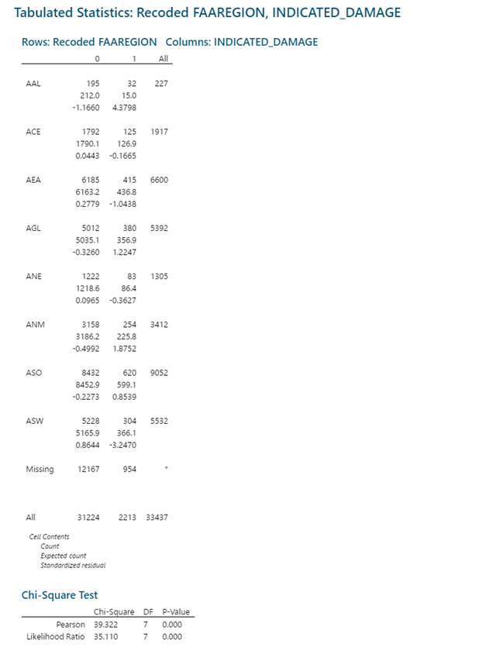
Statistical Test: FAARegion and Damage

Slide 38
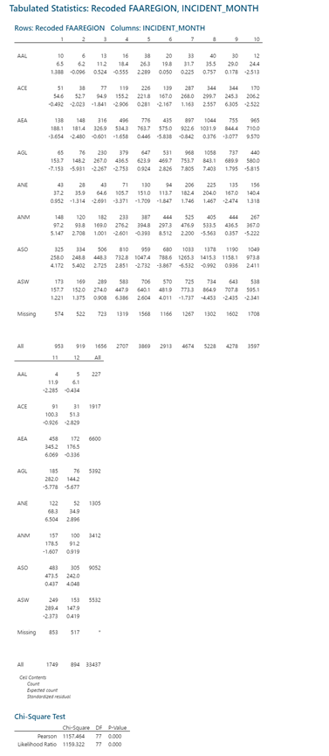
Statistical test: FAA Region and Month

Slide 39
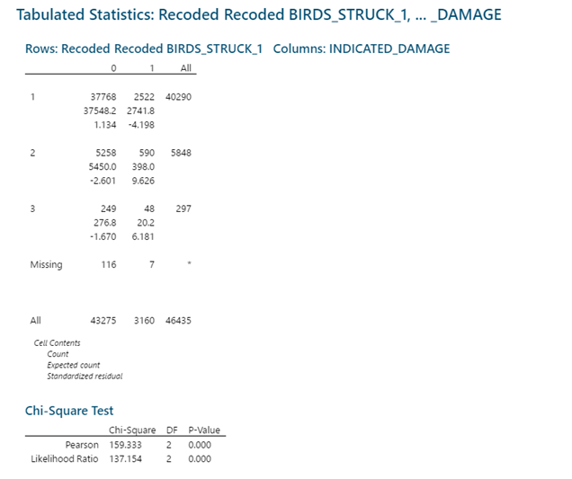
Statistical Test: Number of Birds Struck and Damage

Slide 40
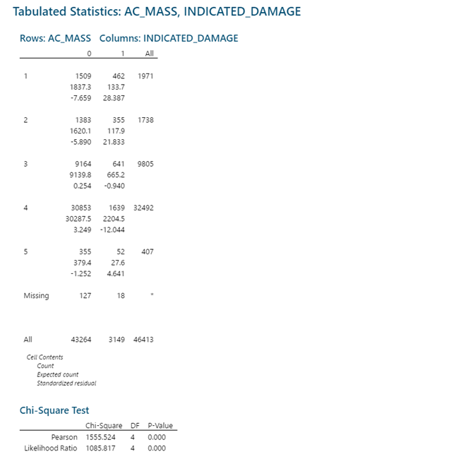
Statistical Test: Airplane Mass and Damage

Slide 41
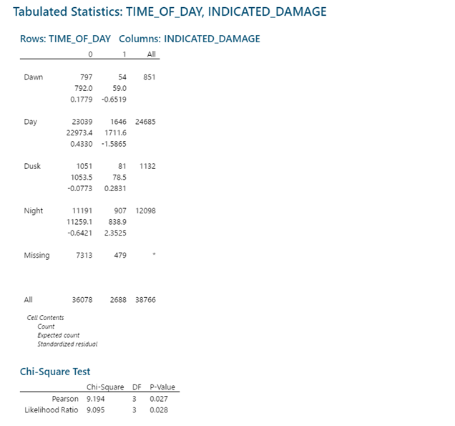
Statistical Test:Time of Day and Damage

Slide 42
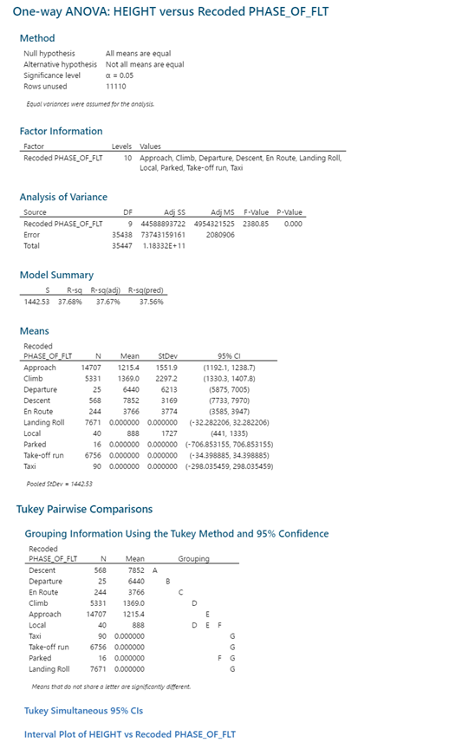
Statistical Test: Height and Phase of Flight

Slide 43
Link to data
https://drive.google.com/open?id=1E99S5ZI9y29MZQrUb6rFCpOgjrlutoFx

