Slide 1
5W Mailing Strategy
Fan Feng, Kal Fernlund, Edmund Pan, Rakshith Raghu, Bryan Soltis
ff9sd@virginia.edu, kaf4ce@virginia.edu, ep8pm@virginia.edu, rr5de@virginia.edu, brs2cp@virginia.edu

Slide 2
Executive Summary
We recommend sending mailers to the 5,000 profiles with the highest scores based on our model
The score can be interpreted as the expected revenue from each person
We expect revenue of about $119,500 and profit of about $115,300
This corresponds to an average of $23.90 per mailer sent and a response rate of 0.16
Even if model performs significantly worse than the prior sample, we expect about $90,600 in revenue and about $86,400 in profit
An expected upper bound for revenue is approximately $131,300

Slide 3
Background
Sample file of data from 40,000 individuals regarding an acquisition campaign and numerous other personal attributes (age, ethnicity, income level, etc)
Conducted data analysis to identify predictors for response and amount paid, ultimately to build a model to score individuals for a future campaign
Objective: To maximize the amount of revenue generated in future campaign of 5,000 mailers out of 40,000 candidate profiles
Metrics: Payment and Response Rate

Slide 4
Assumptions
Values of -1 indicate unknown and were removed from analysis
Payment data not normal, instead discretized with options of $0, $100, and $150
Limits scope and efficacy of statistical tests to run
Data for analysis satisfies the assumptions for a generalized linear model

Slide 5
Data Walkthrough
4871 total payments out of 40,000 mailers (Response Rate = 0.122)
Payments sum to $623,650 ($15.59 per mailer)
Payments were all either $100, $150, or $0 for no response
43.93% of responders contributed $100, 56.07% of responders contributed $150
All data came from North Carolina and South Carolina
NC: Response Rate = 0.128, Payment/Mailer = $16.48
SC: Response Rate = 0.109, Payment/Mailer = $13.95

Slide 6
Restriction of what factors we could looked at
While looking through the data, we found large amounts of data with a -1 which we assumed to be unknown
This happened uniformly for column groups “Cx”, “WCR”, “W5”
We discovered 4 general groups based on how much of the campaign had been filled out
27,389 of the responses had filled out the whole campaign (group 1)
8,436 of the responses had filled out every section but the “Cx” columns (group 2)
4,081 of the responses had filled out every section but the “Cx” and “W5” columns (group 3)
84 of the responses had not filled out “Cx”, “W5”, or “WCR” columns (group 4)
The responses they filled out we assumed to be the original or necessary data to be filled out
We found a significant difference in proportions between the combination of groups 1-2 and groups 3-4
To treat the groups evenly, we only looked at factors filled out by every group

Slide 7
Methodology
We used a generalized linear model to predict 1) how likely is one person going to reply with a 88% accuracy and 2) if so, how likely is that person going to pay $150 with a 69% accuracy.
Predictors we used included: Length of residence, Number of contributing sources, Number of adults/children in household, Match score, Percentage of white people etc. (For a detailed model, reference the appendix)
This model predicts the binary outcome variable by modeling the logarithm of the odds on the occurence of event.

Slide 8
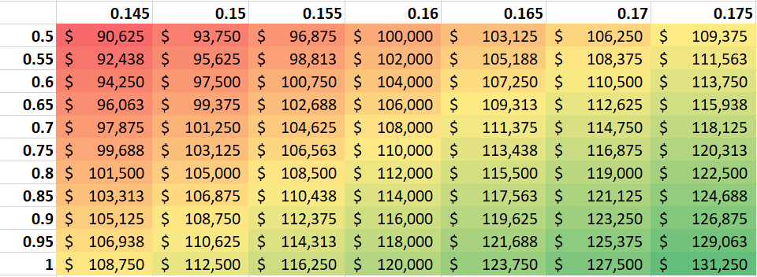
Sensitivity Analysis
Two way sensitivity of average response rate vs proportion of responders giving $150
Model predicts average response rate of 0.16 and 98.7% of responders giving $150
Values displayed are the expected revenue
Based on 99% confidence interval for response rate and wide range of proportion giving $150

Slide 9
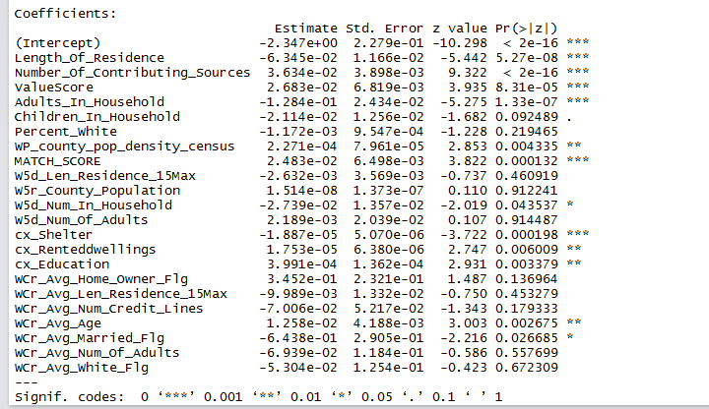
Appendix

Slide 10
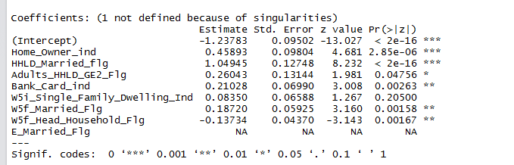

Slide 11
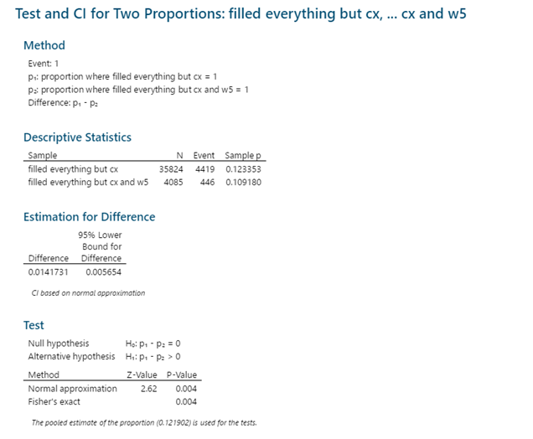
2 sample test of proportions between the combination of groups 1-2 and groups 3-4

