Slide 1
Small Business Case
Fan Feng, Kal Fernlund, Edmund Pan, Rakshith Raghu, Bryan Soltis
ff9sd@virginia.edu, kaf4ce@virginia.edu, ep8pm@virginia.edu, rr5de@virginia.edu, brs2cp@virginia.edu

Slide 2
Executive Summary
Typical small business owner demographic:
Higher income (most probably higher than 150K)
Older than 25, and most probably aged between 35 and 39
Typical small business owner web usage:
More visits to: Business/Finance, Government, and Search/Navigation categories
Less visits to: Social Media, Education, Career Services, Corporate Presence, Entertainment, Family and Youth categories
Small business owner spending:
More spending on: Electronics & Computing, Apparel, Accessories & Jewelry, Air Travel, Video Games, Events & Movie Tickets
Bank Choice:
American Express over Chase, PNC, and Capital One
Feng, Fernlund, Pan, Raghu, Soltis ‹#›

Slide 3
Methodology Used
We make our analysis by visualization and logistic regressions, and compare the effectiveness of predictors by looking at the chi-square test statistic.
Assumptions: We assume that the sample given reflect the true distribution of the general population, and no significant multicollinearity exist between independent variables.
Limitations: Due to limitation of logistic regression, the effects of interaction terms on the response variable are not considered. 7 machine ID’s did not have any data from the traffic or spending sheets.
Feng, Fernlund, Pan, Raghu, Soltis ‹#›

Slide 4
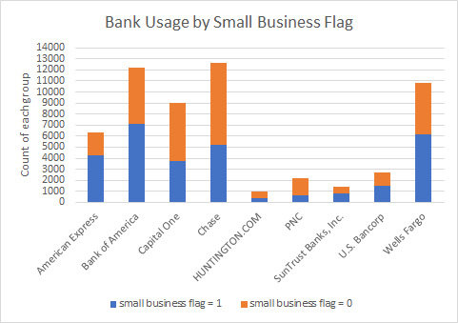
Bank Choice
Bank of America, Chase and Wells Fargo are the top 3 used banks (for all consumers), each with 7101, 5230, and 6136 unique visitors, respectively.
American Express has the highest proportion of small business owners at 67%, and PNC has the lowest proportion of 30.5%.
* This data comes from the traffic data sheet. Thus some machine ID’s will have used more than one bank.
Feng, Fernlund, Pan, Raghu, Soltis ‹#›

Slide 5
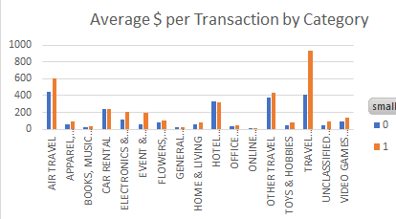
E-commerce Categories
Small business owners spend more per transaction on air travel, travel, electronics, and event/movie tickets than those who are not small business owners
Feng, Fernlund, Pan, Raghu, Soltis ‹#›

Slide 6
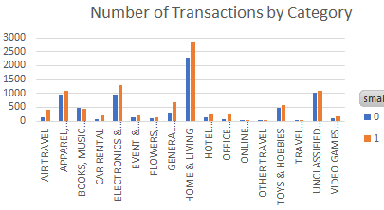
Transactions
Small business owners tend to have more transactions for home and living, apparel, air travel, and electronics.
55.3% of home and living transactions, 53.6% of apparel transactions, 74.6% of air travel transactions, and 57.5% of electronics transactions were made by small business owners.
Feng, Fernlund, Pan, Raghu, Soltis ‹#›

Slide 7
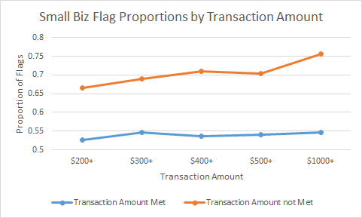
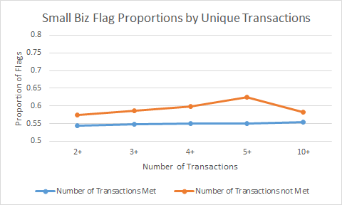
Spending Habits
Both the number of transactions and the dollar amount per transaction were significant and greater for small business owners than non small business owners
Up to a certain point, increasing the threshold for the number of transactions and transaction amounts increased the difference between business owners and non-business owners
Those who spend $500 dollars or more per transaction are 30% more likely to be small business owners than those who spend less than $500
Those who engage in 5 or more transactions are 14% more likely to be small business owners than those who engage in less than 5 transactions
Feng, Fernlund, Pan, Raghu, Soltis ‹#›
Notes:
As the threshold for the transaction amount/number of transactions increase, the proportion of small business owners of those who meet the threshold will generally increase at the expense of sample size. So while increasing the threshold from $500 to $1000 will increase the proportion of small business owners who spend that amount, there will be fewer business owners altogether and thus it is up to comScore to determine an acceptable threshold for your purposes.

Slide 8
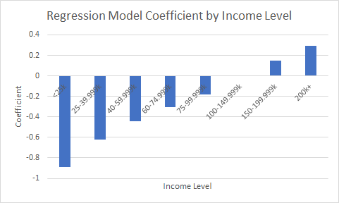
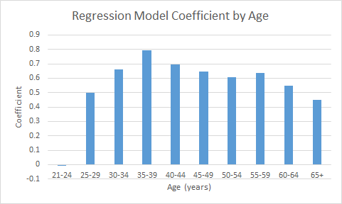
Demographic of Small Business Owners
We compare the effectiveness of predictors by looking at the chi-square test statistic, or equivalently, the p-value of predictors in our binary logistic regression.
Income was the strongest predictor (with the highest Chi-square), with higher income being stronger
Age is a good predictor, with those 21-14 less likely, and those 35-39 the most likely to be owners
Household size was not found to be significant
Feng, Fernlund, Pan, Raghu, Soltis ‹#›

Slide 9
Conclusion
Typical small business owner demographics:
Higher income (most likely greater than 150K)
Older than 25, and most likely aged between 35 and 39
Typical small business owner web usage:
More visits to: Business/Finance, Government, and Search/Navigation categories
Small business owner spending:
More spending on: Electronics & Computing, Apparel, Accessories & Jewelry, Air Travel, Video Games, Events & Movie Tickets
Choice of Bank:
Higher proportion of small business owners use American Express whereas fewer use Chase
Rank of best predictors: Income, Chase, number of banks used, PNC, American Express, Capital One, Business/Finance, Social Media, Education, Head Of Household Age, Office Supplies and Business Machines
Feng, Fernlund, Pan, Raghu, Soltis ‹#›

Slide 10
APPENDIX
Feng, Fernlund, Pan, Raghu, Soltis ‹#›

Slide 11
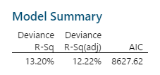
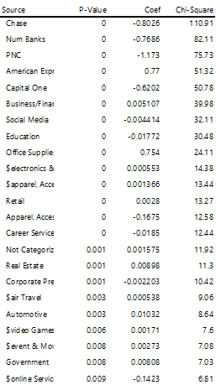
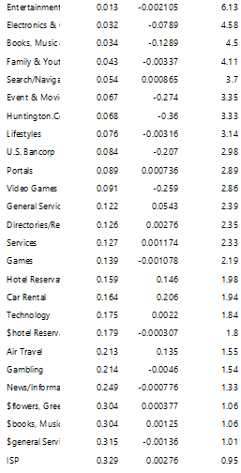
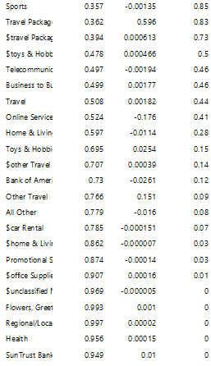
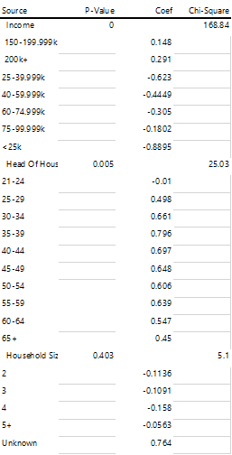
Binary Logistic Regression Results
Feng, Fernlund, Pan, Raghu, Soltis ‹#›

Slide 12
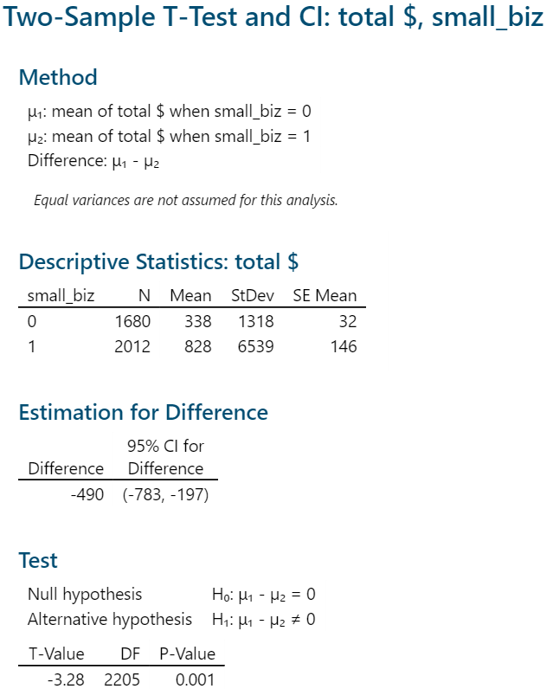
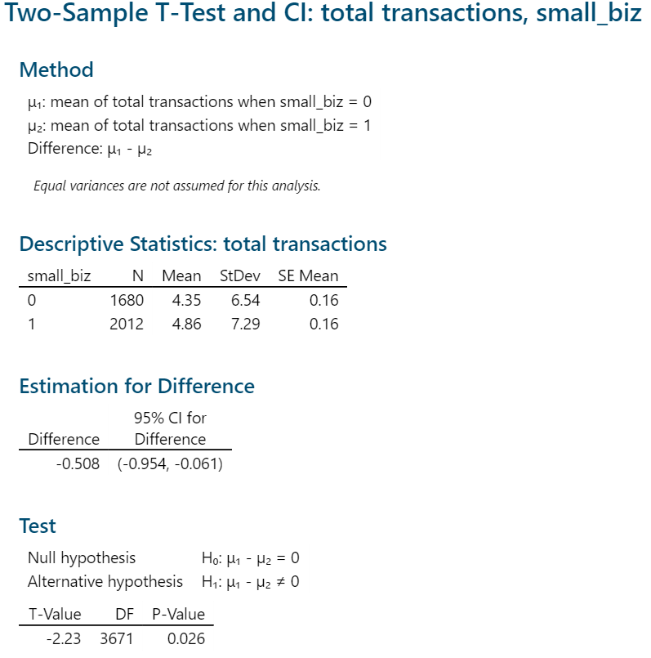
Mean total number of transactions and transaction cost is different
Feng, Fernlund, Pan, Raghu, Soltis ‹#›

Slide 13
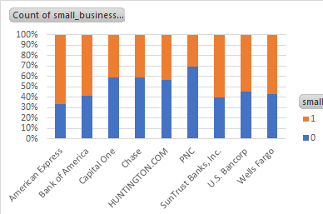
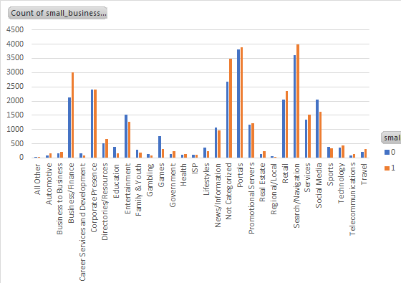
Traffic Dataset
Feng, Fernlund, Pan, Raghu, Soltis ‹#›

