Slide 1
Group Assignment 3
Group E: Fan Feng, Kathryn Murray, Daniel Park, Jacob Rue, Ryley Stevens

Slide 2
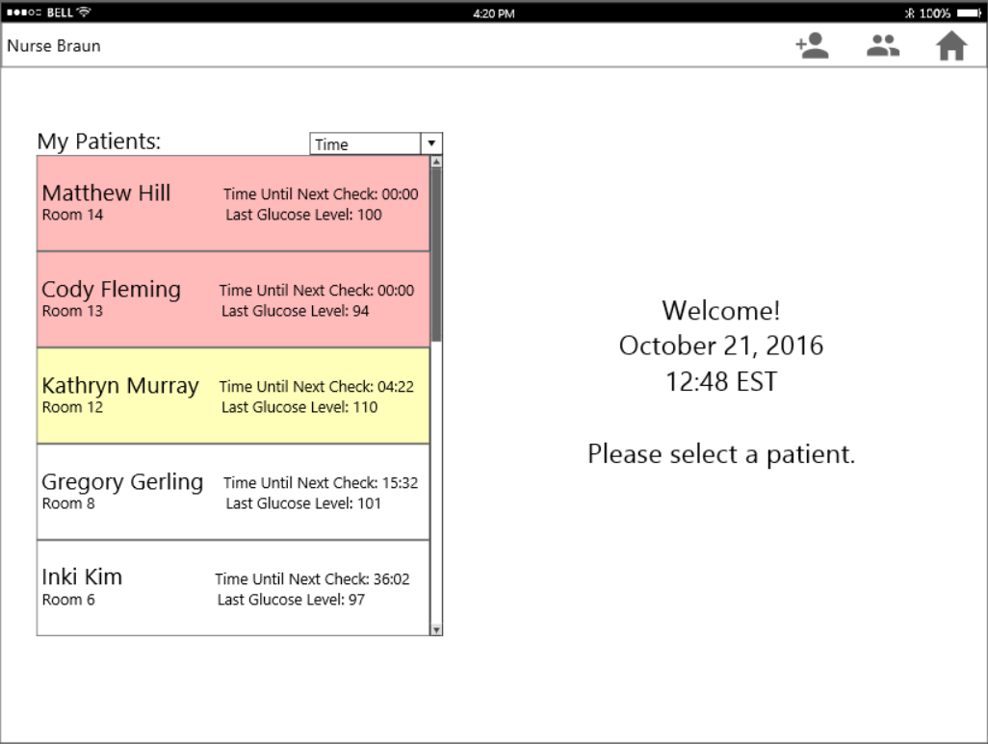
Home Page
General navigation to the home screen
Sort function allows viewing the list by time, name, room, and level
Click patient for more details and data entry
E: Feng, Murray, Park, Rue, Stevens
Notes:
This application is designed for a tablet. Nurses at the start of their shift are assigned an ipad that they have to check out. A tablet was decided as the best device due to its portability and large screen size. Nurses would carry the ipad with them from room to room. A functional need is that they must be able to enter data accurately and it is much easier to enter information on an iPad than a smartphone. The iPad also addresses the privacy issue by only allowing info to be seen by the nurse using the device. By using a tablet no one one other than the nurse can use it. When also looking at the big picture the tablet could be used for other applications in the hospital. The tablet could be used to track other patient info and for nurses to communicate tasks amongst one and other. There is also the potential to have the patients be able to call for help and have the nurse be notified on their respective tablet.
The Home page of this application is intended to be the most used page and assist the nurse in the task of going room to room entering blood glucose data and administering insulin to patients (see next slide for home page when a patient is selected).
The functional needs to complete this task can all be met on this display:
--See list of patients nurse is assigned
--See next patient who needs blood glucose measured
--Record a patient’s blood glucose
--Quickly see if patient’s blood glucose is in target range
--Easily detect if data entry error was made
--Know what dosage of insulin should be administered
--Record what dosage of insulin has been administered
The information requirements needed to complete task:
--Identifying patient information
--Target range of blood glucose
--Recommended insulin dosage
How this is presented in our design:
--”My Patients” list shows the patients assigned to the nurse who is signed in
--”My Patients” list shows name and room number of patient to allow nurse to find patient
--”My Patients” list shows time until next measurement is needed (updated by minute)
--”My Patients” list sorts patients by time until next measurement is needed in order of urgency--assists nurse in taking measurements and entering data for patients in order and on time
-- When a user taps on a patient in the “My Patients” List, they are able to complete the data entry procedure for the selected patient on the same display (see next slide)
Design principles used in our design:
Limiting information access cost-- All information needed for this one task is shown on one display; the nurse does not have to navigate through many pages to complete the simple, repetitive task of entering data for each patient.
Contrast-- Most urgent patients are contrasted with color; if the measurement should be taken in the next minute, the box patient’s box is highlighted yellow and if the measurement is past due the box is shaded in grey.
Redundancy gain-- Since taking measurements on time is an important requirement of this display, this is represented in multiple ways: time until next check is displayed next to patient names, patients are sorted by time until next check, and color is used to indicate urgency.
Matching a user’s mental model--nurses most likely see this task as a queue of patients they have to visit next in order to collect and enter the necessary data. Sorting the patient list in this manner matches this mental model.
Navigation on this page:
--Selecting a patient allows nurse to enter data on the same display
--Right hand corner: Icons link to add new patient, All patients, and Home

Slide 3
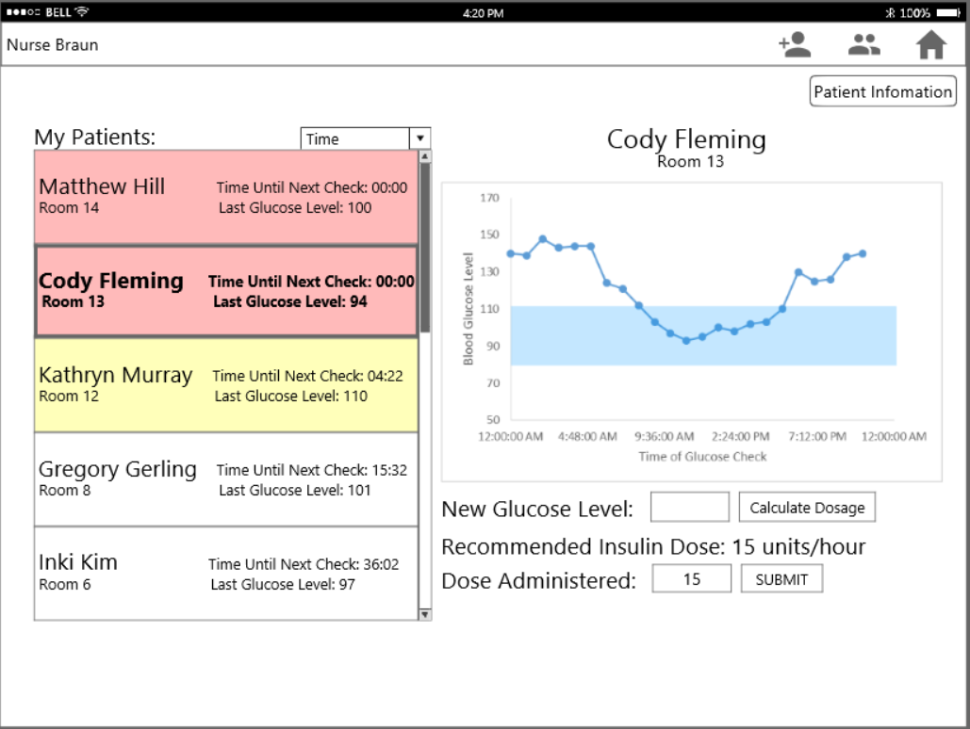
Patient Selected
Selected patient is bolded
Blue region signifies the target range for the patient
Click box to enter measured glucose level
E: Feng, Murray, Park, Rue, Stevens
Notes:
This shows the Home page display after the user (nurse) has clicked on a patient in the “My Patients” list. A graph of the most recent blood glucose data points is shown with a blue band indicating the target range as well as a field to enter the patient’s measured blood glucose level. Once the Calculate Dosage button is clicked, the glucose reading is recorded and the recommended insulin dose is shown on the screen and is automatically entered in the “Dose Administered” box. The nurse may edit this using the same number pad and tap submit or just tap submit to indicate administering the recommended dose. The insulin dosage algorithm is a black box component because it is a static equation where the multiplier and bg levels are the only variables (these can be edited on the Edit Patient Information display). The time until next check is a black box component because the problem specification states that after check up frequencies of and invariable 1 hr, an invariable 6 hrs of stability changes check time to an invariable 2 hrs.
Functional Needs and Information Requirements: see note page of previous slide, this is a continuation of the same task.
Design Principles:
Ink-Data ratio is minimized by removing gridlines and adding shaded target area as a guideline
Proximity - Data entry points are located in close proximity
Contrast - selected patient banner “pops out”, bolds, and becomes more salient
Contrast - input fields and dynamic updated information are different styles to differentiate input/output
Gulf of Execution - Gives nurse information needed to complete task (calculates insulin dosage for them based on the glucose level entered)
Gulf of Evaluation - Indicates that data has been entered and recorded.

Slide 4
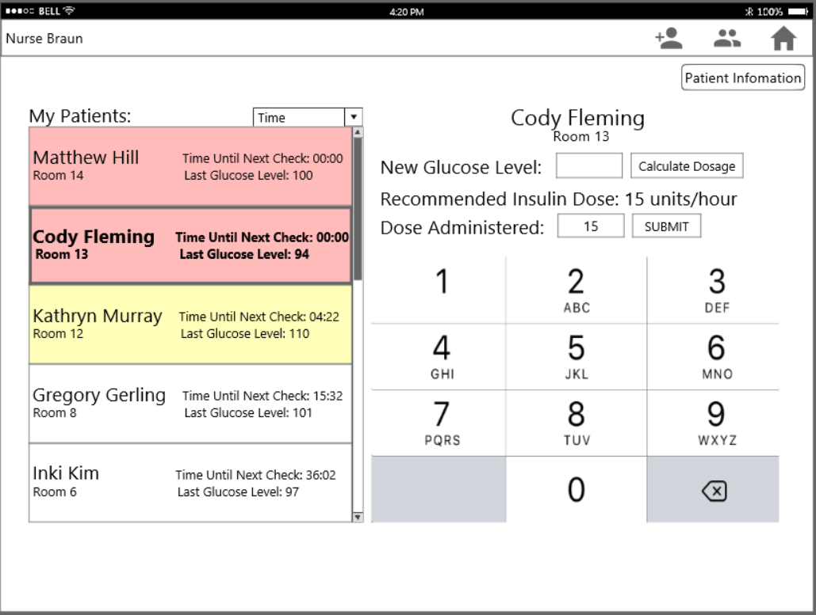
BG Data Input
Click Calculate Dosage to get the recommended insulin amount
Confirm or change the amount administered to the patient, making the alert disappear.
Keypad appears to enter glucose level
E: Feng, Murray, Park, Rue, Stevens
Notes:
Restrict removal of patient if user is the only nurse that is tending patient/patient is on her shift list

Slide 5
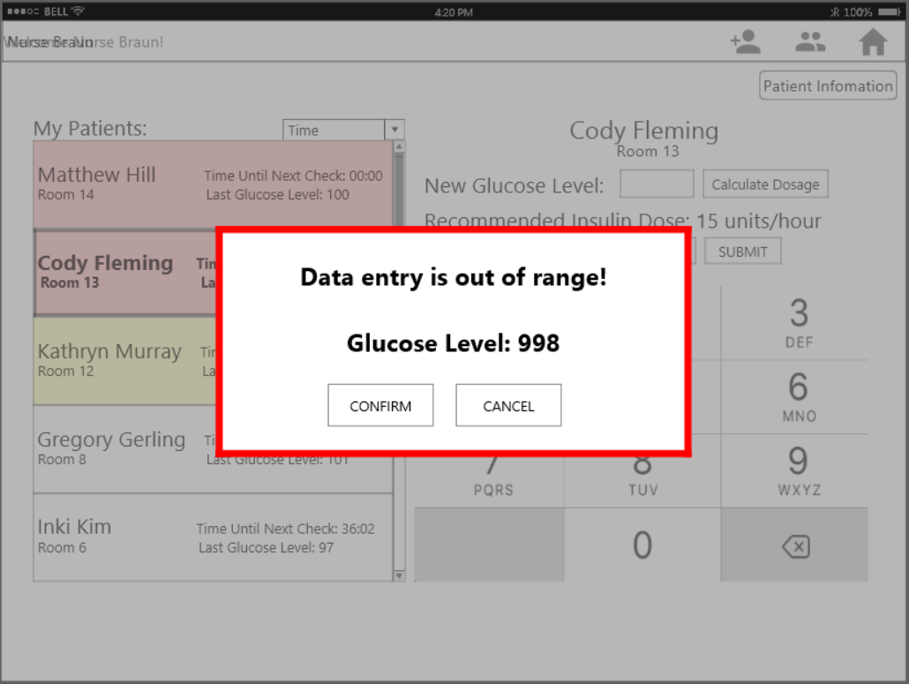
Deviant Data Alert
Unusual results trigger warning before the data is recorded.
E: Feng, Murray, Park, Rue, Stevens
Notes:
This popup only comes up on the rare occasion that the system believes the user may have entered the incorrect data. For example if a patient started out with a glucose level of 140 and then the nurse entered in something significantly different the next time, the system will warn the nurse that the wrong info was potentially submitted or a test should be done again to confirm the data. This does not change the system in anyway, the nurse can easily dismiss the popup by just confirming the data. If things are going well the popup will not come up. Thus nurses are not quick to dismiss it due to how few times it will ever come up. In this case, all other elements on the screen besides the popup are muted to highlight the alerts because entering a wrong value in the system may cause patient death.

Slide 6
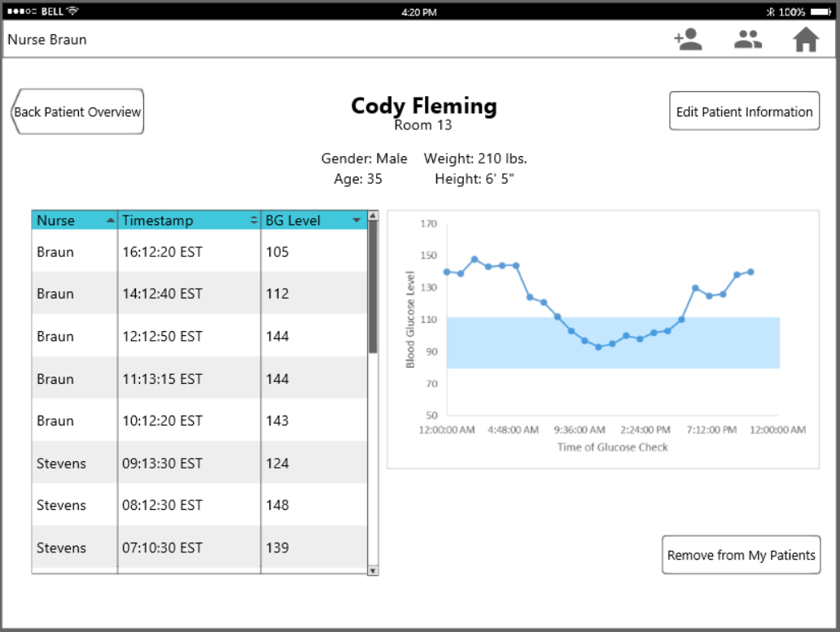
Patient Information
View past data and graph.
Remove can be used when nurses trade or check other patients.
E: Feng, Murray, Park, Rue, Stevens
Notes:
Add patient to nurse’s list in order to be able to edit the data
The system will not let you remove a patient from your list if you are the only nurse with that patient. Thus a patient can not be forgotten or ignored.
You arrive at this page by clicking on a patient from the All Patients Page that is not assigned to you yet.

Slide 7
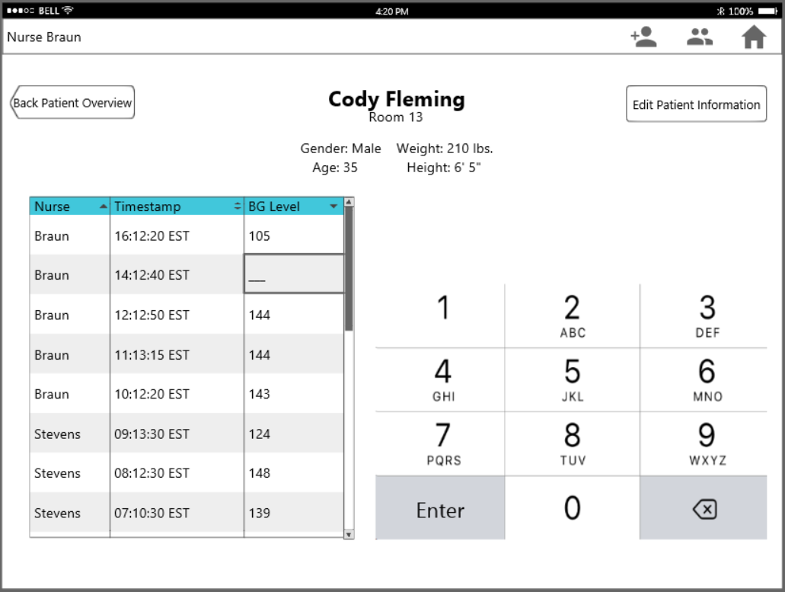
Edit Table Data
Click to go to Patient Data page
Selected field is contrasted
Number pad for data entry
E: Feng, Murray, Park, Rue, Stevens
Notes:
This allows you to edit previous data. You can scroll through the data to correct or alter it. Thus if a mistake was made in data entry there is a way to fix it.

Slide 8
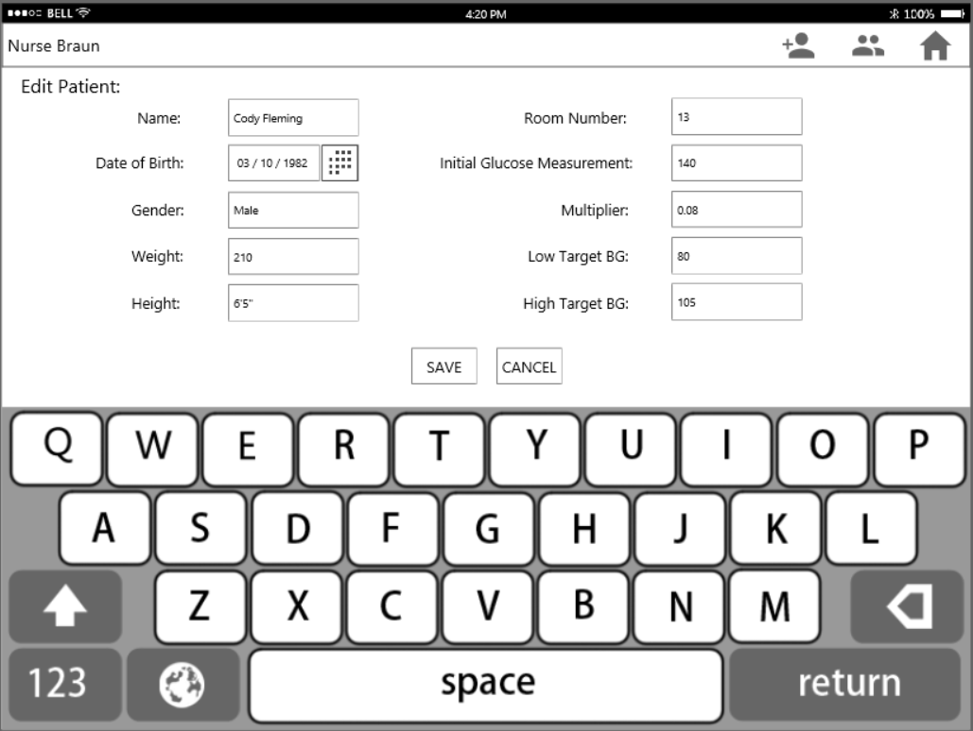
Edit Patient Information
Page designed to have both the fields and the keyboard visible
E: Feng, Murray, Park, Rue, Stevens
Notes:
Proximity: Make information related to patients’ measured data identical in format to highlight their connection.
Alignment: Make information related to patients’ personal information different in format with information related to measurements to imply different types of data.
Contrast: Make closed data in different colors of background to layer each measurement.
Muting the framework: In the BG value vs. Time graph, mute the backgrounds to highlight only the data points.

Slide 9
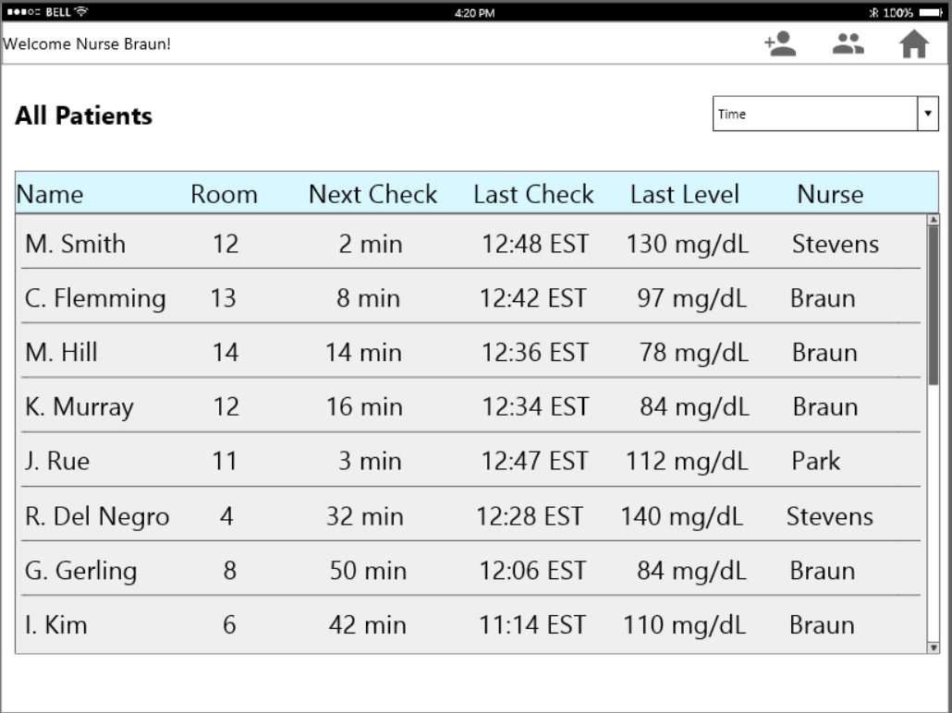
All Patients List
Icon to go to all patients list
Aggregated patient list with most important information
E: Feng, Murray, Park, Rue, Stevens
Notes:
Contrast: Make the keyboard the most salient element on the page to highlight it and to avoid typing errors.
Number pad entry is optimized for touch screen interface

Slide 10
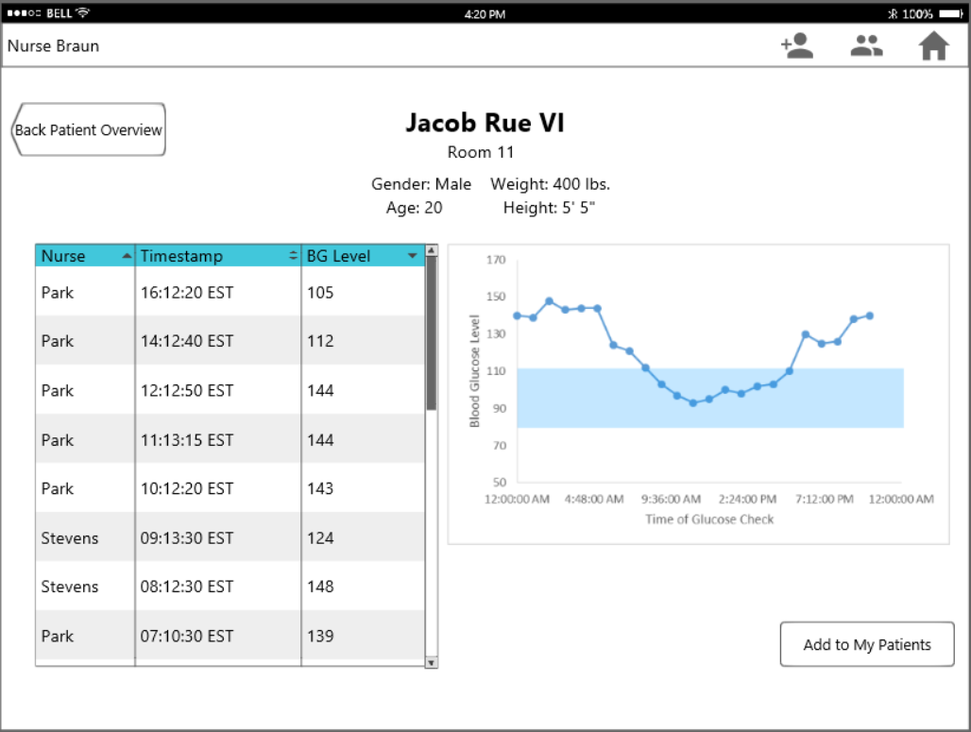
Add Patient to My Patients List
Button to add patient to nurse’s personal list
E: Feng, Murray, Park, Rue, Stevens
Notes:
Alignment - All data input fields and labels are aligned and uniform for consistency
Proximity - Save and Cancel buttons which are final input selectors are side by side

Slide 11
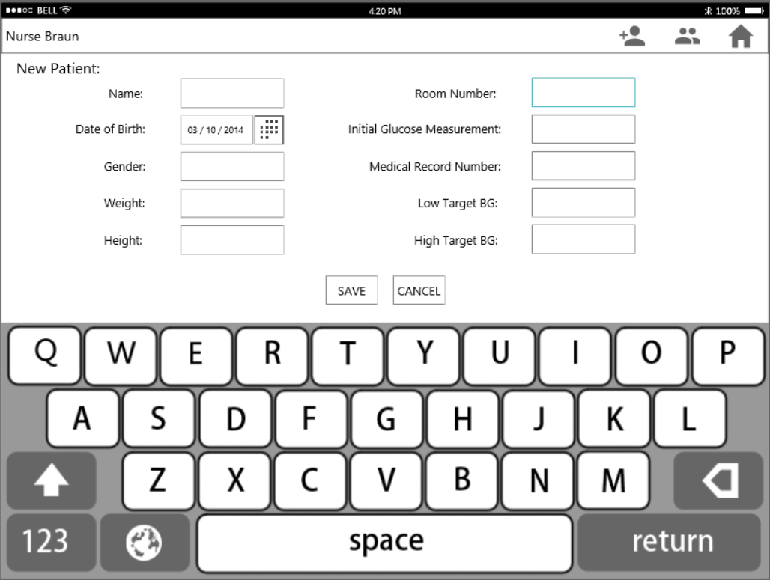
New Patient Input
Icon to add a new patient
Selected input field is highlighted
Keyboard for data entry
E: Feng, Murray, Park, Rue, Stevens

Slide 12
Accommodations to Scenario A
The user is able to obtain dose levels corresponding to different BG value by going through these steps:
Click the “New Patient” button and enter Mr. Berringer’s personal information.
Click the “Save” button and go to the Home Page.
Enter each BG measured value with the Number Pad and click the “Calculate Dosage” button.
The recommended Insulin Dosage is shown on the screen.
In cases which nurses have to inject different Insulin than recommended value, disregard the recommended value and enter the actual value.
E: Feng, Murray, Park, Rue, Stevens
Notes:
Step 1: The low and high target BG values for Mr. Berringer can be added on the “New Patient” page

Slide 13
Accommodations to Scenario B
The user is able to tell when it is necessary to do resample by going through the following steps:
Go to BG Data Input page and enter the measured value.
In the cases which the entered value exceeds the possible range for a person’s BG value, a popup window (like the one in Deviant Data Alert) will appear at the center of screen to remind the nurse to reconsider the value inputted.
If the nurse finds out there is an inputting error, she can click “Cancel” button to enter the right value.
E: Feng, Murray, Park, Rue, Stevens

Slide 14
Questions 4 and 5
Application will be run on an iPad or similar tablet
Addresses privacy concerns
Size of iPad vs. phone--larger screen allows for greater accuracy in data entry, easy to read
Meets need of portability
2*Patients + (X+Y) = total time
Say that X+Y <= 2 minute
10 patients will give 22 mins taken by BG measurements and related tasks
Leaving 38 minutes for other nursing tasks
This question seems highly subjective and dependent on who the nurse is and also on what the real values of X and Y are
E: Feng, Murray, Park, Rue, Stevens
Notes:
Question 4: Each nurse needs to take care of multiple patients, and patients located closely will be assigned to the same nurse. So each nurse is actually in charge of a certain area on the ICU floor. The room number of patients is salient on the Patient Information page for nurses to quickly identify where to go. In cases where nurses have unequal shares of patients, they can help help other and get quick assignment changes of tasks through the Home Page.

