Slide 1
Heart Disease Risk Analysis Using Data Science
Group 7: Felix Fagan, Fei Gu, Chi-Hsin Huang, Yan Sun
Date: 11/22/2019

Slide 2

Motivation
What factors contribute to heart disease ?
Hard to know root cause without medical background
Use data from real patients to find out what factors correlate with heart disease
From this, gain knowledge on what to do or what to avoid in order to prevent heart disease

Slide 3
Objective
1
What factors have high correlation with heart disease?
2
What’s risk of heart disease for different values of features?
Data analysis
3
For each factor, at what value does patient have high risk for heart disease?
4
Give advise to mitigate risk factors
Notes:
What factors contribute to heart disease ?
Hard to know root cause without medical background
Use data from real patients to find out what factors correlate with hear disease
Form this, gain knowledge on what to do or avoid to have heart disease

Slide 4

Methodology
Collect the data from 3 different data set
Find the common features
Clean the data
Analyze the correlation between different features
Visualize data for different factors
=> Determine what factors have a crucial role in assessing heart disease risk

Slide 5
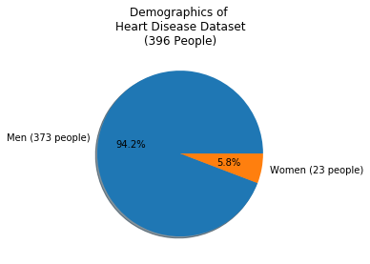
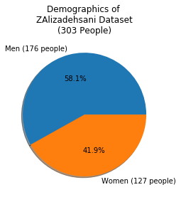
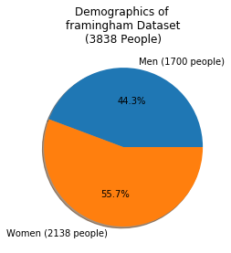
Dataset Used
Heart Disease Data Set in UCI Machine Learning Repository
- locations: Cleveland, Long Beach, Hungary, Switzerland
- Feature:76 (age, sex, blood pressure, years as a smoker, etc.)
- People: 396 (male: 373 /female: 23)
Z-Alizadeh Sani Data Set in UCI Machine Learning Repository
- Feature:54 (sex, age, blood pressure, blood sugar, etc.)
- People: 303 (male:176 /female:127 )
Framingham Heart study dataset
- Feature:16 (sex, age BMI, glucose, etc.)
- People: 3838 (male: 1700/female:2138 )
Total: 4537 people (male:2249/female:2288)
Notes:
Replication Data for: South African Heart Disease in Harvard Dataverse

Slide 6
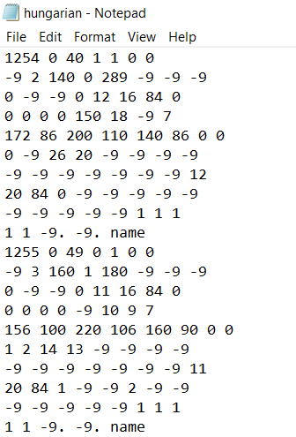
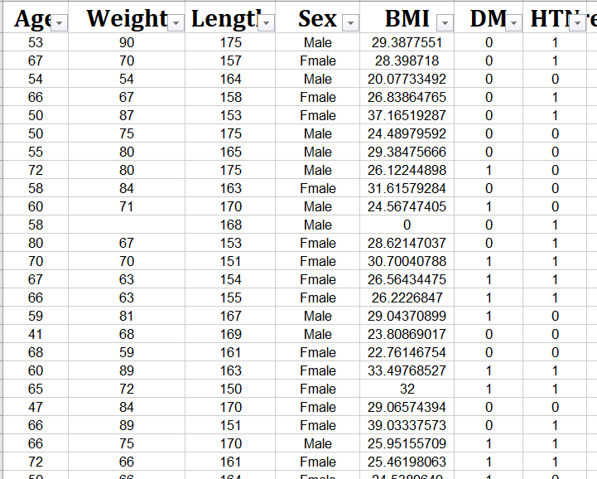
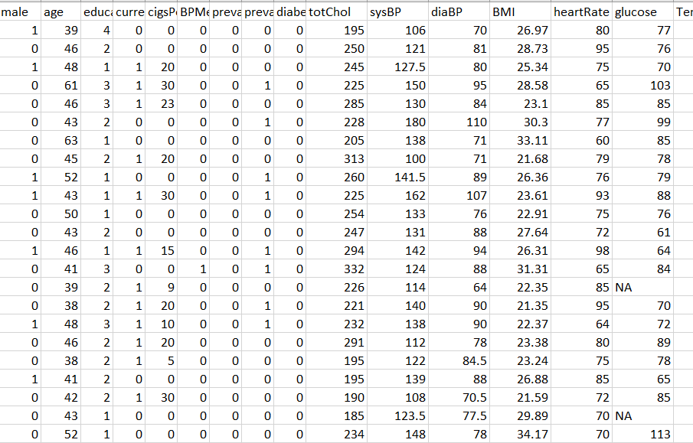
Data Cleaning
Each dataset has different features for each patient
Not all datasets have the same features
Some features have different names and representations (eg 1/0 vs Male/Female)
Filter data to extract all common features
Age, Sex, Blood Pressure, Blood sugar, Current smoking habit, whether they have heart disease
Arrange data from each set into common format
Heart Disease:
Z-Alizadeh Sani:
Framingham:

Slide 7
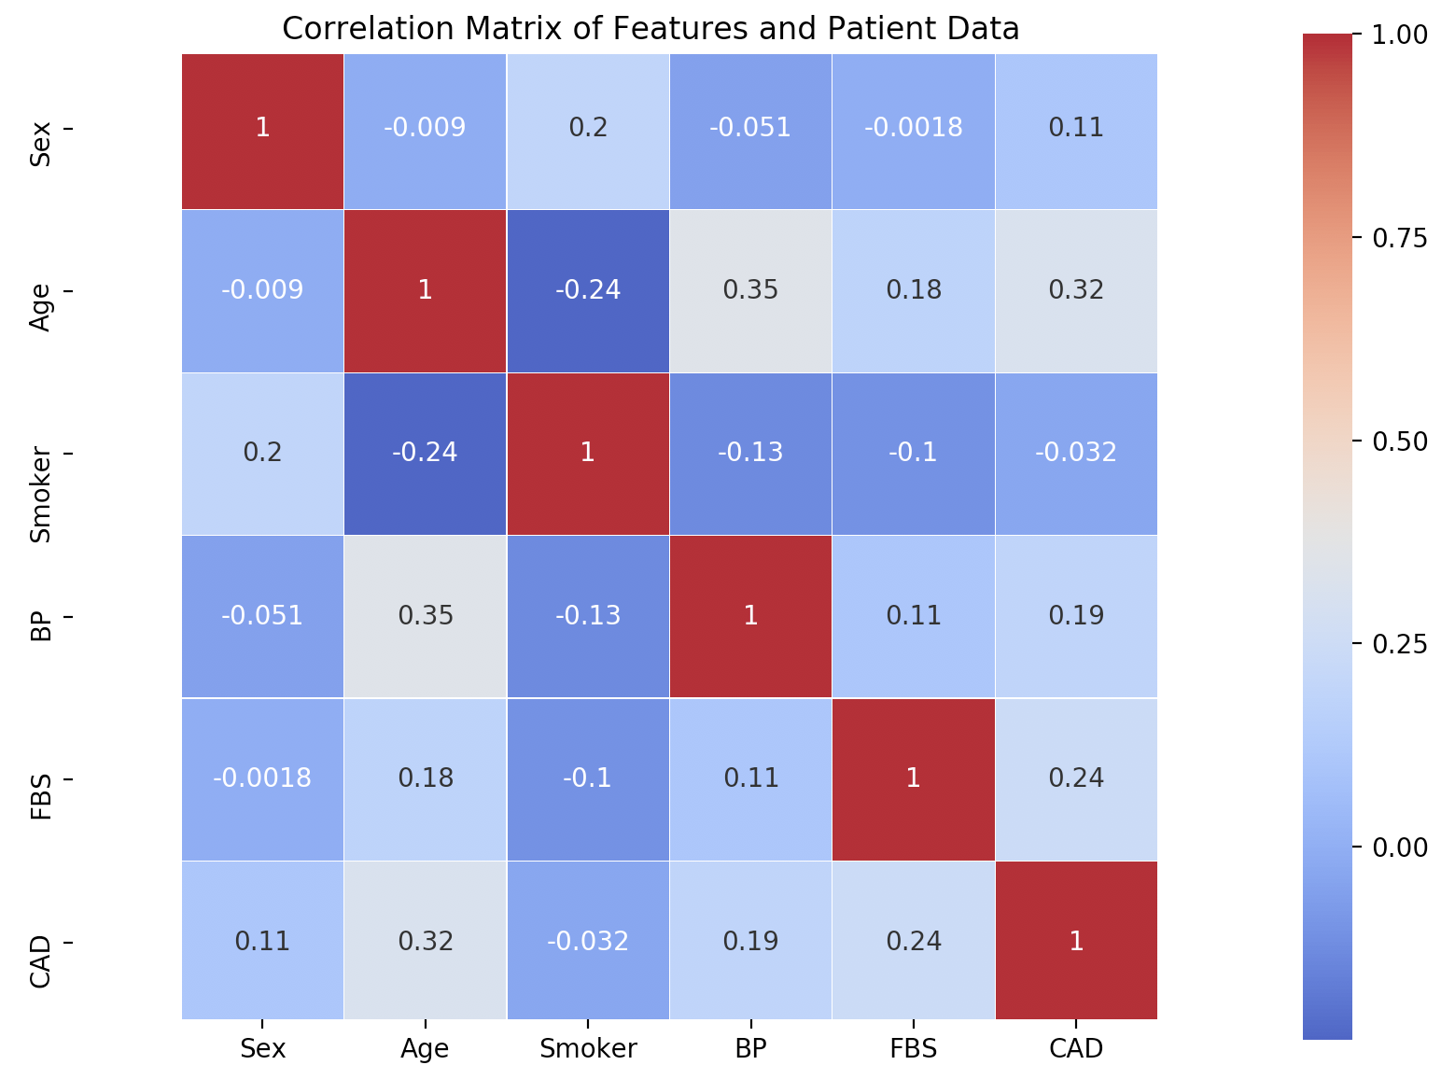
Correlation between Different Features
Feature | Correlation factor
Age | 0.32
Blood Sugar | 0.24
Blood pressure | 0.19
Sex | 0.11
Smoker | -0.032
Correlation between different feature(sex, age, blood pressure (BP), blood sugar(FBS), smoker, CAD)
Higher value =>higher correlation
Age has highest correlation with heart disease; Smoking habit has lowest correlation.

Slide 8
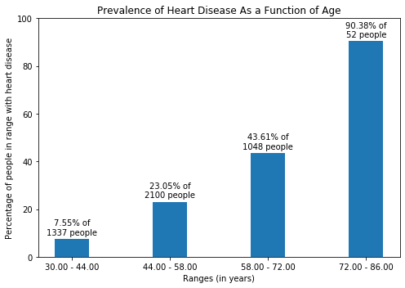
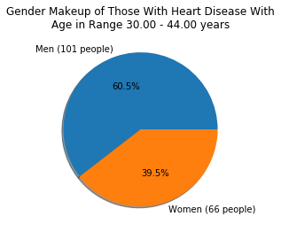

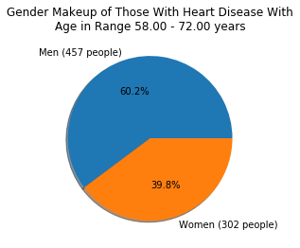
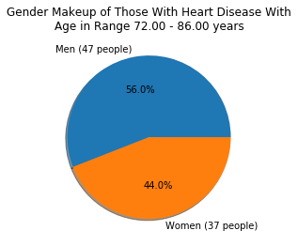
Age
(1)
(2)
(3)
(4)
(1)
(2)
(3)
(4)
Higher age=> higher risk to have heart disease

Slide 9
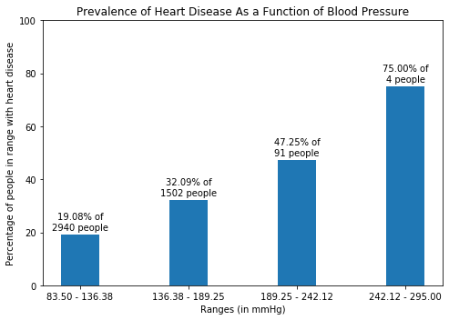
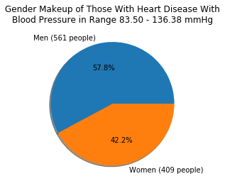

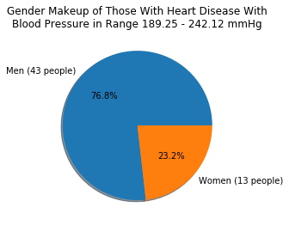
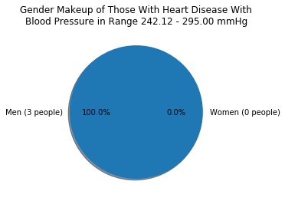
Blood Pressure
(1)
(2)
(3)
(4)
(1)
(2)
(3)
(4)
Higher blood pressure => higher risk to have heart disease

Slide 10
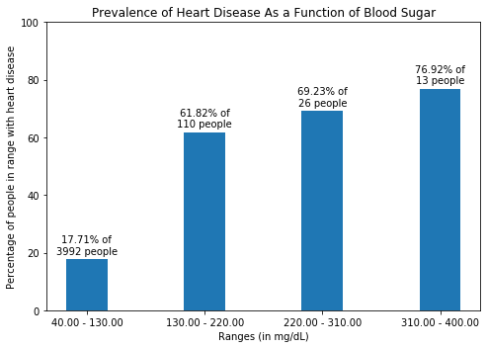
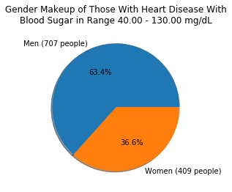
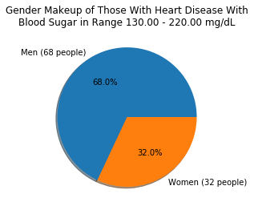

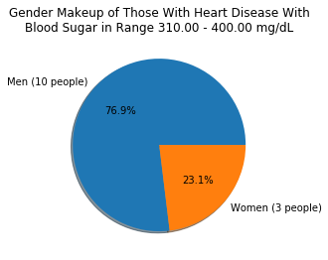
Blood Sugar
(1)
(2)
(3)
(4)
(1)
(2)
(3)
(4)
Higher blood sugar => higher risk to have heart disease

Slide 11
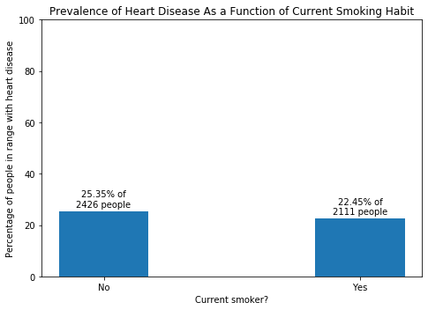
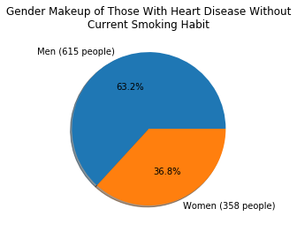
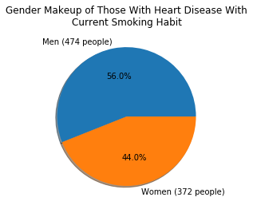
Smoking Habit
(1)
(2)
(1)
(2)
No correlation between with smoke habit and whether they have heart disease.

Slide 12
Conclusion
Conclusion
 | Sex | Age | Blood pressure | Blood sugar | Smoking
Risk | male | Age | Blood pressure | Blood sugar | No correlation
>50% risk when: | male | >60 years old | >200 mmHg | >130 mg/dL | N/A
General advice for decreasing risk of heart disease
Maintain healthy habits to lower blood sugar and blood pressure.
(exercise, good diet, stress management, etc.)
As you get older, be more mindful of keeping other factors at healthy levels.
Notes:
Maintain healthy habits to lower blood sugar and blood pressure
(exercise, good diet, stress management, etc.)
As you get older, be more mindful of keeping other factor at healthy levels

Slide 13
Possible data improvement
Conclusion
More common features (Exercise levels, diabetes, cholesterol, etc. )
More patients data
Complete patient data
Common format (ex. blood pressure)

Slide 14
Conclusion
Thank you for your attention!!!

