Slide 1
Assignment#1: Web Scraping House hunting during uncertain times
Hyeyeon Kim
2020-09-13

Slide 2

“…chance to finally step on the property ladder?”
Very low interest rates
Goal: Scrap condo listings in Toronto
Notes:
(and Band of Canada has no plans to start raising rates until at least 2023)
Rates have already been falling significantly over the last couple of months, with many mortgage rates—including insured 5-year fixeds—now available for under 2.00%.
Perhaps. With interest rates at historic lows, if you are able to buy and hold a home for the medium to long term, this might be a good time to buy

Slide 3


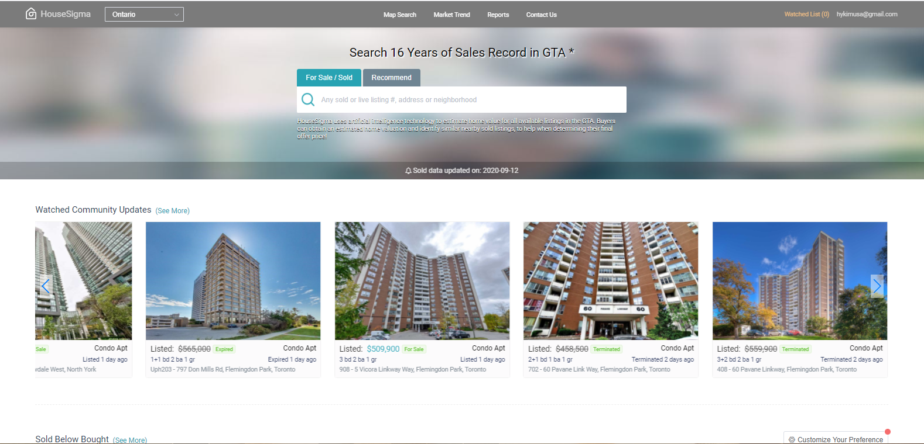
House hunting using HouseSigma & Selenium
Notes:
I used HouseSigma, a free Canadian website, that curates real estate listings, and estimates home values in real time.
Since this website is highly interactive where I would have to click on individual listings, I decided to use Selenium package which automates web browser interaction from Python. Selenium enables you to create step-by-step interactions with a webpage (HouseSigma) and assess the response of a browser to various changes.

Slide 4
Future Directions
A
Notes:
I used HouseSigma, a free Canadian website, that curates real estate listings, and estimates home values in real time.
Since this website is highly interactive where I would have to click on individual listings, I decided to use

