Slide 1
Assignment#1: Web Scraping House hunting during uncertain times
Hyeyeon Kim
2020-09-13

Slide 2

“…chance to finally step on the property ladder?”
Very low interest rates
Goal: Scrap condo listings in Toronto & explore available options

Slide 3


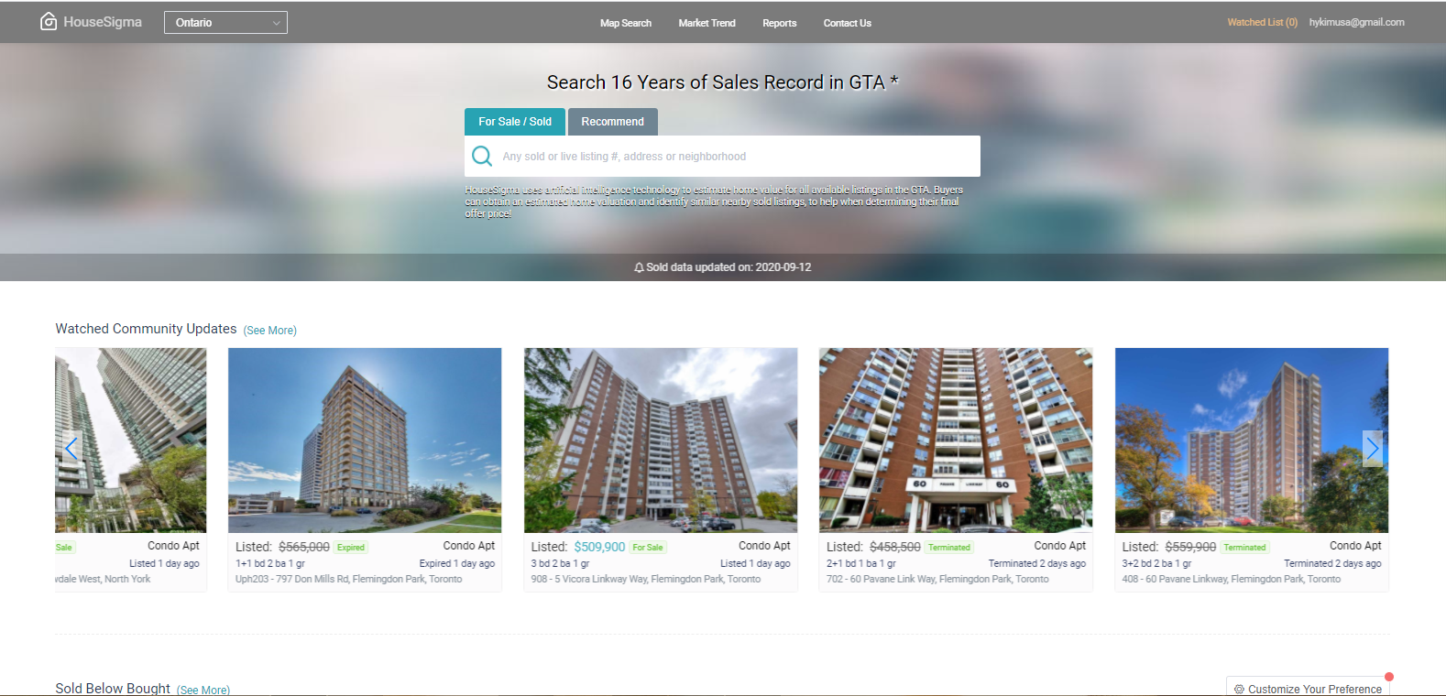
House hunting using HouseSigma & Selenium

Slide 4
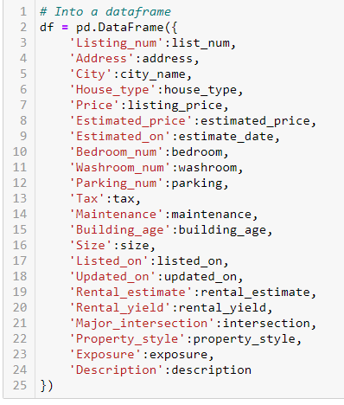

Data Structure

Slide 5
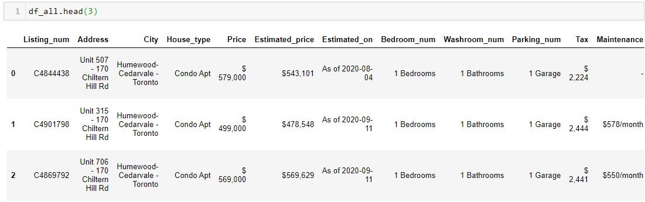
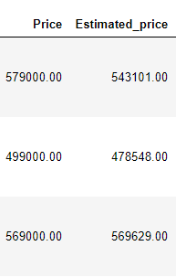

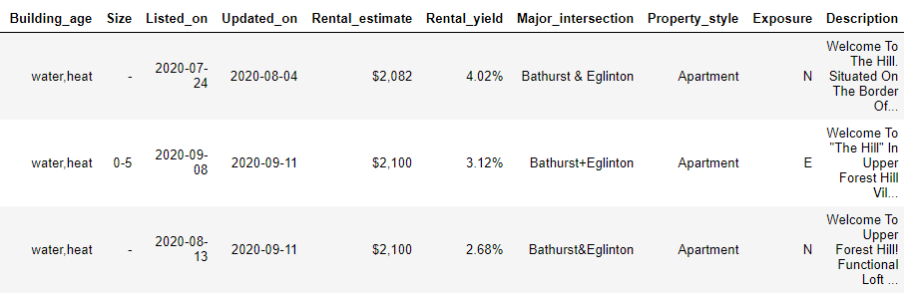
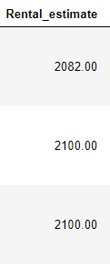
Data Cleaning
Changed to float64

Slide 6
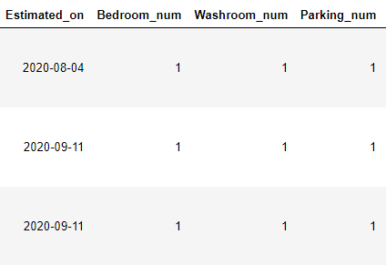
Data Cleaning

Slide 7
Data Cleaning
Changed to ‘datetime’ objects

Slide 8
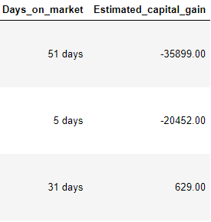
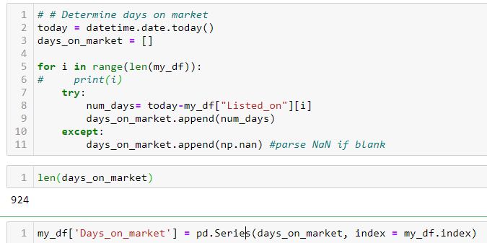
Data Cleaning
Added 2 new columns
“Days_on_market” = Today - “Listed_on”
“Estimated_capital_gain” = “Estimated_price” – “Price”

Slide 9
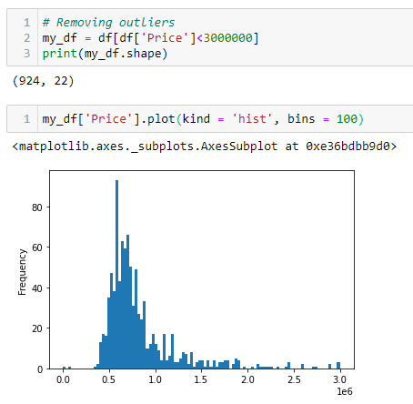
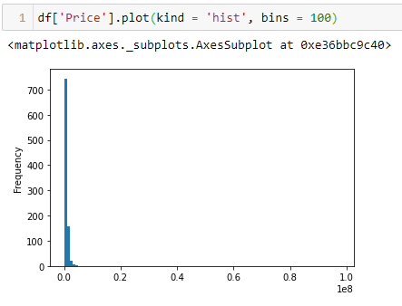
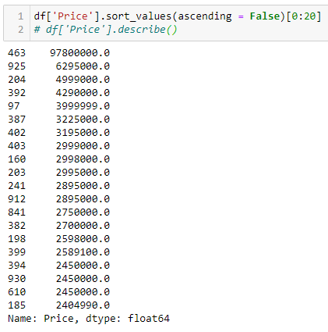
(924, 24)

Slide 10
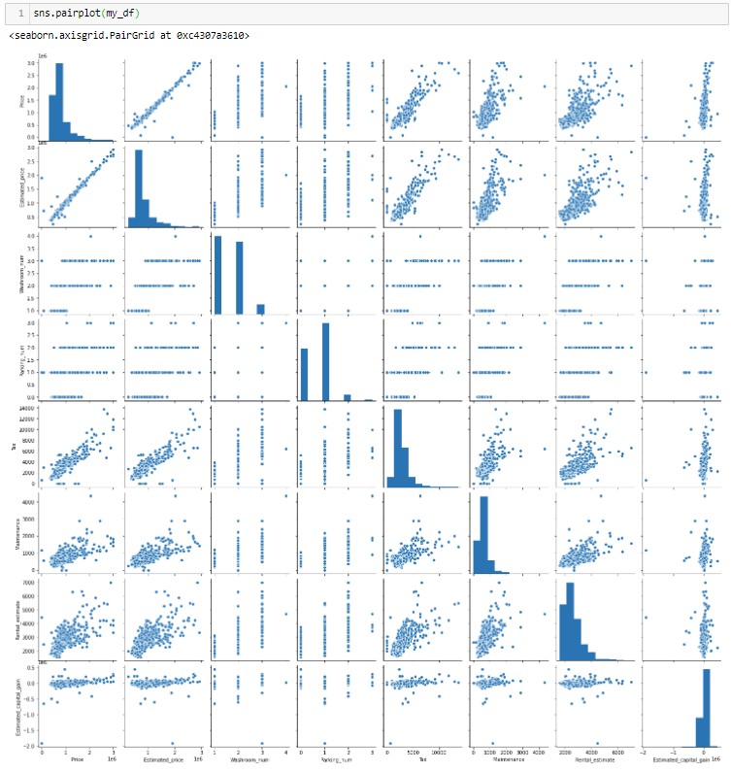

Slide 11
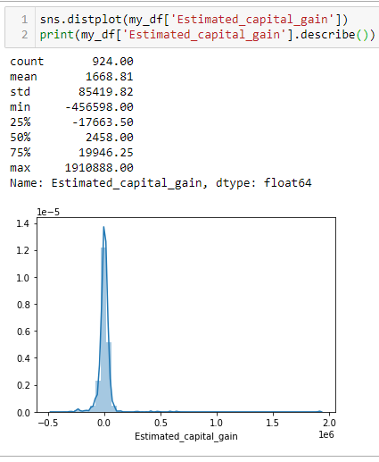

Slide 12
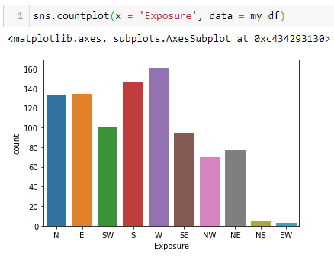

Slide 13
