Slide 1
Interactive Bioinformatics Data Visualisation
Jitender
Tue 07 May 19
Informatics
CSB

Slide 2
Trendy
We will cover most common themes that we see(visualise) in bioinformatics paper
Alignment(protein/DNA) long sequences
Genes on different genomes(synteny) or their relations
Proportion of reads aligned to a Genome
RNAseq based gene expression data
Gene Networks
Go terms

Slide 3
Content
View Multiple sequence alignment (MSA) , an interactive example

Slide 4
“methods to transform information into a visual form for comprehension”
automated processes can reliably find sites where rearrangement occurs, but visualization is then needed to provide a mental image so that the detail of structural variation can be fully appreciated and understood [Wong, Nature Methods volume 9: 1131 (2012)]

Slide 5
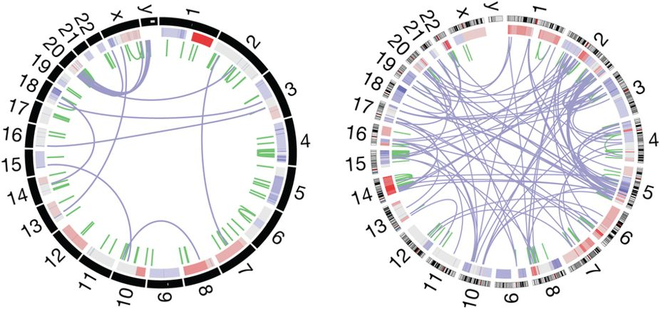
Visualisation of whole-genome rearrangement.
Two different tumours showing gene duplications and chromosome rearrangements.
The outer ring depicts chromosomes arranged end to end.
The inner ring displays copy-number data in green and interchromosomal translocations in purple [ citing: https://www.nature.com/articles/nmeth.2258/figures/1

Slide 6
The 25 Best Data Visualizations of 2018 A list compiled by OranaVelarde
https://visme.co/blog/best-data-visualizations
We can have a vote on this which are your top 3
What features did you like ? and what lead your ranking
I’m sure you would agree there is a space for “a bit of an artistic license”: lot of creativity is need to make a better data-viz displays

Slide 7
Viewing Multiple Sequence alignment(MSA)
https://dash-bio.plotly.host/dash-alignment-viewer
Viewer shows gap and conservation alongside a standard colorscale support and consensus sequence
No matter what size your alignment is, Alignment Viewer is able to display your proteins snappily.
You can quickly scroll through your long sequence with a slider or a heatmap overview.

Slide 8
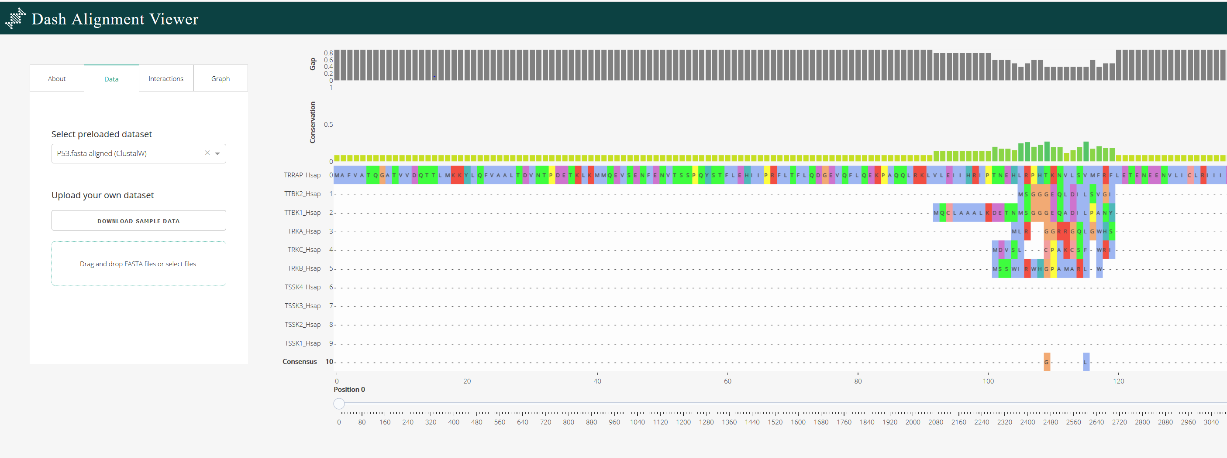
Alignment viewer step 1: Single Click on Drag drop Step 2: Browse the file “human-kinase20.fasta”
Aligned 20 Kinase Human proteins already using
Jalview “you can not only visualise but also edit”

Slide 9
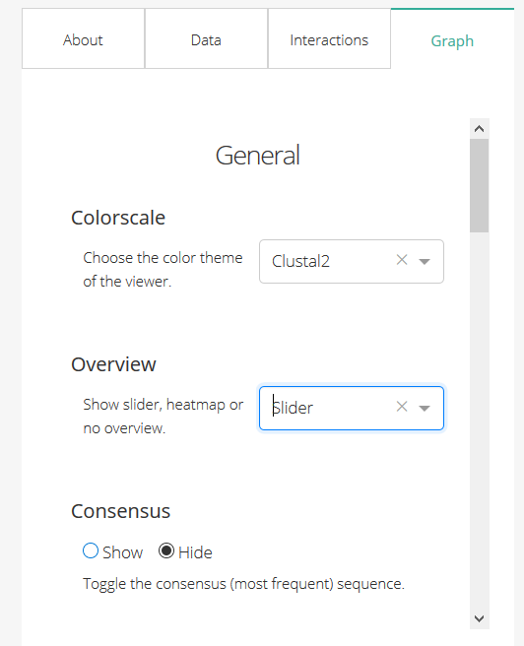
To Toggle to Slider

Slide 10
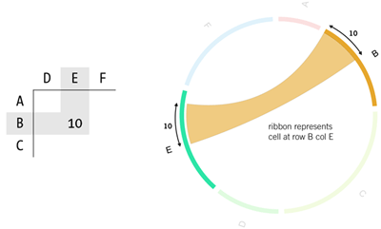
Circos
https://github.com/nicgirault/circosJS
- Please visit the link above to see how a Circos diagram can be customized
Circos is a circular visualization of data, must have seen on the cover of many Journals
Used to highlight relationships between genes, chromosome, etc for example genes that are located on different chromosomes in the genome of an organism(synteny)
http://circos.ca/intro/tabular_visualization/img/circos-visualize-table.png

Slide 11
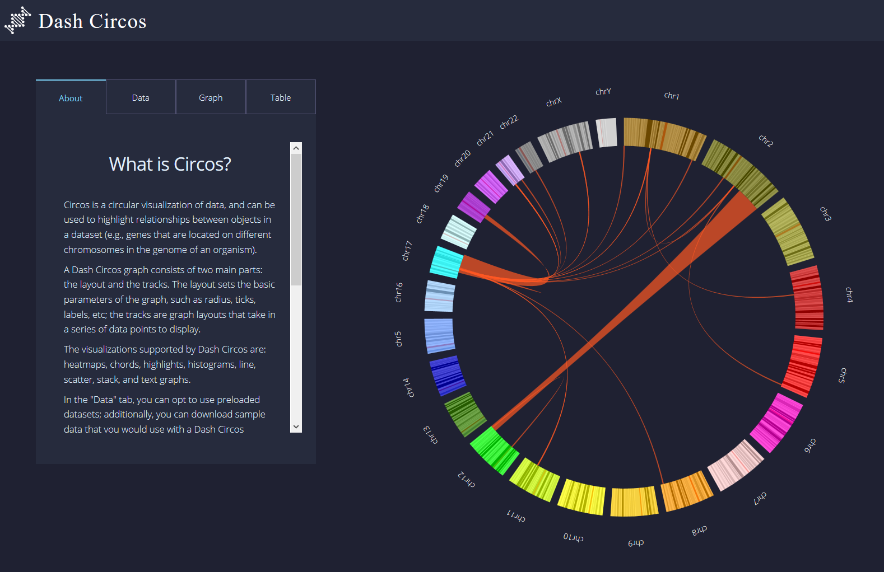
Visualize Circos: Human Chromosomes
https://dash-bio.plotly.host/dash-circos

Slide 12
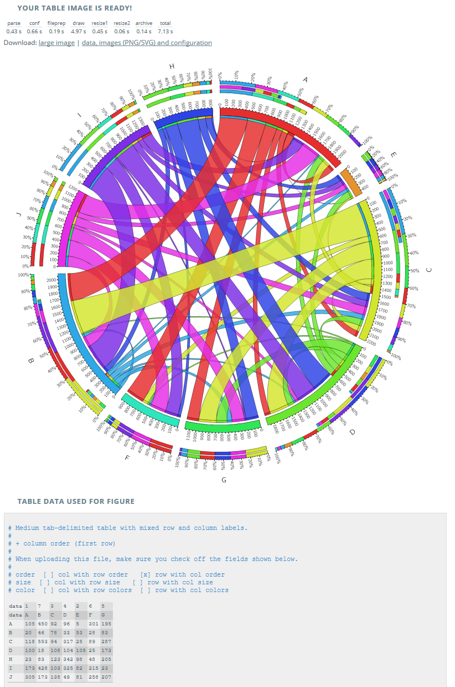
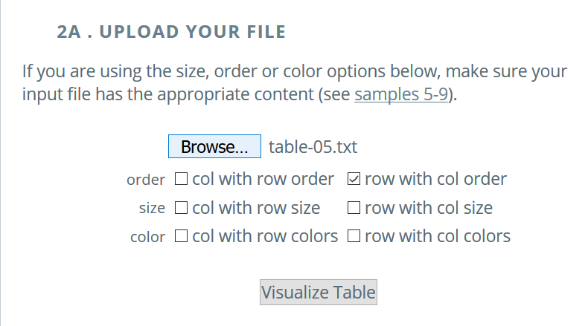
Generic Circos
http://mkweb.bcgsc.ca/tableviewer/samples/
http://mkweb.bcgsc.ca/tableviewer/

Slide 14
RNAseq data visualisation through IGV
Very popular NGS tool ‘Integrative Genomics Viewer’ Robinson et al
2011
Integrated visualization tool for multiple data types and genome annotations.
Data from NGS analysis visualized .
Handles large datasets
Interactive and speedy visualization. Run locally on desktop
View multiple datasets in separate panels on the same pane(integrative).

Slide 15
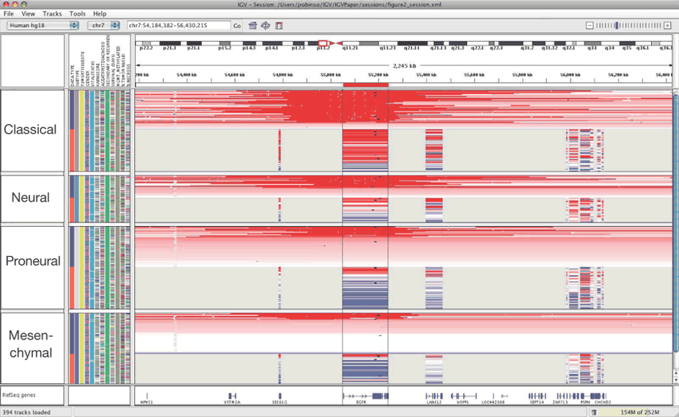
Impressive but busy https://www.nature.com/articles/nbt.1754/figures/1

Slide 16
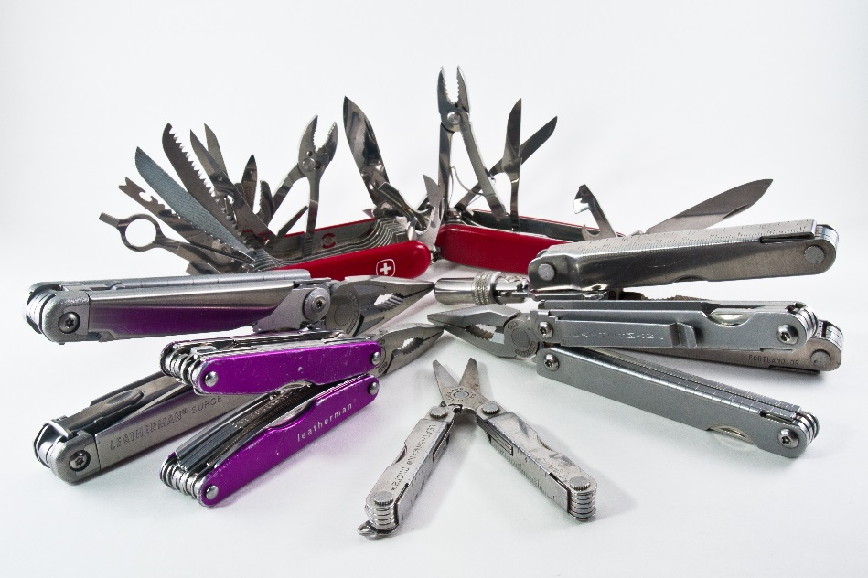
IGV DIY: diagnostics, read mapping, slice events, SNPs, Insertion , deletion, copy numbers, Errors
https://www.flickr.com/photos/pennuja/5363515039/

Slide 17
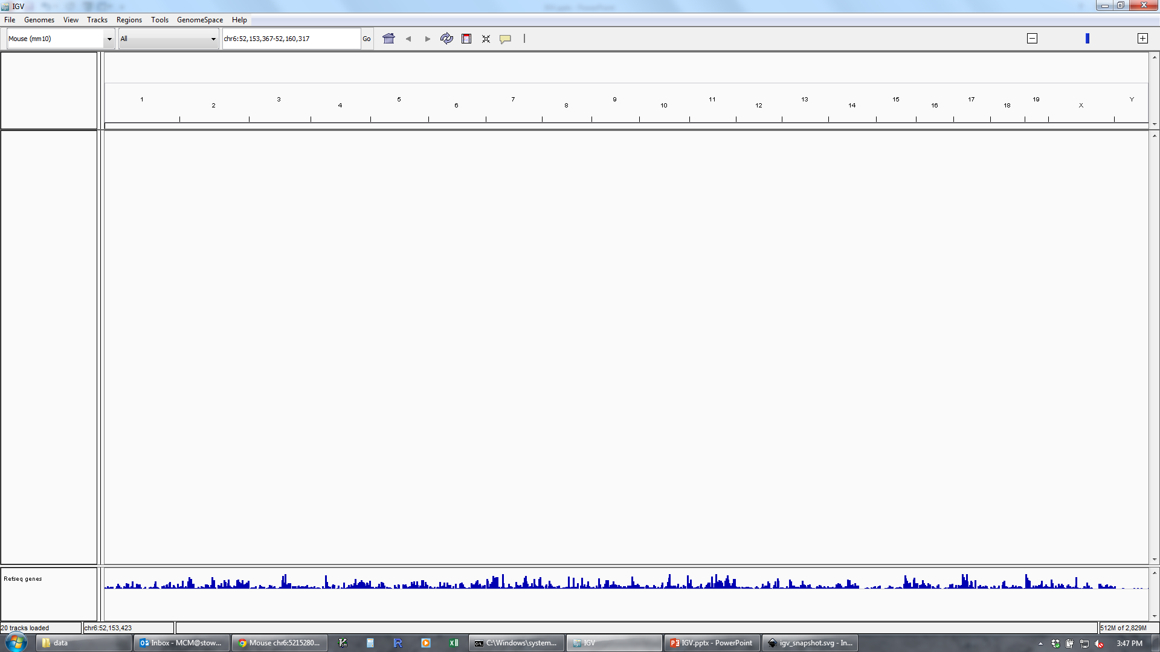
Basic Layout IGV
Genome
Navigation
Configuring Track Visibility
Data Tracks
Annotation Tracks

Slide 18
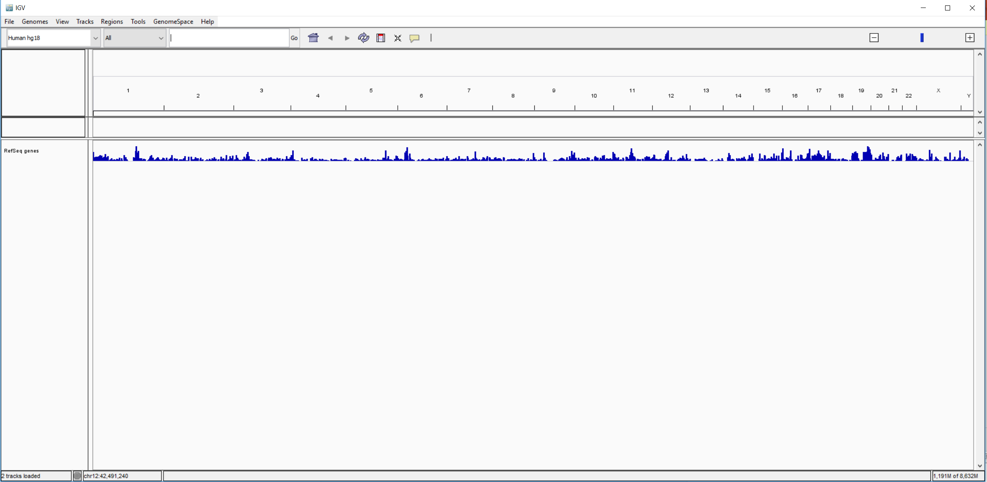
On a clean slate “Load your genome”

Slide 19
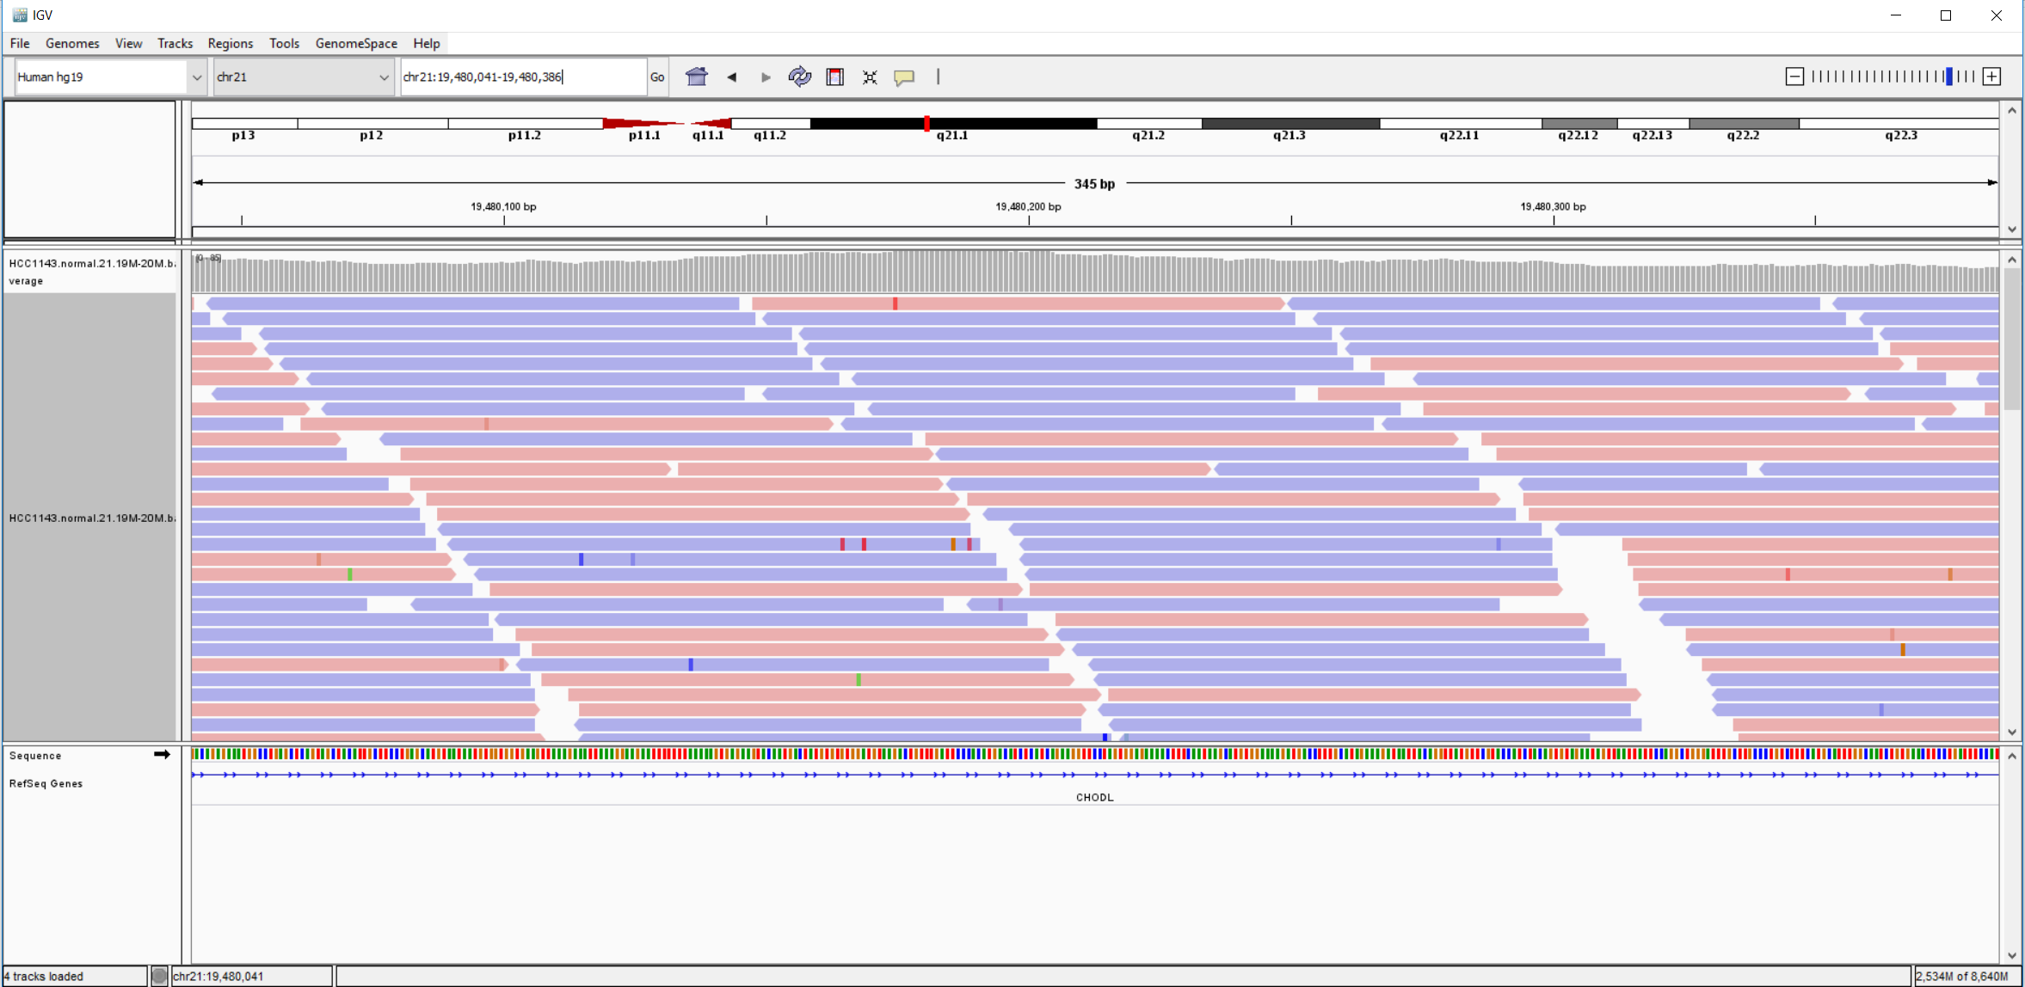
Load IGV loads Human hg19.
https://github.com/griffithlab/rnaseq_tutorial/wiki/IGV-Tutorial
Breast cancer cell line HCC1143 to visualize alignments, only a small portion of chr21 will be loaded (19M:20M) using File.. Load from File
“HCC1143.normal.21.19M-20M.bam”

Slide 20
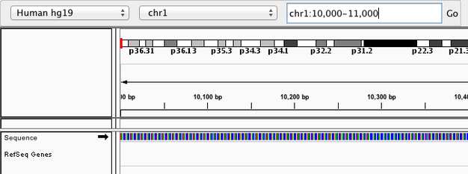
Navigate to a region

Slide 22
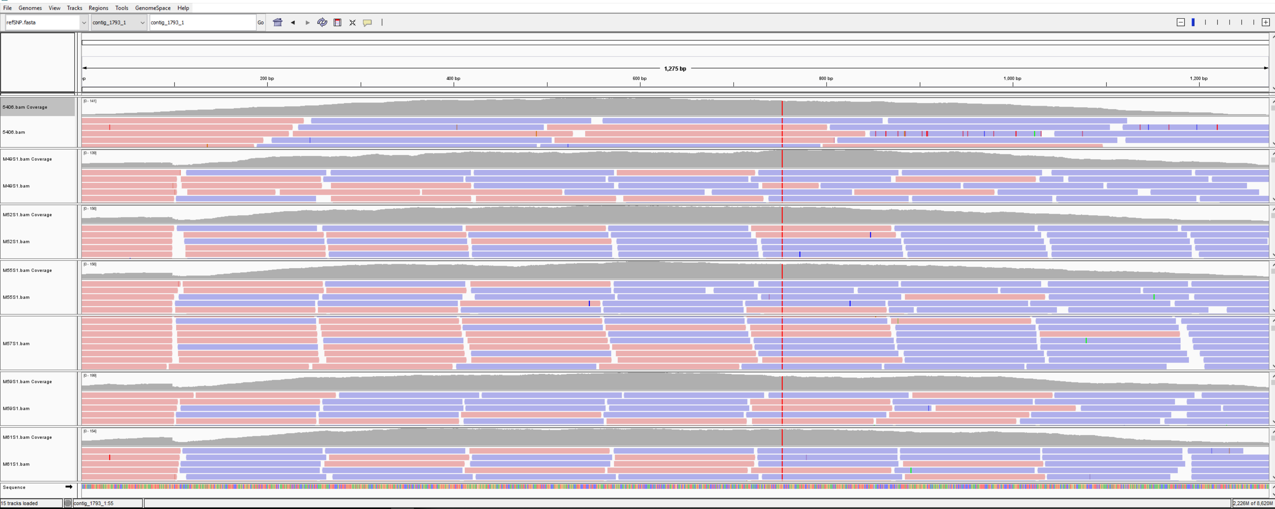
Wild type and 6 other mutants from an unknown species

Slide 23
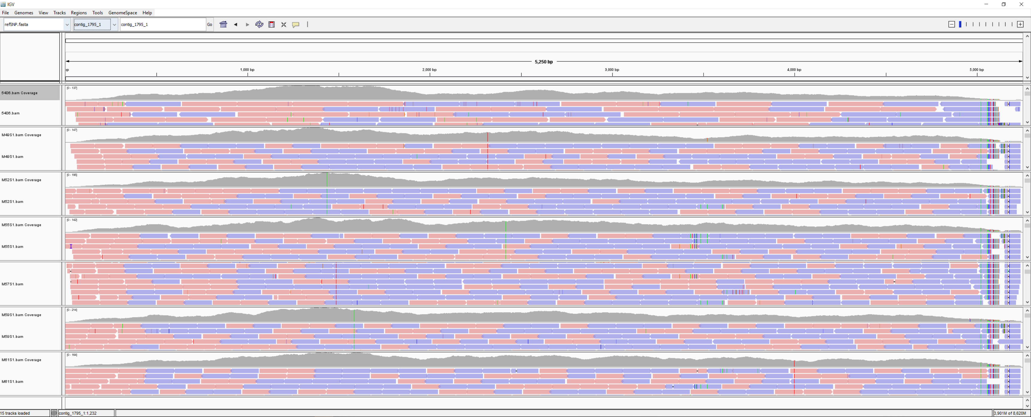

Slide 25
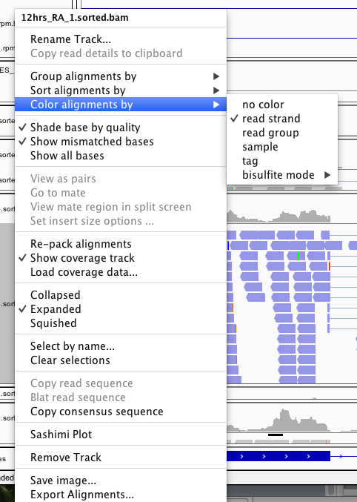
Right click on track name to change a bunch of stuff…

Slide 26
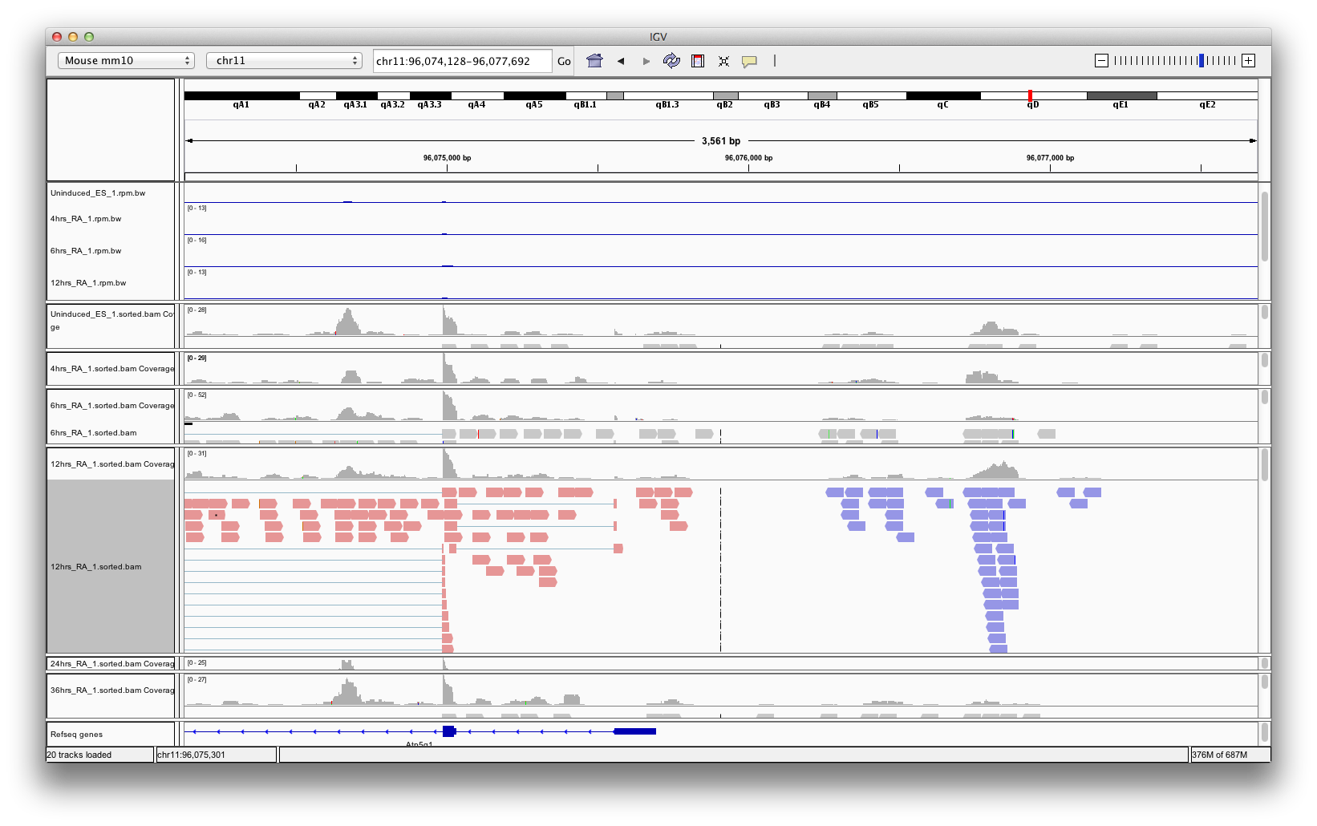
Color alignments by strand

Slide 27
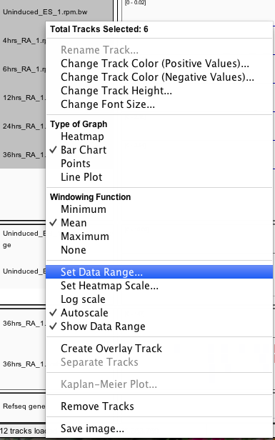
Scale

Slide 28
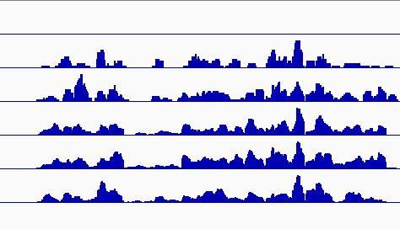
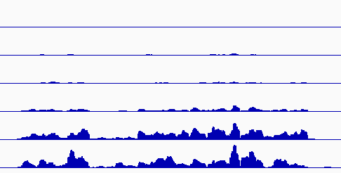
Know your scale…
Autoscale
Set Data Range

Slide 29
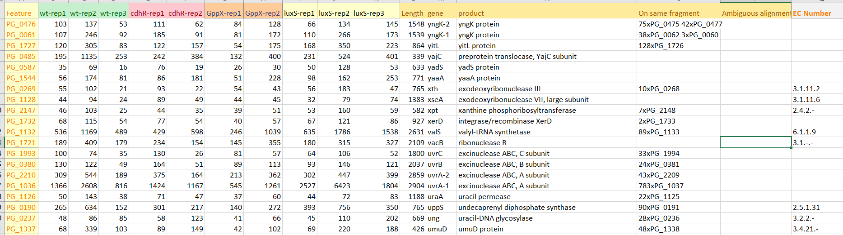
Gene Expression Data
We have count files for each gene as “CSV” file
http://degust.erc.monash.edu/degust/config.html?code=d24c2a88f917954853272af3e80cde5a

Slide 30
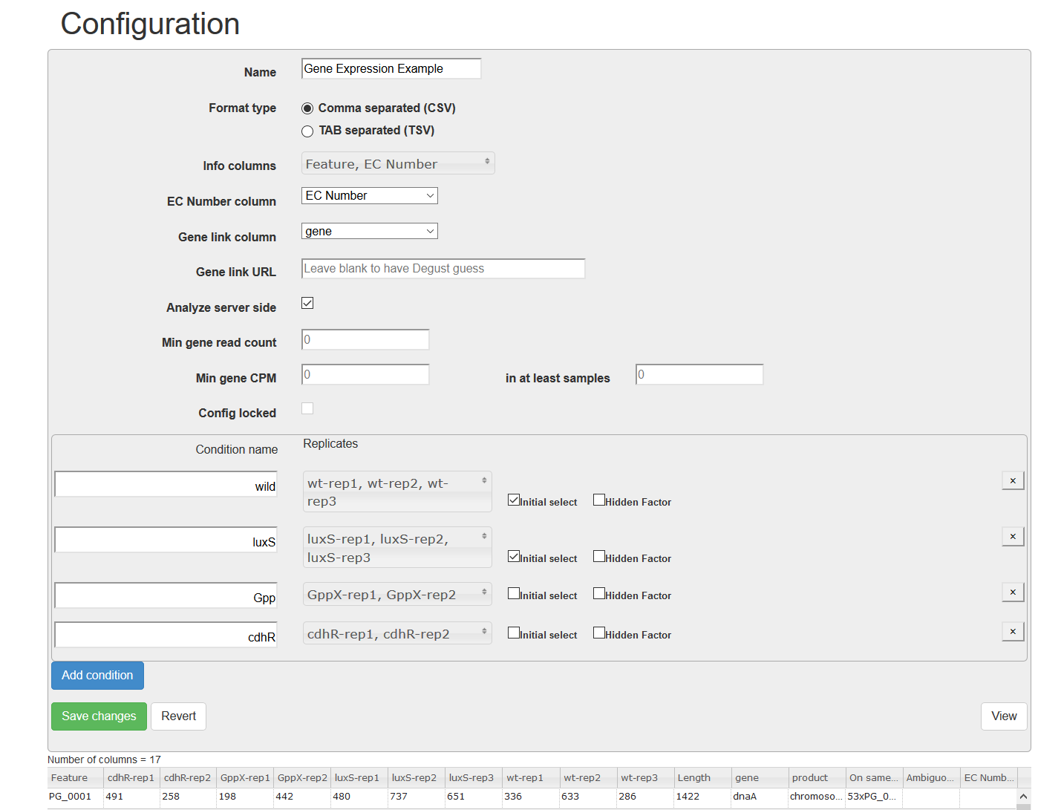
Replicate information

Slide 31
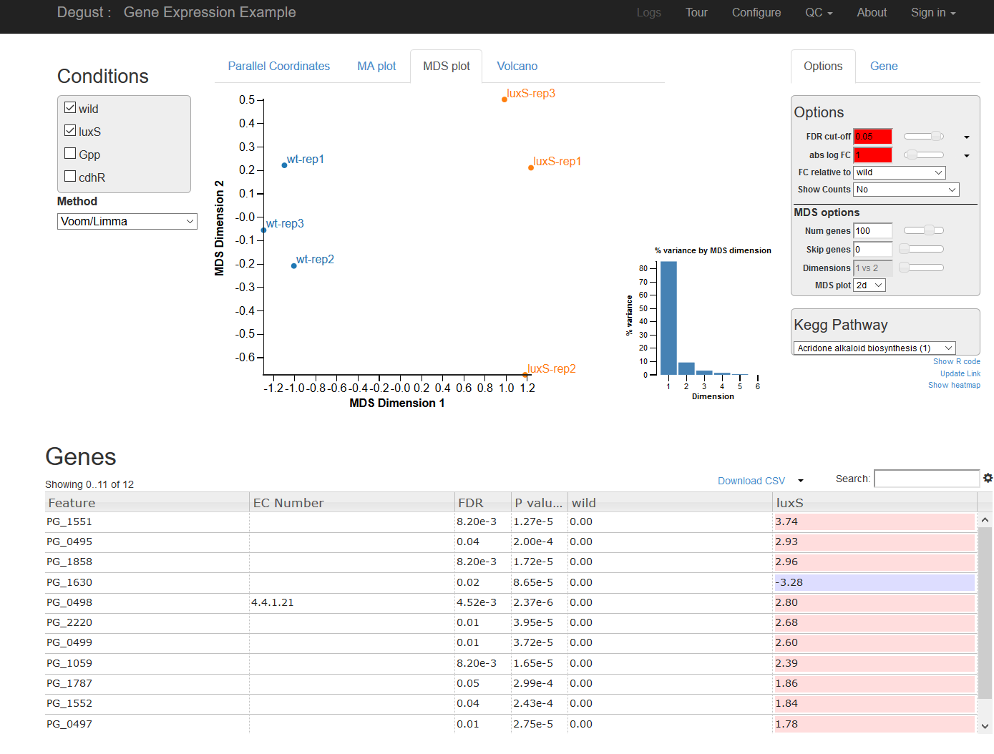
Check two conditions comparison: Verify replicate robustness

Slide 32
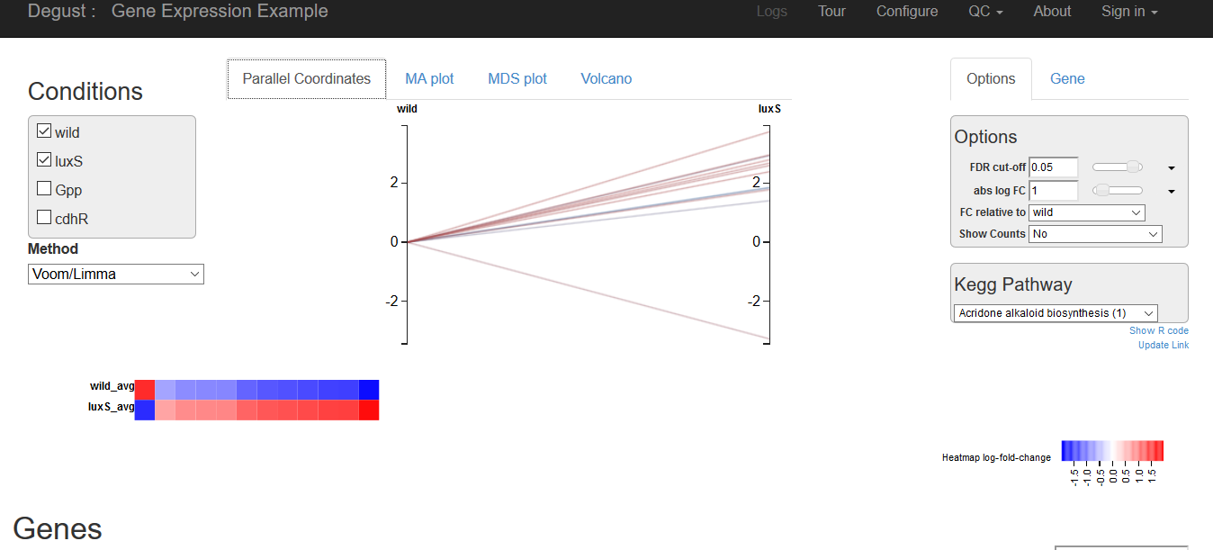

Slide 33
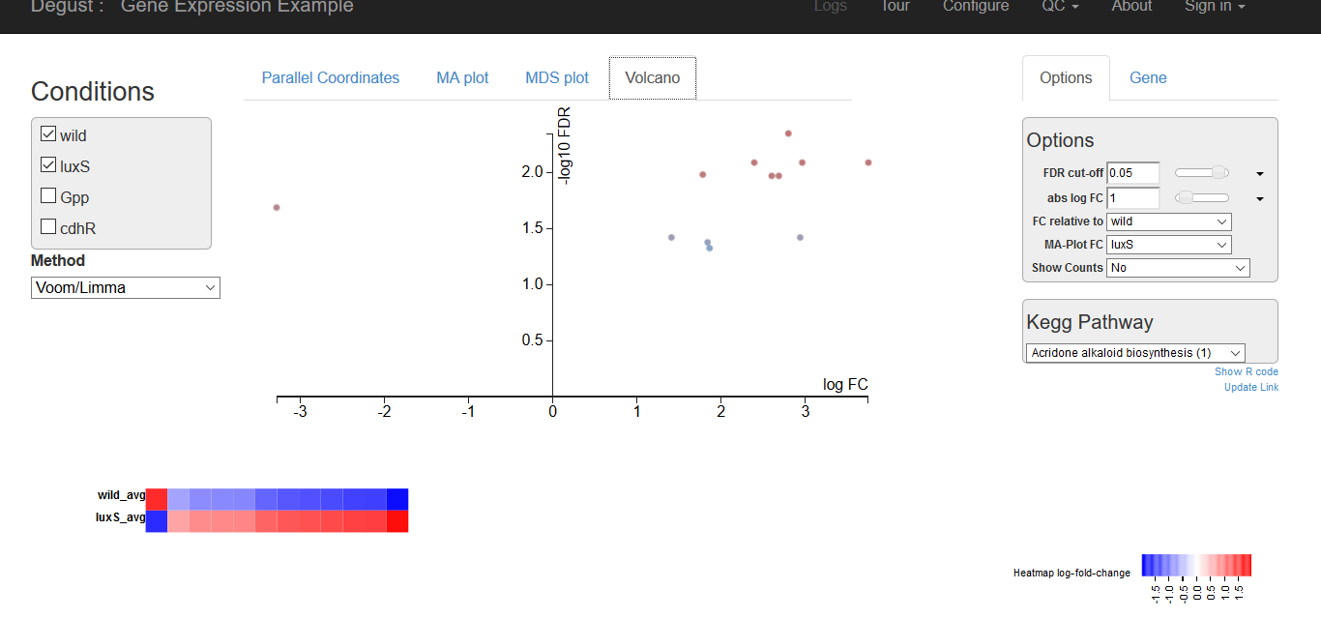

Slide 34
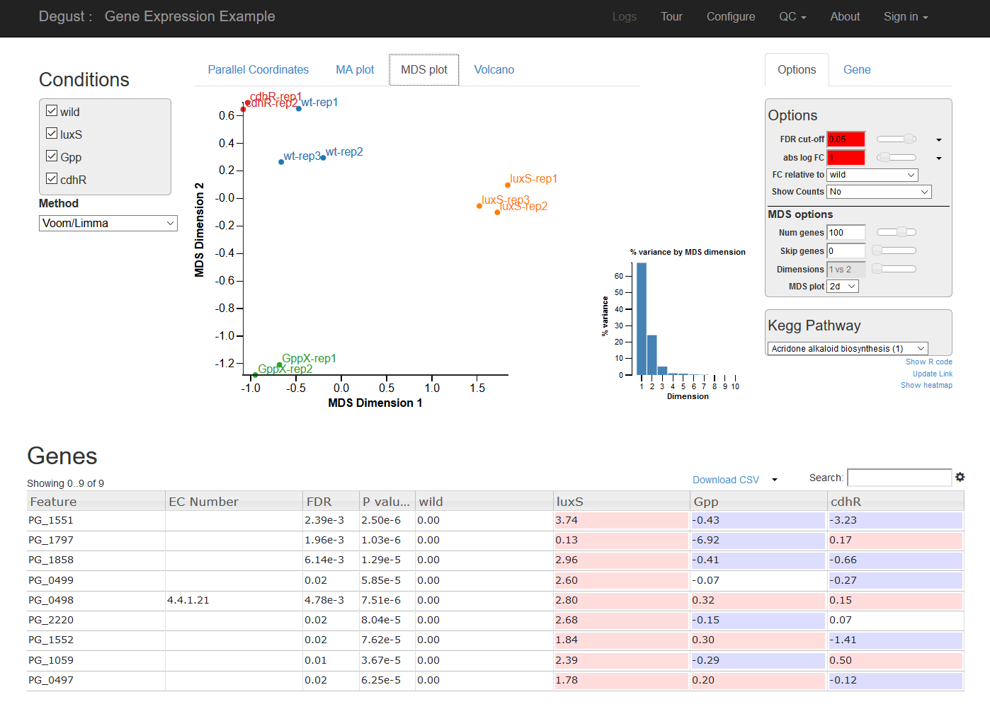
Switch all condition comparions

Slide 35
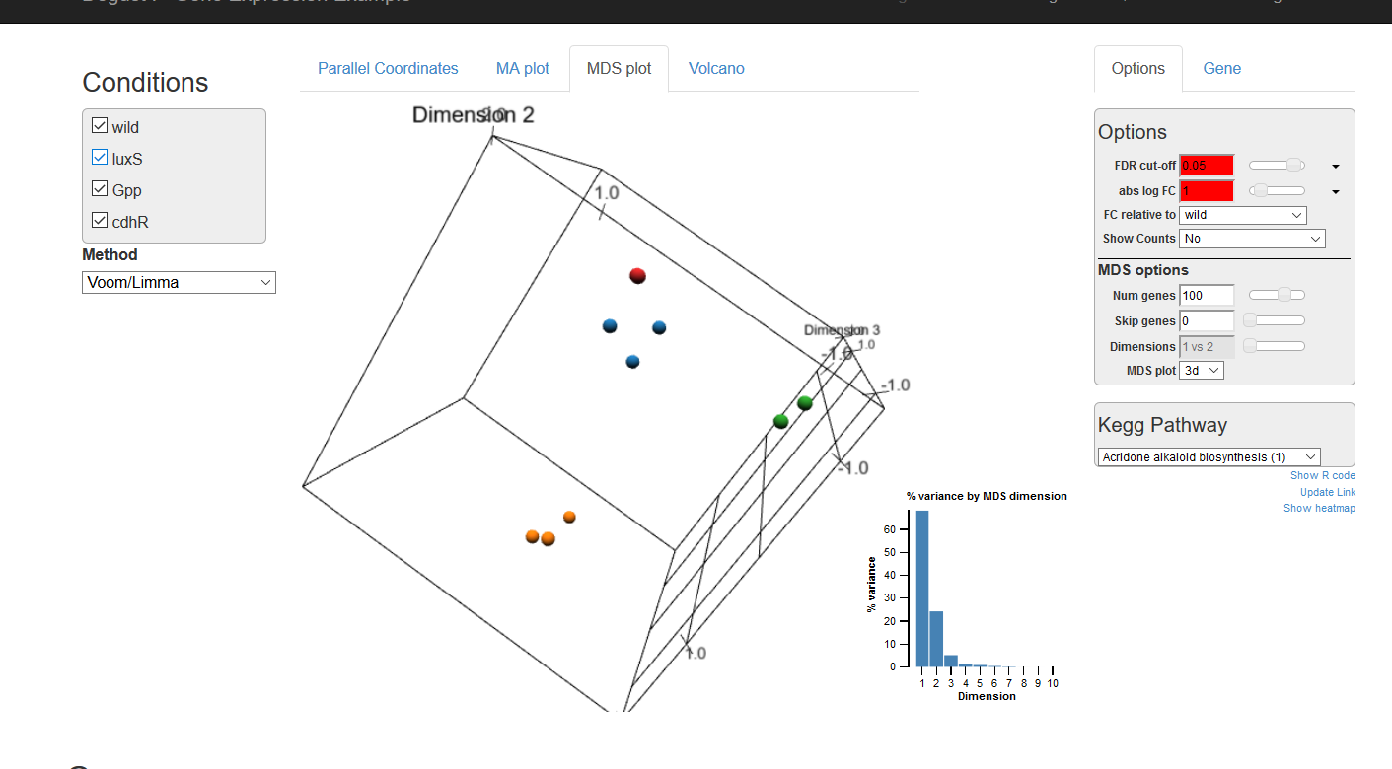
3D mds

Slide 36
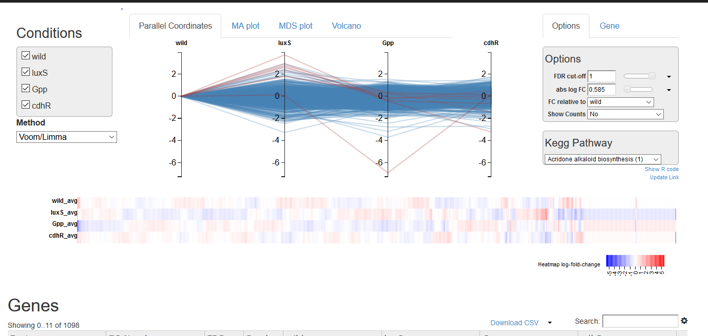
All conditions line plots; trends; can rearrange

Slide 37
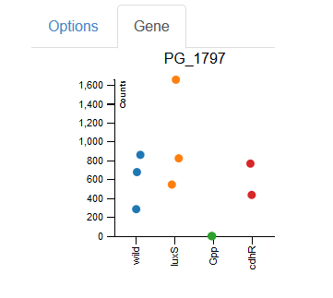
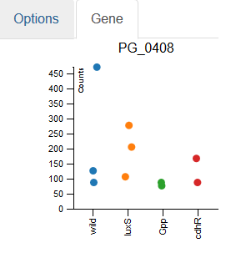
Per Gene spread option

Slide 38
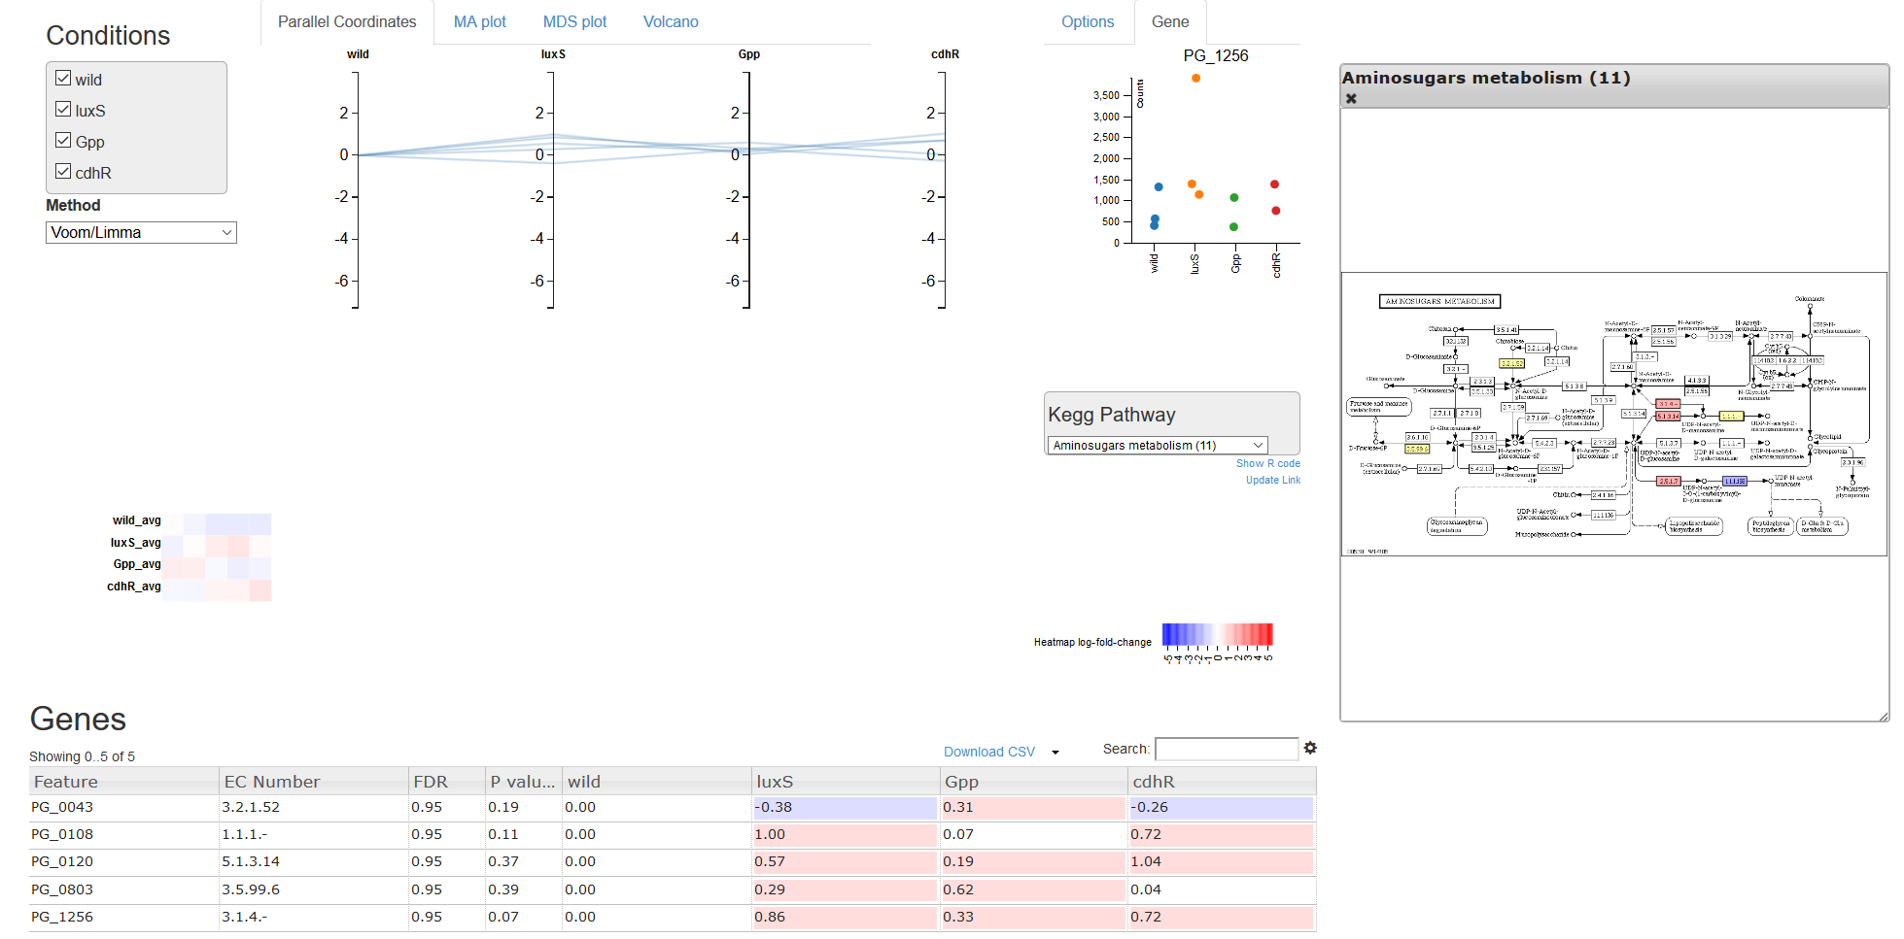
Highlight Gene on Kegg pathways

