Slide 1
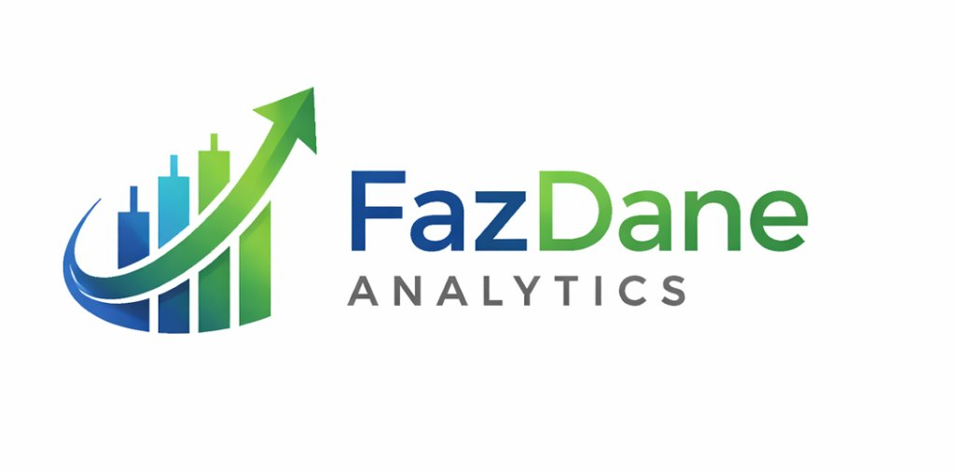
FazDane Analytics
Research & Trading Intelligence Platform
End-to-End Process Flow & Module Architecture
Trading Intelligence Platform

Slide 2
Trading Workflow - 5 Core Phases
1
2
3
4
5
Market & Sector
Regime Analysis
Ticker Scanning
& Discovery
Ticker Analysis
& Mechanics
Opportunity Setup
& Execution
Portfolio Risk &
Performance
Data flows through each phase sequentially, with feedback loops for continuous risk management and model refinement

Slide 3
Phase 1: Market & Sector Regime Analysis (Top-Down)
📊 Market Breadth Dashboard
NYSE/Nasdaq indices, McClellan Oscillator
🔄 Sector Rotation Monitor
11 SPDR sectors - institutional capital flow
🔥 Market Structure Heatmap
Mega-cap leaders vs. laggards
📈 Bradley Siderograph
Cyclical turning points & trend reversals
↓ Output: Market regime identified, sector rotation mapped

Slide 4
Phase 2: Ticker Scanning & Discovery (Filtering)
🔍 Option Search Universe Engine
Mag 7, Premium Selling lists - IV rank, liquidity
📅 Calendar & Seasonality Analysis
Monthly/weekly bullish/bearish trends
📢 Earnings Calendar
Filter out binary announcement risks
↓ Output: Filtered list of candidate tickers for deep analysis

Slide 5
Phase 3: Ticker Analysis & Mechanics (Deep-Dive)
📉 Volatility Strategy Engine
Spot, ATM IV, HV, term structure, skew
⚡ Gamma Flip Line Module
Dealer zero-gamma flip analysis
🌊 Elliott Wave Analysis
Impulse waves (1-5) & corrective (A-C) phases
🔗 Correlation Matrix
Cross-check with core holdings
↓ Output: Quantified metrics & technical setup evaluation

Slide 6
Phase 4: Opportunity Setup & Execution
🎯 Strategy Recommendation
Iron Condor, Avoid Selling, etc.
⚙️ Iron Condor Analyzer
POP, credits, break-evens, margin
💧 Options Liquidity Discovery
Bid-ask spreads, volume, open interest
🔌 ES Pivot Analysis
Support/resistance (R1-R3, S1-S3)
↓ Output: Trade setup parameters & execution ready

Slide 7
Phase 5: Portfolio Risk & Performance Monitoring
⚖️ Portfolio Risk Management
Beta-weighted delta, theta decay, sector concentration
📊 Portfolio Performance
Equity curves, win ratios, performance metrics
↓ Output: Risk-adjusted performance tracking & continuous monitoring

Slide 8
Complete Trading Workflow - Integration View
PHASE 1
Market Analysis
4 Modules
Feedback Loops
Portfolio monitoring feeds back to discovery & analysis phases
Key Data Flows
PHASE 2
Scanning
3 Modules
• Market regime → Sector opportunities
• Tickers → Technical validation
• Setups → Risk parameters
• Performance → Model refinement
PHASE 3
Ticker Analysis
PHASE 4
Execution
PHASE 5
Monitoring
4 Modules
4 Modules
2 Modules

Slide 9
Workflow Architecture - Key Features
✓ Top-Down Market Analysis: Start with macro regime before ticker selection
✓ Systematic Filtering: 3-phase filtering (scan → analyze → validate)
✓ Quantitative Mechanics: Volatility, gamma, Elliott Wave integration
✓ Risk-Aware Execution: Liquidity, margin, and probability assessments
✓ Continuous Monitoring: Real-time portfolio tracking & feedback loops
✓ 17 Integrated Modules: All analysis consolidated in one platform

Slide 10
FazDane Trading Intelligence
End-to-End Professional Trading Workflow
Market Analysis → Discovery → Mechanics → Execution → Monitoring
Advanced Trading Platform Powered by FazDane Analytics

